Slide 1
Aims:
To examine the relationship between humans and nature
To consider how humans and animals might interlink
To create a piece of creative writing using empathy

Slide 2
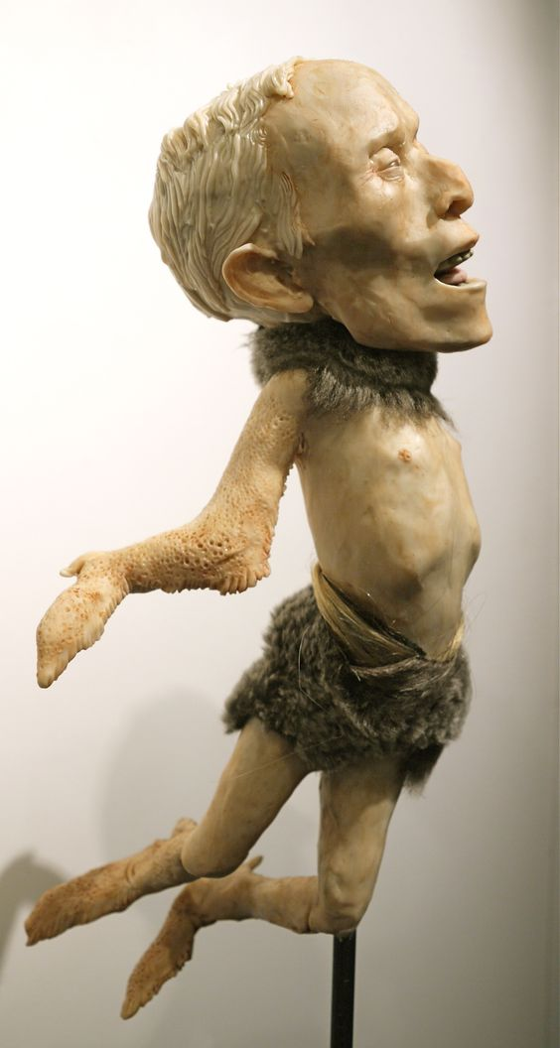
Look at the image of a sculpture titled Eustache Jerk Dupree, the Icarus Man of Ponchatoula, by Eleanor Crook.

Slide 3
Look at the image of a sculpture titled Eustache Jerk Dupree, the Icarus Man of Ponchatoula.
Task:
Talk to the person next to you. Discuss:
What features can you identify in the sculpture?
What do you see?
How does this sculpture make you feel?
Happy? Sad? Disgusted? Entertained?
As you talk, make a mind-map of your discussion in your books; we will add to it as we share our ideas as a class.

Slide 4
Eustache Jerk Dupree, the Icarus Man of Ponchatoula is a model of someone who is half man, half chicken.
Do you see the sculpture as being more human, or more animal?
Discuss with your partner and add your ideas to your mind-map.

Slide 5
Its title is inspired by the story of Icarus, a figure of Ancient Greek myth; the story goes that Icarus and his father Daedalus tried to escape from where they were being held prisoner. They tried to do this by making wings from wax and feathers to fly away. Daedalus managed to escape to Sicily (in Italy), flying on his wings successfully. Icarus, however, flew too near the Sun and his wings melted; he fell into the sea and died.
Has this story changed how you feel about the sculpture?
Why might the artist have used both human and animal features in this piece of art, when referencing the story of Icarus?

Slide 6
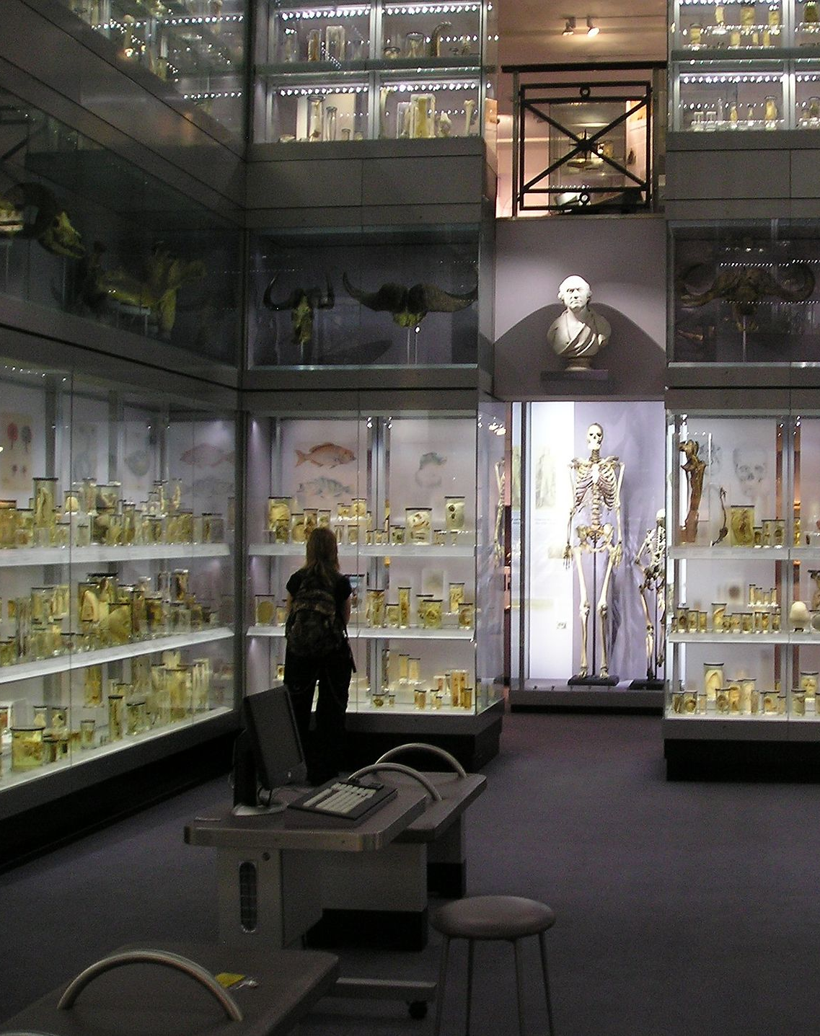
Around the world there are many museums that contain specimens, for research and display purposes.
Some art critics argue that Eustache Jerk Dupree, the Icarus Man of Ponchatoula looks like a specimen, kept in a museum.
Task: Create a label/description of the life of Eustache Jerk Dupree, the Icarus Man of Ponchatoula as if he were to be displayed as a specimen in a museum.
What do you imagine his life was like? Is he more animal, or more human? What do you think about him?
Key term: Specimen - an individual animal, plant, etc. used as an example of its species or as a unique item for scientific study or display.

Slide 7
Find someone in the room that you have not yet spoken to this lesson.
Discuss with them the sculpture we have looked at today, answering these questions:
Is he a monster? Or is he a man?
What do you think his life was like; would he have been happy?
If you met him, what might you think of him?

