Slide 1
JULES global modeling and benchmarking with ILAMB
Patrick McGuire (U. Reading), Pier Luigi Vidale (U. Reading),
Doug Clark (CEH), Carolina Duran Rojas (U. Exeter), Grenville Lister (U. Reading), Toby Marthews (CEH),
Alberto Martinez de la Torre (CEH), Lina Mercado (U. Exeter), Omar Muller (U. Reading), Rebecca Oliver (CEH),
Eddy Robertson (Met Office), Charlie Williams (U. Bristol, formerly U. Reading)
5 November 2018

Slide 2
See previous LSP talk (Spring 2018) for more details of the global modeling work
In that talk, we described how we got the global model for JULES working robustly on CEDA JASMIN
In this talk, we describe:
Addition of the Medlyn conductance model to JULES 5.2
Development of the ILAMB tool on CEDA JASMIN for benchmarking the (Medlyn) JULES models.

Slide 3
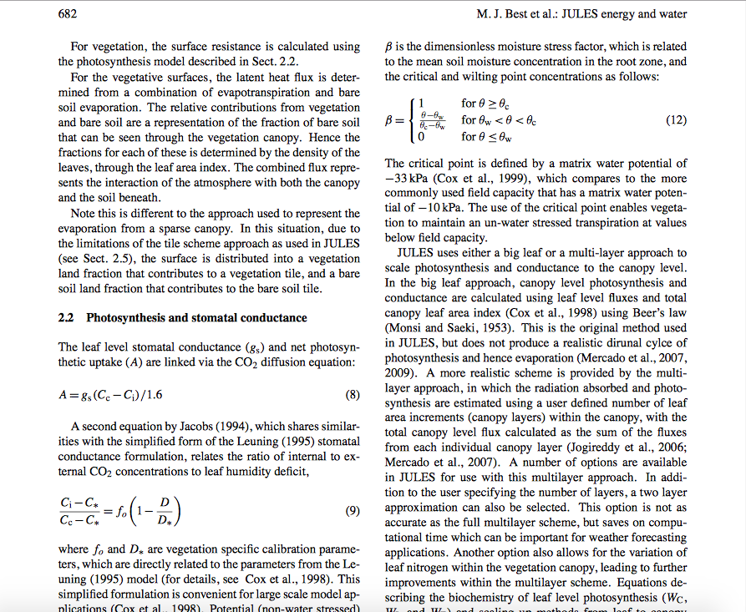
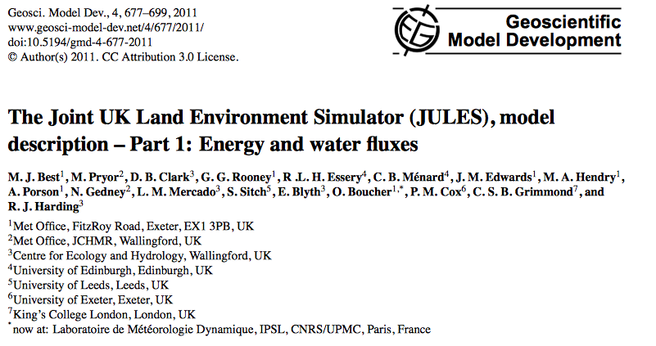

Slide 4
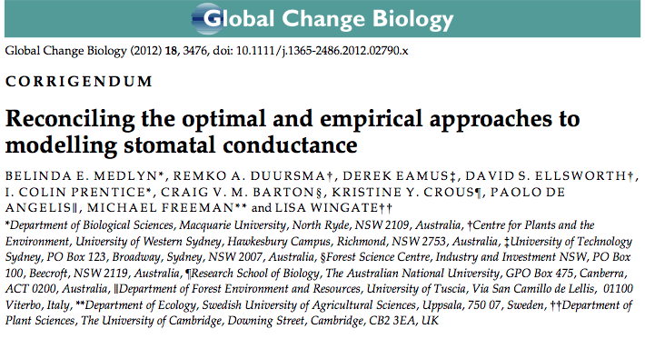
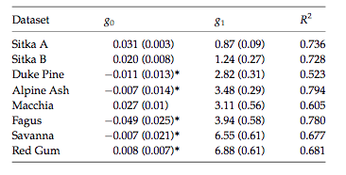
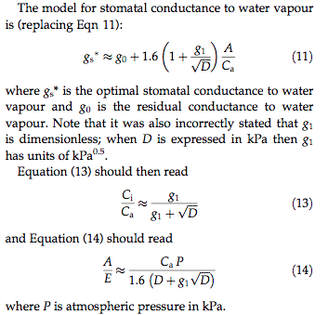
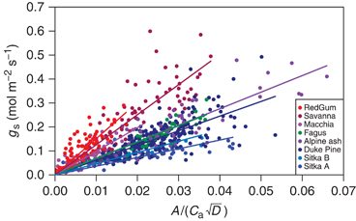
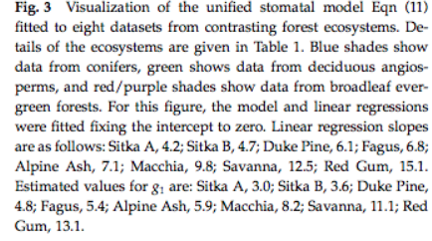
E=transpiration
A=leaf photosynthesis
D=water vapor pressure deficit

Slide 5
Medlyn-conductance branch of JULES: Excerpt from leaf_limits_mod.F90
Broadleaf tree, Needleleaf tree, C3 grass, C4 grass, Shrub ! For the 5 PFTs: ft = plant functional type
dqcrit 0.090, 0.060, 0.100, 0.075, 0.100. ). ! dq = PFT-dependent critical humidity deficit at the leaf surface.
f0 0.875, 0.875, 0.900, 0.800, 0.900
c3 1, 1, 1, 0, 1
g1_stomata 3.99, 2.22, 5.56, 1.10, 2.24
DO j = 1,veg_pts l = veg_index(j)
! ccp = internal CO2 partial pressure at which photosynthesis balances respiration (“photorespiration compensation point”) ; oa = partial pressure of atmospheric oxygen
ccp(l) = 0.5 * oa(l) / tau(l) * REAL(c3(ft)) ! tau is the Rubisco specificity for CO2 rel to O2. The nums in this equation are from Cox, HCTN 24, " Veg Model", eq 53.;: tau = 2600*(q10=0.57)^(0.1(T(Cels)-25))
IF ( stomata_model == stomata_jacobs ) THEN
! Calculate the internal CO2 pressure (Jacobs, 1994), as in the original JULES model; see Eqn.9 of Best et al. (2011), doi:10.5194/gmd-4-677-2011
ci(l) = (ca(l) - ccp(l)) * f0(ft) * (1.0 - dq(l) / dqcrit(ft)) + ccp(l) ! dq = humidity deficit at the leaf surface.
IF (fsmc(l) == 0.0 .OR. dq(l) >= dqcrit(ft) .OR. apar(l) == 0.0) THEN l_open(l) = .TRUE. ! fsmc = soil moisture availability factor = beta ; apar = absorbed PAR (Photosynthetically active radiation)
ELSE l_open(l) = .FALSE. END IF. ! FALSE means the stomata is OPEN
ELSE ! stomata_model == stomata_medlyn ! Calculate the internal CO2 pressure.
! This is Eqn.13 of Medlyn et al. (2012), doi: 10.1111/j.1365-2486.2012.02790.x, also converting specific humidity to vapour pressure.
ci(l) = ca(l) * g1_stomata(ft) / ( g1_stomata(ft) + ( dq(l) * pstar(l) / ( repsilon * 1.0e3 ) )**0.5 )
IF (fsmc(l) == 0.0 .OR. apar(l) == 0.0) THEN l_open(l) = .TRUE. ! Flag where the stomata are closed TRUE means the stomata is CLOSED
ELSE l_open(l) = .FALSE. END IF
END IF ! stomata_model
END DO

Slide 6
See ILAMB web pages presented here (interactively) for our JULES models (with the Medlyn stomatal conductance)
ILAMB is the International Land Model Benchmarking project
Notes:
One of the (gridded) benchmarks is the GBAF benchmark, which is the Global Biosphere Atmosphere Fluxes dataset. This GBAF dataset is derived from FLUXNET-’Model Tree Ensemble’ dataset originally from monthly estimates of global biosphere-atmosphere fluxes from Biogeochemistry group at Max Planck Institute in Jena, Germany. The Model Tree Ensemble is a machine-learning algorithm to do the interpolation/extrapolation from the FLUXNET sites. Citations: Jung et al. 2010, Jung, Reichstein & Bondeau 2009.
We have integrated the monthly-averaged ESA-CCI soil moisture data set into ILAMB. This was provided by Alberto Martinez de la Torre (CEH). We binned the data from 0.25 degrees to 0.5 degrees.
ilamb.org: “The goals of ILAMB are to:
develop internationally accepted benchmarks for land model performance,
promote the use of these benchmarks by the international community for model intercomparison,
strengthen linkages between experimental, remote sensing, and climate modeling communities in the design of new model tests and new measurement programs, and
support the design and development of a new, open source, benchmarking software system for use by the international community.”

