Slide 1




Simulating Global and Local Land Surface Processes with JULES on the CEDA JASMIN Super-data-cluster
Patrick C. McGuire (U. Reading, NCAS), Pier Luigi Vidale (U. Reading, NCAS),
Anna B. Harper (U. Exeter), Grenville M.S. Lister (U. Reading, NCAS),
Alberto Martinez-de la Torre (CEH), Anne Verhoef (U. Reading), Karina E. Williams (Met Office)
16 February 2018

Slide 2
Abstract:
We have ported several examples of the JULES land-surface model to Rose/Cylc suites on the CEDA JASMIN super-data-cluster, for centralization purposes.
The first case is a FLUXNET suite to model the fluxes at several different point sites (distributed globally), from the MONSooN supercomputer.
The second case is a suite to model maize evapotranspiration, also from MONSooN.
The third case is a suite to model land-surface processes globally, from the University of Reading's JASMIN cluster, wherein we ‘robustified’ (i.e, we made less crash-prone) another global JULES model configuration already on CEDA JASMIN.

Slide 3
BACKGROUND:
JULES (the Joint UK Land Environment Simulator) is a land-surface modeling framework that can work either as a standalone program (as used here) or within the Met Office Unified Model (UM) system (Best et al. 2011, Clark et al. 2011).
JULES has been deployed on numerous different platforms, ranging from personal computers to supercomputers.
Access to the Met Office’s MONSooN supercomputer is restricted by passkey distribution, making the CEDA JASMIN super-data-cluster the more logical choice for more widespread JULES deployment.
Centralization of JULES research efforts from personal computers and departmental servers to CEDA JASMIN will make management of computational resources and technical education of JULES users more straightforward.
Rose/Cylc suites are a tool for sharing model configurations between users to facilitate the reproducibility of experiments and cross-institution collaboration.

Slide 4
JULES Models for FLUXNET sites
FLUXNET2015 is a networked effort to record data from 212 sites around the world of the gas and energy fluxes between the biosphere and the atmosphere, as well as associated meteorological variables.
JULES has been used by Harper et al. (2016) to model the land-surface processes at a subset of these FLUXNET2015 sites, in order to compare with the observed data at the sites.
One purpose of this work is to study the discrepancies so that the modeling can be improved.

Slide 5
Methods
The Rose/Cylc suite that is the latest version for doing this JULES modeling on the MONSooN supercomputer is u-at414 (copy of u-al752, which was developed as part of the soil moisture stress on vegetation JPEG).
We have ported u-at414 so that it works on the CEDA JASMIN super-data-cluster, and its suite number is u-at416.
The Python post-processing of the NETCDF JULES output is embedded in the suite, and examples are shown below for some of the FLUXNET2015 sites.
The solid lines are monthly averages, whereas the thin lines are the daily data.

Slide 6
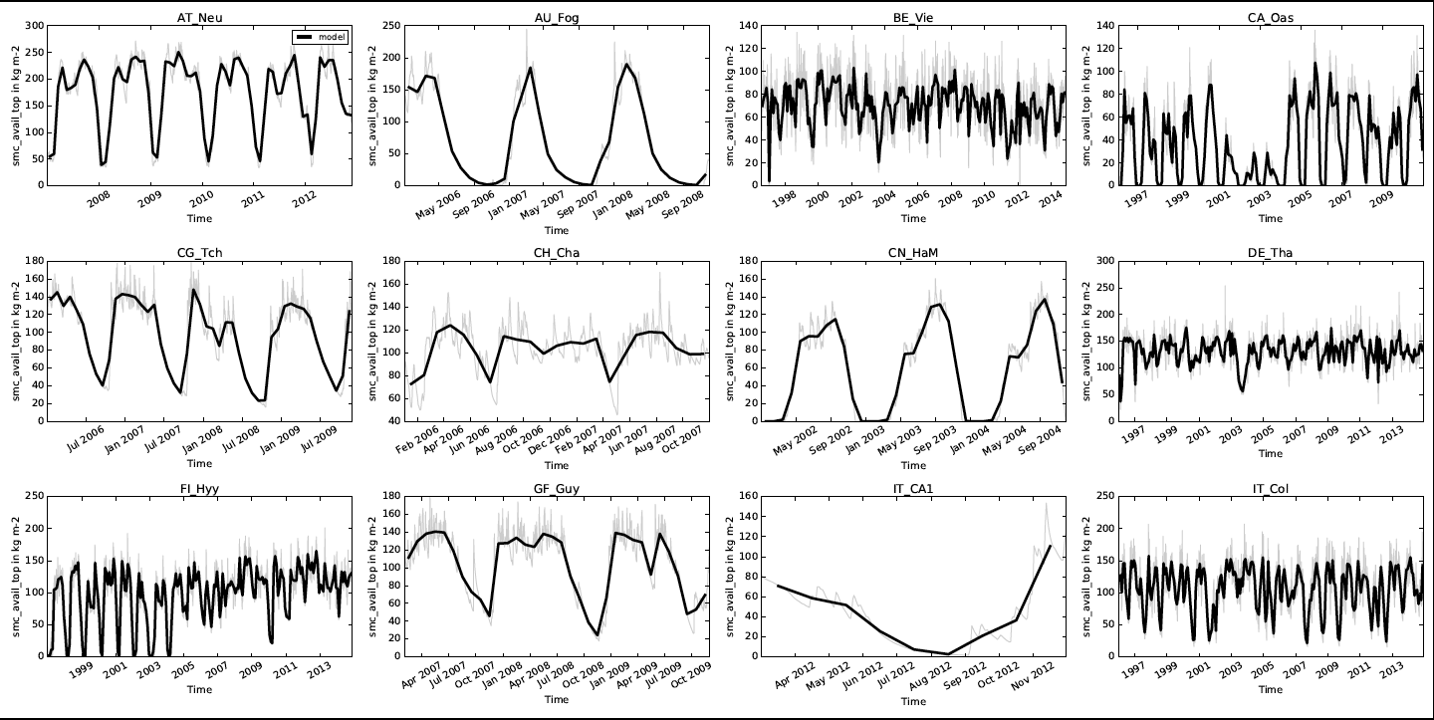
JULES-modeled FLUXNET2015 soil moisture

Slide 7
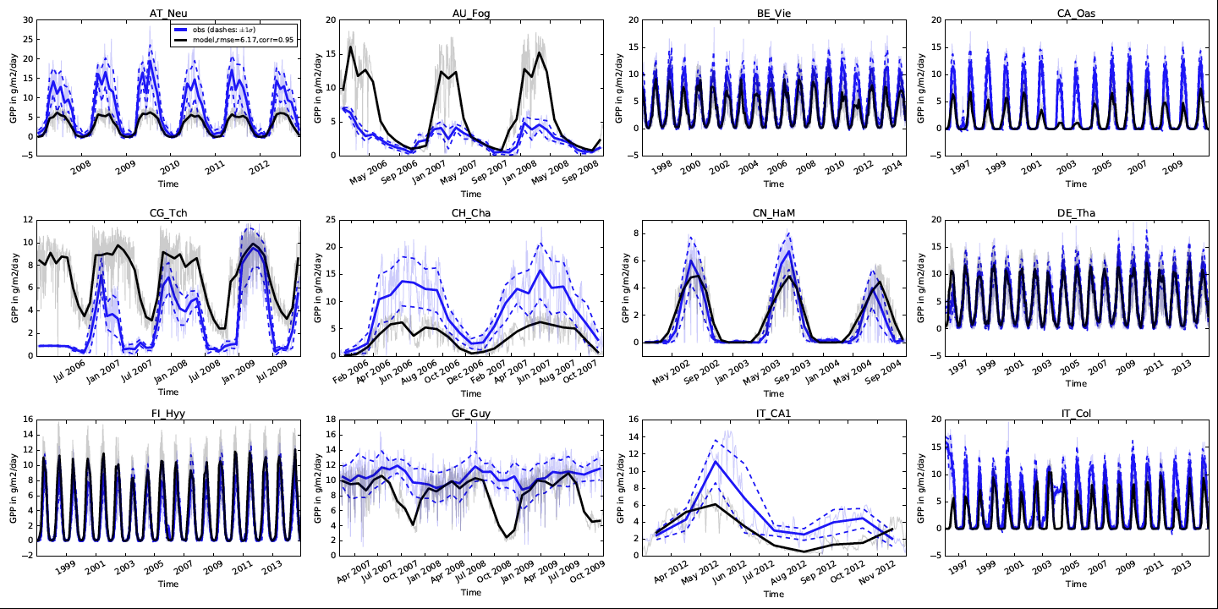
FLUXNET2015 GPP (JULES model compared to observation)

Slide 8
Global JULES Model
We have ’robustified’ a global JULES model focusing on hydrology (Schellekens, Martinez de la Torre, et al., 2017) that was already working on CEDA JASMIN.
A different global JULES model focusing on vegetation (Vidale et al., unpublished) was then substituted in this JULES template, to make the plots below.

Slide 9
Methods
The original Rose/Cylc global hydrology suite was u-ah574, and our ‘robustifying’ efforts prevent frequent crashes by ensuring that the JULES executable was compiled on the same type of processor on which it is run.
  This is important in the heterogeneous architecture of CEDA JASMIN with different machines having different processor types.
  This suite uses the eartH2Observe driving data and the SPDM branch of JULES version 4.7.
  The robustified version for CEDA JASMIN is Rose/Cylc suite u-aq929, which was also upgraded to JULES 4.9.
Furthermore, we used u-aq929 as a template for porting another global model (focusing on vegetation, Vidale et al., unpublished) from the departmental computer cluster of the Department of Meteorology at the University of Reading to CEDA JASMIN.
  This model uses the WFDEI (GPCC) driving data (Weedon et al. 2014) and was upgraded from JULES 4.4 to JULES 4.9.
  Custom Python post-processing was developed and is shown in the plots below, as well as in the computer-based animations below.
  The Rose/Cylc suite for this model is u-as052.

Slide 10
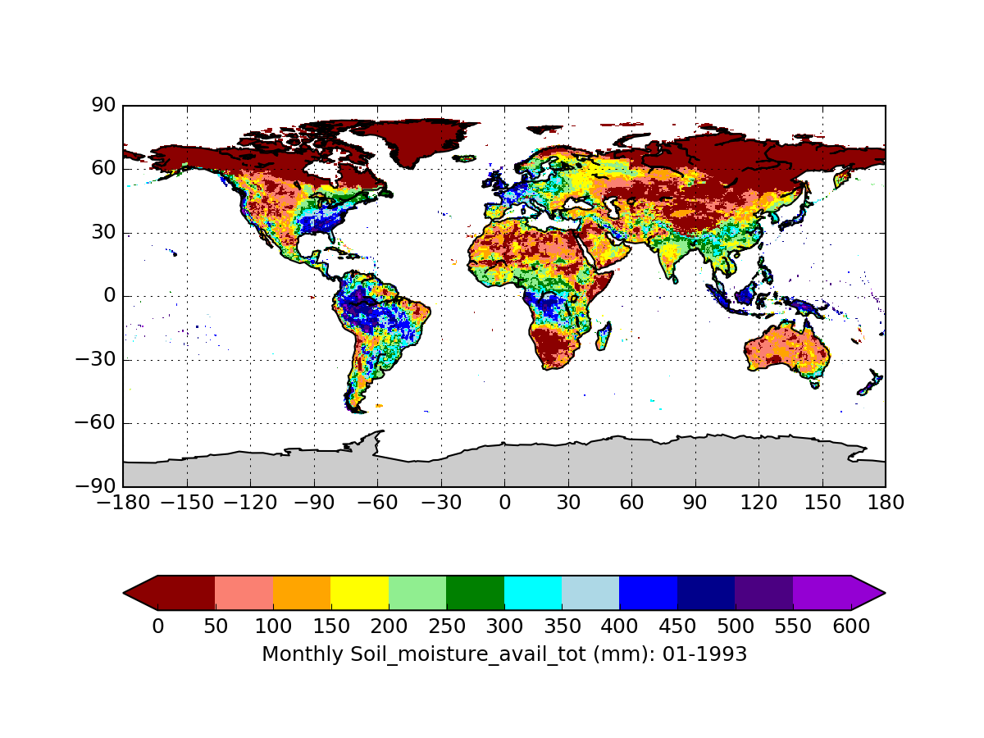
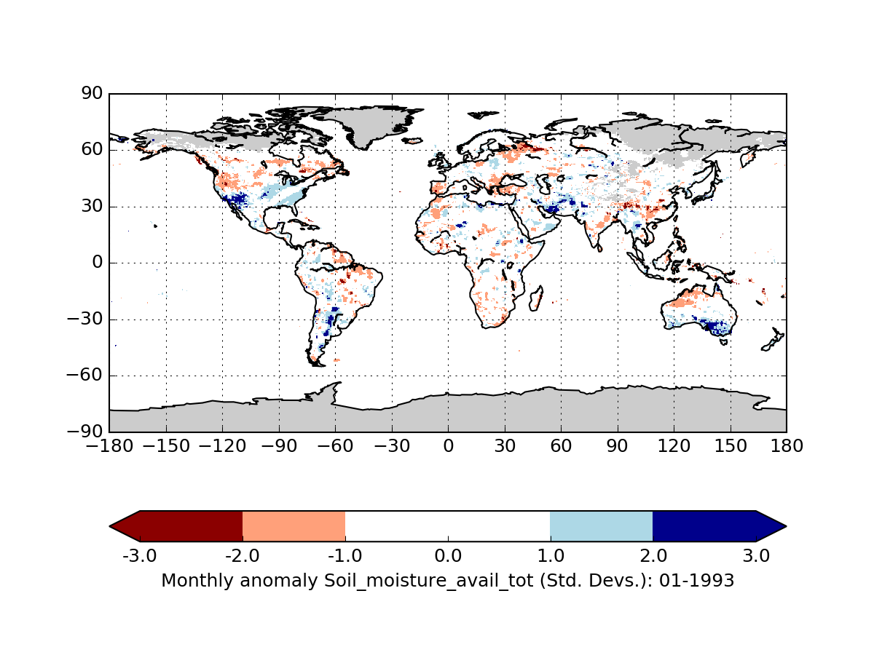
JULES-modeled global soil moisture (Jan. 1993)
a.k.a., a hydrological drought index
JULES-modeled soil moisture anomaly (Jan.’93)
The hydrological drought index is defined here as
the monthly anomaly of soil moisture relative
to the annual climatology over 1979-2012.

Slide 11
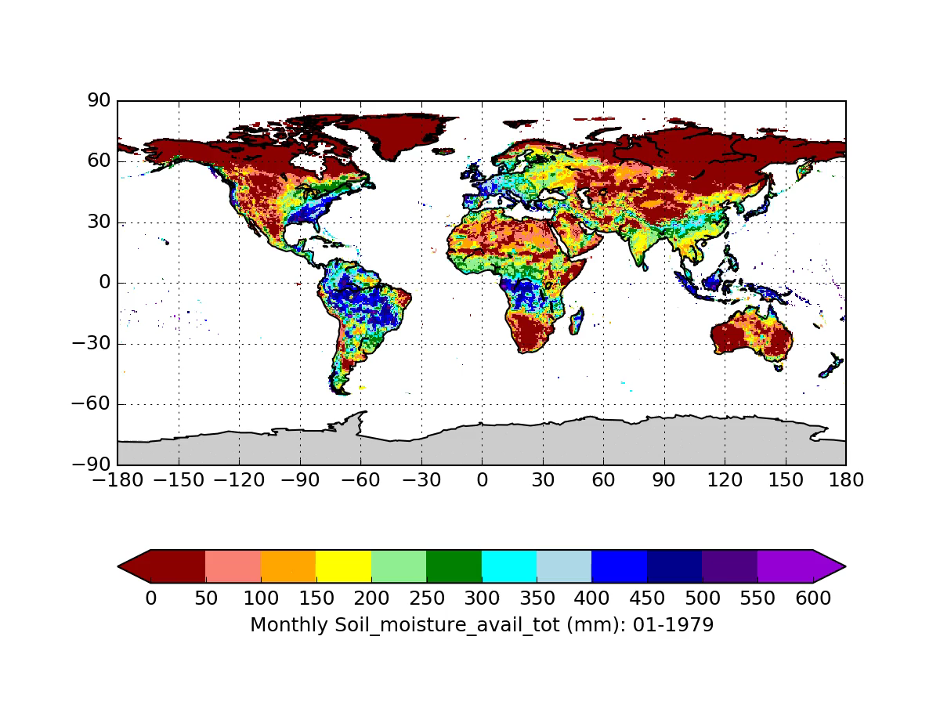
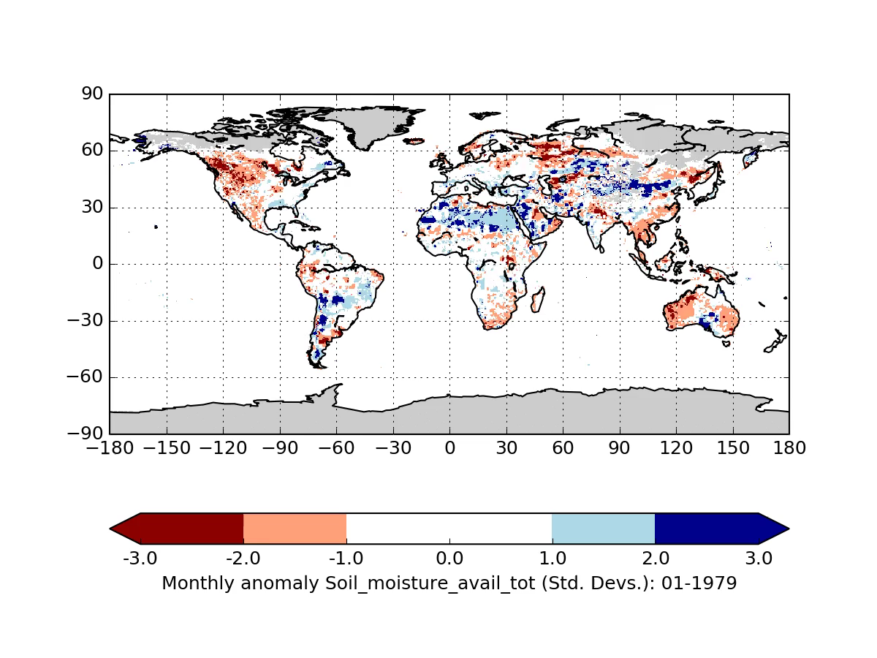
JULES-modeled global soil moisture (1979-2012)
Animations
JULES-modeled soil moisture anomaly (1979-2012)

Slide 12
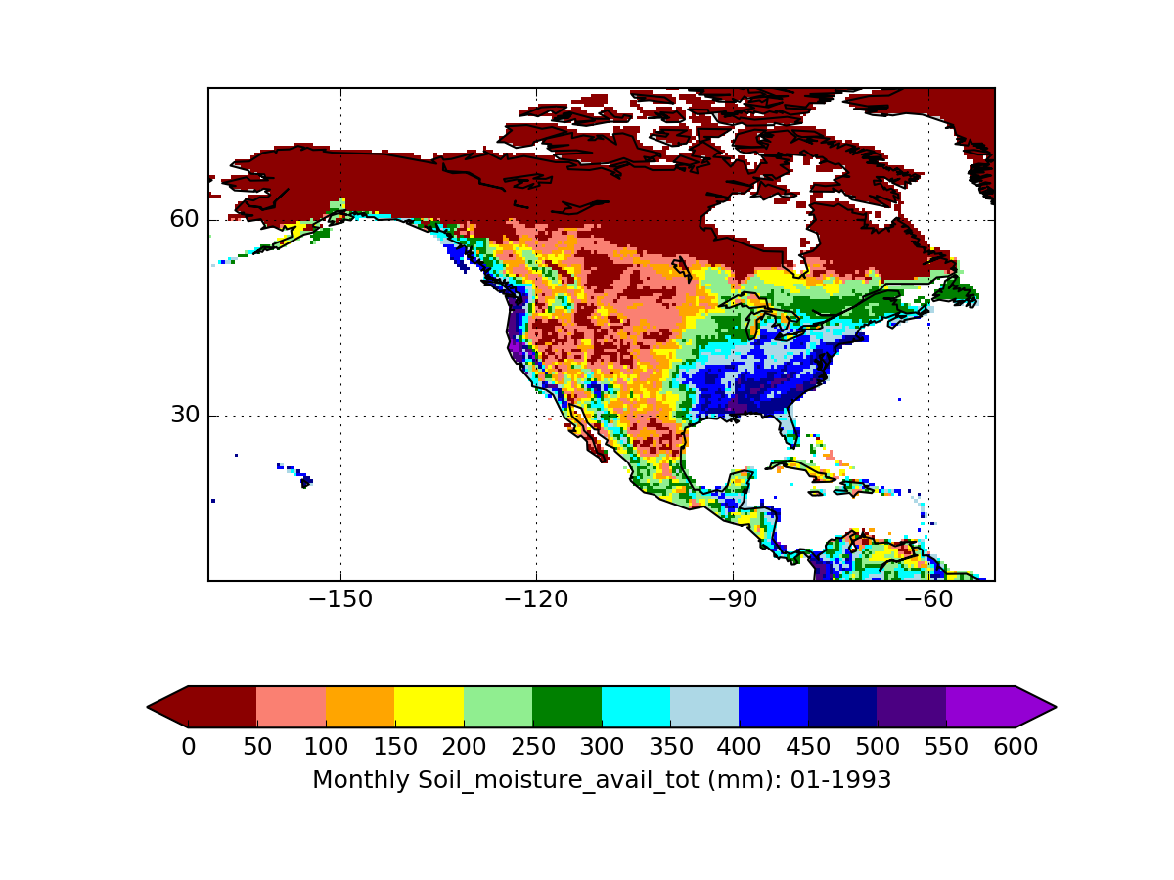
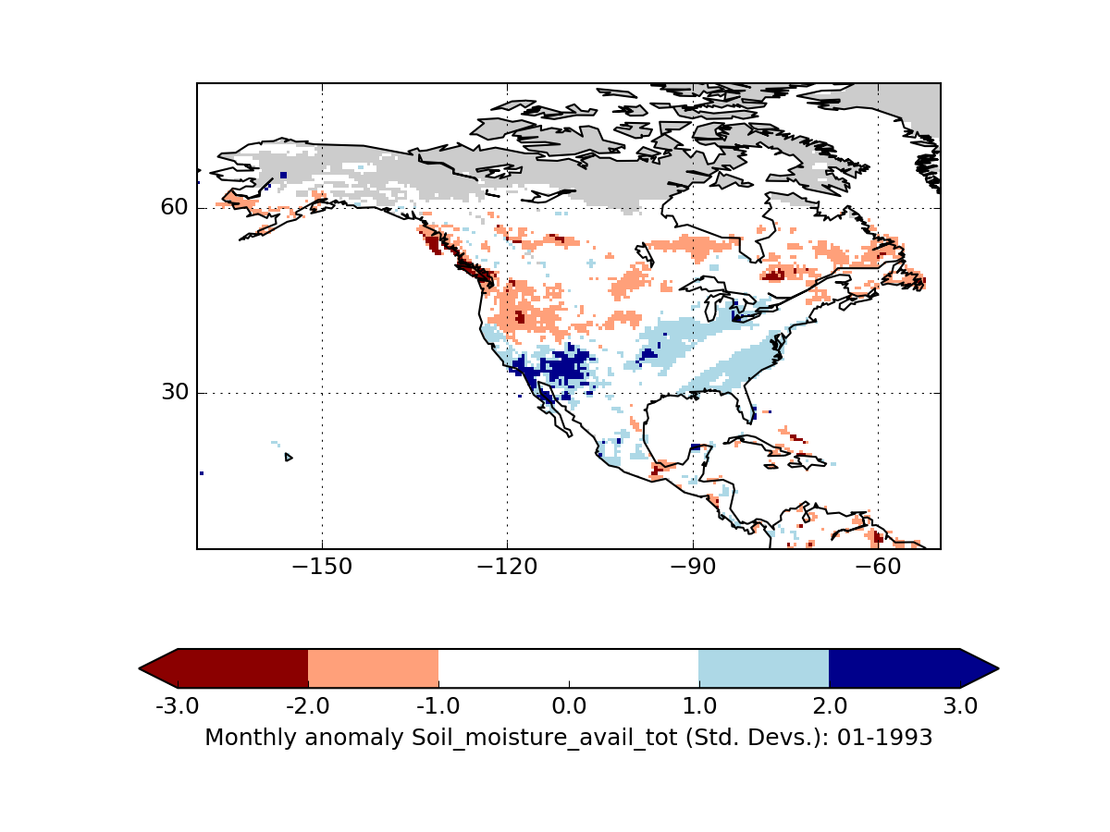
Zoom-in to N. America: Modeled soil moisture (Jan’93)
Zoom-in to N. America: Modeled SM anomaly (Jan’93)

Slide 13
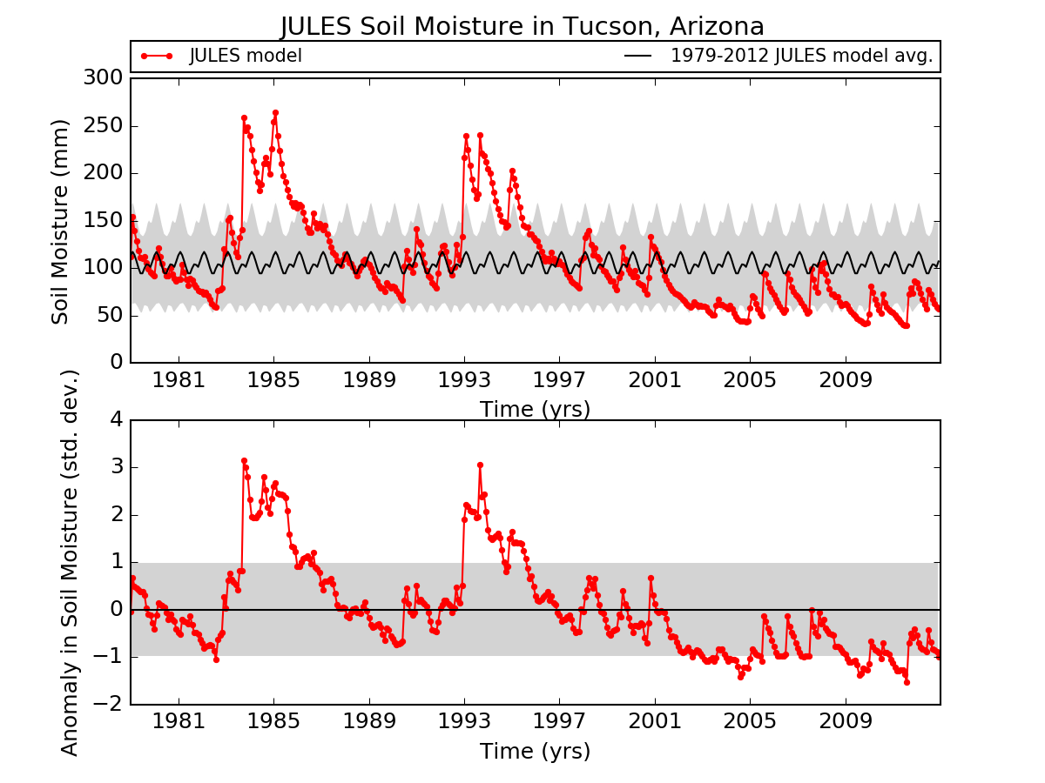
Example of JULES-modeled SM time-series (1979-2012)
The modeled soil-moisture anomaly in Jan. 1993 in Tucson, Arizona matches observed flooding then.

Slide 14
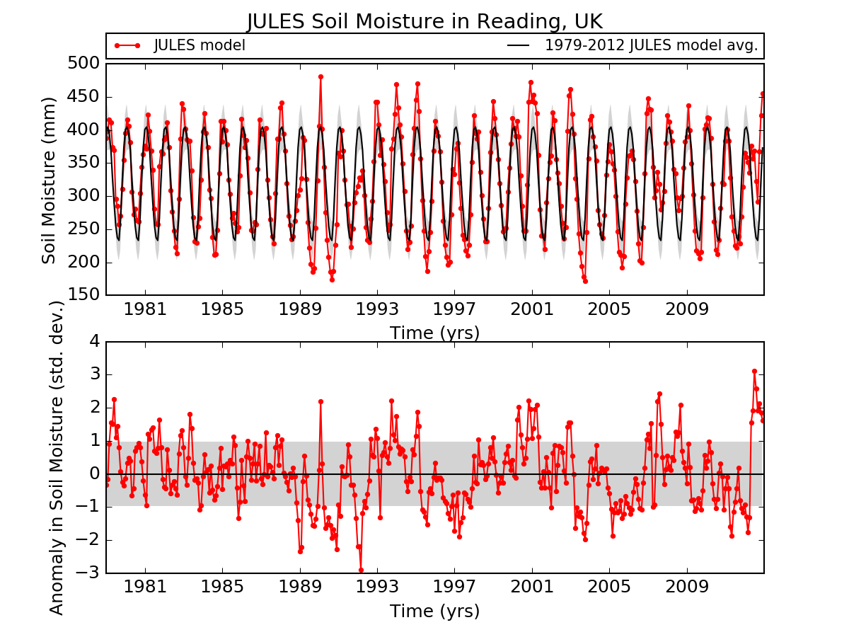
Example of JULES-modeled SM time-series (1979-2012)

Slide 15
JULES Model of AgMIP Maize Evapotranspiration
JULES has been used to model maize evapotranspiration within AgMIP (the AGricultural Model Intercomparison and Improvement Project) (Rosenzweig et al. 2013).

Slide 16
Methods
The original Rose/Cylc suite on MONSooN was u-ac763.
This uses the JULES Crop parametrization of Osborne et al. (2015), with tuned maize parameters from Williams et al. (2017).
The Python post-processing is embedded within the suite.
The newly ported Rose/Cylc suite that works on CEDA JASMIN is
u-aq202.

Slide 17
Modeled Soil Moisture

Slide 18
Maize Leaf Area Index (Observations and JULES Model)

Slide 19
Modeled Net Primary Production

Slide 20
Maize Biomass (Model vs. Observations)

Slide 21
ACKNOWLEDGEMENTS:
PCM acknowledges
financial support from the University of Reading for completing the work described here,
as well as intellectual support from NCAS Computational Modelling Services (CMS).
This work used eddy covariance data acquired and shared by the FLUXNET community, including these networks: AmeriFlux, AfriFlux, AsiaFlux, CarboAfrica, CarboEuropeIP, CarboItaly, CarboMont, ChinaFlux, Fluxnet-Canada, GreenGrass, ICOS, KoFlux, LBA, NECC, OzFlux-TERN, TCOS-Siberia, and USCCC. The ERA-Interim reanalysis data are provided by ECMWF and processed by LSCE. The FLUXNET eddy covariance data processing and harmonization was carried out by the European Fluxes Database Cluster, AmeriFlux Management Project, and Fluxdata project of FLUXNET, with the support of CDIAC and ICOS Ecosystem Thematic Center, and the OzFlux, ChinaFlux and AsiaFlux offices.

Slide 22
REFERENCES:
Best et al., Geosci. Model Dev., 4, 677–699, 2011
Clark et al., Geosci. Model Dev., 4, 701-722, 2011
Harper et al., Geosci. Model Dev., 9, 2415–2440, 2016
Osborne et al., Geosci. Model Dev., 8, 1139–1155, 2015
Rosenzweig et al., Agricultural and Forest Meteorology, 170, 166-182, 2013
Schellekens, Martinez de la Torre, et al., Earth Syst. Sci. Data, 9, 389–413, 2017
Vidale et al., unpublished
Weedon et al., Water Resources Res., 50, 7505–7514, 2014
Williams et al., Geosci. Model Dev., 10, 1291–1320, 2017
u-ac763: https://code.metoffice.gov.uk/trac/jules/wiki/AgmipMaizeEt
u-al752: https://code.metoffice.gov.uk/trac/jules/wiki/FluxnetandLbaSites

