Slide 1
LGBTQ+ and Gender
Notes:
These slides are for a brief (e.g. 30 minutes) training for staff – or longer if you add discussion points.

Slide 2
LGBTQ+ STATS
An estimated 3.1% of the UK population aged 16 years and over identified as lesbian, gay or bisexual (LGB) in 2020, an increase from 2.7% in 2019 and almost double the percentage from 2014 (1.6%). (Sexual orientation, UK - Office for National Statistics ons.gov.uk)
Over half of young LGB don’t feel they have an adult to talk to at school. 3/5ths have no one at home.
About half are bullied on grounds of being LGBTQ+.
Bullying is less likely when LGBT issues have been taught in school.
Trans people are 0.3-0.8% of the UK population.
64% bullied, almost half of trans pupils in the UK have attempted suicide.
77% of LGBTQ+ pupils have never learned about transgenderism in school.
1/3 can’t use preferred name in school, 3/5 can’t use preferred toilets.
Notes:
These statistics should highlight to people why it is worth any potential “hassle” from having uncomfortable conversations. Taken from various sources, mostly Stonewall.
The percentages might seem small – but it suggests at least one child in each cohort (2 form entry primary school) will eventually identify as LGB, and teachers are likely to teach someone who will identify as trans. They will almost certainly teach children who are classmates of trans children – will they be a bully or an ally?
Note the best thing we can do to minimise bullying is teach about LGBT issues.

Slide 3
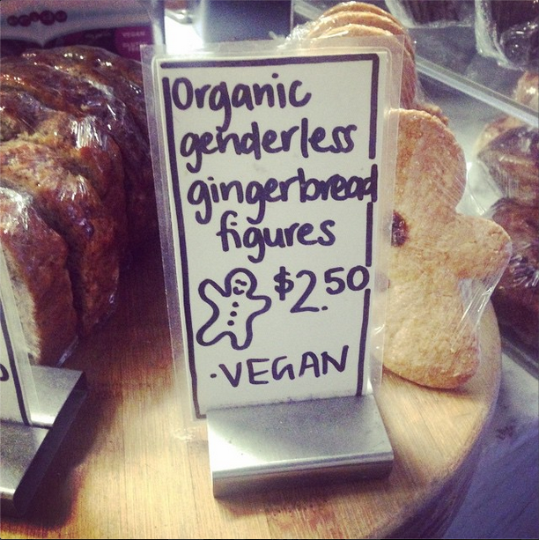
Definitions
Sex is assigned at birth, based on genitals/genetics, binary. Gender is socially constructed and a spectrum.
Gender stereotypes = generalised preconceptions we have about the attributes that people have, or should have, based on their gender.
Transgender/trans = Gender identity is different from sex assigned at birth. Cisgender/cis = Gender identity matches assigned sex.
Non-binary = Gender isn’t strictly male or female.
LGBTQ+ = Lesbian, gay, transgender, bisexual, queer/questioning plus (to include everyone else such as intersex, asexual etc)
Queer = reclaimed word, umbrella term.
Notes:
Address any misconceptions about language. People can feel uneasy about “queer” even though it is a reclaimed word e.g. queer politics, queer spaces, queer academics. Some staff at my school didn’t know what intersex meant.
You may wish to add other terms, and clarify that the appropriate language to use with children will vary by age/ understanding/ situation.
Optional talking points:
-Show the words without the definitions or definitions without the words – can they fill in the blanks?
-Give staff the opportunity to challenge or add any words

Slide 4
DFE Guidance
Statutory relationships guidance: friendships, families, respecting differences, being safe.
Primary schools are strongly encouraged, and enabled, to teach about LGBTQ+ but don’t have to.
Equality Act 2010: Schools have a duty to eliminate discrimination and advance equality of opportunity. Sex, sexual orientation and gender reassignment are protected characteristics.
Notes:
DfE guidance is vague at best. From what I can tell, primary schools are not required to teach LGBT content explicitly but are encouraged to (no real guidance what that means). Acknowledge teachers don’t want to say the wrong thing / upset parents/ get in trouble.
Equalities Act is probably most useful here.

Slide 5
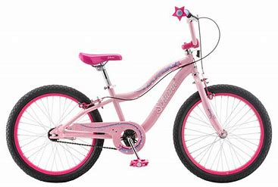
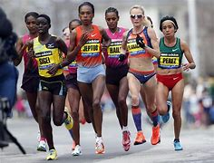
Gender Stereotypes in Children
From the age of 3, most children know if they are a girl or a boy and begin to categorise behaviour by gender.
Behaviour is least stereotypical in nurseries and progressively more stereotypical as children get older.
Boys tend to be more stereotypical than girls.
Children make gendered assumptions and use “girl” as an insult.
Teachers give more attention to boys, and use gendered ways of addressing pupils.
Stereotype threat.
Notes:
From various research – Some NEU/NUT.
Children become more, not less, stereotypical as they get older. Boys tend to avoid anything pink – in the research there was a boy called Sam who “couldn’t” ride a bike because the only one left was pink. Generally parents and teachers are more accepting of Tomboys than “sissy” boys. This is worrying when you consider where it places femininity in the hierarchy.
Stereotype threat is where people feel at risk of conforming to someone else’s stereotype (even if they don’t believe the stereotype themselves), and that in itself effects their outcomes. E.g. African American runners ran less quickly when they were told they were being tested on strategic thinking skills as well as agility. The same has been found in children, e.g. girls do less well on maths tests after being told that boys tend to be better on that test, even though they argued against the stereotype. Implication is that we need to be careful and purposeful when discussing stereotypes with children.
Optional discussion point: Who do you give most attention to in your class? Evidence shows teachers give more attention to boys, even when there are fewer of them.

Slide 6
Gender and Attainment
Debates around gender in education tend to focus on boys’ underachievement
True, bigger difference in “girl dominated” subjects than “boy dominated” subjects.
Doesn’t translate to real world.
Some myth busting:
No evidence that “boy-friendly” curriculums or different learning styles work
Little evidence of neurological differences
Gender identity is a better predictor than sex
Notes:
Despite an academic head start, women are still paid about 18% less.
You could discuss gender and attainment in your own school context here.
Interestingly, gender identity is a better predictor of motivation across the curriculum than biological sex – this suggests there is more work to be done undoing stereotypes than in narrowing the curriculum to appeal to what we think boys intrinsically like.

Slide 7
Actions: Language
Be careful with gendered language around school:
Girls and boys → children
Mums and Dads → families
postman → postal worker.
Use names when addressing children, or be consistent with terms. When asking for helpers, ask for “strong girls” or “helpful boys”.
Model non-stereotypical behaviour.
During sex education topics, use “male bodies” and “female bodies” rather than girls’ or boys’ bodies. Use the word “most” when talking about bodies, e.g. “most girls get periods”.
Notes:
Model non-stereotypical behaviour such as “My son’s favourite doll is…”
“Male” and “female bodies” is a subtle shift away from “girls’ bodies” and “boys’ bodies” – which most PSHE schemes use. It’s a completely inoffensive way to plant the seed that your body isn’t the only thing that makes you a “girl” or a “boy”. Remember, it’s not accurate to say that girls have vulvas/ boys have penises. Alternatively you can use “most”.

Slide 8
Actions: Dealing with Incidents
Always challenge sexist assumptions and problematic comments in an educational way.
Discuss and question.
Explain why it is wrong.
If a child “comes out” in school:
Listen to them.
Don’t promise confidentiality.
Don’t speak to family without the child’s permission.
Record on CPOMs – under “cause for concern”.
Why do you think that?
Is that always true?
What about…?
How could that comment effect others?
Notes:
Most schools take a therapeutic/ educational approach to behaviour management, need to do the same with problematic comments/ language.
Optional activity: Write a different scenario card for each table of staff, with a fictional scenario of a child using homophobic, transphobic or sexist language. On tables, discuss how you would deal with this educationally and then feed back.
Talk to SLT in your school about procedures for if a child comes out at school. It is not inherently a safeguarding issue and the child’s right to privacy should be taken seriously. I feel that staff do need a clear policy here.

Slide 9
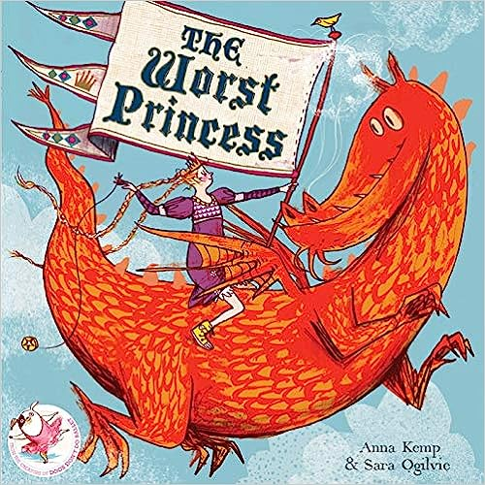
Actions: Curriculum
Integrate LGBTQ+ content across the curriculum as well as in lessons about relationships, avoid stand-alone lessons.
Introduce good role models across the curriculum, and always explicitly talk about the barriers they faced and how they overcame them.
Implicit and explicit inclusion.
Use books as a scaffold, and draw attention to how stereotypes are reinforced as well as challenged.
Notes:
It is not enough to have role models in the curriculum; children need to be taught about barriers and how to overcome them.
E.g. Tom Daley in PE, Alan Turing in Computing, Frida Kahlo in art.
Explicit inclusion: explicitly talking about LGBT issues as lesson content
Implicit inclusion: e.g. maths questions like “Steve’s Dads both gave him £5…”
These three books were chosen to match a “castles” topic in Year 1 to show that there should be diversity across the curriculum in all years. You may wish to change the books to fit one of your topics.

Slide 10
Actions: Other
Activities and play:
In independent learning and at break times encourage all children to take part in all activities.
Consider changes you can make to areas that are dominated by one gender.
Special events:
Never give out gendered rewards/ presents.
Consider costumes.
If you have any children using different facilities in school, plan for this during trips.
Whole-school approach
We are looking at policies, handbook, facilities.
Gently correct colleagues.
Notes:
Break times – e.g. some schools found that sports areas were dominated by boys, so swapped the balls for softer ones, girls then felt safer.
Costumes can be pointlessly gendered – do angels need to wear dresses? You could really upset Daily Mail readers and have “Wise People”.

Slide 11
Framework
Notes:
See separate document for framework, and edit to fit your school. The text in bold is words I think could be especially appropriate to use with children at that age. The text in the red box is what changes most between year groups, lots of the good practice for gender and relationships is the same for all ages.
Here, you need to give teachers time to look at their own PSHE (and other, if you have time) planning and make any changes needed. I would recommend at least half an hour to look at planning, plus some time to digest the language and check in with you if there is anything they are uncomfortable with.

