Slide 1
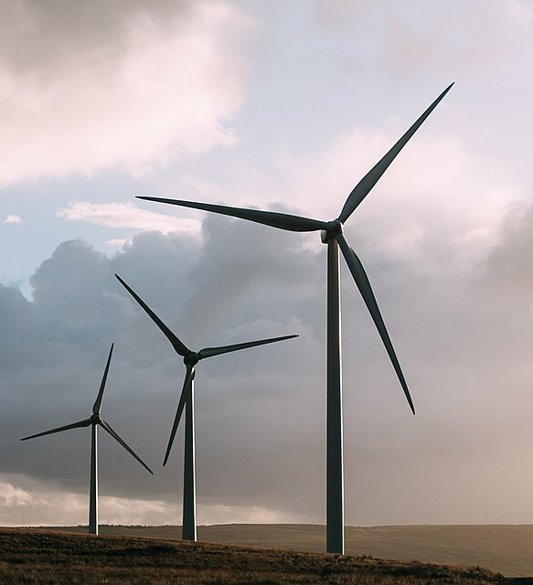
Wind power and climate variability/change
Jan Wohland (jan.Wohland@its.uio.no)
Associate Professor
University of Oslo

Slide 2
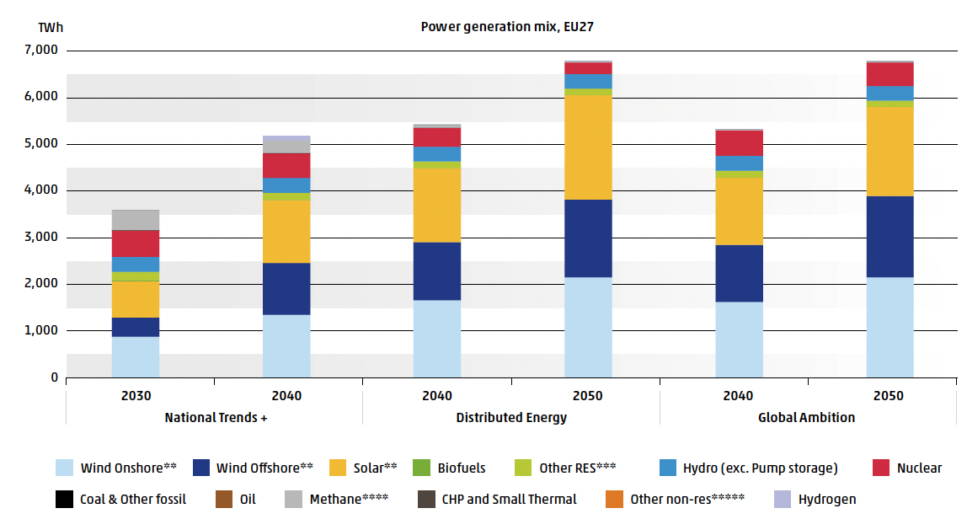
Wind power is essential to achieve net zero
Europe’s Ten Year Net Development Plan (TYNDP)
European Climate law sets an ambitious decarbonization path
2050: climate neutral
2030: 55% reduction relative to 1990
Infrastructure planned now will be operational for decades

Slide 3

Future wind conditions can be different for many reasons
Climate Variability
?
?
Climate Change
Stilling

Slide 4
Future wind conditions can be different for many reasons
Climate Variability
?
?
Climate Change
Stilling

Slide 5
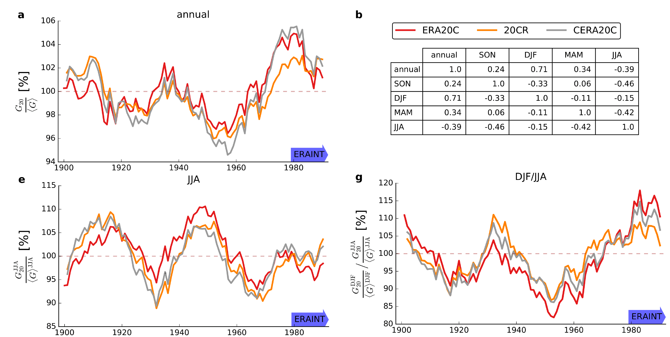
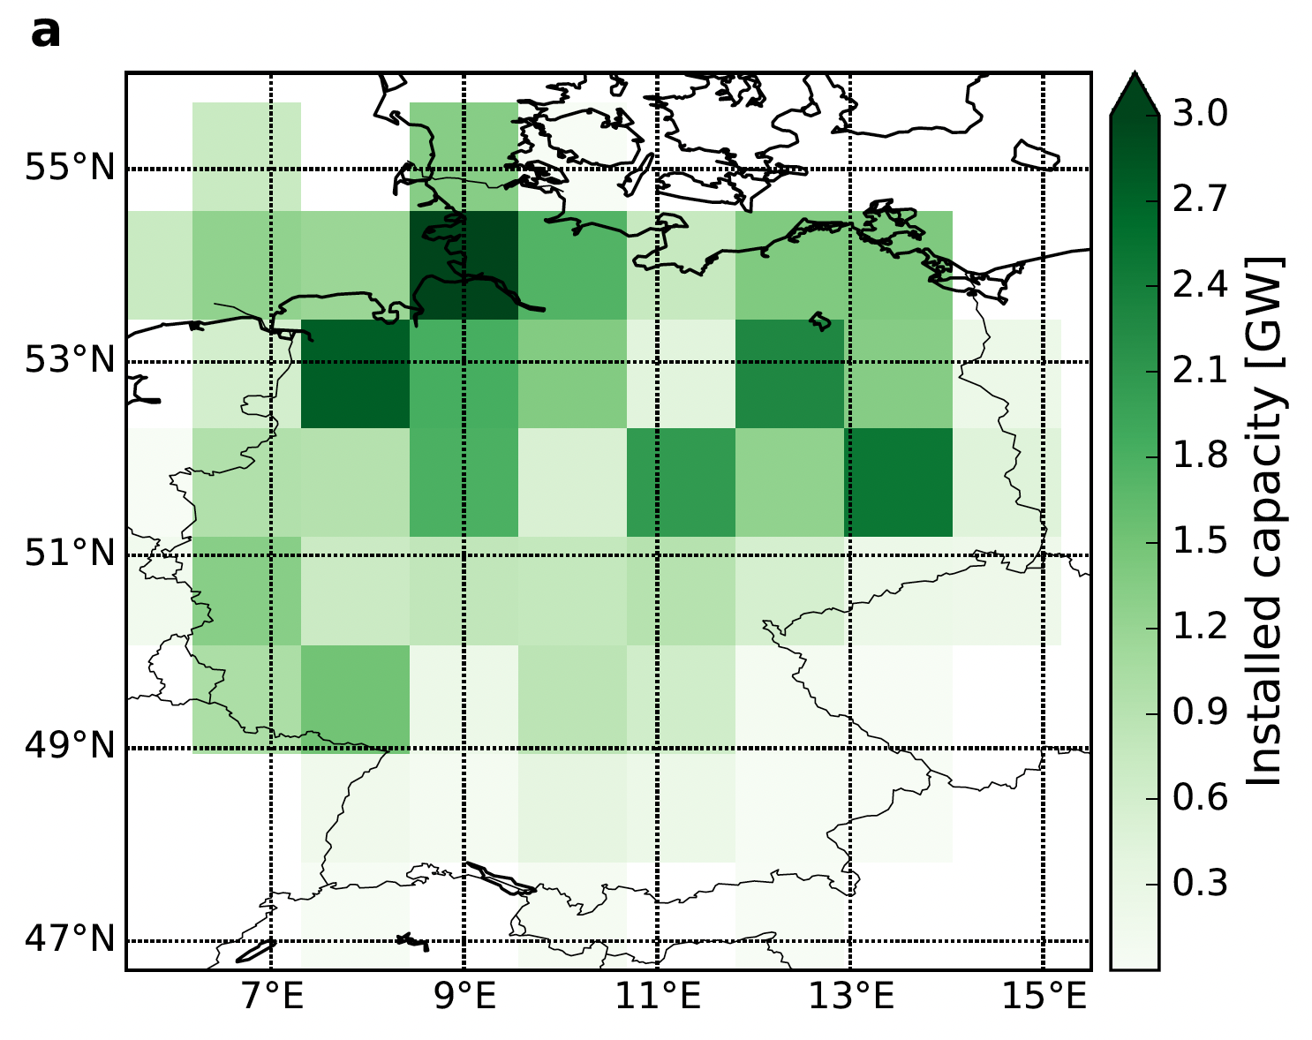
Wind generation potentials vary over multiple decades
How much energy would current German wind park fleet have generated over the 20th century?
Method:
10m wind speeds (3h) → power-law vertical scaling → multiplication with capacity layout → 20y lifetime mean
Lifetime generation [%]
Commissioning year
[Wohland et al., 2019b]
$±$ 5% (whole year), $±$10% (summer), $±$15% (winter-to-summer ratio)

Slide 6
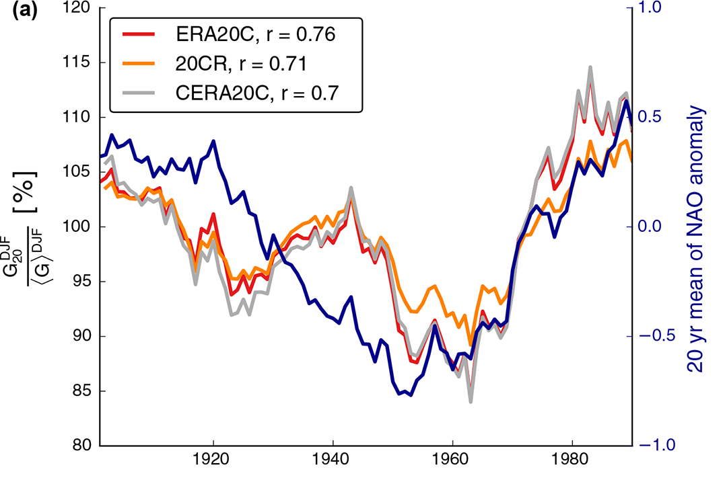
Winter wind generation correlated to NAO
Possibly a hint towards predictability! Ask Ben for details.

Slide 7
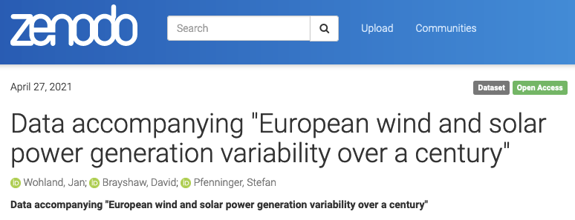
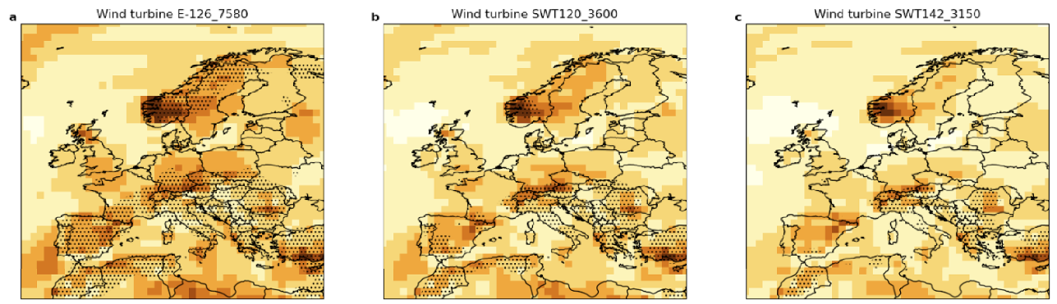
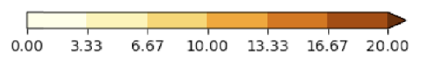
Multidecadal fluctuations occur across Europe
Method:
Combination of 20CRv3 and CERA20C, using 100m winds as input
E-126_7580
SWT120_3600
SWT142_3150
Do what extent are those fluctuations predictable?
[Wohland et al., 2021]
Amplitude of multidecadal variability [%]

Slide 8
Future wind conditions can be different for many reasons
Climate Variability
?
?
Climate Change
Stilling

Slide 9
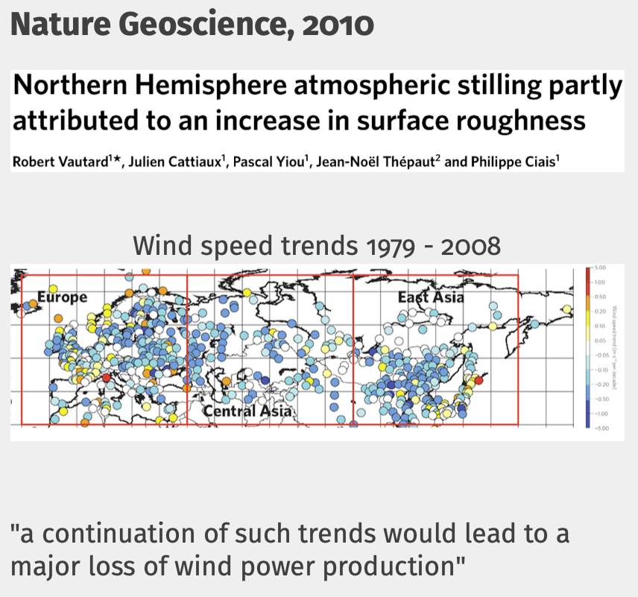
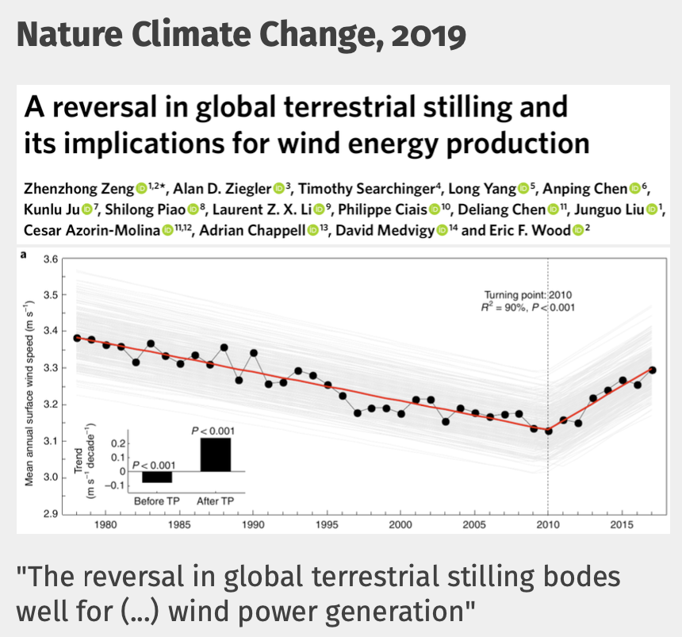
The stilling phenomenon

Slide 10
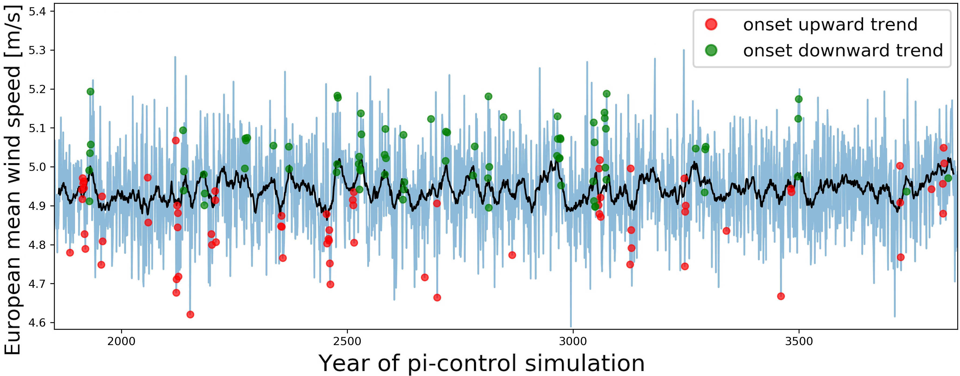
What causes stilling?
Something (Climate Change)
Nothing (Climate Variability)
Method:
Check whether stilling-like events occur in a climate model without human intervention
Land-use change
Altered temperature gradients
Moved storm tracks
Windparks
…
Model year
[Wohland et al., 2021]
Stilling-like trends occur without human intervention!

Slide 11
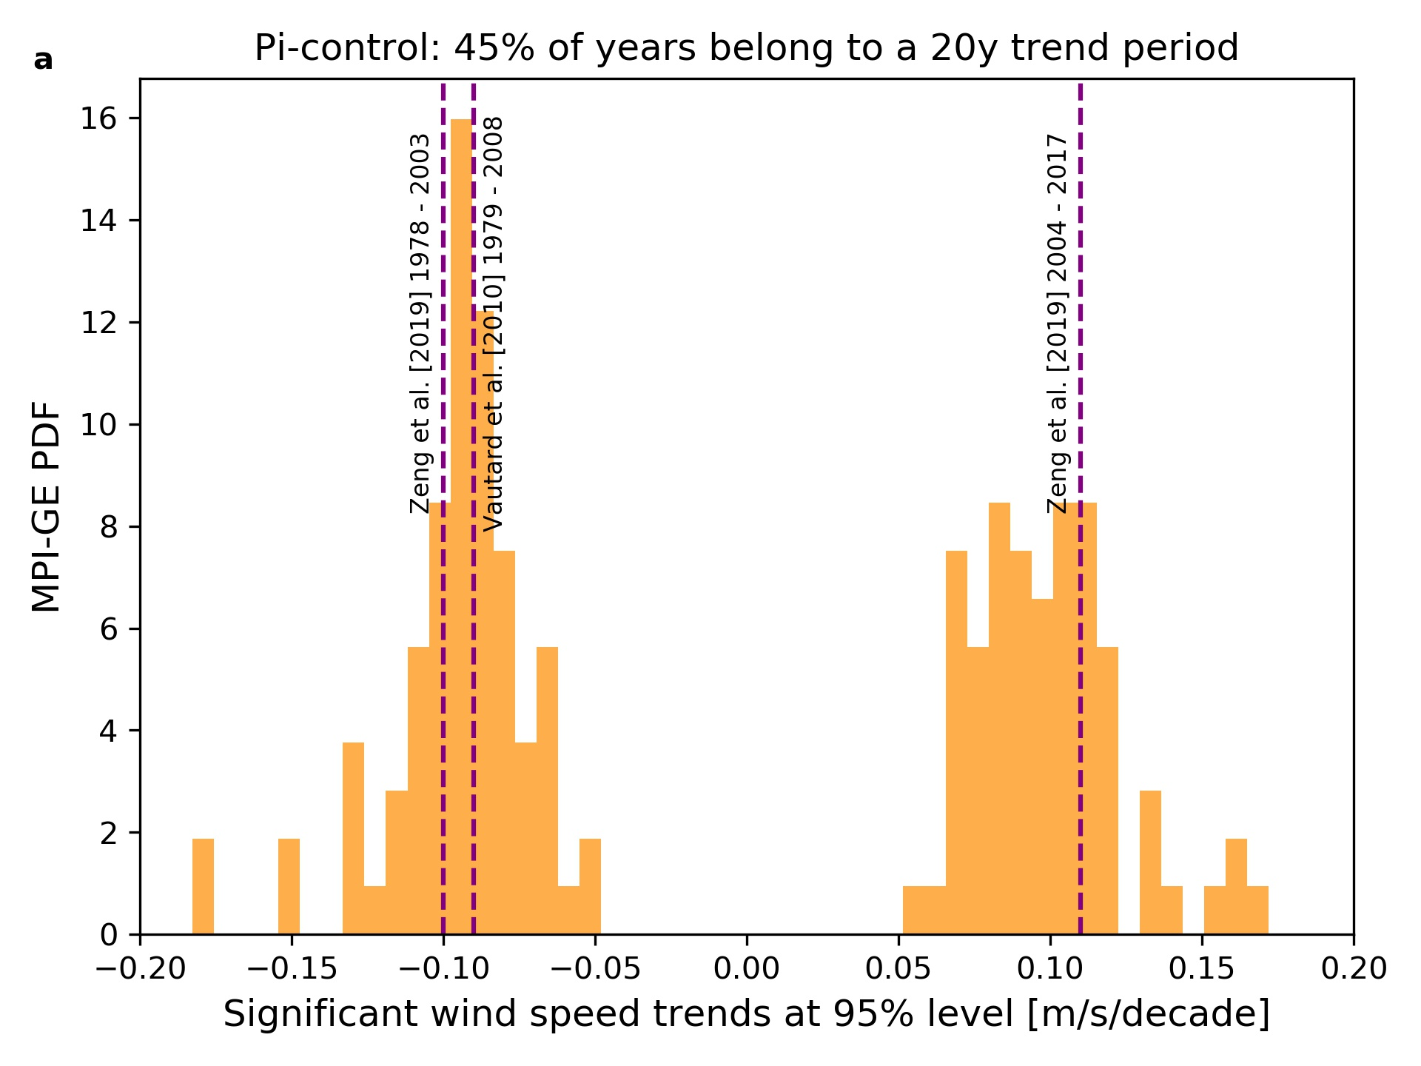
Modeled and observed trends have the same amplitude
Stilling consistent with climate variability
Can happen without any reason
[Wohland et al., 2021]

Slide 12
Future wind conditions can be different for many reasons
Climate Variability
possible
?
Climate Change
Stilling

Slide 13
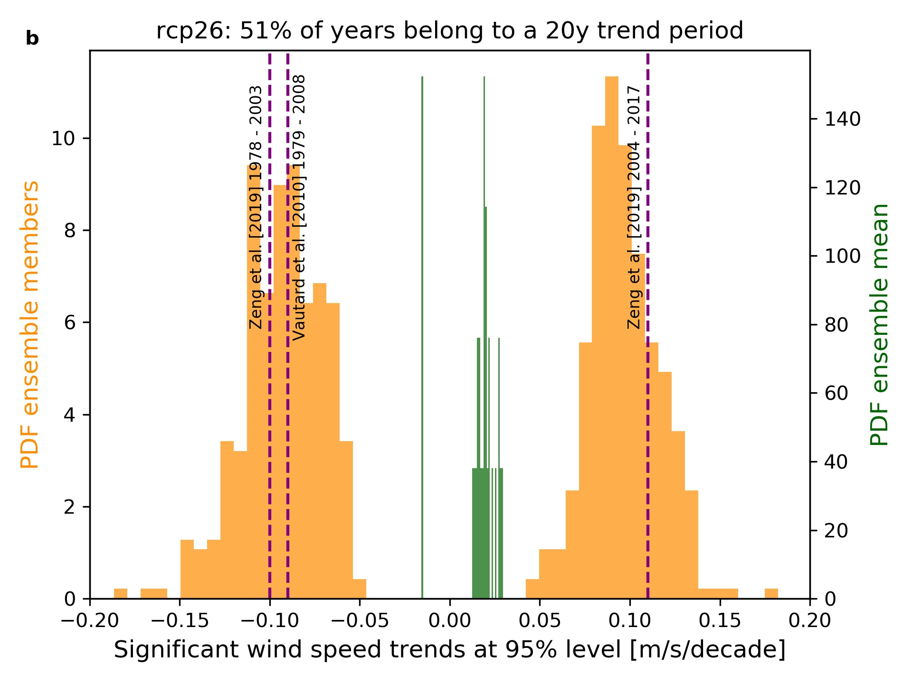
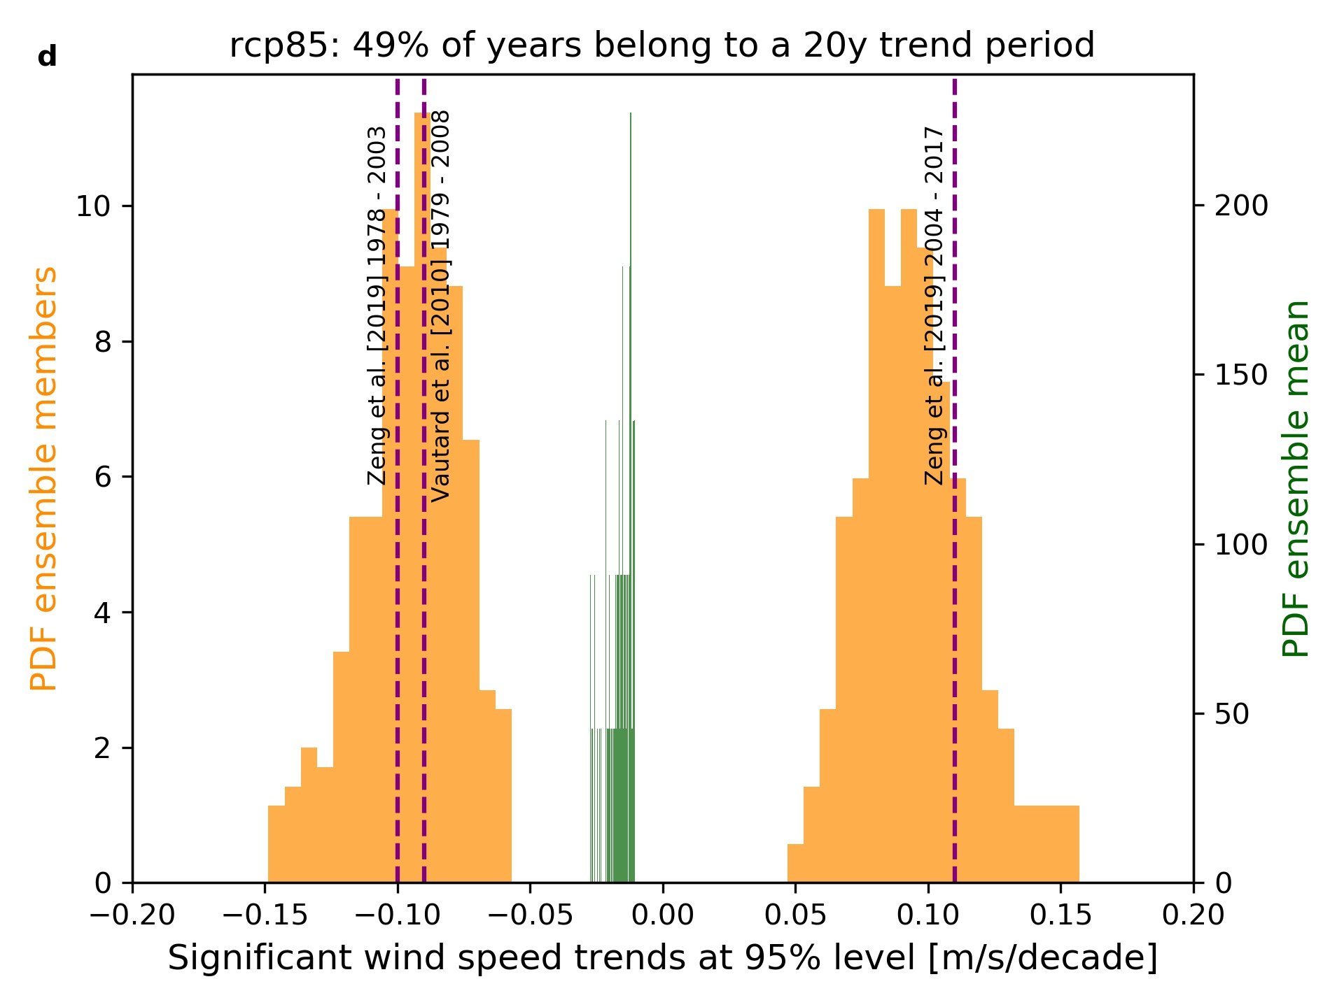
Near future: Climate variability more important than climate change for mean winds in Europe
Weak climate change
Strong climate change
Green shows systematic wind changes due to climate change (trends in the ensemble mean)
[Wohland et al., 2021]

Slide 14
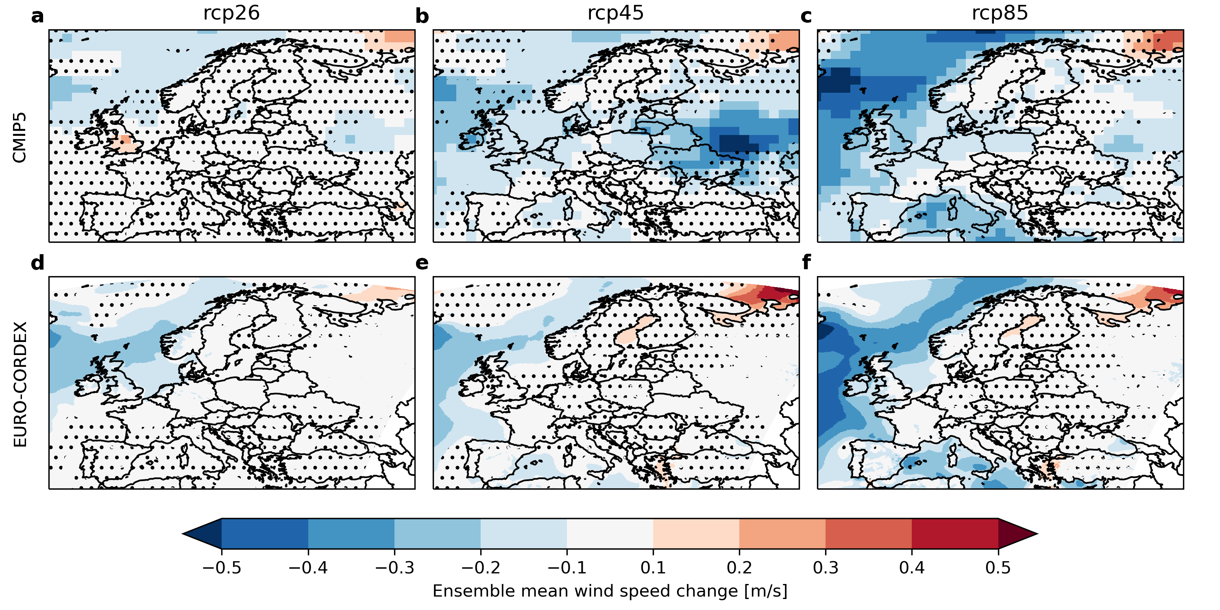
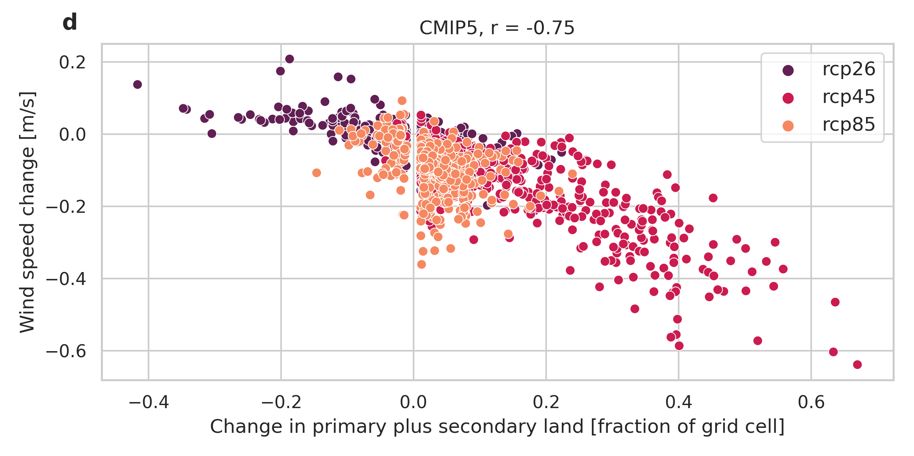
Land-use change can strongly impact onshore winds
2080-2100 minus 1985 - 2005
CMIP5
r = -0.75
CMIP5
EURO-CORDEX
Land-use change can locally alter wind speeds considerably, and scenarios can be quite extreme
[Wohland, 2023]

Slide 15
Climate variability/change and wind power
Take home messages and open questions
Wind energy potentials fluctuate over multiple decades because of climate variability
Climate variability alone can explain Continental-scale wind speed stilling
Land-use change has strong influence on modeled winds and their change
Q: Can we predict the wind resource for the next decade or so?
Q: Can climate variability explain stilling beyond Europe?

