Slide 1


Decadal prediction for energy applications
Benjamin Hutchins – 7th January 2025
David Brayshaw, Paul-Arthur Monerie, Reinhard Schiemann, Jon Robson, Hazel Thornton, Len Shaffrey, Doug Smith

Slide 2
Outline
1. How can decadal predictions be useful for energy applications?
2. Can decadal forecasts be used to make skilful predictions of energy-relevant variables?

Slide 3
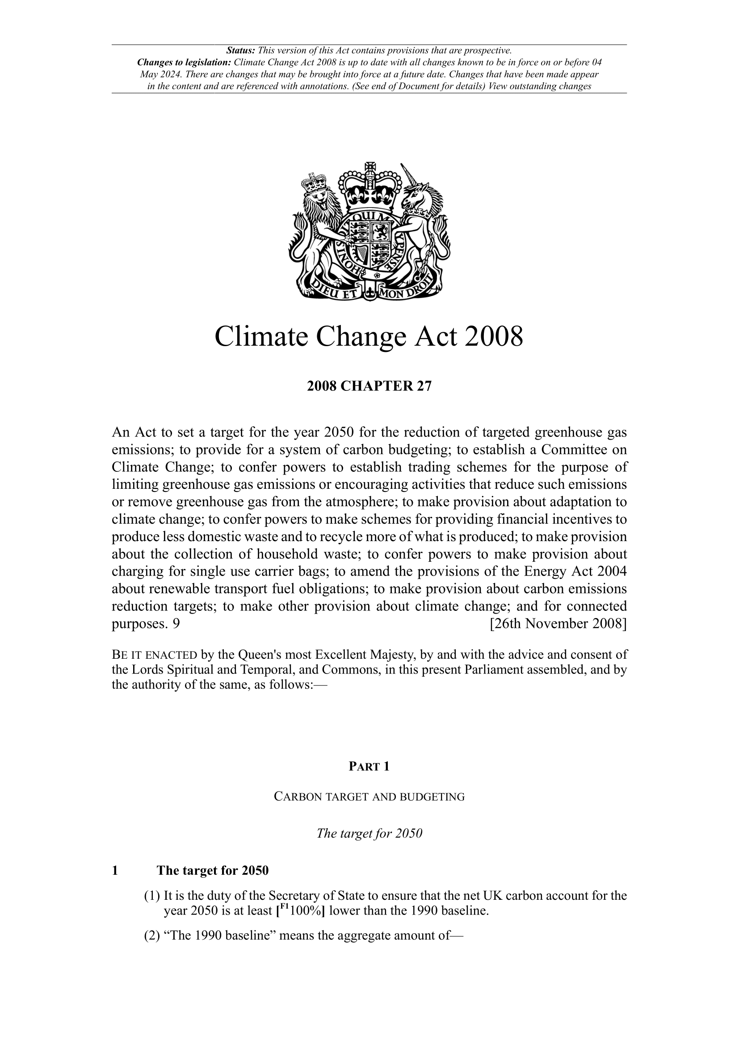
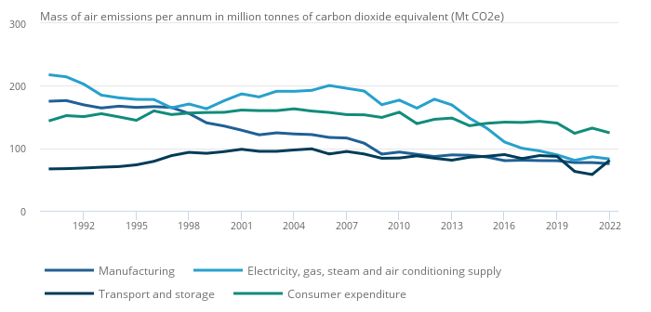
Motivation
ONS (2024)
Notes:
In the UK, the climate change act of 2008 contains a legally binding target to reduce carbon emissions to 100% lower than the 1990 baseline by 2050 – Net Zero.
Although it’s proportion has been reducing, the energy sector makes up ~15-20% of total UK emissions.
Therefore, transitioning to a low carbon energy system remains an important challenge for achieving net zero

Slide 4

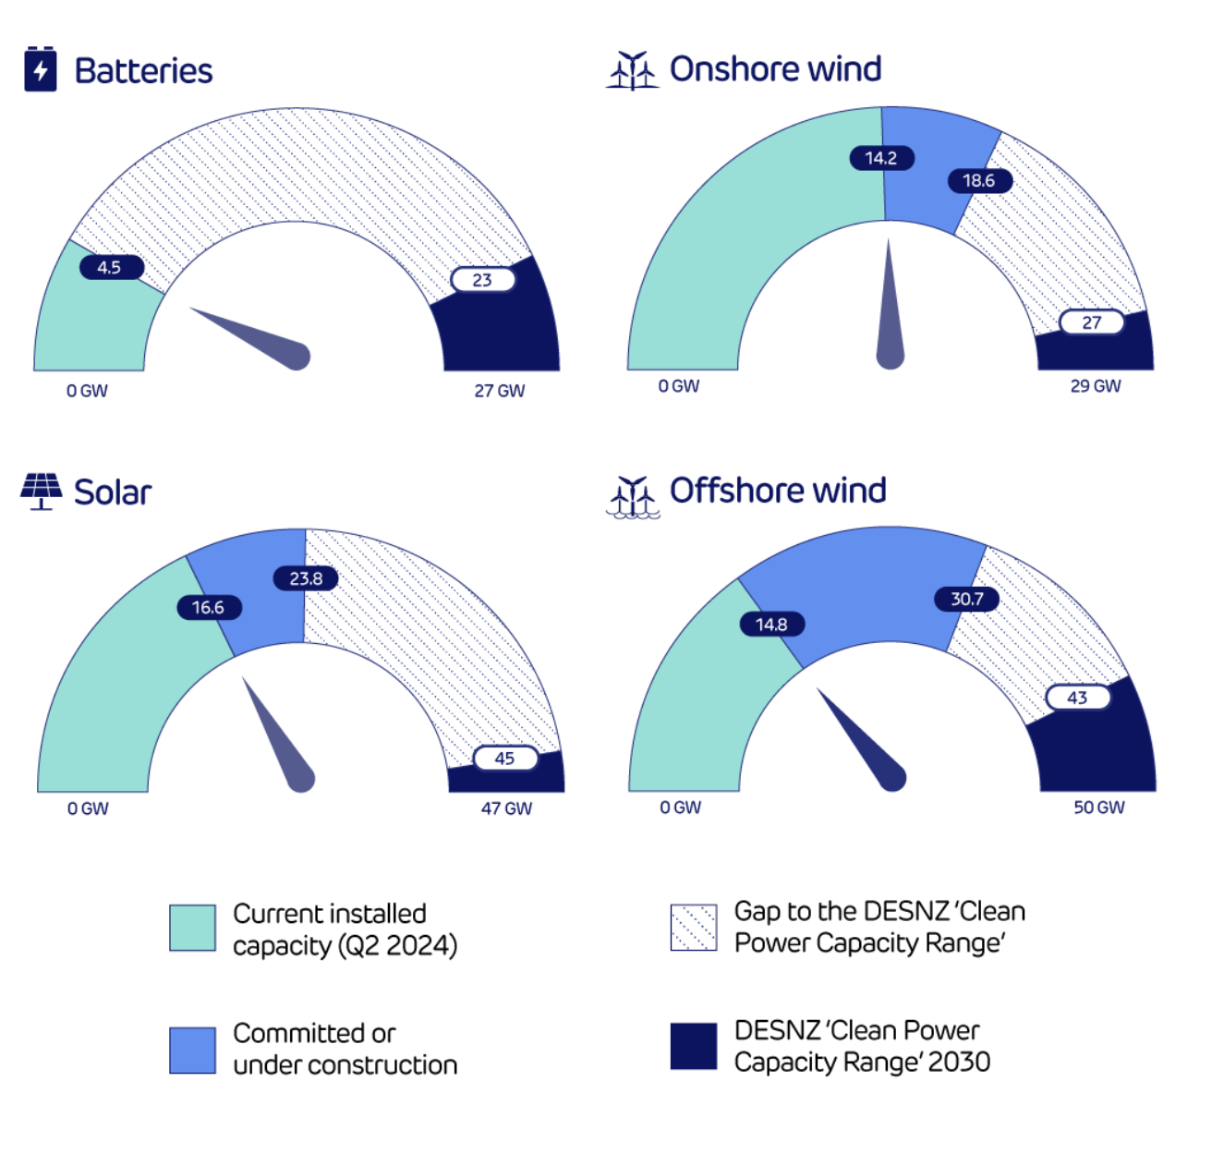
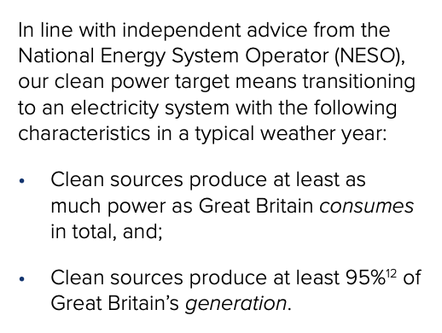
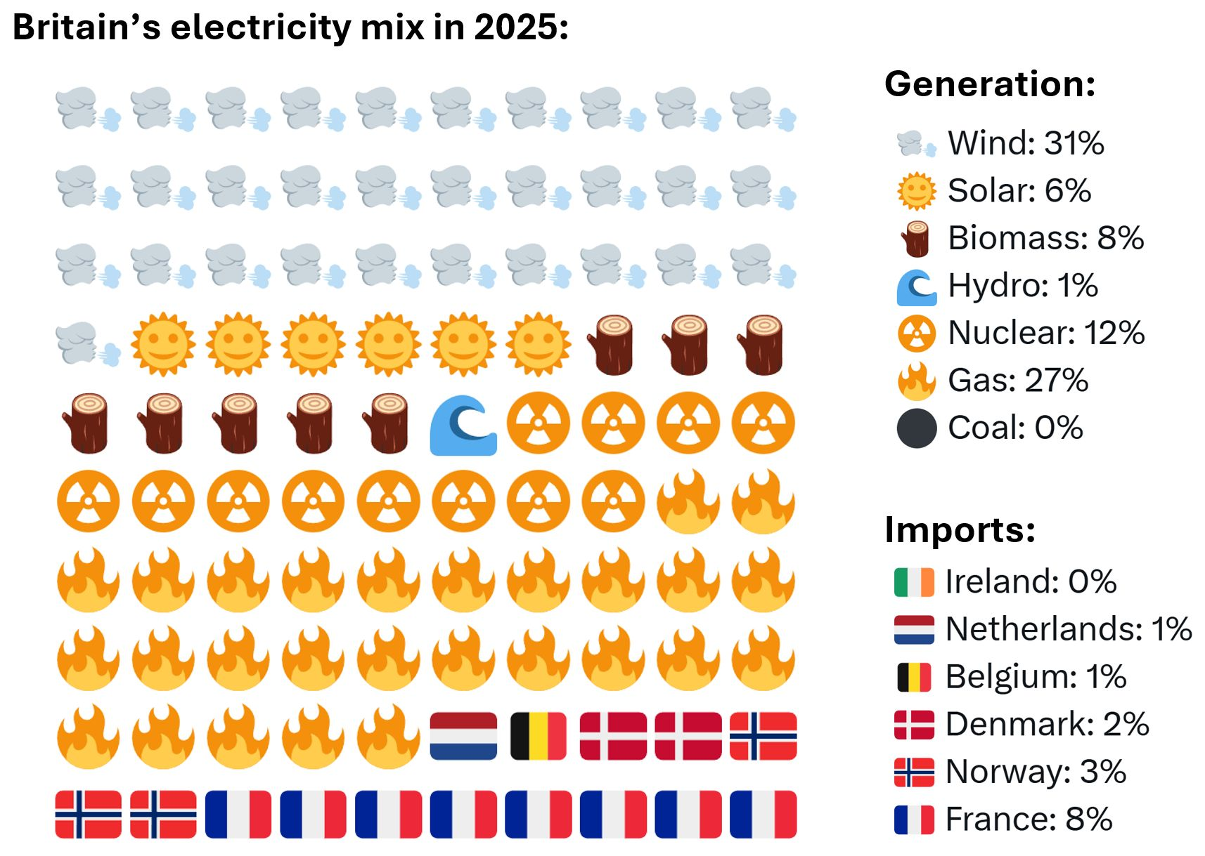
Motivation
2024 generation mix
DESNZ Clean Power 2030 Action Plan (2024); Iain Staffell (2026)

Slide 5



How can decadal predictions be useful?
NESO (2025), DESNZ (2024)
Notes:
Building wind farms requires a huge amount of investment up front, with much of this coming from debt.
By better understanding the risk related to underperformance due to weather, developers can make more informed decisions about debt financing for these large infrastructure projects.
Additionally, this can
Resource adeuqcy planning for coming years
Strategic spatial energy plan released in late 2026
Debt financing
2030s spatial energy planning
Andrew and lisa team NESO

Slide 6
Outline
1. How can decadal predictions be useful for energy applications?
2. Can decadal forecasts be used to make skilful predictions of energy-relevant variables?

Slide 7
Methods
Model
Multi-model ensemble of dcppA-hindcasts
12 models, 178 members
Observations
ERA5 reanalysis
1961-2023

Slide 8
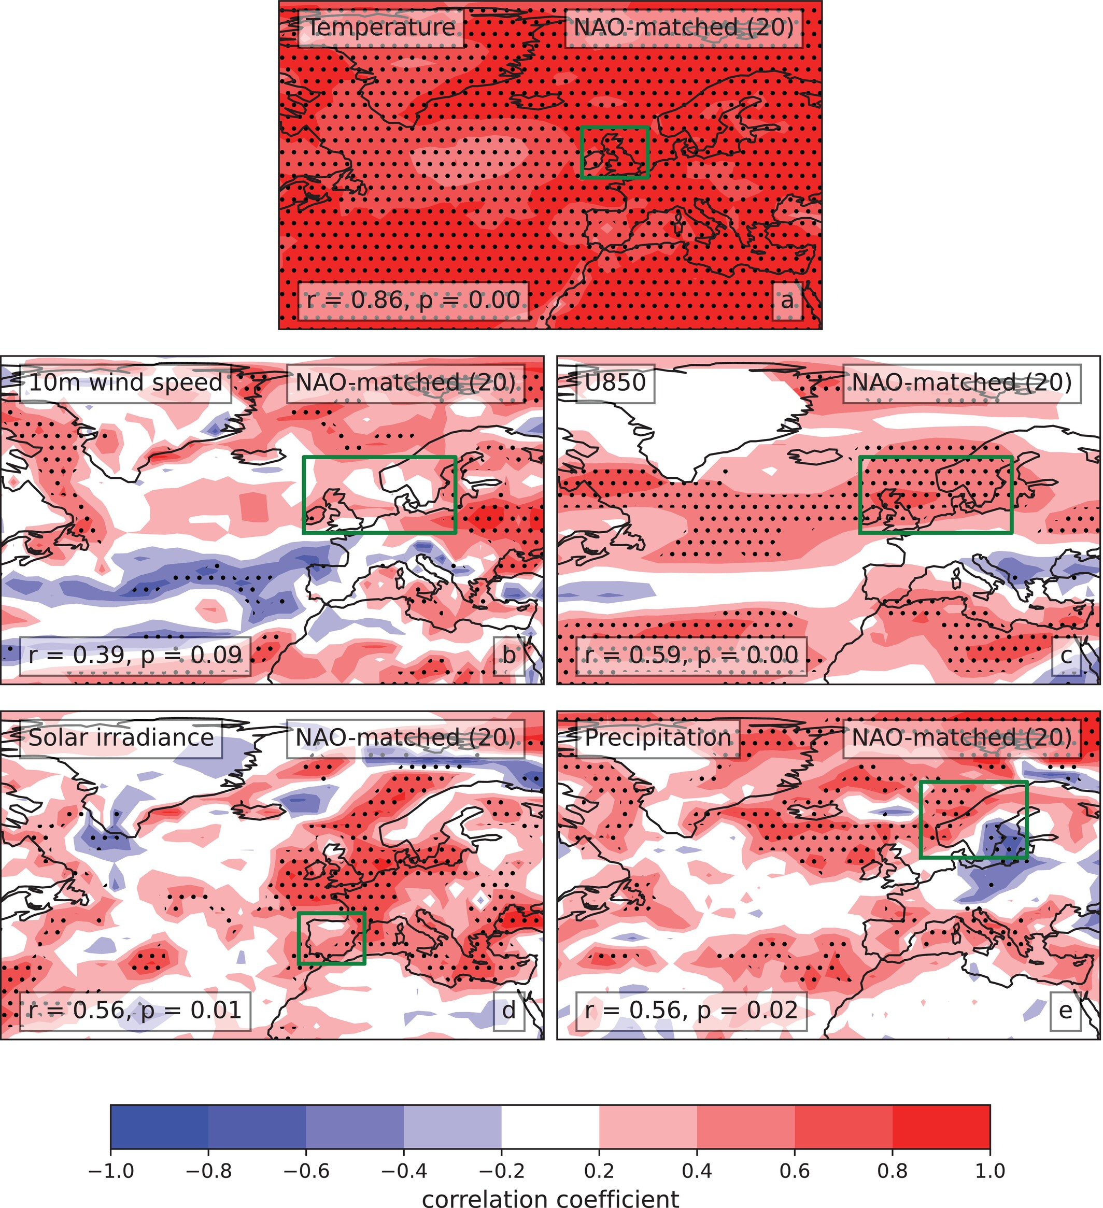
How skilful are decadal forecasts of surface variables?
Forecast years 2-9, ONDJFM

Slide 9
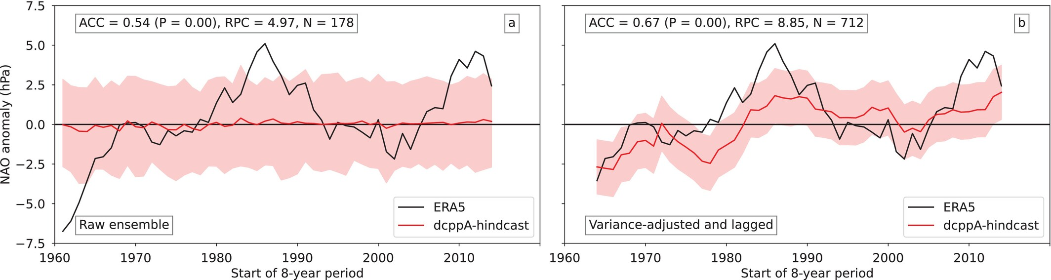
How skilful are decadal forecasts of the NAO?
Forecast years 2-9, ONDJFM
Lagging and variance adjustment improves prediction skill

Slide 10
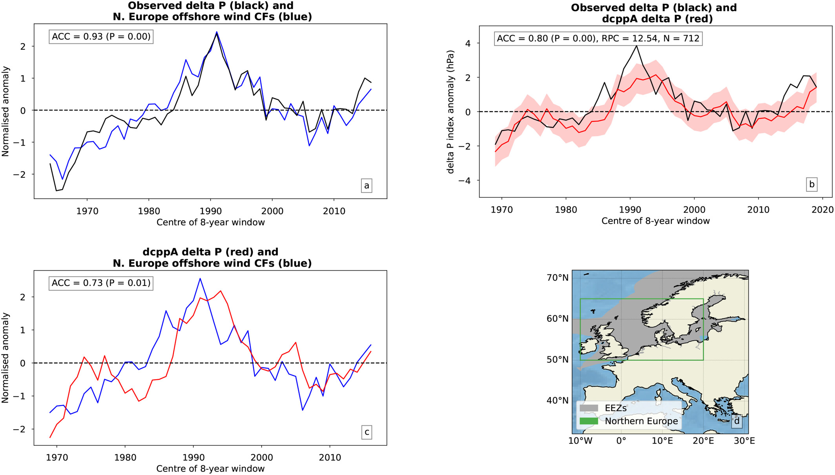
Can we use pattern-based forecasts to predict wind power generation?
Corr(obs delta P, ofs wind)
Corr(obs delta P, hc delta P)
Obs relationship
Hindcast skill
Corr(hc delta P, ofs wind)
Combine skill + rel.

Slide 11
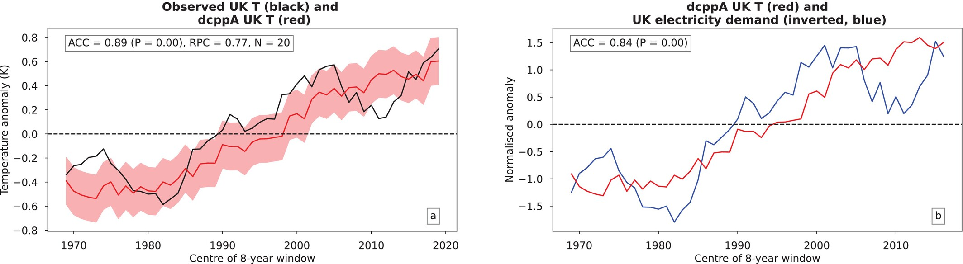
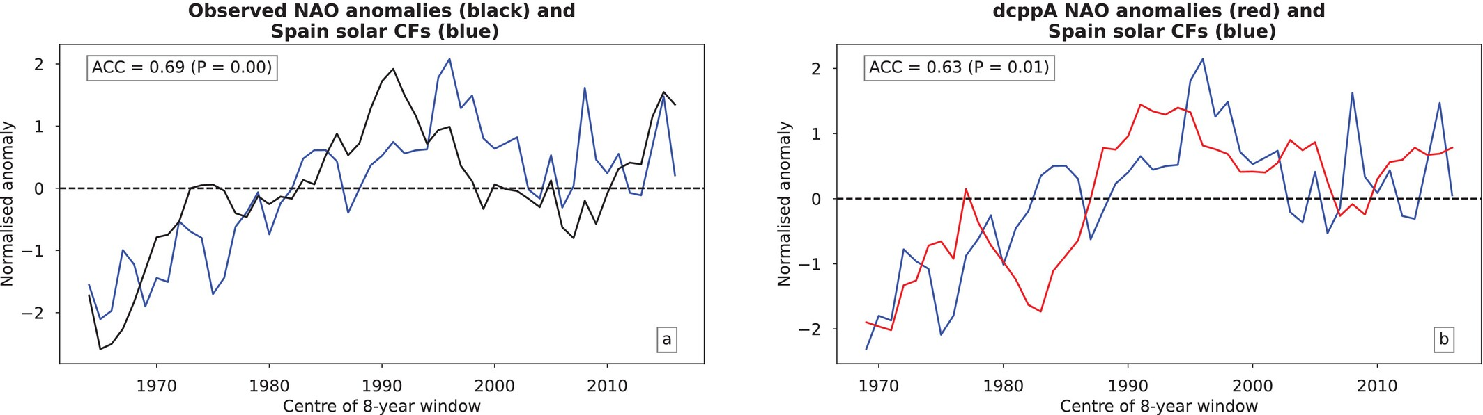
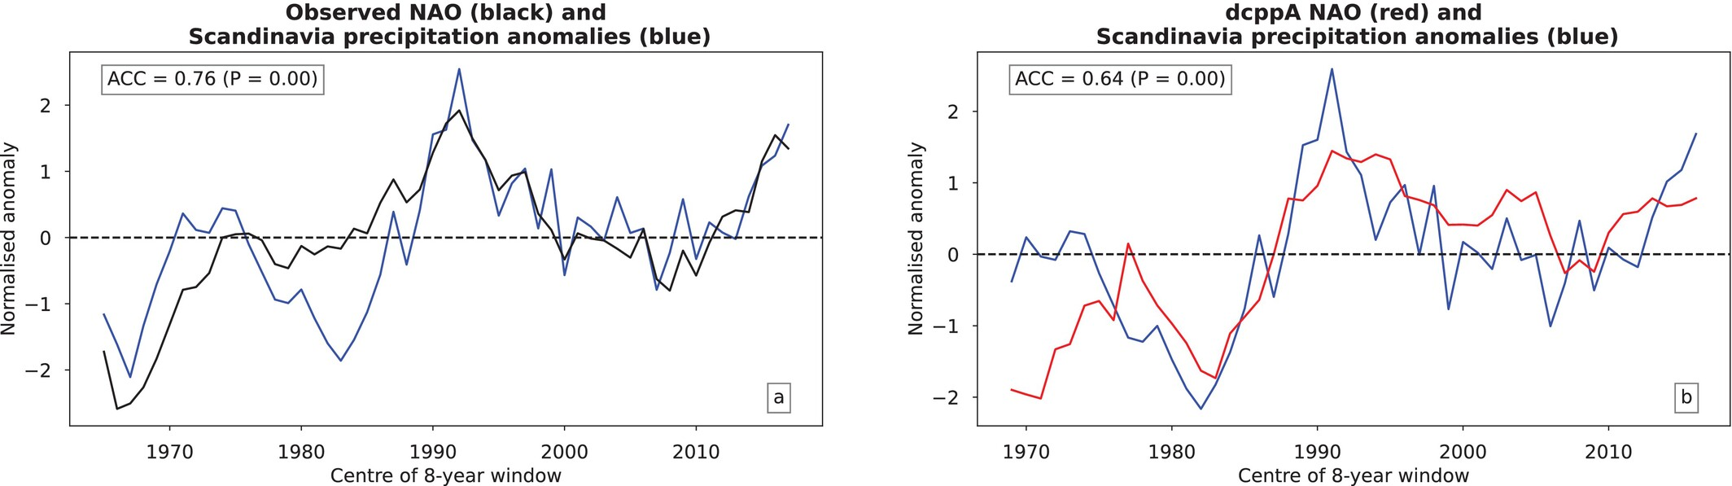
Can we use decadal forecasts for other energy variables?
Predicting UK electricity demand using temperature
Predicting Spain solar capacity factors using the NAO
Predicting Scandinavian precipitation anomalies using the NAO

Slide 12
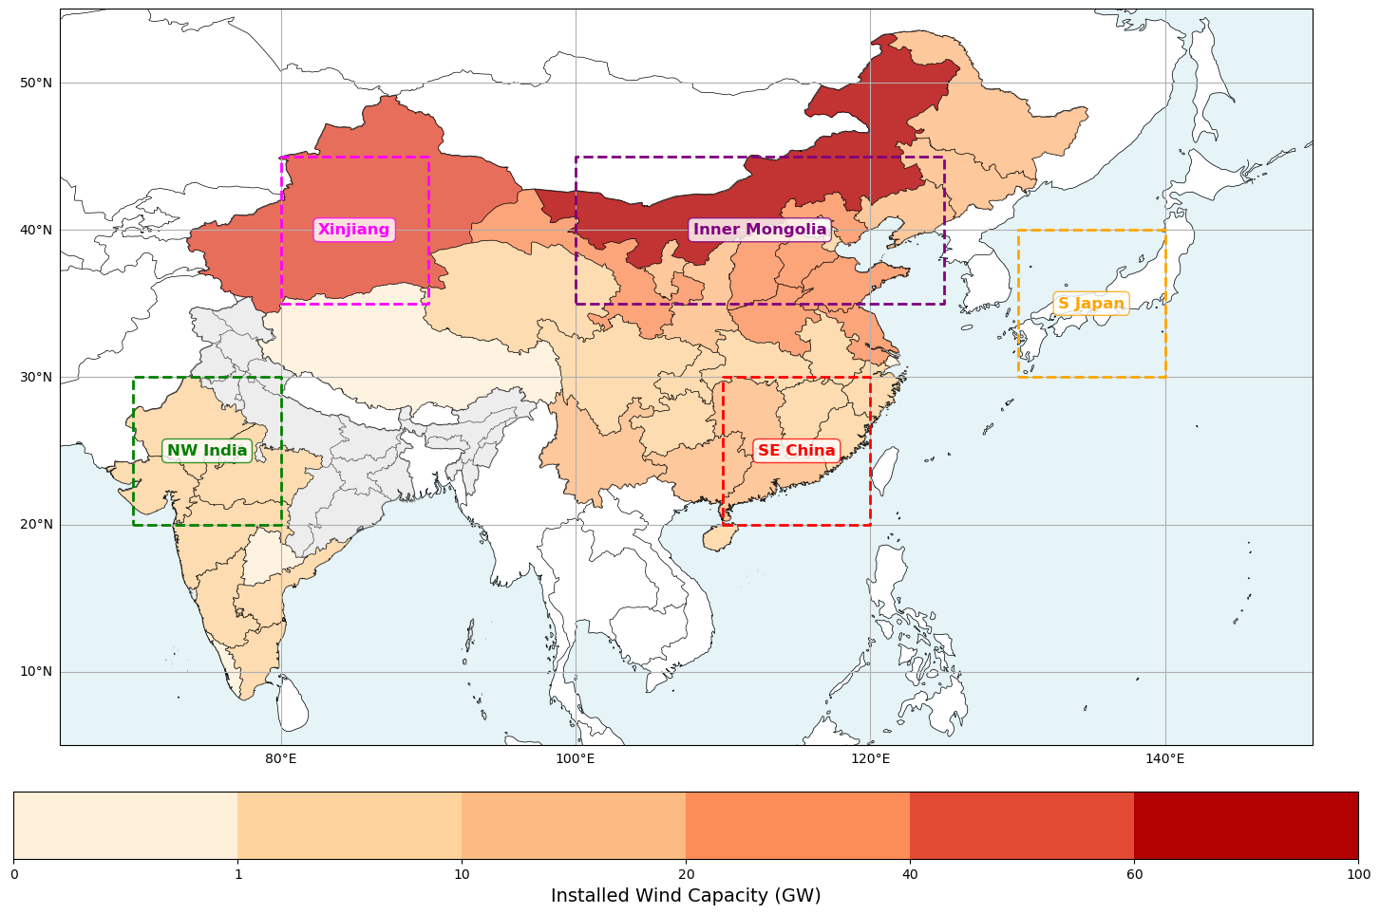
What about other regions?
Installed wind capacities (GW)
Notes:
Note that a single province in China – Inner Mongolia – has ~3x the installed capacity of the UK – and we have the 5th highest installed capacity in the world

Slide 13
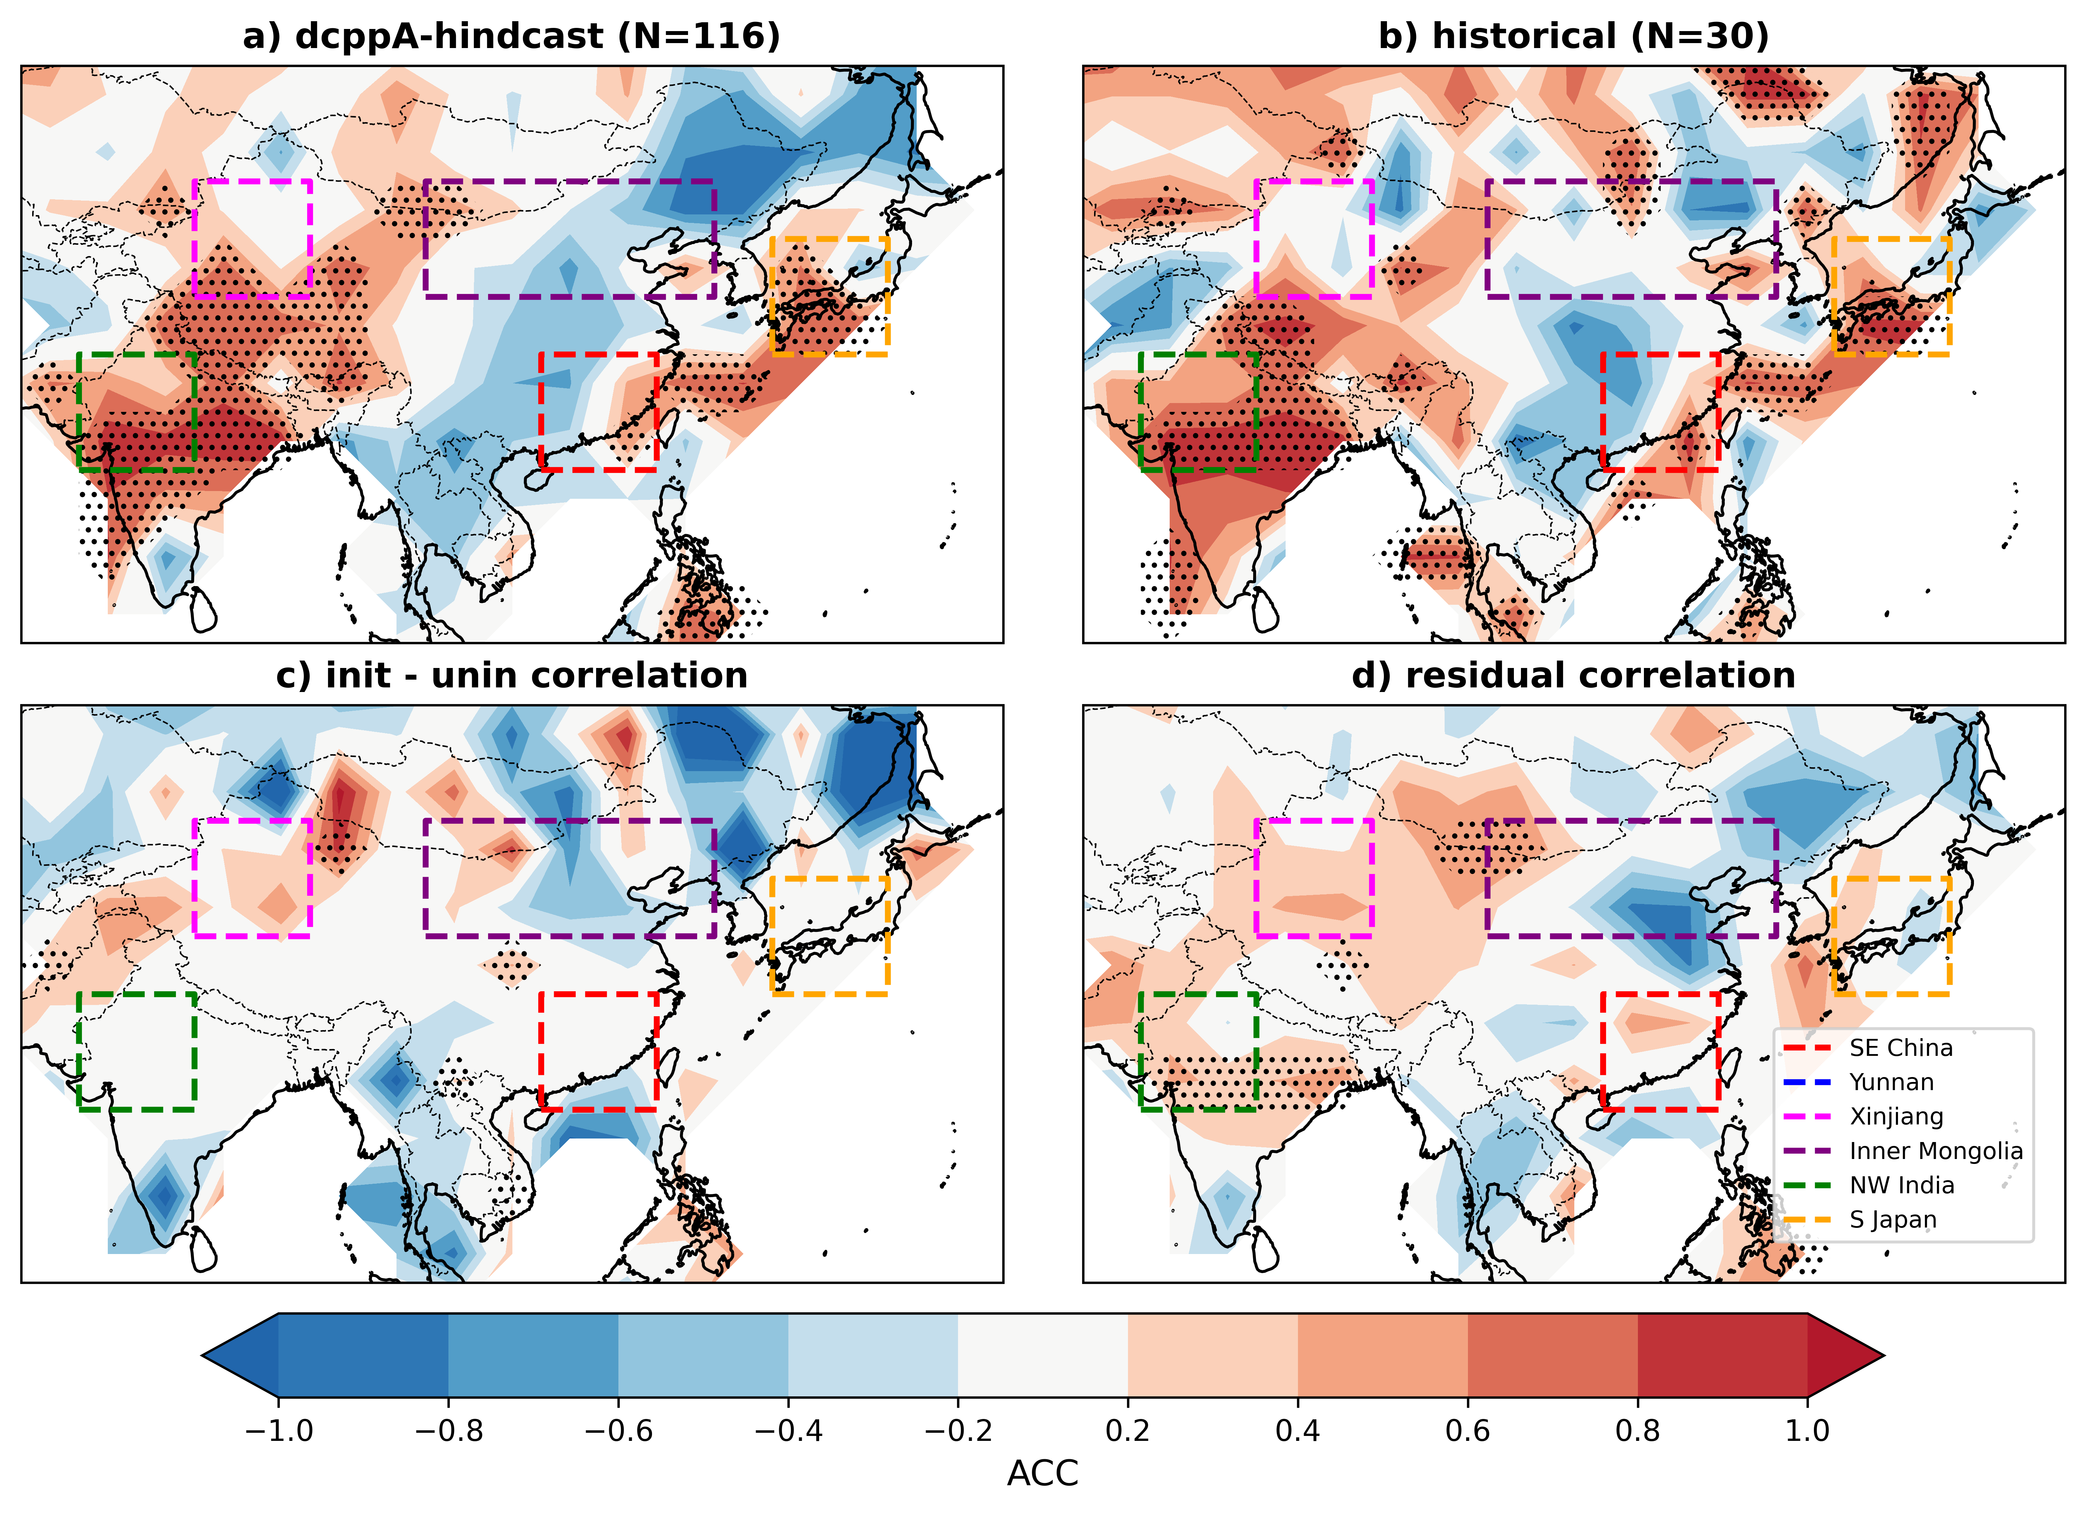
How skilful are decadal forecasts of wind speed in these regions?
Forecast years 2-9, DJF
Region | Corr(dcppA, HadISD3) | Resid. Corr(dcppA, HadISD3)
SE China | 0.34 | -0.18
Xinjiang | 0.41 | 0.57*
Inner Mongolia | -0.82 | -0.33
NW India | 0.84* | 0.37
S Japan | 0.78* | 0.25
Multi-model ensemble of dcppA-hindcasts
HadISD3 gridded obs, 1975-2014
Notes:
Only really see skilful direct predctions of wind speed in NW India and S Japan
Little meaningful skill over China
Where we don’t have prediction skill for direct forecasts of wind speed – e.g., SE China, Inner Mongolia – can we use pattern based predictions here2

Slide 14
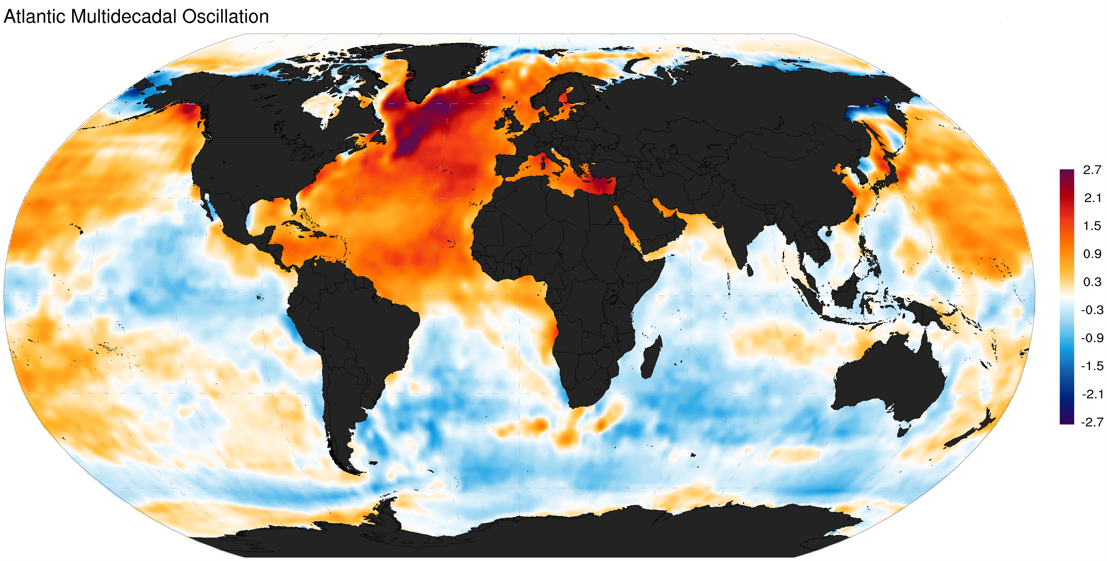
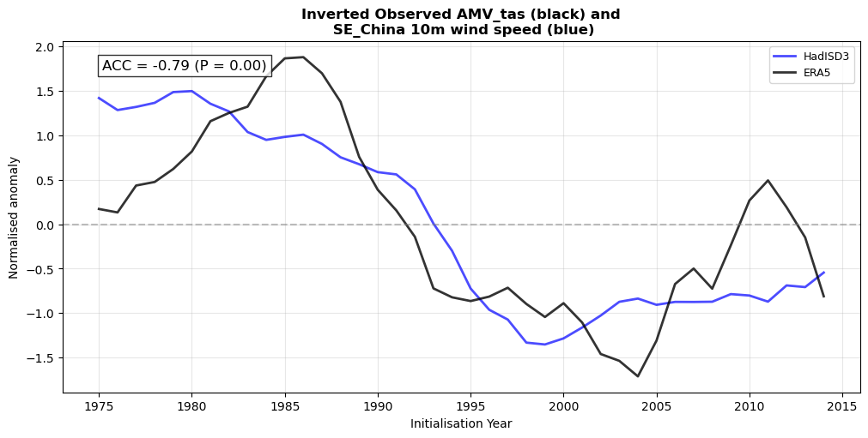
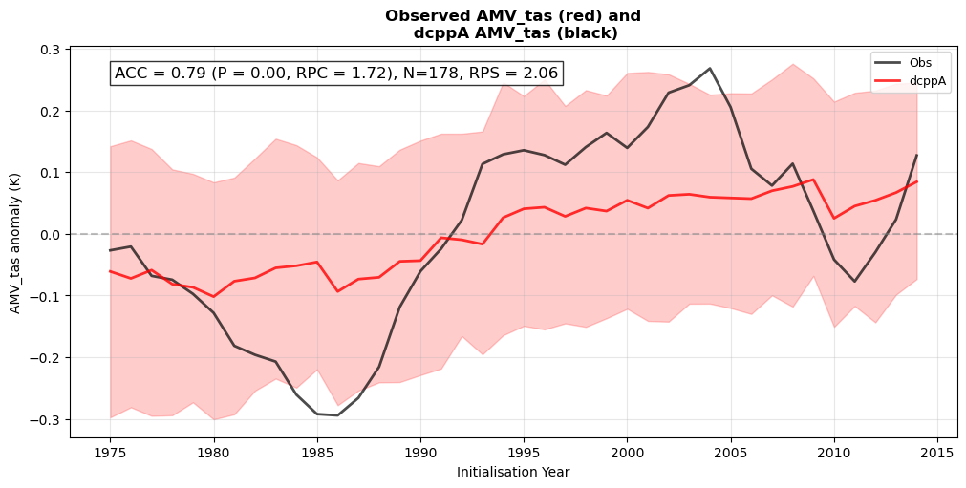
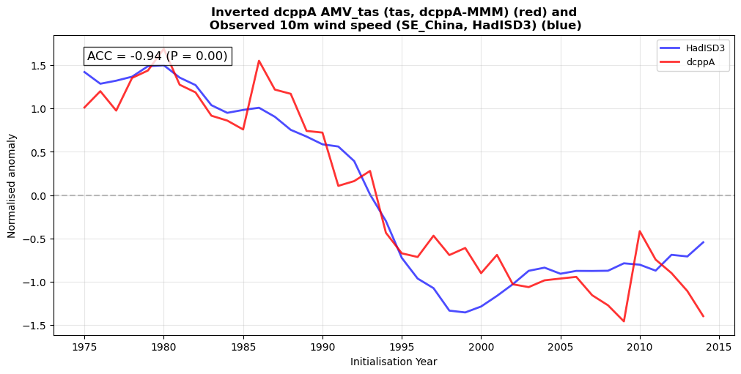
Can we use pattern-based forecasts to predict the wind speed?
Atlantic Multidecadal Variability
Corr(obs AMV, obs SE China wind)
Obs relationship
Corr(obs AMV, hc AMV)
Corr(hc AMV, obs SE China wind)
Hindcast skill
Combine skill + rel.
Forecast years 2-9, DJF
Deser 2014

Slide 15
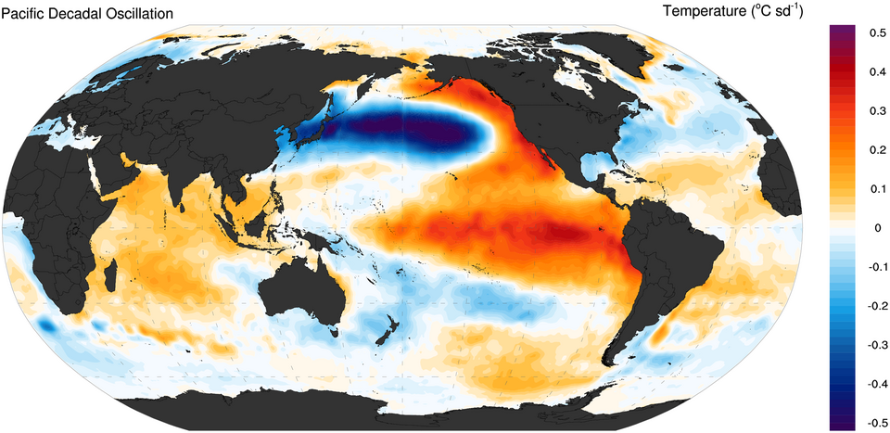
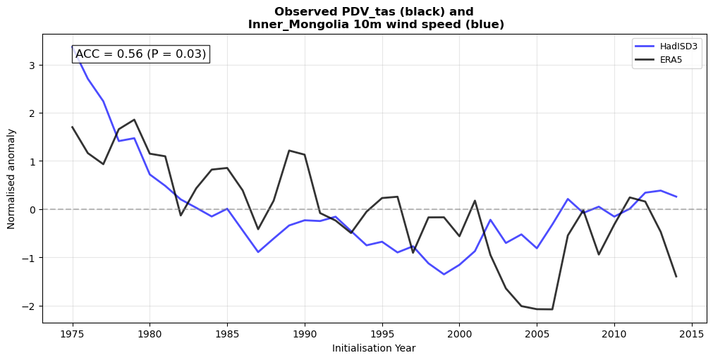
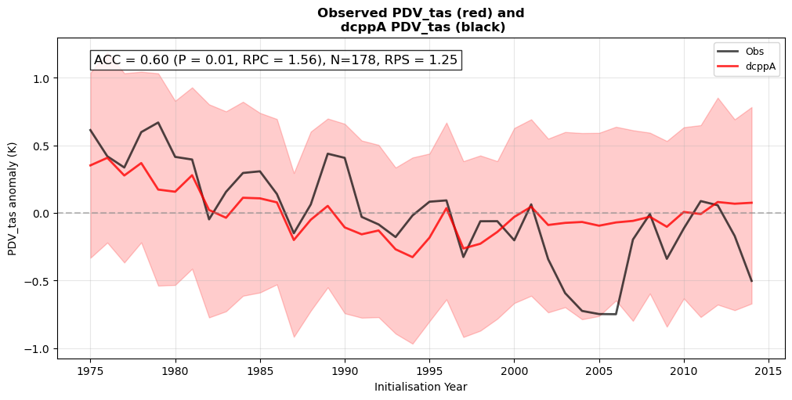
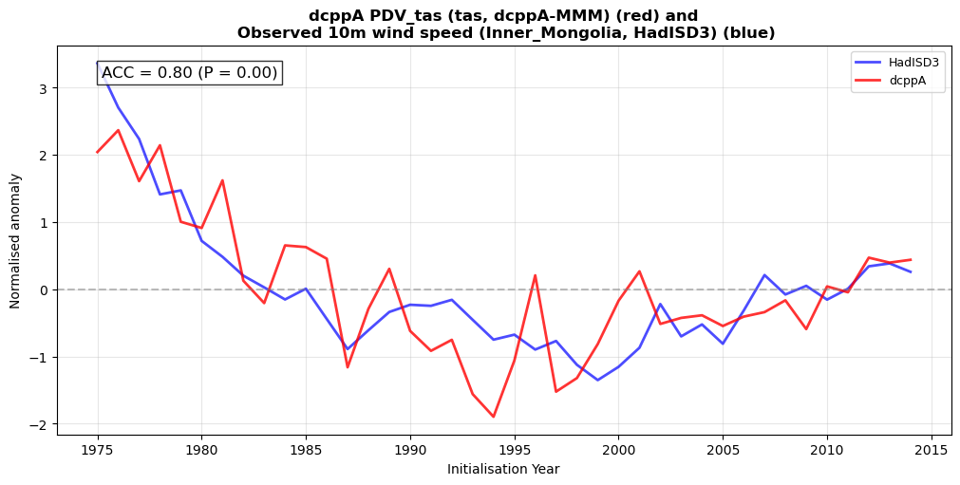
Can we use pattern-based forecasts to predict the wind speed?
Pacific Decadal Variability
Corr(obs PDV, obs IM wind)
Obs relationship
Corr(obs PDV, hc PDV)
Corr(obs IM wind, hc PDV)
Hindcast skill
Combine skill + rel.
Forecast years 2-9, DJF
Deser 2012
Notes:
Still need to diagnose the mechanisms by which AMV and PDV drive wind speed variability over China – using dcppC experiments
Also want to understand how these sources of prediction skill interact

Slide 16



Summary
Decadal predictions show forecast skill for energy-relevant variables
Decadal forecasts can skilfully predict large scale patterns (e.g., NAO, delta P, AMV)
Predictable skill in patterns can be used to create skilful predictions of energy variables

Slide 17


