Slide 1


WISTEREA Project
Reinhard Schiemann
Webinar “Understanding and predicting global wind stilling”, 6 January 2026

Slide 2
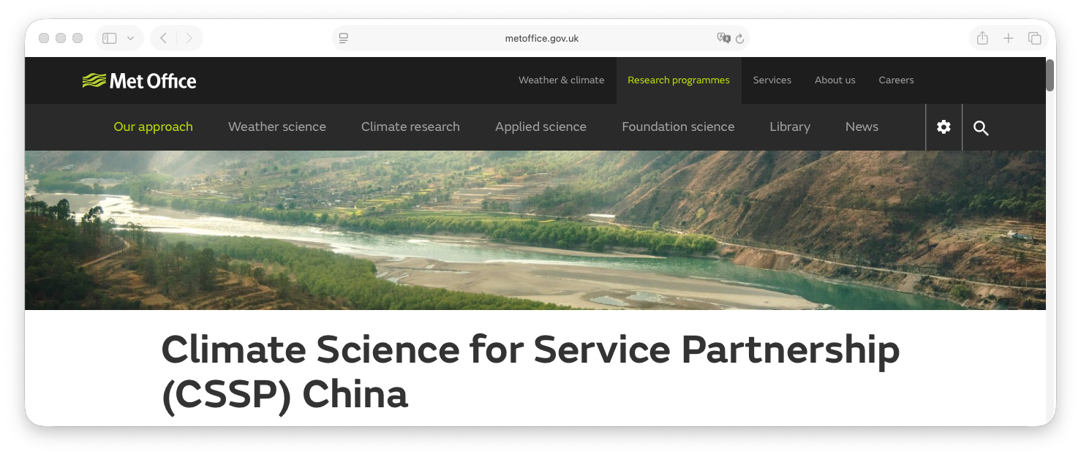
WISTEREA: Wind Stilling and Energy in Europe and Asia
Aims:
Estimating, predicting, and projecting wind speed and available wind power in the last 50 years, over the next ten years, and out to 2100,
Understanding, narrowing, and communicating uncertainties in these estimates, predictions, and projections
Geographical focus: broad, with a particular interest in the UK/Europe and Asia
Funding: CSSP China, through the UK Met Office
April 2024 – March 2027
Team @ Reading
Reinhard Schiemann
David Brayshaw
Jon Robson
Paul-Arthur Monerie
Ben Hutchins
3 visiting scientists (~1 year each) from China Meteorological Administration
Advisory board
Jia Wu (CMA)
Jan Wohland (University of Oslo)
Kate Willett (Met Office)
Robert Dunn (Met Office)

Slide 3
Aims of this webinar
Review progress in the project so far
Disseminate results to a broad audience (168 registered participants!)
Reflect on gaps/opportunities in this research area
Open part until 10am UK / 6pm China
Closed discussion (WISTEREA Team & Advisory board)

Slide 4
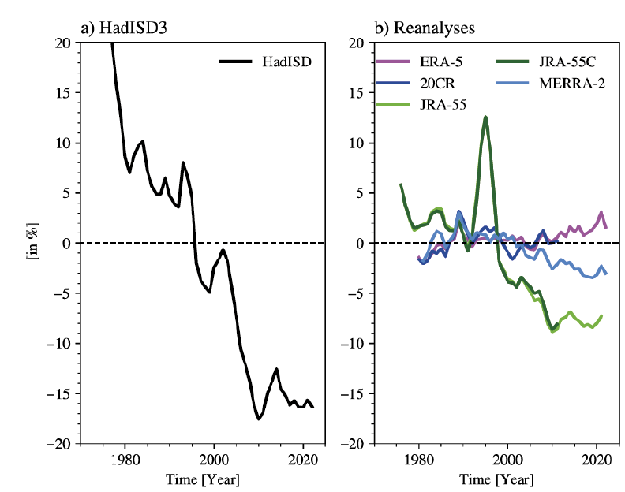
WISTEREA Activity 1 (year 1): Historical variations in wind and wind power
“last 50 years”
to the best of our knowledge, NH land 1980-2010 wind stilling is real
“large enough” to think about impacts
not captured in reanalyses
wind power density (~wind speed³)
Monerie et al. submitted

Slide 5
Activity 2 (year 2): Attributing and predicting wind and available wind power on decadal time scales
“next 10 years”
Q2.1: To what extent do existing prediction systems produce skilful forecasts of wind and wind power up to a decade ahead?
Q2.2: How do the externally-forced response and large-scale climate patterns contribute to skill (or lack thereof) at predicting wind speed and wind power over China and the UK?
Q2.3: Can decadal forecast skill for wind and wind power be improved through calibration, e.g. combining model-based forecasts with observed relationships between regional wind and large-scale climate patterns?
Q2.4: Can we gain skill by combining decadal predictions and projections of wind speed?
… ongoing work (Ben’s talk)

Slide 6
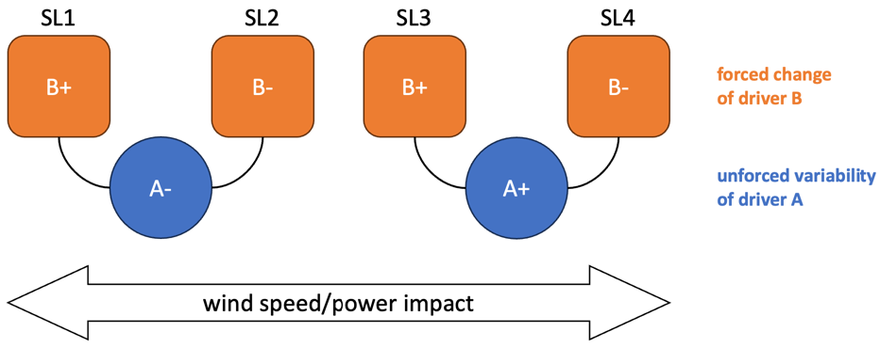
Activity 3 (year 3): Storylines of wind and available wind power
“out to 2100”
Q3.1: What are the main drivers explaining forced projection uncertainty and unforced climate variability in wind speed over the UK and China?
Coupled modes of variability, e.g. PDO, NAO
Land-surface properties (vegetation)
Q3.2: Can these drivers be combined to derive illustrative physical storylines for wind speed and available wind power under climate change?
Q3.3: How does the Mei Yu to midsummer transition impact wind speed and wind power, historically and in different wind energy storylines? More generally, how does surface wind speed vary in the annual cycle of the East Asian Monsoon?
collaboration sought on this topic!
Combined storylines (schematic).

Slide 7
Q&A open session
Review progress in the project so far
Disseminate results to a broader audience (168 registered participants!)
Reflect on gaps/opportunities in this research area
Ask questions
by raising your hand, or
by typing questions in the chat
Open part until 10am UK / 6pm China
Closed discussion (WISTEREA Team & Advisory Group)

Slide 8
Closed session with Advisory Group
Review progress in the project so far
Disseminate results to a broader audience (168 registered participants!)
Reflect on gaps/opportunities in this research area
plans for WISTEREA year 3
in the wider research field, beyond WISTEREA
Advisory Group opening points (~5 mins each)
Jia Wu
Kate Willett
Robert Dunn
Jan Wohland
Open discussion, close by 11am UK / 7pm China.

