Slide 1
Rights-based mapping of race & religion (in)equalities & discrimination in statutory service provision in Reading
PARTICIPATION LAB
Dr. Ruth Evans and Dr. Yaw Adjei-Amoako ACRE, Equalities Alliance & Participation Lab collaborative research project
ACRE AGM, 17 October 2019

Slide 2
Project Overview
Research context
Aims and key research questions
Methods
Q&A

Slide 3
Research context
‘Is Britain a fair & equal society for all?’:
“Fairness is important to us all in Britain. There are few things against which we react more strongly than a sense of unfairness or injustice. It is because we believe that fairness is important that we have put in place an infrastructure of laws and enforcement mechanisms to defend this principle.” (Equality and Human Rights Commission, 2015)

Slide 4
Research context
Britain is a diverse society, but inequalities still remain, and determine access to resources, support, life chances and outcomes
Multiple inequalities and disadvantages experienced by people from BAME backgrounds
result in socio-economic exclusion and create tensions between and within communities (EHRC, 2016, 2018)
Case work and anecdotal evidence from Reading Equalities Alliance Hate Crime Forum suggests some statutory services are not safeguarding the rights of BAME groups and fulfilling their statutory responsibilities under the Equalities Act 2010 and the Human Rights Act/ European Convention on Human Rights

Slide 5
Research Context
Sector | Evidence on BAME groups
Housing | Families are disproportionately located in most deprived neighbourhoods (Neal, 2015) Households are four times likely to be overcrowded and in fuel-poor housing (Gulliver, 2016; EHRC, 2018) Lower access to social housing due to residential qualification criteria (RCLC, 2018)
Police and Community relations | Policing is a site of tension, oppression and resistance: Rates for prosecution and sentencing for Black African and Caribbean people three times higher (Lammy, 2017; Long & Joseph-Salisbury, 2019) Disproportionately represented among police stop and search (Keeling, 2017), vehicle stops (HMIC, 2015), arrests (Hargreaves et al., 2016), use of taser (Dearden 2017) Report lower level of trust and confidence in police, are less likely to report a crime (Long, 2016)
Healthcare | Suffer poorer mental health and poorer access to healthcare (Spencer and Cooper, 2006; EHRC, 2016) 7 times likely to be detained under the Mental Health Act (Barnett et al., 2019) More likely to be misinformed about health and health services (Foster et al., 2016; RCLC, 2018) Disproportionately represented among people with ‘Not Good’ general health (EHRC, 2018) BAME women have four times higher mortality rate (EHRC, 2018)

Slide 6
Research Context
Sector | Evidence on BAME groups
Community safety | 29% increase in race hate crimes (Home Office, 2017) Rising Islamophobia and anti-Semitic hate crimes (EHRC, 2016; Home office 2017) Negative media representations of BAME community (Awan and Zempi, 2015; Hopkins et al., 2015) Limited community participation due to language and cultural barriers (Anjum et al., 2016; RCLC, 2018)

Slide 7
Overarching Research aim
To conduct a rights-based mapping of race and religion (in)equalities and discrimination experienced by people of Black, Asian and Minority Ethnic (BAME) backgrounds within statutory services in Reading
Focus on housing, community safety, police and community relations, healthcare and youth services.

Slide 8
Key research questions
Who is experiencing discrimination or harassment on the basis of race or religion? With which statutory services or agencies?
Which issues/problems are being reported by people from BAME groups to third sector and statutory authorities?
How do organisations and agencies support people experiencing discrimination or harassment on the basis of race or religion?
What are the gaps in practice and areas for improvement to ensure the equality and human rights of people from BAME groups are secured, in line with legal requirements under the Equality Act 2010 and human rights legislation?

Slide 9
Research methods
Mixed methods approach:
2 focus groups with community members & practitioners
10 interviews with practitioners
12 interviews with individuals who have experienced discrimination or harassment on the basis of race and/or religion
Online questionnaires for practitioners and community members to quantify how widespread different practices and reports of discrimination or harassment are.

Slide 10
Report and dissemination plans
Open access report and other outputs to be co-produced with project partners
Launched in a workshop with key stakeholders in April/ May 2020
Disseminated through policy and practice networks eg. Hate Crime Forum and Equalities Alliance.

Slide 11
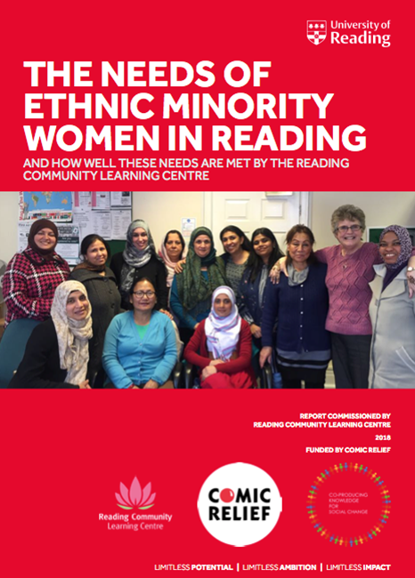
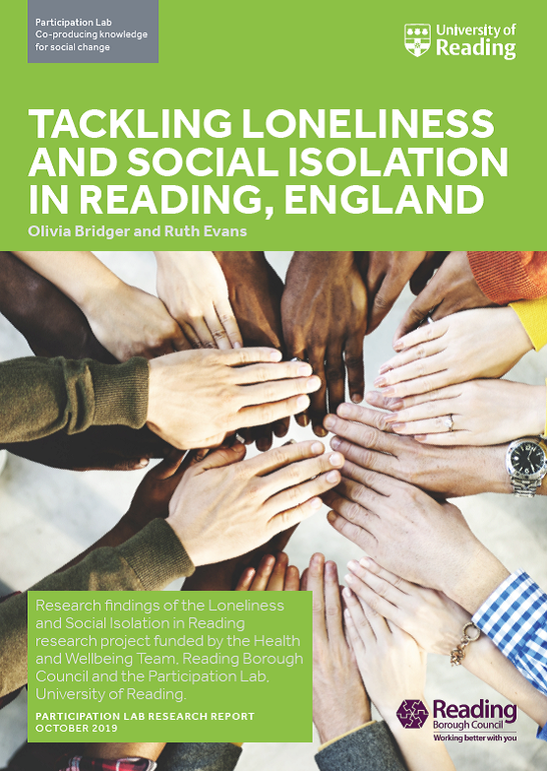
Participation Lab
Co-producing knowledge for social change
https://research.reading.ac.uk/participation-lab/
Thank you. Questions?
Thank you. Questions?
Participation Lab: Co-producing Knowledge for social change https://research.reading.ac.uk/participation-lab/

