Slide 1
Datum: Montag den 2. Juli
h.l.w to know and practise using reading strategies to tackle texts
d.l.s happy and confident learners by the end of the lesson!
Starter
Can you work out the meaning of the
nonsense words underlined on the passage
on your desk?
How did you do it?

Slide 2
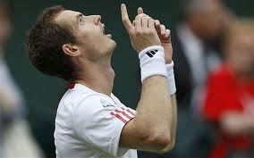
On Saturday I stayed in and watched the wellies because Andy Murray was playing splennis at Wimbledon. I couldn't go because the tickets were really OMG. It was a rooney match and it lasted until late eleven O'Clock at peanuts. The players were both very willywonka but they were mude by the end of the match because it was so rooney. There were lots of Zuschauer in the crowd eating snorbeards and cream Andy Murray's Mutter was there too and was very happy when he hotcrossbunned! People in Scotland must have been over the balloon to see him get into the next round.

Slide 3
wellies ______________
splennis _____________
OMG ______________
rooney ____________
peanuts ____________
willywonka __________
mude _____________
Zuschauer __________
snorbeards_________
Mutter ____________
hotcrossbunned ___________
balloon _____________
How confident are you feeling?

Slide 4
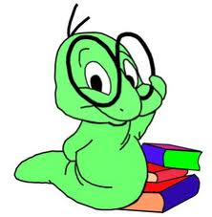
Datum: Freitag den 6. Juli
h.l.w to understand a level 5 text
d.l.s use of reading strategies
Starter: Strategies sheet
Complete column number 1 ONLY using the following code:
A= always
S= sometimes
N= never
Extension: For the ones you have written S and N set yourself some targets for this lesson

Slide 5
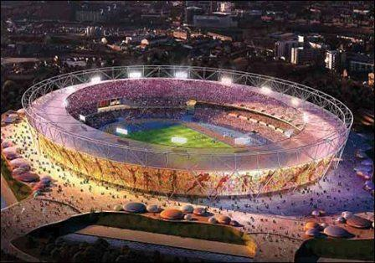
Mein Sommerurlaub in England!

Slide 6
1) Predictions- what words do I expect ? English & German.
2) Strategies discussion- what can we use?
3) Sounds match up
-any other tricky words? How do you think they sound?
4) Read aloud together... then with a partner
5) Teacher models the task
6) Pupil detectives AVOID USE OF DICTIONARY!!!!
Extension: Check your answers in a dictionary
7) Feedback

Slide 7
Hallo Krista!
Ich bin in London mit meiner Familie! Das Wetter hier ist warm und sonnig aber es regnet oft. Das finde ich nicht gut für Wimbledon!
Heute besuche ich das Olympische Stadion, weil es cool und modern ist. Ich besuche auch
Buckingham Palast- die Königin und Prinz Phillip wohnen hier. Ich habe auch ein Spiel zwischen Tottenham und Chelsea gesehen. Das war fantastisch!
Mein Hotel ist sehr gut. Man kann Minigolf spielen und Fisch und Pommes essen. Es gibt auch ein Schwimmbad- ich liebe Schwimmen!
Morgen sehe ich das Diamant Jubiläum Konzert. One Direction singen und Ed Sheeran spielt Gitarre. Es gibt auch zwei Dubstep Bands.
London ist nicht billig. Ein Eis kostet £3.50! Ich habe einen Tennisschläger als Souvenir gekauft.
Tschüs!

Slide 8
sch
au (ow)
v
ei (i)
ie (e)
Fisch
auch
Spiel
Schwimmen
warm
liebe
gekauft
zwei
Wetter
hier
mein
Eis

Slide 9
German | English | Strategy I used (a-k)
sonnig | sunny | j, c, a
regnet
für
heute
Palast
Königin
Spiel
auch
liebe
Minigolf
Diamant
Konzert
billig
Tennisschläger

Slide 10
Hello Krista!
I am in London with my family! The weather here is warm and sunny but it often rains. I find that not good for Wimbledon!
Today I am visiting the olympic stadium, because it is cool and modern. I am also visiting Buskingham Palace- the queen and prince Phillip live here. I have also seen a game between Tottenham and Chelsea. That was fantastic!
My hotel is very good. You can play mini golf and eat fish and chips. There is also a swimming pool- I love swimming!
Tomorrow I am seeing the diamond jubilee concert. One direction are singing and Ed Sheeran is playing guitar. There are also two Dubstep bands.
London is not cheap. An ice-cream costs £2.50. I have bought a tennis racket as a souvenir.
Bye!

Slide 11
Hello Krista!
I am in London with my family! The weather here is warm and sunny but it often rains. I find that not good for Wimbledon!
Today I am visiting the olympic stadium, because it is cool and modern. I am also visiting Buskingham Palace- the queen and prince Phillip live here. I have also seen a game between Tottenham and Chelsea. That was fantastic!
My hotel is very good. You can play mini golf and eat fish and chips. There is also a swimming pool- I love swimming!
Tomorrow I am seeing the diamond jubilee concert. One direction are singing and Ed Sheeran is playing guitar. There are also two Dubstep bands.
London is not cheap. An ice-cream costs £3.50. I have bought a tennis racket as a souvenir.
Bye!

Slide 12
Now complete column 2 of your strategy sheet (tick or cross)
-have you used these strategies today?
Then complete column 3 of your strategy sheet (tick or cross)
-which ones will you use next time?

