Slide 1
Describing me and others
rot
Follow ups 1-5
Term 1 Week 8
Notes:
Artwork by Steve Clarke. Pronoun pictures from NCELP (www.ncelp.org). All additional pictures selected from Pixabay and are available under a Creative Commons license, no attribution required.
Phonics:
Revisit [ie] and [ie] from weeks 4 and 7.
Vocabulary (new): auch [18] aber [31] Punkt [248] wie [25] gut [76] nicht [11] wie geht's? [n/a]
Revisit: was [38] blau [948] falsch [524] gelb [1446] rot [477] richtig [177] das² [1]
The frequency rankings for words that occur in this PowerPoint which have been previously introduced in these resources are given in the SOW and in the resources that first
introduced and formally re-visited those words.
For any other words that occur incidentally in this PowerPoint, frequency rankings will be provided in the notes field wherever possible.

Slide 2
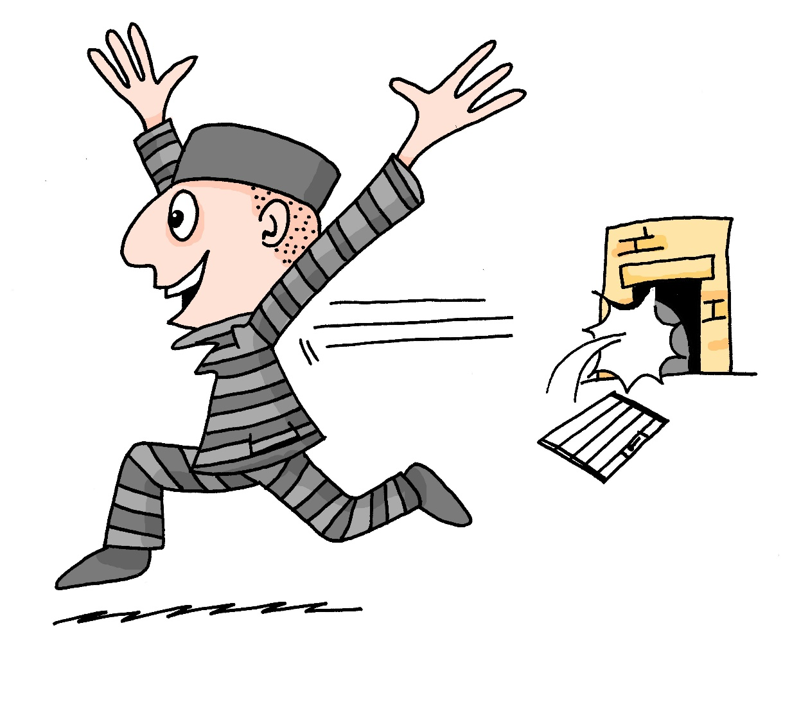
Follow up 1
Lies die Wörter. Ist das [ei] oder [ie]?
ei
ie
aussprechen
Liebe
lesen
ich heiβe
Brief
die
Reise
Feile
Haustier
sie
leider
ein
Wein
hier
Wie geht’s
Beine
Wien
frei
Lieder
klein
allein
Biene
Notes:
Print the HANDOUT at the end of this presentation.
Timing: 5 minutes Aim: To provide practice in distinguishing between this week’s SSC [ie] and the SSC [ei]. Procedure: 1. This is a paired read aloud task. The students use different coloured pencils (1 each) to play. Pupil A says one of the words/phrases and pupil B has 3 seconds to locate it and cross it off with their colour. If the pupil takes longer than 3 seconds pupil A can steal the point. Clearly, the classroom conditions need to be right with the individual class for friendly competition.
2. Alternatively, they can do it more slowly and carefully, scrutinising each other’s pronunciation. If one makes a mistake (quite common with ei/ie), then the other pupil corrects and crosses off in his/her colour.
Note: Almost all of these words have been previously met. However, this pair of SSC is notoriously tricky and needs lots of practice. ☺
Word frequency (1 is the most frequent word in German): Haustier [>5000] Source: Jones, R.L. & Tschirner, E. (2006). A frequency dictionary of German: core vocabulary for learners. Routledge

Slide 3
Follow up 2
Was ist nicht mehr da? [1/4]
Wörter
Vokabeln
auch
nicht
falsch
was
gut
das
Wie geht’s?
Notes:
Timing: 5 minutes (four slides) Aim: To practise recall of the vocabulary introduced last week and this week, using a ‘Kim’s game’ memory activity. Procedure: 1. Allow students to see the words on the slide long enough to attempt to memorise them.
2. Click to make all words disappear and then all but one reappear.
3. Students try to name the missing item.
4. Click to confirm the answer.
Answer: falsch

Slide 4
Follow up 2
Was ist nicht mehr da? [2/4]
Wörter
Vokabeln
auch
nicht
falsch
was
gut
das
Wie geht’s?
Notes:
[2/4]
Answer: nicht

Slide 5
Follow up 2
Was ist nicht mehr da? [3/4]
Wörter
auch
nicht
Vokabeln
falsch
was
gut
das
Wie geht’s?
Notes:
[3/4]
Answer: wie geht’s

Slide 6
Follow up 2
Was ist nicht mehr da? [4/4]
Wörter
Vokabeln
auch
nicht
falsch
was
gut
das
Wie geht’s?
Notes:
[4/4]

Slide 7
Follow up 2
Was ist nicht mehr da? [1/4]
Wörter
Vokabeln
Notes:
Timing: 5 minutes (all four slides) Aim: To practise recall of the vocabulary introduced last week and this week, using a variation of ‘Kim’s game’ in which the words are replaced by pictures. Procedure: 1. Allow students to see the pictures on the slide long enough to attempt to memorise them.
2. Click to make all pictures disappear and then all but one reappear.
3. Students try to name the missing item.
4. Click to confirm the answer.
Answer: richtig

Slide 8
Follow up 2
Was ist nicht mehr da? [2/4]
Wörter
Vokabeln
Notes:
[2/4]
Answer: aber

Slide 9
Follow up 2
Was ist nicht mehr da? [3/4]
Wörter
Vokabeln
Notes:
[3/4]
Answer: rot

Slide 10
Follow up 2
Was ist nicht mehr da? [4/4]
Wörter
Vokabeln
Notes:
[4/4]
Answer: der Punkt

Slide 11
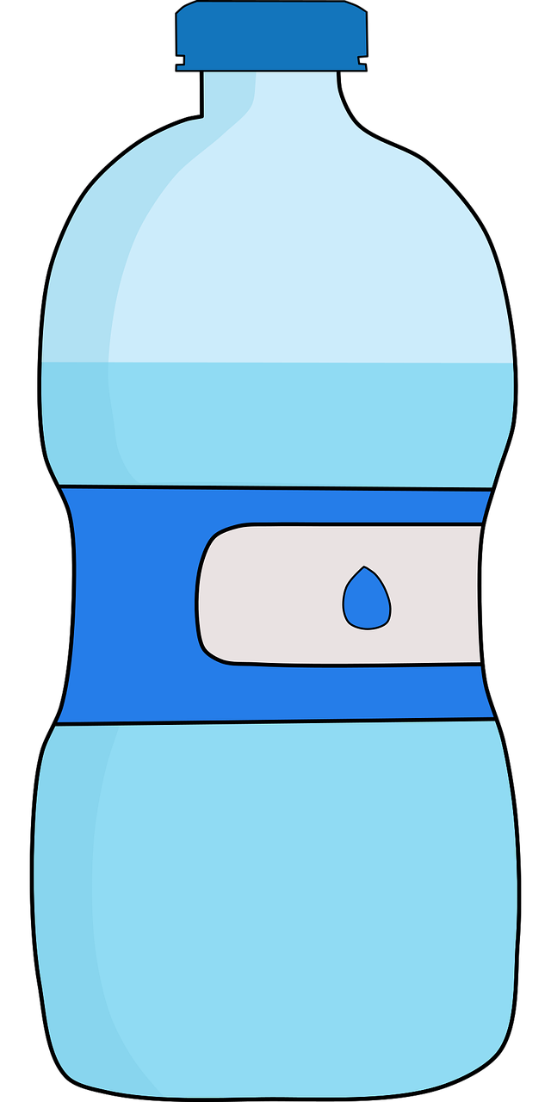
Follow up 3
Mensch, Form oder Ding?
…
sprechen
Was ist das?
Das ist eine Form.
Wie ist die Form?
Die Form ist groß und blau.
Das ist A!
Johanna
C
E
D
A
Notes:
Timing: 5 minutes Aim: To practise describing (speaking modality) how people and things are using the adjectives presented this week. Procedure: 1. Whole class asks teacher: Was ist das?
2. Teacher responds – use example below first time.
3. Class ask: Wie ist …?
4. Teacher responds. 5. Class says the letter or name.
Note: Use the two full examples below. On the following slide there are two examples of each thing which makes the follow up description necessary for identification of the item. In this modelling slide, we have kept it to fewer items for simplicity.
For example: Class: Was ist das?
Teacher: Das ist ein Mensch. Class: Wie ist der Mensch?
Teacher: Der Mensch ist groß und rot.
Class: Das ist Johanna!
Class: Was ist das?
Teacher: Das ist ein Ding. Class: Wie ist das Ding?
Teacher: : Das Ding ist klein und gelb.
Class: Das ist der Bleistift / C.

Slide 12
Follow up 3
Mensch, Form oder Ding? [2/4]
…
sprechen
Was ist das?
Das ist ein Mensch.
Wie ist der Mensch?
Der Mensch is groß und rot.
Das ist Johanna!
Johanna
C
E
D
A
Notes:
[2/4]
Procedure: 1. Whole class asks teacher: Was ist das?
2. Teacher responds – use example 1 below.
3. Class ask: Wie ist …?
4. Teacher responds. 5. Class says the letter or name.
Example 1: Class: Was ist das?
Teacher: Das ist ein Mensch. Class: Wie ist der Mensch?
Teacher: Der Mensch ist groß und rot.
Class: Das ist Johanna!

Slide 13
Follow up 3
Mensch, Form oder Ding? [3/4]
…
sprechen
Was ist das?
Das ist ein Ding.
Wie ist das Ding?
Das Ding is klein und gelb.
Das ist der Bleistift/C!
Johanna
C
E
D
A
Notes:
[3/4]
Procedure: 1. Whole class asks teacher: Was ist das?
2. Teacher responds – use example 2 below.
3. Class ask: Wie ist …?
4. Teacher responds. 5. Class says the letter or name.
Example 2:
Class: Was ist das?
Teacher: Das ist ein Ding. Class: Wie ist das Ding?
Teacher: : Das Ding ist klein und gelb.
Class: Das ist der Bleistift / C.

Slide 14
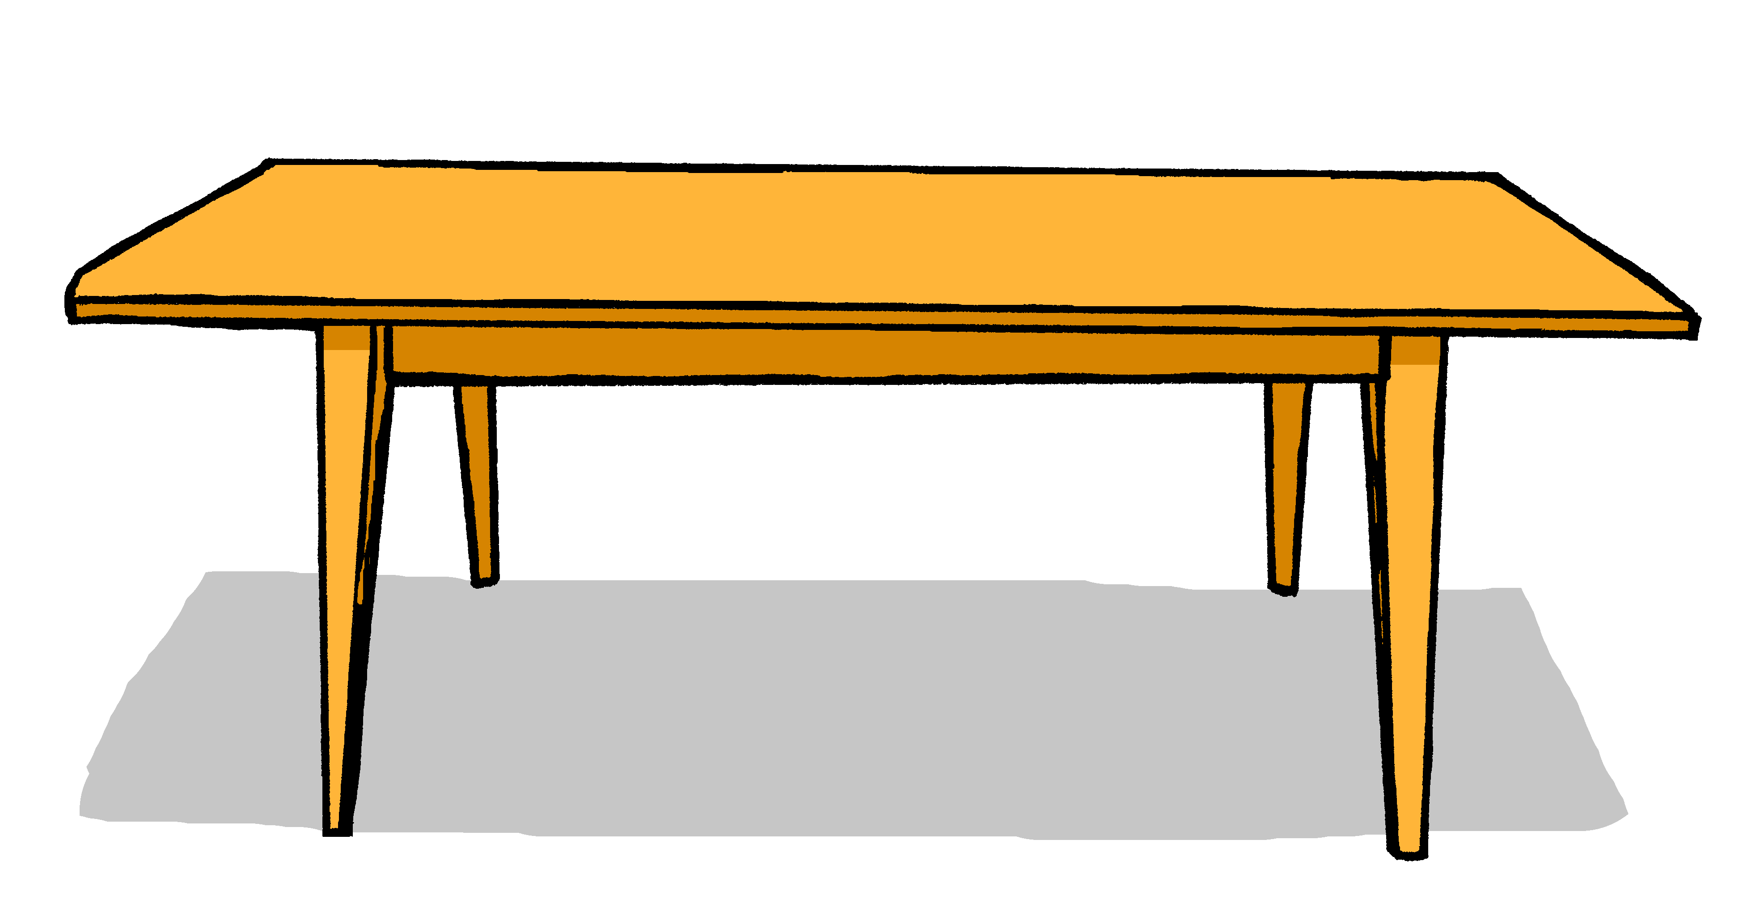
Follow up 3
Mensch, Form oder Ding?
…
B
sprechen
B
C
D
A
E
F
G
Maike
Louisa
Notes:
Timing: 5 minutes Aim: To practise describing (speaking modality) how people and things are using the adjectives presented this week. Procedure: 1. Paired speaking task. Partners repeat speaking task as modelled with the whole class.
For example: Student A selects an item (in his/her head).
Student B asks: Was ist das? Student A answers: Das ist ein Mensch / eine Form / ein Ding. Student B asks: Wie ist der Mensch / die Form / das Ding …?
Student A answers: Der Mensch / die Form / das Ding ist ….. und….. Student B says: Das ist (identifier – name or letter)

Slide 15
Follow up 4
Hör zu.
Put the items in order [1/3].
Farben Was ist rot?
Ein Apfel ist rot!
Das Blut ist rot!
Was ist gelb?
Die Sonne ist gelb!
Eine Banane ist gelb!
Was ist blau?
Der Himmel ist blau!
Das Meer ist blau!
Was ist grün?
Das Gras ist grün!
Ein Baum ist grün!
hören
8
1
C
3
B
A
2
D
5
7
The two dots over the u in the word grün change the pronunciation slightly. You will learn more about this sound soon!
6
G
F
4
H
E
Notes:
Timing: 8 minutes
Aim: to listen to a poem about colours and put the items which appear in the poem in order.
Procedure:
Play the recording or read out the poem.
Click to bring up speech bubble explaining the Umlaut in grün. Click again to disappear speech bubble.
Explain and clarify the new vocabulary.
Pupils put the items A-H in order in which they appear in the poem by writing 1-B, 2-D, 3-C etc.
Click for the answers to appear one by one near the images that they belong to.
Vocabulary): Apfel [3490] Banana [>5009] Baum [1013] Blut [851] Gras [2779] Himmel [889] Meer [852 Sonne [864]
Jones, R.L & Tschirner, E. (2019). A frequency dictionary of German: Core vocabulary for learners. London: Routledge.

Slide 16
Follow up 4
Schreib auf Englisch [2/3].
lesen
lesen
Farben Colours Was ist rot? What is red?
Ein Apfel ist rot! An apple is red!
Das Blut ist rot! The blood is red!
Was ist gelb? What is yellow?
Die Sonne ist gelb! The sun is yellow!
Eine Banane ist gelb! A banana is yellow!
Was ist blau? What is blue?
Der Himmel ist blau! The sky is blue.
Das Meer ist blau! The sea is blue!
Was ist grün? What is green?
Das Gras ist grün! The grass is green!
Ein Baum ist grün! A tree is green!
___
1
2
3
___
___
4
___
5
___
6
___
___
8
___
7
Notes:
Timing: 8 minutes
Aim: to distinguish between definite and indefinite article in the written modality.
Procedure:
Elicit what goes in the gaps of the translation. Pupils need to carefully distinguish between eine/ein and der/die/das. Is it a, or the?
Click to reveal answers one by one.

Slide 17
Follow up 4
Lies. [3/3].
Farben Was ist rot?
Ein Apfel ist rot!
Das Blut ist rot!
Was ist gelb?
Die Sonne ist gelb!
Eine Banane ist gelb!
Was ist blau?
Der Himmel ist blau!
Das Meer ist blau!
Was ist grün?
Das Gras ist grün!
Ein Baum ist grün!
aussprechen
lesen
1
2
3
4
5
6
8
7
Notes:
Timing: 8 minutes
Aim: to read a short poem out loud.
Procedure:
Pupils work in pairs, reading out the poem taking turn for each line.
Pupils swap lines and do the task again.

Slide 18
Follow up 5:

Schreib auf English.
Can you get at least 15 points?
Wörter
 | er | ist | sie
 | das | sein | richtig
 | wie geht’s | falsch | was
 | blau | rot | gelb
 | auch | aber | gut
 | der Punkt | nicht | wie
he
is
she
Vokabeln
x3
that
to be
right
how’s it going
wrong
what
x2
blue
red
yellow
also
but
good
x1
how
(the) dot, point
not
Notes:
Timing: 5 minutes
Aim: to practise written production of vocabulary from this and revisited weeks.
Procedure: 1. Give pupils a blank grid. They fill in the English meanings of any of the words they know, trying to reach 15 points in total. 2. Remind pupils that adjectives can refer to male or female persons and they should note this in their translations. E.g. pleased (f), short (m).
Note: The most recently learnt and practised words are pink, words from the previous week are green and those from week 1 are blue, thus more points are awarded for them, to recognise that memories fade and more effort (heavy lifting!) is needed to retrieve them.

Slide 19
Follow up 5:

Schreibe auf Deutsch.
Can you get at least 15 points?
Wörter
 | she | he | is
 | right | that | to be
 | wrong | yellow | red
 | how’s it going | what | blau
 | how | good | not
 | also | but | (the) dot, point
Vokabeln
sie
er
ist
x3
richtig
das
sein
falsch
gelb
rot
x2
wie geht’s
was
blau
wie
gut
nicht
x1
auch
der Punkt
aber
Notes:
Timing: 5 minutes
Aim: to practise written production of vocabulary from this and revisited weeks.
Procedure: 1. Give pupils a blank grid. They fill in the German meanings of any of the words they know, trying to reach 15 points in total. 2. Remind pupils that adjectives can refer to male or female persons and they should note this in their translations. E.g. pleased (f), short (m).
Note: The most recently learnt and practised words are pink, words from the previous week are green and those from week 1 are blue, thus more points are awarded for them, to recognise that memories fade and more effort (heavy lifting!) is needed to retrieve them.

Slide 20
Tschüss!
rot
Notes:
20

Slide 21
Follow up 1
Lies die Wörter. Ist das [ei] oder [ie]?
ei
ie
Liebe
ich heiβe
Brief
die
Reise
Feile
Haustier
sie
leider
ein
Wein
hier
wie geht’s
Beine
Wien
frei
Lieder
klein
allein
Biene
Notes:
FOLLOW UP 1 – HANDOUT
1 between 2.

Slide 22
Follow up 5:

Schreib auf English.
Can you get at least 15 points?
Wörter
 | er | ist | sie
 | das | sein | richtig
 | wie geht’s | falsch | was
 | blau | rot | gelb
 | auch | aber | gut
 | der Punkt | nicht | wie
Vokabeln
x3
x2
x1
Notes:
Handout

Slide 23
Follow up 5:

Schreib auf Deutsch.
Can you get at least 15 points?
Wörter
 | she | he | is
 | right | that | to be
 | wrong | yellow | red
 | how’s it going | what | blau
 | how | good | not
 | also | but | dot, point
Vokabeln
x3
x2
x1
Notes:
Handout

