Slide 1
Describing me and others
Online-Austausch
blau
Follow ups 1-5
Term 1 Week 1
Notes:
Artwork by Steve Clarke. Pronoun pictures from NCELP (www.ncelp.org). All additional pictures selected from Pixabay and are available under a Creative Commons license, no attribution required.
Phonics:
long [a] ja [45] da [239] Tag [111]
short [a] hallo [1077] danke [877] was? [38]
Vocabulary: wir sind, ihr seid [4] wir [26] ihr [26] schön[188] Garten [1158] Klasse [961] Mitte [711] Zimmer [665]
Jones, R.L & Tschirner, E. (2019). A frequency dictionary of German: Core vocabulary for learners. London: Routledge.
The frequency rankings for words that occur in this PowerPoint which have been previously introduced in these resources are given in the SOW and in the resources that first
introduced and formally re-visited those words.
For any other words that occur incidentally in this PowerPoint, frequency rankings will be provided in the notes field wherever possible.
Note that the first three lessons of the year teach language that can be continuously recycled as lesson routine every lesson in Y5/6.
The idea would be that the class teacher (whether or not s/he teaches the class German can re-use the language as part of the daily routine with the class.

Slide 2
aussprechen
long [a]
…
ja
da
Tag
[yes]
[there]
[day]
Lina
Moritz
Notes:
Timing: 2 minutes
Aim: to consolidate the SSC long [a].
Procedure:
Re-present the SSC and the source word ‘da’ (with gesture, if using).
Click to bring on the picture and get pupils to repeat the word ‘da’ (with gesture, if using).
Present the cluster words in the same way, bringing on the picture and getting pupils to pronounce the words.
Note:
a gesture for ‘da’ might be to point at something away from you
2

Slide 3
aussprechen
short [a]
…
was?
hallo
danke
Notes:
Timing: 2 minutes
Aim: to consolidate the SSC short [a].
Procedure:
Re-present the SSC and the source word ‘hallo’ (with gesture, if using).
Click to bring on the picture and get pupils to repeat the word ‘hallo’ (with gesture, if using).
Present the cluster words in the same way, bringing on the picture and getting pupils to pronounce the words.

Slide 4
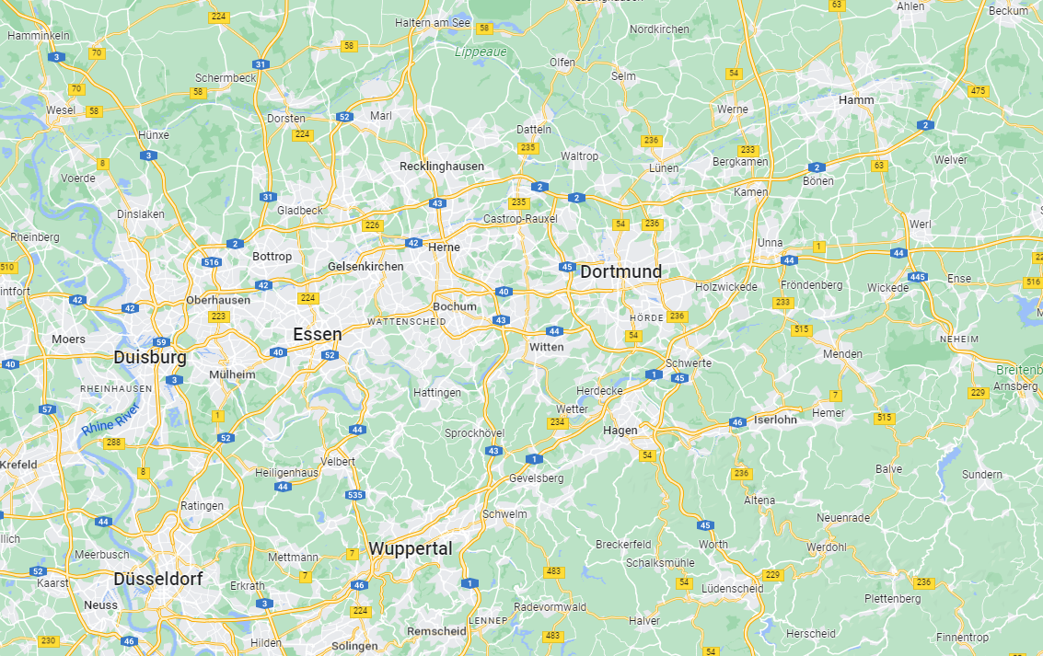
Follow up 1
Sarah und Rafi finden Dortmund bei* Google.
Wie heißt der Ort?
aussprechen
1. Hamminkeln
3. Haltern am See
60
4. Hamm
2. Marl
5. Dinslaken
6. Kamen
S
7. Hattingen
8. Hagen
9. Ratingen
11. Altena
10. Wuppertal
0
12. Radevormwald
bei – here: on
START
Notes:
Timing: 3 minutes
Aim: to practise this week’s SSc’s
Procedure:
Click to start the timer.
Pupils practise long and short [a] pronounciation reading out the 12 place names individually or in pairs.
Click on each place name to hear it pronounced, if desired.
Vocabulary: bei [29]
Jones, R.L & Tschirner, E. (2019). A frequency dictionary of German: Core vocabulary for learners. London: Routledge.

Slide 5
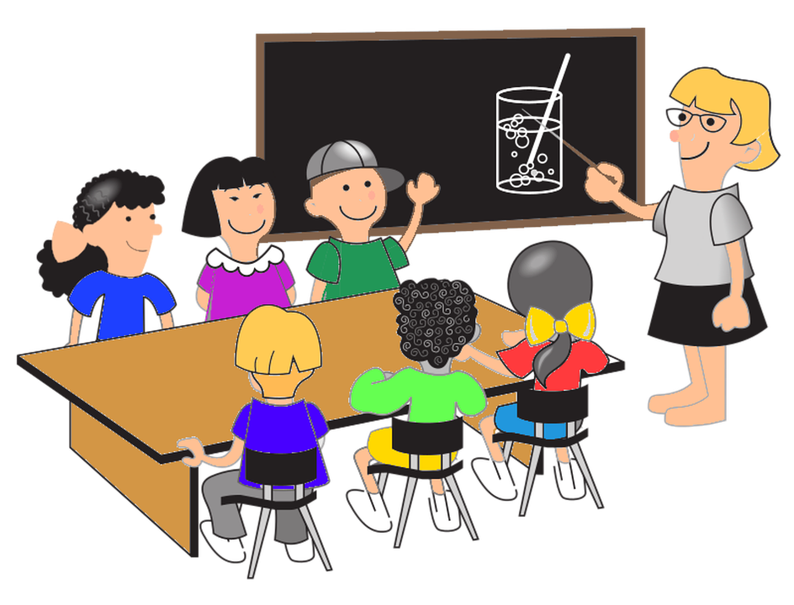
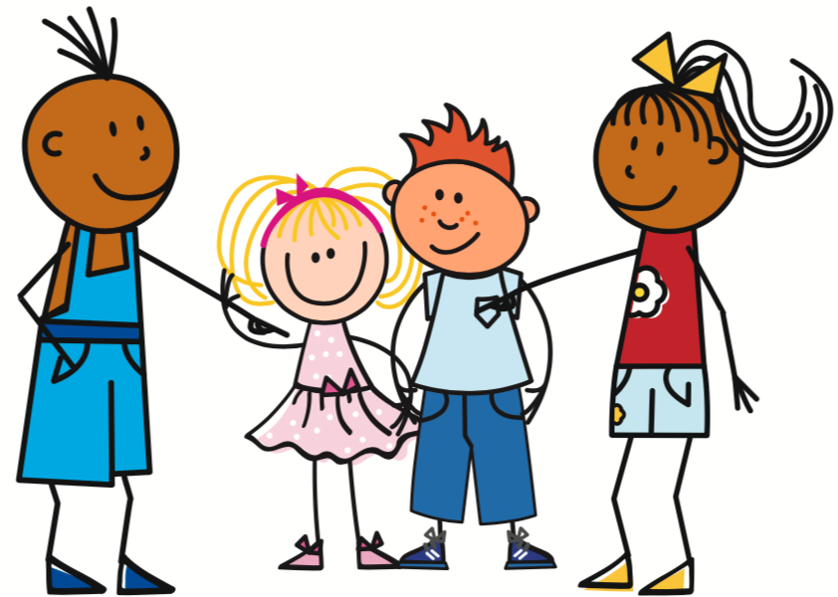
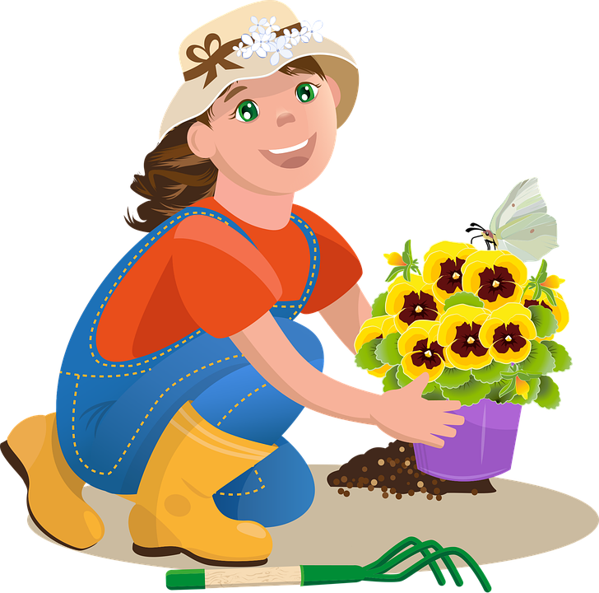
Follow up 2
Hör zu. Wer ist wo?
hören
 | ?
B
A
1
D
1
2
F
2
C
D
E
3
H
3
G
4
4
B
5
F
G
5
H
6
A
6
Notes:
Timing: 8 minutes
Aim: to practise im/ in der and also sind/seid/bist/bin in the listening modality.
Procedure:
Click to play the first recording. Pupils look at the pronoun+ image combinations A-H and select the correct one. NB: there are 8 pronoun/image combinations but only 6 items, so 2 items will be left over.
Elicit answer. Click for answer letter to appear.
Continue for times 2-6.
Click to bring up full sentences audio, which can be used to check answers.
Transcript:
1. Du bist in der [beep] (answer = Klasse) 2. Ihr seid im [beep] (answer = Garten 3. Wir sind im [beep] (answer = Haus) 4. Ich bin in der [beep] (answer = Schule) 5. Sind wir in der [beep]? (answer = Schule) 6. Seid ihr in der [beep]? (answer = Klasse)

Slide 6
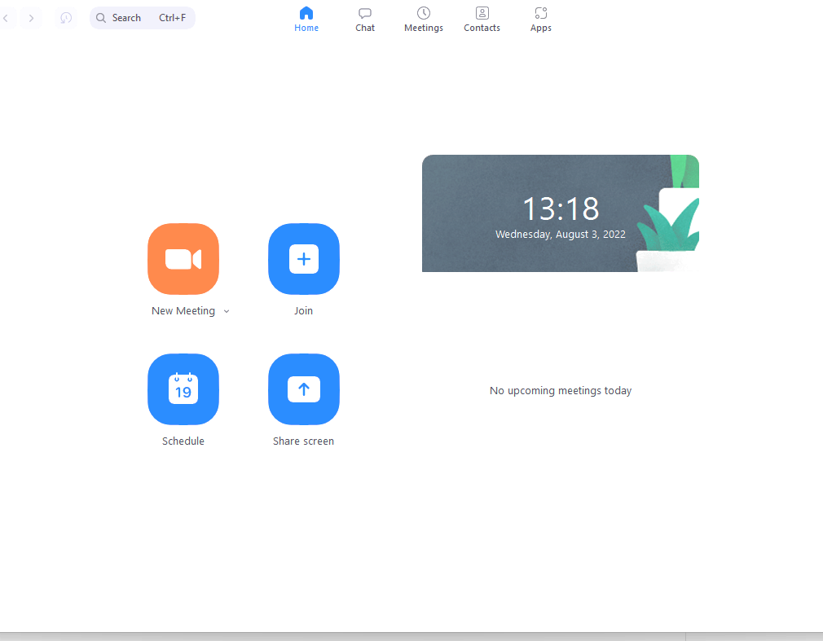
Follow up 3
Rafi schreibt auf Deutsch. Wer ist wo?
Ist das richtig? Nein? Dann korrigiere den Satz*.
lesen
Zoom Room
Sarah
Ali
Annette
 | Richtig oder falsch? | Schreib den Satz richtig!
1 | Anna ist in der Mitte.
2 | Aron ist oben links. | Aron ist unten links.
3 | Laura ist in der Mitte rechts. | Laura ist in der Mitte links.
4 | Sarah ist oben links.
5 | Annette ist oben rechts.
6 | Alina ist oben links. | Alina ist unten rechts.
Laura
Anna
Albert
Aron
Ansgar
Alina
korrigiere – correct
Notes:
Timing: 8 minutes
Aim: to practise adverbs of place in the reading and writing modalities.
Procedure:
Explain the scenario. Pupils number 1-6, tick if the sentence is correct, or write out a corrected version of the sentence, if false.
Click to reveal the answers item by item.
Vocabulary: korrigieren [1326]
Jones, R.L & Tschirner, E. (2019). A frequency dictionary of German: Core vocabulary for learners. London: Routledge.

Slide 7
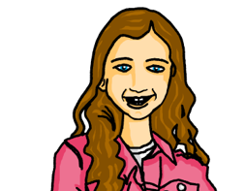
Follow up 4
Wer ist das ?
Partnerarbeit!
A
B
sprechen
Du bist oben in der Mitte.
Albert!
Ihr seid oben links.
Laura
Albert
Alina
Laura und Albert!
Wir sind in der Mitte links.
Johanna und Aisha!
Johanna
Aisha
Annette
Ihr seid unten rechts.
Aron und Sarah!
Ansgar
Aron
Sarah
Notes:
1/3
Timing: 10 minutes for 3 slides.
Aim: to practise spoken production of adverbs of place and forms of sein with personal pronouns.
Procedure: Model slide
Explain that pupils take on the identity of Johanna and Aisha. Pupils have to give clues about names without saying the names.
Model the task, elicit the language needed for item 1.
Click to reveal the answer.
Continue for items 2-4.
As this is an open-ended task, feel free to practise more with the whole class before going on to pair work for the next two slides.
Positions on the next two slides will be jumbled in a different order.
NB: as this is an open-ended task, no answers will be given on the next two slides.
Possible sentences:
Ich bin in der Mitte. Wir sind in der Mitte links. Du bist in der Mitte rechts. Du bist oben links. Ihr seid oben links. Du bist oben in der Mitte.
Du bist oben rechts.
Ihr seid oben rechts. Du bist unten links. Ihr seid unten links. Du bist unten in the Mitte. Ihr seid unten rechts.
Du bist unten rechts.

Slide 8
Follow up 4
Wer ist das ?
Partnerarbeit!
sprechen
A
B
1.
!
2.
Aron
Alina
Annette
!
3.
!
Sarah
Ansgar
Laura
4.
!
5.
Albert
Aisha
Johanna
!
Notes:
2/3

Slide 9
Follow up 4
Wer ist das ?
Partnerarbeit!
sprechen
A
B
1.
!
2.
Sarah
Aisha
Johanna
!
3.
!
Aron
Laura
Ansgar
4.
!
5.
Albert
Annette
Alina
!
Notes:
3/3
Pupils swap roles.

Slide 10
Follow up 5:

Schreib auf Deutsch. Du bist Johanna.
schreiben
Annette
Aisha
Laura
Rafi
Johanna
im Garten
oben rechts
Albert
in der Schule
im Zimmer
im Baum
in der Klasse
1. Wir sind im Garten.
1. We are in the garden.
2. You are above on the right.
3. You (all) are in the school.
4. You are in the room.
5. We are in the tree.
6. I am in the class.
2. Du bist oben rechts.
3. Ihr seid in der Schule.
4. Du bist im Zimmer.
5. Wir sind im Baum.
6. Ich bin in der Klasse.
Notes:
Note: this is the more structured version, with sentences to translate and support provided with some of the language. The next slide has a more challenging version.
Timing: 10 minutes.
Aim: to practise the parts of sein in the written modality.
Procedure:
Explain that pupils are writing as Johanna. They have to translate the verb forms and pronouns for sentences 1-6.
Click for answers.

Slide 11
Follow up 5:

Schreib auf Deutsch. Du bist Johanna.
schreiben
Annette
5
Aisha
Laura
6
Rafi
Johanna
Albert
1
in the garden
2
up on the right
in the tree
in the class
3
in (the) school
4
in the room
1. Wir sind im Garten.
2. Du bist oben rechts.
3. Ihr seid in der Schule.
4. Du bist im Zimmer.
5. Wir sind im Baum.
6. Ich bin in der Klasse.
Notes:
Note: this is the more challenging version, with prompts in English but no full sentences to translate.
Timing: 10 minutes.
Aim: to practise the parts of sein in the written modality.
Procedure:
Explain that pupils are writing as Johanna. They have to translate the full sentences for 1-6.
Click for answers.

Slide 12
Follow up 5:

Schreib auf Deutsch. Du bist Johanna.
schreiben
Annette
Johanna
Aisha
Laura
Rafi
in the garden
Albert
above on the right.
in the tree
in the school
in the room
in the class
1. We are in the garden.
2. You are above on the right.
3. You (all) are in the school.
4. You are in the room.
5. We are in the tree.
6. I am in the class.
1. Wir sind im Garten.
2. Du bist oben rechts.
3. Ihr seid in der Schule.
4. Du bist im Zimmer.
5. Wir sind im Baum.
6. Ich bin in der Klasse.
Notes:
Timing: 10 minutes.
Aim: to practise the learnt grammar in the written modality.
Procedure:
Explain that pupils are writing as Johanna. They have to translate the sentences 1-6.
Click for answers.

Slide 13
Extra:

Schreib auf Englisch.
Can you get at least 12 points?
Wörter
 | Juni | August | der Monat
 | Mai | Oktober | Dezember
 | Juli | Februar | Januar
 | wann? | der Geburtstag | März
 | die Klasse | die Mitte | das Zimmer
 | ihr seid | schön | der Garten
 | wir | ihr | wir sind
June
August
(the) month
Vokabeln
May
October
December
x2
July
February
January
when
(the) birthday
March
(the) class
(the) middle
(the) room
you (all) are
lovely, beautiful
(the) garden
x1
we
you (all)
we are
Notes:
Timing: 5 minutes
Aim: to practise written comprehension of vocabulary from this and revisited weeks.
Procedure: 1. Give pupils a blank grid. They fill in the English meanings of any of the words they know, trying to reach 15 points in total. 2. Remind pupils that adjectives can refer to male or female persons and they should note this in their translations. E.g. pleased (f), short (m).
Note: The most recently learnt and practised words are pink, words from the previous week are green and those from week 1 are blue, thus more points are awarded for them, to recognise that memories fade and more effort (heavy lifting!) is needed to retrieve them.

Slide 14
Extra:

Schreib auf Deutsch.
Can you get at least 12 points?
Wörter
 | July | when? | March
 | January | December | February
 | (the) birthday | August | May
 | (the) month | October | June
 | we | we are | (the) room
 | (the) class | (the) garden | you (all) are
 | you (all) | (the) middle | lovely, beautiful
Juli
wann?
März
Vokabeln
Januar
Dezember
Februar
x2
der Geburtstag
August
Mai
der Monat
Oktober
Juni
wir
wir sind
das Zimmer
die Klasse
der Garten
ihr seid
x1
ihr
die Mitte
schön
Notes:
Timing: 5 minutes
Aim: to practise written comprehension of vocabulary from this and revisited weeks.
Procedure: 1. Give pupils a blank grid. They fill in the German meanings of any of the words they know, trying to reach 15 points in total. 2. Remind pupils that adjectives can refer to male or female persons and they should note this in their translations. E.g. pleased (f), short (m).
Note: The most recently learnt and practised words are pink, words from the previous week are green and those from week 1 are blue, thus more points are awarded for them, to recognise that memories fade and more effort (heavy lifting!) is needed to retrieve them.

Slide 15
Tschüss!
rot
Notes:
15

Slide 16
Extra:

Schreib auf Englisch.
Can you get at least 12 points?
Wörter
 | Juni | August | der Monat
 | Mai | Oktober | Dezember
 | Juli | Februar | Januar
 | wann? | der Geburtstag | März
 | die Klasse | die Mitte | das Zimmer
 | ihr seid | schön | der Garten
 | wir | ihr | wir sind
Vokabeln
x2
x1
Notes:
Template for photocopying

Slide 17
Extra:

Schreib auf Deutsch.
Can you get at least 12 points?
Wörter
 | July | when? | March
 | January | December | February
 | (the) birthday | August | May
 | (the) month | October | June
 | we | we are | (the) room
 | (the) class | (the) garden | you (all) are
 | you (all) | (the) middle | lovely, beautiful
Vokabeln
x2
x1
Notes:
Template for photocopying

