Slide 1
Interacting
Online-Austausch
sein (to be, being) – wir sind, ihr seid
in + R3(dat.) location
SSC long and short [a]
blau
Term 1 Week 1
Notes:
Artwork by Steve Clarke. Pronoun pictures from NCELP (www.ncelp.org). All additional pictures selected from Pixabay and are available under a Creative Commons license, no
attribution required.
Phonics:
long [a] ja [45] da [239] Tag [111]
short [a] hallo [1077] danke [877] was? [38]
Vocabulary: wir sind, ihr seid [4] wir [26] ihr [26] schön[188] Garten [1158] Klasse [961] Mitte [711] Zimmer [665]
Revisit 1: -
Revisit 2: Januar [1052] Februar [1093] März [987] April [1004] Mai [1048] Juni [1148] Juli [1544] August [1929] September [1035] Oktober [1223] November [1273] Dezember [1527] Geburtstag [1779] Monat [316] wann [657]
Jones, R.L & Tschirner, E. (2019). A frequency dictionary of German: Core vocabulary for learners. London: Routledge.
The frequency rankings for words that occur in this PowerPoint which have been previously introduced in these resources are given in the SOW and in the resources that first
introduced and formally re-visited those words.
For any other words that occur incidentally in this PowerPoint, frequency rankings will be provided in the notes field wherever possible.
Note that the first three lessons of the year teach language that can be continuously recycled as lesson routine every lesson in Y5/6.
The idea would be that the class teacher (whether or not s/he teaches the class German can re-use the language as part of the daily routine with the class.
1

Slide 2
Vokabeln
Freundschaft*
die Freundschaft - friendship
Learning languages is about making friends.
You show kindness when you learn even a few words in another language.
Let’s remember some of the friendship sentences we have learnt already!
_ _ _ _ _ _ _’_?
_ _ _ _ _!
Wie geht’s?
Guten Tag!
Hallo!
_ _ _ _ _ _ _ _!
Can you say other kind things?
Brauchst du Hilfe?
Sie ist wunderbar!
Do you need help?
Das ist toll!
She is wonderful!
That’s great!
You are super!
Yes, right!
Du bist super!
Ja, richtig!
Danke!
Ja bitte!
Kann ich helfen?
Thank you!
Yes please!
Can I help?
Notes:
Timing: 3 minutes
Aim: to introduce the idea that learning other languages opens the door to new friendships, and that a few kind words go a long way; to revisit
some previously-taught language from this term that fits our category of ‘friendship sentences’. This is an idea we will return to now and then
during the course.
Procedure:
Click to present the information on the slide.
Elicit the German from pupils for the English greetings and friendly statements.
Allow pupils a few moments to turn to those around them and greet them and say something kind about their work or about them themselves.
Remind pupils that we all need to hear kind words every day, in whatever language!
2

Slide 3
aussprechen
long [a]
…
ja
da
Tag
[yes]
[there]
[day]
Lina
Moritz
Notes:
Timing: 2 minutes
Aim: to consolidate the SSC long [a].
Procedure:
Re-present the SSC and the source word ‘da’ (with gesture, if using).
Click to bring on the picture and get pupils to repeat the word ‘da’ (with gesture, if using).
Present the cluster words in the same way, bringing on the picture and getting pupils to pronounce the words.
Note:
a gesture for ‘da’ might be to point at something away from you
3

Slide 4
aussprechen
short [a]
…
was?
hallo
danke
Notes:
Timing: 2 minutes
Aim: to consolidate the SSC short [a].
Procedure:
Re-present the SSC and the source word ‘hallo’ (with gesture, if using).
Click to bring on the picture and get pupils to repeat the word ‘hallo’ (with gesture, if using).
Present the cluster words in the same way, bringing on the picture and getting pupils to pronounce the words.

Slide 5
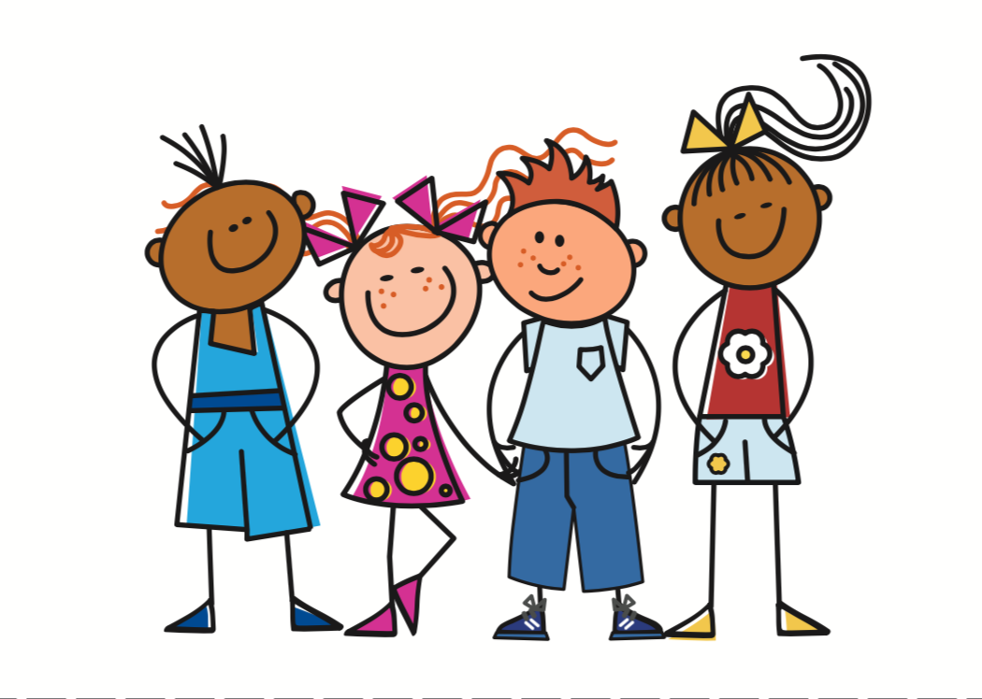
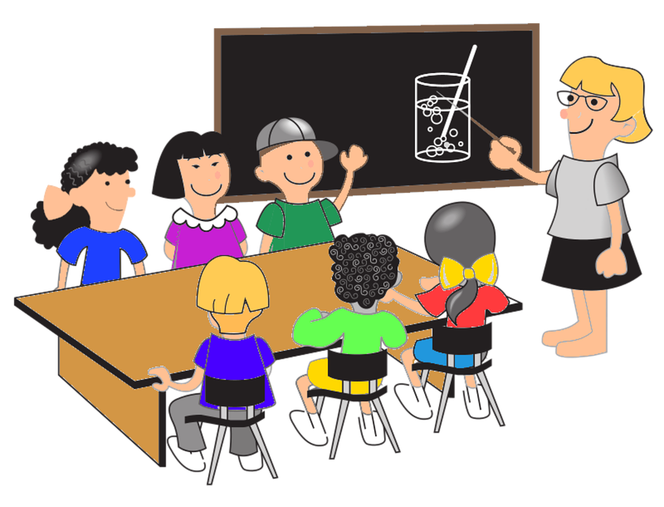
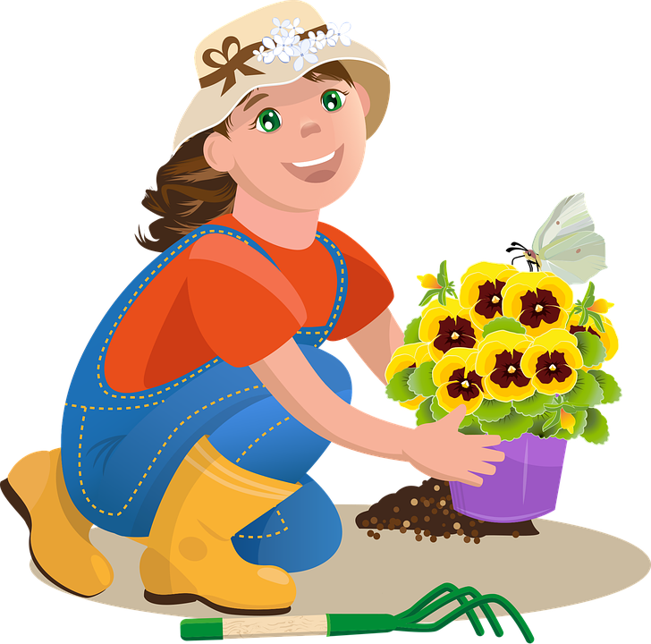
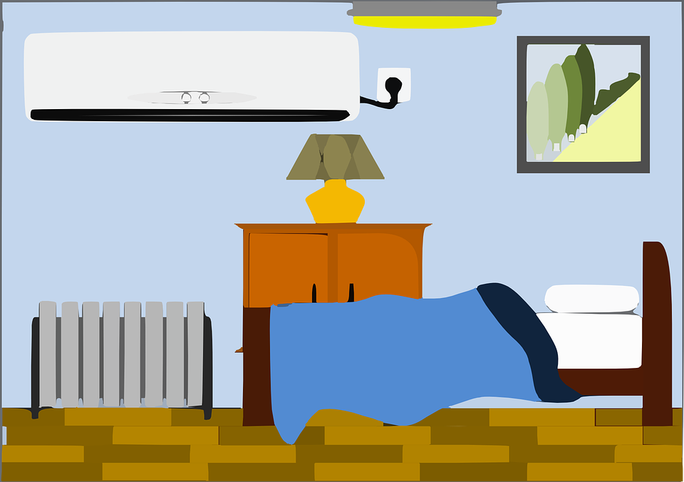
Vokabeln
Hör zu und sag das Wort.
Wörter
wir
ihr
[we]
[you (all)]
der Garten
die Klasse
schön
[garden]
[class, classroom]
[lovely, beautiful]
die Mitte
das Zimmer
[middle]
[room]
Notes:
Aim: to present and practise written comprehension and read aloud of the new vocabulary for this week.
Procedure: 1. Click for a German word. Elicit pronunciation from pupils.
2. Click for the English meaning and picture prompt. Elicit the German word again.
3. Present all seven words like this, in order.
4. Click for one English meaning to disappear. Elicit the English meaning from pupils. Click for meaning to reappear. Continue with the remaining items.
5. Click for the German word to disappear. Elicit the German from pupils. Click for word to reappear. Continue with the remaining items.
5

Slide 6
Sein
You know that the verb sein (to be) is irregular.
ich bin
I am
du bist
you are
To say ‘we are’ and ‘you (all) are’ use:
wir sind
we are
ihr seid
you (all) are
Remember that the final ‘d’ in German sounds like ‘t’!
Notes:
Timing: 2 minutes
Aim: to remind pupils of the irregular verb sein and introduce wird sind and ihr seid.
Procedure:
Click to remind pupils of the use and meaning of sein.
Elicit English translation for the German examples provided line by line.
Click for callout bubble about pronounciation of final ‘d’.
Suggestions for gestures to practise verb parts:
Ich bin – point with one index finger towards self Du bist – point with one index finger away, pointing to a person in front Wir sind – point towards self with both index fingers
Ihr seid – point away to the front with both index fingers
6

Slide 7
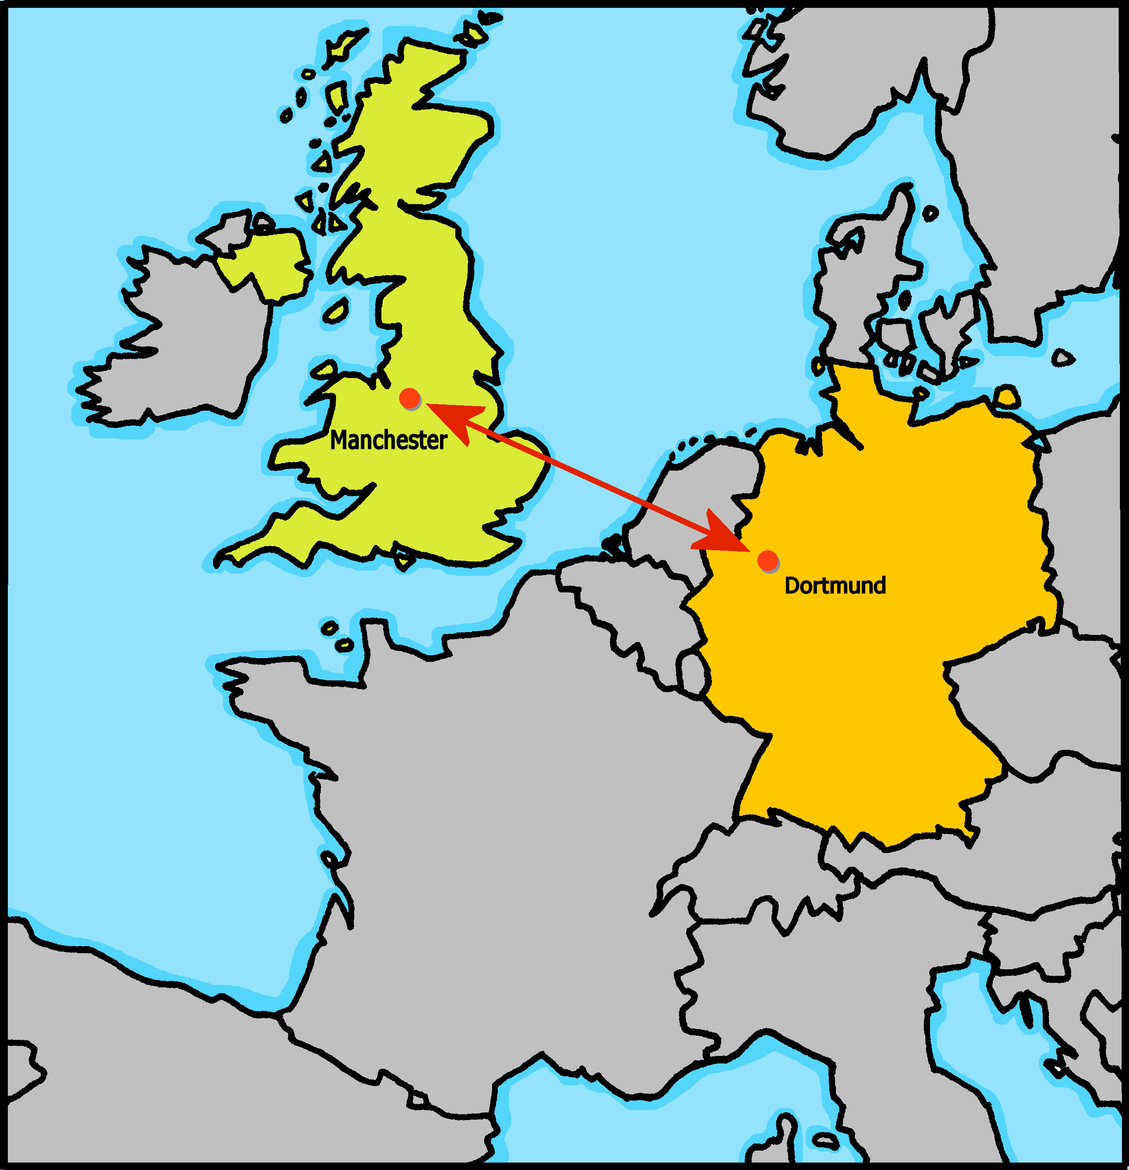
Johanna und Aishas Klasse macht einen Online-Austausch mit Sarah und Rafis Klasse in Manchester, England.
Notes:
Timing: 30 seconds
Aim: to introduce pupils to the context of many of the activities in this term’s course.
Procedure:
Read the slide title with pupils.
Ensure they understand that there is an online exchange between Johanna and Aisha’s class in Dortmund, Germany and Sarah and Rafi’s class in England.

Slide 8
Follow up 4:
Johanna und Aisha haben ein ‘Hallo’ Lied für die Klasse in England.
Hör zu und sing mit!
Hallo! Hallo! Guten Tag! Hallo! Hallo! Guten Tag!
Hallo! Wir sind hier,
Hallo! Ihr seid da, Wie schön, nicht wahr? Wunderbar!
Notes:
Timing: 2 minutes
Aim: to practise some previously learnt vocabulary in a simple song (to the tune of ‘If you’re happy and you know it’).
Procedure: 1. Click to play the audio of the song. Pupils know the song, this is a new verse to practise the new vocabulary.
Note: Teachers might like to re-use this song as part of their lesson starting routine in future lessons. Soon pupils will not need to see the words to recall it.

Slide 9
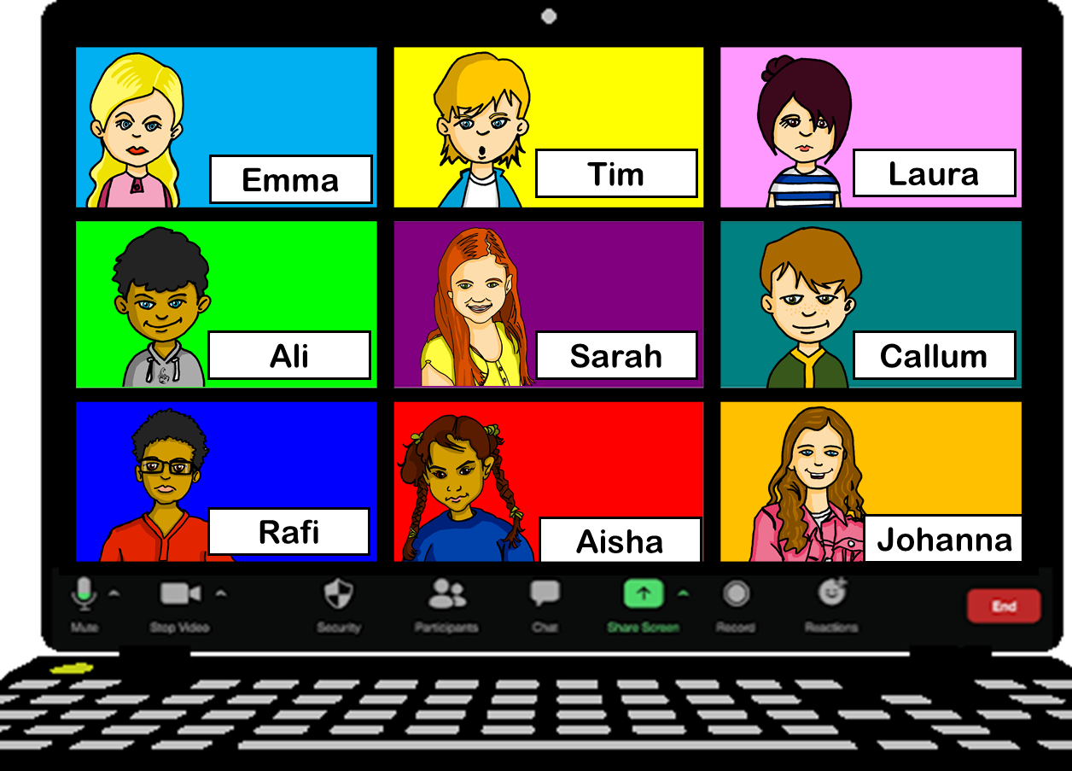
hören
Es gibt ein Problem mit dem Mikro*!
Hör zu. Was sagt Johanna?
wir [we] | ihr [you (all)]
1
2
3
4
5
6
das Mikro (informal) - microphone
Notes:
Timing: 5 minutes
Aim: to practise aural comprehension of two plural forms of sein (to be) – wir sind and ihr seid.
Procedure:
1. Click to listen to sentences without the pronouns wir and ihr.
2. Pupils select wir (we) or ihr (you all).
3. Click to elicit and confirm answers.
Transcript:
[WIr] sind unten rechts.
[Ihr] seid oben links.
[Ihr] seid nett.
[Wir] sind freundlich.
[Wir] sind klein.
[Ihr] seid groß.
9

Slide 10
The preposition ‘in’.
‘In’ is the same word in English and German:
Wir sind in Deutschland.
We are in Germany.
Ihr seid in England.
You (all) are in England.
We shorten ‘in dem‘ to ‘im’.
To say ‘in the’, the words for ‘the’ (der, die, das) change:
der Garten:
in the garden
in dem Garten
im Garten
das Zimmer:
in the room
in dem Zimmer
im Zimmer
die Mitte:
in the middle
in der Mitte
‘Mitte’ still has feminine gender. Just the article spelling has changed.
Notes:
Timing: 2 minutes
Aim: to introduce the preposition ‘in’.
Procedure:
Click through the animations to present the grammar of ‘in’.
10

Slide 11
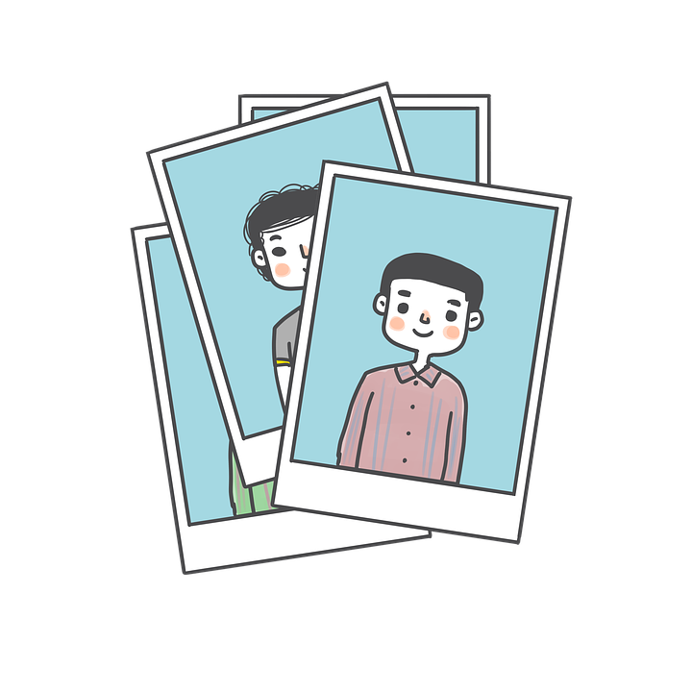
lesen
Das Mikro ist total kaputt*. Die Klassen zeigen* Schulfotos.
Was schreibt Johanna im Chat?
To: everyone
Seid ihr in der Garten | Klasse?
kaputt – broken
zeigen – to show
To: everyone
Wir sind im Zimmer | Schule.
4
1
.
To: everyone
Seid ihr im Baum | Mitte?
To: everyone
Wir sind in der Klasse | Zimmer
2
5
?
.
To: everyone
Ihr seid im Schule | Garten, nicht wahr?
To: everyone
Wir sind hier in der Haus | Schule.
6
3
Notes:
Timing: 8 minutes
Aim: to practise identifying masculine/neuter and feminine nouns after ‘in’ in the written modality.
Procedure:
Explain the scenario.
Pupils identify the correct choice of noun for item one.
Click to block out the incorrect choice and only the correct choice visible.
Elicit oral translations of each message.
Vocabulary: kaputt [295] zeigen [136]
Jones, R.L & Tschirner, E. (2019). A frequency dictionary of German: Core vocabulary for learners. London: Routledge.
11

Slide 12
Tschüss!
blau
Notes:
12

