Slide 1
Interacting
Online-Austausch
sein (to be, being) – wir sind, ihr seid
Subject pronouns 'it' and 'they' - er/sie/es, sie
SSC long and short [u]
blau
Term 1 Week 2
Notes:
Artwork by Steve Clarke. All additional pictures selected from Pixabay and are available under a Creative Commons license, no attribution required.
Vocabulary: sie sind [4] Aktivität [1422] Aufgabe [256] Beispiel [94] Frau [99] Freund, Freundin [273] Geburtstag [1779] Geschichte [262] Herr [154] Klasse [961] Lied [1733] Mensch [90] Party [2809] Person [357] Problem
[210] Satz [432] Song [3373] Spiel [328] Spieler, Spielerin [822] Sport [945] Text [473] Zimmer [665] welcher, welche, welches [122] die² [1]
Revisit 1: -
Revisit 2: können, ich kann, du kannst [23] Instrument [1572]
Jones, R.L & Tschirner, E. (2019). A frequency dictionary of German: Core vocabulary for learners. London: Routledge.
The frequency rankings for words that occur in this PowerPoint which have been previously introduced in these resources are given in the SOW and in the resources that first
introduced and formally re-visited those words.
For any other words that occur incidentally in this PowerPoint, frequency rankings will be provided in the notes field wherever possible.
Note that the first three lessons of the year teach language that can be continuously recycled as lesson routine every lesson in Y5/6.
The idea would be that the class teacher (whether or not s/he teaches the class German can re-use the language as part of the daily routine with the class.
1

Slide 2
aussprechen
long[u]
…
gut
du
super
[good]
[you]
Ruth
Lukas
Notes:
Timing: 2 minutes
Aim: to consolidate the SSC long [u].
Procedure:
Re-present the SSC and the source word ‘du’ (with gesture, if using).
Click to bring on the picture and get pupils to repeat the word ‘du’ (with gesture, if using).
Present the cluster words in the same way, bringing on the picture and getting pupils to pronounce the words.
Note:
a gesture for ‘du’ might be to point at someone else.
2

Slide 3
aussprechen
short [u]
…
Nummer
Punkt
dunkel
[number]
[dot, full stop]
[dark]
Notes:
Timing: 2 minutes
Aim: to consolidate the SSC short [u].
Procedure:
Re-present the SSC and the source word ‘Punkt’ (with gesture, if using).
Click to bring on the picture and get pupils to repeat the word ‘Punkt’ (with gesture, if using).
Present the cluster words in the same way, bringing on the picture and getting pupils to pronounce the words.

Slide 4
Vokabeln
Was ist das auf Deutsch?
Wörter
problem
human being
song
task
text
sport
party
birthday
activity
person
story
die Aktivität
der Sport
die Party
der Geburtstag
das Lied
die Person
der Mensch
der Song
der Text
die Geschichte
das Problem
die Aufgabe
Notes:
Timing: 3 minutes
Aim: to elicit oral production of revisited nouns and two new nouns
Procedure:
1. Click for an English word.
2. Elicit the German word from all pupils, chorally. The only two new nouns are Party and Aktivität.
3. Click to provide the written answer and hear the word pronounced.
4. Depending on level of class, use slide with German words on as a read aloud/ translation activity: pupils read in pairs / one says German word one says English word, swap roles.
4

Slide 5
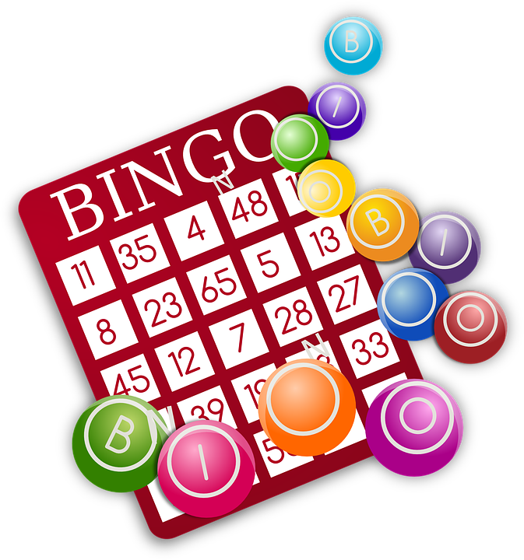
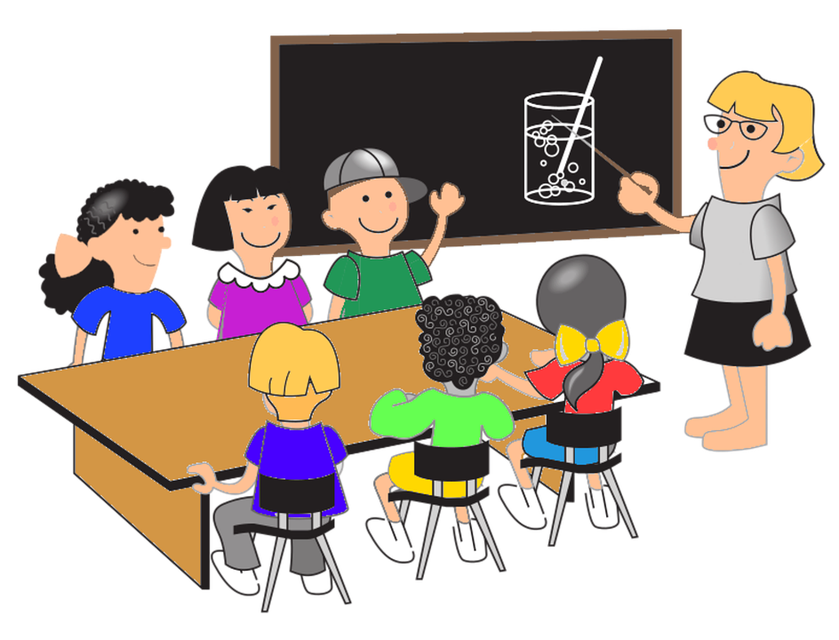
die (the, plural)
You know three words for the in German:
der Text
die Klasse
das Spiel
To say ‘the’ for all plural nouns, use ‘die’.
die Texte
die Klassen
die Spiele
You know two plural noun patterns:
m/nt → +e
f → +(e)n
Notes:
Timing: 3 minutes Aim: To introduce the plural ‘die’ of direct articles der, die das and remind pupils of the two plural patterns they have been introduced to already.
Procedure: Click through the animations to present the information.
5

Slide 6
welcher?/welche?/welches? (which?)
To ask ‘which?’ in German, use welch- with these endings:
der Text
die Klasse
das Spiel
Welcher Text?
Welche Klasse?
Welches Spiel?
Welche? is which? for all plural nouns:
Welche Klassen?
Welche Spiele?
Welche Texte?
Notes:
Timing: 3 minutes Aim: To introduce the question word welcher/welche/welches? (which?)
Procedure: 1. Click through the animations to present the information.
2. For the plural forms, try to elicit the responses from pupils.
6

Slide 7
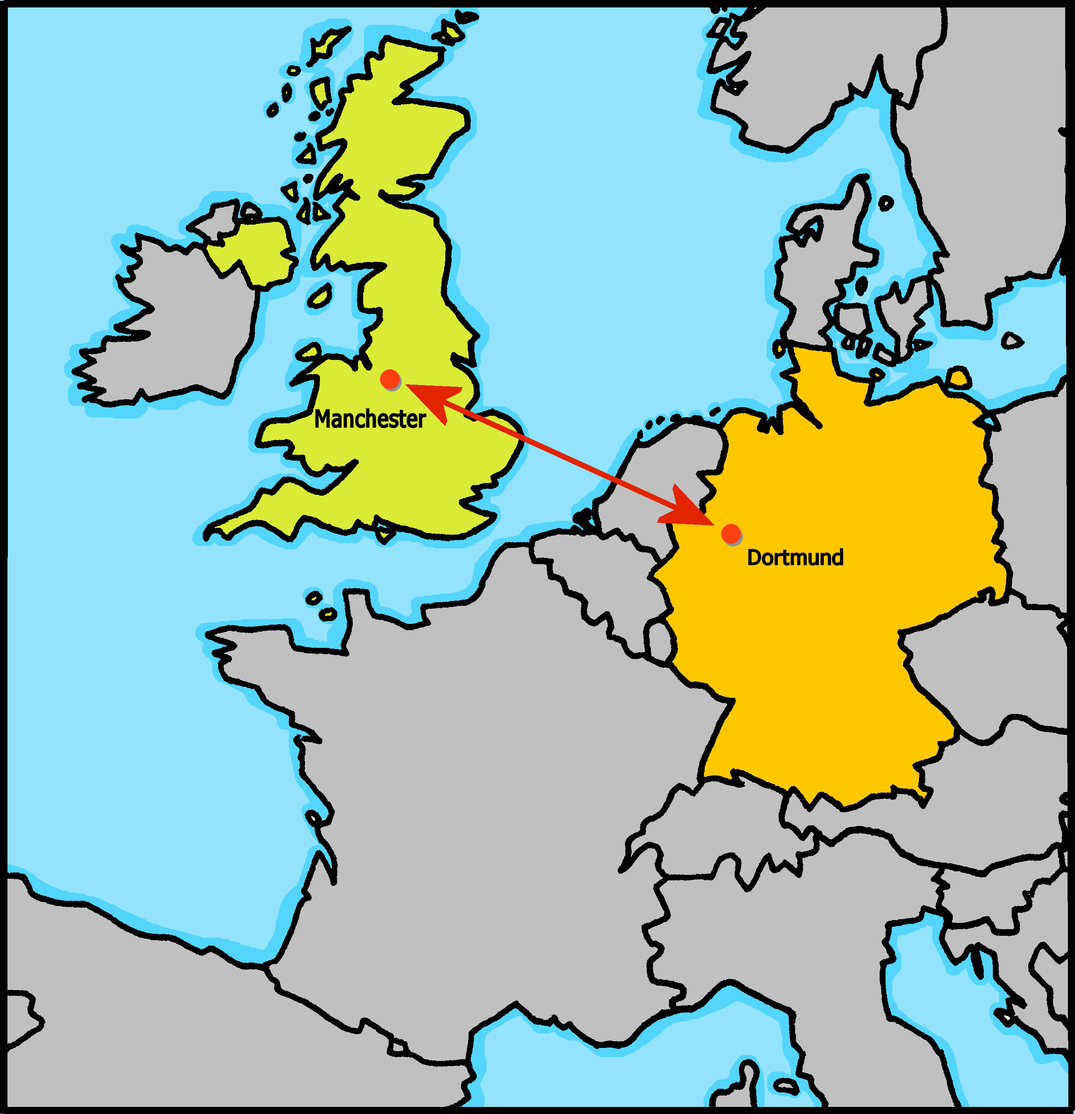
Online-Austausch
Johanna und Aishas Klasse macht einen Online Austausch mit Rafis Klasse in Manchester, England.
Chatbox
To: everyone
Wie geht‘s?
Notes:
Timing: 30 seconds Aim: To remind pupils of the scenario of the Online-Austausch between the English and the German class.
Procedure: Display the slide and read the description with pupils.
7

Slide 8
lesen
Johanna und Aishas Klasse textet* mit Rafis Klasse.
Welches Wort ist das?
textet –
texts, is texting
1. Welche
Aktivität|Sport
ist das?
3. Welches Song|Lied
ist das?
5. Welcher
Geschichte|Textist das?
4. Happy!
Welcher
Mensch|Person
ist das?
6. Hänsel und Gretel! Welches
Problem|Aufgabe
ist das?
2. Fußball!
Welche
Party|Geburtstag
ist das?
David Attenborough!
Mathe!
Johannas!
Notes:
Timing: 8 minutes
Aim: to practise the gender endings of welch- depending on the gender of the noun.
Procedure:
Explain the scenario: the two classes are texting each other.
Pupils identify the correct from of welch- based on the gender of the noun in the text message. Explain that there can only be a grammatical choice based on the ending of welch- as the meaning would work with either noun.
Click to block out the incorrect choice and only the correct choice will be visible.
Elicit oral translations of each message.
Vocabulary: texten [>5009]
Jones, R.L & Tschirner, E. (2019). A frequency dictionary of German: Core vocabulary for learners. London: Routledge.
8

Slide 9
die (the, plural)
You now know four words for the in German!
der Text
die Klasse
das Spiel
die Texte
die Klassen
die Spiele
We use pronouns ‘it’ and ‘they’ to refer to nouns we have already mentioned. In German we need four words to do this:
So, er means he and it, sie means she and it.
That is the text. It is good.
Das ist der Text. Er ist gut.
That is the class. It is big.
Das ist die Klasse. Sie ist groß.
They are (sie sind) is the same verb as we are (wir sind).
That is the game. It is great.
Das ist das Spiel. Es ist toll.
Those are the texts. They are good.
Das sind die Texte. Sie sind gut.
Those are the classes. They are big.
Das sind die Klassen. Sie sind groß.
Those are the games. They are great.
Das sind die Spiele. Sie sind toll.
Notes:
Timing: 3 minutes Aim: To introduce the plural ‘die’ of direct articles der, die das and the singular and plural subject pronouns (er, sie, es – it, sie – they).
Procedure: Click through the animations to present the new information.
9

Slide 10
lesen
Die Klassen schreiben im Chat. Der Chat ist kaputt!
Was ist das? Welches Wort ist richtig?
Chatbox
To: everyone
Das ist der Text | die Geschichte. Sie ist lang!
1
Chatbox
To: everyone
Das ist das Beispiel | der Satz. Er ist einfach!
2
kaputt – broken
Chatbox
To: everyone
Das ist der Song | das Lied. Er ist schön!
Chatbox
To: everyone
Das ist das Spiel| der Sport. Es ist toll!
3
4
Chatbox
To: everyone
Das ist das Problem | die Aufgabe.
Sie ist schwer.
5
Chatbox
To: everyone
Das ist der Mensch | die Person. Er ist jung!
6
Notes:
Timing: 8 minutes
Aim: to practise identifying masculine, feminine, and neuter subject pronouns.
Procedure:
Explain the scenario.
Pupils identify the correct choice of noun for item one, based on the pronoun in the next sentence.
Click to block out the incorrect choice. Only the correct choice will be visible.
Elicit oral translations of each message.
Unknown vocabulary and cognates:
kaputt [295]
Jones, R.L & Tschirner, E. (2019). A frequency dictionary of German: Core vocabulary for learners. London: Routledge.
10

Slide 11
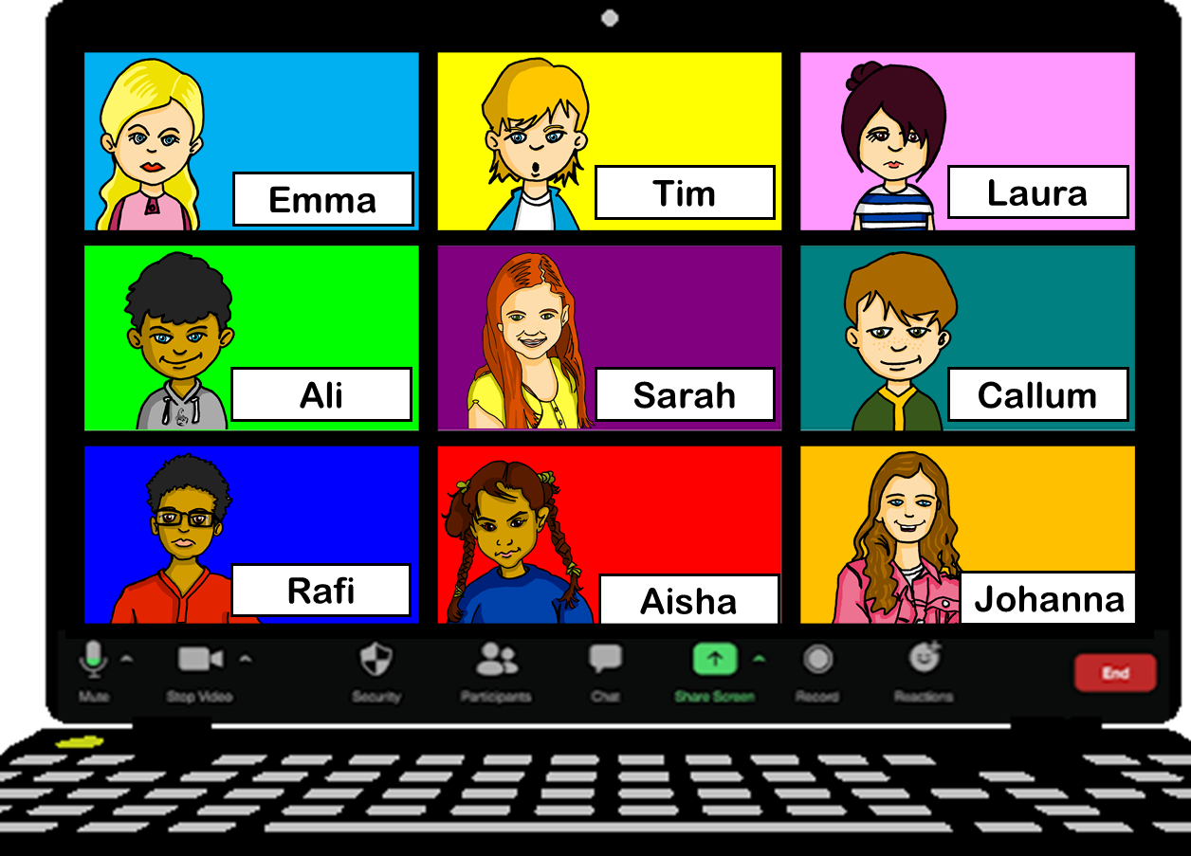
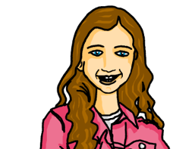
hören
Hör zu.
Es gibt ein Problem mit dem Mikro*. Was sagt Johanna?
1
die Klassen | die Klasse.
die Aktivitäten | die Aktivität.
die Personen | die Person.
die Frau | die Frauen.
die Aufgabe | die Aufgaben.
die Party | die Partys.
.
2
3
4
5
6
.
Some German cognates add –s for plural, like English.
Remember!
die = the (f) and die = the (pl).
Listen out for the verb and look at the noun. Is it singular or plural?
das Mikro (informal) - microphone
Notes:
Note: if time is tight, complete this task as one of the follow up activities (e.g., instead of the phonics task).
Timing: 5 minutes
Aim: to practise identifying singular/plural nouns based on the verb.
Procedure:
Explain the task. Pupils need to select the correct noun from the singular/plural options. (All nouns chosen are feminine so that the only way to choose is by focusing on the singular/plural verb ist/sind, and choosing the corresponding singular/plural form of the noun.
Click to block out the incorrect choice and leave only the correct choice visible.
Unknown and cognate vocabulary:
Mikro [>5009]
Jones, R.L & Tschirner, E. (2019). A frequency dictionary of German: Core vocabulary for learners. London: Routledge.
Transcript:
1. Das sind [die Klassen]. 2. Das ist [die Aktivität]. 3. Das ist [die Person].
4. Das sind [die Frauen].
5. Das sind [die Aufgaben.]
6. Das ist [die Party].
11

Slide 12
Tschüss!
blau
Notes:
12

