Slide 1
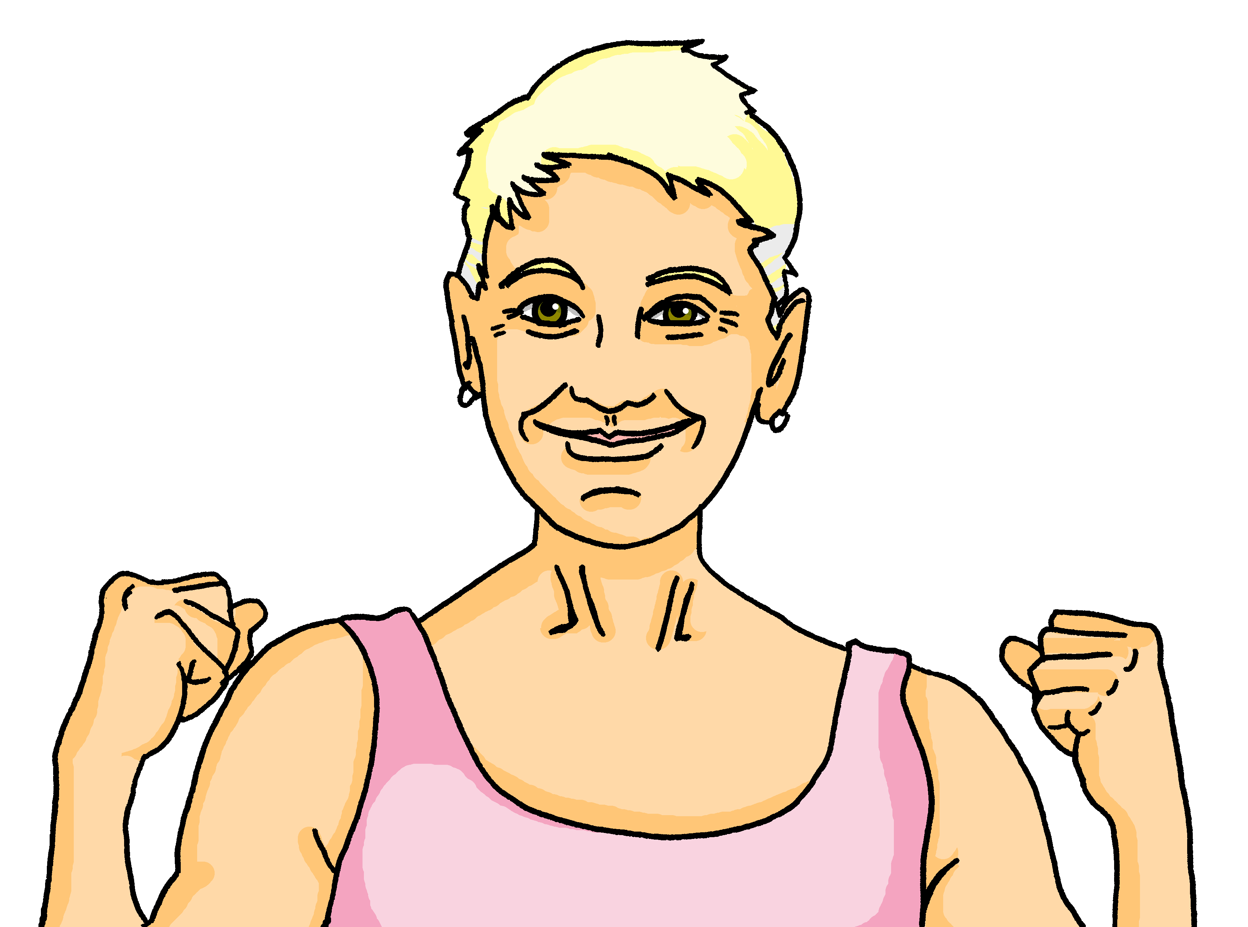
Interacting
Oma hat Geburtstag
blau
Follow ups 1-5
Term 1 Week 5
Notes:
Artwork by Steve Clarke. Pronoun pictures from NCELP (www.ncelp.org). All additional pictures selected from Pixabay and are available under a Creative Commons license, no attribution required.
Phonics:
long [e] geben [49] Idee [451] mehr [52]
short [e] denken [128] Bett [659] helfen [338]
Vocabulary: bleiben [113] brauchen [179] Glas, Gläser [885] Idee [451] gewinnen [372] haben [6] helfen [338] kaufen [506] machen [58] planen [579] singen [1063] spielen [205] wiederholen [988] Kind [133] Kinder [133] Stunde [276] dieser, diese, dieses [24]
Revisit 1: sie sind [4] Aktivität [1422] Aufgabe [256] Beispiel [94] Frau [99] Freund, Freundin [273] Geburtstag [1779] Geschichte [262] Herr [154] Klasse [961] Lied [1733] Mensch [90] Party [2809] Person [357] Problem [210] Satz [432] Song [3373] Spiel [328] Spieler, Spielerin [822] Sport [945] Text [473] Zimmer [665] welcher, welche, welches [122] die² [1]
Revisit 2: heißen [126] wohnen [560] Jahr [53] alt [138] jung [199]
Jones, R.L & Tschirner, E. (2019). A frequency dictionary of German: Core vocabulary for learners. London: Routledge.
The frequency rankings for words that occur in this PowerPoint which have been previously introduced in these resources are given in the SOW and in the resources that first
introduced and formally re-visited those words.
For any other words that occur incidentally in this PowerPoint, frequency rankings will be provided in the notes field wherever possible.

Slide 2
aussprechen
long [e]
…
Notice that the 2nd ‘e’ sounds like the ‘a’ in ‘ago’.
to give
geben
Notes:
Timing: 1 minute
Aim: to introduce the SSC long [e].
Procedure:
Introduce the SSC and present the source word ‘geben’ (with gesture, if using).
Click to bring on the picture and get pupils to repeat the word ‘geben’ (with gesture, if using).
Note: a gesture for ‘geben’ might be to pretend to give someone on object.
geben [49]
2

Slide 3
aussprechen
long [e]
…
geben
to give
more
Idee
mehr
Notes:
Timing: 1 minute
Aim: to introduce the SSC long [e].
Procedure:
Re-present the SSC and the source word ‘geben’ (with gesture, if using).
Click to bring on the picture and get pupils to repeat the word ‘geben’ (with gesture, if using).
Present the cluster words in the same way, bringing on the picture and getting pupils to pronounce the words.
Idee [451] mehr [52]
3

Slide 4
aussprechen
short [e]
…
Notice that the 2nd ‘e’ sounds like the ‘a’ in ‘ago’.
to think
denken
Notes:
Timing: 1 minute
Aim: to consolidate the SSC short [e].
Procedure:
Introduce the SSC and present the source word ‘denken’ (with gesture, if using).
Click to bring on the picture and get pupils to repeat the word ‘denken’ (with gesture, if using).
Note: a gesture for ‘denken’ might be to pretend to to put your finger to your temple as though you are pondering something.
denken [128]

Slide 5
aussprechen
short [e]
…
denken
to think
to help
Bett
helfen
Notes:
Timing: 1 minute
Aim: to consolidate the SSC short [e].
Procedure:
Re-present the SSC and the source word ‘denken’ (with gesture, if using).
Click to bring on the picture and get pupils to repeat the word ‘denken’ (with gesture, if using).
Present the cluster words in the same way, bringing on the picture and getting pupils to pronounce the words.
Note: a gesture for ‘denken’ might be to pretend to to put your finger to your mouth and as if you’re concentrating and thinking about something.
Bett [659] helfen [338]

Slide 6
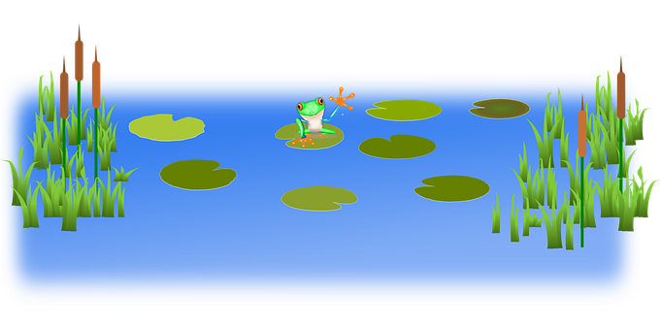
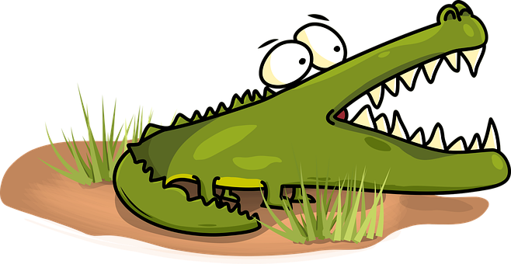
Follow up 1:
Sag die Wörter.
Runde 1: Person A
Runde 2: Person B
Achtung! Krokodil!
Can you pronounce all of the words below correctly in 1 minute?
Can you make a safe path across the water by pronouncing ONLY the words with a long [e]?
aussprechen
gelb
Bett
Idee
Ende
Problem
helfen
geben
England
Fenster
verstehen
mehr
Auf Wiedersehen!
Notes:
Timing: 5 minutes
Aim: to practise knowledge of long and short [e] to known and unknown words.
Procedure:
Click to bring up the instructions.
Pupils work in pairs to practise pronunciation of long and short [e]. For their first go, they can choose where to start and have one minute to pronounce all the words correctly to avoid being eaten by the crocodile. For their second go, students must ONLY pronounce the words with a long [e] to find a safe path across from left to right. If they accidentally say the words with a short [e] they fall into the water.
In their pairs, one student is Person A and one person is Person B. Click to indicate it’s Person A’s turn. Click again to bring up Person B’s turn.

Slide 7
Follow up 2
Hör zu. Wer macht das? Oma (she) oder die Partygäste (they)? Was machen sie?
hören
 | she or they? | activity?
1
they
plan/are planning a party
2
they
buy /are buying presents
3
she
plays/is playing music
4
they
stay /are staying for two hours
5
she
sings/is singing a song
6
she
sits/is sitting in the garden
Notes:
Timing: 10 minutes
Aim: to practise aural identification of singular and plural 3rd person verb endings with the pronoun ‘sie’ (she or they).
Procedure:
Click to play the first recording. Pupils decide whether the verb is in the 3rd person singular (-t ending) or the 3rd person plural (-en ending) and write down ‘she’ or ‘they’. They also try to note the activity mentioned in English.
Click to reveal answers.
Repeat for numbers 2-6.
Extra: Can students recreate the original German sentences?
Transcript:
Sie planen eine Party
Sie kaufen Geschenke
Sie spielt Musik
Sie bleiben zwei Stunden lang.
Sie singt ein Lied.
Sie sitzt im Garten.

Slide 8
Follow up 3
Hör zu.
C Take turns to say the following German words out loud. Your partner will give you a point each time you remember the English translation as well.
Partner A
die Stunde
das Glas
das Kind
gewinnen
planen
machen
wiederholen
A Listen. Write the word that is mentioned.
The letter ‘B’ here stands for ‘Beispiel’ (example)
B.
they make | she wins | she makes
hören
Partner B
die Idee
Gläser
Kinder
bleiben
Kaufen
brauchen
das Lied
1
they sing | she is | she sings
…
2
presents | a glass | glasses
sprechen
3
they play | she stays | they stay
4
a child | children | party
5
Johanna needs | they win | Johanna wins
B Write the number of the matching answer.
D Ping Pong translation in pairs
Round 1: Challenge each other by testing whether you can translate the German words into English.
Round 2: Now challenge your partner by asking for the German words.
4
3
Die Kinder ____ 4. sie bleibt ____
Sie singen ____ 5. Johanna gewinnt____
Sie macht ____ 6. Gläser ____
1
5
E
2
Notes:
Timing: 10 minutes
Aim: to practise aural and oral comprehension and oral production of this week’s new grammar point and vocabulary.
Procedure:
Section A: Click to bring up callout to explain that the ‘B.’ for the first itme stands for ‘Beispiel’ – example. Click again for callout to disappear again, then click to listen. Pupils circle the correct English word(s) that are mentioned in the German (if they have the sheet printed). If not, they can use numbers 1,2,3 to represent the 3 options. Click for answers. Some of these require understanding of singular and plural verb forms; others require recognition of vocabulary.
Section B: Pupils refer to the listening table in Section A, and write the corresponding numbers to match the vocabulary/verb forms. Click for answers.
Sections C & D: Oral work in pairs to focus on pronunciation, translation and recall of vocabulary.
Transcript: E. Sie macht eine Liste. 1. Sie singen ein Lied. 2. Wir kaufen Gläser. 3. Sie bleibt im Garten. 4. Die Kinder spielen. 5. Johanna gewinnt das Spiel.

Slide 9
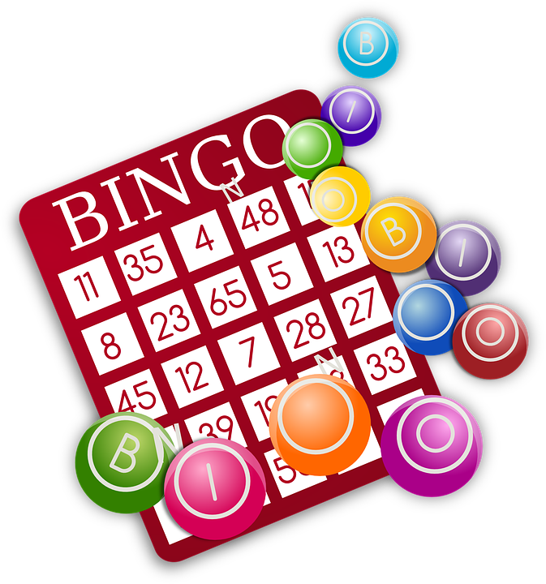
Follow up 4:

Schreib auf Deutsch.
Beschreib die Aktivitäten. Schreib 5 Sätze.
schreiben
E: Ich mache eine Liste; Moritz kauft Gläser; Wir bleiben im Garten
Notes:
Timing: 6-8 minutes Aim: to practise more independent written production of first & third person singular and plural sentences, drawing on a variety of previously taught vocabulary.
Procedure:
Pupils write sentences using the I, s/he, we forms of regular present tense verbs to describe (with 5 sentences) any of the activities that Johanna and Moritz do for the party.
The Venn diagram shows what Johanna and Moritz do together, and what each does on his/her own. Johanna is ‘talking’ so her sentences use the ‘I’ form. The 3 examples demonstrate the different verb forms students should try to use. Note that these examples fade away after about 30 seconds to avoid pupils simply copying them for their answers.
Note: Teachers can add a list of verb phrases to the slide to help pupils, if needed. E.g. Gläser kaufen, Lieder singen, eine Party planen, im Garten bleiben, Spiele gewinnen, eine Liste machen, Ideen brauchen.

Slide 10
Follow up 5:

Schreib auf Englisch.
Can you get at least 15 points?
Wörter
 | alt | sie sind | das Jahr
 | wohnen | jung | heißen
 | die Party | die Aktivität | die
 | welcher? | welche? | welches?
 | die Kinder | dieser | das Kind
 | planen | dieses | kaufen
old
they are
(the) year
Vokabeln
x3
to live, living
young
to be called
(the) party
(the) activity
the (f,pl)
x2
which? (m)
which? (f,pl)
which? (nt)
(the) children
this, that (m)
(the) child
x1
to plan, planning
this,that (nt)
to buy, buying
Notes:
Timing: 5 minutes
Aim: to practise written comprehension of vocabulary from this and revisited weeks.
Procedure: 1. Give pupils a blank grid. They fill in the English meanings of any of the words they know, trying to reach 15 points in total. 2. Remind pupils to try and specify gender (m/f/nt) for welch- and dies- words and to think about singular and plural nouns.
Note: The most recently learnt and practised words are pink, words from the previous week are green and those from week 1 are blue, thus more points are awarded for them, to recognise that memories fade and more effort (heavy lifting!) is needed to retrieve them.

Slide 11
Follow up 5:

Schreib auf Deutsch.
Can you get at least 15 points?
Wörter
 | old | young | they are
 | to be called | to live, living | (the) year
 | which? (f) | which? (nt) | the (f,pl)
 | (the) activity | (the) party | which? (m)
 | (the) children | this, that (m) | this, that (nt)
 | to buy, buying | to plan, planning | (the) child
alt
jung
sie sind
Vokabeln
x3
heißen
wohnen
das Jahr
welche?
welches?
die
x2
die Aktivität
die Party
welcher?
die Kinder
dieser
dieses
x1
kaufen
planen
das Kind
Notes:
Timing: 5 minutes
Aim: to practise written production of vocabulary from this and revisited weeks.
Procedure: 1. Give pupils a blank grid. They fill in the German translations of any of the words they know, trying to reach 15 points in total. 2. Remind pupils to think about m/f/nt/plural forms of ‘which’ and ‘this’ words and to think about singular and plural nouns.
Note: The most recently learnt and practised words are pink, words from the previous week are green and those from week 1 are blue, thus more points are awarded for them, to recognise that memories fade and more effort (heavy lifting!) is needed to retrieve them.

Slide 12
Tschüss!
blau
Notes:
12

Slide 13
Follow up 5:

Schreib auf Englisch.
Can you get at least 15 points?
Wörter
 | alt | sie sind | das Jahr
 | wohnen | jung | heißen
 | die Party | die Aktivität | die
 | welcher? | welche? | welches?
 | die Kinder | dieser | das Kind
 | planen | dieses | kaufen
Vokabeln
x3
x2
x1
Notes:
HANDOUT

Slide 14
Follow up 5:

Schreib auf Deutsch.
Can you get at least 15 points?
Wörter
 | old | young | they are
 | to be called | to live, living | (the) year
 | which? (f) | which? (nt) | the (f,pl)
 | (the) activity | (the) party | which? (m)
 | (the) children | this, that (m) | this, that (nt)
 | to buy, buying | to plan, planning | (the) child
Vokabeln
x3
x2
x1
Notes:
HANDOUT

