Slide 1
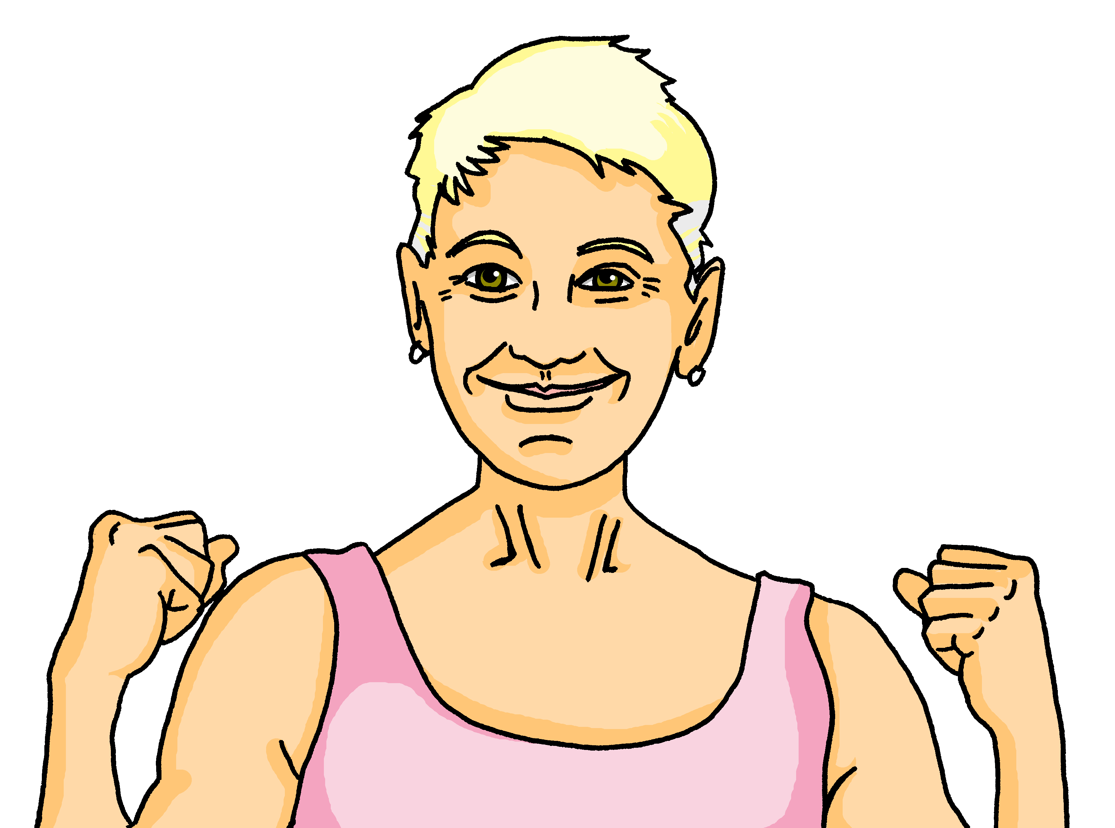
Interacting
Oma hat Geburtstag
blau
Present tense – wir (we), they (sie)
diese(r, s) this/these
SSC long and short [e]
Term 1 Week 5
Notes:
Artwork by Steve Clarke. Pronoun pictures from NCELP (www.ncelp.org). All additional pictures selected from Pixabay and are available under a Creative Commons
license, no attribution required.
Phonics:
long [e] geben [49] Idee [451] mehr [52]
short [e] denken [128] Bett [659] helfen [338]
Vocabulary: bleiben [113] brauchen [179] Glas, Gläser [885] Idee [451] gewinnen [372] haben [6] helfen [338] kaufen [506] machen [58] planen [579] singen [1063] spielen [205] wiederholen [988] Kind [133] Kinder [133] Stunde [276] dieser, diese, dieses [24]
Revisit 1: sie sind [4] Aktivität [1422] Aufgabe [256] Beispiel [94] Frau [99] Freund, Freundin [273] Geburtstag [1779] Geschichte [262] Herr [154] Klasse [961] Lied [1733] Mensch [90] Party [2809] Person [357] Problem [210] Satz [432] Song [3373] Spiel [328] Spieler, Spielerin [822] Sport [945] Text [473] Zimmer [665] welcher, welche, welches [122] die² [1] Revisit 2: heißen [126] wohnen [560] Jahr [53] alt [138] jung [199]
Jones, R.L & Tschirner, E. (2019). A frequency dictionary of German: Core vocabulary for learners. London: Routledge.
The frequency rankings for words that occur in this PowerPoint which have been previously introduced in these resources are given in the SOW and in the resources that first introduced and formally re-visited those words. For any other words that occur incidentally in this PowerPoint, frequency rankings will be provided in the notes field wherever possible.
Remember that at the start of the course (first three lessons of Rot/Gelb) pupils learnt language (for greetings and register taking) that can still be part of the lesson routines in upper KS2 (Blau/Grün). They are not re-taught, as we anticipate that teachers have built these in from early in lower KS2.
1

Slide 2
aussprechen
long [e]
…
Notice that the 2nd ‘e’ sounds like the ‘a’ in ‘ago’.
to give
geben
Notes:
Timing: 1 minute
Aim: to introduce the SSC long [e].
Procedure:
Introduce the SSC and present the source word ‘geben’ (with gesture, if using).
Click to bring on the picture and get pupils to repeat the word ‘geben’ (with gesture, if using).
Note: a gesture for ‘geben’ might be to pretend to give someone on object.
geben [49]
2

Slide 3
aussprechen
long [e]
…
geben
to give
more
Idee
mehr
Notes:
Timing: 1 minute
Aim: to introduce the SSC long [e].
Procedure:
Re-present the SSC and the source word ‘geben’ (with gesture, if using).
Click to bring on the picture and get pupils to repeat the word ‘geben’ (with gesture, if using).
Present the cluster words in the same way, bringing on the picture and getting pupils to pronounce the words.
Idee [451] mehr [52]
3

Slide 4
aussprechen
short [e]
…
Notice that the 2nd ‘e’ sounds like the ‘a’ in ‘ago’.
to think
denken
Notes:
Timing: 1 minute
Aim: to consolidate the SSC short [e].
Procedure:
Introduce the SSC and present the source word ‘denken’ (with gesture, if using).
Click to bring on the picture and get pupils to repeat the word ‘denken’ (with gesture, if using).
Note: a gesture for ‘denken’ might be to pretend to to put your finger to your temple as though you are pondering something.
denken [128]

Slide 5
aussprechen
short [e]
…
denken
to think
to help
Bett
helfen
Notes:
Timing: 1 minute
Aim: to consolidate the SSC short [e].
Procedure:
Re-present the SSC and the source word ‘denken’ (with gesture, if using).
Click to bring on the picture and get pupils to repeat the word ‘denken’ (with gesture, if using).
Present the cluster words in the same way, bringing on the picture and getting pupils to pronounce the words.
Note: a gesture for ‘denken’ might be to pretend to to put your finger to your mouth and as if you’re concentrating and thinking about something.
Bett [659] helfen [338]

Slide 6
lesen
Oma
Hör zu und lies den Text. Wer ist das?
hören
Sie heißt Jutta. Sie ist die Oma von Johanna und Moritz und Maikes Mutter. Sie wohnt auch in Dortmund.
Sie mag Musik und Sport. Sie ist Handballspielerin und sie ist super fit. Jutta is nicht sehr alt – sie ist fünfundfünfzig Jahre jung! Sie hat am 10. Oktober Geburtstag. Johanna und Moritz haben eine Idee!
Notes:
Timing: 5 minutes
Aim: to practise comprehension of previously taught vocabulary and structures in a longer text; to introduce the context for this week’s lesson.
Procedure:
1. Click to listen to the text. Pupils follow along reading. Pause the recording a few times and ask pupils to say the next word.
2. Play the audio again and ask pupils to read the text aloud along with the recording.
3. Ask pupils what they have found out about Jutta from this text.
Note: this text revisits several words from this week’s revisiting sets: heißen, wohnen, Jahr, alt, jung, Geburtstag, Sport, Spielerin. (Text – in the instructions). In addition, teachers may want to use further words to ask questions about the text. For example, Welche Person ist das? Ist das ein Herr? (oder eine Frau)? Ist sie eine Freundin von Maike? Welcher Sport mag sie? Welche Aktivitäten mag sie?
6

Slide 7
Vokabeln
Vokabeln lernen
Wörter
[to buy, buying]
[to need, needing]
kaufen
das Kind
brauchen
[to plan, planning]
planen
Kinder
machen
Notes:
Timing: 3 minutes
Aim: to present the new & revisited vocabulary for this week.
Procedure: 1. Click for a German word. Elicit pronunciation from pupils.
2. Click for the English meaning and picture prompt. Elicit the German word again.
3. Present all 12 words like this, in order.
4. Click for one English meaning to disappear. Elicit the English meaning from pupils. Continue with the remaining items.
5. Click for the German word to disappear. Elicit the German from pupils. Continue with the remaining items.
7

Slide 8
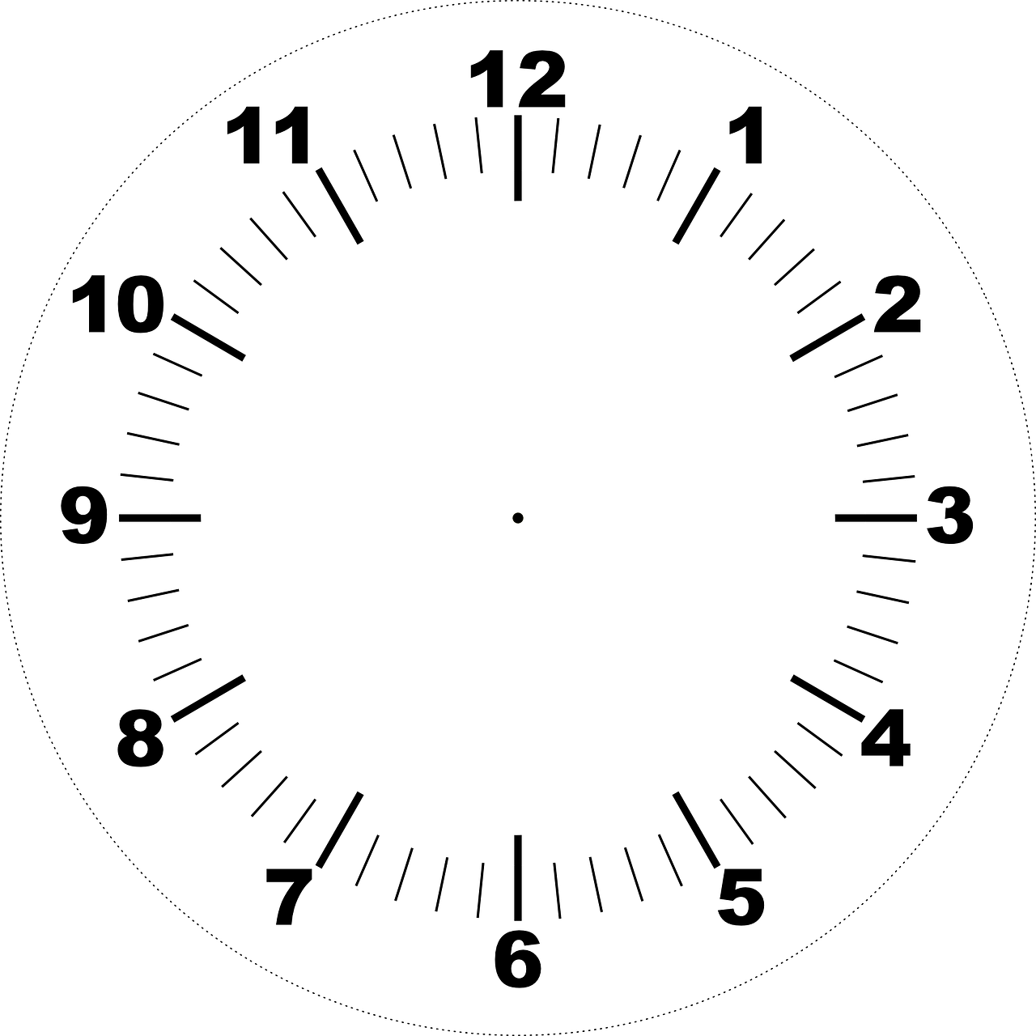
Vokabeln
Vokabeln lernen
Wörter
das Glas
die Idee
bleiben
[hour]
[to win, winning]
Gläser
gewinnen
die Stunde
Notes:
Timing: 3 minutes
Aim: to present the new & revisited vocabulary for this week.
Procedure: 1. Click for a German word. Elicit pronunciation from pupils.
2. Click for the English meaning and picture prompt. Elicit the German word again.
3. Present all 12 words like this, in order.
4. Click for one English meaning to disappear. Elicit the English meaning from pupils. Continue with the remaining items.
5. Click for the German word to disappear. Elicit the German from pupils. Continue with the remaining items.
8

Slide 9
Present tense: wir (we)
As you know, regular verbs have endings which match the subject pronoun.
Ich bleibe zu Hause.
I stay/am staying at home.
Sie singt Lieder.
She sings/is singing songs.
To say wir (we) + regular verb:
Wir bleiben zu Hause.
We stay/are staying at home.
Wir singen Lieder.
We sing/are singing songs.
The wir form of the verb is the same as the infinitive form in the dictionary.
Notes:
Timing: 2 minutes
Aim: to present the 1st person plural form of regular present tense.
Procedure:
Click through the animations to present the new information.
Elicit English translation for the German examples provided.
9

Slide 10
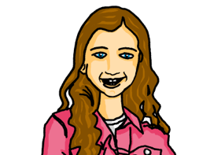
lesen
Johanna und Aisha in der Schule
Was schreibt Johanna? Wer macht was? Ist das Johanna (ich) oder Johanna und Moritz (wir)?
Schreib 1 – 6 und ich oder wir.
1
Ich
4
Ich
plane eine Party!
brauchen Gläser.
Wir
Wir
2
Ich
5
Ich
habe viele Ideen!
schreibe ein Lied.
Wir
Wir
3
Ich
kaufen ein Geschenk.
6
Ich
machen die Party im Garten.
Wir
Wir
Notes:
Timing: 6 minutes
Aim: to practise written comprehension of 1st persons singular and plural of weak (regular) verbs in the present tense.
Procedure:
Read the instructions with pupils and clarify the context. Johanna is excited about the upcoming party and is passing notes to Aisha about it in class. As they’re passed along bits get torn and messages get a bit jumbled.
Pupils read the text fragments and work out whether the activity is something Johanna is doing (I) or Johanna and Moritz are doing together (we).
Elicit each answer from pupils and click to remove the incorrect pronouns.
Elicit orally what pupils understand about the party plans so far.
10

Slide 11
Present tense: sie (they)
You know sie means ‘she’:
Sie singt Lieder.
She sings/is singing songs.
But sie also means ‘they’:
Sie singen Lieder.
They sing/are singing songs.
And it is the same verb form as wir and the infinitive:
Wir singen Lieder.
We sing/are singing songs.
Notes:
Timing: 2 minutes
Aim: to present the 3rd person plural form of regular present tense and the new meaning of the pronoun sie (they).
Procedure:
Click through the animations to present the new information.
Elicit English translations for the German examples provided.
11

Slide 12
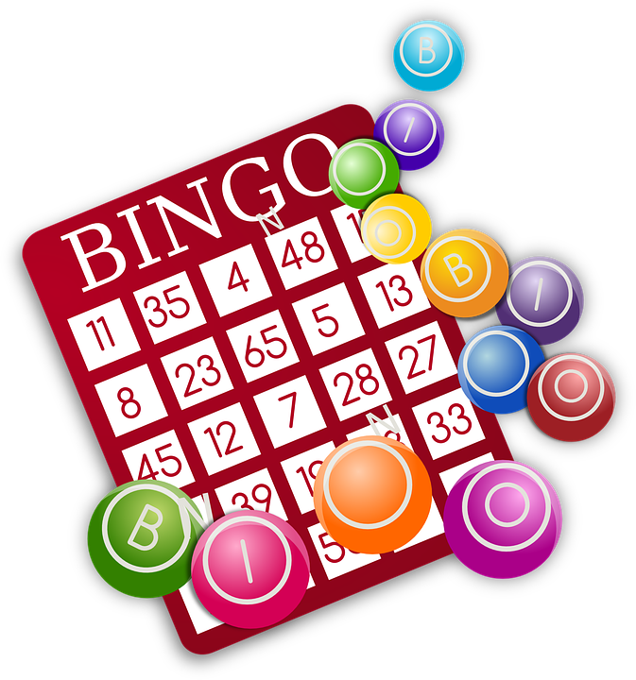
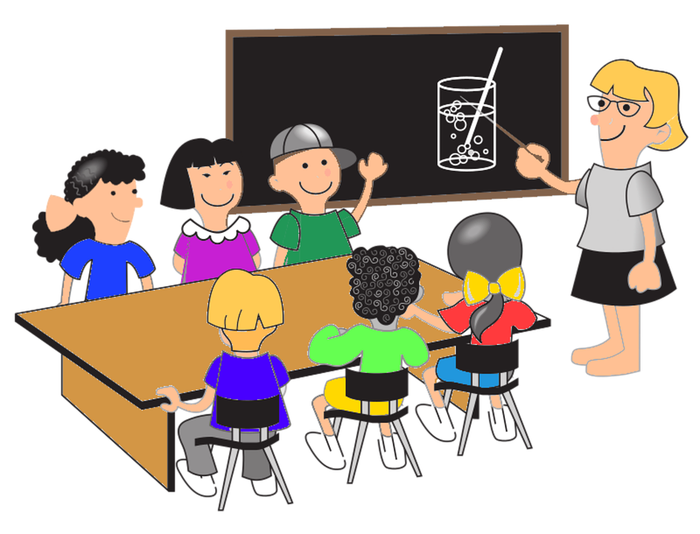
diese, dieser, dieses (this), diese (these)
You already know how to ask ‘which?’:
Welcher Text?
Welche Klasse?
Welches Spiel?
Welche Texte/Klassen/Spiele?
To reply saying ‘this’ use:
dieser Text
diese Klasse
dieses Spiel
this text
this class
this game
diese, meaning ‘these’, is used for all plural nouns:
diese Texte/Klassen/Spiele
Notes:
Timing: 3 minutes
Aim: To introduce dieser/diese/dieses (this/these) and to revisit welcher/welche/welches? (which?)
Procedure:
Click through the animations to present the new grammar.
Elicit English translation for the German examples provided.
12

Slide 13
lesen
Moritz plant auch. Er textet mit Johanna.
Schreib 1 – 5 und she oder they. Dann schreib Moritzs Idee auf Englisch.
1
Sie brauchen dieses Glas | Gläser.
she
.
they
2
4
she
they
Sie gewinnt diese Partyspiele/Preis.
Sie spielt diese Spiel/Musik.
.
they
she
3
5
she
they
Sie wiederholen dieses Lieder/Lied.
Sie machen dieses Foto/Liste.
.
she
they
Notes:
Timing: 5 minutes
Aim: to practise written comprehension of 3rd persons singular and plural of regular present tense verbs, as well as dies-.
Procedure:
Do number one together as an example, encouraging pupils to notice both the plural verb ending and the ‘dieses’.
Pupils write down ‘they’ or ‘she’. They also note down the correct noun: ‘Glas’ or ‘Gläser’. Click to reveal answers.
Pupils complete items 2-5.
Elicit pupil responses and click to reveal answers 2-5.
Pupils then write Moritz’s ideas down in English. Alternatively, teachers can elicit these orally from the class.
13

Slide 14
Tschüss!
blau
Notes:
14

