Slide 1
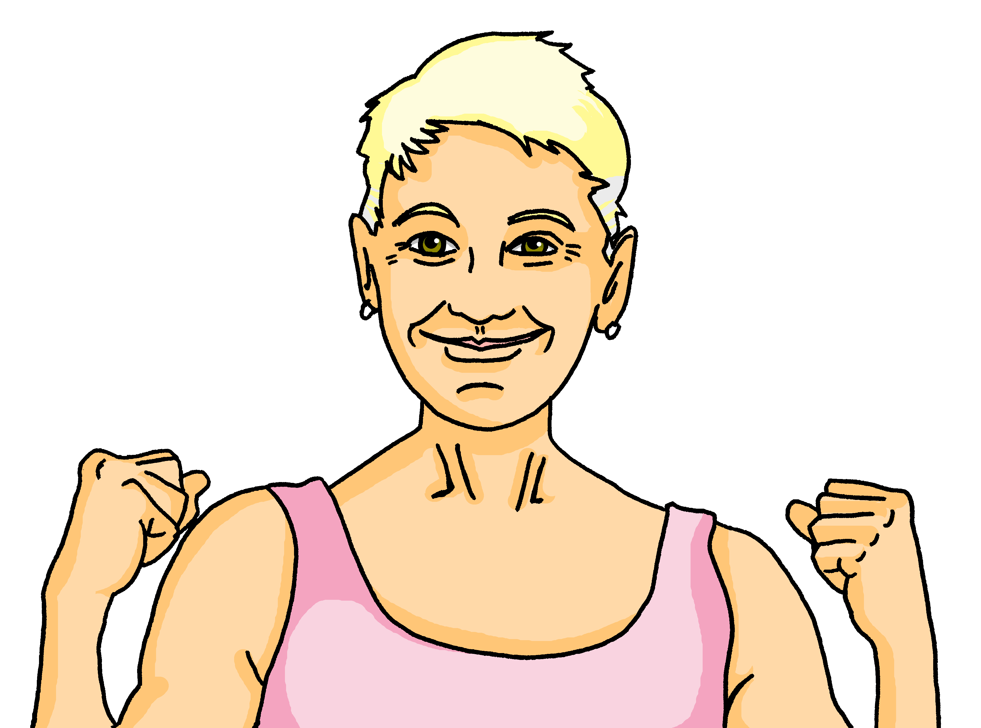
Interacting
Omas Party
blau
Follow ups 1-5
Term 1 Week 6
Notes:
Artwork by Steve Clarke. Pronoun pictures from NCELP (www.ncelp.org). All additional pictures selected from Pixabay and are available under a Creative Commons license, no attribution required.
Phonics:
long [i] Familie [329] Linie [926] ihn [92]
short [i] bitte [471] mit [13] Hilfe [481]
Vocabulary: suchen [293] tanzen [1497] trinken [634] genug [498] (plus language from week 5)
Revisit 1: mögen, ich mag, du magst, er/sie/es mag [168] Bilder [253] Bücher [300] Glas [885] Gläser [885] Lieder [1733] Morgen [621] Sommer [771] Winter [1206] Wörter [194]
Revisit 2: --
Jones, R.L & Tschirner, E. (2019). A frequency dictionary of German: Core vocabulary for learners. London: Routledge.
The frequency rankings for words that occur in this PowerPoint which have been previously introduced in these resources are given in the SOW and in the resources that first
introduced and formally re-visited those words.
For any other words that occur incidentally in this PowerPoint, frequency rankings will be provided in the notes field wherever possible.

Slide 2
aussprechen
long [i]
…
The 2nd ‘i’ is short.
Here’s the ‘e’ that sounds like the ‘a’ in ‘ago’, again!
Familie
Notes:
Timing: 1 minute
Aim: to introduce the SSC long [i].
Procedure:
Introduce the SSC and present the source word ‘Familie’ (with gesture, if using).
Click to bring on the picture and get pupils to repeat the word ‘Familie’ (with gesture, if using).
Note:
A gesture for ‘Familie’ might be to mime a roof overhead followed by a ‘heart’ shape with both hands.
Familie [49]
2

Slide 3
aussprechen
long [i]
…
Familie
Linie
ihn
Notes:
Timing: 1 minute
Aim: to introduce the SSC long [i].
Procedure:
Re-present the SSC and the source word ‘Familie’ (with gesture, if using).
Click to bring on the picture and get pupils to repeat the word ‘Familie’ (with gesture, if using).
Present the cluster words in the same way, bringing on the picture and getting pupils to pronounce the words.
ihn [52] Linie [451]
3

Slide 4
aussprechen
short [i]
…
🙏
bitte
Notes:
Timing: 1 minute
Aim: to consolidate the SSC short [i].
Procedure:
Procedure:
Introduce the SSC and present the source word ‘bitte’ (with gesture, if using).
Click to bring on the picture and get pupils to repeat the word ‘bitte’ (with gesture, if using).
Note: a gesture for ‘bitte’ might be to put your hands together as though asking for something.
bitte [471]
Image attribution: please emoji from https://emojipedia.org/folded-hands/

Slide 5
aussprechen
short [i]
…
bitte
with
🙏
Hilfe!
mit
Notes:
Timing: 1 minute
Aim: to consolidate the SSC short [i].
Procedure:
Re-present the SSC and the source word ‘bitte’ (with gesture, if using).
Click to bring on the picture and get pupils to repeat the word ‘bitte’ (with gesture, if using).
Present the cluster words in the same way, bringing on the picture and getting pupils to pronounce the words.
Note: a gesture for ‘bitte’ might be to put your hands together as though asking for something.
Hilfe [481] mit [13]

Slide 6
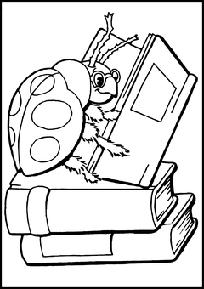
Follow up 1:
Sag die Zungenbrecher! Dann hör zu.
aussprechen
1
Immanuel der Igel wohnt in einem idealen Iglu.
20
Immanuel the hedgehog lives in an ideal igloo.
2
Ingos intelligentes Insekt ist in Innsbruck.
Ingo’s intelligent insect is in Innsbruck.
3
Ida spielt irische Instrumente mit Außerirdischen.
0
Ida plays Irish instruments with extraterrestrials (aliens!).
START
Notes:
Timing: 5 minutes
Aim: to practise oral production of the long and short [i] sounds in tongue-twister style sentences.
Procedure:
Pupils practise first in pairs, trying to pronounce the tongue-twisters, focusing on long and short [i].
Discuss meanings of tongue-twisters (using picture prompts to help) and show English translations.
Click to listen to the tongue twisters said by a native speaker at three different speeds: slow, medium, fast.
Give pupils more time practise saying them at whatever speed they can manage! Important to maintain clear pronunciation.

Slide 7
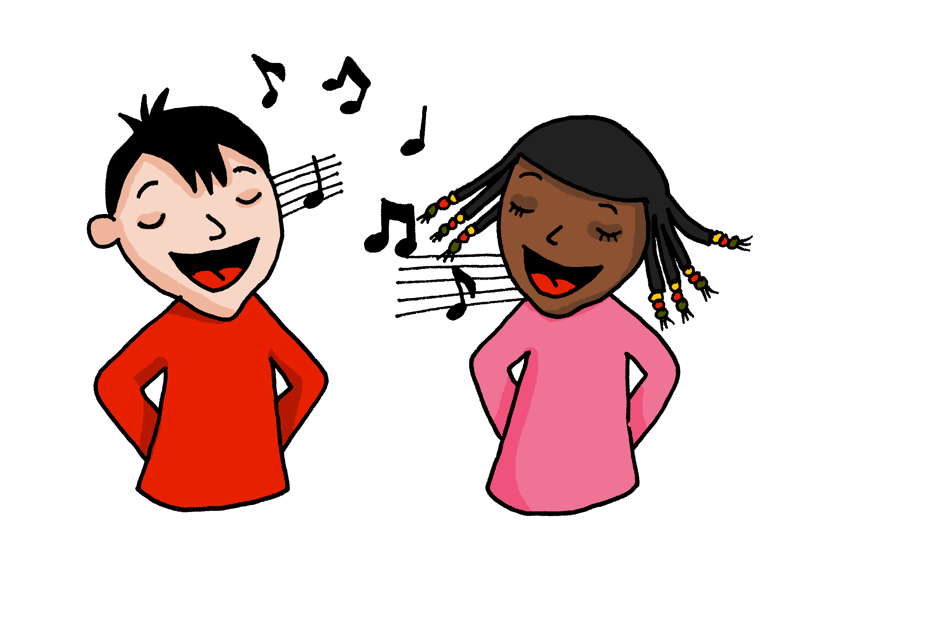
Follow up 2
Hör zu und sing mit.
Here is the first line of a song you know very well in English. Can you work out the meaning? Which song do you think it is?
Now you can see a full verse of the song ‘Happy Birthday’ in German. Listen to the music and sing along! The tune is the same as in English.
singen
Zum Geburtstag viel Glück Zum Geburtstag viel Glück Zum Geburtstag liebe Paula
Zum Geburtstag viel Glück.
Zum Geburtstag viel Glück Zum Geburtstag viel Glück Zum Geburtstag lieber Alex
Zum Geburtstag viel Glück.
Zum Geburtstag viel Glück Zum Geburtstag viel Glück Zum Geburtstag alles Gute
Zum Geburtstag viel Glück.
Zum Geburtstag viel Glück
zu or zum = to/at. How might we say zum Geburtstag in English?
Viel Glück = lots of luck
In English, we might say: Good luck!
Glück = luck
What could viel Glück mean?
Does Gute look like a word you know?
Alles Gute = everything/all good. In English we might say: All the best!
You have met the two words in bold before. Can you remember their meaning?
Geburtstag = birthday
viel = lots of
Is it somebody’s birthday today in your class? If so, sing Lieber/Liebe and their name here instead!
Many songs and poems put the words in an unusual order to make them fit better with the music.
Notes:
Timing: 5 minutes
Aim: to be introduced to the German version of the song Happy Birthday (tune will be familiar!), to understand the language in it, and to practise singing along with a recorded version.
Procedure:
Ask pupils to look at the first line of the song and see if they can work out a) the meaning of the words and b) which song it is.
Click to see explanations of the known and unknown vocabulary.
Discuss how songs can change the normal order of words to make them fit with the music or to help them rhyme.
Show them the full verse and give them time in pairs to practise reading aloud.
Listen to the song, and ask pupils to sing along. Repeat!
Video to sing Happy Birthday:
https://www.youtube.com/watch?v=fNUAqFRIMaE
Transcript: Zum Geburtstag viel Glück Zum Geburtstag viel Glück Zum Geburtstag alles Gute
Zum Geburtstag viel Glück.
Note: when you know the name of the person you are singing to, you replace ‘alles Gute’ with ‘Dear [name]’. Dear is ‘lieber’ (for a boy) and ‘liebe’ (for a girl), which of course aligns with many endings on words that pupils are already familiar with – welche(r), diese(r), der/die etc…

Slide 8
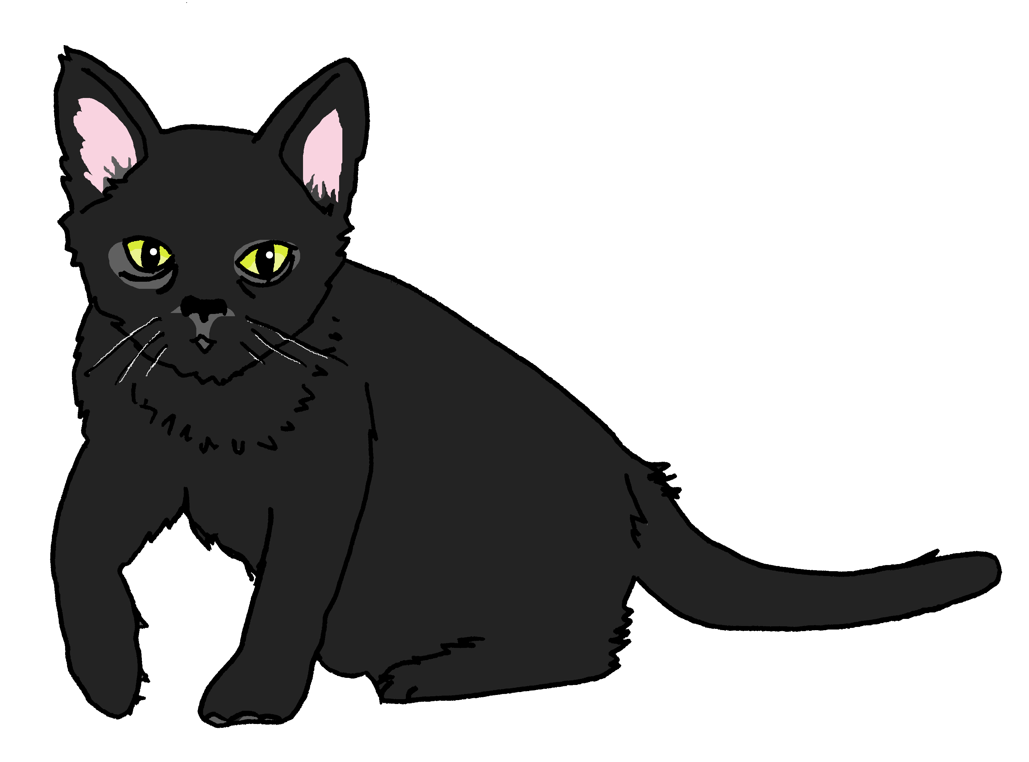
Follow up 3
Wie sagt man das…?
…
Miau!
Minze singt auch ‘Happy Birthday’!
sprechen
Remember that regular (weak) verbs in the present tense follow this pattern:
60
wir miauen
we meow?
miauen | to meow
ich miaue | I meow
du miaust | you meow
er, sie, es miaut | he, she, it meows
wir miauen | we meow
ihr miaut | you (all) meow
sie miauen | they meow
I meow?
___ _____
they meow?
Ich miaue
___ ______
S
sie miauen
___/___/__ ______
___ _______
you meow?
you all meow?
___ _______
du miaust
ihr miaut
___ _______
0
Wie sagt man:
she meows?
sie miaut
START
Notes:
Timing: 5 minutes
Aim: to practise all known verb endings with an unknown regular cognate verb.
Procedure:
Remind pupils that regular (weak) verbs all follow a certain pattern in the present tense. Can they remember the pattern?
Click to show them and hear the ‘ich’ form, then elicit the different forms from the class and click to reveal and listen.
Give pupils 60 seconds to try and pronounce all verb forms in pairs, then run through them again as a class.
Click to reveal English verbs forms one at a time in a random order and ask: Wie sagt man ‘he meows’ auf Deutsch? Wie sagt man ‘they meow’ auf Deutsch?
Additional task suggestions: 1. Pupils could practise this pattern with any other regular (weak) verbs they know. Each pair could choose a verb e.g. spielen; trinken; planen; gewinnen; bleiben; singen and write it out in full on mini whiteboards, then practise saying the different verb forms aloud.
2. You might like to introduce the verb ‘rappen’ – to rap- to keep with the musical theme of singing: ich rappe, du rappst, er rapt, wir rappen, ihr rapt, sie rappen.

Slide 9
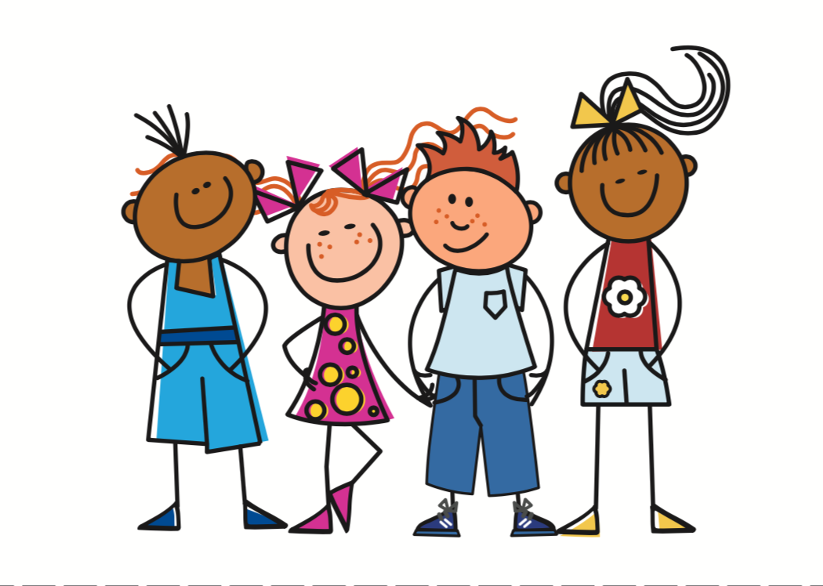
Follow up 4:
Partnerarbeit: wir sprechen!
…
Person A spricht.
sprechen
Person B findet das richtige Bild. Ist das eine Frage oder ein Satz?
Person A
Are you (all) drinking Fanta?
Person B
1) _____________________
[A] [B] ?
Trinkt ihr Fanta?
Are you all drinking Fanta?.
B
A
Notes:
Timing: 5-10 minutes
Aim: to practise receptive and productive knowledge of first and second person plural (wir/ihr) regular verbs and yes/no questions in present tense
Procedure: 1. Use this slide to model the task.
2. Pupil A produces the statement or question in German. Discuss with class how a statement and question will be different (word order).
3. Pupil B identifies the correct picture – (we or you (all)?), writes the English down, and identifies whether or not it is a question. Ensure that pupils are clear which image is ‘wir’ and which ‘ihr’.
4. Complete items 1-5 for partner A.
5. Then pupils swap roles and repeat the task. 6. See next slides for answers and handouts at the end of the presentation.
Note: pupils have learnt that the German present tense translates into present simple and present continuous in English. Here, as there are no adverbs many of the sentences/questions could be either present simple or continuous, so if pupils have given a different formulation in their answer, they can be reassured about this.

Slide 10
Round 1
…
Person A
1) We are dancing in the garden.
……………………………….
2) Are you (all) drinking cola?.
……………………………….
3) You (all) buy presents.
……………………………….
4) Are we winning the games?
……………………………….
5) Are we singing a song?
………………………………..
Person B
sprechen
[A] [B] ?
We dance/are dancing in the garden.
Wir tanzen im Garten.
Are you (all) drinking cola?
Trinkt ihr Cola?
You (all) buy/are buying presents.
Ihr kauft Geschenke.
Are we winning the games?
Gewinnen wir die Spiele?
Are we singing a song?
Singen wir ein Lied?
Notes:
ANSWERS ROUND 1

Slide 11
Round 2
…
Person B
1) We are playing football .
……………………………….
2) Do we need glasses?
……………………………….
3)You (all) are staying at home.
……………………………….
4)Are you (all) looking for Johanna?
……………………………….
5) We repeat the song.
………………………………..
Person A
sprechen
[A] [B] ?
Wir spielen Fußball.
We play / are playing football.
Brauchen wir Gläser?
Do we need glasses?
Ihr bleibt zu Hause.
You (all) are staying at home.
Are you (all) looking for Johanna?
Sucht ihr Johanna?
Wir wiederholen das Lied.
We repeat the song.
Notes:
ANSWERS ROUND 2

Slide 12
Follow up 5:

Schreib auf Englisch.
Can you get at least 15 points?
Wörter
 | der Sommer | die Wörter | die Gläser
 | die Lieder | der Winter | der Morgen
 | die Bücher | sie mag | du magst
 | ich mag | die Bilder | mögen
 | genug | suchen | trinken
Vokabeln
(the) summer
(the) words
(the) glasses
x3
(the) songs
(the) winter
(the) morning
x2
(the) books
she likes
you like
I like
(the) pictures
to like
x1
to search, look for
to drink, drinking
enough
Notes:
Timing: 5 minutes
Aim: to practise written comprehension of vocabulary from this and revisited weeks.
Procedure: 1. Give pupils a blank grid. They fill in the English meanings of any of the words they know, trying to reach 15 points in total.
2. Click to reveal answers from the bottom left up.
Note: The most recently learnt and practised words are pink, words from the previous week are green and those from week 1 are blue, thus more points are awarded for them, to recognise that memories fade and more effort (heavy lifting!) is needed to retrieve them.

Slide 13
Follow up 5:

Schreib auf Deutsch.
Can you get at least 15 points?
Wörter
 | (the) summer | (the) winter | (the) words
 | (the) glasses | (the) songs | (the) morning
 | She likes | (the) pictures | (the) books
 | to like | I like | You like
 | to look for | to drink | enough
der Sommer
der Winter
die Wörter
Vokabeln
x3
die Gläser
die Lieder
der Morgen
x2
sie mag
die Bilder
die Bücher
mögen
ich mag
du magst
x1
suchen
trinken
genug
Notes:
Timing: 5 minutes
Aim: to practise written production of vocabulary from this and revisited weeks.
Procedure: 1. Give pupils a blank grid. They fill in the German meanings of any of the words they know, trying to reach 15 points in total. 2. Remind pupils to think about genders and plural forms of nouns.
Note: The most recently learnt and practised words are pink, words from the previous week are green and those from week 1 are blue, thus more points are awarded for them, to recognise that memories fade and more effort (heavy lifting!) is needed to retrieve them.

Slide 14
Tschüss!
blau
Notes:
14

Slide 15
Person A
…
sprechen
Person A
We are dancing in the garden.
……………………………….
2) Are you (all) drinking cola?
……………………………….
3) You (all ) buy presents.
……………………………….
4) Are we winning the games?
……………………………….
5) Are we singing a song?
………………………………..
Person A
[A] [B] ?
Notes:
HANDOUT Person A

Slide 16
Person B
…
Round 1
Round 2
Person B
sprechen
Person B
1) We are playing football .
……………………………….
2) Do we need glasses?
……………………………….
3)You (all) are staying at home.
……………………………….
4)Are you (all) looking for Johanna?
……………………………….
5) We repeat the song.
………………………………..
[A] [B] ?
Notes:
Handout Person B

Slide 17
Follow up 5:

Schreib auf Englisch.
Can you get at least 15 points?
Wörter
 | der Sommer | die Wörter | die Gläser
 | die Lieder | der Winter | der Morgen
 | die Bücher | sie mag | du magst
 | ich mag | die Bilder | mögen
 | genug | suchen | trinken
Vokabeln
x3
x2
x1
Notes:
HANDOUT

Slide 18
Follow up 5:

Schreib auf Deutsch.
Can you get at least 15 points?
Wörter
 | (the) summer | (the) winter | (the) words
 | (the) glasses | (the) songs | (the) morning
 | She likes | (the) pictures | (the) books
 | to like | I like | You like
 | to look for | to drink | enough
Vokabeln
x3
x2
x1
Notes:
HANDOUT

