Slide 1
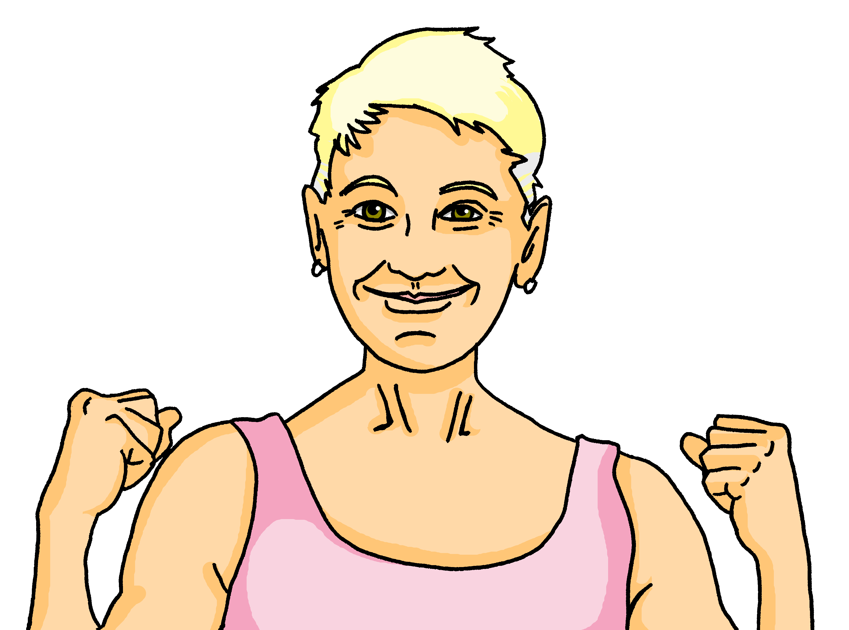
Interacting
Omas Party
blau
Present tense
yes/no and wh-word questions
SSC long & short [i]
Term 1 Week 6
Notes:
Artwork by Steve Clarke. Pronoun pictures from NCELP (www.ncelp.org). All additional pictures selected from Pixabay and are available under a Creative Commons license, no
attribution required.
Phonics:
long [i] Familie [329] Linie [926] ihn [92]
short [i] bitte [471] mit [13] Hilfe [481]
Vocabulary: suchen [293] tanzen [1497] trinken [634] genug [498] (plus language from week 5)
Revisit 1: mögen, ich mag, du magst, er/sie/es mag [168] Bilder [253] Bücher [300] Glas [885] Gläser [885] Lieder [1733] Morgen [621] Sommer [771] Winter [1206] Wörter [194]
Revisit 2: --
Jones, R.L & Tschirner, E. (2019). A frequency dictionary of German: Core vocabulary for learners. London: Routledge.
The frequency rankings for words that occur in this PowerPoint which have been previously introduced in these resources are given in the SOW and in the resources that first introduced and formally re-visited those words.
For any other words that occur incidentally in this PowerPoint, frequency rankings will be provided in the notes field wherever possible.
Remember that at the start of the course (first three lessons of Rot/Gelb) pupils learnt language (for greetings and register taking) that can still be part of the lesson routines in upper KS2 (Blau/Grün). They are not re-taught, as we anticipate that teachers have built these in from early in lower KS2.
1

Slide 2
aussprechen
long [i]
…
The 2nd ‘i’ is short.
Here’s the ‘e’ that sounds like the ‘a’ in ‘ago’, again!
Familie
Notes:
Timing: 1 minute
Aim: to introduce the SSC long [i].
Procedure:
Introduce the SSC and present the source word ‘Familie’ (with gesture, if using).
Click to bring on the picture and get pupils to repeat the word ‘Familie’ (with gesture, if using).
Note:
A gesture for ‘Familie’ might be to mime a roof overhead followed by a ‘heart’ shape with both hands.
Familie [49]
2

Slide 3
aussprechen
long [i]
…
Familie
Linie
ihn
Notes:
Timing: 1 minute
Aim: to introduce the SSC long [i].
Procedure:
Re-present the SSC and the source word ‘Familie’ (with gesture, if using).
Click to bring on the picture and get pupils to repeat the word ‘Familie’ (with gesture, if using).
Present the cluster words in the same way, bringing on the picture and getting pupils to pronounce the words.
ihn [52] Linie [451]
3

Slide 4
aussprechen
short [i]
…
🙏
bitte
Notes:
Timing: 1 minute
Aim: to consolidate the SSC short [i].
Procedure:
Introduce the SSC and present the source word ‘bitte’ (with gesture, if using).
Click to bring on the picture and get pupils to repeat the word ‘bitte’ (with gesture, if using).
Note: a gesture for ‘bitte’ might be to put your hands together as though asking for something.
bitte [471]
Image attribution: please emoji from https://emojipedia.org/folded-hands/

Slide 5
aussprechen
short [i]
…
bitte
with
🙏
Hilfe!
mit
Notes:
Timing: 1 minute
Aim: to consolidate the SSC short [i].
Procedure:
Re-present the SSC and the source word ‘bitte’ (with gesture, if using).
Click to bring on the picture and get pupils to repeat the word ‘bitte’ (with gesture, if using).
Present the cluster words in the same way, bringing on the picture and getting pupils to pronounce the words.
Note: a gesture for ‘bitte’ might be to put your hands together as though asking for something.
Hilfe [481] mit [13]

Slide 6
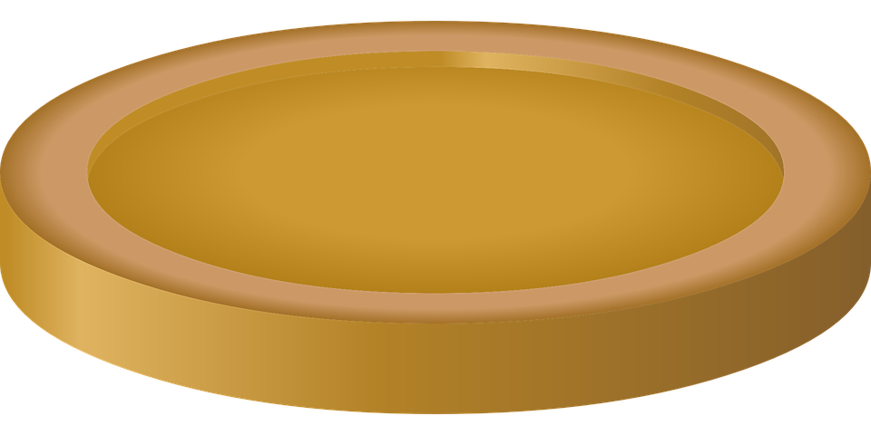
prononcer
Sag die Wörter und sammle* das Geld.
sammeln - to collect
das Geld - money
aussprechen
aussprechen
Musik
ihn
60
Film
Finger
Tourist
Linie
Kilo
S
Idee
ideal
privat
Tisch
Hilfe
Zimmer
Juli
0
gewinnen
sitzen
bitte
Start
Notes:
Timing: 2 minutes [2 rounds]
Aim: To practise the pronunciation of words with long or short [i].
Procedure:
Pupils work in pairs to practise pronunciation.
Pupil A starts from either ‘Tourist’, ‘Idee’ or ‘bitte’, and follows the path to pronounce the words and collect the corresponding coins in 60 seconds. Pupil B listens and notes down the number of coins for his/her partner.
Repeat with pupils switching roles. Who has the most gold?
Click on each word to hear it pronounced, as required.
6

Slide 7
Vokabeln
Sag die Wörter. Wie heißt das auf Englisch?
Wörter
genug
[enough]
suchen
trinken
[to look for]
[to drink]
Notes:
Timing: 2 minutes
Aim: to present and practise new vocabulary for this week.
Procedure:
Click to present the German word and pupils repeat the word.
Click to present the English meaning and image. Pupils repeat the German meaning.
Click to remove the English meaning and image. Pupils recall the English meaning.
Click to remove the German meaning. Pupils recall the German meaning.
7

Slide 8
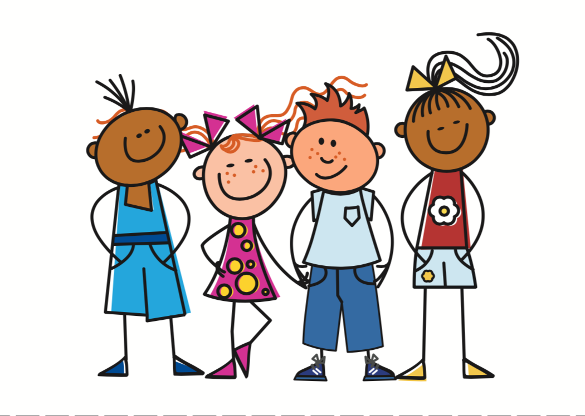
Present tense: ihr (you all)
You have practised the endings for plural subjects ‘we’ and ‘they’:
Wir singen Lieder.
We sing/are singing songs.
Sie singen Lieder.
They sing/are singing songs.
Both these plural forms are the same as the infinitive.
To say ihr (you all) + regular verb:
Ihr singt Lieder.
You (all) sing/are singing songs.
This is ‘you’ for talking to more than one person you know well or who is the same age as you.
Notes:
Timing: 2 minutes
Aim: to present the 2nd person plural form (‘you all’) of regular present tense.
Procedure:
Click through the animations to present the new information.
Elicit English translation for the German examples provided.
8

Slide 9
hören
Omas Party
Nearly time for the party but still lots to do! Mum and Dad help…
Was sagt Maike? Was machen Maike und Steffen (wir) und Johanna und Moritz (ihr)?
 | wir (we) | ihr (you all) | activity?
1
look for the glasses
1
2
2
drive/go into town; don’t have enough Fanta
3
3
also buy the present
4
4
help Grandad in the garden
5
5
plan the party games
6
6
write the birthday card
Notes:
Timing: 8 minutes
Aim: to practise aural comprehension of 1st and 2nd person plural (we and you (all)) verb forms in the present tense.
Procedure:
1. Click to play number 1 as an example. Pupils note down whether the activity is being done by ‘we’ or ‘you all’ by listening carefully to the verb ending ‘en’ or ‘t’. They also note down in English what the activity is.
2. Repeat for numbers 2-6.
3. Click to reveal answers.
4. Extra: Can pupils accurately recreate the German sentences when giving answers?
Transcript:
1. Also, [ihr] sucht die Gläser.
2. [Wir] fahren in die Stadt. [Wir] haben nicht genug Fanta.
3. [Wir] kaufen auch das Geschenk.
4. [Ihr] helft Opa im Garten. 5. [Ihr] plant die Partyspiele. 6. Und [ihr] schreibt die Geburtstagskarte.
9

Slide 10
Fragen
To ask yes/no questions in German, you know to swap the verb and subject:
Wir singen Lieder.
We sing/are singing songs.
Singen wir Lieder?
Do we sing songs? Are we singing songs?
And remember! To ask a wh-question, just add a question word in front.
Wo singen wir Lieder?
Where do we sing songs? Where are we singing songs?
Wann singen wir Lieder?
When do we sing songs? When are we singing songs?
Notes:
Timing: 2 minutes
Aim: to remind pupils about subject-verb inversion questions and wh-questions in German.
Procedure:
Click through the animations to present the new information.
Elicit English translation for the German examples provided.
10

Slide 11
lesen
Maike textet mit Johanna. Was passiert* auf der Party?
Wer macht was? Schreib ‘wir’ (we) oder ‘ihr’ (you all)’.
*passiert –
is happening
1. Was macht ihr im Moment?
4. Ach, ja. Das Spiel ist zu Ende. Wir trinken jetzt Cola…
Was?!
__
__
2. Fußball!
Also, wir spielen Fußball und Oma
ist die Trainerin!
7. Mutti wo bist du?
Was macht ihr ?
__
__
5. Das ist gut. Ihr sitzt und trinkt…
__
8.Wir kaufen Fanta und Geschenke! Wir kommen jetzt…
__
3. Was? Sitzt ihr
nicht mit Oma im Garten?
__
6. Ähm… nein, jetzt singen und tanzen wir mit Oma…
__
__
Notes:
Timing: 6 minutes
Aim: to practise written comprehension of 1st and 2nd person plural (we and you (all)) verb forms in the present tense.
Procedure:
Explain the scenario: Maike & Stefan have gone shopping and still aren’t back but the party has started. Maike exchanges information about what is happening at the party with Johanna.
Pupils identify the correct subject (wir-we) or (ihr-you all) from the verb form used.
Pupils make notes on what Oma/the children/the party guests are doing, and what Maike & Stefan (parents) are doing.
Elicit oral translations of each message.
Vocabulary: texten [>5009]
Jones, R.L & Tschirner, E. (2019). A frequency dictionary of German: Core vocabulary for learners. London: Routledge.
11

Slide 12
schreiben
Maike und Johanna sprechen über die Party.
Was ist die Frage? Was ist die Antwort? Schreib die richtige Verbform.
 | Frage | Antwort
1 | Spielt ihr Fussball? | Ja! Wir spielen Fussball.
2 | Kauft ihr Cola? | Nein. Wir kaufen Fanta.
3 | Wo tanzt ihr? | Wir tanzen im Garten.
4 | Singt ihr ein Lied? | Ja, wir singen!
5 | Wo sitzt ihr? | Wir sitzen im Garten.
6 | Was schreibt ihr? | Wir schreiben eine Geburtstagskarte.
1
2
3
4
5
6
Notes:
Timing: 6 minutes
Aim: to practise written production of the ‘wir’ and ‘ihr’ forms of the verb in the context of asking and answering questions.
Procedure:
Explain to pupils that Maike and Johanna are continuing their conversation about the party.
Pupils must complete the answers (numbers 1-3) using the ‘wir’ form of the verb and the questions (numbers 4-6) using the ‘ihr’ form of the verb.
Note: For numbers 3 & 6, pupils are also expected to write the pronoun.
Elicit translations of each question & answer pair.
If time allows, pupils could practise the questions and answers in pairs, changing details if they can. E.g. Spielt ihr Fussball? Nein! Wir spielen Partyspiele!
12

Slide 13
Tschüss!
blau
Notes:
13

