Slide 1
Describing me and others
Frohe Weihnachten
Vocab and Grammar quiz
Christmas activities
rot
Term 1 Week 13
Notes:
Artwork by Steve Clarke. All additional pictures selected from Pixabay and are
available under a Creative Commons license, no attribution required.
Word frequency (1 is the most frequent word in German):
Jones, R.L & Tschirner, E. (2019). A frequency dictionary of German: Core vocabulary for learners. London: Routledge.
The frequency rankings for words that occur in this PowerPoint which have been previously introduced in these resources are given in the SOW and in the resources that first introduced and formally re-visited those words. For any other words that occur incidentally in this PowerPoint, frequency rankings will be provided in the notes field wherever possible.
1

Slide 2
hören
Robbie is from another planet. They like earth and speaking German but often forget word meanings, spellings and things like gender and verb forms. Help Robbie by answering the questions in this quiz.
Vocabulary
A For each question, put a cross (x) under the English meaning that matches what you hear. You will hear each German word twice. Choose one correct answer only. (4 points on this slide)
 | A | B | C | D
 | goodbye | also, too | Germany | book
 | ☐ | ☐ | ☐ | ☐
2. | to be | day | England | your
 | ☐ | ☐ | ☐ | ☐
3. | it | false | shape | no
 | ☐ | ☐ | ☐ | ☐
4. | human being | house | how | place
 | ☐ | ☐ | ☐ | ☐
1
2
3
4
Notes:
1/2.
Timing: 20-25 minutes (all assessment slides)
Aim: to practise aural comprehension of vocabulary taught in weeks 1-12 of the course.
Procedure:
1. Click the audio buttons to play each item. (The words are recorded twice with a pause to allow pupils to process the information).
2. Pupils can either write 1C, etc.. or if they have the assessment on a print out they can put a X in the correct box.
3. After items 1-4, continue to the next slide to complete the remainder of the task.
Transcript:
Deutschland
sein
falsch
wie
2

Slide 3
hören
A - continued. (4 points on this slide)
 | A | B | C | D
 | right | red | yellow | board
 | ☐ | ☐ | ☐ | ☐
 | dot, point, full stop | animal | and | bag
 | ☐ | ☐ | ☐ | ☐
 | bye | down, below | great | he
 | ☐ | ☐ | ☐ | ☐
 | or | left | yes | right, on the right
 | ☐ | ☐ | ☐ | ☐
5
6
7
8
Notes:
2/2.
Transcript:
gelb
Tasche
er
links
3

Slide 4
hören
B For each question, put a cross (x) under the type of word you hear. You will hear each German word twice. Choose one correct answer only. (4 points on this slide)
This word is a good example of …
 | A | B | C | D
1. | a country ☐ | a person ☐ | an animal ☐ | an object ☐
2. | an object ☐ | a description ☐ | a question word ☐ | a country ☐
3. | an animal ☐ | an object ☐ | a person ☐ | a question word ☐
4. | a question word ☐ | a country ☐ | a location ☐ | a greeting ☐
1
2
3
4
Notes:
1/2
Procedure:
1. Click the audio buttons to play each item. (The words are recorded twice with a pause to allow pupils to process the information).
2. Pupils can either write 1C, etc.. or if they have the assessment on a print out they can put a X in the correct box.
3. Continues on next slide.
Transcript:
Freundin
wo
Haustier
Hallo
4

Slide 5
hören
B continued. (4 points on this slide)
This word is a good example of …
 | A | B | C | D
1. | an object ☐ | a greeting ☐ | a person ☐ | a country ☐
2. | a greeting ☐ | an object ☐ | an animal ☐ | a person ☐
3. | a location ☐ | a country ☐ | a greeting ☐ | a question word ☐
4. | an object ☐ | an animal ☐ | a person ☐ | a description ☐
5
6
7
8
Notes:
2/2
Transcript:
du
Ding
oben
gut
5

Slide 6
lesen
C Help Robbie to translate the underlined German word(s) to complete each English sentence. (6 points on this slide)
lesen
1. Guten Tag Finn! ________________ Finn!
2. Wo ist das Heft? Where is _____ exercise book/notebook?
3. Der Fußball ist da. The ______________ is there.
4. Emma ist hier. Emma is ____________.
5. Wie geht’s? _____________________ ?
6. Das Fenster ist groß. The ___________ is _________ .
Notes:
Aim: to practise written recall of previously taught vocabulary.
Procedure:
Ensure that the task is clear.
Pupils could write 1 – 6 and the individual English word meanings (or they could fill in if they have printed assessment sheets).
6

Slide 7
schreiben
D Translate the underlined English words to complete the German sentence. (8 points on this slide, 2 each for items 5 and 6)
schreiben
1. The example is clear. Das Beispiel ist _______ . (write one word)
2. What is that? _______ ist das? (write one word)
3. The pencil is not blue. Der Bleistift ist ______ blau. (write one word)
4. I am big. Ich _____ groß. (write one word)
5. My (male) friend is here. Mein _______ ist hier. (write one word)
6. She is small. ____ ist ______. (write two words)
Notes:
Aim: to practise written recall of previously taught vocabulary.
Procedure:
Ensure that the task is clear.
Pupils could write 1 – 6 and the individual English word meanings (or they could fill in if they have printed assessment sheets).
7

Slide 8
lesen
Grammar
A Put a (X) next to the person the sentence is about. (3 points on this slide)
lesen
1 | ☐ I ☐ you _{[singular]} ☐ she/he | …bist klein.
2 | ☐ I ☐ you _{[singular]} ☐ she/he | …bin groß.
3 | ☐ I ☐ you _{[singular]} ☐ she/he | …ist da.
Notes:
Aim: to practise written understanding of previously taught grammar features.
Procedure:
Ensure that the task is clear.
Pupils could write 1 – 3 and the correct English pronoun (or they could fill in if they have printed assessment sheets).
8

Slide 9
lesen
B Add a full stop (.) or a question mark (?) next to each sentence to show whether it is a statement or a question. (2 points on this slide)
lesen
1. Der Tisch ist hier
2. Ist die Flasche da
Notes:
Aim: to practise understanding of previously taught grammar (word order) features.
Procedure:
Ensure that the task is clear.
Pupils could write 1 – 3 and the correct punctuation mark, or they could fill in the boxes if they have printed assessment sheets).
9

Slide 10
lesen
C Choose which noun completes each phrase. (3 points on this slide)
lesen
1 | meine | ☐ Punkt (m) ☐ Tafel (f)
2 | mein | ☐ Schule (f) ☐ Foto (nt)
3 | mein | ☐ Bleistift (m) ☐ Farbe (f)
Notes:
Aim: to practise written understanding of previously taught grammar features.
Procedure:
Ensure that the task is clear.
Pupils could write 1 – 3 and the correct word, or they could fill in the boxes if they have printed assessment sheets).
10

Slide 11
lesen
D Decide whether each sentence is true or false based on the picture. (2 points on this slide)
lesen
1. Die Flasche ist nicht blau. True False
2. Das ist die Schule. True False
Notes:
Aim: to practise written understanding of previously taught grammar features.
Procedure:
Ensure that the task is clear.
Pupils could write 1 – 2 and true or false, or they could circle one of true or false if they have printed assessment sheets.
11

Slide 12
schreiben
E Write the German word for ‘a’.
(3 points for section E)
schreiben
1. _______ Tier (nt) 2. _______ Person (f)
3. _______ Mensch (m)
F Write the German word for ‘the’.
(3 points for section F)
1. ______ Form (f) 2. ______ Ort (m)
3. ______ Buch (nt)
Notes:
Aim: to practise written recall of previously taught vocabulary.
Procedure:
Ensure that the task is clear.
Pupils could write 1 – 6 and the individual English word meanings (or they could fill in if they have printed assessment sheets).
12

Slide 13
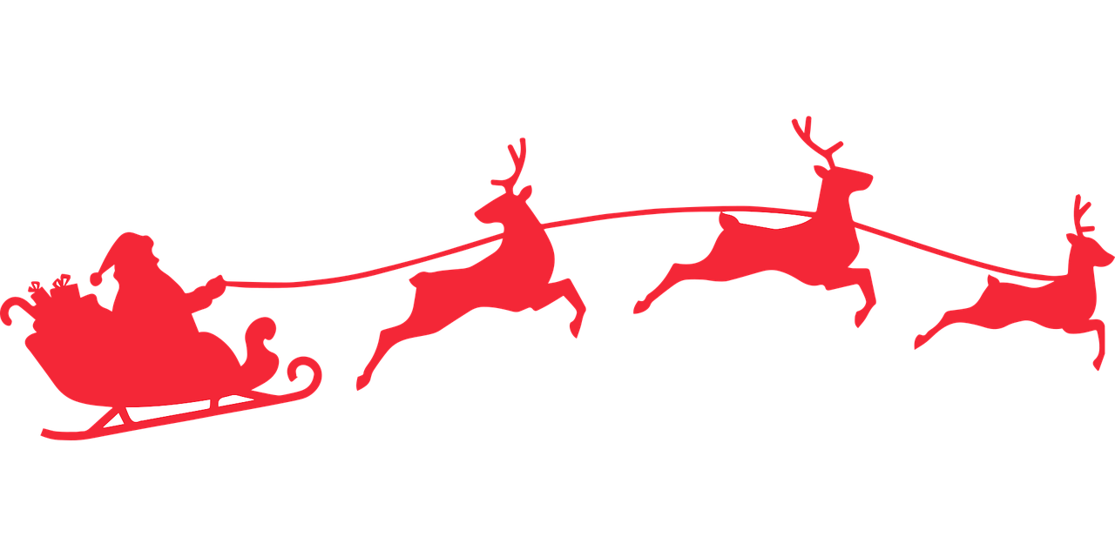
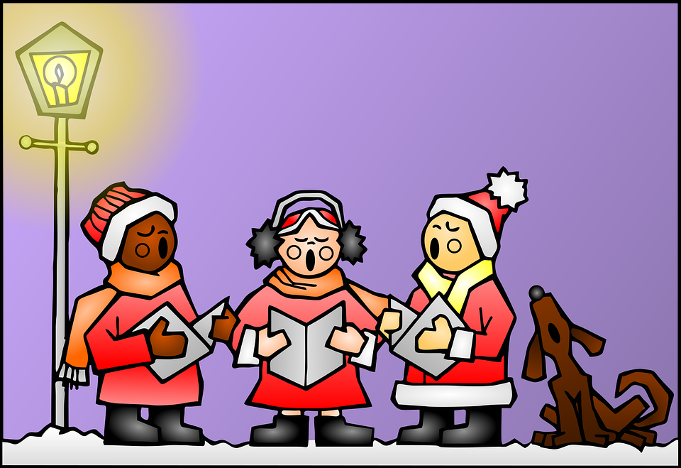
hören
Ein Weihnachtslied!
A Listen and fill in.
B Then, read and sing!
Morgen kommt der Weihnachtsmann
kommt mit seinen Ga ben.
B i lderbücher, Malpapier,
Ei senbahn und Panthert ie r,
und ein richtige s Klavier
mö ch ten wir gern haben.
Tomorrrow comes the ‘Christmas man’
comes to us with his gifts.
Picture books, drawing papee,
a trainset and a soft toy panther,
and a real piano
that’s what we’d like to have.
_
_
_
__
__
_
__
_
der Weihnachtsmann – Literally: “Christmas man”!
What would we call the “Christmas man” in English?
Notes:
Timing: flexible
Note: the majority of this lesson will be taken up with the vocabulary and grammar parts of the assessment. However, this Christmas carol can fit in either at the end of this week’s lesson or in the follow up time this week. There are no other follow up materials this week, as we anticipate schools will be busy at this time of term. The song would make a good addition to a Christmas assembly.
Aim: to enjoy a German Christmas song; to listen out for key SSC and transcribe them; to join in with the song whilst listening and reading.
NB: creative, not literal translation.
Song with text: https://www.youtube.com/watch?v=4JSOmSsv4zc
Handout with words: http://www.ac-grenoble.fr/ecoles/bv/IMG/pdf/canon_de_noel.pdf
Procedure: 1. Play the first verse of the YouTube video with sound only (without showing the video). Pupils listen and fill in the missing letters. 2. Click to reveal answers. 3. Play whole video so pupils can join in with the song.
Note: The whole song lyrics are available below the YouTube video if you click ‘Show more’.
13

Slide 14
Tschüss!
rot
Quiz answers below
Notes:
this slide has an audio-fied Tschüss
14

Slide 15
hören
Robbie is from another planet. They like earth and speaking German but often forget word meanings, spellings and things like gender and verb forms. Help Robbie by answering the questions in this quiz.
Vocabulary
A For each question, put a cross (x) under the English meaning that matches what you hear. You will hear each German word twice. Choose one correct answer only. (4 points on this slide)
 | A | B | C | D
1. | goodbye | also, too | Germany | book
 | ☐ | ☐ | ☐ | ☐
2. | to be | day | England | your
 | ☐ | ☐ | ☐ | ☐
3. | it | false | shape | no
 | ☐ | ☐ | ☐ | ☐
4. | human being | house | how | place
 | ☐ | ☐ | ☐ | ☐
1
2
3
4
Notes:
Answers
Procedure for all answers slides: Click for the animated answers to appear.
1/2.
Transcript
Deutschland
sein
falsch
wie
15

Slide 16
hören
A - continued. (4 points on this slide)
 | A | B | C | D
 | right | red | yellow | board
 | ☐ | ☐ | ☐ | ☐
 | dot, point, full stop | animal | and | bag
 | ☐ | ☐ | ☐ | ☐
 | bye | down, below | great | he
 | ☐ | ☐ | ☐ | ☐
 | or | left | yes | right, on the right
 | ☐ | ☐ | ☐ | ☐
5
6
7
8
Notes:
Answers
2/2.
Transcript:
gelb
Tasche
er
links
16

Slide 17
hören
B For each question, put a cross (x) under the type of word you hear. You will hear each German word twice. Choose one correct answer only. (4 points on this slide)
This word is a good example of …
 | A | B | C | D
1. | a country ☐ | a person ☐ | an animal ☐ | an object ☐
2. | an object ☐ | a description ☐ | a question word ☐ | a country ☐
3. | an animal ☐ | an object ☐ | a person ☐ | a question word ☐
4. | a question word ☐ | a country ☐ | a location ☐ | a greeting ☐
1
2
3
4
Notes:
Answers
1/2
Transcript:
Freundin
wo
Haustier
Hallo
17

Slide 18
hören
B continued. (4 points on this slide)
This word is a good example of …
 | A | B | C | D
1. | an object ☐ | a greeting ☐ | a person ☐ | a country ☐
2. | a greeting ☐ | an object ☐ | an animal ☐ | a person ☐
3. | a location ☐ | a country ☐ | a greeting ☐ | a question word ☐
4. | an object ☐ | an animal ☐ | a person ☐ | a description ☐
5
6
7
8
Notes:
Answers
2/2
Transcript:
du
Ding
oben
gut
18

Slide 19
lesen
C Help Robbie to translate the underlined German word(s) to complete each English sentence. (6 points on this slide)
lesen
1. Guten Tag Finn! ________________ Finn!
2. Wo ist das Heft? Where is _____ exercise book/notebook?
3. Der Fußball ist da. The ______________ is there.
4. Emma ist hier. Emma is __________.
5. Wie geht’s? _____________________ ?
6. Das Fenster ist groß. The ___________ is _________ .
Hello
the
football
here
How‘s it going
window
big
Notes:
Answers
19

Slide 20
schreiben
D Translate the underlined English words to complete the German sentence. (8 points on this slide, 2 each for items 5 and 6)
schreiben
1. The example is clear. Das Beispiel ist _______ . (write one word)
2. What is that? _______ ist das? (write one word)
3. The pencil is not blue. Der Bleistift ist ______ blau. (write one word)
4. I am big. Ich _____ groß. (write one word)
5. My (male) friend is here. Mein _______ ist hier. (write one word)
6. She is small. ____ ist ______. (write two words)
klar
Was
nicht
bin
Freund
Sie
klein
Notes:
Answers
20

Slide 21
lesen
Grammar
A Put a (X) next to the person the sentence is about. (3 points on this slide)
lesen
1 | ☐ I ☐ you _{[singular]} ☐ she/he | …bist klein.
2 | ☐ I ☐ you _{[singular]} ☐ she/he | …bin groß.
3 | ☐ I ☐ you _{[singular]} ☐ she/he | …ist da.
Notes:
Answers
21

Slide 22
lesen
B Add a full stop (.) or a question mark (?) next to each sentence to show whether it is a statement or a question. (2 points on this slide)
lesen
.
1. Der Tisch ist hier
?
2. Ist die Flasche da
Notes:
Answers
22

Slide 23
lesen
C Choose which noun completes each phrase. (3 points on this slide)
lesen
1 | meine | ☐ Punkt (m) ☐ Tafel (f)
2 | mein | ☐ Schule (f) ☐ Foto (nt)
3 | mein | ☐ Bleistift (m) ☐ Farbe (f)
Notes:
Answers
23

Slide 24
lesen
D Decide whether each sentence is true or false based on the picture. (2 points on this slide)
lesen
1. Die Flasche ist nicht blau. True False
2. Das ist die Schule. True False
Notes:
Answers
24

Slide 25
schreiben
E Write the German word for ‘a’.
(3 points for section E)
schreiben
1. _______ Tier (nt) 2. _______ Person (f)
3. _______ Mensch (m)
ein
eine
ein
F Write the German word for ‘the’.
(3 points for section F)
1. ______ Form (f) 2. ______ Ort (m)
3. ______ Buch (nt)
die
der
das
Notes:
Answers
25

