Slide 1
Describing me and others
Frohe Weihnachten
rot
Phonics quiz
Christmas activities
Term 1 Week 14
Notes:
Word frequency (1 is the most frequent word in German):
Jones, R.L & Tschirner, E. (2019). A frequency dictionary of German: Core vocabulary for learners. London: Routledge.
The frequency rankings for words that occur in this PowerPoint which have been previously introduced in these resources are given in the SOW and in the resources that first introduced and formally re-visited those words. For any other words that occur incidentally in this PowerPoint, frequency rankings will be provided in the notes field wherever possible.
1

Slide 2
aussprechen
long
[u]
short
[u]
aussprechen
tun
uns
[to do]
[us]
Notes:
1/8
slides 2-9: Phonics assessment slides.
Procedure:
1. Pupils pronounce SSCs of unknown words. Assessment sheet is provided on slide 10. Independent work activity is provided on slide 10.
Word frequency (1 is the most frequent word in German):
tun [123] uns [75]
2

Slide 3
aussprechen
long
[a]
short
[a]
aussprechen
Jahr
machen
[year]
[to make]
Notes:
2/8
Word frequency (1 is the most frequent word in German):
Jahr [53] machen [58]
3

Slide 4
aussprechen
long
[o]
short
[o]
aussprechen
so
von
[so]
[from]
Notes:
3/8
Word frequency (1 is the most frequent word in German):
so [28] von [9]
4

Slide 5
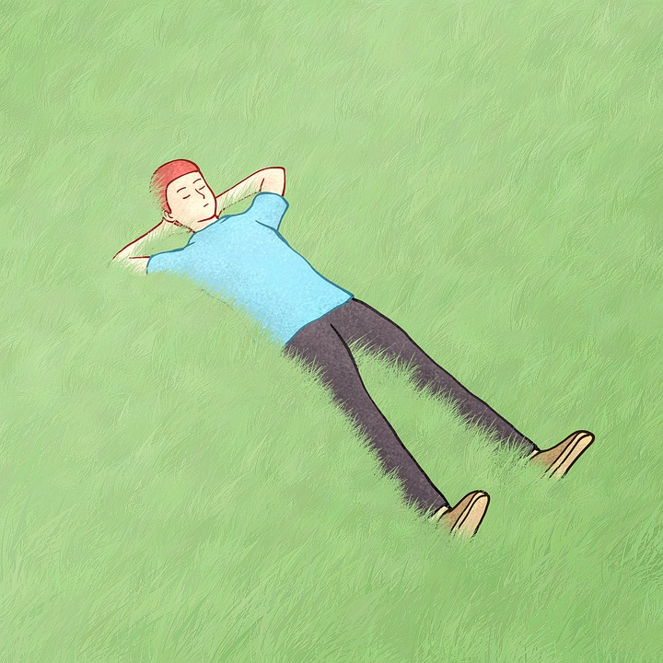
aussprechen
[ei]
[ie]
aussprechen
weil
liegen
[because]
[to lie]
Notes:
4/8
Word frequency (1 is the most frequent word in German):
liegen [107] weil [988
5

Slide 6
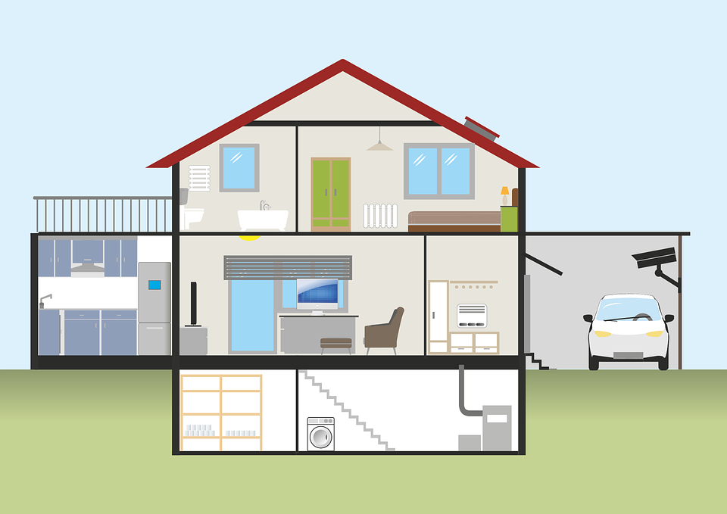
aussprechen
long
[e]
short [e]
aussprechen
leben
denn
[to live]
[then, because]
Notes:
5/8
Word frequency (1 is the most frequent word in German):
denn [93] leben [98]
6

Slide 7
aussprechen
long
[i]
short
[i]
aussprechen
ihm
finden
[him]
[to find]
Notes:
6/8
Word frequency (1 is the most frequent word in German):
finden [103] ihm [91]
7

Slide 8
aussprechen
[w]
[z]
aussprechen
wer?
zeigen
[who?]
[to show]
Notes:
7/8
Word frequency (1 is the most frequent word in German):
wer [149] zeigen [136]
8

Slide 9
aussprechen
soft [ch]
hard [ch]
aussprechen
dich
Sache
[you, to you]
[thing]
Notes:
8/8
Word frequency (1 is the most frequent word in German):
dich [217] Sache [318]
9

Slide 10
aussprechen
Pupil name:
Pupil name:
SSC and word | px
tun
uns
Jahr
machen
so
von
weil
liegen
leben
denn
ihm
finden
wer?
zeigen
dich
Sache
SSC and word | px
tun
uns
Jahr
machen
so
von
weil
liegen
leben
denn
ihm
finden
wer?
zeigen
dich
Sache
Notes:
Pupil feedback and assessment sheet
10

Slide 11
A message!
c
t
e
r
o
F
h
W
i
n
a
1. Use the colours to decipher the message:
3. Make a poster using the German message and draw a picture.
F
r
o
h
e
W
e
i
h
n
a
c
h
t
e
n
2. Unscramble the letters to translate the message into English.
Happy
Christmas
paHpy staChrims ➡ _ _ _ _ _ _ _ _ _ _ _ _ _ _
Notes:
A Christmas activity for pupils to work on independently while teacher conducts Phonics assessment.

Slide 12
aussprechen
Teacher audio version
SSC and word | px
tun
uns
Jahr
machen
so
von
weil
liegen
SSC and word | px
leben
denn
ihm
finden
wer?
zeigen
dich
Sache
Notes:
Pupil feedback and assessment sheet
12

