Slide 1
Interacting
Neu* an der Schule
blau
Follow ups 1-5
Term 1 Week 10
Notes:
Artwork by Steve Clarke. Pronoun pictures from NCELP (www.ncelp.org). All additional pictures selected from Pixabay and are available under a Creative Commons license, no
attribution required.
Phonics: [z] Zug [675] sitzen [231] Platz [326] Zimmer [665] zehn [333]
Vocabulary: essen [323] lesen [305] sitzen [231] sprechen [161] Antwort [522] Hilfe [481] Moment [358] langsam [526] manchmal [382] oft [223] nie [196] schnell [203] neben [266]
Revisit 1: Aufgabe [256] Aktivität [1422] Beispiel [94] Bild [253] Blatt, Blätter [1270] Buch [300] Computer [1252] Frage [157] Frau [99] Heft [3862] Kuchen [4381] Lehrer [695] Lied [1733] Liste [1792] Preis [334] Schüler [556] Text [473] Tisch [529] Wort [194] Zimmer [665] keine² [46]
Revisit 2: sie sind [4] Aktivität [1422] Aufgabe [256] Beispiel [94] Frau [99] Freund, Freundin [273] Geburtstag [1779] Geschichte [262] Herr [154] Klasse [961] Lied [1733] Mensch [90] Party [2809] Person [357] Problem [210] Satz [432] Song [3373] Spiel [328] Spieler, Spielerin [822] Sport [945] Text [473] Zimmer [665] welcher, welche, welches [122] die² [1]
Jones, R.L & Tschirner, E. (2019). A frequency dictionary of German: Core vocabulary for learners. London: Routledge.
The frequency rankings for words that occur in this PowerPoint which have been previously introduced in these resources are given in the SOW and in the resources that first introduced and formally re-visited those words. For any other words that occur incidentally in this PowerPoint, frequency rankings will be provided in the notes field wherever possible.

Slide 2
Follow up 1:
Johanna und Aisha haben ein ‘Hallo’ Lied für die Klasse in England.
Hör zu und sing mit!
Hallo! Hallo! Guten Tag! Hallo! Hallo! Guten Tag!
Hallo! Wir sind hier,
Hallo! Ihr seid da, Wie schön, nicht wahr? Wunderbar!
Notes:
Timing: 2 minutes
Aim: to practise some previously learnt vocabulary in a simple song (to the tune of ‘If you’re happy and you know it’).
Procedure: 1. Click to play the audio of the song. Pupils know the song, this is a new verse to practise the new vocabulary.
Note: Teachers might like to re-use this song as part of their lesson starting routine in future lessons. Soon pupils will not need to see the words to recall it.

Slide 3
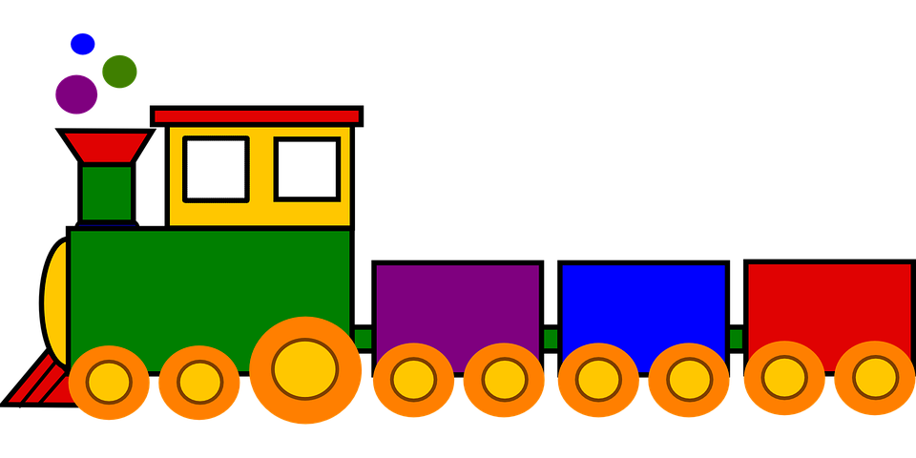
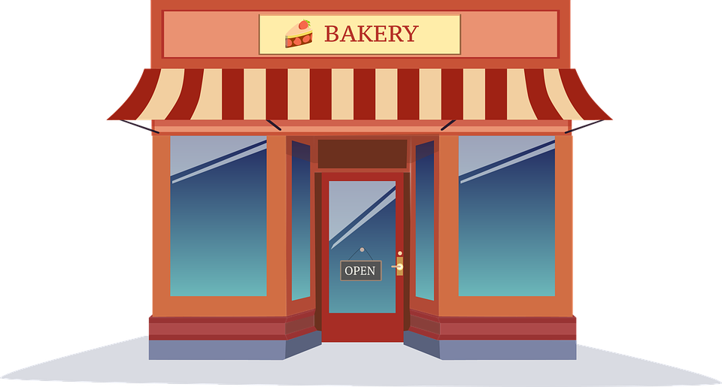
Follow up 1:
Sag die Zungenbrecher*
Zungenbrecher – tongue twister (tongue ‘breaker’!)
aussprechen
Siebzehn Zwerge mit Zipfelmützen
ziehen den Zug worin Prinzen sitzen
60
Seventeen dwarves with pointy hats
draw a train in in which princes sit
Eins zwei drei die Polizei
isst Zwetschgen in der Bäckerei
S
One two three the Police
eat plums in the bakery
Dreizehn Rezepte für Medizin
zeigt Zander der Apothekerin
0
Thirteen prescriptions for medicine
Zander shows to the pharmacist
START
Notes:
Timing: 5 minutes
Aim: to practise the SSC [z] by reading out tongue twisters.
Procedure:
1. Read out the tongue twisters or play the recordings. Each one is recorded three times in increasing speed. 2. Start the timer. Pupil A tries to read all three tongue twisters, within the 60 seconds allowed.
3. Pupil B listens. If Pupil A makes a mistake, Pupil B can direct him/her to start again from the beginning. 4. They swap roles and repeat the task.

Slide 4
Follow up 2:
der
Satz
sent-ence
never
die
Hilfe
nie
Wörter
Spiel Dominos
activity
Vokabeln
to speak
schnell
essen
help
neben
essen
fast
sprech-en
birth-day
some-times
fast
never
room
Geburt-stag
schnell
sprech-en
to eat
manch-mal
die
Aktivität
next to
die
Hilfe
activity
Zimmer
room
birth-day
to speak
sent-
ence
to eat
next to
help
die Aktivität
Geburt-stag
der
Satz
neben
manch-mal
some-times
nie
Zimmer
Notes:
Timing: 5 minutes
Aim: to practise written comprehension and spoken pronunciation of new and previously taught vocabulary.
Procedure:
Starting from the play button, pupils work in pairs or chorally, led by the teacher, to complete the domino orally.
Note: they only need to pronounce the German word each time.
If working as a whole class the teacher can click to provide the answers at each turn.
4. The activity can be repeated to speed up recall.

Slide 5
Follow up 3
Hör zu und schreib die Buchstaben.
hören
A I | E read | I sometimes | K a book
B you | F eat | J never | L cake
C he | G speak |  | M a text
D they | H be |  | N in the water
 |  |  | O a word
 |  |  | P in the room
 |  |  | Q in the class
 |  |  | R ice cream
1
D
H
I
P
5
B
F
J
R
2
A
G
J
O
6
A
F
I
L
3
B
E
I
K
7
C
E
J
M
4
C
H
J
N
8
D
H
J
Q
Notes:
Timing: 5 minutes Aim: to practise aural comprehension of this week’s new language.
Procedure:
Click the numbered buttons to listen.
Pupils select 4 letters for each sentence.
Click to correct after each one, to give pupils instant feedback.
If time allows, elicit the German sentences from pupils chorally and click again for the audio, to listen and check.
Transcript:
Sie sind manchmal im Zimmer.
Ich spreche nie ein Wort.
Du liest manchmal ein Buch.
Er ist nie im Wasser.
Du isst nie Eis.
Ich esse manchmal Kuchen.
Er liest nie einen Text.
Sie sind nie in der Klasse.

Slide 6
Follow up 4
Rede mit deinem Partner/deiner Partnerin.
keine Antwort
B
sprechen
Beispiel:
A
 | I | she/he
1 | viel Kuchen | keine Antwort
2
3
4
5
1. She gives...
Sie gibt…

She gives no answer.
Notes:
Example slide.
Timing: 5 minutes (three slides)
Aim: to practise the difference between the verb forms and pronouns in first and third person singular in a combined listening and speaking task.
Procedure:
Click through the animations to explain the task. Person A says Sie gibt…
Person B chooses the correct sentence ending based on whether they hear the ‘ich’ or the ‘er/sie’ form of the verb.
Person A writes the whole sentence in English: She gives no answer.
Now give out the handouts. DO NOT DISPLAY THE NEXT SLIDE until ready for feedback. It has been animated to prevent accidental premature revealing of the answers.

Slide 7
Follow up 4a
Rede mit deinem Partner/deiner Partnerin.
…
Antworten [1]
B
A
…
sprechen
1. She eats…
2. I read…
3. He speaks…
4. She gives…
5. I eat…
Sie isst…
 | I | she/he
1 | viel Eis | keine Tiere
2 | keine Bücher | viele Texte
3 | kein Deutsch | viel Englisch
4 | manchmal Kuchen | nie Antworten
5 | schnell Eis | langsam Kuchen
Ich lese…
Er spricht…
Sie gibt…

Ich esse…
1. She eats no animals.
2. I read no books.
3. He speaks a lot of English.
4. She never gives answers.
5. I eat ice cream fast.
Notes:
ANSWER SLIDE ROUND 1 – DO NOT DISPLAY DURING THE TASK
Slide 1 of 2.
Procedure:
Elicit and click to reveal each pair of answers, making a full German sentence from A + B, and the English meaning.
Move to the next slide to swap roles, taking care NOT to click to reveal the prompts too early.

Slide 8
Follow up 4b
Rede mit deinem Partner/deiner Partnerin.
…
Antworten [2]
A
B
…
sprechen
1. I give…
2. She reads…
3. He eats…
4. She gives…
5. I read…
Ich gebe…
Sie liest…
 | I | she/he
1 | nie Listen | manchmal Hilfe
2 | viele Lieder | nie ein Buch
3 | schnell Kuchen | Eis langsam
4 | keine Fotos | schnell Antwort
5 | Bücher schnell | Texte nie
Er isst…
Sie gibt…

Ich lese…
1. I never give lists.
‘Antwort ‘ is singular but here best translated in the plural.
2. She reads many songs.
3. He eats ice cream slowly.
4. She gives answers fast.
5. I read books fast.
Notes:
ANSWER SLIDE ROUND 2 – DO NOT DISPLAY DURING THE TASK
Slide 2 of 2.
Procedure:
Elicit and click to reveal each pair of answers, making a full German sentence from A + B, and the English meaning.
Move to the next slide to swap roles, taking care NOT to click to reveal the prompts too early.

Slide 9
Follow up 5:

Schreib auf Englisch.
Can you get at least 15 points?
Wörter
 | das Spiel | die Geschichte | Herr
 | die Freundin | sie sind | die Klasse
 | die Aufgabe | das Beispiel | das Buch
 | Frau | das Lied | der Kuchen
 | schnell | sprechen | essen
 | langsam | nie | Moment
 | manchmal | die Antwort | lesen
(the) game
(the) story
Mr
Vokabeln
x3
(the) friend
they are
(the) class
(the) task
(the) example
(the) book
x2
Mrs, Ms, Miss
(the) song
(the) cake
fast
to speak
to eat
slow, slowly
never
(the) moment
x1
sometimes
(the) answer
to read
Notes:
Timing: 5 minutes
Aim: to practise written production of vocabulary from this and revisited weeks.
Procedure: 1. Give pupils a blank grid. They fill in the English meanings of any of the words they know, trying to reach 15 points in total.
Note: The most recently learnt and practised words are pink, words from the previous week are green and those from week 1 are blue, thus more points are awarded for them, to recognise that memories fade and more effort (heavy lifting!) is needed to retrieve them.

Slide 10
Follow up 5:

Schreib auf Deutsch.
Can you get at least 15 points?
Wörter
 | (the) class | (the) friend (f) | they are
 | (the) story | Mr | (the) game
 | (the) book | Mrs, Ms, Miss | (the) song
 | (the) task | (the) example | (the) cake
 | never | fast | (the) answer
 | (the) moment | slow, slowly | sometimes
 | to eat | to read | to speak
die Klasse
die Freundin
sie sind
Vokabeln
x3
die Geschichte
Herr
das Spiel
das Buch
Frau
das Lied
x2
die Aufgabe
das Beispiel
der Kuchen
nie
schnell
die Antwort
der Moment
langsam
manchmal
x1
essen
lesen
sprechen
Notes:
Timing: 5 minutes
Aim: to practise written production of vocabulary from this and revisited weeks.
Procedure: 1. Give pupils a blank grid. They fill in the German meanings of any of the words they know, trying to reach 15 points in total.
Note: The most recently learnt and practised words are pink, words from the previous week are green and those from week 1 are blue, thus more points are awarded for them, to recognise that memories fade and more effort (heavy lifting!) is needed to retrieve them.

Slide 11
Tschüss!
blau
Notes:
11

Slide 12
Follow up 4a
Rede mit deinem Partner/deiner Partnerin.
A
…
Round 1
…
Round 2
sprechen
A
1. She eats…
2. I read…
3. He speaks…
4. She gives…
5. I eat…
 | I | she/he
1 | nie Listen | manchmal Hilfe
2 | viele Lieder | nie ein Buch
3 | schnell Kuchen | Eis langsam
4 | keine Fotos | schnell Antwort
5 | Bücher schnell | Texte nie

1
2
3
4
5
Notes:
HANDOUT for Partner A

Slide 13
Follow up 4b
Rede mit deinem Partner/deiner Partnerin.
B
…
Round 2
B
Round 1
sprechen
…
1. I give…
2. She reads…
3. He eats…
4. She gives…
5. I read…
 | I | she/he
1 | viel Eis | keine Tiere
2 | keine Bücher | viele Texte
3 | kein Deutsch | viel Englisch
4 | manchmal Kuchen | nie Antworten
5 | Eis schnell | langsam Kuchen

1
2
3
4
5
Notes:
HANDOUT for Partner B

Slide 14
Follow up 5:

Schreib auf Englisch.
Can you get at least 15 points?
Wörter
 | das Spiel | die Geschichte | Herr
 | die Freundin | sie sind | die Klasse
 | die Aufgabe | das Beispiel | das Buch
 | Frau | das Lied | der Kuchen
 | schnell | sprechen | essen
 | langsam | nie | der Moment
 | manchmal | die Antwort | lesen
Vokabeln
Notes:
HANDOUT

Slide 15
Follow up 5:

Schreib auf Deutsch.
Can you get at least 15 points?
Wörter
 | (the) class | (the) friend (f) | they are
 | (the) story | Mr | (the) game
 | (the) book | Mrs, Ms, Miss | (the) song
 | (the) task | (the) example | (the) cake
 | never | fast | (the) answer
 | (the) moment | slow, slowly | sometimes
 | to eat | to read | to speak
Vokabeln
x3
x2
x1
Notes:
HANDOUT

