Slide 1
Interacting
Neu* an der Schule
blau
Present tense strong verbs (e→i, e→ ie)
SSC [z]
neu - new
Term 1 Week 10
Notes:
Artwork by Steve Clarke. Pronoun pictures from NCELP (www.ncelp.org). All additional pictures selected from Pixabay and are available under a Creative Commons license, no
attribution required.
Phonics: [z] Zug [675] sitzen [231] Platz [326] Zimmer [665] zehn [333]
Vocabulary: essen [323] lesen [305] sitzen [231] sprechen [161] Antwort [522] Hilfe [481] Moment [358] langsam [526] manchmal [382] oft [223] nie [196] schnell [203] neben [266]
Revisit 1: Aufgabe [256] Aktivität [1422] Beispiel [94] Bild [253] Blatt, Blätter [1270] Buch [300] Computer [1252] Frage [157] Frau [99] Heft [3862] Kuchen [4381] Lehrer [695] Lied [1733] Liste [1792] Preis [334] Schüler [556] Text [473] Tisch [529] Wort [194] Zimmer [665] keine² [46]
Revisit 2: sie sind [4] Aktivität [1422] Aufgabe [256] Beispiel [94] Frau [99] Freund, Freundin [273] Geburtstag [1779] Geschichte [262] Herr [154] Klasse [961] Lied [1733] Mensch [90] Party [2809] Person [357] Problem [210] Satz [432] Song [3373] Spiel [328] Spieler, Spielerin [822] Sport [945] Text [473] Zimmer [665] welcher, welche, welches [122] die² [1]
Jones, R.L & Tschirner, E. (2019). A frequency dictionary of German: Core vocabulary for learners. London: Routledge.
The frequency rankings for words that occur in this PowerPoint which have been previously introduced in these resources are given in the SOW and in the resources that first
introduced and formally re-visited those words.
For any other words that occur incidentally in this PowerPoint, frequency rankings will be provided in the notes field wherever possible.
Remember that at the start of the course (first three lessons of Rot/Gelb) pupils learnt language (for greetings and register taking) that can still be part of the lesson routines in upper KS2 (Blau/Grün). They are not re-taught, as we anticipate that teachers have built these in from early in lower KS2.
1

Slide 2
aussprechen
[z]
…
This is a German high-speed train called ICE, which stands for Intercity Express.
Zug
Notice that alphabet letters sound different in German. ‘C’ sounds similar to ‘Z’!
ICE
Notes:
Timing: 1 minute
Aim: to introduce the SSC [z].
Procedure:
Introduce the SSC and present the source word ‘Zug’ (with gesture, if using).
Click to bring on the picture and get pupils to repeat the word ‘Zug’ (with gesture, if using).
Click again to bring up speech bubble to explain cultural reference re ICE train.
Click again to bring up an audio button to hear I-C-E pronounced. This is how these letters are pronounced in the German alphabet. We are not learning this here, but click to bring up a callout to raise awareness that the alphabet letters ‘C’ and ‘Z’ have the same starting sound.
Note:
a gesture for ‘Zug’ might be to roll your arms like wheels of a train and make a tche-tche-thche-tche sound like a train.
Vocabulary: Zug [675]
Jones, R.L & Tschirner, E. (2019). A frequency dictionary of German: Core vocabulary for learners. London: Routledge.
2

Slide 3
aussprechen
[z]
Which words are nouns? How do you know?
…
Zug
sitzen
Platz
zehn
Zimmer
Notes:
Timing: 1 minute
Aim: to consolidate the SSC [z].
Procedure:
Re-present the SSC and the source word ‘Zug’ (with gesture, if using).
Click to bring on the picture and get pupils to repeat the word ‘Zug’ (with gesture, if using).
Present the cluster words in the same way, bringing on the picture and getting pupils to pronounce the words.
Click to bring up call-out explaining the pronounciation of ‘z’.
Click to bring up the prompt to identify the nouns (the ones with capital letters). This is still very new knowledge for pupils, so it’s good to revisit this as often as we can. Plus, it gives an additional opportunity to pronounce the words.
Click to highlight the 3 x nouns.
Vocabulary:
sitzen [231] Platz [326] Zimmer [665] zehn [333]
Jones, R.L & Tschirner, E. (2019). A frequency dictionary of German: Core vocabulary for learners. London: Routledge.

Slide 4
aussprechen
[z]
Sag die Namen.
Zelda
Moritz
Franziska
Franz
Zander
Lorenz
Zara
Aliz
Notes:
Timing: 2 minutes
Aim: to consolidate the SSC [z] by reading out pupil names (which function as unknown words).
Procedure:
Pupils play the role of teacher.
Click for one of the pupils on the slide to raise their hand.
Pupils call the name (as they would call on a pupil in class, as the teacher).
Click on the name to listen and check.
Continue until all 8 pupils have raised their hands and had their names called.

Slide 5
Vokabeln
Freundschaft*
die Freundschaft - friendship
Remember that learning languages is about making friends.
When someone starts a new school, it’s especially important to show kindness.
What do Johanna and Aisha say to Nina?
Wie geht’s?
_ _ _ _ _ _ _’_?
Hallo!
Guten Tag!
_ _ _ _ _!
_ _ _ _ _ _ _ _!
Wie heißt du?
_ _ _ _ _ _ _ _ _ _?
Du bist toll!
Hast du eine Frage?
You are great!
Das ist gut!
That’s not a problem!
Do you have a question?
That’s good!
Kann ich helfen?
Das ist kein Problem!
Can I help?
Notes:
Timing: 3 minutes
Aim: to revisit the idea that learning other languages opens the door to new friendships, and that a few kind words go a long way; to revisit some previously-taught language from this term that fits our category of ‘friendship sentences’. In this lesson
the context is the arrival of a new pupil in school, so we revisit appropriate language for that situation.
Procedure:
Click to present the information on the slide.
Elicit the German from pupils for the English greetings and friendly statements.
Allow pupils a few moments to turn to those around them and greet them and say something kind or helpful that they might say to a new pupil in school.
Remind pupils that we all need to hear kind words every day, but especially when we go into new, unfamiliar situations where we don’t know anyone.
5

Slide 6
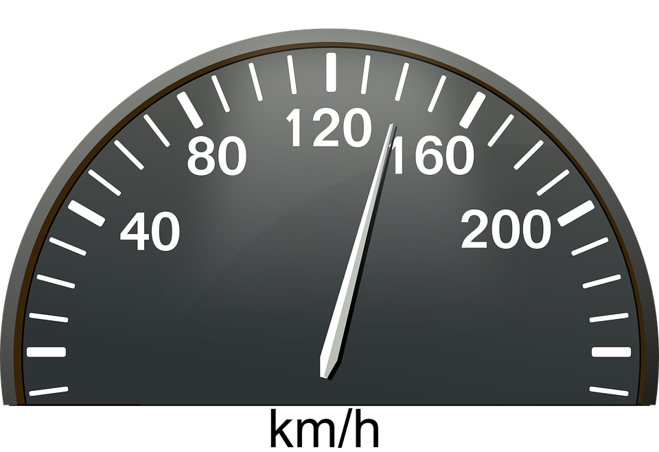
Vokabeln
Sag die Wörter auf Deutsch. Was ist das auf Englisch?
Wörter
essen
langsam
[slow, slowly]
lesen
manchmal
…
sprechen
nie
[to speak]
der Moment
schnell
[fast]
Notes:
[1/3]
Timing: 3 minutes
Aim: to introduce new vocabulary for this week.
Procedure 1. Pupils either work by themselves or in pairs, reading out the words and reading their English meanings (1 minute). 2. Then, on the next slide, students try to recall the English orally (chorally), looking at the German (1 minute). 3. Then, on the following slide, they to recall the German meanings orally (again, chorally), looking at the English (1 minute).
Notes:
Note that images/words won’t disappear and appear in this activity as in previous resources.
6

Slide 7
Vokabeln
Sag die Wörter auf Deutsch. Was ist das auf Englisch?
…
Wörter
to eat
essen
never
nie
to read
lesen
sometimes
manchmal
slow, slowly
to speak
sprechen
langsam
(the) moment
der Moment
fast
schnell
Notes:
[2/3]
Procedure: 1. Students try to recall the English orally (chorally), looking at the German (1 minute). 2. Elicit answers and click to reveal
3. Then, in the following slide, they to recall the German meanings orally (again, chorally), looking at the English (1 minute).
7

Slide 8
Vokabeln
Sag die Wörter auf Deutsch. Was ist das auf Englisch?
Wörter
slow, slowly
to eat
essen
langsam
to read
lesen
sometimes
manchmal
…
to speak
sprechen
never
nie
(the) moment
der Moment
schnell
fast
Notes:
[3/3]
Procedure: 1. Students recall the German meanings orally (again, chorally), looking at the English (1 minute).
2. Click to reveal the answers.
8

Slide 9
Present tense: strong verbs e→ i, e→ ie
Some German verbs change the vowel in the er/sie/es form.
The ‘e’ in the stem changes to ‘i’:
We call these strong verbs.
…
Ich spreche.
I speak/am speaking.
Sie spricht.
She speaks/is speaking.
…
In other verbs, the ‘e’ in the stem changes to ‘ie’:
Ich lese.
I read/am reading.
Er liest.
He reads/is reading.
The verb endings are the same for all verbs in the present tense.
Notes:
Timing: 2 minutes
Aim: to present the 1st and 3rd persons singular of strong verbs with e→i and e→ie change.
Procedure:
Click through the animations to present the new information.
Elicit English translation for the German examples provided.
9

Slide 10
hören
Nina
Nina ist neu in Johannas und Aishas Klasse.
Johanna und Aisha helfen.
Hör zu. Wer macht was? Johanna (ich) oder Nina (sie)?
She speaks slowly.
I speak fast.
I help often.
She is not reading books.
She gives no/doesn’t give any answers.
She never helps in class.
I eat a lot but she doesn’t eat much at the moment.
ich (I)
sie (she)
Was? Schreib auf Englisch.
B.
1
2
3
4
5
6
Notes:
Timing: 8 minutes
Aim: to practise aural comprehension of strong verbs in 1st and 3rd persons singular as well as vocabulary for this week.
Procedure:
Ensure that the scenario is clear.
Explain the pupils need to listen out for the verb to decide if Johanna is talking about herself (I) or Nina the new pupil at school.
Explain that they will listen again and write the action/activity in English.
Complete the example. Click to give feedback.
Repeat steps 1-4 for items 1 – 6.
Click to correct.
Note: there are two clues in the verbs here, the verb ending and the vowel, so we are not just isolating the vowel change for practice. This first task develops familiarity with the verb forms and the new vocabulary. In the follow up activities we will contrast the ihr (you all) form e.g., sprecht with the er/sie form spricht, to focus pupils solely on the vowel change. In addition, the reading activity that follows obscures the endings as well as the pronouns, so the pupils are compelled to focus all their attention on the spelling of the verb stem.
Transcript:
Beispiel: [sie] spricht langsam.
[ich] spreche schnell.
[ich] helfe oft.
[sie] liest keine Bücher.
[sie] gibt keine Antworten.
[sie] hilft nie in der Klasse.
[ich] esse viel aber [sie] isst nicht viel im Moment. Wie kann ich helfen?
10

Slide 11
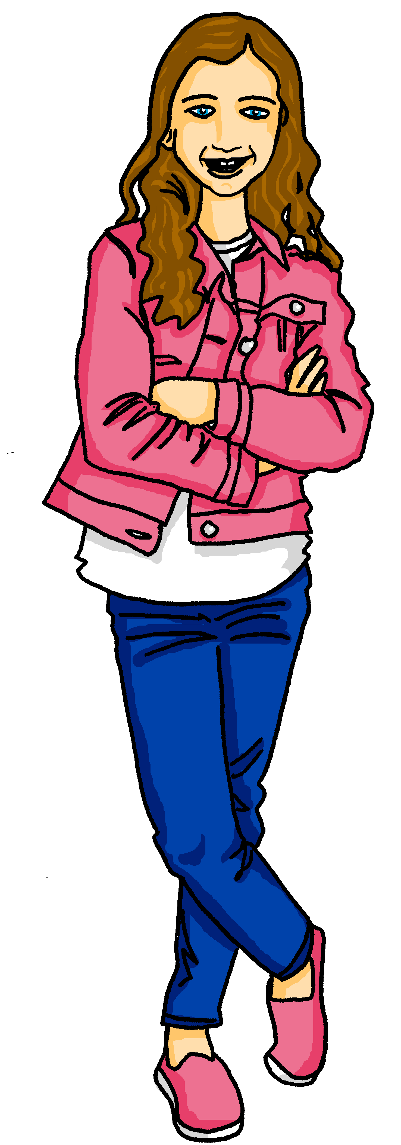
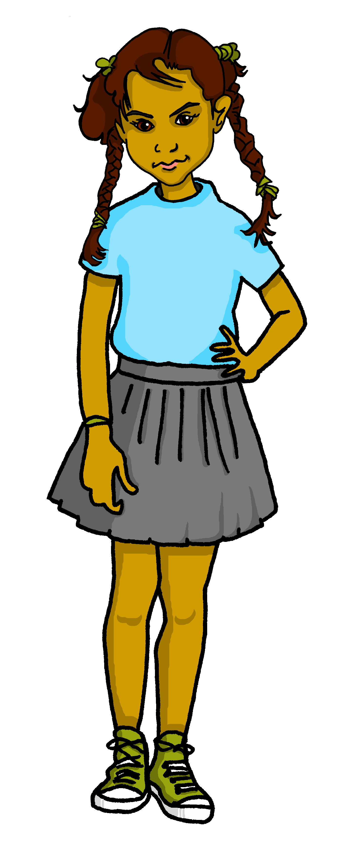
lesen
Johanna textet mit Maike.
Mutti! Nina ist neu in der Klasse und…
Wer macht was? Schreib 1 – 6, ich oder sie, und die Aktivität auf Englisch.
1. Sie isst jeden Tag aber nie sehr viel.
nnn gibn manchmal eine Antwort.
1. nnn issn jeden Tag aber nie sehr viel.
4. Sie gibt manchmal eine Antwort.
4.
5. Sie spricht jetzt manchmal Deutsch.
2.
nnn sprichn jetzt* manchmal Deutsch.
nnn sitzn neben Aisha.
5.
2. Sie sitzt neben Aisha.
nnn spieln im Moment.
3.
6.
nnn sprechn langsam.
6. Ich spiele im Moment.
3. Ich spreche langsam.
jetzt - now
Notes:
Timing: 5 minutes
Aim: to practise recognising stem changes between ich and sie and connecting these with meaning.
Procedure:
Pupils write down 1 to 6 .
Pupils read Johanna’s messages, and for each message say whether it applies to ich (Johanna) or sie (Nina), based upon whether or not there is a stem change.
Note: teachers tell pupils that they will only be able to decide I or she if the verbs are strong verbs. For weak (regular) verbs that don’t change their stems you need the verb ending and pronoun.
3. Elicit full phrase answers from pupils in German – click to reveal written messages. 4. Elicit English meanings (see below).
Translation
She eats every day but never very much.
Sie sits next to Aisha.
I speak slowly.
She sometimes gives an answer.
She sometimes speaks German now.
I am playing at the moment.
11

Slide 12
Tschüss!
blau
Notes:
12

