Slide 1
Interacting
Neu* an der Schule
blau
Follow ups 1-5
Term 1 Week 11
Notes:
Artwork by Steve Clarke. Pronoun pictures from NCELP (www.ncelp.org). All additional pictures selected from Pixabay and are available under a Creative Commons license, no attribution required.
Phonics:
soft [ch] ich [10] leicht [311] sprechen [161]
hard [ch] Buch [300] Woche [219] machen [58]
Vocabulary: sehen [79] vergessen [584] nichts [109] Sprache [421] Wochenende [1243] immer [64] jetzt [72]
(plus language from Week 10:→ essen [323] lesen [305] sitzen [231] sprechen [161] Antwort [522] Hilfe [481] Moment [358] langsam [526] manchmal [382] oft [223] nie [196] schnell [203] neben [266]
Revisit 1: alles [36] alle [36] viele [56] Beispiel [94] Bild [253] Computer [1252] Eis [1874] Essen¹ [323] Foto [633] Frage [157] Handy [1693] Heft [3862] Kunst [554] Lied [1733] Liste [1792] Preis [334] Satz [432] Song [3373] Text [473]
Tisch [529]
Revisit 2: mögen, ich mag, du magst, er/sie/es mag [168] Bilder [253] Bücher [300] Glas [885] Gläser [885] Lieder [1733] Morgen [621] Sommer [771] Winter [1206] Wörter [194]
Jones, R.L & Tschirner, E. (2019). A frequency dictionary of German: Core vocabulary for learners. London: Routledge.
The frequency rankings for words that occur in this PowerPoint which have been previously introduced in these resources are given in the SOW and in the resources that first
introduced and formally re-visited those words.
For any other words that occur incidentally in this PowerPoint, frequency rankings will be provided in the notes field wherever possible.

Slide 2
aussprechen
soft [ch]
…
ich
Notes:
Timing: 1 minute
Aim: to introduce the SSC soft [ch].
Procedure:
Introduce the SSC and present the source word ‘ich’ (with gesture, if using).
Click to bring on the picture and get pupils to repeat the word ‘ich’ (with gesture, if using).
Note:
a gesture for ‘ich’ might be to point to yourself.
2

Slide 3
aussprechen
soft [ch]
…
ich
leicht
sprechen
Notes:
Timing: 1 minute
Aim: to consolidate the SSC soft [ch].
Procedure:
Re-present the SSC and the source word ‘ich’ (with gesture, if using).
Click to bring on the picture and get pupils to repeat the word ‘ich’ (with gesture, if using).
Present the cluster words in the same way, bringing on the picture and getting pupils to pronounce the words.
Vocabulary: leicht [311] sprechen [161]
Jones, R.L & Tschirner, E. (2019). A frequency dictionary of German: Core vocabulary for learners. London: Routledge.

Slide 4
aussprechen
hard [ch]
…
Buch
Notes:
Timing: 1 minute
Aim: to introduce the SSC soft [ch].
Procedure:
Introduce the SSC and present the source word ‘Buch’ (with gesture, if using).
Click to bring on the picture and get pupils to repeat the word ‘Buch’ (with gesture, if using).
Note:
a gesture for ‘Buch’ might be to fan out your hands as if opening up a book.
Vocabulary: Buch [300]
Jones, R.L & Tschirner, E. (2019). A frequency dictionary of German: Core vocabulary for learners. London: Routledge.
4

Slide 5
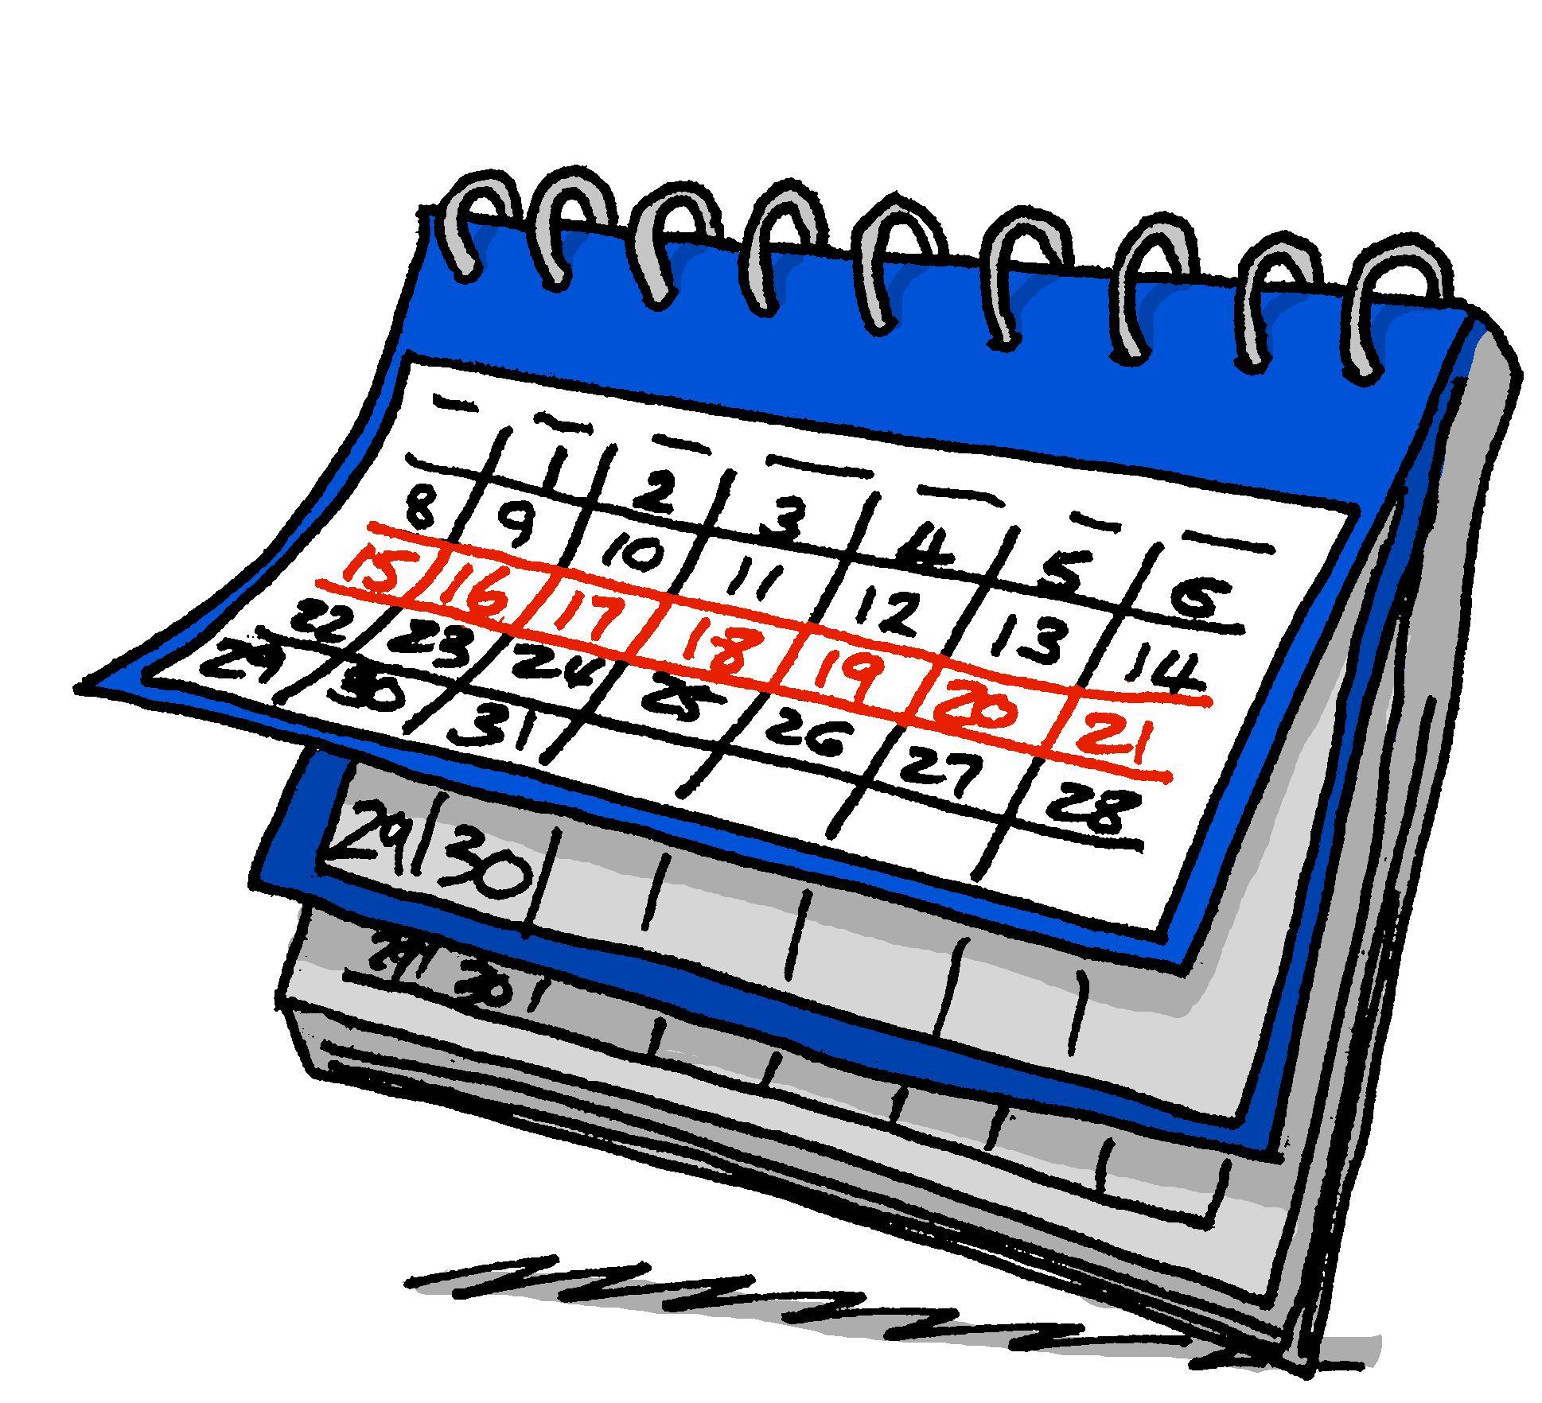
aussprechen
hard [ch]
…
Buch
Woche
machen
We usually use a hard ‘ch’ sound when the ‘ch’ follows an ‘a’, ‘o’ or ‘u’.
Notes:
Timing: 1 minute
Aim: to consolidate the SSC soft [ch].
Procedure:
Re-present the SSC and the source word ‘ich’ (with gesture, if using).
Click to bring on the picture and get pupils to repeat the word ‘ich’ (with gesture, if using).
Present the cluster words in the same way, bringing on the picture and getting pupils to pronounce the words.
Vocabulary: Woche [219] machen [58]
Jones, R.L & Tschirner, E. (2019). A frequency dictionary of German: Core vocabulary for learners. London: Routledge.

Slide 6
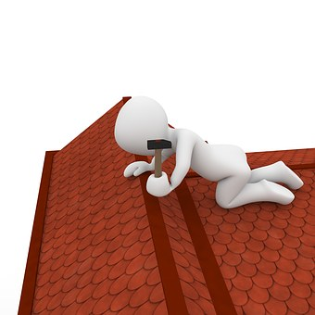
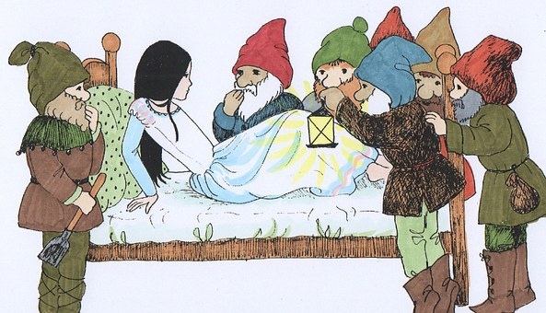
Follow up 1:
Sag die Wörter!
Over to you! Can you pronounce each of the words below, first slowly and carefully, then against the clock?
Eichhörnchen
aussprechen
10
Rotkäppchen
Meerschweinchen
To pronounce longer words like this one, try breaking them down into the different syllables. Pronounce each syllable separately, thinking carefully about the sounds you have learnt, then together!
S
Dachdecker
Wörterbuchsuche
Schneewittchen
Nachmacher
[copycat, imitator]
0
START
Notes:
Timing: 5 minutes
Aim: to practise the SSC [ch] by reading aloud some tricky to pronounce words.
Procedure:
Click to show pupils how to break down a tricky word into different syllables. Highlight the [ch] sound that they have been learning this week.
Give pupils a couple of minutes in pairs or individually to try breaking down and pronouncing the other words. Teachers could either use the handout (at the end of this presentation) so pupils can draw in the syllable divisions OR elicit them physically (as an arm gesture top to bottom) from pupils, along with choral pronunciation of each word.
Click to reveal the syllable division lines for each word.
Click on the words to hear the them pronounced first carefully and slowly. Then click on the pictures to hear them pronounced quickly.
Ask pupils to have another go at pronouncing the words, this time against the 10 second timer. Can they pronounce all words correctly in time?
Rotkäppchen= Little Red Riding Hood
Dachdecker= roofer
Schneewitchen= Snow White
Wörterbuchsuche= dictionary search
Meerschweinchen= guinea pig
Streichholzschachtel= match box
Nachmacher= imitator
Quietscheentchen= rubber duck (literally ‘squeaky duck’)

Slide 7
Compound words
Remember that in German, you can put several words together to make one long word! This is called a compound word.
neuter
masculine
masculine!
das Glas
der Tisch
der Glastisch
(the) table
(the) glass table
(the) glass
The gender of a compound noun is always the gender of the last word.
Notes:
Timing: 2 minutes
Aim: to recap the concept of compounds.
Procedure:
Click through the animations to present the new information.
Using the question mark animations, elicit English translation for the German examples provided.
7

Slide 8
Follow up 2: [1/9]
Nina lernt Deutsch.
Johanna und Aisha helfen Nina mit Deutsch. Was ist das auf Englisch?
lesen
der Liedtext | der Songtext
song text
Notes:
Slide 1 of 9
Timing: 5 minutes
Aim: to practise written vocabulary recognition of compound words
Procedure:
Click to bring up German compound word.
Elicit meaning in English.
Click to bring up English meaning. There are 9 compound words in total.

Slide 9
Follow up 2: [2/9]
Nina lernt Deutsch.
lesen
der Sommermorgen
summer morning
Notes:
[2/9]

Slide 10
Follow up 2: [3/9]
Nina lernt Deutsch.
lesen
das Handyfoto
(mobile) phone photo
Notes:
[3/9]

Slide 11
Follow up 2: [4/9]
Nina lernt Deutsch.
lesen
die Liedliste
song list
Notes:
[4/9]

Slide 12
Follow up 2: [5/9]
Nina lernt Deutsch.
lesen
das Deutschheft
German exercise book
Notes:
[5/9]

Slide 13
Follow up 2: [6/9]
Nina lernt Deutsch.
lesen
die Kunstbilder
art pictures/ images
Notes:
[6/9]

Slide 14
Follow up 2: [7/9]
Nina lernt Deutsch.
lesen
die Englischwörter
English words
Notes:
[7/9]

Slide 15
Follow up 2: [8/9]
Nina lernt Deutsch.
lesen
der Computertisch
computer table
Notes:
[8/9]

Slide 16
Follow up 2: [9/9]
Nina lernt Deutsch.
lesen
die Computersprache
computer language
Notes:
[9/9]

Slide 17
Follow up 3
Nina’s German is improving, but she finds it difficult to hear the difference between ihr (you all) and er (he). Can you help?
??
Hör zu. Ist das you (all) oder he?
hören
 | you (all) | he | English?
1
Are you (all) eating now?
2
Does he speak German?
3
Do you (all) always do art?
4
Doesn’t he forget anything?
5
Do you (all) read a book sometimes?
6
Are you (all) learning English?
Notes:
Timing: 5 minutes Aim: to practise comprehension of questions and differentiating between the ihr and er forms of strong and weak verbs.
Procedure:
1. Pupils write down 1-6. 2. Click on the audio buttons to play each question 1-6.
3. Pupils write down you (all) or he, depending on which pronoun and verb form they hear.
4. Pupils listen again to each question and try to translate the question into English. 5. Elicit answers and click to display answers. Discuss different variations for question translation as in main lesson e.g. Does he speak German or Is he speaking German?
Note: With strong verbs pupils are given two clues: ihr versus er and the vowel e.g. er spricht/ihr sprecht. With weak verbs, pupils just need to focus on the pronoun ihr or er.
Transcript:
Esst ihr jetzt?
Spricht er Deutsch?
Macht ihr immer Kunst?
Vergisst er nichts?
Lest ihr manchmal ein Buch?
Lernt ihr Englisch?

Slide 18
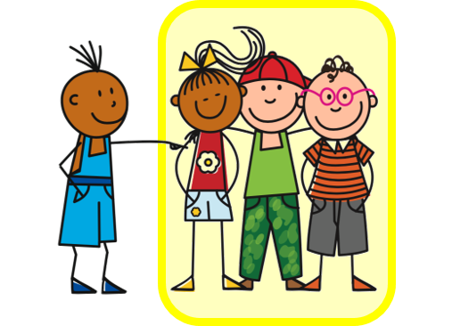
Follow up 4
Rede mit deinem Partner/deiner Partnerin.
sprechen
Beispiel:
I
A
B
Siehst du?
1 | Do you see? Are you seeing?
2 | ……….. ……….
I
A
Notes:
Example slide.
Timing: 5 minutes (two slides)
Aim: to practise asking questions with strong verbs using du and ihr forms of you.
Procedure:
Click through the animations to explain the task. Person A says Siehst du?
Person B chooses the correct letter from two and writes down the letter.
Person A continues to ask the remaining eight questions in Round 1.
At the end, Person B will have a nine-letter phrase to read out to Person A who should recognise and translate it.
Then pupils swap and repeat the task. Person B will now make the questions using Round 2.

Slide 19
Follow up 4
Rede mit deinem Partner/deiner Partnerin.
1
2
3
sprechen
W
I
C
I
H
R
4
5
6
S
M
I
A
G
N
7
8
9
D
G
A
E
N
S
Notes:
Timing: 5 minutes
Aim: to practise asking questions with strong verbs using du and ihr forms of you.
Procedure:
Give out handouts to pupils. Both face the board. Display this slide.
Pupil A translates English prompts into German questions, working in numerical order from 1 – 9.
Pupils B identifies the correct letter according to his/her understanding of what A says.
After all nine questions have been asked by Pupil A, Pupil B reads aloud the sentence/message produced by the answer letters.
It should read ‘Wir singen’.
Pupils swap roles and repeat the activity. Pupil A’s sentence should read: ‘Ich mag das’.
To check answers for each square, click on the letters in the circles.

Slide 20
Follow up 5:

Schreib auf Englisch.
Can you get at least 15 points?
Wörter
 | mögen | du magst | er/sie/es mag
 | der Morgen | das Glas | die Gläser
 | das Essen | viele | alle
 | die Kunst | das Eis | alles
 | sehen | nicht | nichts
 | vergessen | viel | immer
 | die Sprache | das Wochenende | jetzt
to like, liking
you like
he/she/it likes
Vokabeln
x3
(the) morning
(the) glass
(the) glasses
(the) food
many, a lot
all (of the)
x2
(the) art
(the)ice cream
everything
to see, seeing
not
nothing
a lot, much
always
to forget, forgetting
x1
(the) language
(the) weekend
now
Notes:
Timing: 5 minutes
Aim: to practise written production of vocabulary from this and revisited weeks.
Procedure: 1. Give pupils a blank grid. They fill in the English meanings of any of the words they know, trying to reach 15 points in total.
Note: The most recently learnt and practised words are pink, words from the previous week are green and those from week 1 are blue, thus more points are awarded for them, to recognise that memories fade and more effort (heavy lifting!) is needed to retrieve them.

Slide 21
Follow up 5:

Schreib auf Deutsch.
Can you get at least 15 points?
Wörter
 | (the) glass | (the) glasses | he/she/it likes
 | to like, liking | you like | (the) morning
 | (the) ice cream | (the) food | (the) art
 | everything | all (of the) | many, a lot
 | now | not | a lot, much
 | (the) language | (the) weekend | always
 | to see, seeing | to forget, forgetting | nothing
das Glas
die Gläser
er/sie/es mag
Vokabeln
x3
mögen
du magst
der Morgen
das Eis
das Essen
die Kunst
x2
alles
alle
viele
jetzt
nicht
viel
die Sprache
das Wochenende
immer
x1
sehen
vergessen
nichts
Notes:
Timing: 5 minutes
Aim: to practise written production of vocabulary from this and revisited weeks.
Procedure: 1. Give pupils a blank grid. They fill in the German meanings of any of the words they know, trying to reach 15 points in total.
Note: The most recently learnt and practised words are pink, words from the previous week are green and those from week 1 are blue, thus more points are awarded for them, to recognise that memories fade and more effort (heavy lifting!) is needed to retrieve them.

Slide 22
Tschüss!
blau
Notes:
22

Slide 23
Follow up 1
Follow up 1
Rotkäppchen
Rotkäppchen
Meerschweinchen
Meerschweinchen
Dachdecker
Dachdecker
Wörterbuchsuche
Wörterbuchsuche
Schneewitchen
Schneewitchen
Nachmacher
[copycat, imitator]
Nachmacher
[copycat, imitator]
Notes:
HANDOUT

Slide 24
Follow up 4
Follow up 4
Round 1
Round 2
A
…
B
…
1 | Do you (all) eat? Are you (all) eating?
2 | Do you read? Are you reading?
3 | Do you (all) forget? Are you (all) forgetting?
4 | Do you give? Are you giving?
5 | Do you see? Are you seeing?
6 | Do you (all) speak? Are you (all) speaking?
7 | Do you forget? Are you forgetting?
8 | Do you eat? Are you eating?
9 | Do you (all) see? Are you (all) seeing?
1 | Do you eat? Are you eating?
2 | Do you (all) read? Are you (all) reading?
3 | Do you forget? Are you forgetting?
4 | Do you (all) give? Are you (all) giving?
5 | Do you (all) see? Are you (all) seeing?
6 | Do you speak? Are you speaking?
7 | Do you (all) forget? Are you (all) forgetting?
8 | Do you (all) eat? Are you eating?
9 | Do you see? Are you seeing?
Notes:
HANDOUT

Slide 25
Follow up 5:

Schreib auf Englisch.
Can you get at least 15 points?
Wörter
 | mögen | du magst | er/sie/es mag
 | der Morgen | das Glas | die Gläser
 | das Essen | viele | alle
 | die Kunst | das Eis | alles
 | sehen | nicht | nichts
 | vergessen | viel | immer
 | die Sprache | das Wochenende | jetzt
Vokabeln
x3
x2
x1
Notes:
HANDOUT

Slide 26
Follow up 5:

Schreib auf Deutsch.
Can you get at least 15 points?
Wörter
 | (the) glass | (the) glasses | he/she/it likes
 | to like, liking | you like | (the) morning
 | (the) ice cream | (the) food | (the) art
 | everything | all (of the) | many, a lot
 | now | not | a lot, much
 | (the) language | (the) weekend | always
 | to see, seeing | to forget, forgetting | nothing
Vokabeln
x3
x2
x1
Notes:
HANDOUT

