Slide 1
Interacting
Neu* an der Schule²
blau
Present tense strong verbs (e→i, e→ ie)
SSC soft/hard [ch]
neu - new
Term 1 Week 11
Notes:
Artwork by Steve Clarke. Pronoun pictures from NCELP (www.ncelp.org). All additional pictures selected from Pixabay and are available under a Creative Commons license, no attribution required.
Phonics:
soft [ch] ich [10] leicht [311] sprechen [161]
hard [ch] Buch [300] Woche [219] machen [58]
Vocabulary: sehen [79] vergessen [584] nichts [109] Sprache [421] Wochenende [1243] immer [64] jetzt [72]
(plus language from Week 10:→ essen [323] lesen [305] sitzen [231] sprechen [161] Antwort [522] Hilfe [481] Moment [358] langsam [526] manchmal [382] oft [223] nie [196] schnell [203] neben [266]
Revisit 1: alles [36] alle [36] viele [56] Beispiel [94] Bild [253] Computer [1252] Eis [1874] Essen¹ [323] Foto [633] Frage [157] Handy [1693] Heft [3862] Kunst [554] Lied [1733] Liste [1792] Preis [334] Satz [432] Song [3373] Text [473] Tisch [529]
Revisit 2: mögen, ich mag, du magst, er/sie/es mag [168] Bilder [253] Bücher [300] Glas [885] Gläser [885] Lieder [1733] Morgen [621] Sommer [771] Winter [1206] Wörter [194]
Jones, R.L & Tschirner, E. (2019). A frequency dictionary of German: Core vocabulary for learners. London: Routledge.
The frequency rankings for words that occur in this PowerPoint which have been previously introduced in these resources are given in the SOW and in the resources that first introduced and formally re-visited those words.
For any other words that occur incidentally in this PowerPoint, frequency rankings will be provided in the notes field wherever possible.
Remember that at the start of the course (first three lessons of Rot/Gelb) pupils learnt language (for greetings and register taking) that can still be part of the lesson routines in upper KS2 (Blau/Grün). They are not re-taught, as we anticipate that teachers have built these in from early in lower KS2.
1

Slide 2
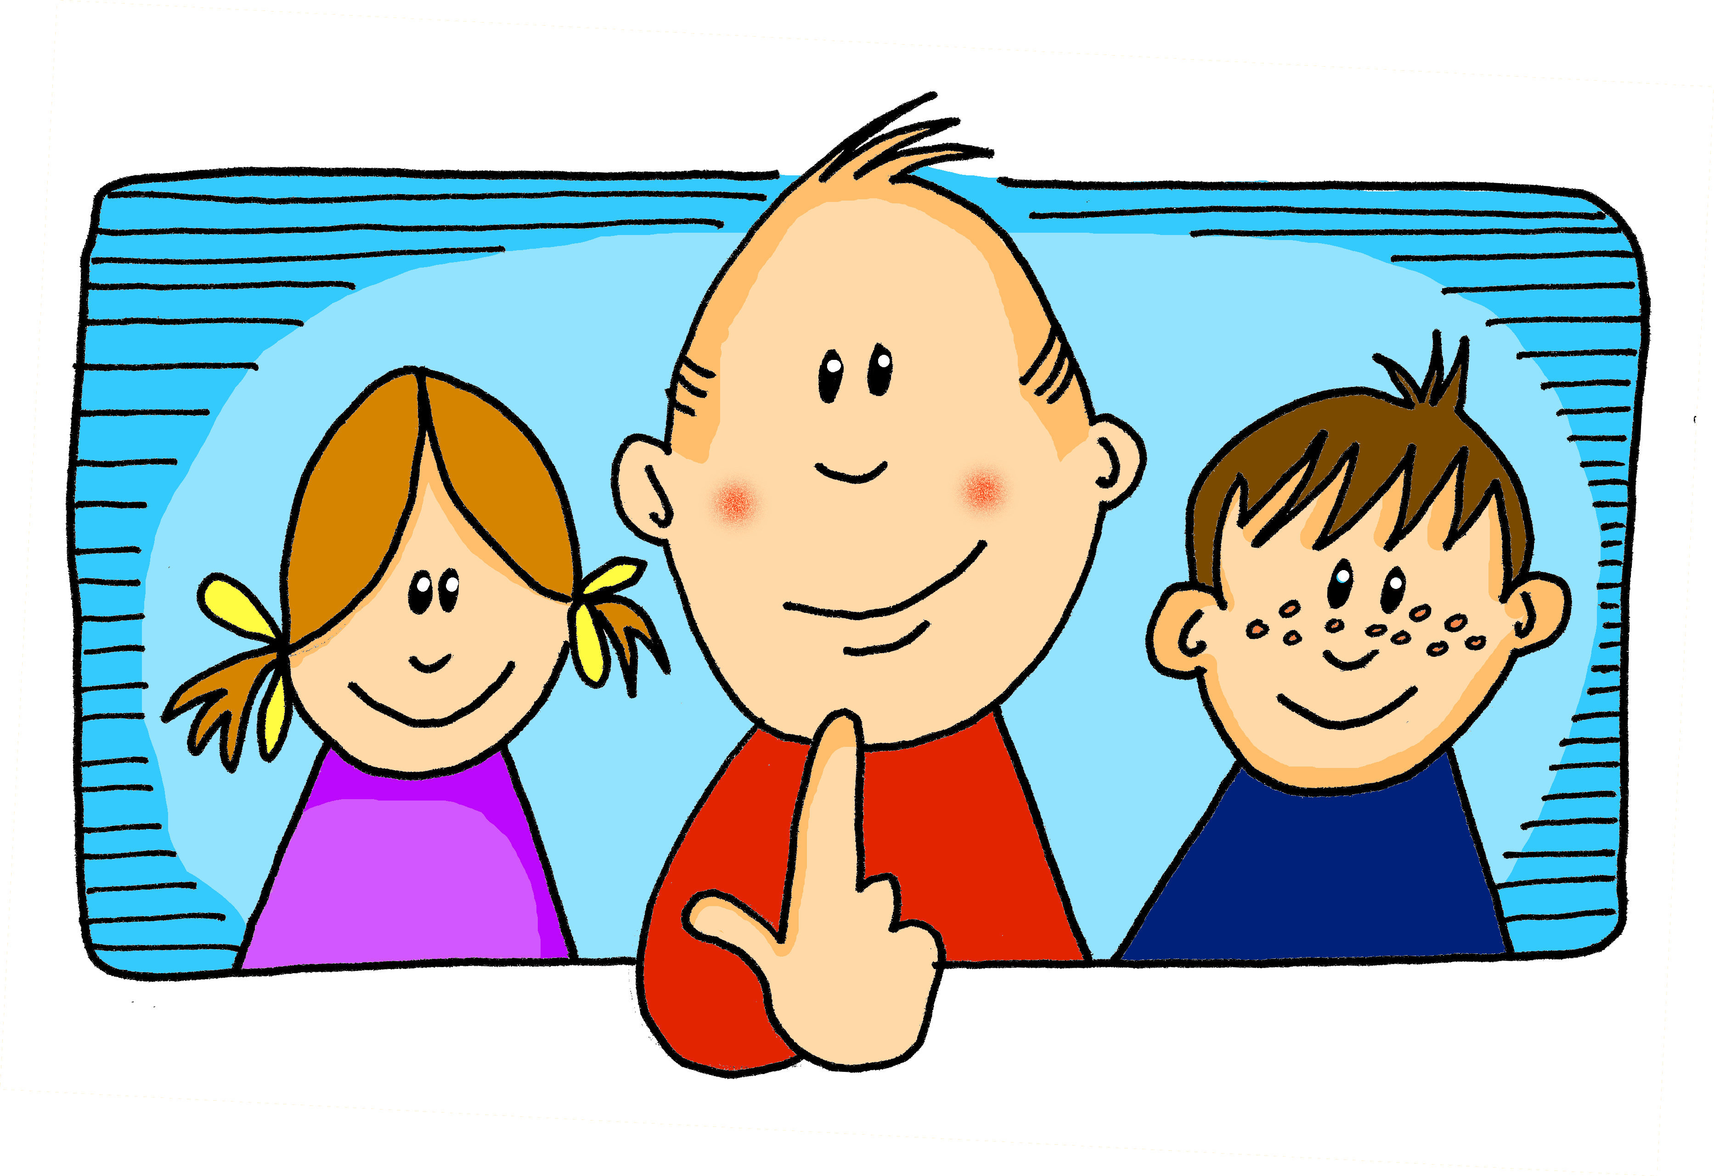
aussprechen
soft [ch]
…
ich
Notes:
Timing: 1 minute
Aim: to introduce the SSC soft [ch].
Procedure:
Introduce the SSC and present the source word ‘ich’ (with gesture, if using).
Click to bring on the picture and get pupils to repeat the word ‘ich’ (with gesture, if using).
Note:
a gesture for ‘ich’ might be to point to yourself.
2

Slide 3
aussprechen
soft [ch]
…
ich
leicht
sprechen
Notes:
Timing: 1 minute
Aim: to consolidate the SSC soft [ch].
Procedure:
Re-present the SSC and the source word ‘ich’ (with gesture, if using).
Click to bring on the picture and get pupils to repeat the word ‘ich’ (with gesture, if using).
Present the cluster words in the same way, bringing on the picture and getting pupils to pronounce the words.
Vocabulary: leicht [311] sprechen [161]
Jones, R.L & Tschirner, E. (2019). A frequency dictionary of German: Core vocabulary for learners. London: Routledge.

Slide 4
aussprechen
hard [ch]
…
Buch
Notes:
Timing: 1 minute
Aim: to introduce the SSC soft [ch].
Procedure:
Introduce the SSC and present the source word ‘Buch’ (with gesture, if using).
Click to bring on the picture and get pupils to repeat the word ‘Buch’ (with gesture, if using).
Note:
a gesture for ‘Buch’ might be to fan out your hands as if opening up a book.
Vocabulary: Buch [300]
Jones, R.L & Tschirner, E. (2019). A frequency dictionary of German: Core vocabulary for learners. London: Routledge.
4

Slide 5
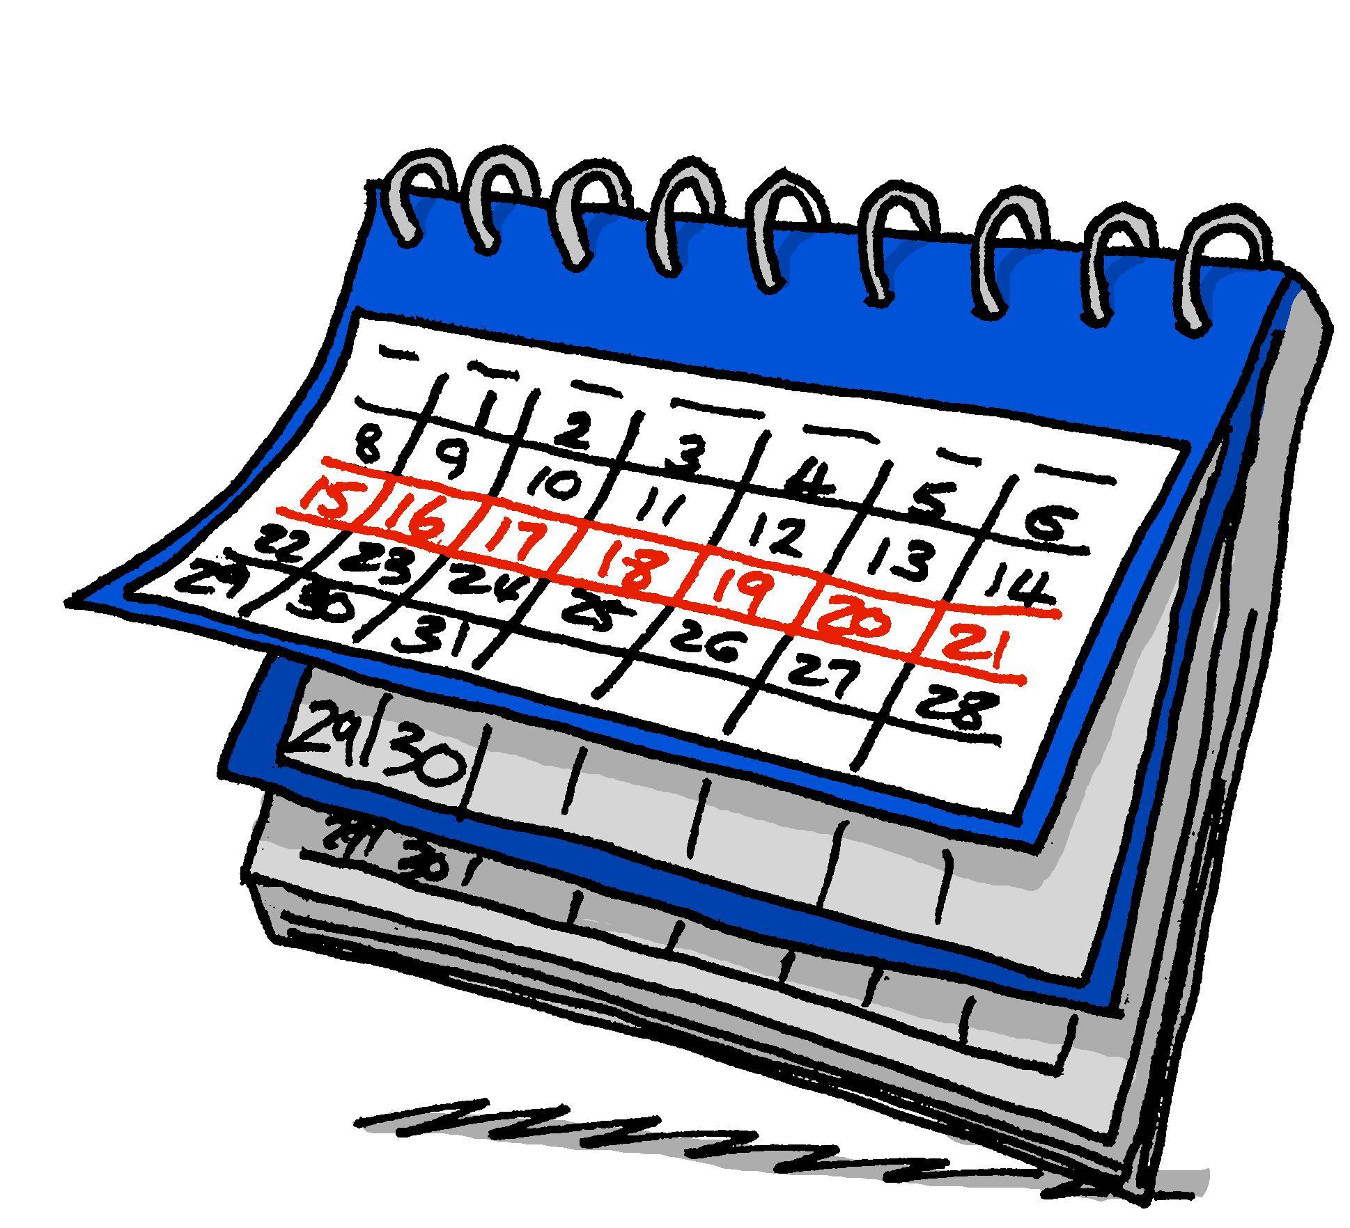
aussprechen
hard [ch]
…
Buch
Woche
machen
We usually use a hard ‘ch’ sound when the ‘ch’ follows an ‘a’, ‘o’ or ‘u’.
Notes:
Timing: 1 minute
Aim: to consolidate the SSC soft [ch].
Procedure:
Re-present the SSC and the source word ‘ich’ (with gesture, if using).
Click to bring on the picture and get pupils to repeat the word ‘ich’ (with gesture, if using).
Present the cluster words in the same way, bringing on the picture and getting pupils to pronounce the words.
Vocabulary: Woche [219] machen [58]
Jones, R.L & Tschirner, E. (2019). A frequency dictionary of German: Core vocabulary for learners. London: Routledge.

Slide 6
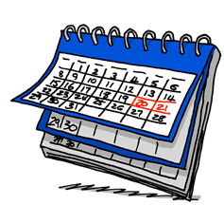
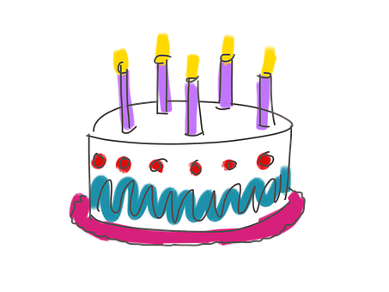
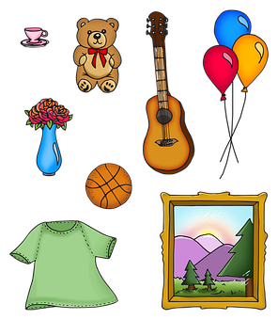
aussprechen
[ch]
Sprich mit einem/einer Partner(in). Hard [ch] dann soft [ch]…
30
18
Bücher
machen
[to do, doing]
achtzehn
Recht
[right, law]
nichts
[nothing]
freundlich
Sprache
Österreich
S
Mädchen
Nacht
Wochenende
Sachen
[things]
Geschichte
[story, history]
Kuchen
[weekend]
0
START
Notes:
Timing: 2 minutes
Aim: to consolidate the SSC hard and soft [ch] in a paired read aloud task.
Procedure:
Pupils work in pairs.
Pupil A selects a word with a hard [ch] and says it aloud.
Pupil B needs to select a word with soft [ch] to pronounce.
Pupils continue alternating until all words have been said or the time has run out, whichever comes soonest.
They can repeat the activity with Partner B starting with a different word.
If a pupil says a word with the same [ch] sound as the one before they need to start from the beginning.
Click on individual words to hear correct pronunciation.
Word frequency:
nichts [109] Bücher [300] machen [58] Sprache [421] Wochenende [1243] achtzehn [3741] Recht [242] Mädchen [602] Nacht [325] freundlich [1566] Österreich [707] Sachen [ 318] Geschichte [262] Kuchen [4381]
Jones, R.L & Tschirner, E. (2019). A frequency dictionary of German: Core vocabulary for learners. London: Routledge.

Slide 7
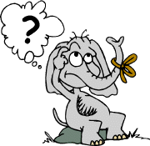
Sag die Wörter auf Deutsch. Was ist das auf Englisch?
Wörter
Vokabeln
1.geben
2.lesen
[to give]
[to see]
…
3.essen
4.vergessen
[to eat]
[to speak]
5.sprechen
6.sehen
[to read]
[to forget]
Notes:
Timing: 3 minutes
Aim: to introduce the verbs for this week. 4 are revisited and 2 are new: sehen (to see, seeing) & vergessen (to forget, forgetting).
Procedure 1. Pupils either write down numbers 1-6 and match the German and English verbs, or they discuss the matching pairs with a partner.
2. Click to highlight the German and English pairs and practise pronunciation as a class. 3. Click to cover up the English/pictures one by one. Can pupils say the German word (on the board) for each English verb that disappears? 4. Click to make the English reappear, then repeat with the German verbs disappearing.
5. Finally, click to cover up all 6 verbs in German and English (Click 3 times in succession to cover up row by row). How many verbs can pupils remember? Answers: 1. geben (to give), 2. lesen (to read), 3.essen (to eat), 4.vergessen (to forget), 5.sprechen (to speak), 6.sehen (to see).

Slide 8
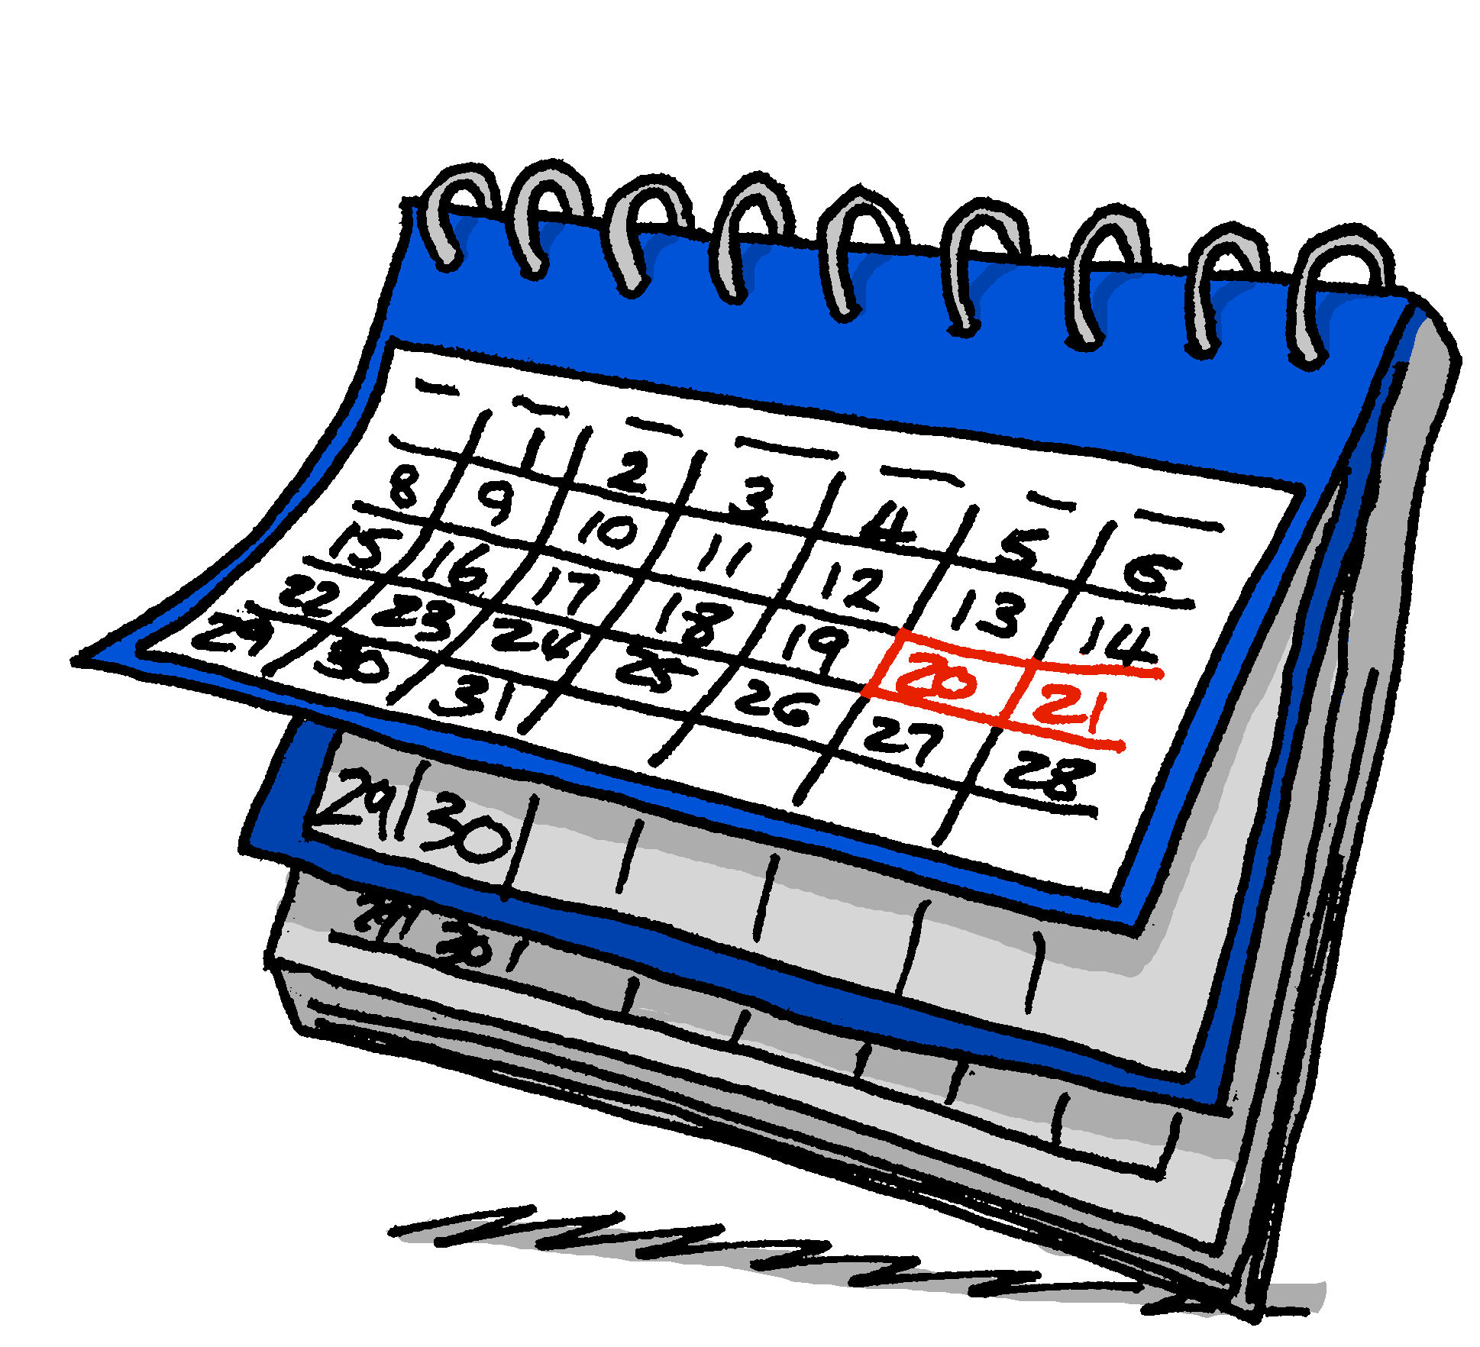
Vokabeln
Sag die Wörter auf Deutsch. Was ist das auf Englisch?
Wörter
die Sprache
das Wochenende
[language]
[weekend]
…
nichts
jetzt
immer
[nothing]
[now]
[always]
You already know some other time phrases: manchmal [sometimes] and nie [never]
Notes:
[1/3]
Timing: 3 minutes
Aim: to introduce 5 new items of vocabulary for this week.
Procedure 1. Pupils either work by themselves or in pairs, reading out the words and reading their English meanings (1 minute). 2. Then, on the next slide, pupils try to recall the English orally (chorally), looking at the German (1 minute). 3. Then, on the following slide, they recall the German meanings orally (again, chorally), looking at the English (1 minute).
Notes:
Note that images/words won’t disappear and appear in this activity as in previous resources.
8

Slide 9
Vokabeln
Sag die Wörter auf Deutsch. Was ist das auf Englisch?
…
Wörter
(the) language
die Sprache
(the) weekend
das Wochenende
nothing
nichts
now
jetzt
always
immer
Notes:
[2/3]
Procedure: 1. Pupils try to recall the English orally (chorally), looking at the German (1 minute). 2. Elicit answers and click to reveal
3. Then, on the following slide, they recall the German meanings orally (again, chorally), looking at the English (1 minute).
9

Slide 10
Vokabeln
Sag die Wörter auf Deutsch. Was ist das auf Deutsch?
…
Wörter
jetzt
now
nichts
nothing
das Wochenende
(the) weekend
immer
always
die Sprache
(the) language
Notes:
[3/3]
Procedure: 1. Pupils try to recall the German orally (chorally), looking at the English (1 minute). 2. Elicit answers and click to reveal
10

Slide 11
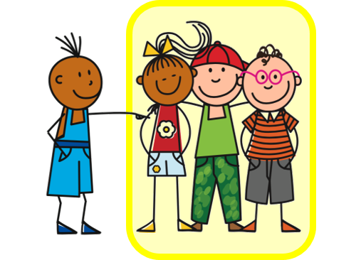
Present tense: strong verbs e→ i, e→ ie
In German, strong verbs change the stem vowel in the er/sie/es form and also the du form:
The ‘e’ → ‘i’ in essen, geben, sprechen, vergessen.
Ich vergesse.
I forget/am forgetting.
Du vergisst.
You forget/are forgetting.
Sie vergisst.
She forgets/is forgetting.
All plural forms (you all, we, they) keep the original vowel, like ich:
Ihr vergesst.
You (all) forget/are forgetting.
Notes:
Timing: 3 minutes (two slides)
Aim: to recap singular forms of strong verbs with e→i and e→ie change.
Procedure:
Click through the animations to present the information.
Elicit English translation for the German examples provided.
11

Slide 12
Present tense: yes/no questions
This is the same for all verbs, weak and strong.
Remember that to ask yes/no questions, the verb and subject swap:
Du siehst.
You see/are seeing.
The ‘e’ → ‘ie’ in lesen, sehen
Do you see? Are you seeing?
Siehst du…?.
And remember, there is no vowel change in plural forms (you all, we, they):
Seht ihr…?
Do you (all) see? Are you (all) seeing?
Notes:
Aim: to recap formation of yes/no questions, this time with strong verbs.
Procedure:
Click through the animations to present the information.
Elicit English translation for the German examples provided.
12

Slide 13
hören
Nina
Nina lernt Deutsch mit Aisha und Johanna.
Hör zu. Fragt sie Johanna (du) oder Johanna und Aisha (ihr)?
In English we might even translate this as: Can you (all) see my exercise book?
ihr (you both)
Do you (all) see my exercise book?
Are you reading a book at the moment?
Are you (all) reading my homework now?
Do you forget nothing/not forget anything?
Do you also speak English?
Do you (all) always eat ice cream at the weekend?
Are you giving lots of/many answers in class?
du (you)
Was? Schreib auf Englisch.
B.
1
2
3
4
5
6
Notes:
Timing: 8 minutes
Aim: to practise aural comprehension of strong verbs in 2nd person singular and plural, as well as vocabulary for this week.
Procedure:
Ensure that the scenario is clear: Nina is learning German with Aisha and Johanna. Is she asking one or both of them a question?
Explain that pupils need to listen out for the verb form to decide if Nina is asking just Johanna (du) or both Johanna and Aisha (ihr). The pronouns are bleeped so they need to listen out for vowel changes in the strong verbs.
Explain that they will listen again and write the action/activity in English.
Complete the example (B). Click to share answers.
Repeat steps 1-4 for items 1 – 6.
Click to share answers.
Note:
Here we are contrasting the ihr (you all) form e.g. sprecht with the er/sie form e.g. spricht, to focus pupils solely on the vowel change in strong verbs. This differs from the listening in Week 10, where pupils were able to use the verb ending to make their decision.
English translations given here are the most likely, but encourage pupils to think about the simple and continuous translations of each. E.g. Do you also speak English? Are you also speaking English? Do both work in every situation? Why (not)?
Transcript:
Beispiel: Seht [ihr] mein Heft?
Liest [du] im Moment ein Buch?
Lest [ihr] jetzt meine Hausaufgaben?
Vergisst [du] nichts?
Sprichst [du] auch Englisch?
Esst [ihr] immer Eis am Wochenende?
Gibst [du] viele Antworten in der Klasse?
13

Slide 14
nicht (not) | nichts (nothing)
More often we say ‘You don’t forget’.
Remember that nicht means not:
Du vergisst nicht.
You forget not.
Du liest nicht.
You don’t read.
More often we say ‘You don’t forget anything’.
Nichts means nothing:
Du vergisst nichts.
You forget nothing.
Du liest nichts.
You don’t read anything.
Notes:
Timing: 2 minutes
Aim: to introduce the meaning of ‘nichts’ and contrast with ‘nicht’.
Procedure:
Click through the animations to present the information.
Elicit English translation for the German examples provided.
14

Slide 15
lesen
Nina textet mit Johanna.
Was fragt Nina? Schreib 1 – 6, ihr oder du, und die Aktivität auf Englisch.
 | Was fragt Nina?
1 | Don’t you (all) eat anything in school?
2 | Don’t you see?
3 | Don’t you (all) read at the weekend?
4 | Do you(all) forget nothing?/ Don’t you (all) forget anything?
5 | Aren’t you playing?/Don’t you play?
6 | Aren’t you (all) giving anything?/Are you (all) giving nothing?
4.
1. Esst ihr nichts in
der Schule?
Vergesst ihr
nichts?
2.
Siehst du
nicht?
Spielst du nicht?
5.
Gebt ihr
nichts?
3.
6.
Lest ihr nicht am Wochenende?
Notes:
THIS IS THE MORE CHALLENGING VERSION OF THIS ACTIVITY.
Timing: 5 minutes
Aim: to practise recognising stem changes between du and ihr and differentiating between nicht and nichts.
Procedure:
Pupils write down 1 to 6 .
Pupils read Johanna’s messages, and for each message say whether it applies to du (Johanna) or ihr (Johanna und Aisha), based on whether or not there is a stem change.
Pupils then try to translate each question, focusing on use of nicht and nichts.
Elicit full phrase answers from pupils in German, clicking to reveal written messages, and then elicit the translation in English. The German audio is available by clicking the picture of Nina on each message.
Note:
1. A version of this activity with more support is given on the next slide.
2. Pupils may have varying translations of the questions e.g. ‘Are you eating?’ instead of ‘Do you eat?’ Discuss the possibilities here. The main thing to check is whether or not pupils have noticed nicht(s) and how this changes the meaning of the question.
15

Slide 16
lesen
Nina textet mit Johanna.
Was fragt Nina? Schreib 1 – 6, ihr oder du, und A oder B.
Was fragt Nina? A oder B?
 | A | B
1 | Don’t you (all) eat anything in school? | Don’t you eat in school?
2 | Don’t you see anything? | Don’t you see?
3 | Don’t you (all) read at the weekend? | Don’t you (all) read anything at the weekend?
4 | Don’t you (all) forget ? | Don’t you (all) forget anything?
5 | Aren’t you playing?/Don’t you play? | Aren’t you playing anything?/ Don’t you play anything?
6 | Aren’t you (all) giving anything? | Aren’t you (all) giving?
1. Esst ihr nichts in
der Schule?
4.
Vergesst ihr
nichts?
2.
Siehst du
nicht?
Spielst du nicht?
5.
3.
6.
Lest ihr nicht am Wochenende?
Gebt ihr
nichts?
Notes:
THIS IS THE MORE SUPPORTED VERSION OF THIS ACTIVITY.
Timing: 5 minutes
Aim: to practise recognising stem changes between du and ihr and differentiating between nicht and nichts.
Procedure:
Pupils write down 1 to 6 .
Pupils read Johanna’s messages, and for each message say whether it applies to du (Johanna) or ihr (Johanna und Aisha), based on whether or not there is a stem change.
Pupils then read the two translations (A and B) given of each question and decide which is correct, focusing on the use of nicht and nichts.
Elicit full phrase answers from pupils in German, clicking to reveal written messages, and then elicit the correct translation in English. The German audio is available by clicking the picture of Nina on each message.
Note:
1. A version of this activity without the multiple choice support is given on the previous slide.
2. Pupils may suggest varying translations of the questions e.g. ‘Are you eating?’ instead of ‘Do you eat?’ Discuss the possibilities here. The main thing to check is whether or not pupils have noticed nicht(s) and how this changes the meaning of the question.
16

Slide 17
Tschüss!
blau
Notes:
17

