Slide 1
What I can do
Ich kann das!
blau
Phonics, Vocabulary
and Grammar revision
Follow ups 1-5
Term 1 Week 12
Notes:
Artwork by Steve Clarke. Pronoun pictures from NCELP (www.ncelp.org). All additional pictures selected from Pixabay and are available under a Creative Commons license, no attribution required.
Phonics: revisit SSC long and short [a] [e] [i] [o] [u] (for these also write long or short); [ei] [ie] [w] [z] hard and soft [ch]
Vocabulary: revisit words from lessons 1 - 11
Jones, R.L & Tschirner, E. (2019). A frequency dictionary of German: Core vocabulary for learners. London: Routledge.
The frequency rankings for words that occur in this PowerPoint which have been previously introduced in these resources are given in the SOW and in the resources that first
introduced and formally re-visited those words.
For any other words that occur incidentally in this PowerPoint, frequency rankings will be provided in the notes field wherever possible.
Remember that at the start of the course (first three lessons of Rot/Gelb) pupils learnt language (for greetings and register taking) that can still be part of the lesson routines in upper KS2 (Blau/Grün). They are not re-taught, as we anticipate that teachers have built these in from early in lower KS2.
1

Slide 2
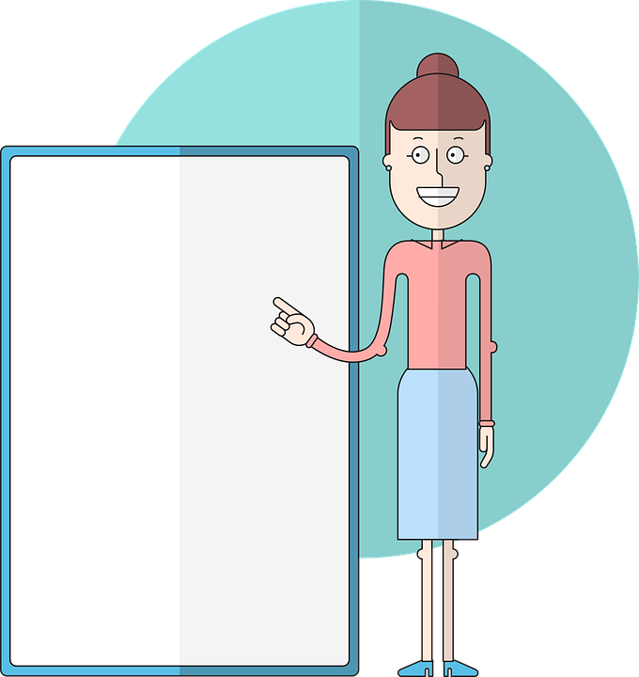
aussprechen
Follow up 1
long [u]
short [u]
Uhr
Unterricht
[watch, clock, o’clock]
[teaching, lessons]
Notes:
Timing: 5 minutes (eight slides)
Aim: to practise read aloud of SSC learnt so far with unknown words.
Procedure:
Tell pupils that they are going to practise the sounds of German that they have learnt this year.
Click to bring up the first ‘flashcard’.
Elicit the SSC first. (To bring all pupils in together, teachers could use a silent 3-2-1 countdown gesture with their fingers).
Elicit the word, using the same countdown procedure.
Click to bring up the 2nd flashcard and repeat steps 3-4.
Word frequency (1 is the most frequent word in German):
Uhr [348] Unterricht [1823]
Jones, R.L & Tschirner, E. (2019). A frequency dictionary of German: Core vocabulary for learners. London: Routledge.
2

Slide 3
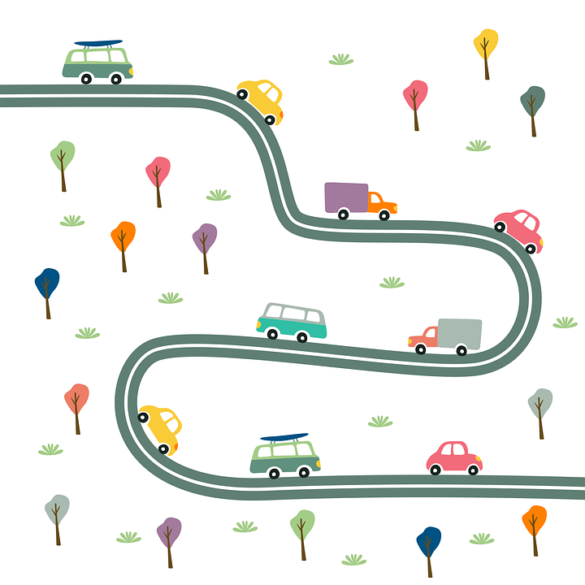
aussprechen
long [a]
short [a]
Straße
Stadt
[street]
[town]
Notes:
[2/8]
Word frequency (1 is the most frequent word in German):
Straße [391] Stadt [204]
3

Slide 4
aussprechen
long [o]
short [o]
froh
wollen
[glad, happy]
[ want (to)]
Notes:
3/8
Word frequency (1 is the most frequent word in German):
froh [1424] wollen [57]
4

Slide 5
aussprechen
[ei]
[ie]
die Schweiz
lieben
[to love, loving]
Notes:
4/8
Word frequency (1 is the most frequent word in German):
Schweiz [764] lieben [701]
5

Slide 6
aussprechen
long [e]
short [e]
stehen
Wetter
[to stand, standing]
Notes:
5/8
Word frequency (1 is the most frequent word in German):
stehen [85] Wetter [1881]
6

Slide 7
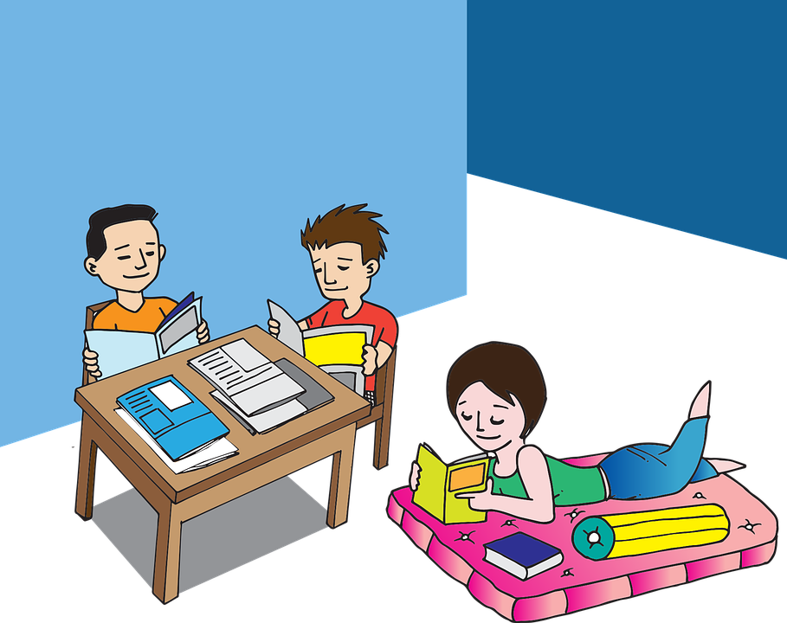
aussprechen
long [i]
short [i]
liegen
wohin?
[to lie, be lying]
[where (to)?]
Notes:
6/8
Word frequency (1 is the most frequent word in German):
liegen [107] wohin [1811]
7

Slide 8
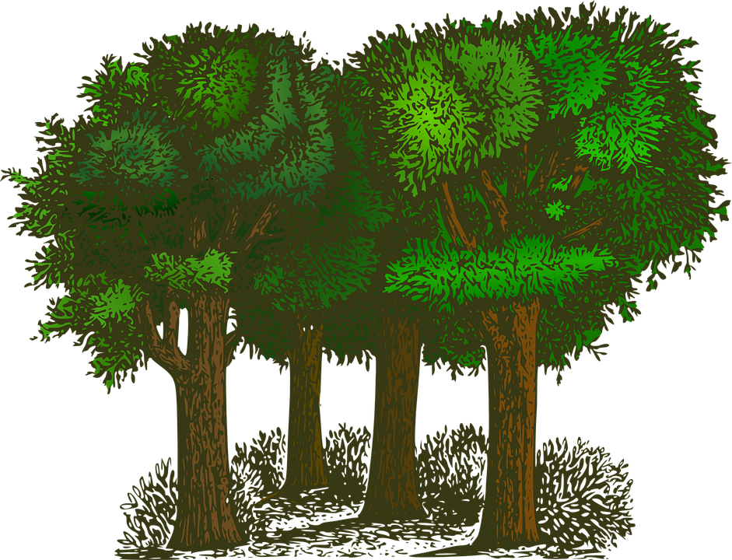
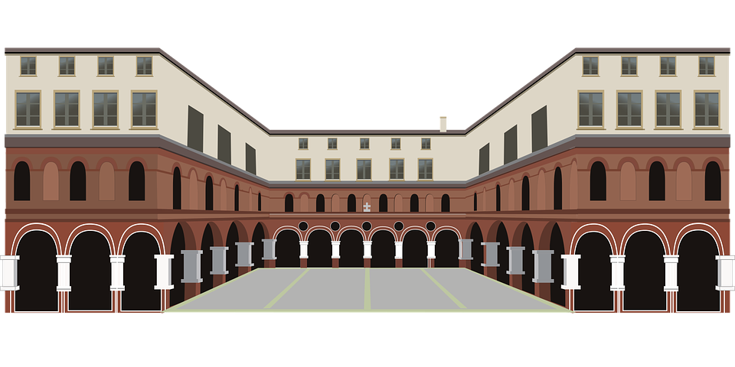
aussprechen
[w]
[z]
Wald
Platz
[forest, wood]
[square]
Notes:
7/8
Word frequency (1 is the most frequent word in German):
Wald[1028]Platz [326]
8

Slide 9
ausprechen
soft [ch]
hard [ch]
Österreich
nach
[Austria]
[to, towards]
Notes:
8/8
Word frequency (1 is the most frequent word in German):
Österreich [707] nach [34]
9

Slide 10
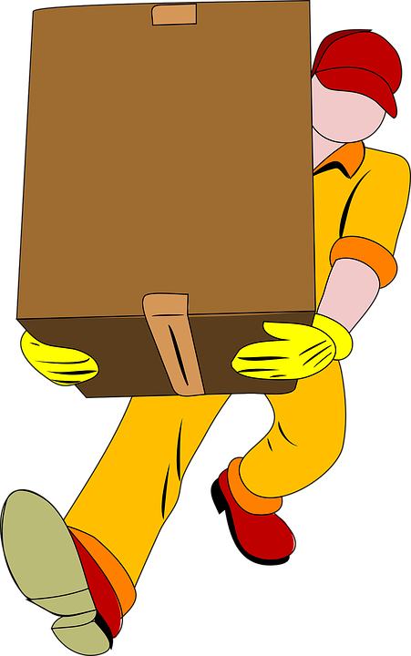
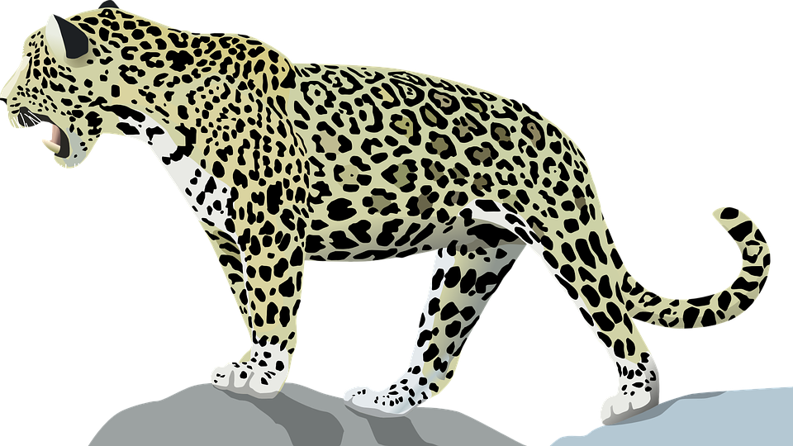
Follow up 2: Sag die Wörter.
aussprechen
November
Mensch
Ding
zu
60
[to]
tragen
Wasser
S
Juni
Tier
[to carry]
du willst
Hunger
Gute Nacht
Ostern
0
[you want to]
START
Notes:
Timing: 5 minutes
Aim: to practise applying knowledge of previously learnt SSCs to known and unknown words.
Procedure: 1. Start the timer. Pupil A tries to read aloud all of the words taking care with their pronounciation of the highlighted SSC’s, within the 60 seconds allowed.
2. Pupil B listens. If Pupil A makes a slip, Pupil B can direct him/her to start again from the beginning. 3. They swap roles and repeat the task.
Word frequency for unknown words: (1 is the most frequent word in German):
Hunger [2097] willst [57] gute Nacht [N/A] Ostern [> 5009] zu [21]

Slide 11
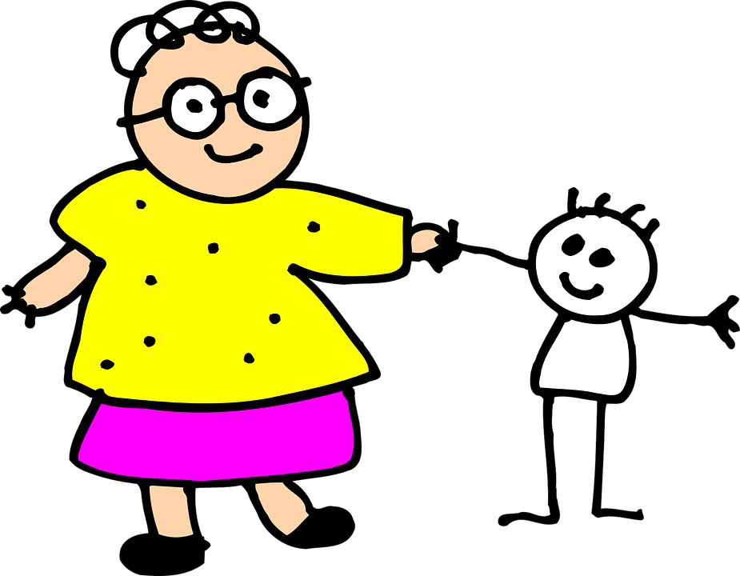
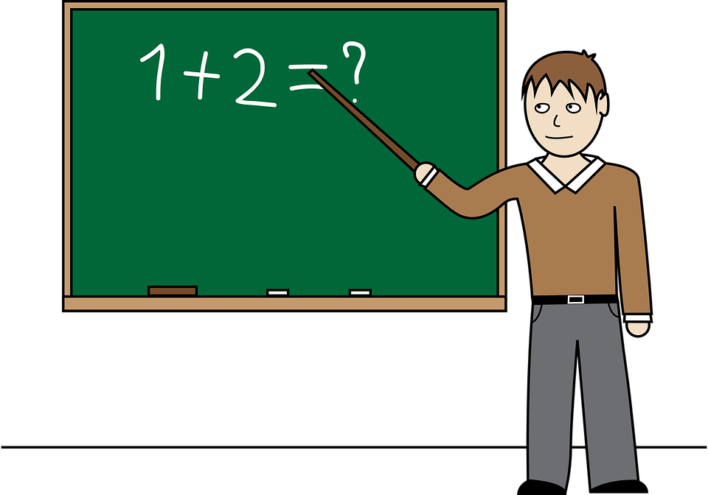
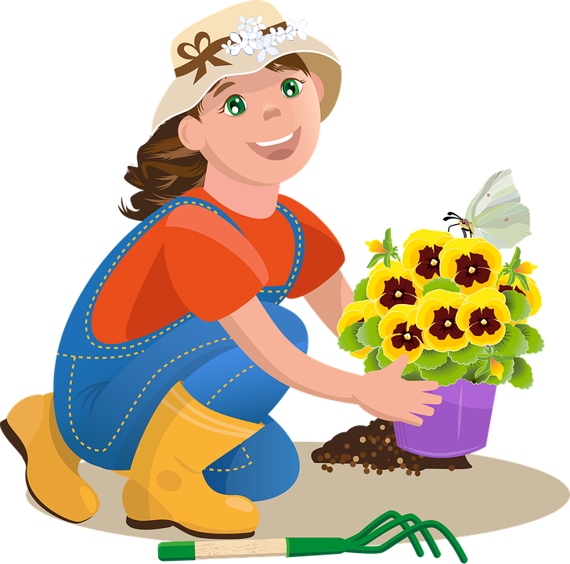
Follow up 3
Sag die Wörter.
sprechen
sprechen
der
das
die
Notes:
Timing: 5 minutes
Aim: to practise spoken production of a range of vocabulary and practise applying gendered articles
Procedure:
Click to bring up the image. Pupils say the word and say them aloud with the appropriate article.
Click again for the words to disappear into the appropriate ‘pacman’.
Continue for the rest of the items.
Items in order:
der Garten
das Eis
die Oma
der Bleistift
die Schule
der Lehrer
das Handy
der Kuchen
die Blume
der Film
die Aktivität
das Glas

Slide 12
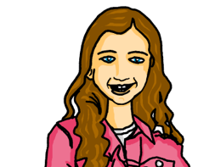
hören
Follow up 4
Das ist ein Quiz für dich, Robbie!
For each question, put a cross (x) under the type of word you hear. You will hear each German word twice. Choose one correct answer only.
This word is a good example of …
 | A | B | C | D
1. | a time span ☐ | a person ☐ | an animal ☐ | an object ☐
2. | an object ☐ | a description ☐ | a question word ☐ | a country ☐
3. | an animal ☐ | an object ☐ | a description ☐ | a question word ☐
4. | a person ☐ | a country ☐ | a question word ☐ | a greeting ☐
1
2
3
4
Notes:
Timing: 5 minutes
1/2
Procedure:
Pupils write 1-8 and write down A, B, C, or D for each word that they hear. Items 5-8 continue on the next slide.
Click to reveal answers 1-4 in turn.
Transcript:
Minute
jung
schön
wie
12

Slide 13
hören
Follow up 4
This word is a good example of …
 | A | B | C | D
 | an object ☐ | a greeting ☐ | a person ☐ | a country ☐
 | a greeting ☐ | an object ☐ | an animal ☐ | a person ☐
 | a season ☐ | a country ☐ | a greeting ☐ | a question word ☐
 | an object ☐ | an animal ☐ | a person ☐ | a number ☐
5
6
7
8
Notes:
Answers
2/2
Transcript:
Freundin
Hund
Winter
dreißig
13

Slide 14
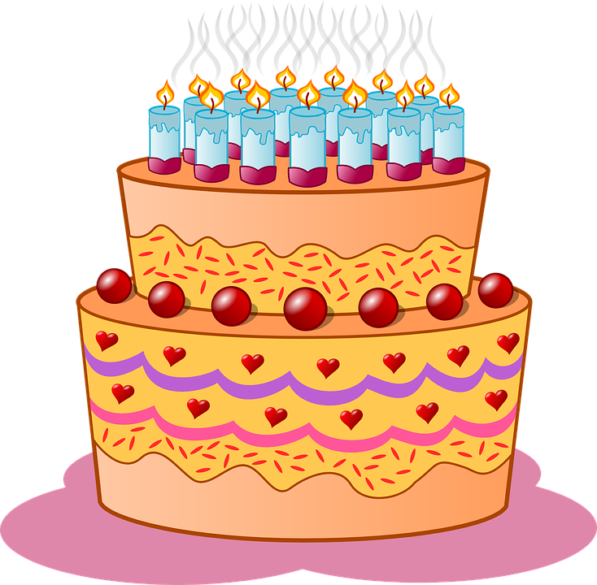
Follow up 5:

Schreib auf Deutsch.

schreiben
1 _____________________________
Du hast am fünften Juli Geburtstag.
You have on the fifth of July (your) birthday.

Ich habe am dreizehnten Oktober Geburtstag.
2 _____________________________
I have on 13 October (my) birthday .

3 _____________________________
Sie hat am einunddreißigsten Dezember Geburtstag!
She has on 31 Dezember (her) birthday!
Notes:
Timing: 5 minutes
Aim: to revise forms of the verb haben and dates.
Procedure:
Pupils translate the sentences from English into German.
Click for answers.

Slide 15
Tschüss!
blau
Notes:
15

