Slide 1
What I can do
Ich kann das!
blau
Phonics, Vocabulary
and Grammar revision
Term 1 Week 12
Notes:
Artwork by Steve Clarke. Pronoun pictures from NCELP (www.ncelp.org). All additional pictures selected from Pixabay and are available under a Creative Commons license, no attribution required.
Phonics: revisit SSC long and short [a] [e] [i] [o] [u] (for these also write long or short); [ei] [ie] [w] [z] hard and soft [ch]
Vocabulary: revisit words from lessons 1 - 11
Jones, R.L & Tschirner, E. (2019). A frequency dictionary of German: Core vocabulary for learners. London: Routledge.
The frequency rankings for words that occur in this PowerPoint which have been previously introduced in these resources are given in the SOW and in the resources that first
introduced and formally re-visited those words.
For any other words that occur incidentally in this PowerPoint, frequency rankings will be provided in the notes field wherever possible.
Remember that at the start of the course (first three lessons of Rot/Gelb) pupils learnt language (for greetings and register taking) that can still be part of the lesson routines in upper KS2 (Blau/Grün). They are not re-taught, as we anticipate that teachers have built these in from early in lower KS2.
1

Slide 2
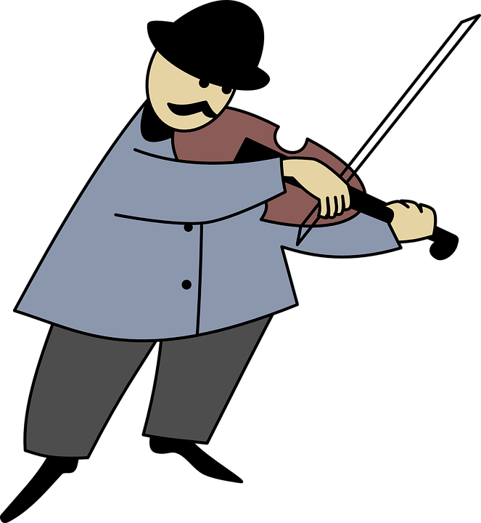
hören
Hör zu.
Write 1-8 und the sound: [a], [e], [i] ,[o], [u] (and long or short); [ei], [ie], [w], [z], [ch] (for [ch] also hard or soft).
Final syllable vowels can be short or long before consonants so just listen out extra carefully!
hören
1 | I n s e l
2 | A u t o
3 | Gute Na ch t
4 | R u cksack
5 | L a nd
6 | j e den Tag
7 | M u siker
8 | Schmer z en
?
?
short
short
?
?
long
long
?
?
hard
long
?
?
short
Notes:
1/2
Timing: 5 minutes
Aim: to practise aural recognition and transcription of previously taught SSCs using unknown words.
Procedure:
Click for instructions to come up.
Click audio button 1 to play the recording for item 1. Pupils need to write down the SSC.
Elicit the answer.
Click to reveal the spelling of word 1.
Elicit the meaning, based on the image.
Continue for items 2-8.
Transcript and word frequency: 1. Insel [1029] (short [e])
2. Auto [361] (long [o])
3. Gute Nacht [n/a] (hard [ch])
4. Rucksack [3180] (short [u])
5. Land [134] (short [a])
6. jeden Tag [n/a] [long [e])
7. Musiker [2577] (long [u])
8. Schmerzen [1483] ([z])
Source: Jones, R.L. & Tschirner, E. (2019). A frequency dictionary of German: core vocabulary for learners. Routledge

Slide 3
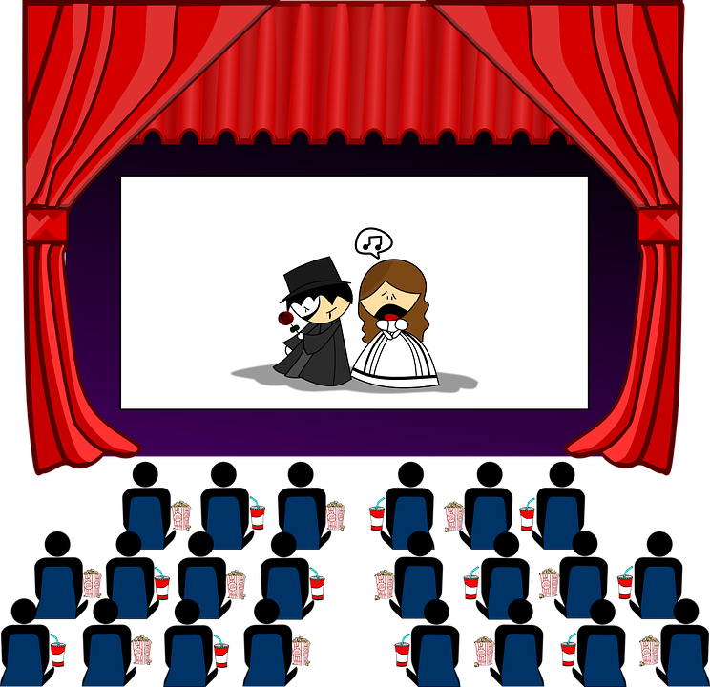
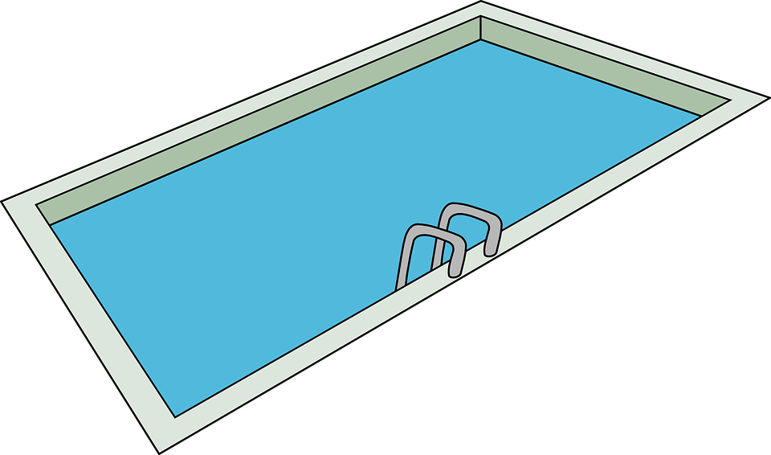
hören
Hör zu.
Write 1-8 und the sound: [a], [e], [i] ,[o], [u] (and long or short); [ei], [ie], [w], [z], [ch] (for [ch] also hard or soft).
hören
1 | K i no
2 | f i nden
3 | Unterri ch t
4 | Sp a ß
5 | K o nzert
6 | Sch w immbad
7 | l i e gen
8 | Arb ei t
?
?
long
short
?
?
short
?
?
soft
?
?
long
Notes:
2/2
Timing: 5 minutes
Transcript and word frequency: 1. Kino [2020] (long [i])
2. finden [103] (short [i])
3. Unterricht[1823] (soft [ch])
4. Spaß [1045] [long [a]]
5. Konzert [2350] (short [o])
6. Schwimmbad [>5009] [w]
7. liegen [107] ([ie])
8. Arbeit [208] ([ei])

Slide 4
Vokabeln
Meet the Primary Bee!
Wörter
Word knowledge not spelling
Open to Y5/6
Three stages (school, regional, national) each with 40 words
Notes:
Timing: 5 minutes
Aim: to present and practise new vocabulary for this week combined with an introduction to the Primary Bee.
Procedure:
Click through the animations and briefly explain the Primary Bee: https://www.routesintolanguages.ac.uk/events/primary-bee
Notes taken from the Primary Bee Teachers’ Pack (2022): The aim of the Primary Bee is for students in Years 5 & 6 who have started learning a foreign language ab initio in KS2 to practise and improve their vocabulary, pronunciation and memory skills in the target language (French, Spanish and German). Native or bilingual students, as well as those who communicate in or are exposed to the language on a regular basis at home (speaking and/or listening), are not eligible to compete. It is the classroom teacher’s responsibility, with careful consideration of the ethos of the competition, to decide whether or not a student falls into this category.
Words and phrases have been selected according to the work of NCELP (National Centre for Excellence in Language Pedagogy) which highlights the importance of word frequency in informing vocabulary learning, particularly during the early stages of language development. The list includes many high-frequency words (e.g., some numbers, some colours, some verbs, days of the week, question words and a number of common verbs to help early learners to acquire a robust knowledge of verb vocabulary. These most common verbs are included in the infinitive and 3rd person singular forms; these two verb forms have been shown to provide a very useful linguistic core that can subsequently be further developed. For information we publish the word lists, indicating the word frequency.
To register, please visit https://www.sanako.co.uk/Spelling-Bee-Competition/
4

Slide 5
Vokabeln
Was ist das auf Englisch?
Wörter
ich weiß nicht
März
danke
Montag
wohnen
spielen
gut
gelb
richtig
Monday
yellow
well, fine
to play
I don’t know
thank you
March
to live
right, correct
Notes:
Timing: 6 minutes (two slides)
Aim: to practise written comprehension and read aloud of vocabulary from the Primary bee which overlaps with years 3/4 vocabulary.
Procedure: 1. Click for a German word. Elicit pronunciation from pupils.
2. Elicit the English meaning from pupils and click to confirm.
3. Continue with the remaining words.
4. Then move on to the next slide.
Transcript:
danke
gut
Montag
ich weiß nicht
März
wohnen
spielen
gelb
richtig
5

Slide 6
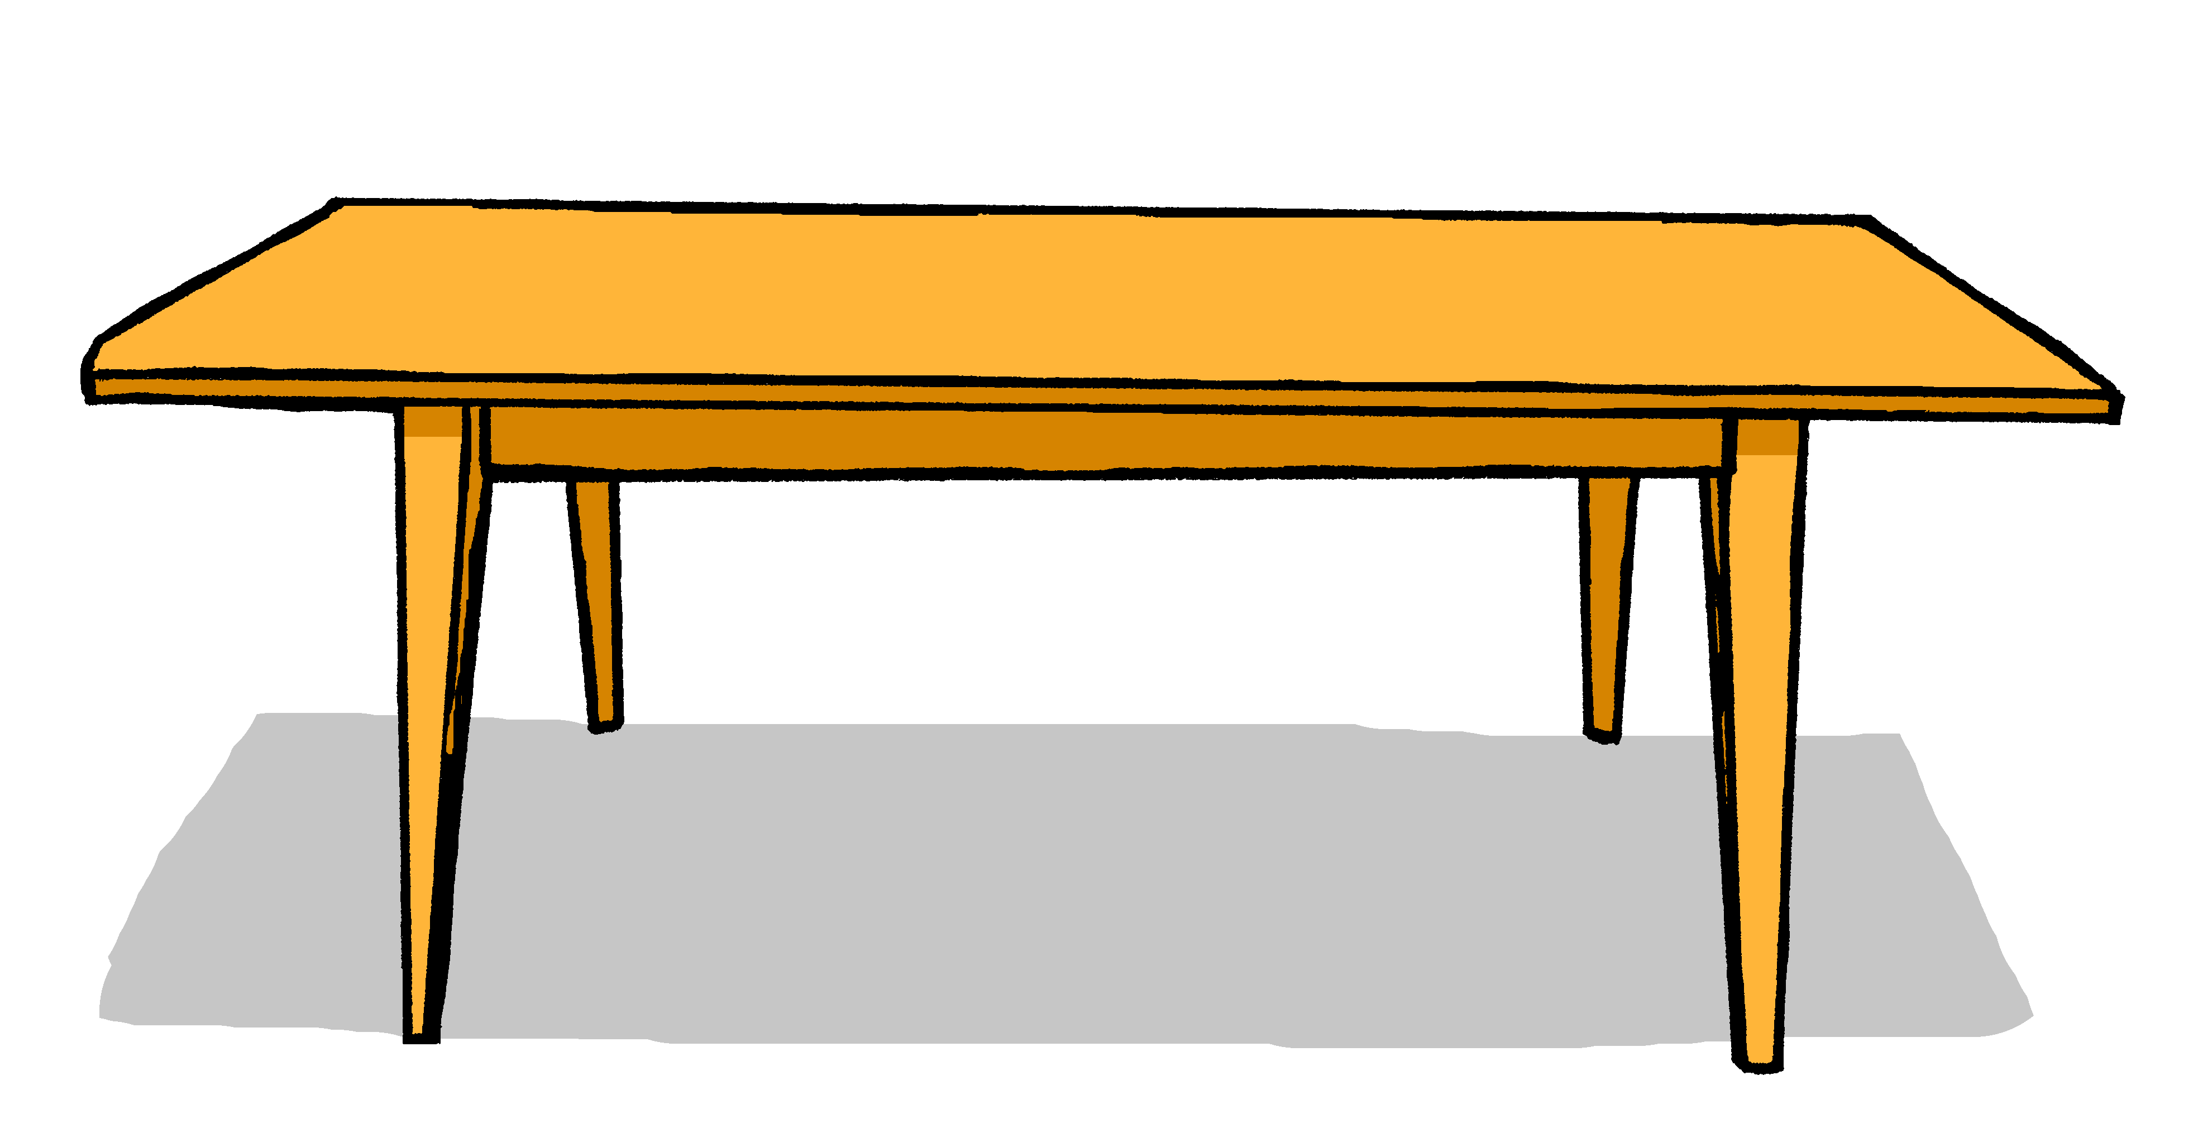
Vokabeln
Was ist das auf Deutsch?
Wörter
table
example
exercise book
Deutschland
word
answer
school
question
book
das Heft
das Wort
der Tisch
die Antwort
Deutschland
das Beispiel
die Schule
das Buch
die Frage
Notes:
Aim: to elicit oral production and accurate read-aloud of nouns from the Primary Bee (all previously taught from this SOW).
Procedure: 1. Click for an English word.
2. Elicit the German word from all pupils, chorally.
3. Click to provide the written answer.
4. If needed, click on the picture to hear the word pronounced.
6

Slide 7
lesen
Robbie has forgotten some of their German. Can you help them?
Remember!
 |  | A: mag | B: magst |  | C: 1 oder 2?
1 | ich |  |  | keinen | ☐ Bleistifte (pl) ☐ Computer (m)
2 | er |  |  | kein | ☐ das Spiel (nt) ☐ Lied (nt)
3 | du |  |  | keine | ☐ Geschenke (pl) ☐ Song (m)
4 | sie |  |  |  | ☐ den Kuchen (m) ☐ Frage (f)
5 | ich |  |  | kein | ☐ Bilder (pl) ☐ Wort (nt)
6 | du |  |  |  | ☐ Glas (nt) ☐ den Film (m)
7 | es |  |  | keinen | ☐ Baum (m) ☐ Ideen (pl)
8 | ich |  |  | keine | ☐ Probleme (pl) ☐ Zimmer (nt)
kein means no/not a, but in English it sometimes sounds better to say ‘any’ with a negative verb: Ich mag keinen Computer. I like no computer → I don’t like any computer.
Danke!
1
2
3
4
5
6
7
8
Notes:
Timing: 8 minutes
Aim: to revise the singular forms of mögen and negation of plural nouns with keine.
Procedure:
Pupils write out 1-9, and write down A (mag), B (magst) and C1 or C2, depending on the form of kein or absence of kein before each noun. Note that the gender/number indicator has been provided to focus all of pupils’ attention on the connection between the form of kein and these aspects of each noun, or the absence of kein and the connection to the use of the definite article.
Click to bring up answer ticks in turn.
If time, elicit English translations for the full sentences.
Click on the number buttons for listen and check.
Note: the animations are set up for completion and correction of columns A/B first (the verb contrast) and then for Column C1/C2 (kein form/no kein noun contrast). Teachers can adapt this, as required.
Transcript: 1. Ich mag keinen Computer.
2. Er mag kein Lied. 3. Du magst keine Geschenke.
4. Sie mag den Kuchen. 5. Ich mag kein Wort. 6. Du magst den Film. 7. Es mag keinen Baum. 8. Ich mag keine Probleme.
7

Slide 8
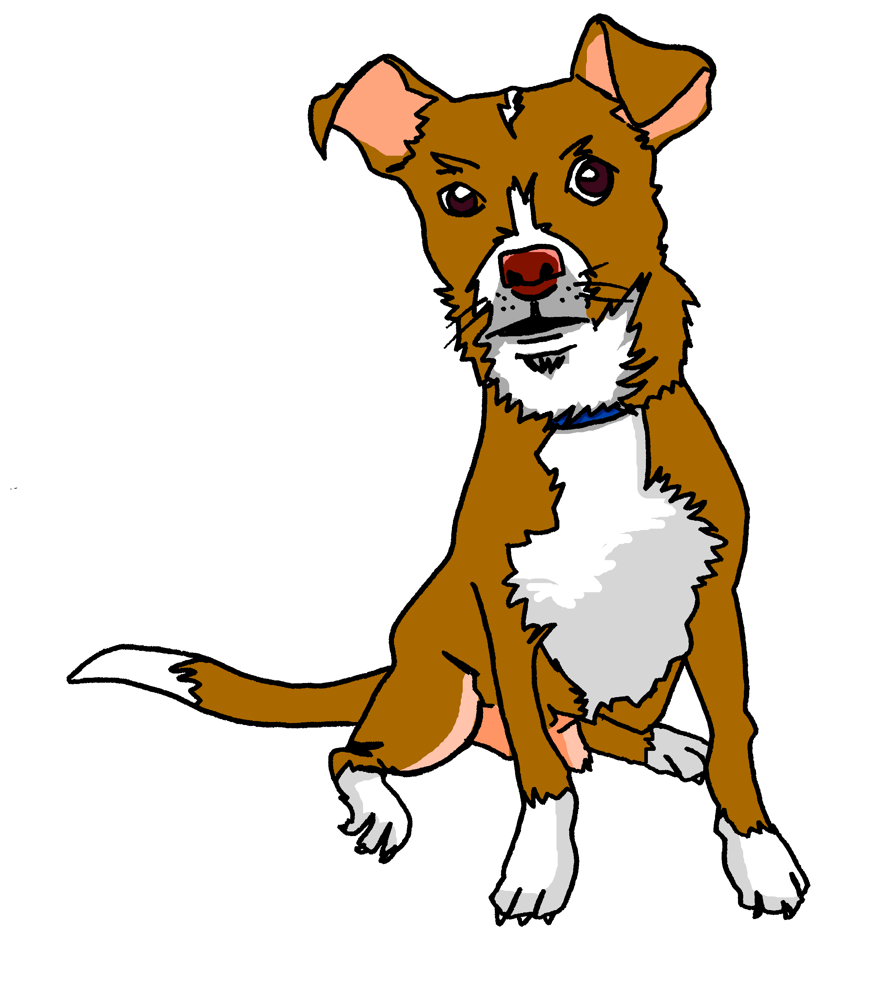
hören
Sie (sg) oder sie (plural)?
Ist das Johanna, oder sind das Johanna und Aisha?
Johanna | Johanna und Aisha
B.
1
Tasso
2
3
4
5
6
Notes:
Timing: 5 minutes
Aim: to practise aural comprehension of sie (plural) vs sie (singular) based on singular or plural verb forms.
Procedure:
1. Click to play the audio for the example. Pupils choose their answer, based on the verb.
2. Click for answer tick. Click again to bring up Tasso, Johanna and Moritz’s dog, who we haven’t see for a while.
3. Continue for items 1-6.
Transcript:
Beispiel: Sie gibt Tasso Wasser.
Sie geben Moritz ein Geschenk.
Sie haben im April Geburtstag.
Sie ist in der Klasse.
Sie sind in Deutschland in der Schule.
Sie mag Apfelkuchen.
Sie hat einen Bruder.
8

Slide 9
sprechen
Remember!
Partnerarbeit
Positive plural statements need no article: → Er gibt Bilder (He gives pictures). Negative plural statements with nouns use keine: → Ich habe keine Flaschen. (I have no bottles / I don’t have any bottles.)
Aisha und Robbie take it in turns to say as many sentences as they can in one minute. You do the same with a partner!
60
 |  |  | Eis (nt)
 | gebe |  | Kuchen (m)
 | gibt |  | Bleistift (m)
ich | gebt | einen | Geschenk (nt)
er | habe | eine | Flaschen (pl)
ihr | hat | ein | Hund (m)
 | habt | keine | Katze (f)
 |  |  | Tasche (f)
 |  |  | Bilder (pl)
S
0
START
Notes:
1/2
Timing: 2 minutes (2 slides)
Aim: to practise spoken production of forms of geben and haben with forms of the indefinite article einen, eine, ein and keine for plural and/or feminine nouns.
Procedure:
Explain that pupils have to make as many sentences as they can and say them out loud in under one minute (use the timer).
First, the gender is indicated in brackets so that pupils can practise to get this right.
On the second slide, pupils do the task without the gender of the nouns being indicated in brackets.
If their partner notices a gender mistake, they swap over.
9

Slide 10
sprechen
Partnerarbeit
Aisha und Robbie take it in turns to say as many sentences as they can in one minute. You do the same with a partner!
60
 |  |  | Eis
 | gebe |  | Kuchen
 | gibt |  | Bleistift
ich | gebt | einen | Geschenk
er | habe | eine | Flaschen
ihr | hat | ein | Hund
 | habt | keine | Katze
 |  |  | Tasche
 |  |  | Bilder
S
0
START
Notes:
2/2
Slide 2 without the gender of the nouns being indicated in brackets.
10

Slide 11
Can you help Robbie with their German?
Put a (X) next to the noun that completes each sentence.
lesen
1. | Diese | ☐ Lehrerin (f) ☐ Freund (m) | ist sehr nett.
2. | Dieser | ☐ Film (m) ☐ Wochenende (nt) | ist lang.
3. | Dieses | ☐ Blume (f) ☐ Bild (nt) | ist schön.
4. | Hast du | einen | ☐ Hund (m)? ☐ Haustier (nt)?
5. | Er hat | keine | ☐ Foto (nt). ☐ Tasche (f).
Notes:
Aim: to practise written understanding of dieser/diese/dieses and indefinite articles in the accusative/Row 2.
Note: the audio version of this resource has the audio attached the answer cross (click on the green cross for each item, once it has appeared.
Procedure:
Pupils select the correct choice out of two for items 1-5.
Elicit answers.
Click for answers.
11

Slide 12
Tschüss!
blau
Notes:
12

