Slide 1
Interacting
blau
Phonics quiz
Term 1 Week 14
Notes:
Artwork by Steve Clarke. Pronoun pictures from NCELP (www.ncelp.org). All additional pictures selected from Pixabay and are available under a Creative Commons license, no attribution required.
This lesson contains a phonics assessment to check progress in the SSCs introduced and practised in the first 12 weeks of this year’s course, as well as those from the previous two years.
The ratio of old to new SSCs in the quiz is approximately 50:50.
1

Slide 2
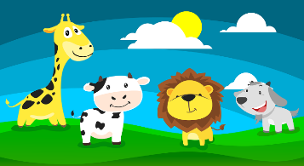
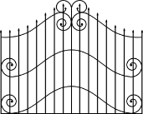
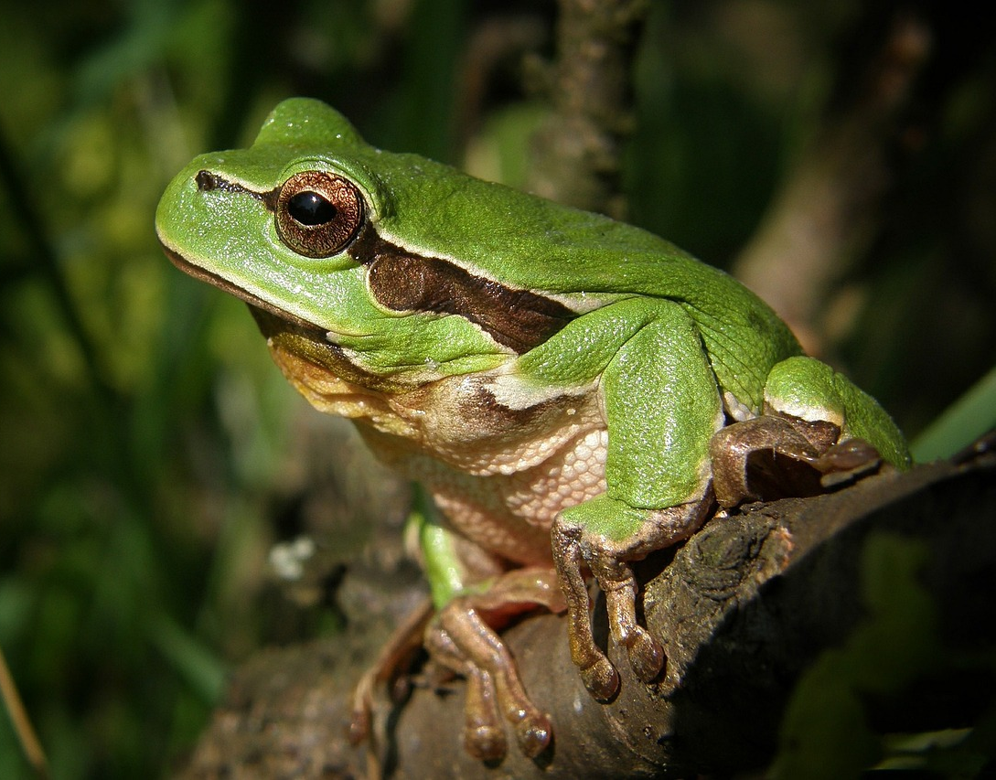
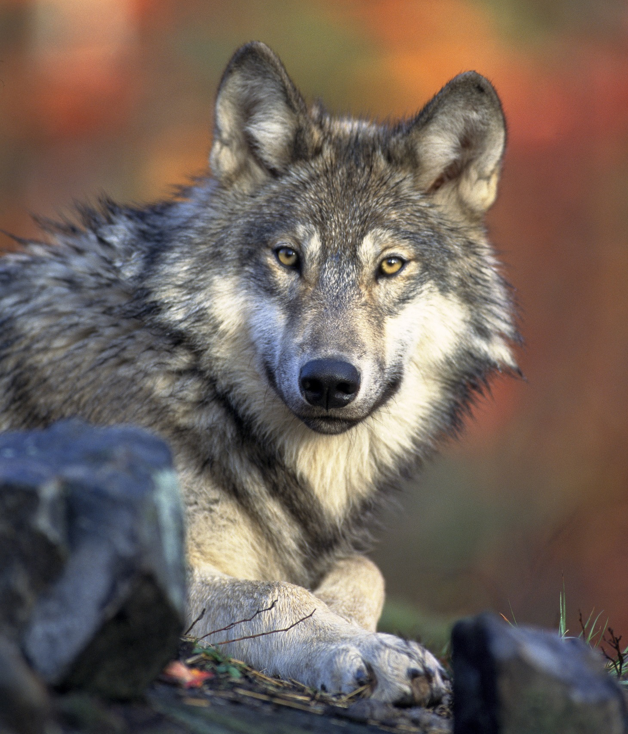
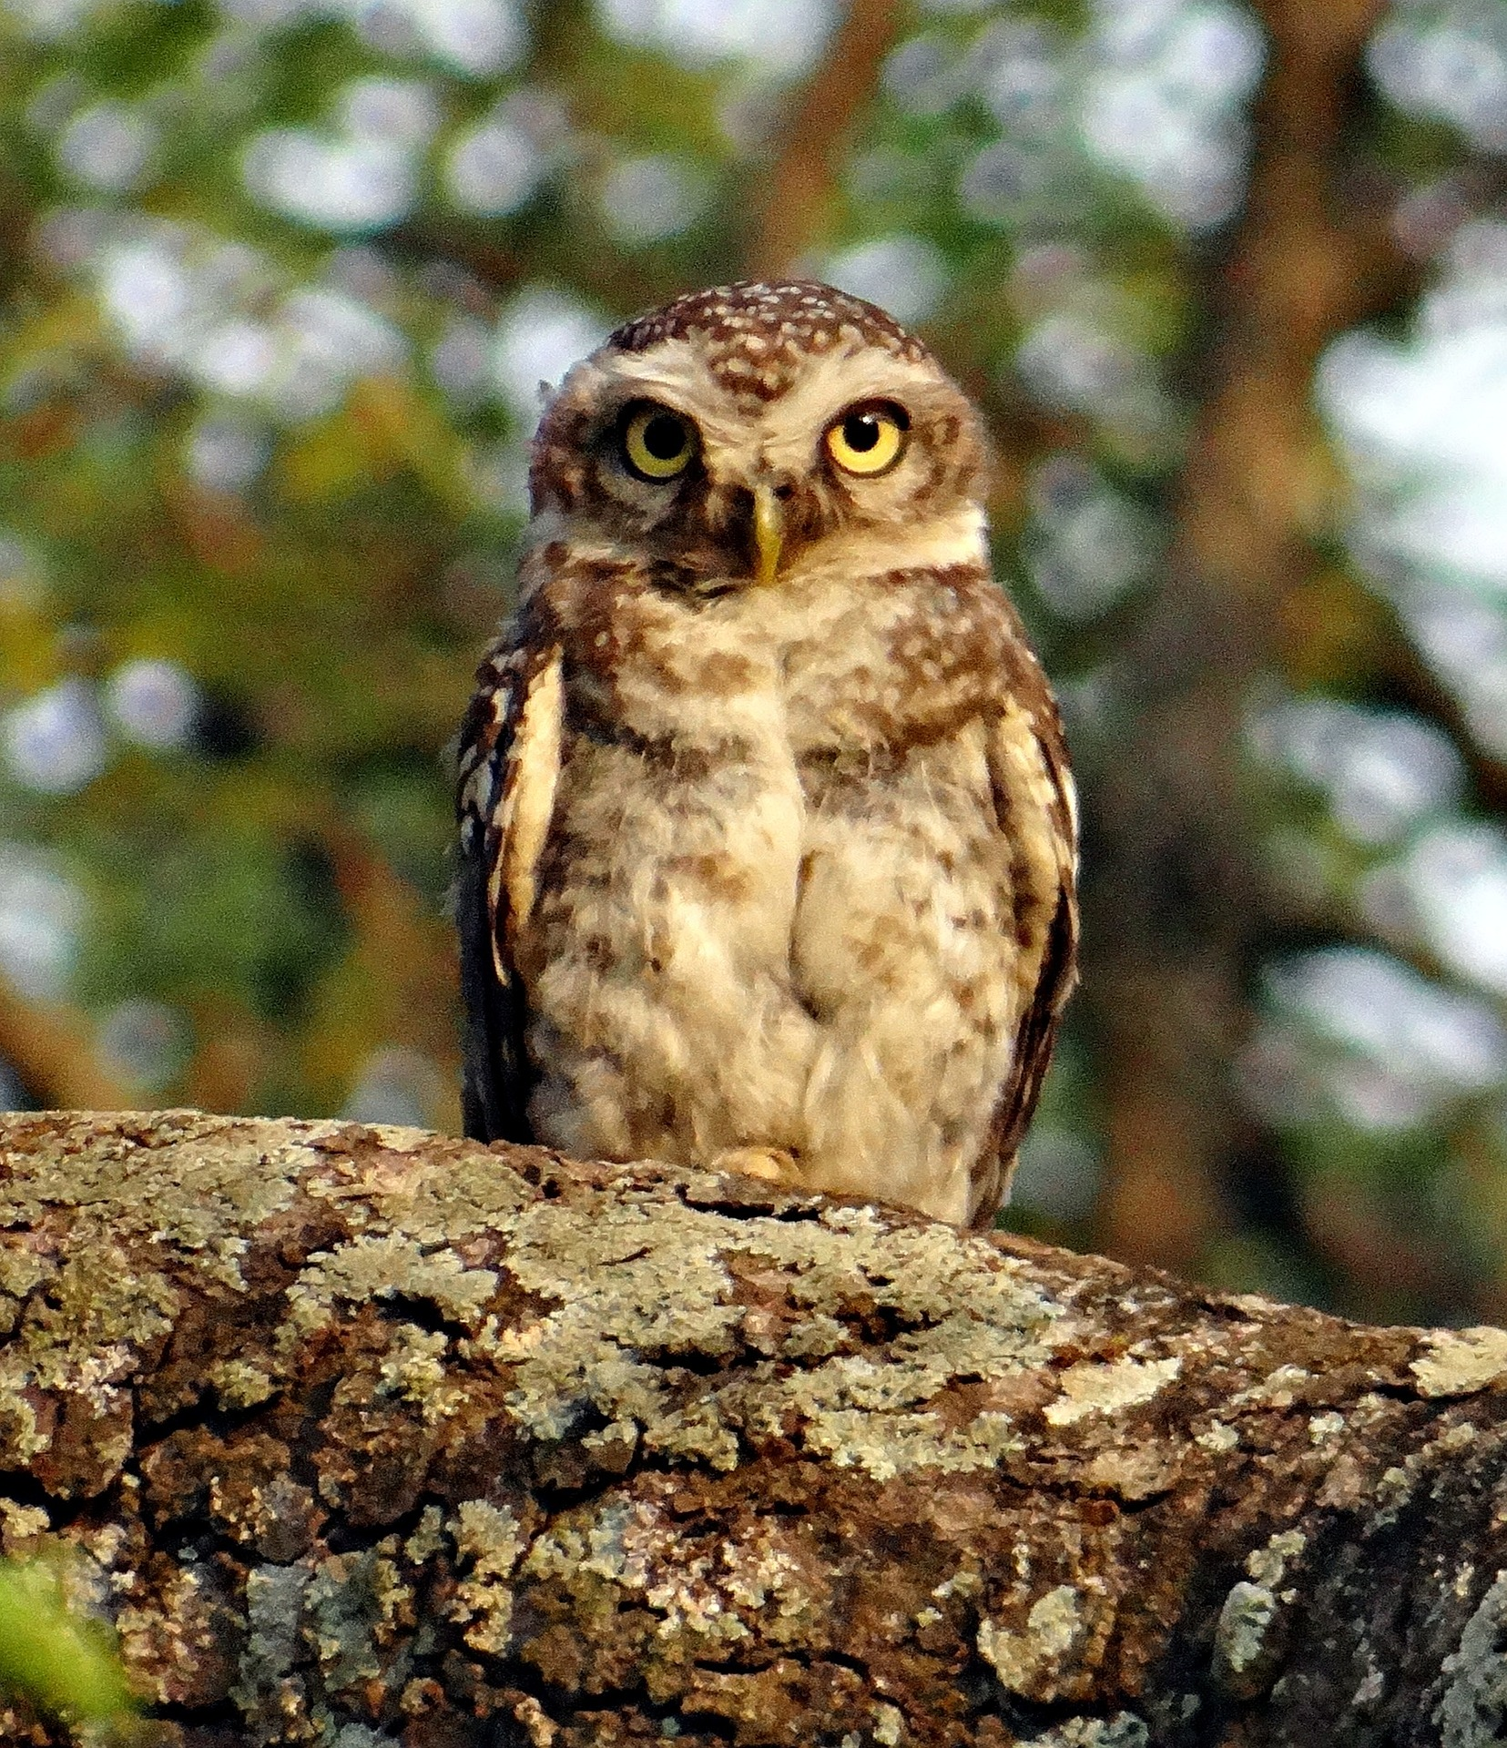
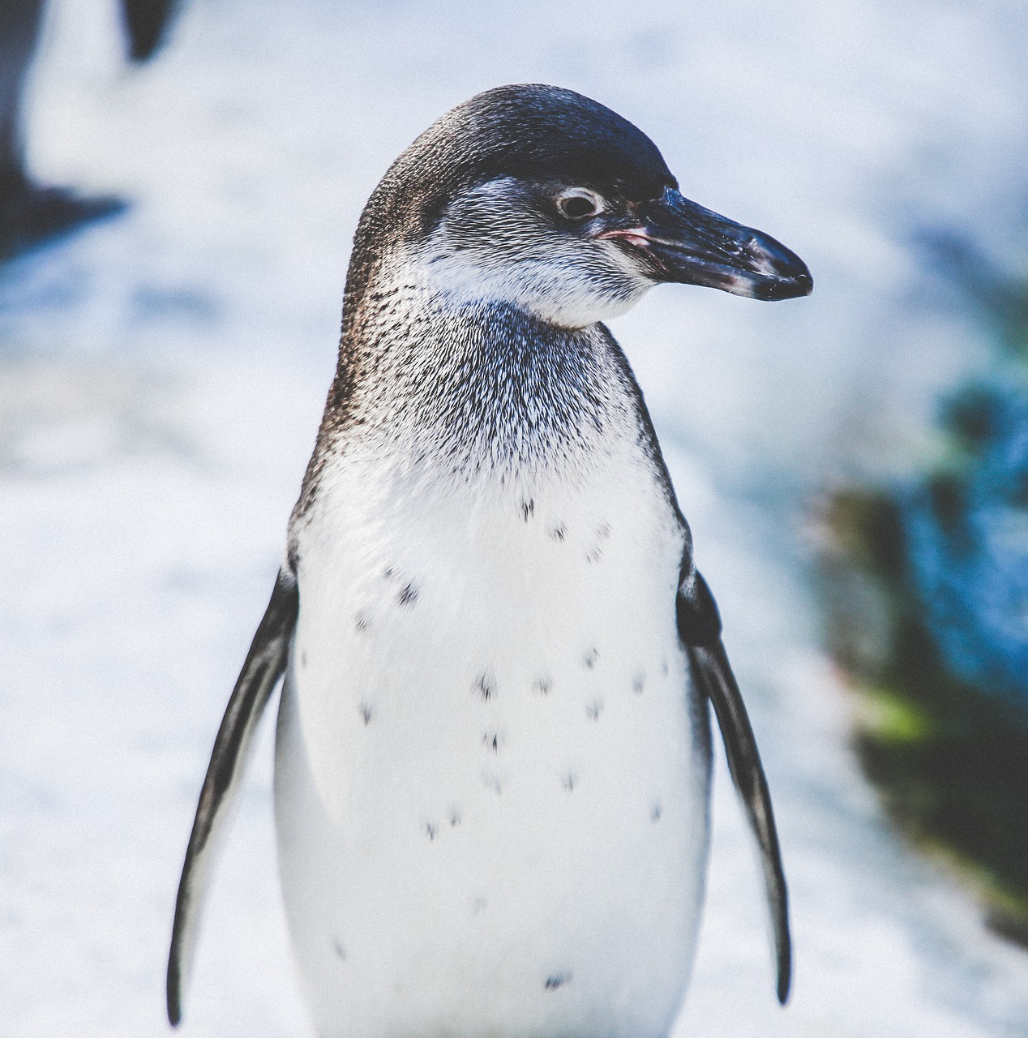
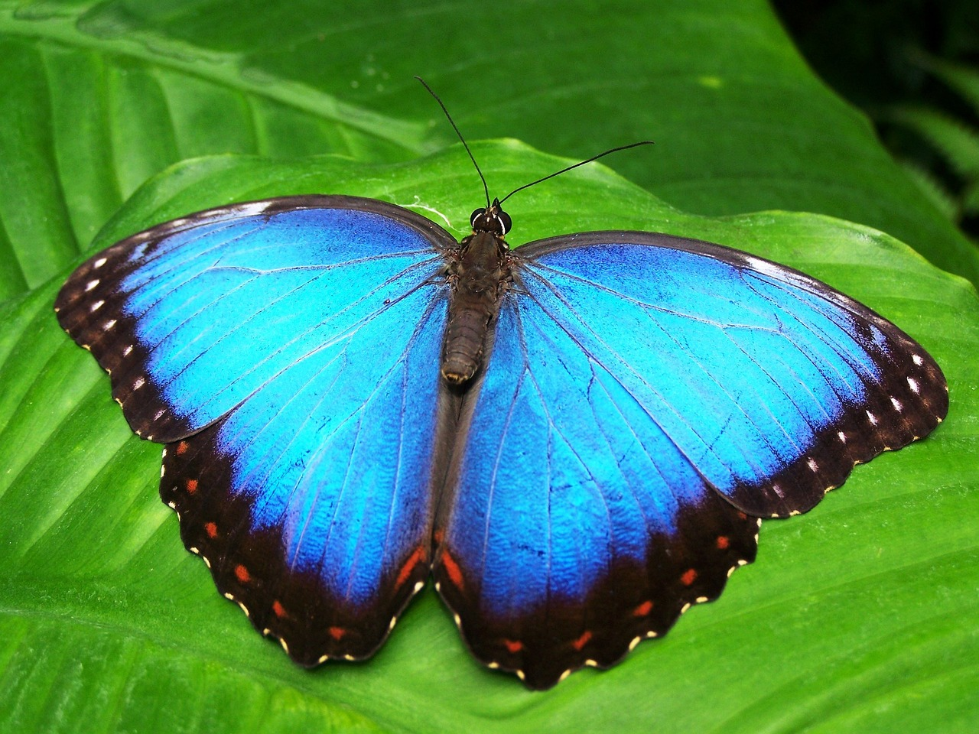
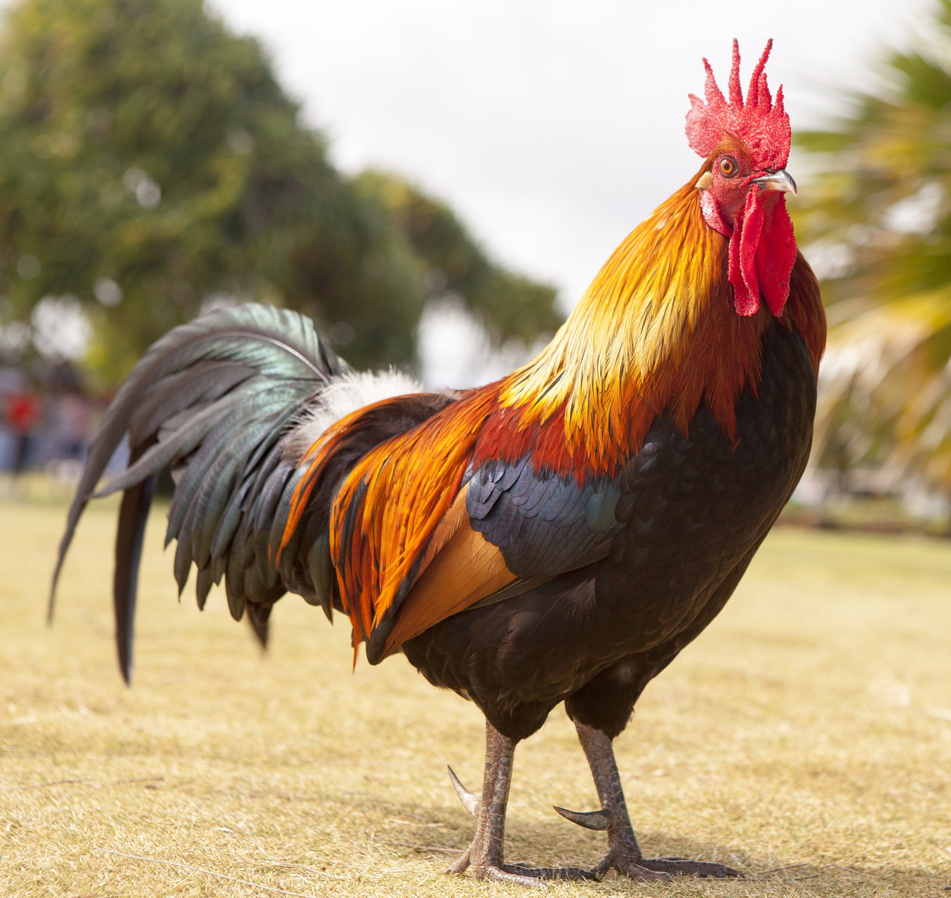
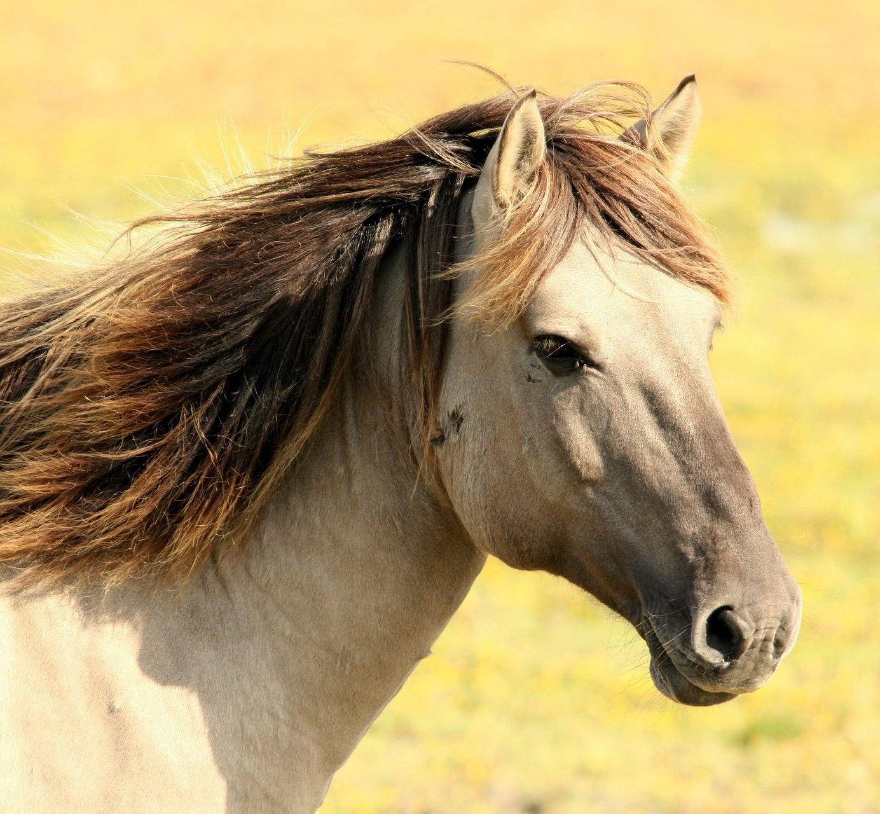
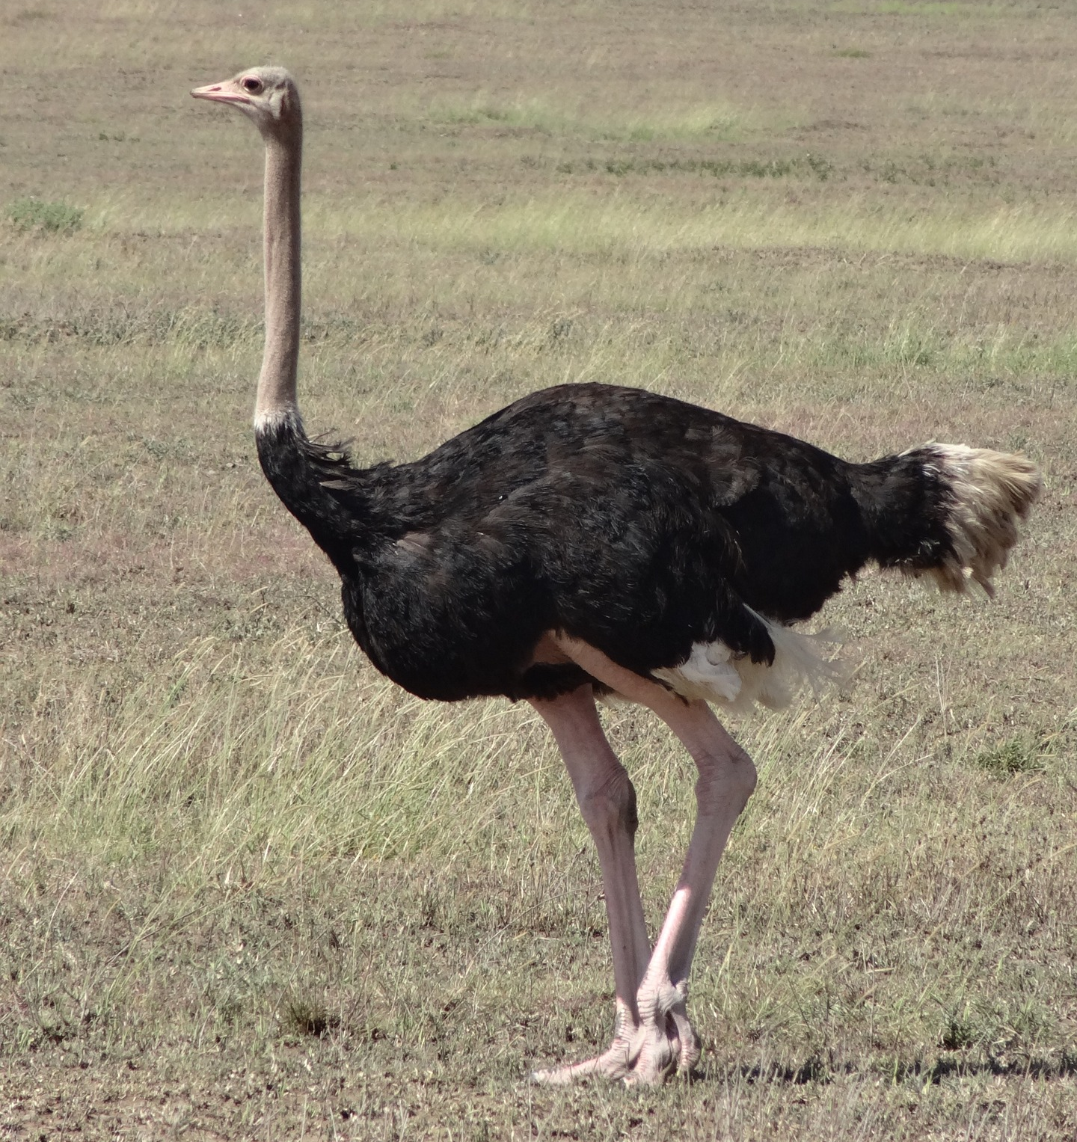
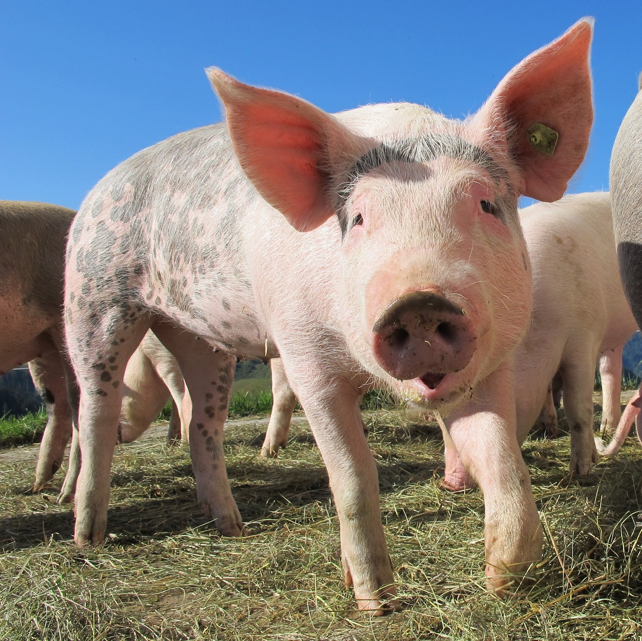
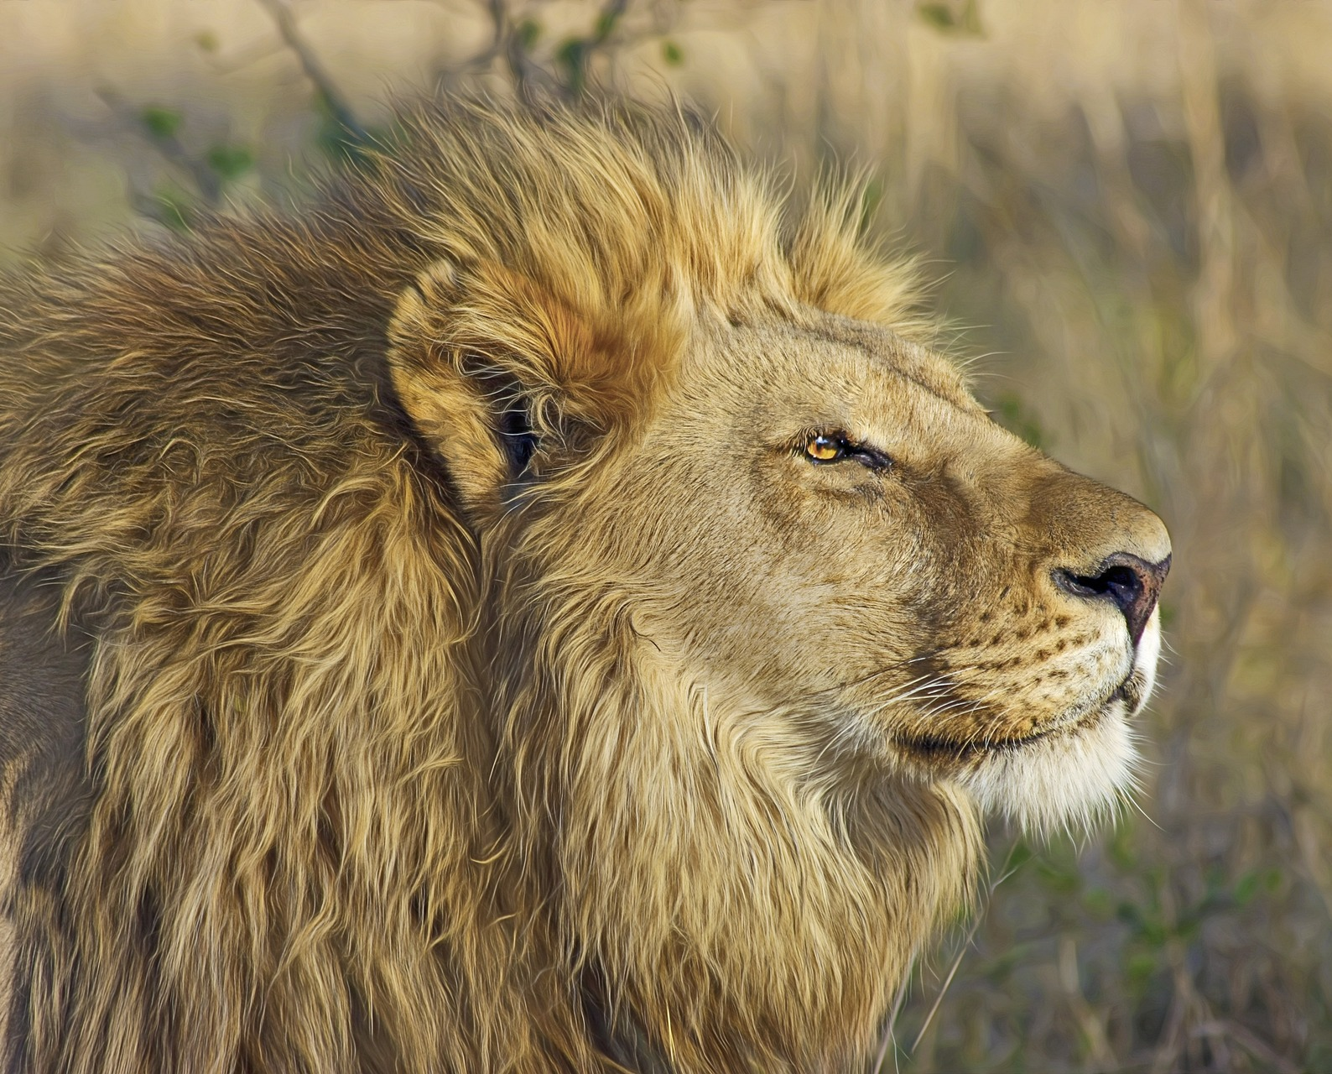
Read aloud the German name of each animal. You have not learnt these words so just use what you know about how to pronounce German. ☺ Concentrate on the underlined letters.
Der Zoo
…
ZOO
1 | 2 | 3 | 4
5 | 6 | 7 | 8
9 | 10 | 11 | 12
aussprechen
Frosch
Wolf
Eule
Luchs
Pinguin
Schmetterling
Vogel
Hahn
Pferd
Strauß
Schwein
Löwe
Notes:
Visual of the pupil handout (printable version of pupil and teacher handout at the end of this slide deck)
This slide can also be used to share the answers to the assessment once the children have completed it. Click on each photo to hear the word.

Slide 3
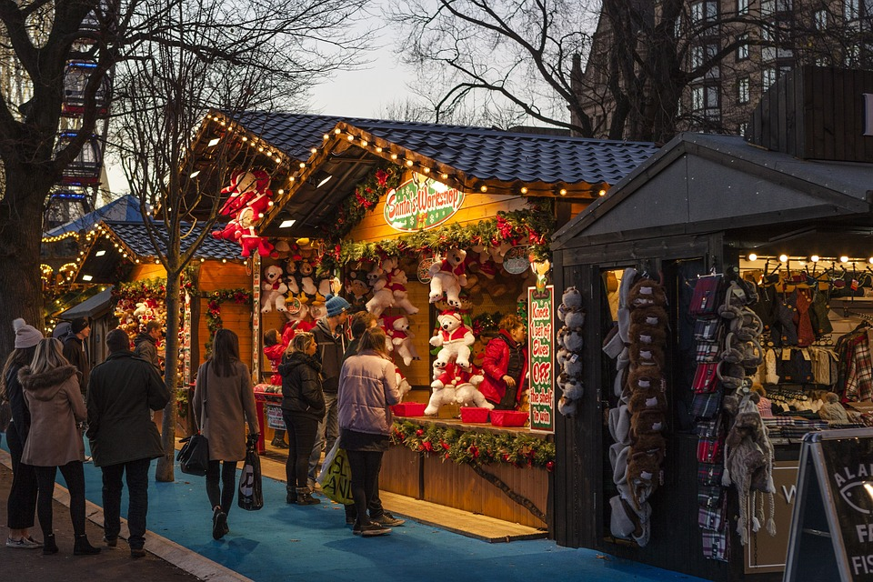
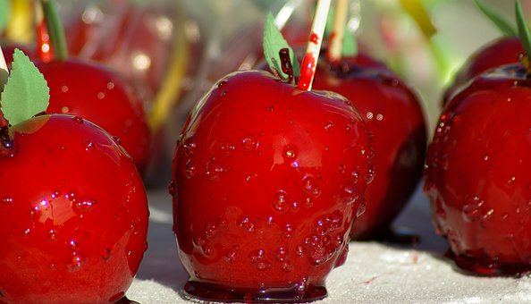
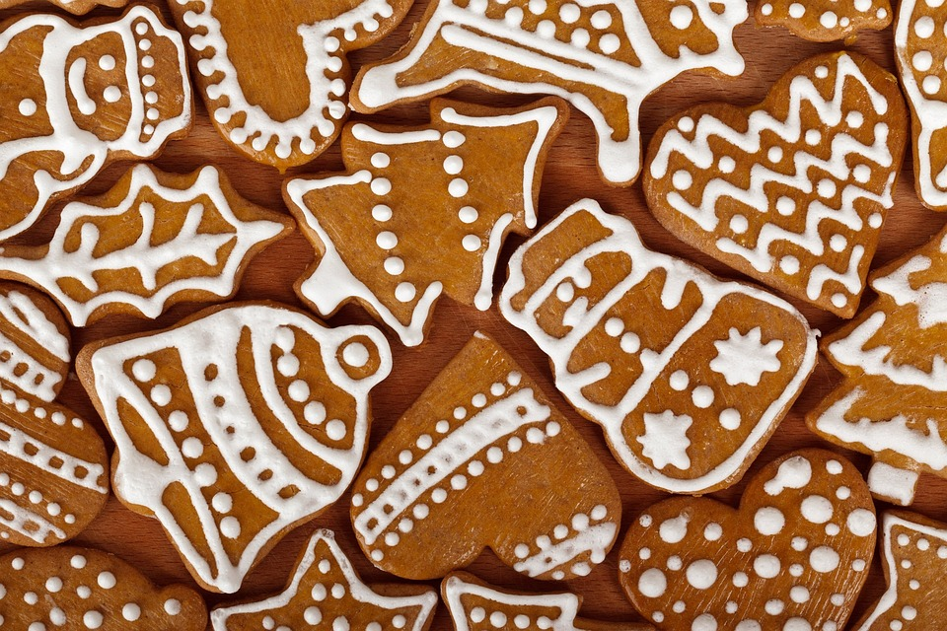
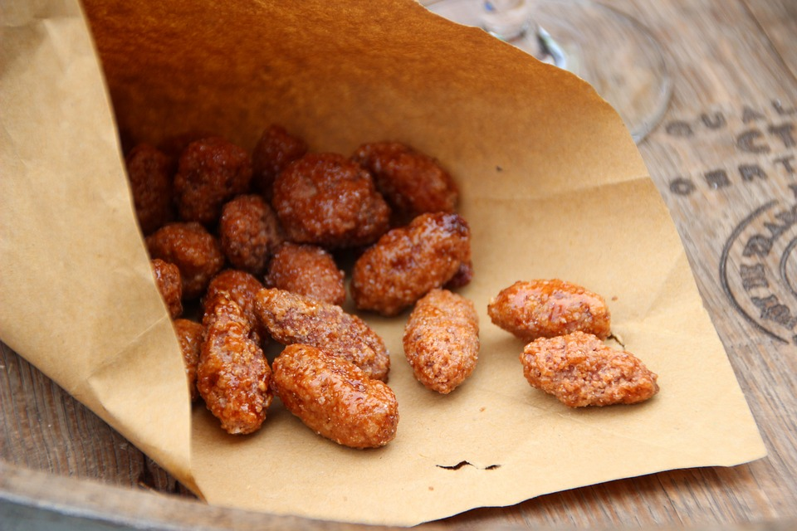
Kultur
Der Weihnachtsmarkt*
Weihnachtsmarkt –Christmas market
beantworten –to answer
Lies den Text. Beantworte* die Fragen 1- 3.
Deutschland ist für die Weihnachtsmärkte bekannt. Hier gibt es Geschenke, Essen, und Getränke zu kaufen. Viele Touristen kommen Weihnachten nach Deutschland und kaufen hier ein. Sie genießen die Atmosphäre und machen viele Fotos.
lesen
What three things can you buy at the Christmas market?
A
C
Geschenke – presents
Essen – food
Getränke – drinks
Man isst gerne kandierte Äpfel, gebrannte Mandeln und Lebkuchen.
B
3. Name three types of food that are mentioned. Which picture is which?
2. What four things do tourists do?
kommen nach Deutschland – come to Germany
kaufen hier ein – shop here
genießen die Atmosphäre – enjoy the atmosphere
machen viele Fotos – take a lot of photos
A. kandierte Äpfel – toffee apples
B. gebrannte Mandeln – roasted almonds
C. Lebkuchen – spicy ginger cookies
Notes:
Timing: 15 minutes
Aim: Independent activity for pupils to work on while teacher conducts Phonics assessment.
Procedure:
Pupils read the text and answer the questions.
Click for answers.
Pupils can then read the text aloud with a partner, reading one sentence each and helping each other work out the English translation. A recording of the text is provided (click on the text boxes).
3

Slide 4
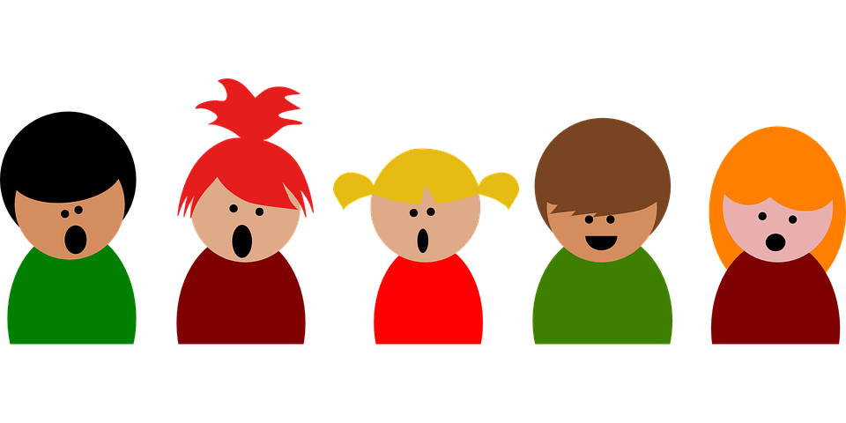
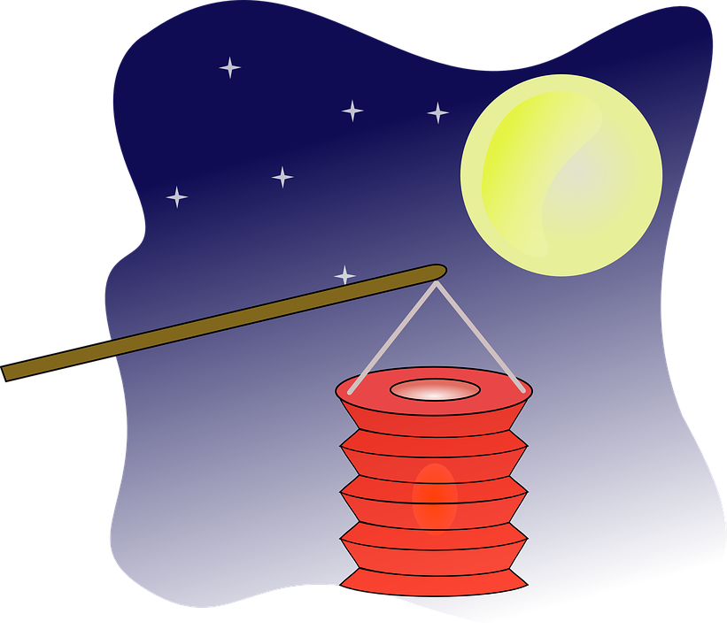
hören
Lied: Ich geh mit meiner Laterne
Read the lyrics with a partner.
St. Martin’s Day is celebrated on 6 November. Children make lanterns (or you can buy them) and, with their families, they sing songs and go on a lantern procession around the streets.
Chorus:
lesen
Ich geh' mit meiner Laterne
und meine Laterne mit mir.
Da oben leuchten die Sterne,
hier unten leuchten wir.
I‘m walking with my lantern,
my lantern is walking with me.
Above the stars are a-shining,
down here a-shining are we.
1
2
1. Ein Lichtermeer zu Martins Ehr, Rabimmel, Rabammel, Rabumm x2.
1. A sea of lights to honour St Martin, Rabimmel Rabammel Rabumm.
3
2. Der Martinsmann, der zieht voran. Rabimmel, Rabammel, Rabumm x2.
2. St Martin the man, he‘s at the front, Rabimmel Rabammel Rabumm.
Can you guess what words are under numbers 1-3?
Notes:
https://www.youtube.com/watch?v=oixRjkUsV1g
1/2
Traditional German St Martin’s Day song for children, sung by children.
Creative, not literal translation.
Includes karaoke-style lyrics for singing along Procedure: 1. Read the explanation on the slide about the St Martin’s Day in Germany. If the class situation allows, play the YouTube video for pupils to watch and eventually sing along to. If not, pupils can read the lyrics with a partner. A spoken recording is provided (click on the text). Each lien of the verse is read twice. After each new verse, pupils read the chorus.
2. See if pupils can come up with the three hidden words. Click for answer to appear.
3. Click to the next slide for verses 3-5. 4. If using the Youtube video, play the song again and join in.
4

Slide 5
hören
Lied: Ich geh mit meiner Laterne
Chorus:
Ich geh' mit meiner Laterne
und meine Laterne mit mir.
Da oben leuchten die Sterne,
hier unten leuchten wir.
I‘m walking with my lantern,
my lantern is walking with me.
Above the stars are a-shining,
down here a-shining are we.
lesen
3. Wie schön das klingt, wenn jeder singt, Rabimmel, Rabammel, Rabumm x2.
3. How lovely it sounds when everbody is singing, Rabimmel Rabammel Rabumm.
1
4. Ein Kuchenduft liegt in der Luft, Rabimmel, Rabammel, Rabumm x2.
4. A smell of cakes hangs in the air, Rabimmel Rabammel Rabumm.
2
5. Beschenkt uns heut, ihr lieben Leut, Rabimmel, Rabammel, Rabumm x2.
5. Please give us presents today, dear people, Rabimmel Rabammel Rabumm.
3
6. Mein Licht ist aus, ich geh nach Haus, Rabimmel, Rabammel, Rabumm x2.
6. My light has gone out, I‘m going home, Rabimmel Rabammel Rabumm.
4
Notes:
2/2
Continue with versus 3-6. Pupils guess the hidden words, click for answers.
5

Slide 6
Tschüss!
blau
Notes:
6

Slide 7
Der Zoo Read aloud the German name of each animal.
Der Zoo Read aloud the German name of each animal.
You have not learnt these words so just use what you know about how to pronounce German. ☺
Concentrate on the underlined letters.
ZOO
You have not learnt these words so just use what you know about how to pronounce German. ☺
Concentrate on the underlined letters.
ZOO
1 Frosch | 2 Wolf | 3 Eule | 4 Luchs
5 Pinguin | 6 Schmetterling | 7 Vogel | 8 Hahn
9 Pferd | 10 Strauß | 11 Schwein | 12 Löwe
1 Frosch | 2 Wolf | 3 Eule | 4 Luchs
5 Pinguin | 6 Schmetterling | 7 Vogel | 8 Hahn
9 Pferd | 10 Strauß | 11 Schwein | 12 Löwe
Notes:
Pupil handout To copy and cut in half

Slide 8
Der Zoo Read aloud the German name of each animal.
Pupil name: ___________________________________
Total score: _____ / 12
You have not learnt these words so just use what you know about how to pronounce German. ☺
Concentrate on the underlined letters.
ZOO
 | Animal | SSC [sound-symbol correspondence] | p/ x
1 | Frosch | short [o]
2 | Wolf | [w]
3 | Eule | [eu]
4 | Luchs | short [u]
5 | Pinguin | short [i]
6 | Schmetterling | [sch]
7 | Vogel | [v]
8 | Hahn | long [a]
9 | Pferd | [pf]
10 | Strauß | [ß]
11 | Schwein | [ei]
12 | Löwe | [ö]
1 | 2 | 3 | 4
5 | 6 | 7 | 8
9 | 10 | 11 | 12
Frosch
Wolf
Eule
Luchs
Pinguin
Schmetterling
Vogel
Hahn
Pferd
Strauß
Schwein
Löwe
Notes:
Teachers award one point for each SSC, as per SSC list above.
Notes:
Teacher handout
Click on each picture to hear the word.

