Slide 1
Interacting
Kann ich helfen?
blau
Follow ups 1-5
Term 1 Week 7
Notes:
Artwork by Steve Clarke. Pronoun pictures from NCELP (www.ncelp.org). All additional pictures selected from Pixabay and are available under a Creative Commons license, no attribution required.
Phonics: [ie] Liebe [844] sie [7] Brief [838]
Vocabulary: Aufgabe [256] Aktivität [1422] Beispiel [94] Bild [253] Blatt, Blätter [1270] Buch [300] Computer [1252] Frage [157] Frau [99] Heft [3862] Kuchen [4381] Lehrer [695] Lied [1733] Liste [1792] Preis [334] Schüler [556] Text [473]
Tisch [529] Wort [194] Zimmer [665] keine² [46]
Revisit 1: dreizehn [4772] vierzehn [3950] fünfzehn [2858] sechzehn [4924] siebzehn [n/a] achtzehn [3741] neunzehn [n/a] zwanzig [1359] zweiundzwanzig [n/a] dreißig [2046] einunddreißig [n/a] an [19]
Revisit 2: -
Jones, R.L & Tschirner, E. (2019). A frequency dictionary of German: Core vocabulary for learners. London: Routledge.
The frequency rankings for words that occur in this PowerPoint which have been previously introduced in these resources are given in the SOW and in the resources that first
introduced and formally re-visited those words.
For any other words that occur incidentally in this PowerPoint, frequency rankings will be provided in the notes field wherever possible.

Slide 2
Follow up 1:
Sag nur die Wörter mit der SSC [ie] oder langem [i].
Remember! Long [i] sounds the same as [ie]!
aussprechen
30
klein
Lied
Tier
Juli
Juni
Spiel
Lieblings-
siebzehn
viel
S
sieben
wie?
Freitag
sie
hier
wiederholen
Preis
vierzehn
heiße
0
Bleistift
Dienstag
START
Notes:
Timing: 5 minutes
Aim: to practise applying knowledge of [ie] to previously taught words.
Procedure: 1. Start the timer. Pupil A tries to read aloud all of the words with the SSC [ie], within the 30 seconds allowed.
2. Pupil B listens. If Pupil A says one of the other words by mistake, Pupil B can direct him/her to start again from the beginning. 3. They swap roles and repeat the task.

Slide 3
Follow up 2:

Schreib auf Englisch.
Can you get at least 15 points?
Wörter
 | an | sechzehn | einunddreißig
 | dreizehn | achtzehn | zweiundzwanzig
 | die Frauen | die Schüler | die Zimmer
 | die Tische | die Wörter | die Aktivitäten
 | das Blatt | die Lieder | die Preise
 | keine | die Blätter | die Aufgaben
 | die Beispiele | die Fragen | die Kuchen
on
16
31
Vokabeln
x3
13
18
22
(the) women
(the) pupils
(the) rooms
x2
(the) tables
(the) words
(the) activities
(the) sheet
(the) songs
(the) prizes
not (any) /no (pl)
(the) sheets
(the) tasks
x1
(the) examples
(the) questions
(the) cakes
Notes:
Timing: 5 minutes
Aim: to practise written production of vocabulary from this and revisited weeks.
Procedure: 1. Give pupils a blank grid. They fill in the English meanings of any of the words they know, trying to reach 15 points in total.
Note: The most recently learnt and practised words are pink, words from the previous week are green and those from week 1 are blue, thus more points are awarded for them, to recognise that memories fade and more effort (heavy lifting!) is needed to retrieve them.

Slide 4
Follow up 2:

Schreib auf Deutsch.
Can you get at least 15 points?
Wörter
 | 18 | 22 | on
 | 31 | 13 | 16
 | (the) pupils | (the) rooms | (the) activities
 | (the) women | (the) tables | (the) words
 | (the) examples | (the) questions | (the) tasks
 | (the) prizes | (the) cakes | (the) songs
 | not (any)/no (pl) | (the) sheet | (the) sheets
achtzehn
zweiundzwanzig
an
Vokabeln
x3
einunddreißig
dreizehn
sechzehn
die Schüler
die Zimmer
die Aktivitäten
x2
die Frauen
die Tische
die Wörter
die Beispiele
die Fragen
die Aufgaben
die Preise
die Kuchen
die Lieder
x1
keine
das Blatt
die Blätter
Notes:
Timing: 5 minutes
Aim: to practise written production of vocabulary from this and revisited weeks.
Procedure: 1. Give pupils a blank grid. They fill in the German meanings of any of the words they know, trying to reach 15 points in total.
Note: The most recently learnt and practised words are pink, words from the previous week are green and those from week 1 are blue, thus more points are awarded for them, to recognise that memories fade and more effort (heavy lifting!) is needed to retrieve them.

Slide 5
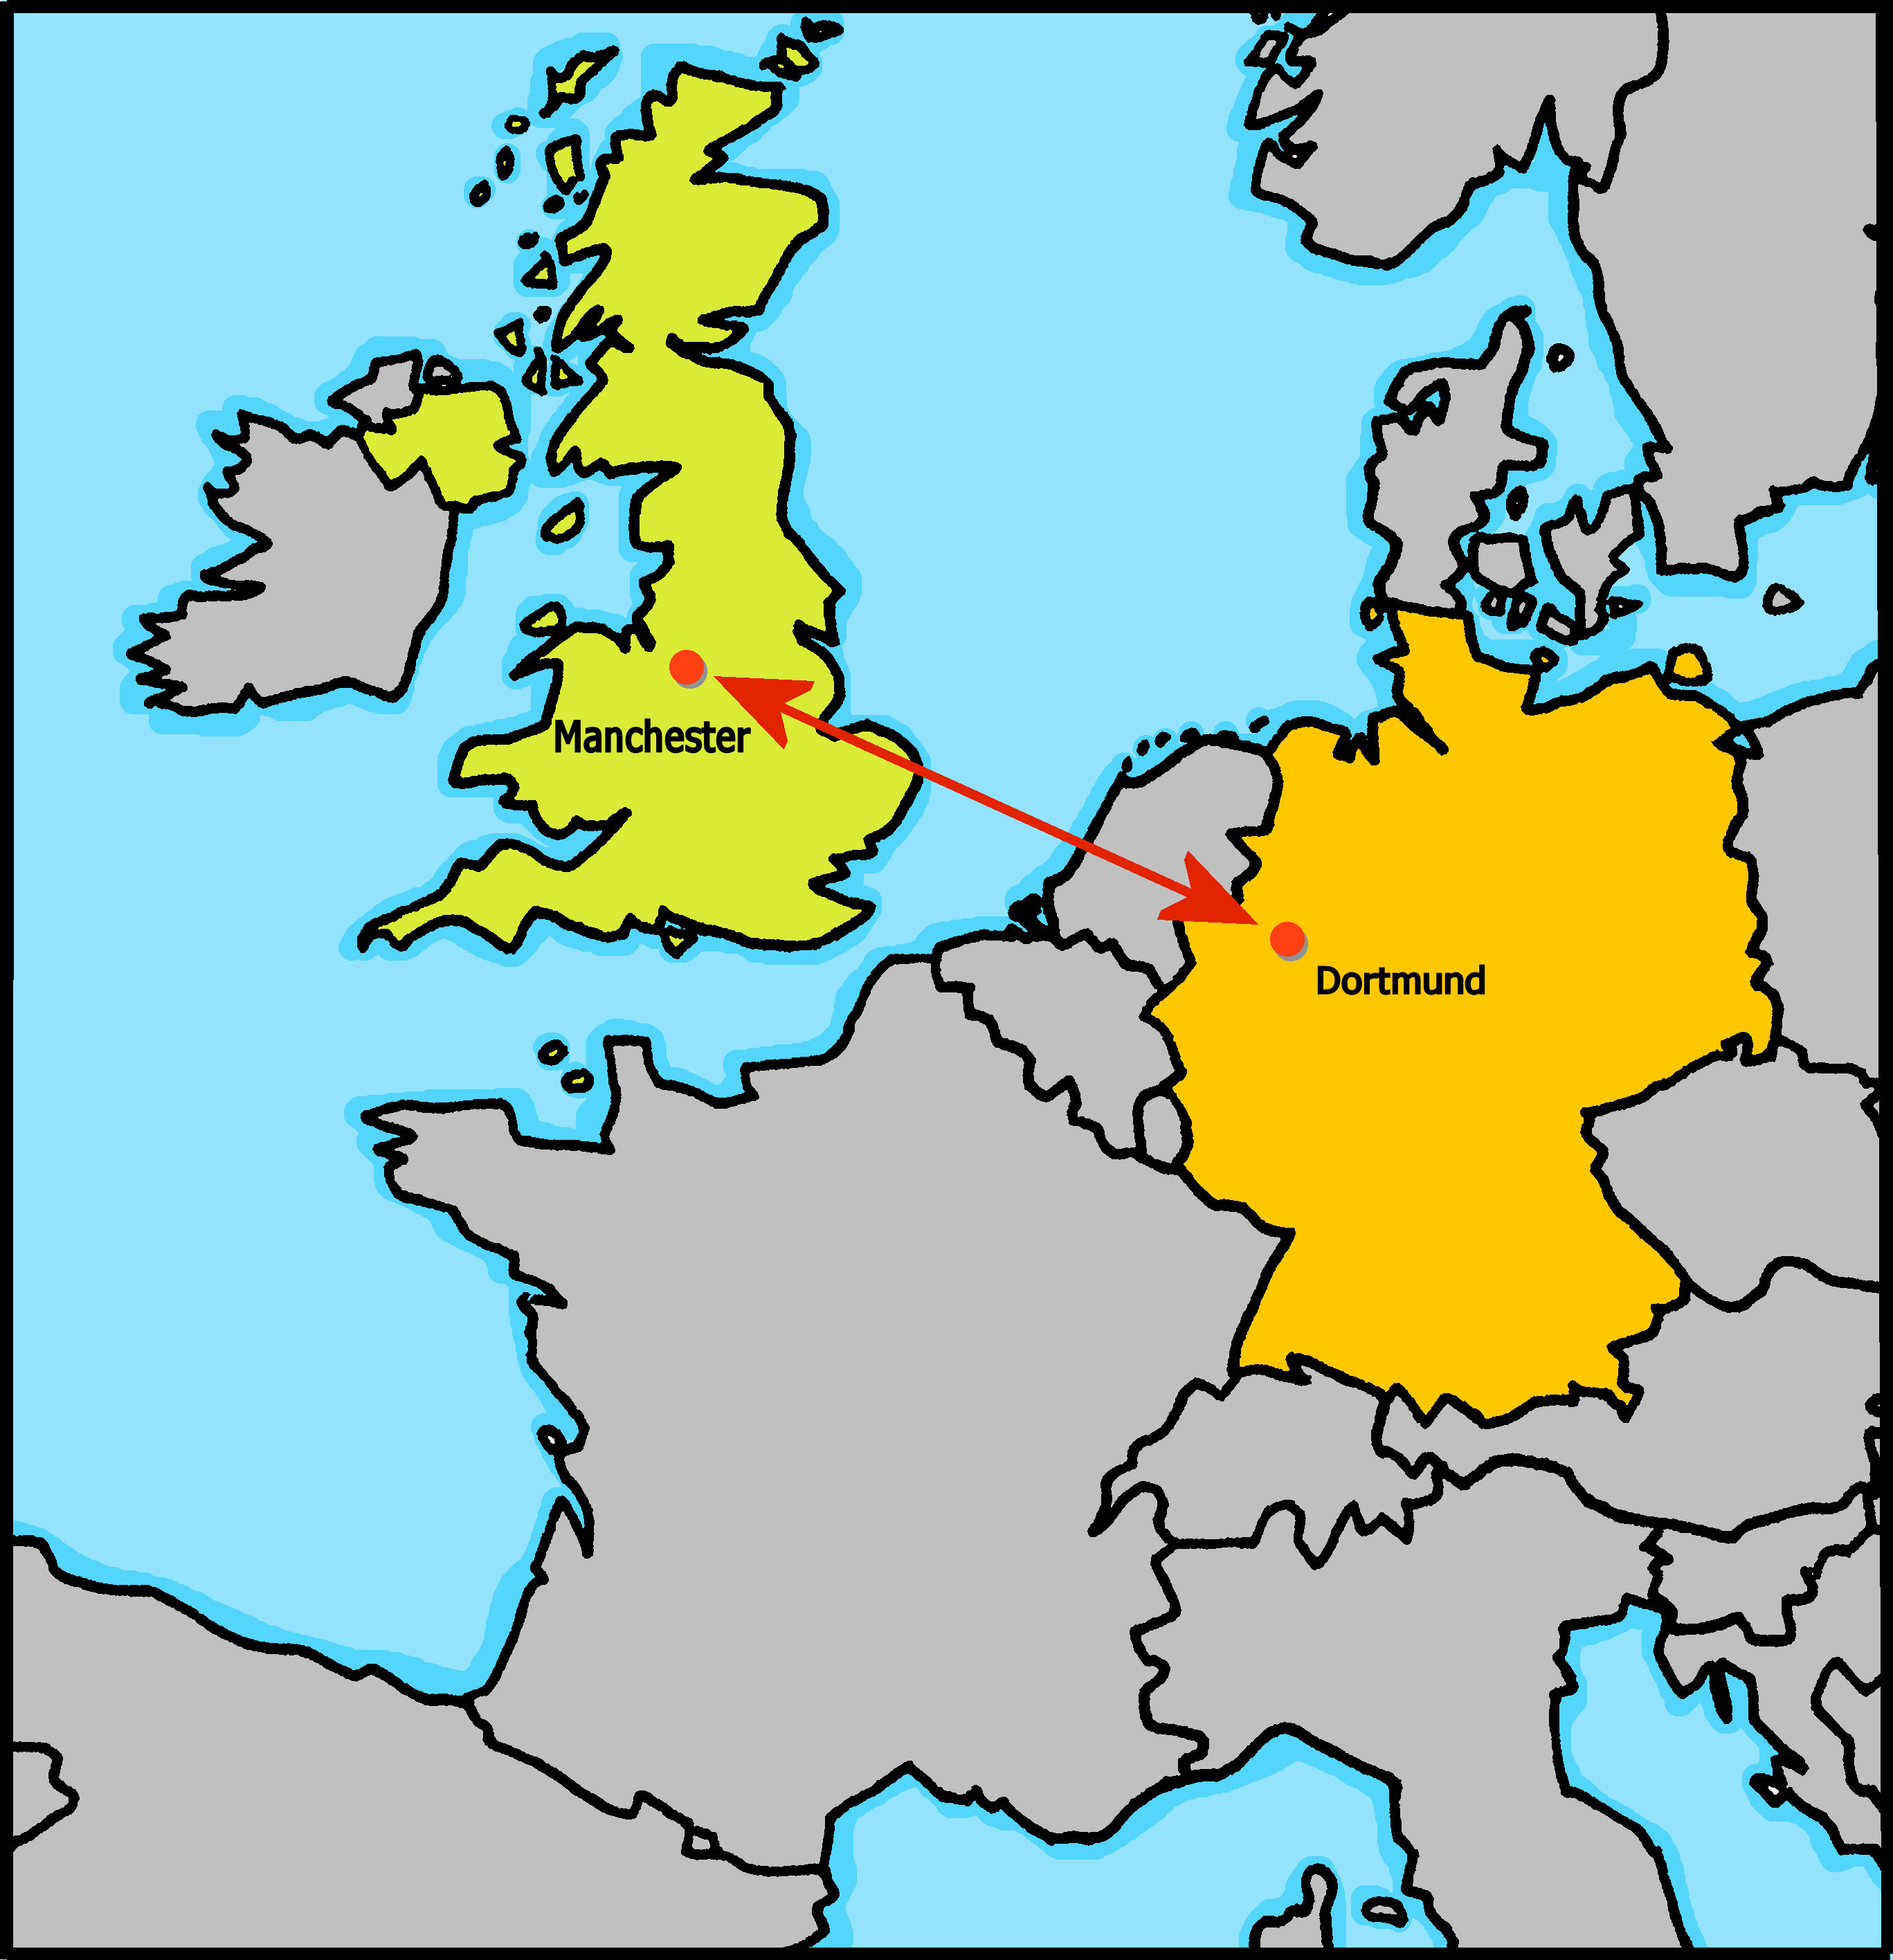
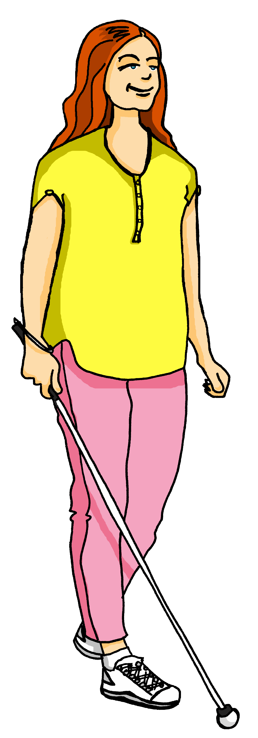
Follow up 3
Sarah schreibt auf Deutsch (und auf Englisch!)
Lies den Text und schreib die englischen Wörter auf Deutsch.
lesen
Hallo Dortmund! Ich [am called] Sarah. Ich [live] in Manchester. Ich [am learning] Deutsch, [but] ich [think], die Verben [are] schwer.
Ich mag [songs] und [friends] in der Schule. Ich [like] auch [books]. Ich habe Braille-[books] – ich [am] blind.
Ich [write] mit einer Brailleschreibmaschine.
[Thank you] für die Deutschhilfe, bis bald, Sarah ☺
heiße
wohne
schreiben
lerne
aber
denke,
sind
Lieder
Freunde
mag
Bücher.
Bücher
bin
What is it called when German sticks two or more nouns together?
schreibe
Danke
Can you work out what it means? Which word is a cognate? Which word is a proper noun?
Notes:
Timing: 8 minutes
Aim: to practise written production of previously taught vocabulary and verbs (1st person singular) and understanding of a longer text; to revisit previously taught vocabulary in a new longer written context.
Procedure:
Pupils write 1-14 and the correct German word for each English item.
Click on the image of Sarah to listen to the whole message and check answers. Click to reveal written answers, too.
Teacher uses questioning to ensure pupils’ understanding of the text. E.g. Tell me two things you know about Sarah now etc..

Slide 6
Follow up 4

Schreib auf Englisch. [1/5]
hören
1
The teachers are here.
Schreib!
Die Lehrer sind hier.
Notes:
Timing: 5 minutes (5 slides)
Aim: to practise aural comprehension of previously-taught words in short sentences.
Procedure:
Complete this first slide with pupils to model the activity.
Tell students this is a translation activity. They will hear a sentence twice and then need to write its meaning in English.
Click the audio button to hear the audio.
Click for the instruction ‘Schreib’ and pupils need to write the whole sentence.
Click to reveal the English meaning and again to reveal the original German sentence they heard. Note: teachers may prompt pupils to produce the German sentence from the English prompt for additional practice.
Repeat steps 3-6 with the remaining 4 slides.
Transcript: Die Lehrer sind hier.

Slide 7
Follow up 4

Schreib auf Englisch. [2/5]
hören
2
We sing/are singing 14 songs.
Schreib!
Wir singen vierzehn Lieder.
Notes:
[2/5]
Procedure:
Click the audio button to hear the audio.
Click for the instruction ‘Schreib’ and pupils need to write the whole sentence.
Click to reveal the English meaning and again to reveal the original German sentence they heard. Note: teachers may first prompt pupils to produce the German sentence from the English prompt for additional practice.
Repeat steps 1-3 with the remaining 3 slides.
Transcript: Wir singen vierzehn Lieder.

Slide 8
Follow up 4

Schreib auf Englisch. [3/5]
hören
3
There are 15 computers in the classroom.
Schreib!
Es gibt fünfzehn Computer im Klassenzimmer.
This compound is also a cognate, because it’s very similar to English ‘classroom’.
Notes:
[3/5]
Procedure:
Click the audio button to hear the audio.
Click for the instruction ‘Schreib’ and pupils need to write the whole sentence.
Click to reveal the English meaning and again to reveal the original German sentence they heard. Note: teachers may first prompt pupils to produce the German sentence from the English prompt for additional practice.
Repeat steps 1-3 with the remaining 2 slides.
Transcript: Es gibt fünfzehn Computer im Klassenzimmer.

Slide 9
Follow up 4

Schreib auf Englisch. [4/5]
English often just puts two nouns next to each other.
hören
4
I like German. The German tasks are great.
Schreib!
Ich mag Deutsch. Die Deutschaufgaben sind toll.
German usually joins the words together as one compound noun.
Notes:
[4/5]
Procedure:
Click the audio button to hear the audio.
Click for the instruction ‘Schreib’ and pupils need to write the whole sentence.
Click to reveal the English meaning and again to reveal the original German sentence they heard. Note: teachers may first prompt pupils to produce the German sentence from the English prompt for additional practice.
Repeat steps 1-3 with the remaining slide.
Transcript: Ich mag Deutsch. Die Deutschaufgaben sind toll.

Slide 10
Follow up 4

Schreib auf Englisch. [5/5]
hören
5
I learn/am learning words and I can read texts.
Schreib!
Ich lerne Wörter und ich kann Texte lesen.
Notes:
[5/5]
Procedure:
Click the audio button to hear the audio.
Click for the instruction ‘Schreib’ and pupils need to write the whole sentence.
Click to reveal the English meaning and again to reveal the original German sentence they heard. Note: teachers may first prompt pupils to produce the German sentence from the English prompt for additional practice.
Transcript: Es gibt fünfzehn Computer im Klassenzimmer.

Slide 11
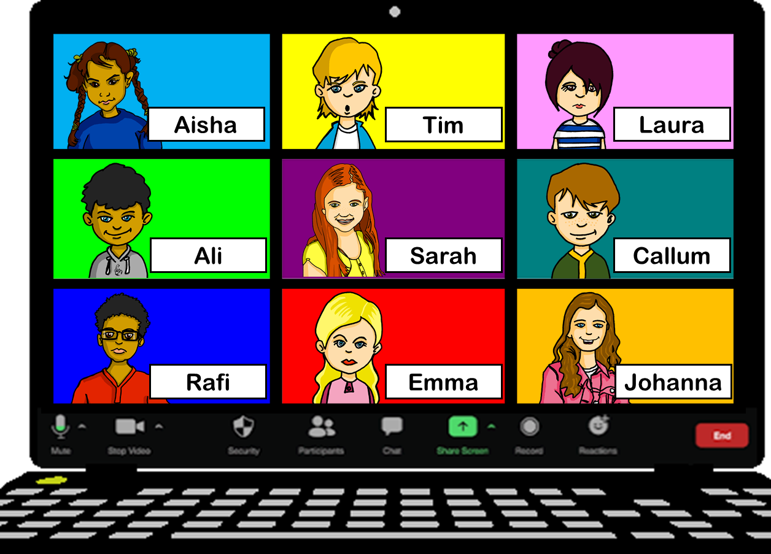
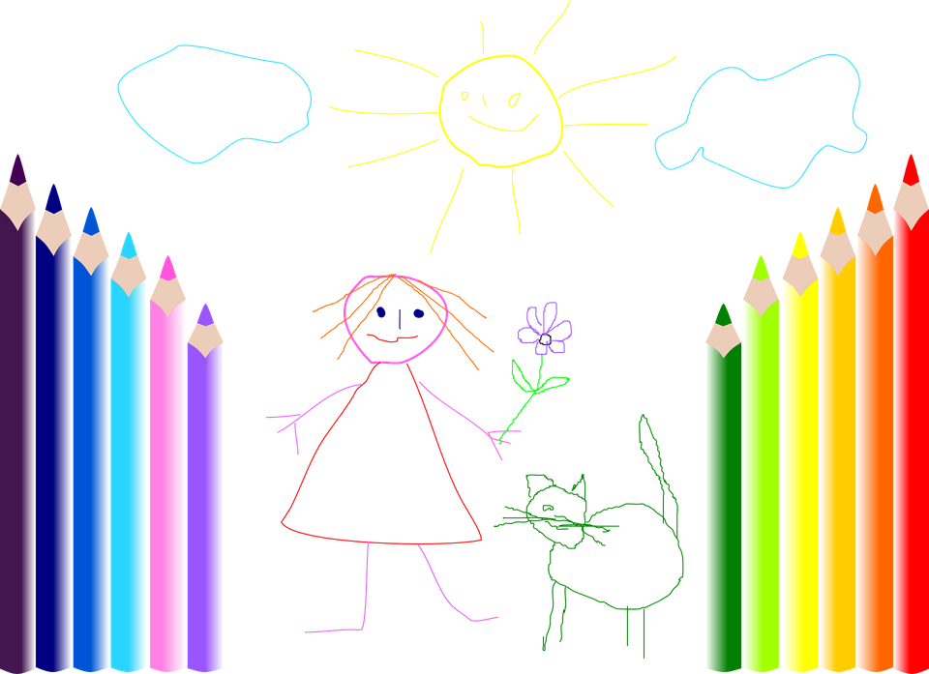
Follow up 5a
Rede mit deinem Partner/deiner Partnerin.
sprechen
13
30
3
Beispiel:
Person A: Hast du drei Bücher? Person B: Ja. Person A: Bist du Laura? Person B: Nein!
Person A: Hast du drei Bilder? Person B: Nein, ich habe keine Bilder.
Person: Ah, du bist Callum!
30
13
3
3
3
3
13
3
13
30
13
Notes:
Timing: 5 minutes (two slides)
Aim: to practise spoken production of vocabulary and structures from this week and previous learning; in particular, the use of ‘keine’ with plural nouns.
Procedure:
Person B chooses a person to be.
Person A asks yes/no questions about the two items (Bücher and Bilder) to work out who B is.
Pupils can answer yes/ no but if they have ‘none’ of an item, they need to say so (i.e., Nein, ich habe keine…)
They want their partner to guess so that they can do more rounds of the game. They can spend 2 minutes on this slide and then move to the next slide for different items and no prompts on slide.

Slide 12
Follow up 5a
Rede mit deinem Partner/deiner Partnerin.
sprechen
3
30
3
30
13
3
3
3
3
13
13
13
30
13
Notes:
[2/2]
Aim: to practise spoken production of vocabulary and structures from this week and previous learning; in particular, the use of ‘keine’ with plural nouns.
Procedure:
Person A chooses a person to be.
Person B asks yes/no questions about the two items (Lieder and Blätter) to work out who A is.
Pupils can answer yes/ no but if they have ‘none’ of an item, they need to say so (i.e., Nein, ich habe keine…)
They want their partner to guess so that they can do more rounds of the game.

Slide 13
Tschüss!
blau
Notes:
13

Slide 14
Follow up 2:

Schreib auf Englisch.
Can you get at least 15 points?
Wörter
 | an | sechzehn | einunddreißig
 | dreizehn | achtzehn | zweiundzwanzig
 | die Frauen | die Schüler | die Zimmer
 | die Tische | die Wörter | die Aktivitäten
 | das Blatt | die Lieder | die Preise
 | keine | die Blätter | die Aufgaben
 | die Beispiele | die Fragen | die Kuchen
Vokabeln
x3
x2
x1
Notes:
HANDOUT

Slide 15
Follow up 2:

Schreib auf Deutsch.
Can you get at least 15 points?
Wörter
 | 18 | 22 | on
 | 31 | 13 | 16
 | (the) pupils | (the) rooms | (the) activities
 | (the) women | (the) tables | (the) words
 | (the) examples | (the) questions | (the) tasks
 | (the) prizes | (the) cakes | (the) songs
 | not (any)/no (pl) | (the) sheet | (the) sheets
Vokabeln
x3
x2
x1
Notes:
HANDOUT

