Slide 1
Interacting
Kann ich helfen?
Negation with keine (plural)
Plural noun patterns 1-4
SSC [ie]
blau
Term 1 Week 7
Notes:
Artwork by Steve Clarke. Pronoun pictures from NCELP (www.ncelp.org). All additional pictures selected from Pixabay and are available under a Creative Commons license, no attribution required.
Phonics: [ie] Liebe [844] sie [7] Brief [838]
Vocabulary: Aufgabe [256] Aktivität [1422] Beispiel [94] Bild [253] Blatt, Blätter [1270] Buch [300] Computer [1252] Frage [157] Frau [99] Heft [3862] Kuchen [4381] Lehrer [695] Lied [1733] Liste [1792] Preis [334] Schüler [556] Text [473] Tisch [529] Wort [194] Zimmer [665] keine² [46]
Revisit 1: dreizehn [4772] vierzehn [3950] fünfzehn [2858] sechzehn [4924] siebzehn [n/a] achtzehn [3741] neunzehn [n/a] zwanzig [1359] zweiundzwanzig [n/a] dreißig [2046] einunddreißig [n/a] an [19]
Revisit 2: -
Jones, R.L & Tschirner, E. (2019). A frequency dictionary of German: Core vocabulary for learners. London: Routledge.
The frequency rankings for words that occur in this PowerPoint which have been previously introduced in these resources are given in the SOW and in the resources that first
introduced and formally re-visited those words.
For any other words that occur incidentally in this PowerPoint, frequency rankings will be provided in the notes field wherever possible.
Remember that at the start of the course (first three lessons of Rot/Gelb) pupils learnt language (for greetings and register taking) that can still be part of the lesson routines in upper KS2 (Blau/Grün). They are not re-taught, as we anticipate that teachers have built these in from early in lower KS2.
1

Slide 2
Johanna und Aisha singen das Lied noch einmal.*
Sing mit!
noch einmal – again
Hallo! Hallo! Guten Tag! Hallo! Hallo! Guten Tag!
Hallo! Wir sind hier,
Hallo! Ihr seid da, Wie schön, nicht wahr? Wunderbar!
Notes:
Timing: 2 minutes
Aim: to practise some previously learnt vocabulary in a simple song (to the tune of ‘If you’re happy and you know it’).
Procedure: 1. Click to play the audio of the song.
2. Pupils join in immediately as they are familiar with the song and recap it every few weeks.

Slide 3
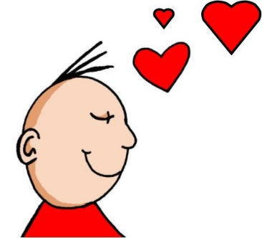
aussprechen
[ie]
…
Liebe
Notes:
Timing: 1 minute
Aim: to introduce the SSC [ie].
Procedure:
Introduce the SSC and present the source word ‘Liebe’ (with gesture, if using).
Click to bring on the picture and get pupils to repeat the word ‘Liebe’ (with gesture, if using).
Note:
A gesture for ‘Liebe’ might be to make a ‘heart’ shape with both hands approximately where your heart is in your body.
Liebe [844]
Jones, R.L & Tschirner, E. (2019). A frequency dictionary of German: Core vocabulary for learners. London: Routledge.
3

Slide 4
aussprechen
[ie]
…
sie
Liebe
Brief
Notes:
Timing: 1 minute
Aim: to introduce the SSC [ie].
Procedure:
Re-present the SSC and present the source word ‘Liebe’ (with gesture, if using).
Click to bring on the picture and get pupils to repeat the word ‘Liebe’ (with gesture, if using).
Present the cluster words in the same way, bringing on the picture and getting pupils to pronounce the words.
sie [7] Brief [838]
Jones, R.L & Tschirner, E. (2019). A frequency dictionary of German: Core vocabulary for learners. London: Routledge.
4

Slide 5
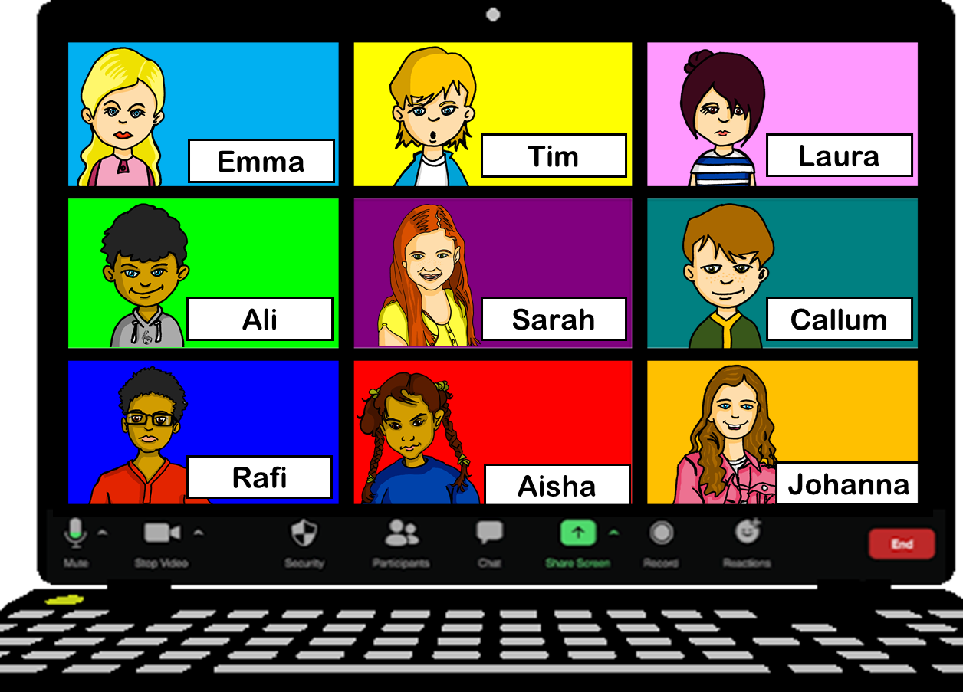
hören
Johanna und Aisha üben* mit Sarahs und Rafis Klasse.
üben – to practise
Hör zu. Schreib das Wort mit der SSC [ie].
 | Wort mit SSC [ie]
1 | dieses
2 | siebzehn
3 | hier
4 | Lied
5 | Spieler
6 | die
Notes:
Timing: 5 minutes
Aim: to practise transcription of previously taught words, distinguishing [ie] from two other SSC, [ei] and [i].
Procedure:
1. Click to listen to three items.
2. Pupils write down the word that contains the SSC [ie].
3. They may need to listen several times to each item.
4. Additionally, they may write the English.
5. Elicit responses and click to reveal the correct words.
Transcript:
dreizehn | Kinder | dieses
singen | siebzehn | bleiben
seid | hier | Mitte
in | nein| Lied
Spieler | sind | bleiben
Geschichte| die | zwei
5

Slide 6
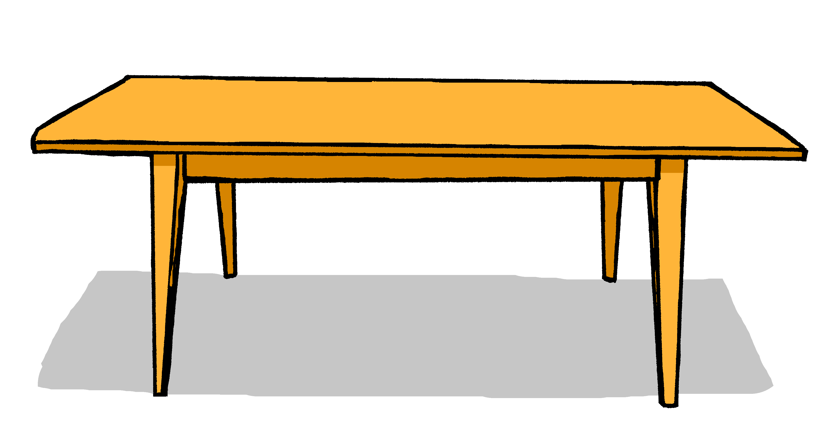
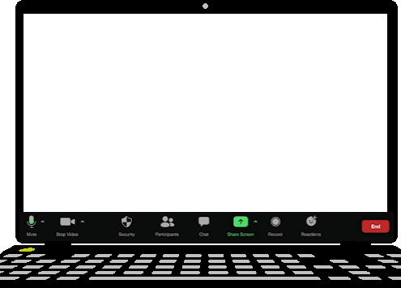
Vokabeln
Wie heißt das auf Deutsch?
Wörter
Sag das Wort und den Artikel auf Deutsch.
Hallo!
der
die
das
Blatt
Text
Bild
Computer
Frau
Heft
Kuchen
Aktivität
Wort
Preis
Frage
Lied
Tisch
Liste
Buch
Notes:
Timing: 5 minutes
Aim: to recap previously taught vocabulary and connect with the correct gender article.
Procedure:
Click for a picture prompt.
Pupils name the item with definite article in German.
Click again – the picture disappears and the written German word appears in the correct gender ‘bucket’.
Complete for all 15 items.
6

Slide 7
Plural patterns 1-4
This is plural pattern 2. More than 90% feminine nouns add (e)n for the plural.
You know four plural noun patterns:
This is plural pattern 1.
der Text
die Texte
die Frage
die Fragen
This is plural pattern 3.
Masculine or neuter words ending in –er or –en may not change:
der Computer
die Computer
der Kuchen
die Kuchen
This is plural pattern 4.
About 25% single syllable neuter nouns add –er, some with an umlaut:
das Lied
die Lieder
das Wort
die Wörter
das Blatt
die Blätter
Hallo!
Hallo!
Hallo!
Remember! The word for ‘the’ is ‘die’ for all plural nouns.
Notes:
Timing: 3 minutes Aim: to revisit the four plural noun patterns that pupils have practised previously.
Procedure: 1. Click through the animations to present the information.
2. Elicit the English meanings for the German.
7

Slide 8
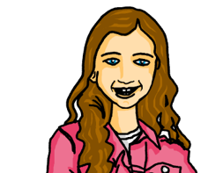
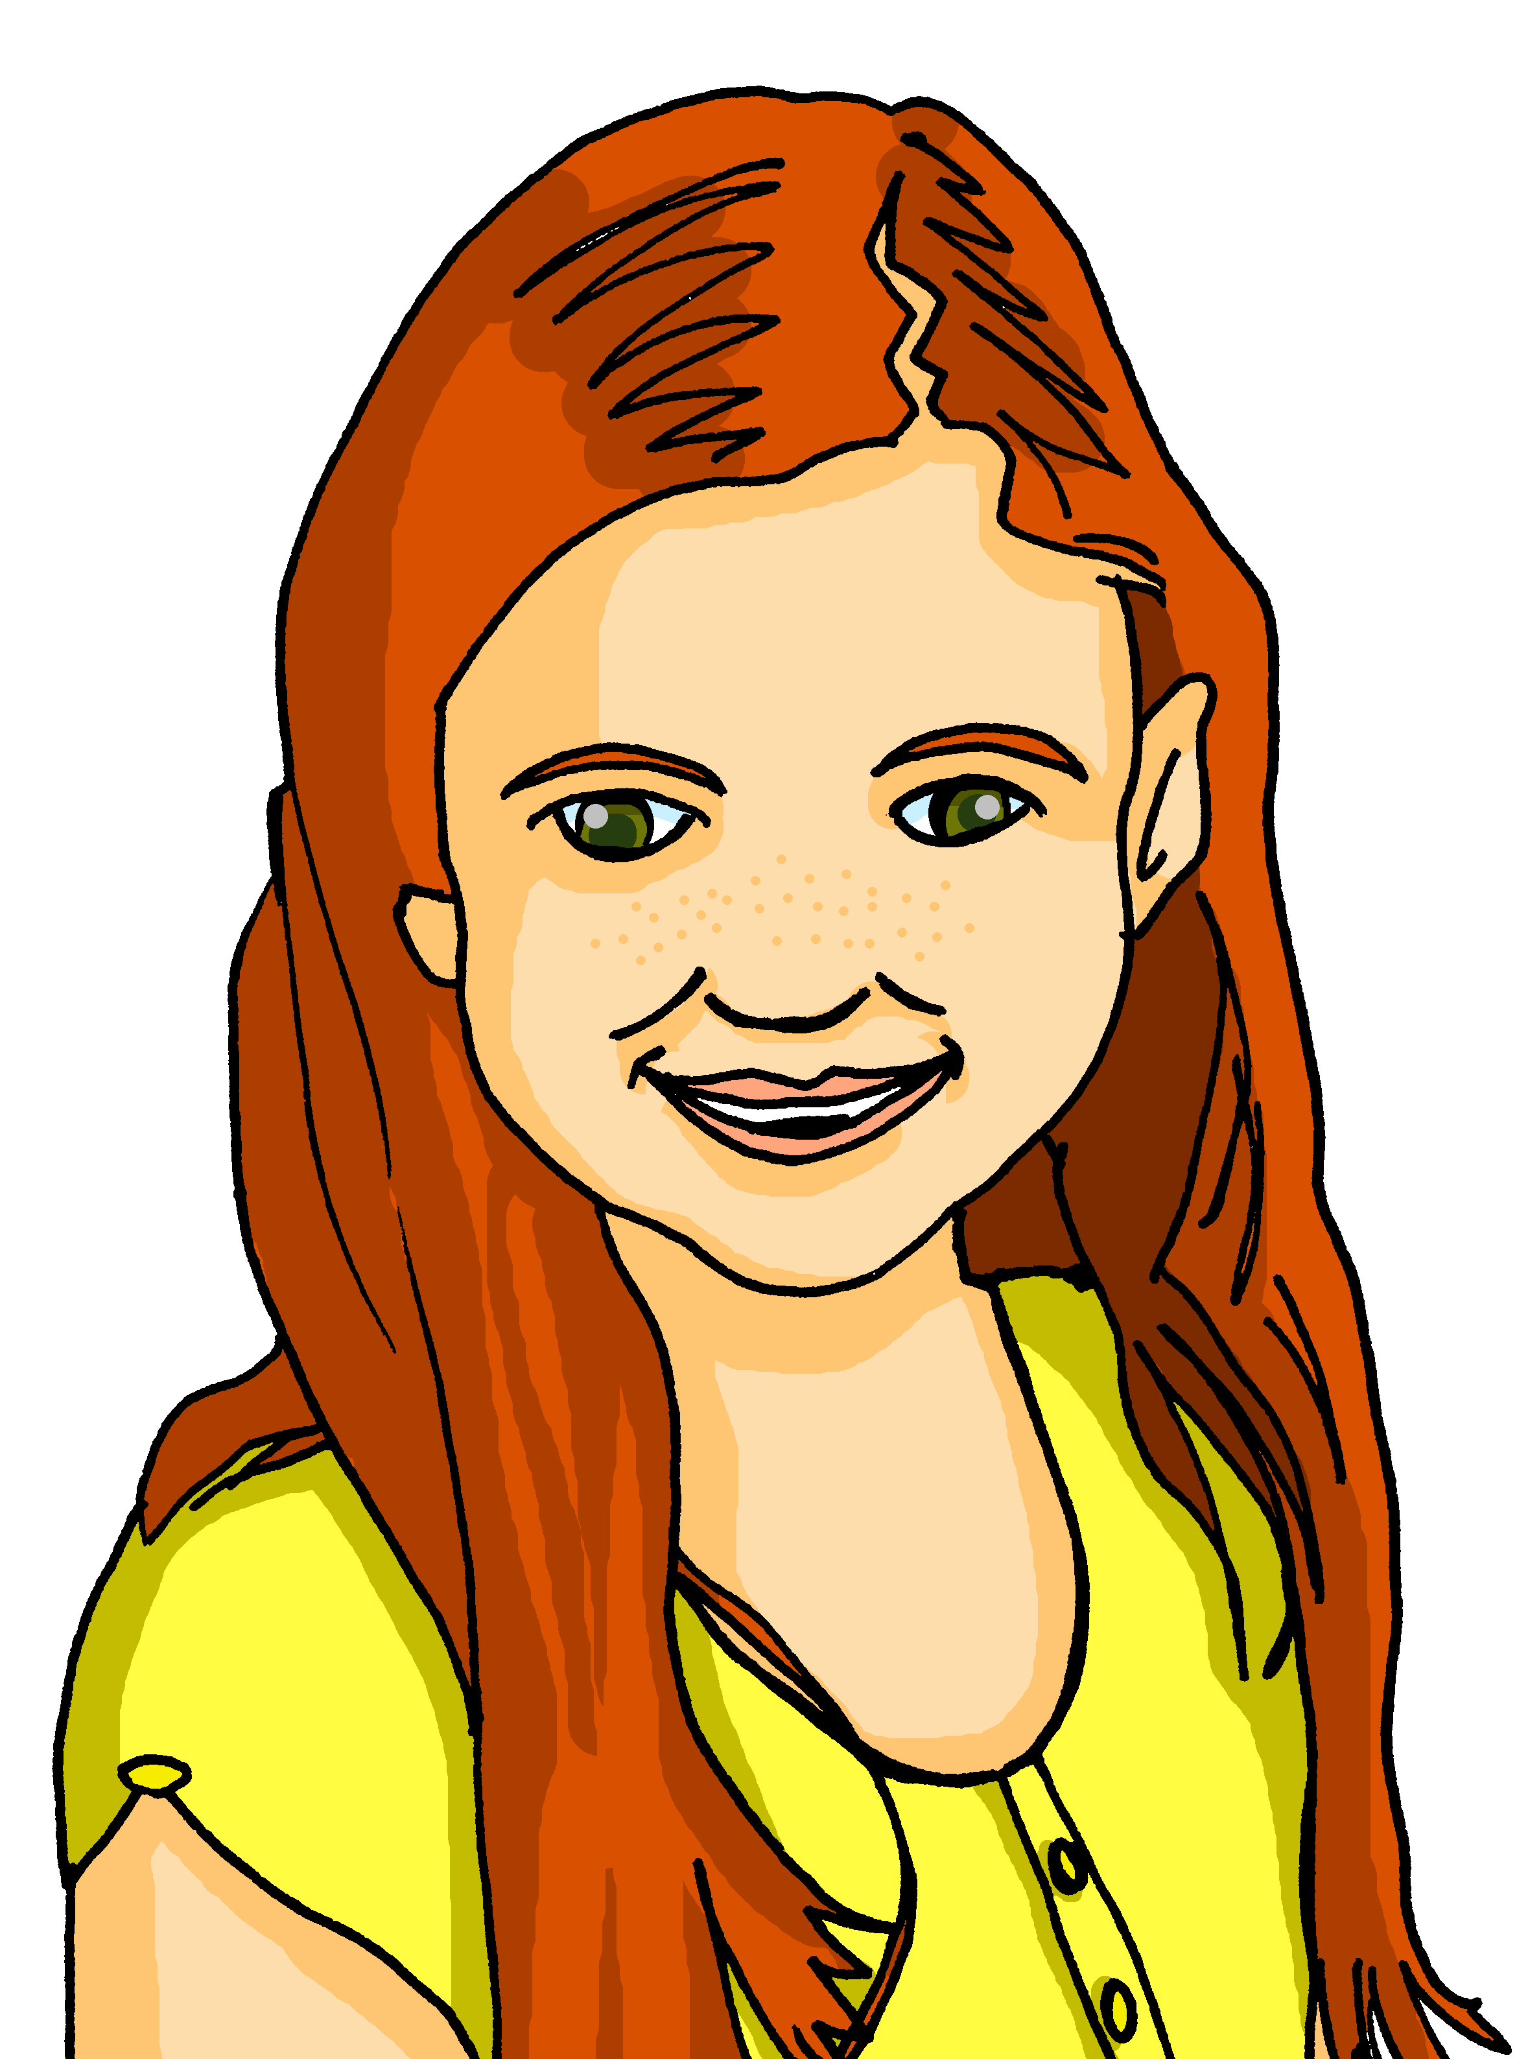
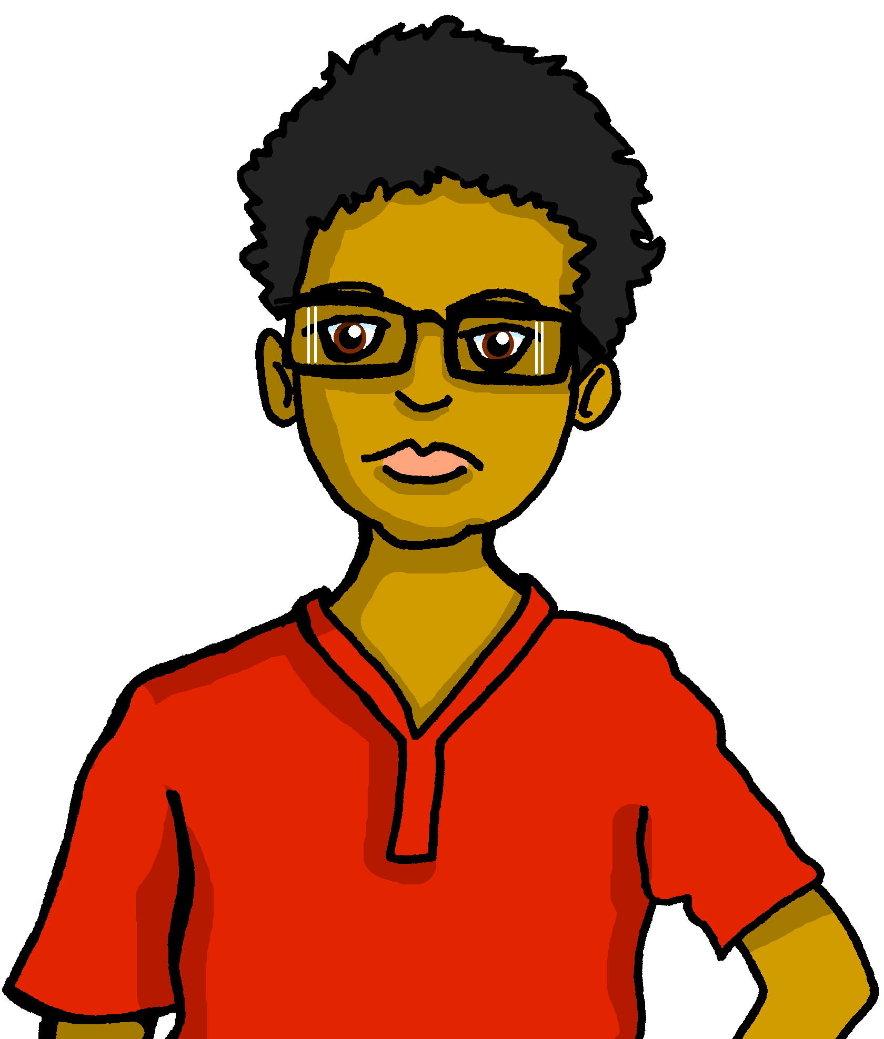
hören
Johanna und Aisha machen ein Quiz für Sarahs und Rafis Klasse.
Hör zu. Ist das Wort im Singular oder im Plural?
Singular | Plural | Wort | Englisch
 |  | Frau | woman
 |  | Bilder | pictures
 |  | Listen | lists
 |  | Aufgaben | tasks
 |  | Blatt | sheet
 |  | Aktivitäten | activities
 |  | Computer | computer(s)
B
1
2
3
4
5
6
Notes:
Timing: 5 minutes
Aim: to practise aural comprehension of plural and singular nouns.
Procedure:
1. Click to hear the example word.
2. Pupils decide whether the word is singular or plural, then write the word in German and its meaning in English.
3. Elicit responses orally and click to reveal the answer. Ask pupils to say what they would have heard if the example had been plural. (i.e., Frauen).
4. Repeat steps 1-3 with items 1 – 6.
Prompt pupils to note that number 6 could be either because it is an example of plural pattern 3 – no change.
Also prompt pupils to note the different plural patterns that English has – e.g. +s, woman → women, activity → activities.
Transcript:
Beispiel: Frau
Bilder
Listen
Aufgaben
Blatt
Aktivitäten
Computer
8

Slide 9
Negation with keine
Remember that after most verbs, kein → keinen for masculine nouns: e.g., Ich habe keinen Preis.
Remember! To say ‘not a/no’ with nouns, use kein:
‘kein’ works like ‘ein’ and matches the gender of the noun.
Das ist kein Preis.
That is not a/no prize.
Das ist keine Frage.
That is not a/no question.
Das ist kein Blatt.
That is not a/no sheet.
Use ‘keine’ for all plural nouns.
To say ‘not (any)/no’ with plural nouns, use keine:
Das sind keine Preise.
Those are not/no prizes.
Das sind keine Fragen.
Those are not/no questions.
Das sind keine Blätter.
Those are not/no sheets.
Notes:
Timing: 2 minutes
Aim: to revisit knowledge of singular noun negation with kein; to introduce the plural form keine.
Procedure:
Click through the animations to present the new information.
Elicit English translation for the German examples provided.
9

Slide 10
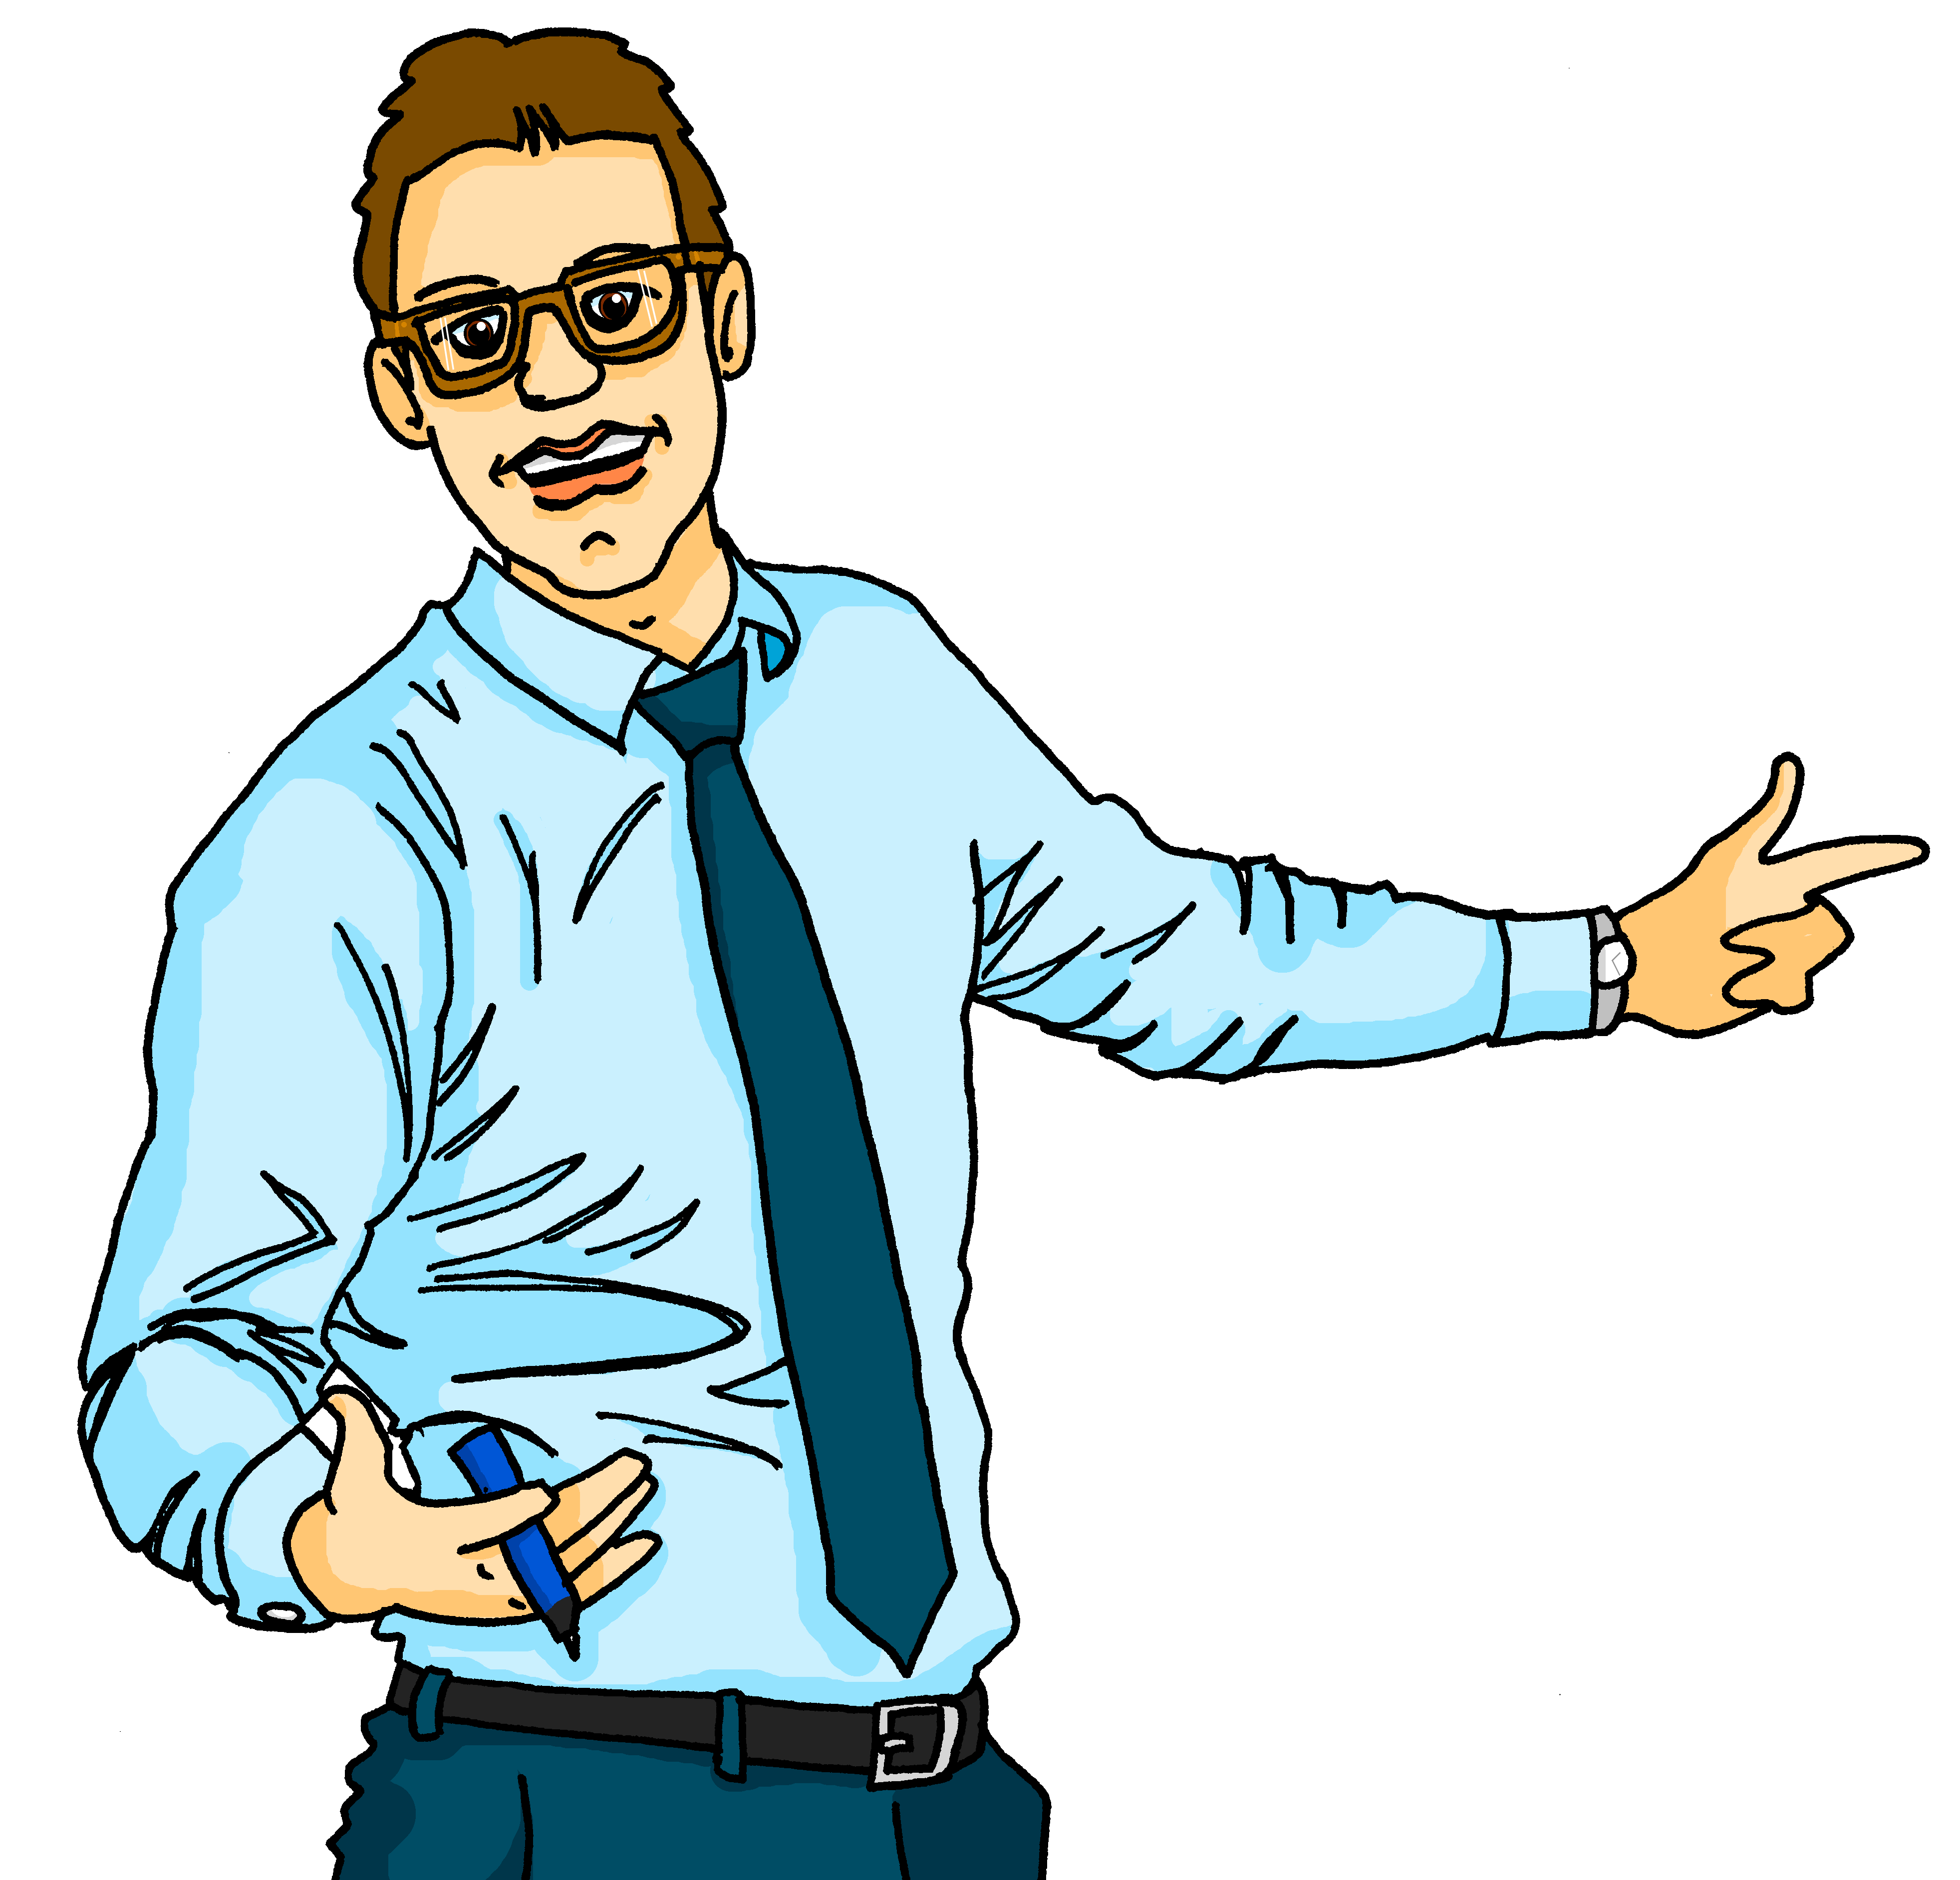
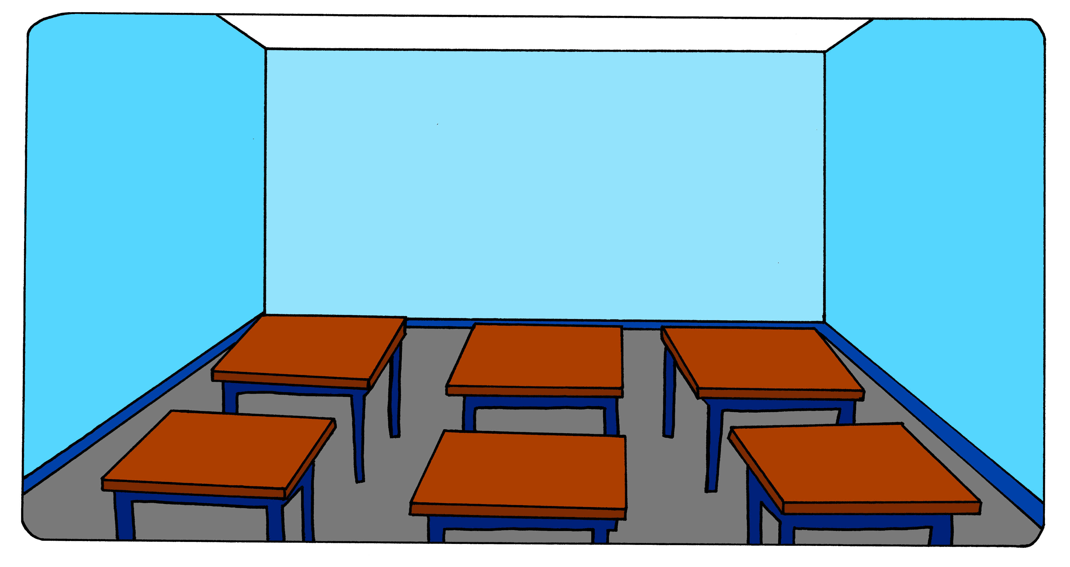
hören
Aisha gibt Beispiele.
Hör zu. Welches Bild ist richtig?
A
B
1
2
3
4
5
6
7
8
Notes:
Timing: 5 minutes
Aim: to practise aural comprehension and distinction of keinkeine/keinen with plural and singular nouns.
Procedure:
1. Do number 1 with pupils to model the task. Tell pupils that when the plural and singular forms of the noun are the same, they will only get the answer from the form of ‘kein’ they hear. Otherwise they will get two clues, one from kein and one from the noun itself.
2. Pupils decide whether the word is singular or plural, and write A or B.
3. Elicit responses (A/B) orally and click to reveal the answer tick. Elicit the German sentence from pupils for additional practice/stretch and challenge.
4. Repeat steps 1-3 with items 2-8.
Transcript:
Ich habe keinen Lehrer.
Ich habe kein Zimmer.
Ich habe keine Computer.
Ich habe keine Kuchen.
Ich habe keine Bilder.
Ich habe kein Buch.
Ich habe keine Lieder.
Ich habe keine Schüler.
10

Slide 11
Tschüss!
blau
Notes:
11

