Slide 1
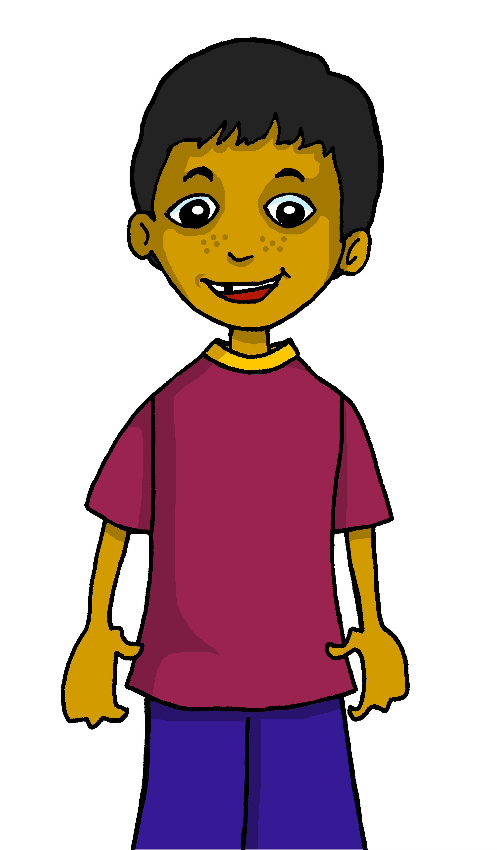
Interacting
blau
Follow ups 1-5
Term 1 Week 8
Notes:
Artwork by Steve Clarke. Pronoun pictures from NCELP (www.ncelp.org). All additional pictures selected from Pixabay and are available under a Creative Commons license, no
attribution required.
Phonics: [ei] vs [ie]
Vocabulary: alles [36] alle [36] viele [56] Beispiel [94] Bild [253] Computer [1252] Eis [1874] Essen1 [323] Foto [633] Frage [157] Handy [1693] Heft [3862] Kunst [554] Lied [1733] Liste [1792] Preis [334] Satz [432] Song [3373] Text [473] Tisch [529]
Revisit 1: bleiben [113] brauchen [179] Glas, Gläser [885] Idee [451] gewinnen [372] haben [6] helfen [338] kaufen [506] machen [58] planen [579] singen [1063] spielen [205] wiederholen [988] Kind [133] Kinder [133] Stunde [276] dieser, diese, dieses [24]
Revisit 2: bekommen [212] benutzen [1119] brauchen [179] erklären [238] kennen [216] lernen [288] lieben [701] schreiben [184] schwimmen [1863] singen [1063] spielen [205] Geld [235] dieser, diese, dieses [24]
Jones, R.L & Tschirner, E. (2019). A frequency dictionary of German: Core vocabulary for learners. London: Routledge.
The frequency rankings for words that occur in this PowerPoint which have been previously introduced in these resources are given in the SOW and in the resources that first
introduced and formally re-visited those words.
For any other words that occur incidentally in this PowerPoint, frequency rankings will be provided in the notes field wherever possible.
Remember that at the start of the course (first three lessons of Rot/Gelb) pupils learnt language (for greetings and register taking) that can still be part of the lesson routines in upper KS2 (Blau/Grün). They are not re-taught, as we anticipate that teachers have built these in from early in lower KS2.

Slide 2
Follow up 1a
Word snake!
Put capitals on the nouns, then sort into [ei] and [ie].
Wörter
Vokabeln
[ei]
[ie]
zwei
sieben
dein
viel
sieben
Dienstag
Lieder
kein
Tier
zwei
Preis
siebzehn
Bleistift
sie
dein
vierzehn
drei
Preis
Lieder
viel
Tier
heiße
siebzehn
kein
sie
drei
Bleistift
heiße
Notes:
Slide 1 of 2
Timing: 5 minutes
Aim: to differentiate between [ei] and [ie]
Procedure: 1. Pairwork. One pupil turns away from board to listen, the other pupil reads out the words.
2. Pupil who listens says for each word whether they hear [ei] or [ie].
3. More challenging version: Pupil who listens transcribes the full word.
4. Click through solutions with all pupils facing the front again – first reveal the words, then the [ei] /[ie] sorting.
5. On next slide, pupils swap roles.
Note: if desired, teachers can click on the darker green text boxes to hear each word pronounced.

Slide 3
Follow up 1b
Word snake!
Put capitals on the nouns, then sort into [ei] and [ie].
Wörter
Vokabeln
[ei]
[ie]
Freitag
wiederholen
klein
hier
wiederholen
Haustier
einunddreißig
Spiel
hier
einunddreißig
Eis
Lieblings-
Freitag
Eis
keine
Haustier
Spiel
keine
Papier
Lieblings-
Papier
vier
klein
vier
Notes:
2/2
Pupils swap roles
Note: if desired, teachers can click on the darker green text boxes to hear each word pronounced.

Slide 4
Words for ‘a’ (ein, eine, ein)
After haben and most other verbs, the words for ‘a’ are:
masculine
feminine
neuter
Wir haben
einen Tisch
eine Tafel
ein Heft
We have
a table
a board
an exercise book
Ihr plant
einen Text
eine Party
ein Lied
You plan
a text
a party
a song
Sie schreiben
einen Song
eine Liste
ein Buch
They write
a song
a list
a book
Notes:
Timing: 2 minutes
Aim: to revise the indefinite singular articles after ‘haben’ (and most other verbs)
Procedure:
Click through the animations to present the new information.
Elicit English translation for the German examples provided.
4

Slide 5
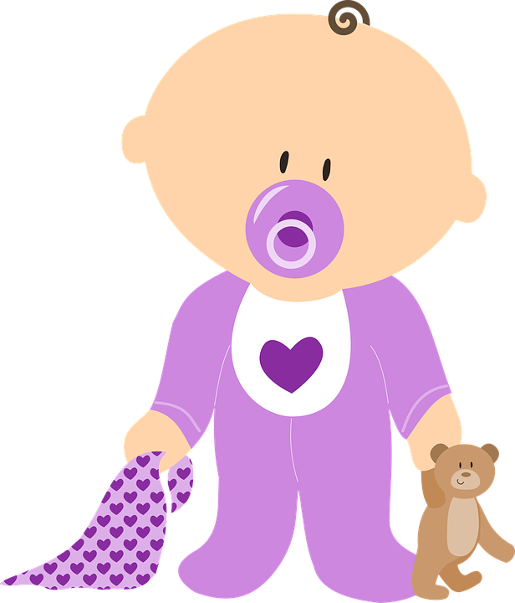
Follow up 2
Hör zu.
B Welches Bild ist richtig? Schreib A/B oder das Wort.
A Welches Wort ist das? Und auf Englisch?
A B
B.
Bild | Bilder
lots of pictures
1 Ich habe einen…
Tisch.
hören
1
Stunde | Stunden
lots of hours
Kind.
2 Ich habe ein…
lesen
2
Glas | Gläser
one glass
Stunde.
3 Ich habe eine…
3
Kind | Kinder
one child
schreiben
Heft.
4 Ich habe ein…
4
Song | Songs
lots of songs
Preis.
5 Ich habe einen…
5
Heft | Hefte
lots of exercise books
Notes:
Timing: 5 minutes
Aim: to practise aural comprehension of the difference between one and many, to identify correct written indefinite article forms depending on gender of the noun.
Procedure:
Listening: Click to listen. Pupils circle the correct word (singular or plural) (if they have the sheet printed). If not, they can use numbers 1 and 2.
Click for answer.
Elicit English translation, click to bring up translation.
Reading:
5. Click for instructions.
6. Click for first item. Pupils decide based on gender of the noun which picture is the correct one. Elicit the answer.
7. Click for answer tick. Elicit the word – for a more challenging version, pupils can write down the correct word.
8. Click to bring up the written version of the correct word.
9. Continue for items 2-5.
Transcript: Beispiel: Wir haben viele [Bilder].
Wir bleiben viele [Stunden].
Wir brauchen ein [Glas].
Wir haben ein [Kind].
Wir singen viele [Songs].
Wir haben viele [Hefte].

Slide 6
Follow up 3

Schreib die Wörter auf Deutsch und auf Englisch.
Hallo, __ _________ eine Präsentation: ______ über England!
England _____ ____ Musik.
______ _______ sind auf Englisch.
London und Oxford ______ _____ Touristen.
_____ Städte haben ____ Kultur.
schreiben
wir machen
_______ we are doing __ ____________ all about England!
England has _ __ __ _______.
Many songs are in _____________.
London and Oxford have a lot of _________.
All the ______ have a lot of _______ .
Hello,
a
alles
presentation:
hat viel
a lot of music
Viele Songs
English
haben viele
tourists
Alle
viel
cities
culture
Notes:
Timing: 5-10 minutes
Aim: to practise written production of the plural forms of haben, viel, viele, alle and alles.
This is a jigsaw translation task.
Procedure:
Students write the missing words in both German and English to complete the sentences.
Teacher clicks to provide the written answers and/or clicks the audio buttons to hear the full German sentences.
Differentiation: 1. For a different challenge (i.e. to practise spelling rather than full written recall of the missing German words), the task could be completed as a transcription task initially, by listening to the full sentences and writing the words.
2. Then pupils could complete the English part of the jigsaw.

Slide 7
Follow up 4
Rede mit deinem Partner/deiner Partnerin.
sprechen
Beispiel:
B
Fotos
A
1 | Fotos | Kunst
2
3
4
5
Wir haben viele…

We have lots of photos.
Notes:
Example slide.
Timing: 5 minutes (two slides)
Aim: to practise viel/ viele with countable and uncountable plural nouns, and the plural forms of haben.
Procedure:
Click through the animations to explain the task. Person A says Wir haben viele…
Person B chooses the correct word out of two (Fotos).
3. Person A write the whole sentence in English: We have lots of photos.

Slide 8
Follow up 4a
Rede mit deinem Partner/deiner Partnerin.
A
…
sprechen
1. Wir haben viel…
2. Ihr habt viele…
3. Sie haben viele…
4. Wir haben viel…
5. Sie haben viele…
…
B
1 | Eis | Tiere
2 | Chips | Hunger
3 | Wasser | Preise
4 | Kunst | Songs
5 | Papier | Lehrer

1. We have lots of ice cream.
2. You (all) have lots of crisps.
3. They have lots of prizes.
4. We have lots of art.
5. They have lots of teachers.
Notes:
Round 1
Procedure:
Partner As turn away.
Click to bring up partner B’s prompts, which they copy down.
Partner Bs turn away.
Click to bring up Partner A’s prompts. Partner As say each of the 5 sentences.
Partner Bs listen out for viel or viele and provide the ending to Partner A’s sentences, depending on whether is it a countable/uncountable noun.
Partner As listen and write the full sentence that the they have jointly created, in English.
Partner Bs turn back to the board.
Click to reveal answers.
Move to the next slide to swap roles.
Note: the procedure is designed to avoid using paper/printing. However, if it is too time-consuming then pupils can be give their prompts on a paper handout. See the end of the presentation.

Slide 9
Follow up 4b
Rede mit deinem Partner/deiner Partnerin.
B
…
sprechen
1. Ihr habt viele…
2. Wir haben viel…
3. Sie haben viele…
4. Wir haben viele…
5. Ihr habt viel…
A
…
1 | Computer | Musik
2 | Kunst | Bilder
3 | Handys | Papier
4 | Essen | Listen
5 | Gläser | Eis

1. You (all) have lots of computers.
2. We have lots of art.
3. They have lots of mobile phones.
4. We have lots of lists.
5. You (all) have lots of ice cream.
Notes:
Slide 2 of 2. Pupils swap roles.

Slide 10
Follow up 5:

Schreib auf Englisch.
Can you get at least 15 points?
Wörter
 | die Kinder | planen | kaufen
 | dieses | trinken | diese
 | die Gläser | bleiben | die Idee
 | gewinnen | kaufen | brauchen
 | alles | alle | viele
 | das Eis | das Essen | die Kunst
(the) children
to plan
to buy
Vokabeln
x3
this, that (f), these, those
this, that (nt)
to drink
(the) glasses
to stay
(the) idea
x2
to win
to buy
need
everything
all (of the)
many, lots of
x1
(the) ice cream
(the) food, meal
(the) art
Notes:
Timing: 5 minutes
Aim: to practise written production of vocabulary from this and revisited weeks.
Procedure: 1. Give pupils a blank grid. They fill in the English meanings of any of the words they know, trying to reach 15 points in total.
Note: The most recently learnt and practised words are pink, words from the previous week are green and those from week 1 are blue, thus more points are awarded for them, to recognise that memories fade and more effort (heavy lifting!) is needed to retrieve them.

Slide 11
Follow up 5:

Schreib auf Deutsch.
Can you get at least 15 points?
Wörter
 | this, that (m) | this, that (nt) | this, that (f), these, those
 | to drink | to plan | (the) children
 | (the) idea | to win | to buy
 | to stay | need | (the) glasses
 | (the) ice cream | (the) food, meal | (the) art
 | everything | all (of the) | many, a lot
dieser
dieses
diese
Vokabeln
x3
trinken
planen
die Kinder
die Idee
gewinnen
kaufen
x2
bleiben
brauchen
die Gläser
das Eis
das Essen
die Kunst
x1
alles
alle
viele
Notes:
Timing: 5 minutes
Aim: to practise written production of vocabulary from this and revisited weeks.
Procedure: 1. Give pupils a blank grid. They fill in the German meanings of any of the words they know, trying to reach 15 points in total.
Note: The most recently learnt and practised words are pink, words from the previous week are green and those from week 1 are blue, thus more points are awarded for them, to recognise that memories fade and more effort (heavy lifting!) is needed to retrieve them.

Slide 12
Tschüss!
blau
Notes:
12

Slide 13
Follow up 4 Partner A
Round 1
A
…
sprechen
1. Wir haben viel…
2. Ihr habt viele…
3. Sie haben viele…
4. Wir haben viel…
5. Sie haben viele…
A
Round 2
1 | Computer | Musik
2 | Kunst | Bilder
3 | Handys | Papier
4 | Essen | Listen
5 | Gläser | Eis

1
2
3
4
5
Notes:
Partner A Handout

Slide 14
Follow up 4 Partner B
Round 2
B
B
…
sprechen
Round 1
1. Ihr habt viele…
2. Wir haben viel…
3. Sie haben viele…
4. Wir haben viele…
5. Ihr habt viel…
1 | Eis | Tiere
2 | Chips | Hunger
3 | Wasser | Preise
4 | Kunst | Songs
5 | Papier | Lehrer

1
2
3
4
5
Notes:
Partner B Handout

Slide 15
Follow up 5:

Schreib auf Englisch.
Can you get at least 15 points?
Wörter
 | die Kinder | planen | kaufen
 | dieses | trinken | diese
 | die Gläser | bleiben | die Idee
 | gewinnen | kaufen | brauchen
 | alles | alle | viele
 | das Eis | das Essen | die Kunst
Vokabeln
x3
x2
x1
Notes:
Handout

Slide 16
Follow up 5:

Schreib auf Deutsch.
Can you get at least 15 points?
Wörter
 | this, that (m) | this, that (nt) | this, that (f), these, those
 | to drink | to plan | (the) children
 | (the) idea | to win | to buy
 | to stay | need | (the) glasses
 | (the) ice cream | (the) food, meal | (the) art
 | everything | all (of the) | many, a lot
Vokabeln
x3
x2
x1
Notes:
Handout

