Slide 1
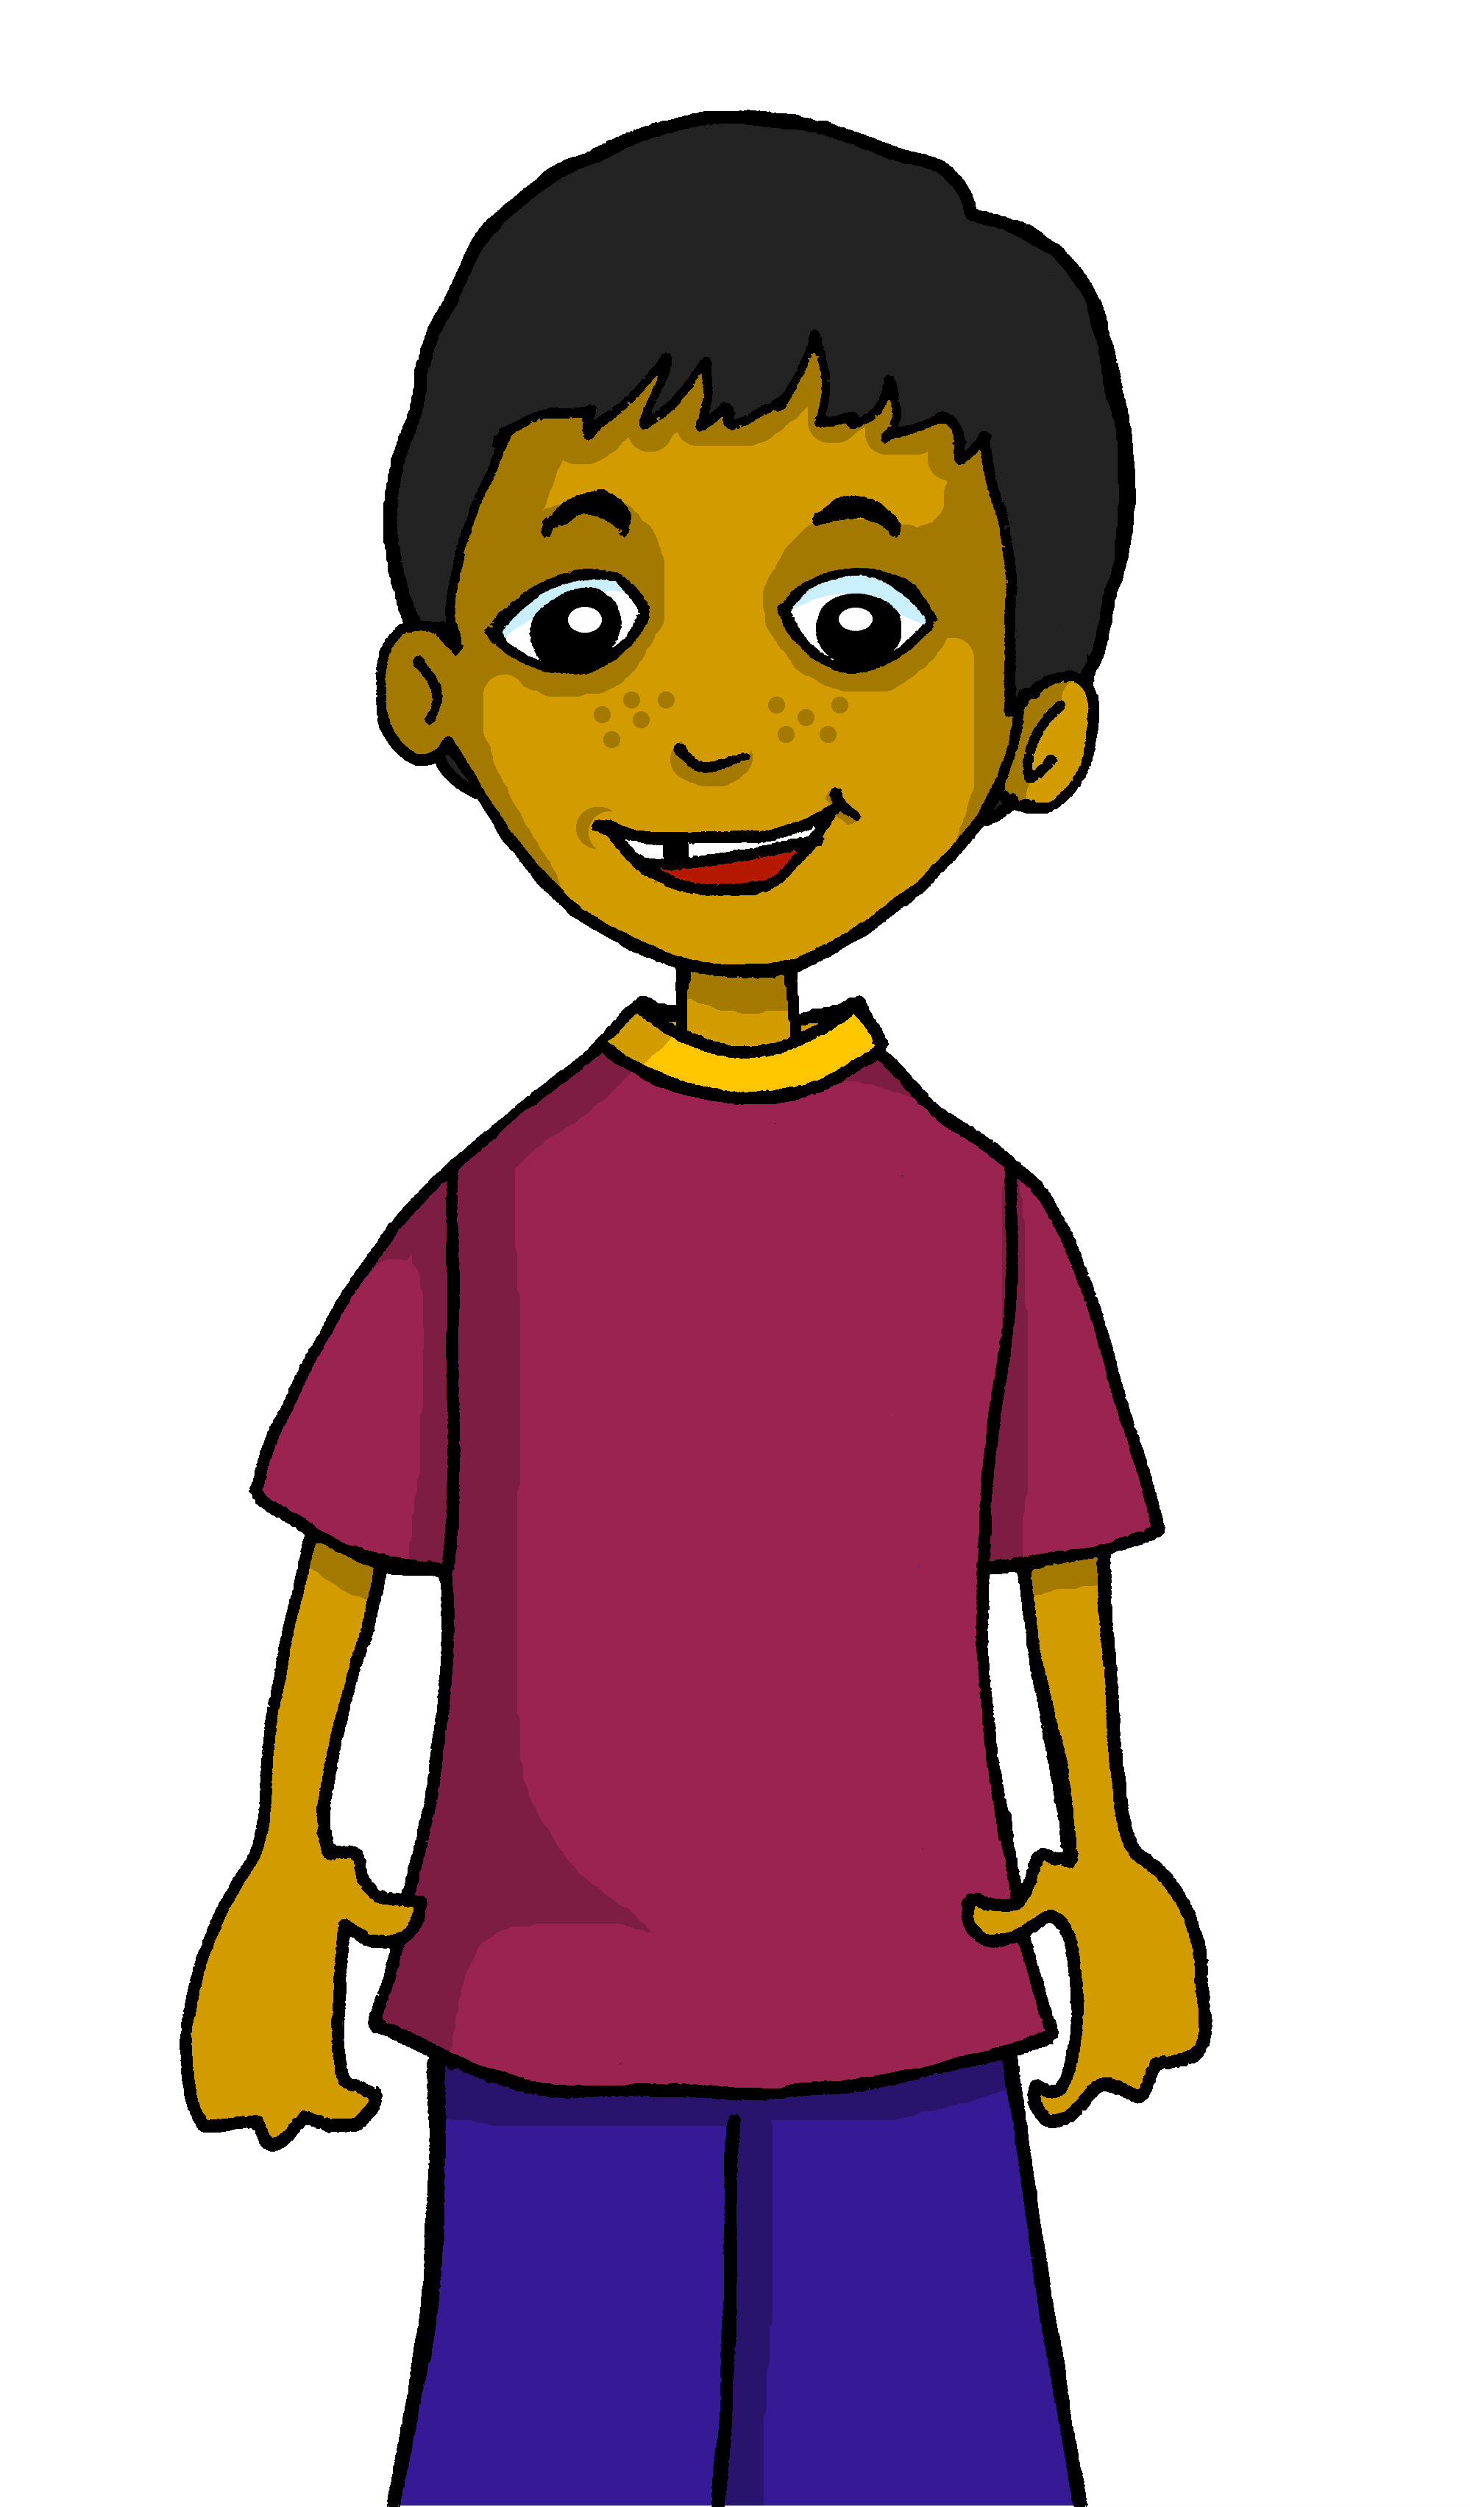
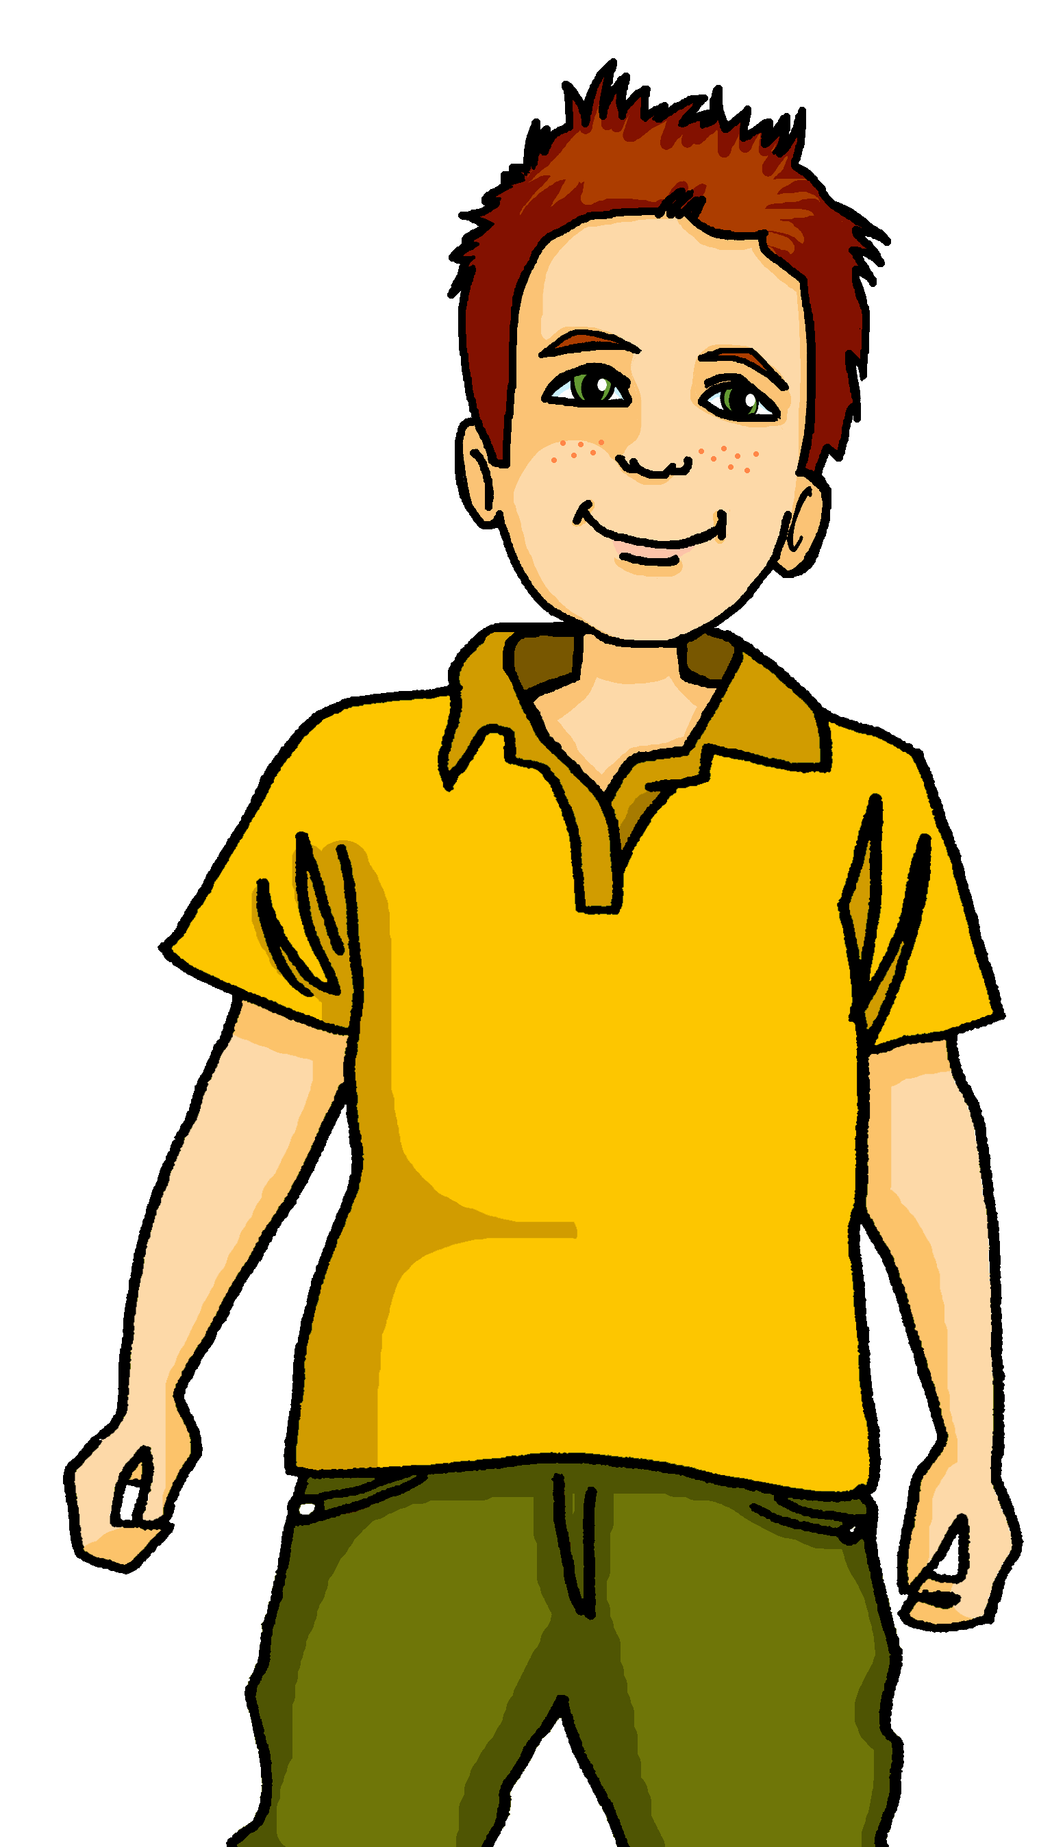
Interacting
Projekt Deutschland
blau
HABEN – wir, ihr, sie
viel, viele, alle
SSC [ei] [ie]
Term 1 Week 8
Notes:
Artwork by Steve Clarke. Pronoun pictures from NCELP (www.ncelp.org). All additional pictures selected from Pixabay and are available under a Creative Commons license, no
attribution required.
Phonics:
revisit [ei] - frei [318] ein [5] klein [114] sein [3] allein [258]
revisit [ie] - Brief [838] Liebe [844] sie [7]
Vocabulary: alles [36] alle [36] viele [56] Beispiel [94] Bild [253] Computer [1252] Eis [1874] Essen1 [323] Foto [633] Frage [157] Handy [1693] Heft [3862] Kunst [554] Lied [1733] Liste [1792] Preis [334] Satz [432] Song [3373] Text [473] Tisch [529]
Revisit 1: bleiben [113] brauchen [179] Glas, Gläser [885] Idee [451] gewinnen [372] haben [6] helfen [338] kaufen [506] machen [58] planen [579] singen [1063] spielen [205] wiederholen [988] Kind [133] Kinder [133] Stunde [276] dieser, diese, dieses [24]
Revisit 2: bekommen [212] benutzen [1119] brauchen [179] erklären [238] kennen [216] lernen [288] lieben [701] schreiben [184] schwimmen [1863] singen [1063] spielen [205] Geld [235] dieser, diese, dieses [24]
Jones, R.L & Tschirner, E. (2019). A frequency dictionary of German: Core vocabulary for learners. London: Routledge.
The frequency rankings for words that occur in this PowerPoint which have been previously introduced in these resources are given in the SOW and in the resources that first
introduced and formally re-visited those words.
For any other words that occur incidentally in this PowerPoint, frequency rankings will be provided in the notes field wherever possible.
Remember that at the start of the course (first three lessons of Rot/Gelb) pupils learnt language (for greetings and register taking) that can still be part of the lesson routines in upper KS2 (Blau/Grün). They are not re-taught, as we anticipate that teachers have built these in from early in lower KS2.
1

Slide 2
aussprechen
[ei]
…
free
frei
Notes:
Timing: 1 minute
Aim: to revisit the SSC [ei].
Procedure:
Re-present the SSC [ei] and present the source word ‘frei’ (with gesture, if using).
Click to bring on the picture and get pupils to repeat the word ‘frei’ (with gesture, if using).
Note:
a gesture for frei’ might be to throw you hands up in the air and pretend to run away.
Vocabulary: frei [318
Jones, R.L & Tschirner, E. (2019). A frequency dictionary of German: Core vocabulary for learners. London: Routledge.
2

Slide 3
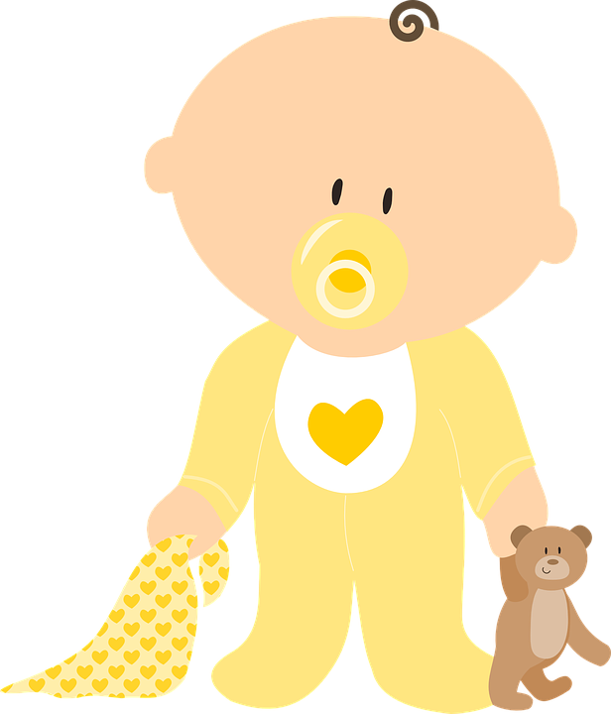
aussprechen
[ei]
…
frei
/a
sein
ein
alone
klein
allein
Notes:
Timing: 1 minute
Aim: to revisit the SSC [ei].
Procedure:
Re-present the SSC and the source word ‘frei’ (with gesture, if using).
Click to bring on the picture and get pupils to repeat the word ‘frei’ (with gesture, if using).
Present the cluster words in the same way, bringing on the picture and getting pupils to pronounce the words.
Vocabulary: frei [318] ein [5] klein [114] sein [3] allein [258]
Jones, R.L & Tschirner, E. (2019). A frequency dictionary of German: Core vocabulary for learners. London: Routledge.

Slide 4
aussprechen
[ie]
…
Liebe
Notes:
Timing: 1 minute
Aim: to revisit the SSC [ie].
Procedure:
Re-present the SSC [ie] and present the source word ‘Liebe’ (with gesture, if using).
Click to bring on the picture and get pupils to repeat the word ‘Liebe’ (with gesture, if using).
Note:
A gesture for ‘Liebe’ might be to make a ‘heart’ shape with both hands approximately where your heart is in your body.
Liebe [844]
Jones, R.L & Tschirner, E. (2019). A frequency dictionary of German: Core vocabulary for learners. London: Routledge.
4

Slide 5
aussprechen
[ie]
…
sie
Liebe
Brief
Notes:
Timing: 1 minute
Aim: to revisit the SSC [ie].
Procedure:
Re-present the SSC and present the source word ‘Liebe’ (with gesture, if using).
Click to bring on the picture and get pupils to repeat the word ‘Liebe’ (with gesture, if using).
Present the cluster words in the same way, bringing on the picture and getting pupils to pronounce the words.
sie [7] Brief [838]
Jones, R.L & Tschirner, E. (2019). A frequency dictionary of German: Core vocabulary for learners. London: Routledge.
5

Slide 6
Vokabeln
Sag die Wörter auf Deutsch.
Remember the difference in pronounciation between [ei] and [ie]!
Wörter
das Beispiel
das Essen
das Bild
die Frage
das Lied
der Satz
(the)
ice cream
(the) food/meal
all
(of the)
(the) question
(the) example
(the) song
(the) phone
(the) prizes
(the) sentence
(the) picture
(the) list
everything
many
(the) art
das Eis
das Handy
die Liste
die Kunst
alles
alle
die Preise
viele
Notes:
Timing: 5 minutes
Aim: to present and practise new vocabulary for this week
Procedure:
Click to bring up the English clue for item 1 in the yellow star in the middle.
Click again for corresponding German word to change colour.
Say the word as it appears or play the recording.
Pupils repeat.
Continue for all items (14).
Order of words:
das Handy das Beispiel das Lied das Bild die Preise der Satz die Kunst das Essen das Eis viele
alle die Frage die Liste alles
6

Slide 7
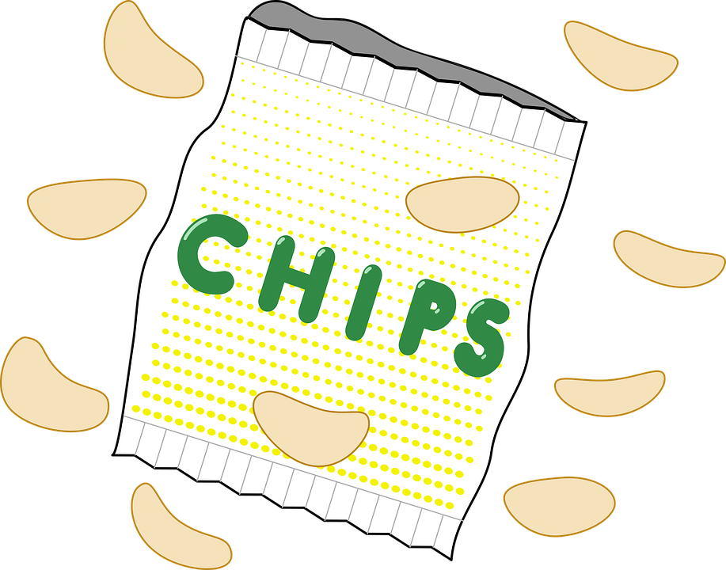
viel | viele (lots of)
Uncountable means you can’t put a number in front of it to make it plural e.g., money, luck.
Viel and viele both mean ‘lots of’.
Use viel with uncountable nouns.
E.g., two books, three prizes, four tables.
Remember! alles = everything and is not followed by a noun.
Use viele with countable nouns.
Ich habe viel Hunger.
I have lots of hunger.
Du hast viele Chips!
You have lots of crisps!
Ich?!? Du hast alle Chips!
Me?!? You have all (of) the crisps!
Notes:
Timing: 3 minutes
Aim: to introduce viel and viele.
Procedure:
Click through the animations to present the new information.
Elicit English translation for the German examples provided.
7

Slide 8
Grammatik
Moritz macht ein Projekt über Deutschland
Was hat Moritz für das Projekt? Viel oder viele?
Beispiele
viel (uncountable) | viele (countable)
To check whether a noun is countable or uncountable, try putting a number in front of the English word.
Musik
Musik
Beispiele
Wasser
Bilder
Wasser
Kunst
Texte
Bilder
Papier
Lieder
Texte
Papier
Kunst
Lieder
Notes:
Timing: 5 minutes
Aim: to practise recognition of countable and uncountable nouns and their connection to viel | viele.
Procedure:
Click through the animations to present the new information.
Elicit English translation for the German examples provided.
8

Slide 9
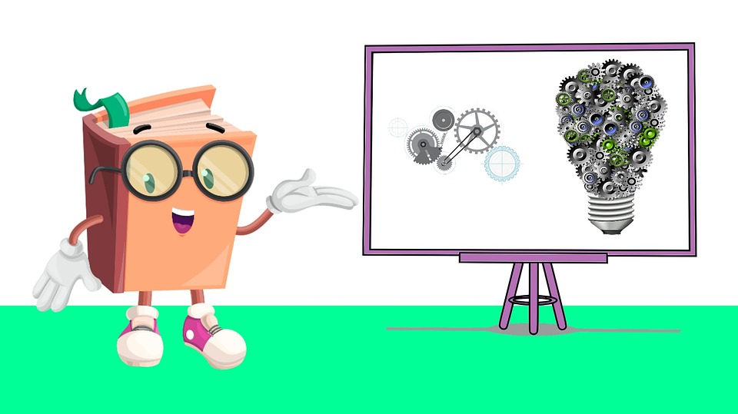
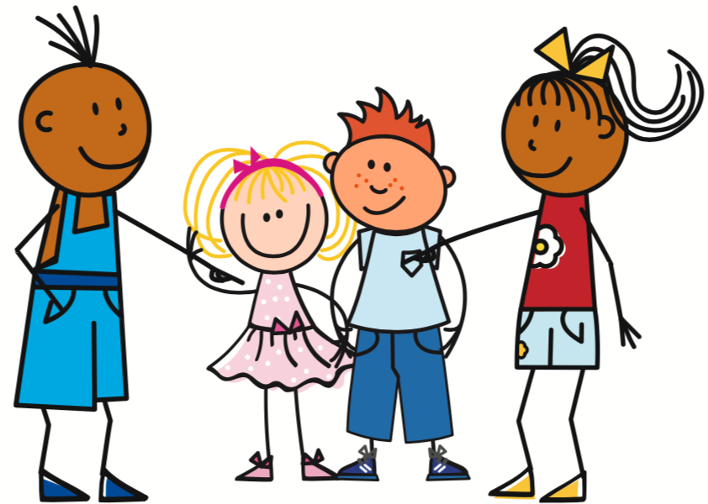
haben – wir, ihr, sie
In plural forms, haben (to have) works like other weak verbs you know.
we have
Wir haben…
viele Fotos.
you (all) have
Ihr habt…
alle Beispiele.
they have
Sie haben…
viele Fragen.
Notes:
Timing: 2 minutes
Aim: to introduce the plural forms of the verb haben.
Procedure:
Click through the animations to present the new information.
Elicit German and English translations, as appropriate.
9

Slide 10
lesen
Johanna und Aisha helfen Moritz und Hamza. Habt ihr alles?
Wer hat was? Mach eine Liste 1-6 mit Objekt.
1
4
Wir haben viele
Fotos | Musik.
Wir haben viele Lied | Preise.
ihr (you all)
.
lots of art
lots of computers
2
5
lots of water
Ihr habt viel Beispiele | Kunst.
Ihr habt viele Text | Computer.
wir (we)
3
6
lots of photos
Wir haben viel Bilder | Papier.
Ihr habt viel Wasser | Sätze.
lots of paper
.
lots of prizes
Notes:
Timing: 5 minutes
Aim: to practise written comprehension of ihr habt and wir haben and nouns new and previously taught.
Procedure:
Pupils write 1-6 and the correct English noun from the two options, under their two headings ‘ihr’ and ‘wir’.
Click to reveal answers.
In audio version, click on the numbered buttons to hear the full sentences, if desired.
10

Slide 11
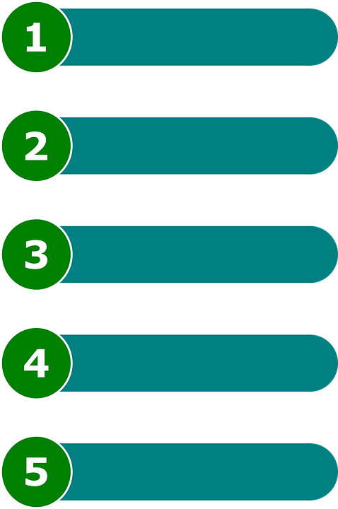
hören
Moritz und Hamza machen eine Präsentation.
Hör zu. Welches Wort ist richtig? A oder B?
A | B
alles | alle
viele | viel
viele | viel
viel | viele
alle | alles
viel | viele
alles | alle
1
2
3
4
5
6
7
Notes:
Timing: 6 minutes
Aim: to practise aural comprehension of viel, viele, alle and their connection with countable and uncountable nouns and alles.
Procedure:
1. Explain that Moritz and Hamza are giving a presentation about Germany to the exchange/partner school online.
2. Explain that the audio keeps cutting in and out and that they need to decide which word out of the choices is in each bleeped gap.
3. Do the first one as an example. Click to bring up answer tick. NB the correct audio is attached to the answer tick! So make sure you click on the audio button first before clicking anywhere else, otherwise the answer tick and answer audio comes up before the task item.
4. Continue with items 2-7, elicit responses and click for the answer.
5. Elicit meanings orally in English.
Transcript:
1. Hallo! Wir machen eine Präsentation über Deutschland. Wir sagen [alle] Sätze auf Deutsch.
2. Deutschland hat [viel] Musik. Wir mögen Rap, HipHop und Popmusik.
3. Wir haben auch [viele] Pizzarestaurants hier. Das Essen hier ist toll!
4. Es gibt auch [viel] Kunst in Deutschland.
5. Deutschland hat [alles]! Es ist super!
6. Habt ihr [viele] Fragen?
7. Alles klar? Nein!. Ok, wir wiederholen [alle] Sätze.
11

Slide 12
Kultur
Lies den Text. Wie ist Deutschland?
Deutschland hat viel Musik mit Liedern auf Englisch – aber auch auf Deutsch!
Oben in den Charts findest du: Nina Chuba, DJ Robin & Schürze, und Kontra K, Sido & Leony.
Viele Menschen aus Italien wohnen in Deutschland. Nicht alle mögen Pizza, aber: Deutschland hat sehr viele Pizzarestaurants! Und – das ist super – es hat auch sehr viel Eis!
Viele Menschen finden Museen toll. Die Haupstadt Berlin hat mehr als* 300 Kunstmuseen!
Bis bald – in Deutschland? ☺
mehr als – more than
Notes:
Timing: 5 minutes
Aim: to present cultural information on Germany, expanding on the previous slide.
Procedure:
Read the text or play the recording.
Ensure pupils understand the general meaning.
Compare and contrast with countries pupils have experience of – UK and others.
12

Slide 13
Tschüss!
blau
Notes:
13

