Slide 1
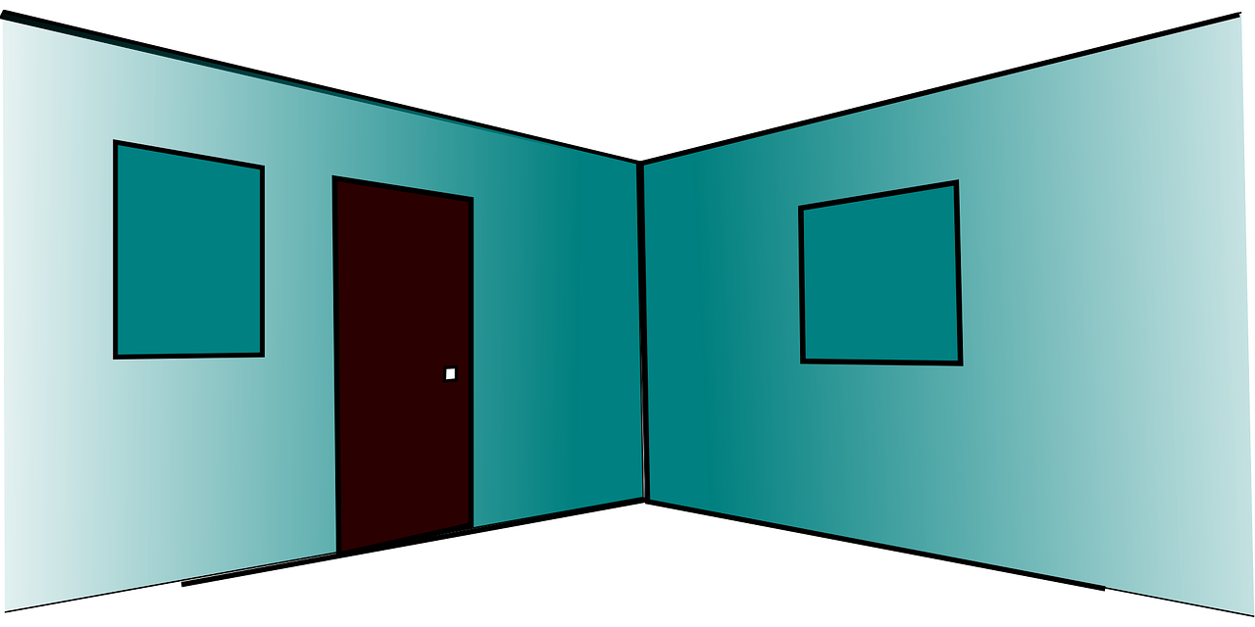
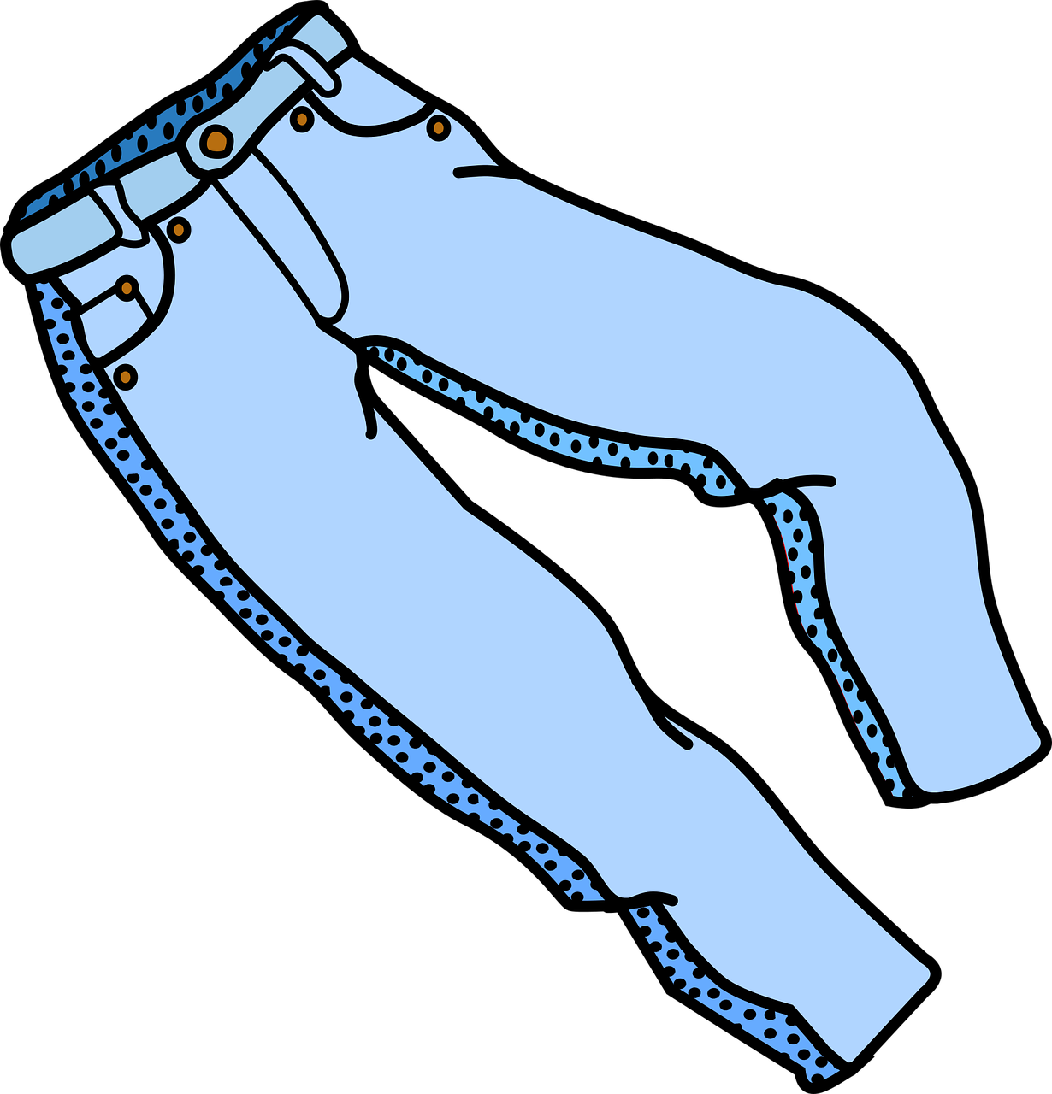
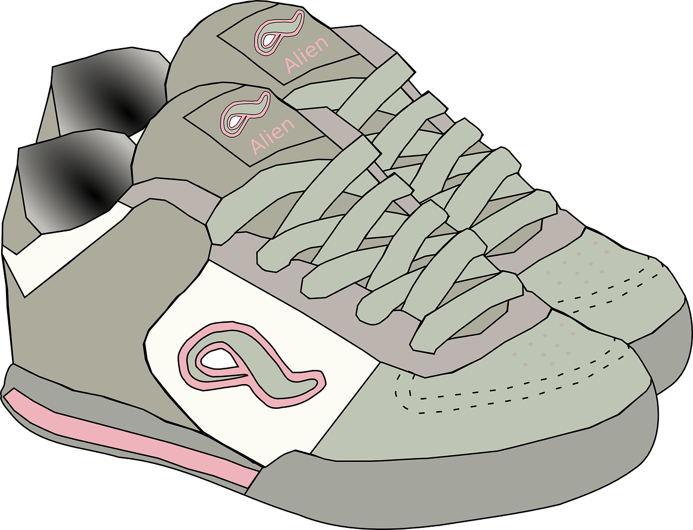
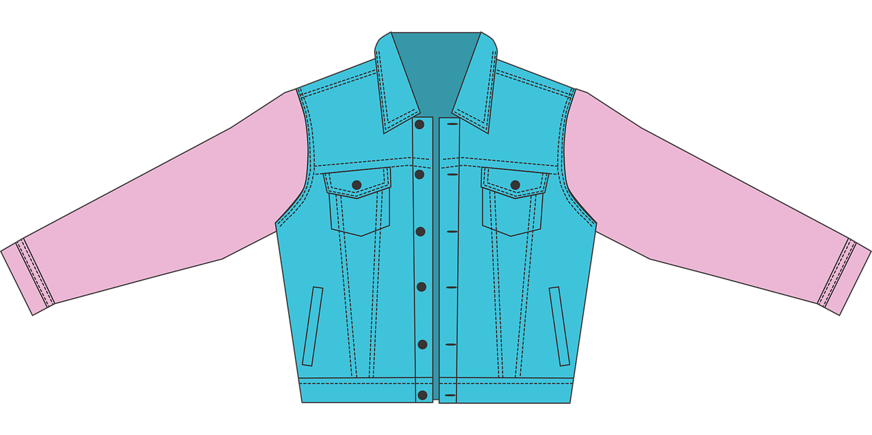
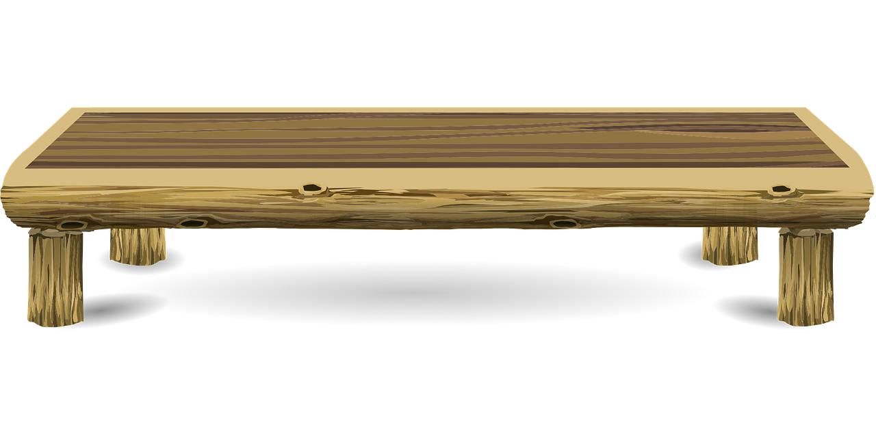
Describing me and others
blau
Follow ups 1-5
Term 1 Week 9
Notes:
Artwork by Steve Clarke. Pronoun pictures from NCELP (www.ncelp.org). All additional pictures selected from Pixabay and are available under a Creative Commons license, no attribution required.
Phonics: [w] Welt [164] Wasser [245] Antwort [522] wahr [737] gewinnen [372]
Vocabulary: geben [49] Ball [1782] Baum [1013] Bild [253] Blume [2463] Buch [300] Computer [1252] Foto [633] Glas [885] Jacke [3287] Kleidung [2820] Spiel [328] Stoff [758] Tier [614]
Revisit 1: suchen [293] tanzen [1497] trinken [634] genug [498] (plus language from week 5 - bleiben [113] brauchen [179] Glas, Gläser [885] Idee [451] gewinnen [372] haben [6] helfen [338] kaufen [506] machen [58] planen [579] singen
[1063] spielen [205] wiederholen [988] Kind [133] Kinder [133] Stunde [276] dieser, diese, dieses [24])
Revisit 2: wir sind, ihr seid [4] wir [26] ihr [27] freundlich [1566] nett [1565] schön [188] wunderbar [1603] da [48] hier [68] Baum [1013] Garten [1158] Haus [147] Klasse [961] Mitte [711] Schule [359] Zimmer [665] links [893] oben [417]
rechts [829] unten [710] in [3] nicht wahr [n/a] ja [45] nein [148]
Jones, R.L & Tschirner, E. (2019). A frequency dictionary of German: Core vocabulary for learners. London: Routledge.
The frequency rankings for words that occur in this PowerPoint which have been previously introduced in these resources are given in the SOW and in the resources that first
introduced and formally re-visited those words.
For any other words that occur incidentally in this PowerPoint, frequency rankings will be provided in the notes field wherever possible.

Slide 2
aussprechen
[w]
…
Welt
Notes:
NOTE: Use of these 3 phonics slides is an optional priming/preparation activity before Follow Up 1. They can be omitted, if teachers decide they are not needed.
Timing: 1 minute
Aim: to introduce the SSC [w].
Procedure:
Introduce the SSC and present the source word ‘Welt’ (with gesture, if using).
Click to bring on the picture and get pupils to repeat the word ‘Welt’ (with gesture, if using).
Note:
a gesture for ‘Welt’ might be to mime a big sphere with your hands.
Vocabulary: Welt [164]
Jones, R.L & Tschirner, E. (2019). A frequency dictionary of German: Core vocabulary for learners. London: Routledge.
2

Slide 3
aussprechen
[w]
…
Wasser
Antwort
Welt
wahr
gewinnen
Notes:
Timing: 1 minute
Aim: to consolidate the SSC [w].
Procedure:
Re-present the SSC and the source word ‘Welt’ (with gesture, if using).
Click to bring on the picture and get pupils to repeat the word ‘Welt’ (with gesture, if using).
Present the cluster words in the same way, bringing on the picture and getting pupils to pronounce the words.
Vocabulary: Antwort [522] gewinnen [372] wahr [737] Wasser [245] Welt [164]
Jones, R.L & Tschirner, E. (2019). A frequency dictionary of German: Core vocabulary for learners. London: Routledge.

Slide 4
aussprechen
[v]
…
Vater
Notes:
Timing: 1 minute
Aim: to recap the SSC [v] before meeting [w] and [v] together on next slide.
Procedure:
Present the SSC and the source word ‘Vater’
Click to bring on the picture and get pupils to repeat the word ‘Vater’, with gesture if using.
Note:
a gesture for ‘Vater’ might be to use the BSL gesture, found here: https://www.signbsl.com/sign/father. Although the gesture is not evocative of father, it does tap out the two syllables and the words father/Vater share the same origin, and are very similar, so this does work for the German word, too. Teachers may prefer other alternatives, or not to have a gesture at all.
Vocabulary: Vater [232]
Jones, R.L & Tschirner, E. (2019). A frequency dictionary of German: Core vocabulary for learners. London: Routledge.

Slide 5
aussprechen
[v]
…
Vater
vier
viel
4
[a lot, much]
verstehen
Notes:
Timing: 1 minute
Aim: to consolidate the SSC [v]
Procedure:
Present the SSC and the source word ‘Vater’
Click to bring on the picture and get pupils to repeat the word ‘Vater’
Present the cluster words in the same way, bringing on the picture and getting pupils to pronounce the words.
Vocabulary: Vater [232] vier [200] verstehen [211] viel [56]
Jones, R.L & Tschirner, E. (2019). A frequency dictionary of German: Core vocabulary for learners. London: Routledge.

Slide 6
Follow up 1
[v]
[w]
Hör zu. Welches Wort ist das? Schreib die Nummer.
A
B
C
D
E
F
aussprechen
4
6
9
12
10
5
1. weil
2. wir
3. Veilchen
4. Wetter
[because]
[we]
[violet]
[weather]
6. viel
7. Vetter
5. Wehlen
8. Velen
[town in Germany]
[a lot, much]
[male cousin]
[town in Germany]
9. Vieh
10. vier
11. wie?
12. Weilchen
[four] 4
[cattle]
[how?]
[a little while]
Notes:
Timing: 5 minutes
Aim: to practise aural recognition of words containing SSC [w] or [v]; the [v] words act as significant distractors given that English [v] = German [w].
Procedure: 1. Pupils write down letters A-F. They are going to hear six words. They need to write down the number of the word they hear.
2. Click on audio buttons A-F to listen to each word.
2. Pupils note down the numbers of the word they hear, next to each letter A-F.
3. Elicit answers by asking pupils to say the word in German and give its number.
4. Answers revealed on clicks. English translation of words appears too.
5. After each answer the ‘distractor’ partner word for the answer is highlighted to elicit pupils’ pronunciation, so that they can compare and contrast the two words.
5. Pupils then work in pairs to pronounce all of the words 1-12 as accurately as they can.
Transcript:
Wetter
viel
Vieh Weilchen vier Wehlen

Slide 7
Negation with kein
As you know, kein means ‘not a/no’ with nouns, and matches the gender of the noun:
Das ist kein Ball.
That is not a/no ball.
Das ist keine Blume.
That is not a/no flower.
Das ist kein Foto.
That is not a/no photo.
After most other verbs kein becomes keinen for masculine nouns:
Es gibt keinen Ball.
There is not a/no ball.
It is still ‘keine’ for feminine and ‘kein’ for neuter nouns.
Es gibt keine Blume.
There is not a/no flower.
Es gibt kein Foto.
There is not a/no photo.
Es gibt keine Bälle.
Use ‘keine’ for all plural nouns.
There are not any/no balls.
Notes:
Timing: 2 minutes
Aim: to revisit knowledge of singular noun negation with kein; to introduce the accusative form keinen for masculine nouns after most verbs.
Procedure:
Click through the animations to present the new information.
Elicit English translation for the German examples provided.
7

Slide 8
Follow up 2
Ronja and Lias’ mum Leonie tells their dad Lothar about the sale, but reception is bad and it’s hard to hear.
Hör zu. Ist das Verb ‘ist’ oder nicht?
hören
 | ist? | other verb?
1
1
Hör noch mal zu. Was sagt Leonie?
2
That is not material.
2
3
Lias has no/doesn’t have a computer.
3
Lias is not looking for a tree.
4
4
A cuddly toy is not a prize.
5
5
Ronja is not giving a ball.
6
6
That is not a table.
Notes:
Timing: 5 minutes Aim: to practise comprehension of indefinite negative article kein – and distinction between nominative R1 and accusative R2 forms with masculine nouns - in the listening modality.
Procedure: 1. Click on the audio buttons to play the sentences which are missing the verb.
2. Pupils tick the column of the missing verb in each case (by listening to the form of ‘kein’ which follows).
3. Click to bring up the answers. 4. Play the full sentences. Teachers elicit English meanings. It is not straightforward to translate ‘kein’ so well worth practising its English meaning in these different sentences.
Transcript:
Das [ist] kein Stoff.
Lias [hat] keinen Computer.
Er [sucht] keinen Baum.
Ein Stofftier [ist] kein Preis!
Ronja [gibt] keinen Ball.
Das [ist] kein Tisch.

Slide 9
Follow up 3
Lies die Sätze.
Lias macht eine Liste.
Ronja schreibt die Liste. Ist das richtig oder falsch?
lesen
Er gibt ein Stofftier.
Er gibt eine Jacke.
Er gibt keine Bücher.
Er gibt keinen Computer.
Er gibt ein Spiel.
Er gibt keinen Ball.
kein
viele/-
einen
Notes:
Timing: 5 minutes
Aim: to practise recognition of positive and negative statements using ‘ein’ and ‘kein’ words in written form.
Procedure:
Explain the scenario: Ronja asks Lias to make a list of everything he is donating and everything he is not ready to give up for the sale. He draws the items and ticks/crosses to show whether he will give them away. Ronja writes the list out in full… but has she got it right?
Pupils write down numbers 1-6. Looking at Lias’ picture list on the left, they decide whether Ronja’s sentences on the right are true or false, and draw a tick or a cross.
Pupils should also be encouraged to try and correct the false sentences by writing the correct word or whole sentence in German.
Click to reveal true/false answers and corrected sentences.
Additional Task suggestions:
Pupils could quickly draw their own version of a picture list (using vocab from this or previous lessons). Their partner should then say/write sentences in the 3rd person about the list e.g. Alex gibt ein Bild; er gibt keinen Baum.

Slide 10
Follow up 4

Schreib die Wörter auf Deutsch und auf Englisch.
In English we are more likely to say: He isn’t giving a ball.
Es gibt _______ Gläser.
Er _______ ________ Ball.
Gebt ___ genug ________?
____ _____ kein Stofftier!
Diese _______ ist ______!
schreiben
__________lots of ___________ .
______gives no ______.
___ you (all)_______ ________ books?
That is _________ _____________!
____ flower ___ beautiful!
1
viele
There are
glasses
This could also mean: Do you give enough books?
2
gibt
keinen
He
ball
Are
giving
enough
3
ihr
Bücher
4
Das
ist
not a/no
cuddly toy
5
Blume
schön
This
is
Notes:
Timing: 5-10 minutes
Aim: to practise written production and comprehension of this week’s new verb forms (gibt/gebt), kein, new and revisited vocabulary.
This is a jigsaw translation task.
Procedure:
Pupils write the missing words in both German and English to complete the sentences.
Teacher clicks to provide the written answers and/or clicks the audio buttons to hear the full German sentences.
Pupil HANDOUT at end of this presentation
Differentiation: 1. For a different challenge (i.e. to practise spelling rather than full written recall of the missing German words), the task could be completed as a transcription task initially, by listening to the full sentences and writing the words.
2. Then pupils could complete the English part of the jigsaw.

Slide 11
Follow up 5:

Schreib auf Englisch.
Can you get at least 15 points?
Wörter
 | schön | die Mitte | der Baum
 | das Haus | da | hier
 | wunderbar | die Klasse | der Garten
 | wir sind | nett | ihr
 | wir | freundlich | ihr seid
 | suchen | geben | der Stoff
 | trinken | tanzen | genug
lovely, beautiful
(the) middle
(the) tree
Vokabeln
x3
(the) house
there
here
wonderful
(the) class
(the) garden
x2
we are
nice
you (all)
we
friendly
you (all) are
to look for
to give, giving
(the) material
x1
to drink, drinking
to dance, dancing
enough
Notes:
Timing: 5 minutes
Aim: to practise written comprehension of vocabulary from this and revisited weeks.
Procedure: 1. Give pupils a blank grid. They fill in the English meanings of any of the words they know, trying to reach 15 points in total. 2. Click to reveal answers from bottom of the grid up.
Note: The most recently learnt and practised words are pink, words from the previous week are green and those from week 1 are blue, thus more points are awarded for them, to recognise that memories fade and more effort (heavy lifting!) is needed to retrieve them.

Slide 12
Follow up 5:

Schreib auf Deutsch.
Can you get at least 15 points?
Wörter
 | (the) house | (the) class | (the) middle
 | here | (the) tree | (the) garden
 | lovely, beautiful | wonderful | there
 | you (all) | friendly | nice
 | we are | you (all) are | we
 | to dance, dancing | to drink, drinking | enough
 | to give, giving | (the) material | to look for
das Haus
die Klasse
die Mitte
Vokabeln
x3
hier
der Baum
der Garten
schön
wunderbar
da
x2
ihr
freundlich
nett
wir sind
ihr seid
wir
tanzen
trinken
genug
x1
geben
der Stoff
suchen
Notes:
Timing: 5 minutes
Aim: to practise written production of vocabulary from this and revisited weeks.
Procedure: 1. Give pupils a blank grid. They fill in the German meanings of any of the words they know, trying to reach 15 points in total. 2. Click to reveal answers from the bottom of the grid up.
Note: The most recently learnt and practised words are pink, words from the previous week are green and those from week 1 are blue, thus more points are awarded for them, to recognise that memories fade and more effort (heavy lifting!) is needed to retrieve them.

Slide 13
Tschüss!
blau
Notes:
13

Slide 14
Follow up 4

Schreib die Wörter auf Deutsch und auf Englisch.
Es gibt _______ Gläser.
Er _______ ________ Ball.
Gebt ___ genug ________?
____ _____ kein Stofftier!
Diese _______ ist ______!
schreiben
______ _____lots of __________.
____ gives no ________.
____ you (all)_______ ________ books?
That is _________ _____________!
____ flower ___ beautiful!
Notes:
HANDOUT

Slide 15
Follow up 5:

Schreib auf Englisch.
Can you get at least 15 points?
Wörter
 | schön | die Mitte | der Baum
 | das Haus | da | hier
 | wunderbar | die Klasse | der Garten
 | wir sind | nett | ihr
 | wir | freundlich | ihr seid
 | suchen | geben | der Stoff
 | trinken | tanzen | genug
Vokabeln
x3
x2
x1
Notes:
HANDOUT

Slide 16
Follow up 5:

Schreib auf Deutsch.
Can you get at least 15 points?
Wörter
 | (the) house | (the) class | (the) middle
 | here | (the) tree | (the) garden
 | lovely, beautiful | wonderful | there
 | you (all) | friendly | nice
 | we are | you (all) are | we
 | to dance, dancing | to drink, drinking | enough
 | to give, giving | (the) material | to look for
Vokabeln
x3
x2
x1
Notes:
HANDOUT

