Slide 1
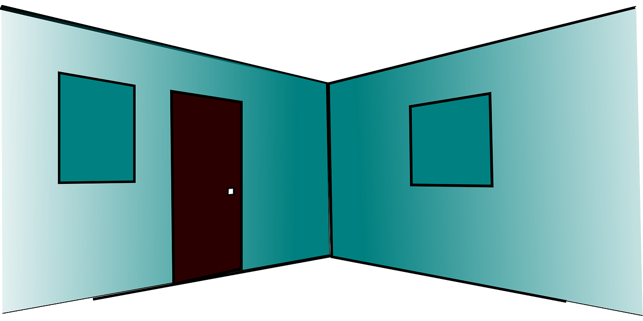
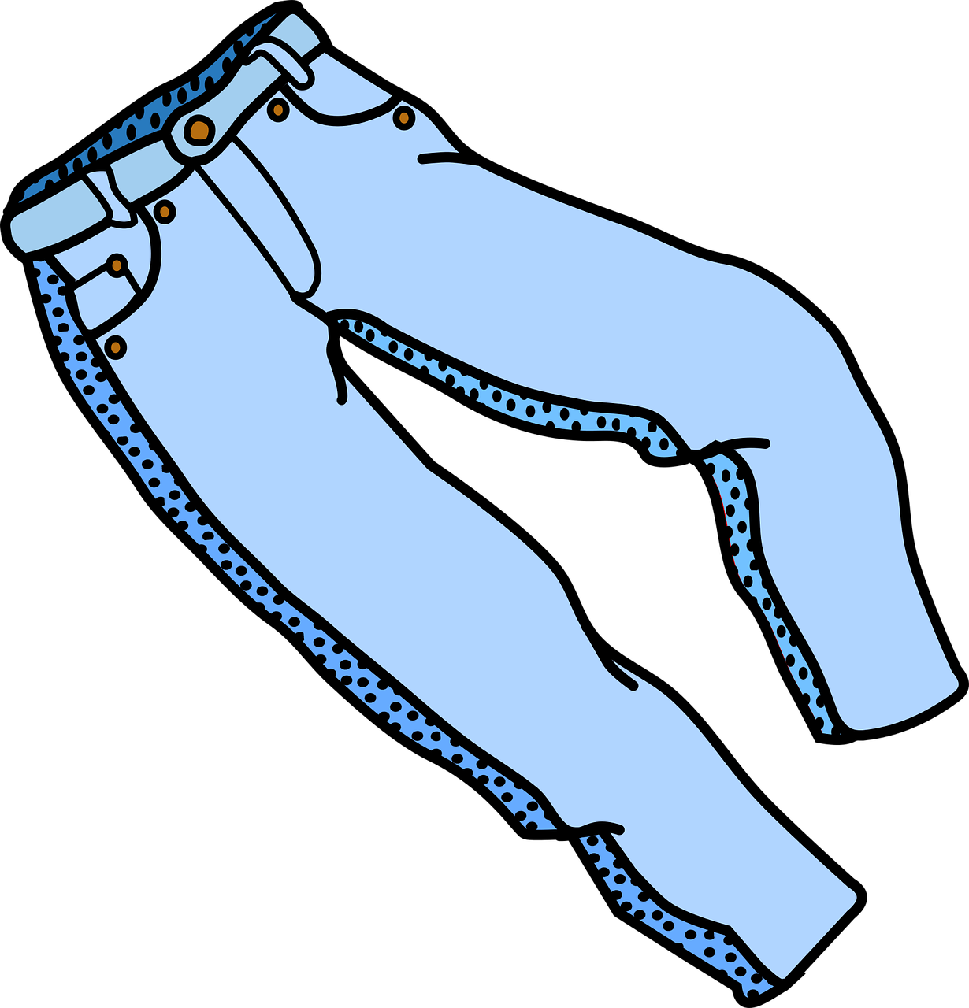
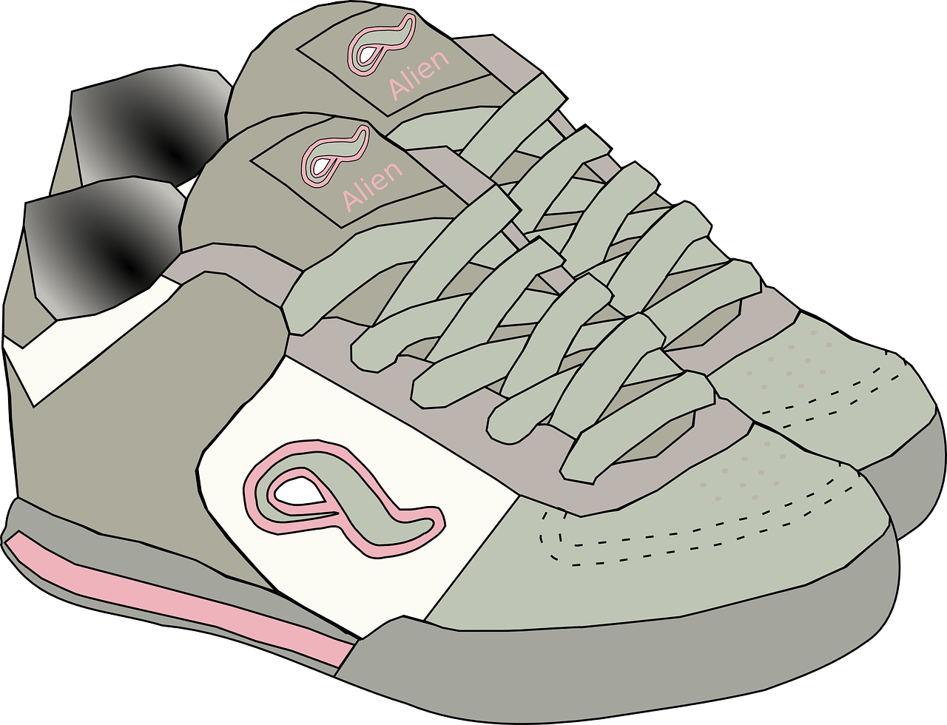
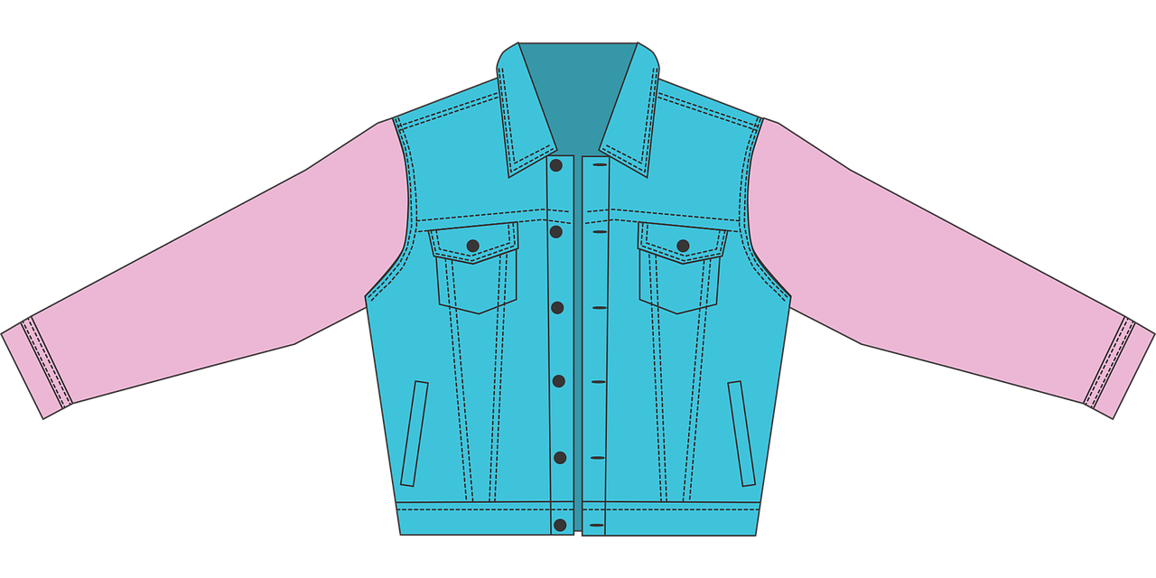
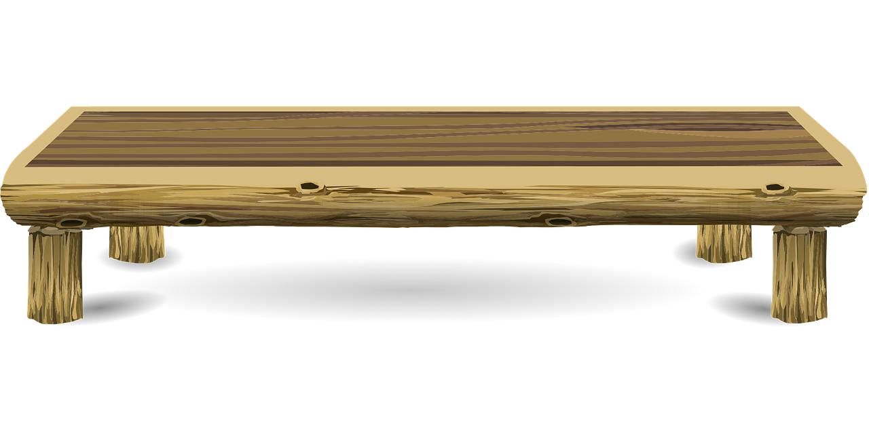
Interacting
blau
Negation with kein (R2-acc.)
Es gibt vs. geben
SSC [w]
Term 1 Week 9
Notes:
Artwork by Steve Clarke. Pronoun pictures from NCELP (www.ncelp.org). All additional pictures selected from Pixabay and are available under a Creative Commons license, no
attribution required.
Phonics: [w] Welt [164] Wasser [245] Antwort [522] wahr [737] gewinnen [372]
Vocabulary: geben [49] Ball [1782] Baum [1013] Bild [253] Blume [2463] Buch [300] Computer [1252] Foto [633] Glas [885] Jacke [3287] Kleidung [2820] Spiel [328] Stoff [758] Tier [614]
Revisit 1: suchen [293] tanzen [1497] trinken [634] genug [498] (plus language from week 5 - bleiben [113] brauchen [179] Glas, Gläser [885] Idee [451] gewinnen [372] haben [6] helfen [338] kaufen [506] machen [58] planen [579] singen [1063] spielen
[205] wiederholen [988] Kind [133] Kinder [133] Stunde [276] dieser, diese, dieses [24])
Revisit 2: wir sind, ihr seid [4] wir [26] ihr [27] freundlich [1566] nett [1565] schön [188] wunderbar [1603] da [48] hier [68] Baum [1013] Garten [1158] Haus [147] Klasse [961] Mitte [711] Schule [359] Zimmer [665] links [893] oben [417] rechts [829]
unten [710] in [3] nicht wahr [n/a] ja [45] nein [148]
Jones, R.L & Tschirner, E. (2019). A frequency dictionary of German: Core vocabulary for learners. London: Routledge.
The frequency rankings for words that occur in this PowerPoint which have been previously introduced in these resources are given in the SOW and in the resources that first
introduced and formally re-visited those words.
For any other words that occur incidentally in this PowerPoint, frequency rankings will be provided in the notes field wherever possible.
Remember that at the start of the course (first three lessons of Rot/Gelb) pupils learnt language (for greetings and register taking) that can still be part of the lesson routines in upper KS2 (Blau/Grün). They are not re-taught, as we anticipate that teachers have built these in from early in lower KS2.
1

Slide 2
aussprechen
[w]
…
Welt
Notes:
Timing: 1 minute
Aim: to introduce the SSC [w].
Procedure:
Introduce the SSC and present the source word ‘Welt’ (with gesture, if using).
Click to bring on the picture and get pupils to repeat the word ‘Welt’ (with gesture, if using).
Note:
a gesture for ‘Welt’ might be to mime a big sphere with your hands.
Vocabulary: Welt [164]
Jones, R.L & Tschirner, E. (2019). A frequency dictionary of German: Core vocabulary for learners. London: Routledge.
2

Slide 3
aussprechen
[w]
…
Wasser
Antwort
Welt
wahr
gewinnen
Notes:
Timing: 1 minute
Aim: to consolidate the SSC [w].
Procedure:
Re-present the SSC and the source word ‘Welt’ (with gesture, if using).
Click to bring on the picture and get pupils to repeat the word ‘Welt’ (with gesture, if using).
Present the cluster words in the same way, bringing on the picture and getting pupils to pronounce the words.
Vocabulary: Antwort [522] gewinnen [372] wahr [737] Wasser [245] Welt [164]
Jones, R.L & Tschirner, E. (2019). A frequency dictionary of German: Core vocabulary for learners. London: Routledge.

Slide 4
aussprechen
[v]
…
Vater
Notes:
Timing: 1 minute
Aim: to recap the SSC [v] before meeting [w] and [v] together on next slide.
Procedure:
Present the SSC and the source word ‘Vater’
Click to bring on the picture and get pupils to repeat the word ‘Vater’, with gesture if using.
Note:
a gesture for ‘Vater’ might be to use the BSL gesture, found here: https://www.signbsl.com/sign/father. Although the gesture is not evocative of father, it does tap out the two syllables and the words father/Vater share the same origin, and are very similar, so this does work for the German word, too. Teachers may prefer other alternatives, or not to have a gesture at all.
Vocabulary: Vater [232]
Jones, R.L & Tschirner, E. (2019). A frequency dictionary of German: Core vocabulary for learners. London: Routledge.

Slide 5
aussprechen
[v]
…
Vater
vier
viel
4
[a lot, much]
verstehen
Notes:
Timing: 1 minute
Aim: to consolidate the SSC [v]
Procedure:
Present the SSC and the source word ‘Vater’
Click to bring on the picture and get pupils to repeat the word ‘Vater’
Present the cluster words in the same way, bringing on the picture and getting pupils to pronounce the words.
Vocabulary: Vater [232] vier [200] verstehen [211] viel [56]
Jones, R.L & Tschirner, E. (2019). A frequency dictionary of German: Core vocabulary for learners. London: Routledge.

Slide 6
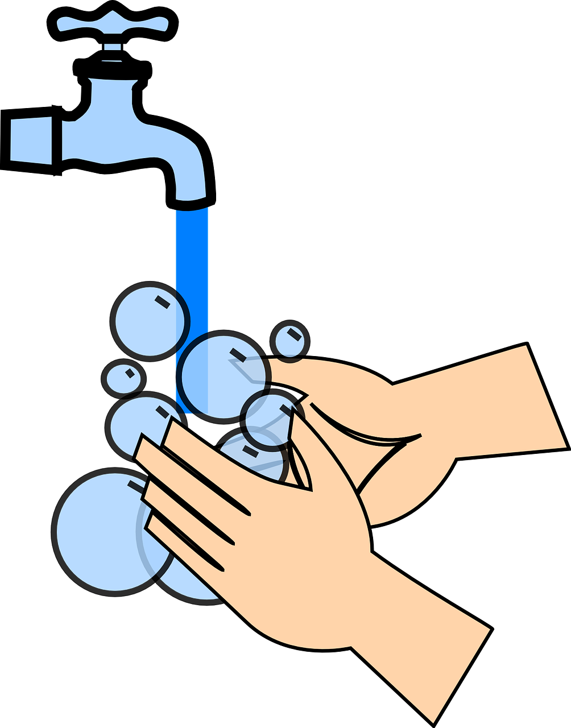
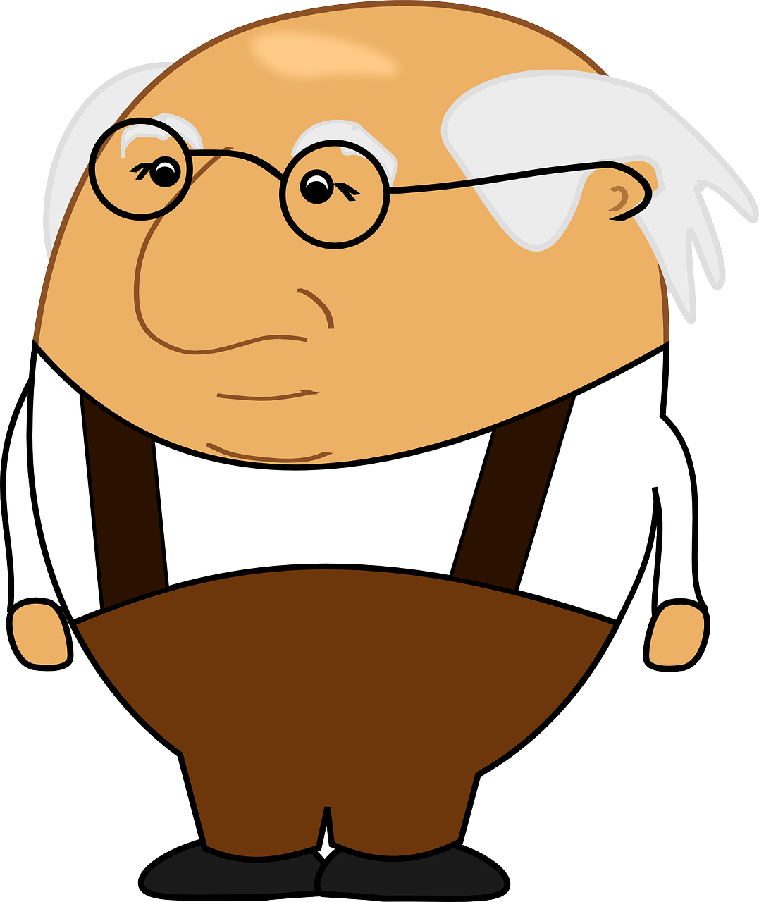
aussprechen
[w] oder [v]?
Hör zu. Schreib [w] oder [v].
1 |  | 5
2 |  | 6
3 |  | 7
4 |  | 8
waschen
Sch weiz
West
Wald
vierundz wanzig
24
Groß v ater
Vogel
Weihnachten
Notes:
Timing: 5 minutes
Aim: to consolidate the SSC [w] by listening and transcribing the missing letters. [w] is contrasted with [v] because in English we pronounce [v] like [w] in German.
Procedure:
1. Explain the task.
2. Pupils listen to each word and write either [w] or [v]. Note: if pupils want to challenge themselves they can turn away from the board to write each whole word.
3. Elicit the full word pronunciation from pupils.
4. Click to reveal the answer and click again for a picture to support meaning.
Vocabulary:
Großvater [3166] Vogel [1701] Wald [1028] waschen [2315] Weihnachten [2971] West [1010]
Jones, R.L & Tschirner, E. (2019). A frequency dictionary of German: Core vocabulary for learners. London: Routledge.
Transcript:
waschen
West
Großvater Vogel Schweiz
Wald
vierundzwanzig
Weihnachten

Slide 7
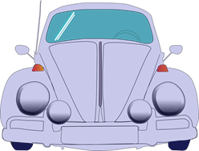
Kultur
Autos* in Deutschland
Was ist das?
aussprechen
Das ist ein Volkswagen!
Many famous car brands are made in Germany. How many can you name?
Volkswagen is one of the most famous. It means ‘people’s car’. Can you pronounce it correctly?
*Auto-car
Notes:
Timing: 2 minutes
Aim: to practise pronunciation of [w] and [v] within one well known compound noun; to raise awareness of German car brands.
Procedure:
Click to bring up the question ‘Was ist das?’ and click again to reveal the answer ‘Das ist ein Volkswagen’. Explain this is a famous German make of car.
Ask pupils if they know any other famous German makes of car. Possible answers could include: BMW; Mercedes-Benz; Audi; Porsche; Opel…
Ask pupils to practise pronouncing ‘Volkswagen’, emphasising the contrasting sounds of [v] and [w]. Click to hear and check pronunciation.
Note: Pupils might notice that we are using both ‘Auto’ and ‘Wagen’ to mean ‘car’ here. ‘Wagen’ can mean cart, carriage, wagon (worth pointing out this cognate) or car. ‘Auto’ is more commonly used to mean ‘car’ these days.
7

Slide 8
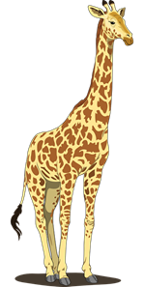
Vokabeln
Was ist das auf Deutsch?
Wörter
glass
jacket
to give, giving
book
material, fabric
computer
clothing
tree
there is, there are
flower
ball
animal
picture
game
photo
der Ball
die Blume
das Foto
die Kleidung
geben
das Buch
das Glas
das Spiel
es gibt
der Baum
die Bücher
die Gläser
These 2 nouns can be combined to make a compound noun: Stofftier.
What do you think this means?
Will it be der or das Stofftier?
there is,
there are
Can you remember the plural forms of these two nouns?
das Bild
der
Computer
die Jacke
der Stoff
das Tier
das Stofftier = cuddly toy
Notes:
Timing: 3 minutes
Aim: to elicit oral production and translation of revisited vocabulary and 2 new items.
Procedure:
1. Click for an English word.
2. Elicit the German word from all pupils, chorally. The only two new words are der Stoff (material, fabric) and geben (to give, giving), which appear last.
3. With pictures now covered up, pupils work in pairs to a) pronounce the German words b) translate the German words back into English.
4. Click for all pictures to reappear for pupils to check meanings.
4. If needed, click on the pictures to hear the words pronounced.
5. Click to bring up the callout about the compound noun Stofftier and the picture of the teddy bear. Compound nouns always take their gender from the final noun (here: das Tier).
6. Click to elicit plural forms of 2 revisited nouns.
8

Slide 9
geben | es gibt
The verb geben means to give. It changes ‘e’ to ‘i’ in the er/sie/es form:
ich gebe
er gibt
I give/I am giving
he gives/he is giving
Remember! After most verbs ein (m) changes to einen. But eine (f) and ein (nt) stay the same.
sie gibt
she gives/she is giving
Remember that ‘es gibt’ (it gives) usually means ‘there is’ or ‘there are’:
Es gibt einen Ball.
There is a ball.
Notes:
Timing: 2 minutes
Aim: to highlight the vowel change in 3rd person singular of the verb ‘geben’ & to remind pupils of the commonly used phrase ‘es gibt’ (there is/are).
Procedure:
Click through the animations to present the new information.
Elicit English translation for the German examples provided.
9

Slide 10
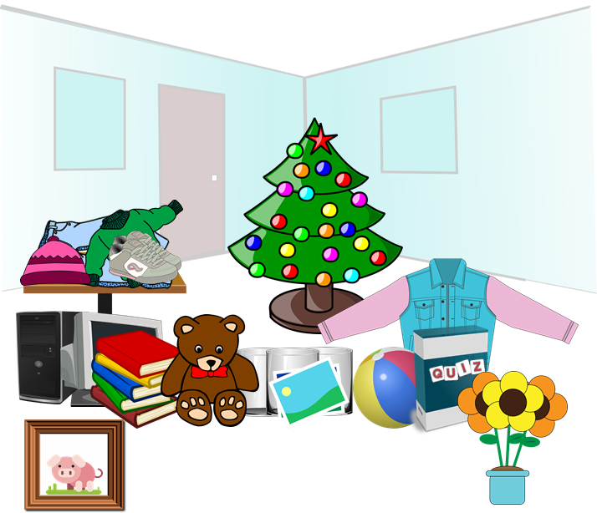
hören
Lias and Ronja are donating some of their things for a sale. Which items are they giving away?
Hör zu. Was gibt es und was geben Lias und Ronja?
s/he is giving | there is/are
What?
B
a flower
1
a computer
2
a photo
3
a ball
4
a book
5
lots of glasses
6
a cuddly toy
Notes:
Timing: 5 minutes
Aim: to practise aural comprehension of the 3rd person singular of geben and its two different meanings: er/sie gibt (he/she gives) versus es gibt (there is/are)
Procedure:
1. Introduce the context of Lias and Ronja giving away some of their belongings for a sale. Lias and Ronja are the twin cousins of Johanna and Moritz. They live in Biel in Switzerland- show pupils on the map next to the characters.
2. Click to hear example. Pupils decide whether the sentence is telling us that Lias or Ronja (he/she) is giving something away (er/sie gibt) or whether it is telling us what there is (es gibt). They also note down what the item is in English. Click for answers
3. Repeat for items 1-6.
Transcript:
Beispiel: Sie gibt eine Blume
Es gibt einen Computer
Es gibt ein Foto
Er gibt einen Ball
Sie gibt ein Buch
Es gibt viele Gläser
Er gibt ein Stofftier
10

Slide 11
geben
The verb geben keeps the ‘e’ in plural forms:
wir geben
we give / we are giving
ihr gebt
you (all) give / you (all) are giving.
sie geben
they give / they are giving
Notes:
Timing: 2 minutes
Aim: to highlight the return to ‘e’ for plural forms of ‘geben’, in contrast to the vowel change seen earlier in the 3rd person singular.
Procedure:
Click through the animations to present the new information.
Elicit English translation for the German examples provided.
11

Slide 12
Johanna und Ronja texten. Schreiben sie über Lias oder Lias und Ronja?
Schreib 1-6 und ‘he’ oder ‘you (all)’.
lesen
1
4
1. Er gibt einen Ball…meinen Lieblingsball!
__
4. Er gibt keinen Baum!
__
 | he or you (all/both) | What given away?
1
2
3
4
5
6
ihr means ‘you’ (more than one person). Sometimes we translate this as ‘you both’, ‘you two’, ‘you all’ or even just ‘you’. Which do you think works best here when referring to Ronja & Lias?
2
5
he
a (favourite)
ball
2.Gebt ihr alte Bücher?
5. Gebt ihr viele Spiele?
__
__
you (all)
(old) books
he
clothing
he
(no) tree
3
6
you (all)
lots of games
6. Gibt er ein Stofftier? Nicht Teddy?!
3. Gibt er Kleidung?
__
__
he
a cuddly toy
Notes:
Timing: 5 minutes
Aim: to practise written comprehension of sentences using the 3rd person singular and the second person plural of the verb geben and of new and revisted vocabulary.
Procedure:
Explain the context to pupils: Johanna and Ronja are texting about what Lias/Lias and Ronja have given away for the sale.
Pupils write 1-6, read the sentences, and decide whether each sentence is about Lias (he) or about Lias and Ronja (you all/both) by looking carefully at the verb form- er gibt or ihr gebt.
They also write the English for which item(s) are being donated. Pay attention to plural forms and use of ‘kein’ here.
Elicit and then click to reveal the answers in the table.
12

Slide 13
Tschüss!
blau
Notes:
13

