Slide 1
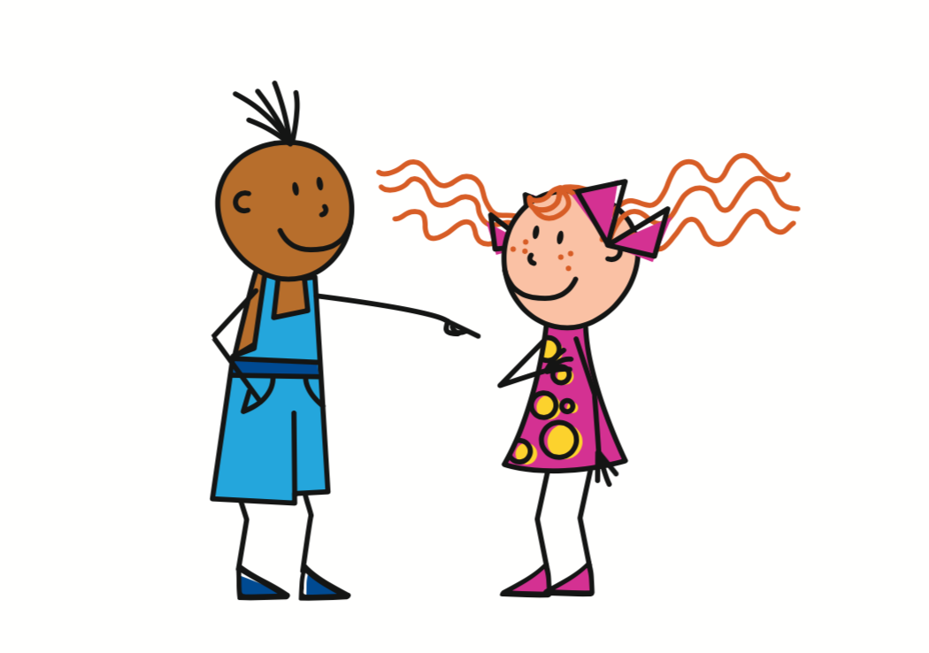
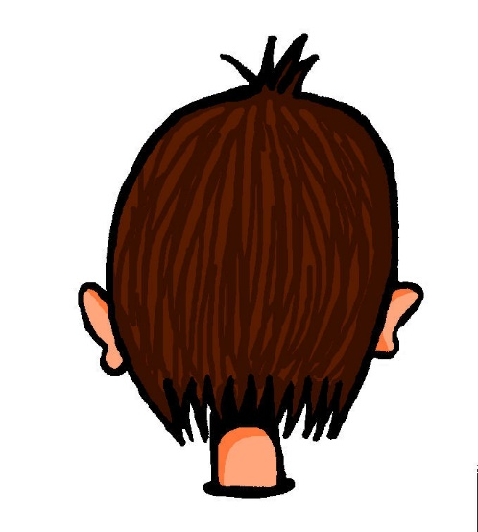
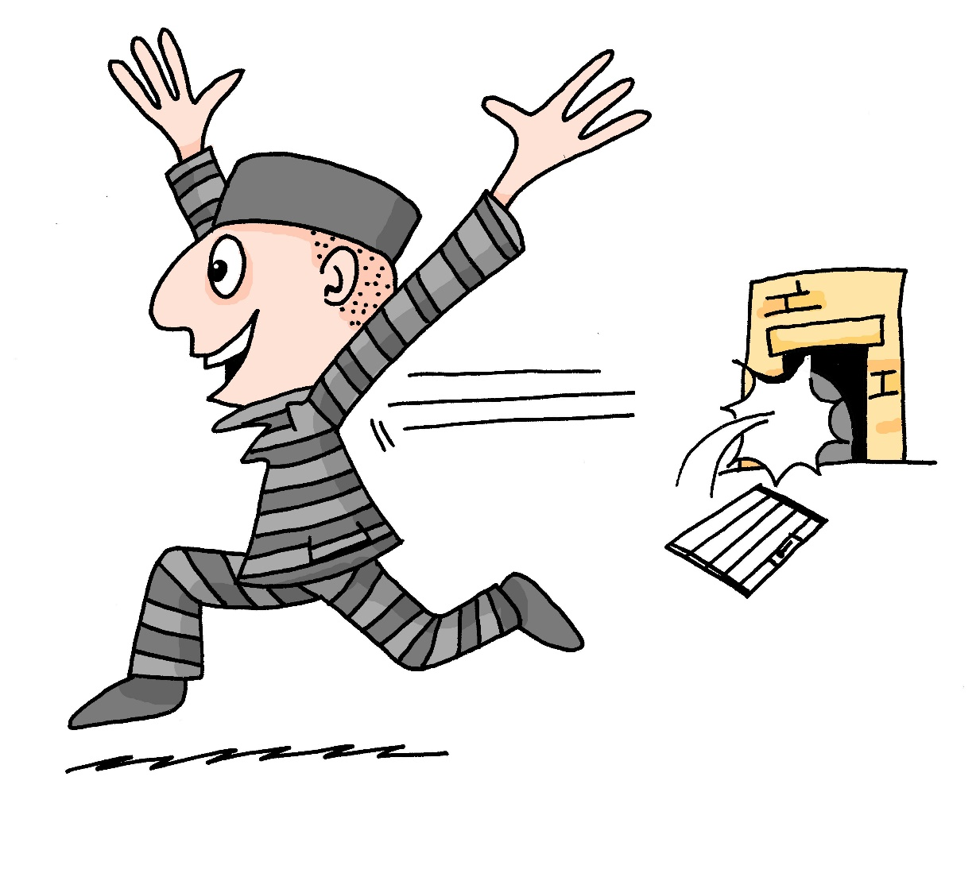
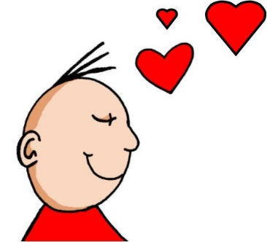
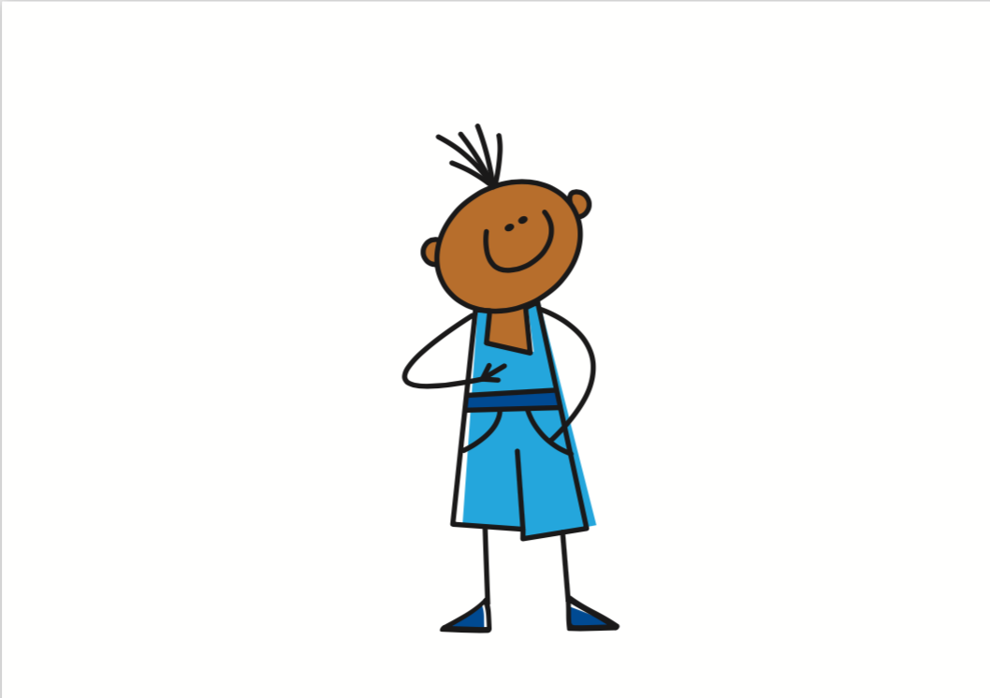
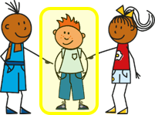
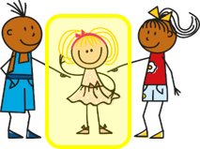
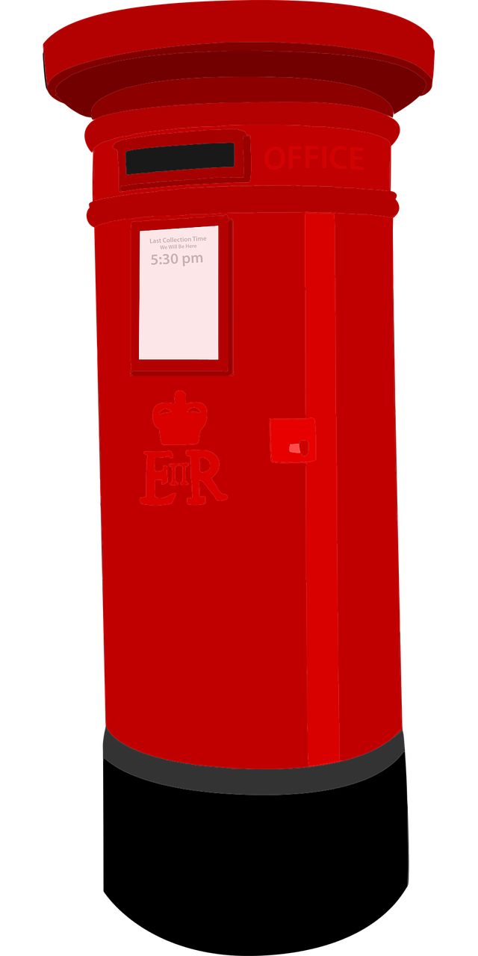
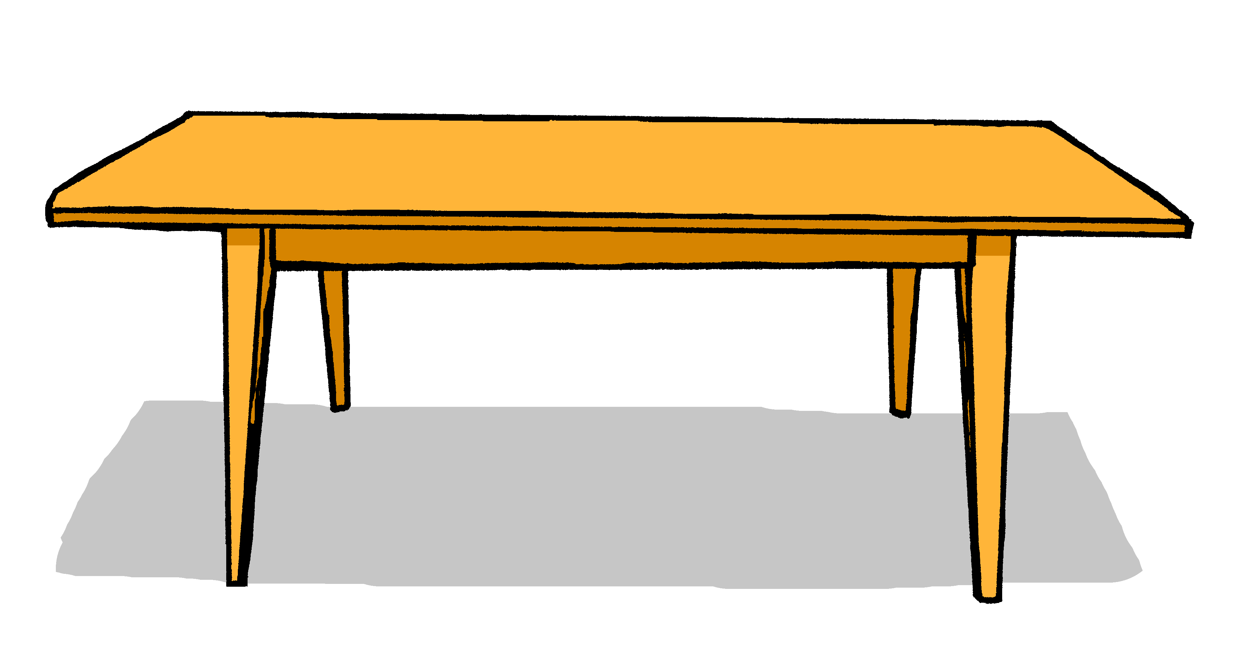
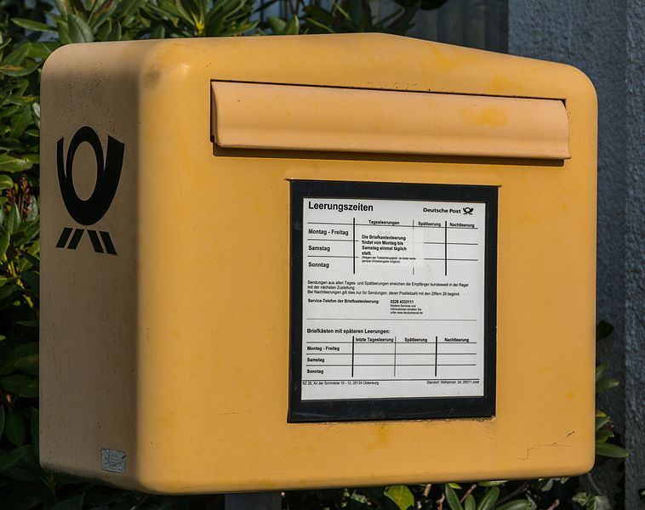
Rot Knowledge Organiser - Autumn Term A
Useful first words
ich – I
du – you
er – he
sie – she
es – it
sein – to be, being
ich bin – I am
du bist – you are
er/sie/es ist – he/she/it is
ja – yes
nein – no
der – the (m)
die – the (f)
das¹ – the (n)
und – and
oder – or
Hallo – hello
Guten Tag – hello (formal)
Auf Wiedersehen – goodbye
Tschüss – bye
wo? – where?
was? – what?
England – England
Deutschland – Germany
das² – that
Things and people
der Bleistift – pencil (m)
der Ort – place (m)
der Tisch – table (m)
die Farbe – colour (f)
die Flasche – bottle (f)
die Form – shape (f)
die Person – person (f)
die Tafel – board (f)
das Beispiel – example (n)
das Buch – book (n)
das Ding – thing (n)
das Fenster – window (n)
das Heft – exercise book (n)
Describing things
da – there
here – hier
toll – great
groß – big
klein – small
klar – clear
Phonics
 | long [a] | short [a] | long [u] | short [u]
…
[there]
da
Hallo
du
Punkt
long [o] | short [o] | [ei] | long [e] | short [e]
wo?
Kopf
frei
geben
denken
long [i] | short [i]
🙏
Familie
bitte
Liebe
Start with wo to make a where question:
Wo ist das?
Where is that?
Start with was to make a what question:
Was ist das?
What is that?
Personal pronouns ich ➜ I du ➜ you er ➜ he sie ➜ she es ➜ it | Describing people with the verb sein | Asking yes/ no questions
Capitalisation of nouns All German nouns start with a capital letter, wherever they are in a sentence: Der Tisch ist da. | Indefinite articles ein, eine, ein (a) | Definite articles der, die, das (the)
In English we swap ‘I am’ to ‘Am I’ to make a yes/ no questions. In German we do the same:
ich bin
I am
es ist
du bist
sein
Ich bin Hannah.
it is
you are
➜
I am Hannah.
sie ist
er ist
she is
he is
Bin ich Hannah?
Am I Hannah?
Wo ist das?
German has three words for ‘the’. We say that nouns have grammatical gender: masculine, feminine, and neuter. Der (m), die (f), das (n) refers to something already mentioned or known.
German has two words for ‘a’. Ein (m), eine (f), ein(n) (‘a’) often introduces new information and identifies something to the listener:
Countries have different colours for some things.
Das ist in Deutschland.
The table is there.
Proper nouns do this in English too: e.g. London, Monday, Emily.
Das ist eine Tafel.
This is a board.
Die Tafel ist groß.
The board is big.

Slide 2
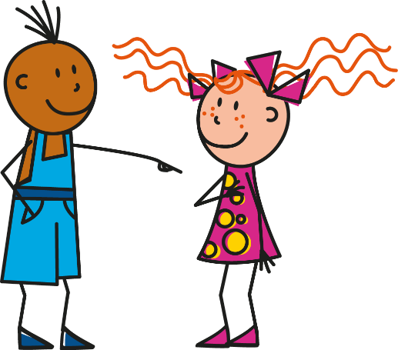
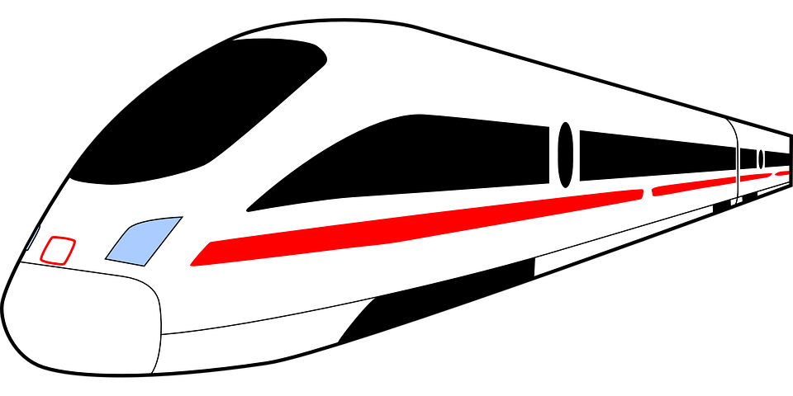
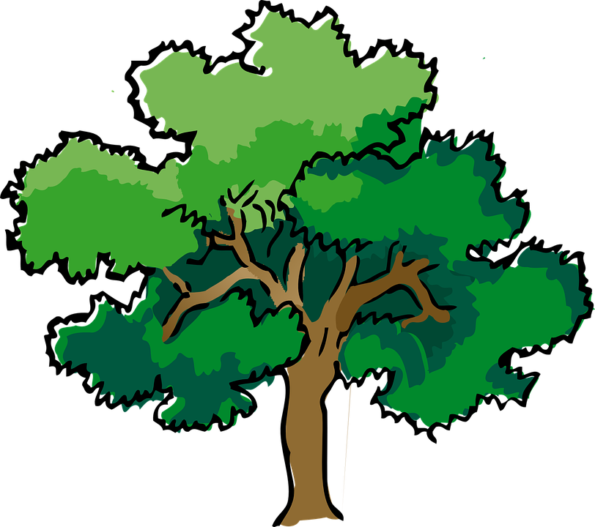
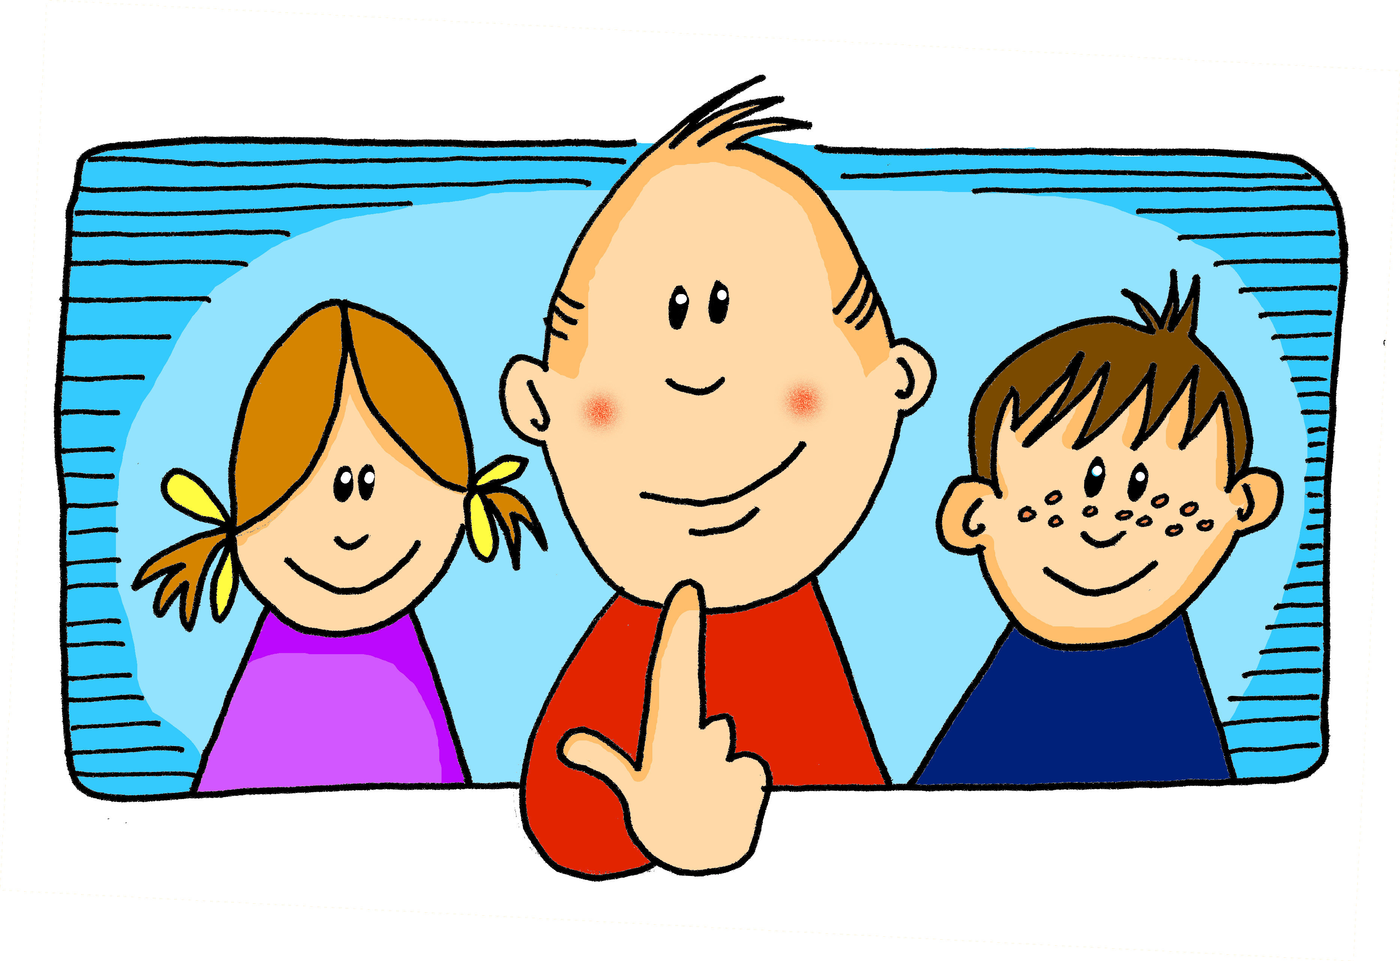
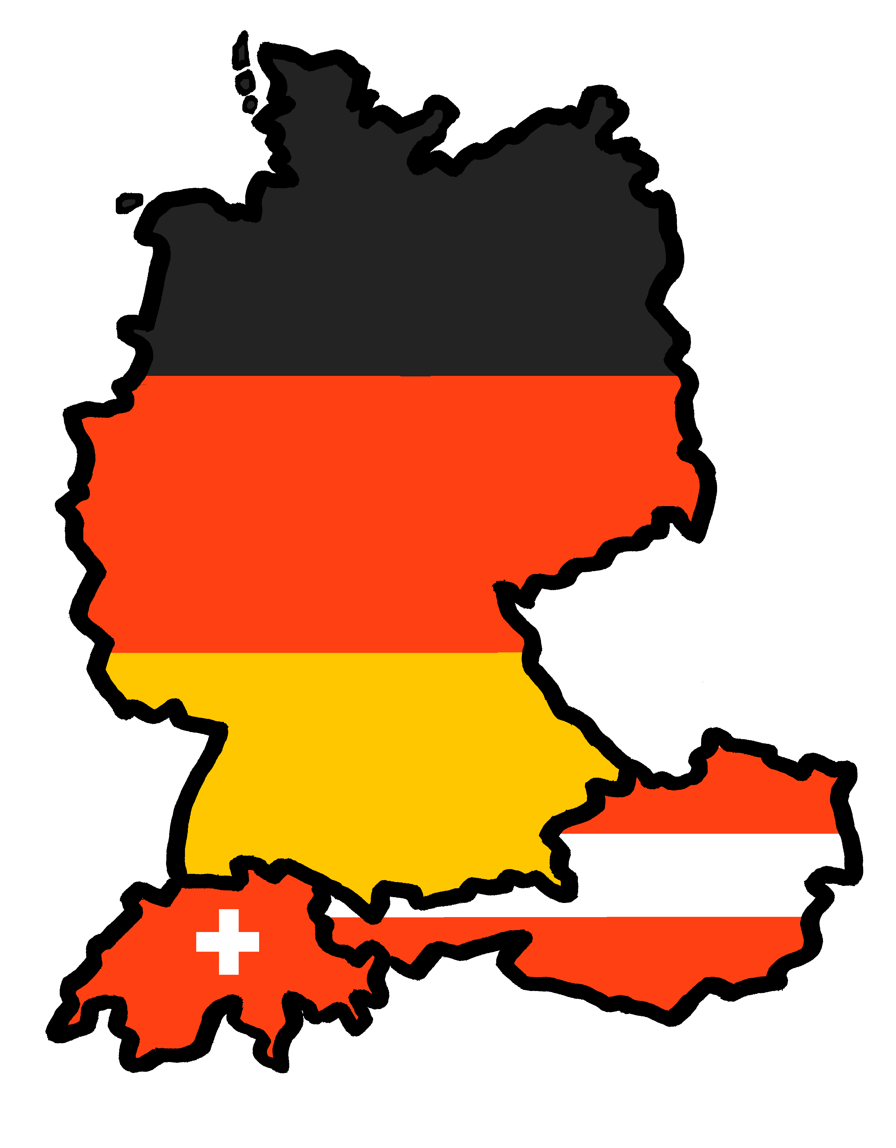
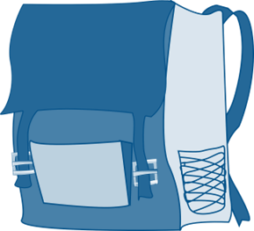
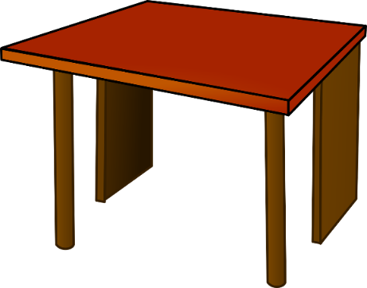
Rot Knowledge Organiser - Autumn Term B
More useful words
gut – good
aber – but
auch – also
nicht – not
mein, meine, mein – my
dein, deine, dein – your
wie? – how?
wie geht’s? – how's it going?
nicht wahr? – isn’t it? isn’t that right?
links – left, on the left
oben – up, above
rechts – right, on the right
unten – down, below
People and things
der Freund – (male) friend
der Fußball – football (m)
der Punkt – dot, point, full stop(m)
die Freundin – (female) friend
die Schule – school (f)
die Tasche – bag (f)
das Bild – picture (n)
das Foto – photo (n)
das Haustier – pet (n)
das Tier – animal (n)
Phonics
[ei] | [ie]: | [ei] | [ie] | [ei] | [ie]
frei
Liebe
sein
Brief
Bleistift
sie
[w] | [z] | soft [ch] | hard [ch]
Buch
Welt
Zug
ich
Start with wie to make a how question:
Wie ist das?
Guten Tag!
How is that? (What is that like?)
Every country has a national tree. German has the ‘Eiche’ (oak) and… so does England! Can you say Eiche? The phonics above will help you!
Hallo!
Learning languages is about making friends. You show kindness when you learn even a few words in another language.
Let’s remember some of the friendship sentences we have learnt already!
Das ist toll!
Du bist toll!
Du bist super!
Danke!
Asking ‘How are you?’ | Possessive adjectives mein/dein (my/ your) | Nicht (not)
In Germany, children start school at 6 years old. In most of the country, primary school takes four years. School finishes around lunchtime, and there is no school uniform!
To ask someone how they are, you say: Wie geht’s?
Use nicht before an adjective or adverb to mean not:
masculine
feminine
neuter
Wie geht’s?
mein
meine
mein
I am not here.
The literal translation is ‘How goes it?’. A better translation in English is: ‘How’s it going?’ or ‘How are you?’
dein
deine
dein
Ich bin nicht hier.
The words ‘mein’ (my) and ‘dein’ (your) must agree with the gender of the noun that follows. E.g.:
Use nicht before ‘der, die, das’ and a noun to mean not the:
gut!
nicht gut.
Das ist nicht der Tisch.
good!
not good.
meine Tasche (f)
my bag
That is not the table.

