Slide 1
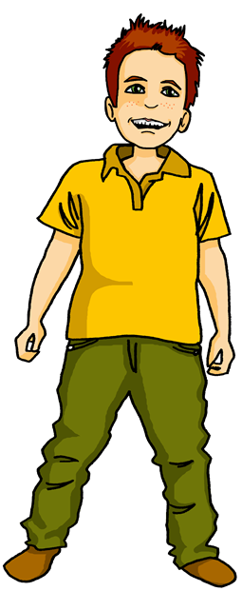
Talking about things and things to do
eine Party
rot
haben – to have
‘the’ – den, die, das
SSC [ü] vs [u]
Term 2 Week 3
Notes:
Artwork by Steve Clarke. Pronoun pictures from NCELP (www.ncelp.org). All additional pictures selected from Pixabay and are available under a Creative Commons license, no
attribution required.
Phonics:
[ü] – Tür [375] grün [682] müde [2000]
Vocabulary: Wer? [149] haben, ich habe, er, sie, es hat [6] Blume [2463] Geschenk [2595] Spiel [328] Kuchen [4381]
Revisit 1: revisit a selection of previously taught words
Revisit 2: Beispiel [94] Form [307] Mensch [90] groß [67] klein [110] Auf Wiedersehen [n/a] tschüss [3766]
Jones, R.L & Tschirner, E. (2019). A frequency dictionary of German: Core vocabulary for learners. London: Routledge.
The frequency rankings for words that occur in this PowerPoint which have been previously introduced in these resources are given in the SOW and in the resources that first
introduced and formally re-visited those words.
For any other words that occur incidentally in this PowerPoint, frequency rankings will be provided in the notes field wherever possible.
Note that the first three lessons of the year teach language that can be continuously recycled as lesson routine every lesson in Y3/4.
The idea would be that the class teacher (whether or not s/he teaches the class German can re-use the language as part of the daily routine with the class.
1

Slide 2
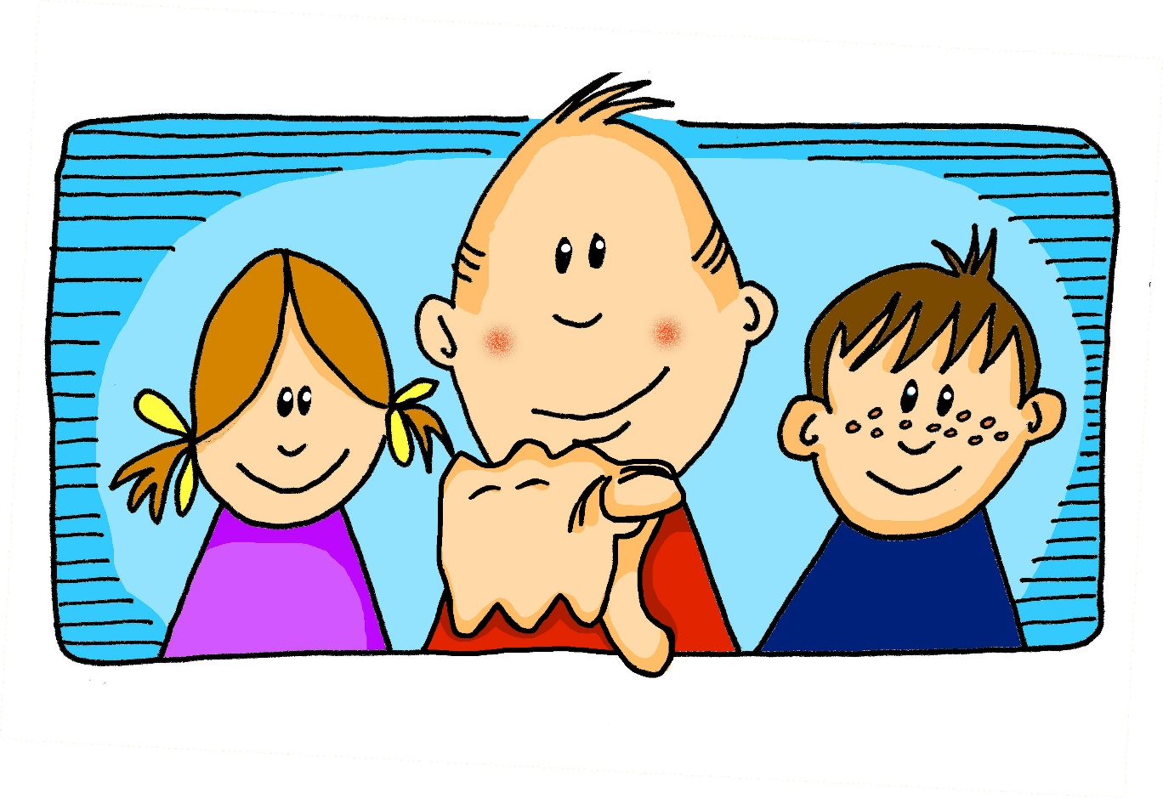
aussprechen
long[u]
…
du
Notes:
Timing: 1 minute
Aim: to recap the SSC long [u].
Procedure:
Introduce the SSC and present the source word ‘du’ (with gesture, if using).
Click to bring on the picture and get pupils to repeat the word ‘du’ (with gesture, if using).
Note: a gesture for ‘du’ might be to point at someone.
2

Slide 3
aussprechen
long[u]
…
gut
du
super
[good]
[you]
Ruth
Lukas
Notes:
Timing: 2 minutes
Aim: to consolidate the SSC long [u].
Procedure:
Re-present the SSC and the source word ‘du’ (with gesture, if using).
Click to bring on the picture and get pupils to repeat the word ‘du’ (with gesture, if using).
Present the cluster words in the same way, bringing on the picture and getting pupils to pronounce the words.
Note:
a gesture for ‘du’ might be to point at someone else.
3

Slide 4
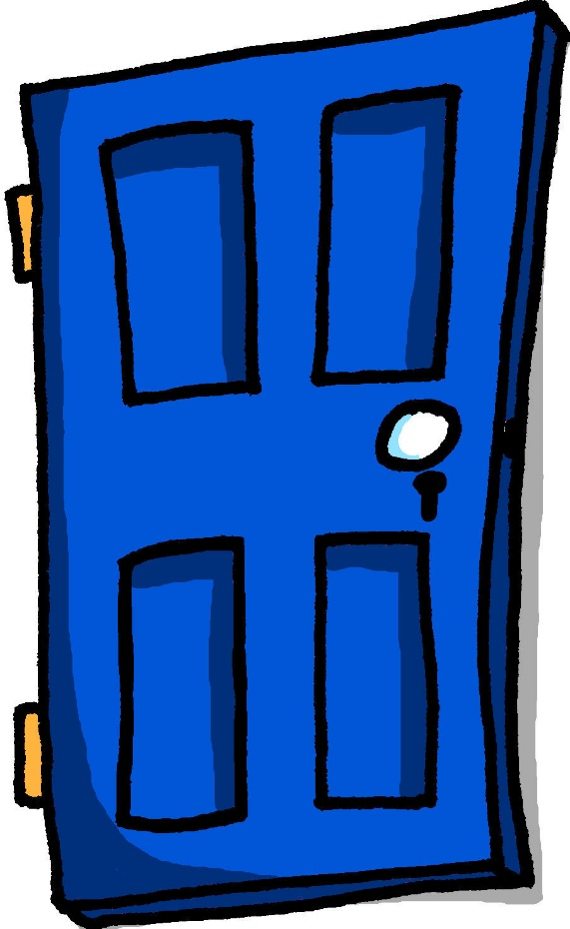
aussprechen
[ü]
…
Tür
Notes:
Timing: 1 minute
Aim: to introduce the SSC [ü].
Procedure:
Introduce the SSC and present the source word ‘Tür’ (with gesture, if using).
Click to bring on the picture and get pupils to repeat the word ‘Tür’ (with gesture, if using).
Note:
a gesture for ‘Tür’ might be miming the opening of a door by using one hand as the ‘hinges’ and the second hand to move out away from the first making a right-angled action of opening and closing.
4

Slide 5
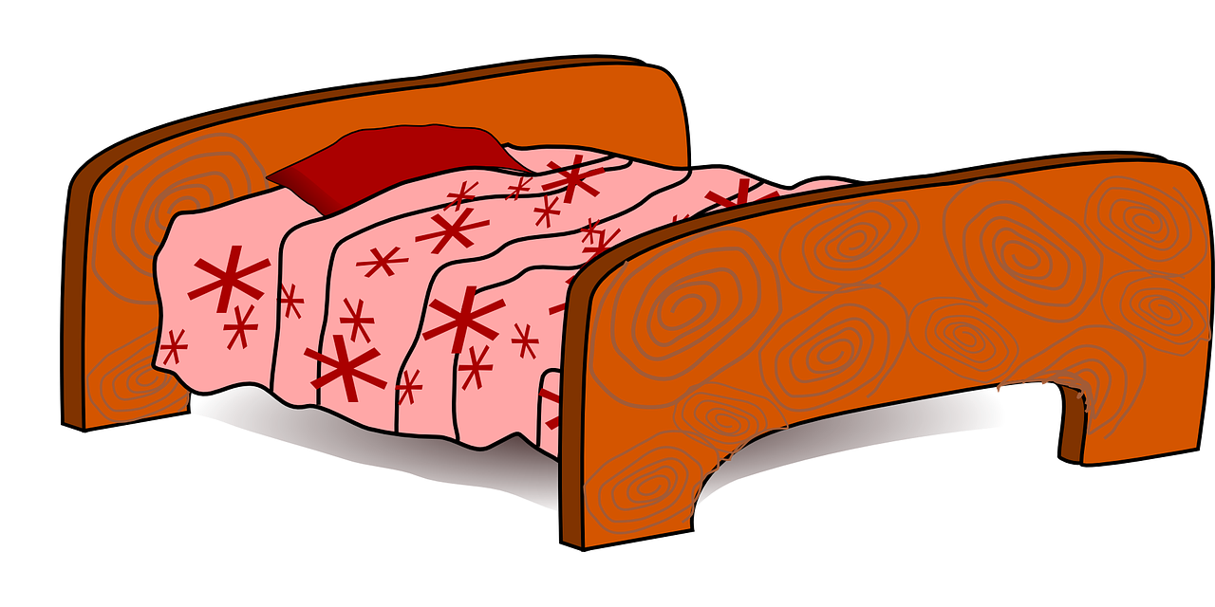
aussprechen
[ü]
…
grün
müde
Tür
[tired]
Notes:
Timing: 1 minute
Aim: to introduce the SSC [ü].
Procedure:
Introduce the SSC and present the source word ‘Tür’ (with gesture, if using).
Click to bring on the picture and get pupils to repeat the word ‘Tür’ (with gesture, if using).
Note:
a gesture for ‘Tür’ might be miming the opening of a door by using one hand as the ‘hinges’ and the second hand to move out away from the first making a right-angled action of opening and closing.
ii) as with all vowels, there are long and short versions of [ü]. This week we focus on differentiating [ü] from previously taught [u] and we mainly work with longer versions of the vowels as it is easier to hear the difference. In Y5/6 we will focus more on long/short versions of the vowels.
5

Slide 6
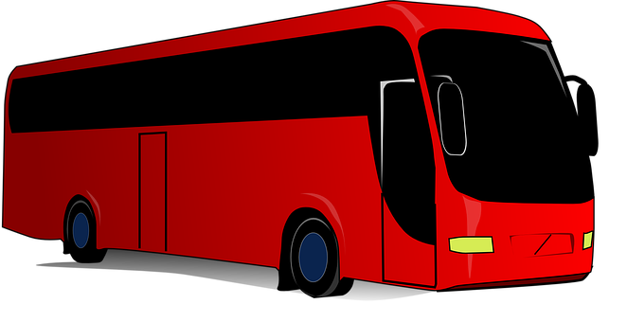
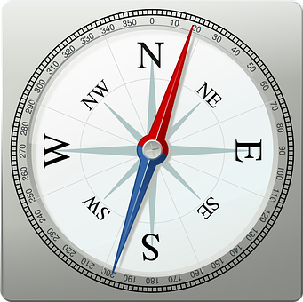
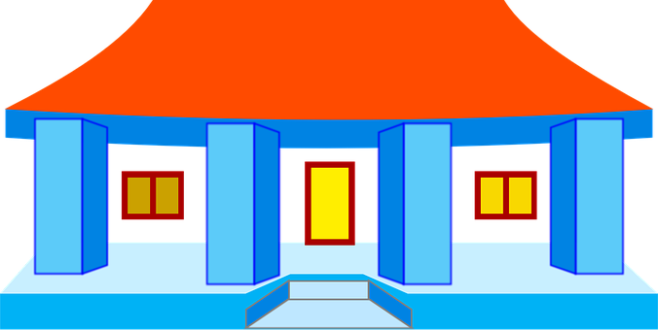
[ü] oder [u]?
Schreib A – B oder B – A.
Hör zu. Ist es [u] oder [ü]?
 | A | B
B. | Grund [reason] | grün
1 | Tour | Tür
2 | Mode [fashion] | müde
3 | Sudan | Süden
4 | Schule | Schüler
5 | rufen [to call] | prüfen [to check]
6 | Schuss | Tschüss
A - B
B - A
A - B
A - B
B - A
B - A
A - B
Notes:
Timing: 5 minutes
Aim: to consolidate the SSC [ü] by aurally differentiating between pairs of similar sounding words.
Procedure:
1. Click to listen to the example (Beispiel). Both words are heard. Pupils decide which order they hear the words in and write either A – B OR B – A.
2. Click to correct the example.
3. Continue with items 1-6 and click to correct.
Transcript: Beispiel: Grund – grün. Tür – Tour Mode – müde
Sudan – Süden
Schüler – Schule
prüfen – rufen
Schuss – Tschüss
Word frequency (1 is the most frequent word in German): Grund [249], grün [682], Tour [ 2640], Tür [375], Mode [3867], müde [2000], Sudan [N/A ], Süden [1771], Schule [359], Schüler [556], rufen [530], prüfen [1408], Schuss [2460], Tschüss [3766] Source: Jones, R.L. & Tschirner, E. (2019). A frequency dictionary of German: core vocabulary for learners. Routledge

Slide 7
Vokabeln
You now know 4 question words: wo (where), was (what), wie (how) and wer (who).
Vokabeln lernen
Are these nouns masculine, feminine or neuter?
Wörter
Sag die Wörter auf Deutsch. Was ist das auf Englisch?
der Kuchen
das Geschenk
Wer?
die Blume
das Spiel
Notes:
Timing: 5 minutes
Aim: to present and practise new vocabulary for this week
Procedure:
Pupils either work by themselves or in pairs, reading out the words and thinking about their English meanings (30 seconds).
Click to make an image disappear. Pupils do a quick sketch of the missing picture or write the English. Click again for the picture to return for pupils to check. Repeat for all pictures.
Click for the words to disappear one by one. This time pupils say the missing word in chorus then try to write it in the air with their finger. Focus on just the noun (not the article) to keep it simpler, but ask pupils at the end which gender each of the new nouns is.
7

Slide 8
haben
After most verbs the masculine word for ‘the’, der, changes its spelling to den. It still means ‘the’.
to have | having
In German the verb haben means ‘to have’.
I have, he has and she has are parts of the verb ‘to have’.
ich habe
I have
er hat
he has
sie hat
she has
Ich habe das Geschenk.
Er hat die Blume.
Sie hat den Kuchen.
I have the present.
He has the flower.
She has the cake.
Notes:
Timing: 3 minutes
Procedure:
Read the grammar explanation about haben. Make sure pupils are clear about the ‘I’, ‘he’ and ‘she’ pictures.
Elicit English translation for the German examples provided. This is another opportunity to hear and see three of our new words.
Draw attention to the den used here after haben for masculine nouns.
8

Slide 9
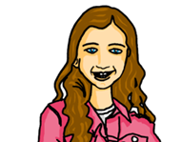
lesen
Moritz hat Geburtstag*.
Johanna and her dad are party planning. Johanna texts her mum. What does her dad Steffen have and what does she have?
Schreib 1 – 6 und ‘I have’ oder ‘he has’.
1
I have
4
Er hat das Spiel.
I have
Er hat den
Kuchen.
He has
He has
2
He has
5
Have I
Ich habe das Geschenk.
Habe ich den Hund?
I have
Has he
3
6
Has he
Er hat den Fußball.
He has
Hat er das Wasser?
I have
Have I
Geburtstag=birthday
Notes:
Timing: 6 minutes (2 slides)
1/2
Aim: to practise written comprehension of first and third person singular forms of the verb haben (to have).
Procedure:
Pupils write 1-6 and the correct English meaning from the two options given. Encourage them to look at the verb form: habe or hat? Items 5 and 6 are questions, but pupils still just need to look for the verb form.
Click to reveal answers.
9

Slide 10
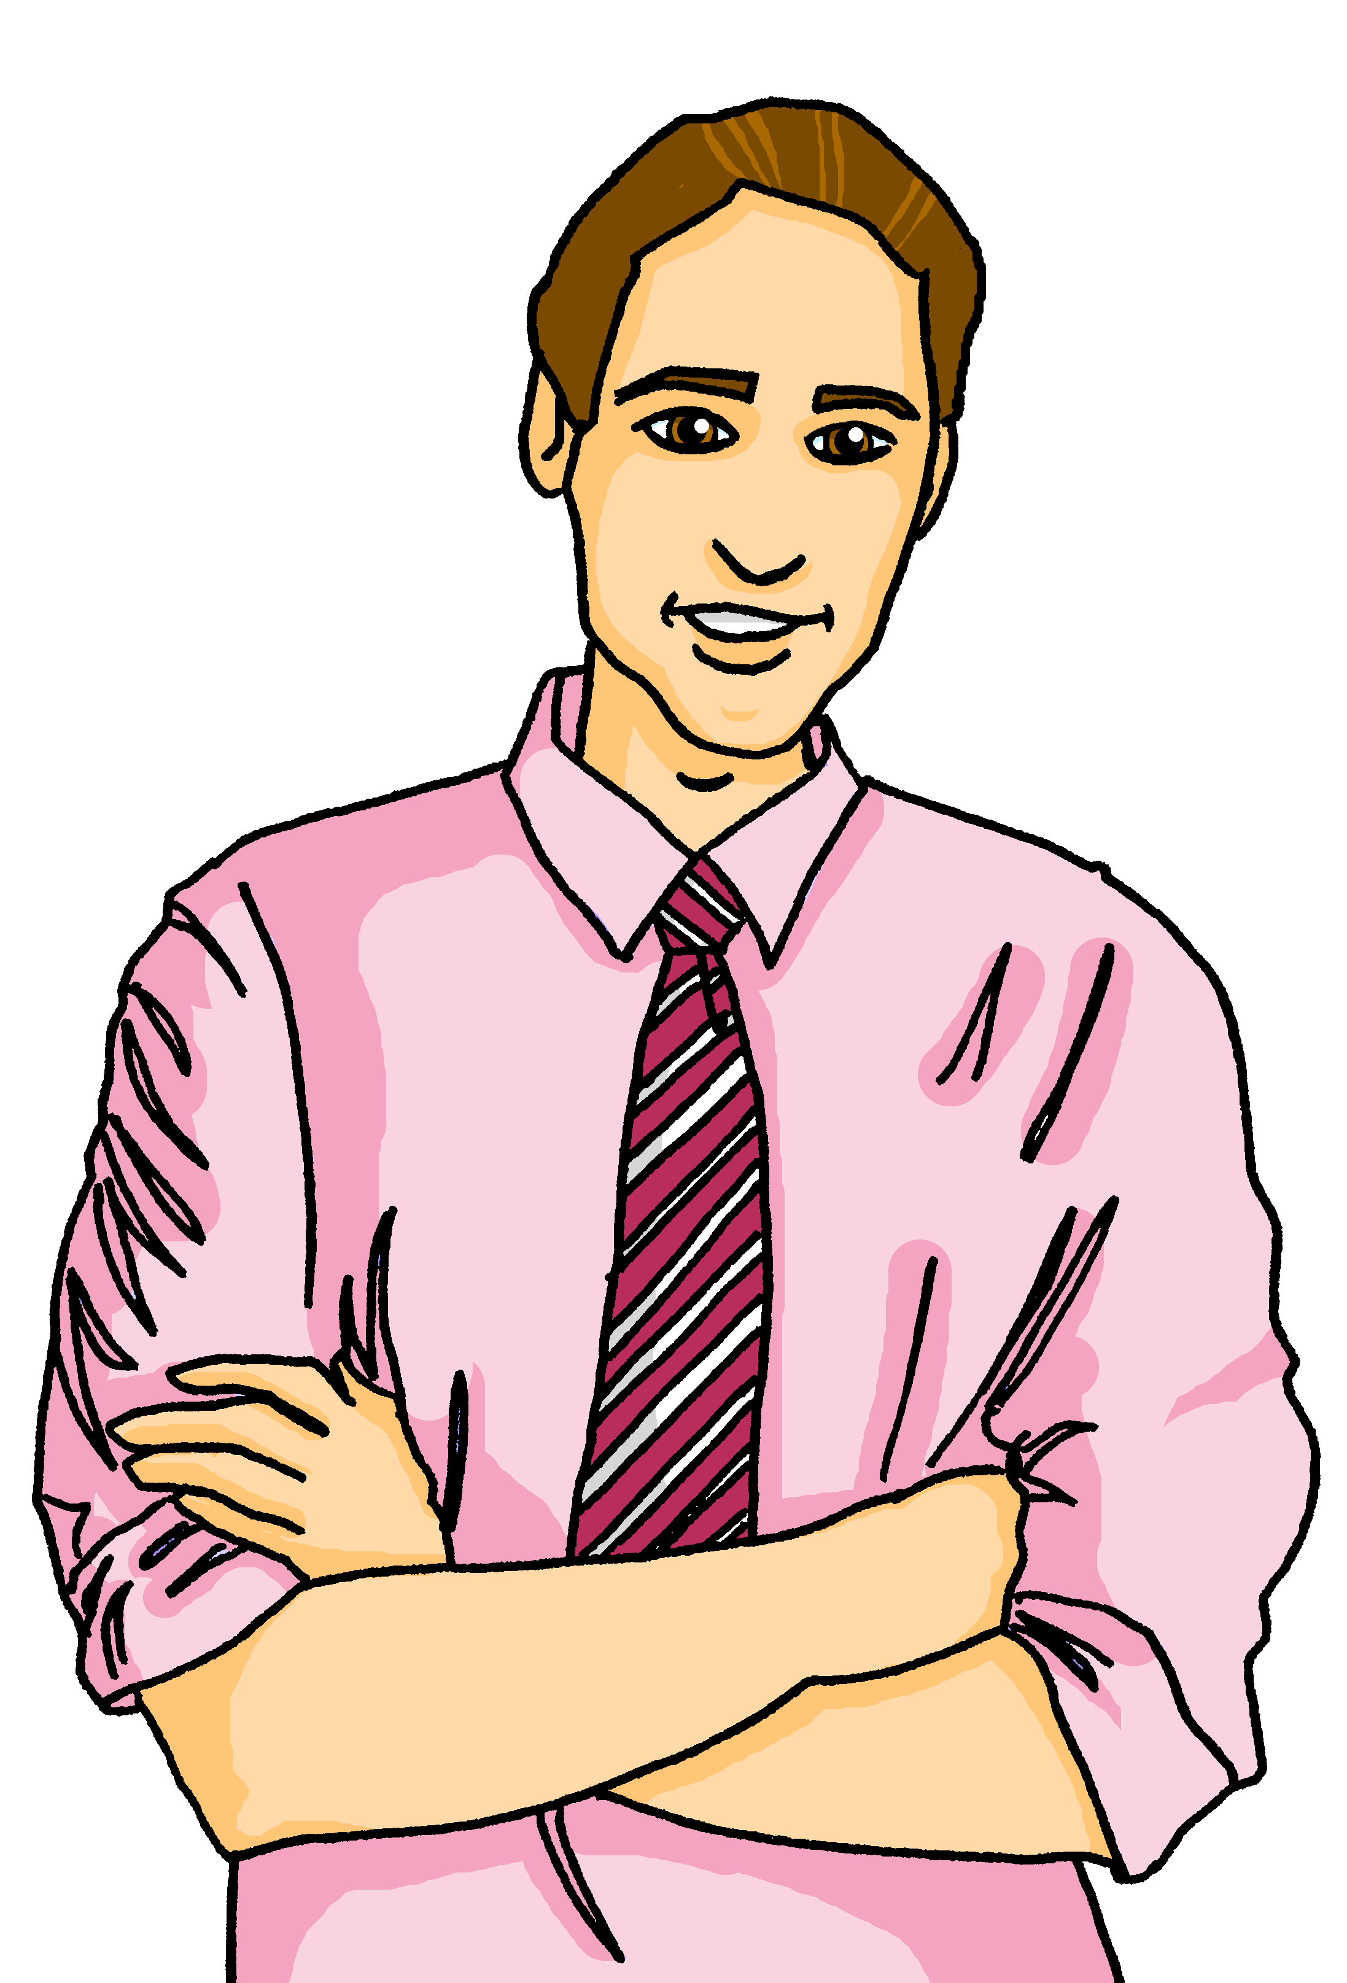
lesen
Moritz hat Geburtstag.
Make 2 lists. What does Johanna (I) have? What does her dad (he) have?
Schreib auf Englisch.
1
4
Er hat den
Kuchen.
Er hat das Spiel.
Johanna | Steffen (dad)
2
5
Ich habe das Geschenk.
Habe ich den Hund?
present
cake
dog
football
game
3
6
Remember that the masculine word for ‘the’ changes to den after most verbs.
Er hat den Fußball.
water
Hat er das Wasser?
Notes:
Timing: 5 minutes
2/2
Aim: to practise written comprehension of new and revisited vocabulary as well as the first and 3rd person forms of haben.
Procedure:
Pupils write English lists for Johanna and Steffen to show which items each person has.
Click to reveal answers.
Additonal task suggestion:
1. Pupils translate the whole sentence, including thinking about how to translate the questions ‘Has he the water?’ into correct English.
10

Slide 11
hören
Moritz hat Geburtstag
Are these nouns masculine, feminine or neuter?
Hör zu. Wer hat was?
Johanna (I) | Steffen (he)
A | B
Kuchen | Handy
Wasser | Flasche
Tasche | Buch
Geschenk | Bleistift
Fußball | Spiel
Hund | Haustier
Foto | Blume
B.
1
2
3
4
5
6
Notes:
Timing: 5 minutes
Aim: to practise aural comprehension of 1st and 3rd person forms of haben and words for ‘the’.
Procedure:
1. Click the B to hear the example. Pupils decide whether Johanna is taking about herself (ich habe) or Steffen (er hat) and note down J or S. Click for answer.
2. Repeat for items 1-6, with pupils noting down J or S. Elicit and click for answers.
3. Click to bring up the second table and ask pupils to think about/discuss the gender of each noun using the call-out. Remind pupils that ‘der’ changes to ‘den’ after most verbs.
4. Listen to each sentence again, this time asking pupils to decide between the two nouns, based on the gender of the word ‘the’ they hear. Pupils write down A or B.
5. Click to circle the correct noun.
Transcript:
Ich habe den [Kuchen].
Er hat das [Wasser].
Er hat das [Buch]
Ich habe den [Bleistift]
Er hat das [Spiel]
Ich habe den [Hund]
Ich habe die [Blume}
11

Slide 12
Tschüss!
rot
Notes:
12

