Slide 1
Talking about things and things you do
rot
Follow ups 1-5
Term 2 Week 5
Notes:
Artwork by Steve Clarke. Pronoun pictures from NCELP (www.ncelp.org). All additional pictures selected from Pixabay and are available under a Creative Commons license, no attribution required.
Phonics:
Introduce [äu] [äu] Häuser [Haus-147] Mäuse [Maus-3463], träumen [1793]
Revisit [au] Haus [147] blau [948] laufen [252]
Vocabulary: Film [505] Lieblings- [n/a] Lied [1733] Musik [509]
Revisit 1: Frau [99] Herr [154] Lehrer, Lehrerin [695] Mann [121] sehr [81]
Revisit 2: links [893] oben [417] rechts [829] unten [710]
Jones, R.L & Tschirner, E. (2019). A frequency dictionary of German: Core vocabulary for learners. London: Routledge.
The frequency rankings for words that occur in this PowerPoint which have been previously introduced in these resources are given in the SOW and in the resources that first
introduced and formally re-visited those words.
For any other words that occur incidentally in this PowerPoint, frequency rankings will be provided in the notes field wherever possible.

Slide 2
aussprechen
[au]
…
Haus
Notes:
Timing: 1 minute
Aim: to revisit the SSC [au].
Procedure:
Introduce the SSC and present the source word ‘Haus’ (with gesture, if using).
Click to bring on the picture and get pupils to repeat the word ‘Haus’ (with gesture, if using).
Note:
a gesture for ‘Haus’ might be to make a roof above your head with two hands.
2

Slide 3
aussprechen
[au]
…
Haus
[to run, running]
blau
laufen
Notes:
Timing: 1 minute
Aim: to consolidate the SSC [au].
Procedure:
Re-present the SSC and the source word ‘Haus’ (with gesture, if using).
Click to bring on the picture and get pupils to repeat the word ‘Haus’ (with gesture, if using).
Present the cluster words in the same way, bringing on the picture and getting pupils to pronounce the words.
3

Slide 4
aussprechen
[äu]
The sound [äu] is the same as the sound [eu] in Deutschland.
…
Häuser
This is the plural of the word Haus. For more than one Haus, use Häuser.
Notes:
Timing: 1 minute
Aim: to introduce the SSC [äu].
Procedure:
Introduce the SSC and present the source word ‘Häuser’ (with gesture, if using).
Click to bring on the picture and get pupils to repeat the word ‘Häuser’ (with gesture, if using).
Use the call-outs to explain that Häuser is the plural of Haus and to demonstrate that the new sound [äu] is the same sound as last week’s [eu].
4

Slide 5
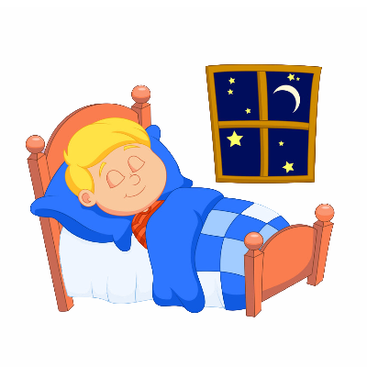
aussprechen
[äu]
The sound [äu] here is the same as the sound [eu] in Deutschland, Freund and heute.
…
Häuser
[to dream]
[mice]
träumen
Mäuse
Notes:
Timing: 1 minute
Aim: to consolidate the SSC [äu].
Procedure:
Re-present the SSC and the source word ‘Häuser’ (with gesture, if using).
Click to bring on the picture and get pupils to repeat the word ‘Häuser’ (with gesture, if using).
Present the cluster words in the same way, bringing on the picture and getting pupils to pronounce the words.
Use the call-out to remind pupils of other words with the [eu] sound from last week, which sound the same as the new [äu].
Word frequency:
Haus [147] Maus [3463] träumen [1793]
Jones, R.L & Tschirner, E. (2019). A frequency dictionary of German: Core vocabulary for learners. London: Routledge.
5

Slide 6
Follow up 1
Lies die Wörter. Ist das [au] oder [äu]?
au
äu
aussprechen
Bäume
Baum
Gebäude
Traum
Kräuter
Maus
Häuser
glauben
träumen
Haus
Läufer
laut
Räuber
Schau!
Mäuse
laufen
häufig
Zaun
genau
Bräuche
Notes:
HANDOUT at the end of this presentation.
Timing: 5 minutes Slide 1/2
Aim: To provide practice in distinguishing between this week’s SSC [äu] and the SSC [au]. Procedure: 1. This is a paired read aloud task. The pupils use 2 different coloured pencils (1 each) to play on the same sheet. Pupil A says one of the words/phrases and pupil B has 3 seconds to locate it and cross it off with their colour. If the pupil takes longer than 3 seconds pupil A can ‘steal’ the point.
2. Alternatively, they can do it more slowly and carefully, scrutinising each other’s pronunciation. If one makes a mistake, then the other pupil corrects and crosses off in his/her colour.
3. Use the next slide to check/discuss the meanings of the words if time.
Word frequency (1 is the most frequent word in German):
Baum [1013] Traum [992] Maus [3463] laut [572] Schau! [510] glauben [156] Haus [147] laufen [252] Zaun [3279] genau [167]
Gebäude [1386] Kräuter [N/A] träumen [1793] Läufer [N/A] Räuber [N/A] häufig [407]
Source: Jones, R.L. & Tschirner, E. (2006). A frequency dictionary of German: core vocabulary for learners. Routledge

Slide 7
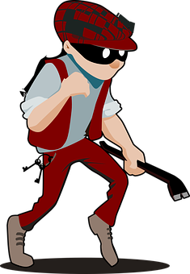
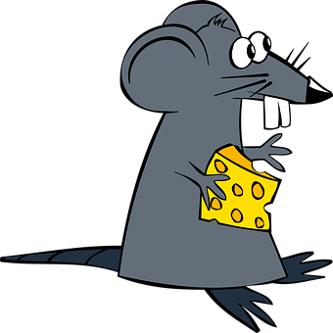
Follow up 1
Was ist das auf Englisch?
au
äu
aussprechen
Bäume
Baum
Kräuter
Gebäude
Traum
Maus
Häuser
träumen
glauben
[believe]
Haus
Läufer
laut
Räuber
Schau!
Mäuse
laufen
häufig
Zaun
genau
Bräuche
[frequent]
[exactly]
[customs]
Notes:
Slide 2/2
Meanings:
Baum- tree
Maus- mouse
Traum-dream
glauben- to believe
laut-loud
Haus-house
Schau!-look!
laufen- to run
Zaun-fence
genau-exactly
Bäume-trees
Kräuter-herbs
Gebäude-building(s)
träumen- to dream
Häuser- houses
Läufer-runners
Räuber- robber(s)
häufig-frequent
Bräuche-customs
Mäuse-mice

Slide 8
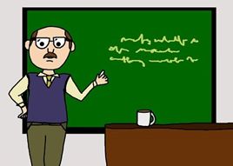
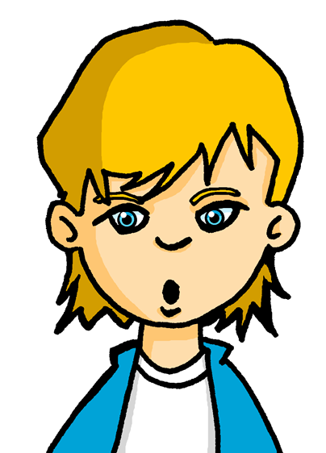
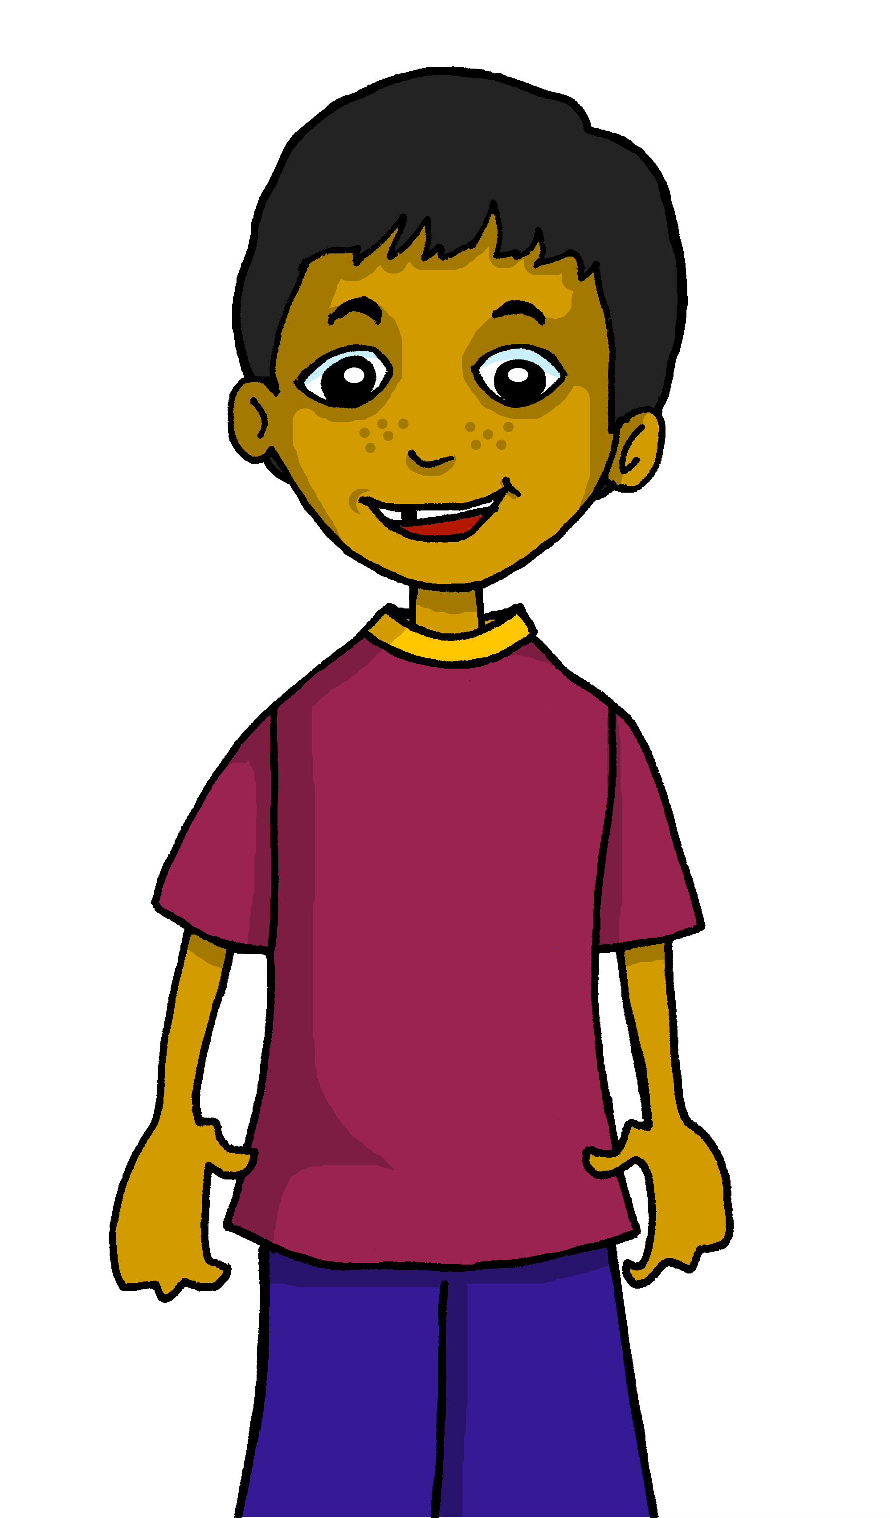
Follow up 2
Lieblingsdinge*. Was hat Hamza?
Lukas is finding out about Hamza’s favourite things. Listen and help him to note down whether Hamza does (✔ ) or doesn’t (x) have a favourite.
hören
1
2
3
4
5
6
A
A. Ich habe kein Lieblingslied aber ich habe einen Lieblingsfilm.
B
Have you got … ?
I’ve got / I haven’t got …
C
D
E
*Dinge-things
F
Notes:
Timing: 5 minutes Aim: To provide practice in noticing negation with kein and to practise the use of Lieblings- with new and revisited vocabulary.
Procedure:
Explain the scenario. Hamza is talking about whether or not he has favourite things. Pupils need to listen out for ein or kein in each sentence and identify which of the two pictures Hamza has a favourite of, and which he doesn’t. The pictures could be mentioned left then right or right then left. This represents an increase in challenge from the lesson activity.
Ask pupils to write down letters A-F
Listen to A together and click to show sentence on board. Pupils should draw a tick and cross in the correct order, based on which thing Hamza has a favourite of.
Click to listen to each of sentences B-F and ask pupils to decide on their answers independently.
Click to display answer ticks and crosses.
Transcript
A. Ich habe kein Lieblingslied aber ich habe einen Lieblingsfilm.
B. Ich habe keine Lieblingslehrerin aber ich habe einen Lieblingslehrer.
C. Ich habe ein Lieblingswort aber ich habe keine Lieblingsfarbe.
D. Ich habe keine Lieblingsmusik aber ich habe ein Lieblingstier.
E. Ich habe keinen Lieblingsort aber ich habe eine Lieblingsperson.
F. Ich habe ein Lieblingsspiel aber ich habe keinen Lieblingsmensch.

Slide 9
Follow up 3
Lies die Sätze*.
schreiben
lesen
Oh je! Frau Tahler has listed the children’s favourite things, but she smudged the articles and can’t remember some of the words! Help her complete the sentences.
buch
film.
1. Moritz hat kein Lieblings aber er hat einen Lieblings .
farbe
spiel.
2. Hamza hat keine Lieblings aber er hat ein Lieblings . .
ort
person.
3. Lukas hat einen Lieblings aber er hat keine Lieblings .
wort
musik.
4. Hamza hat ein Lieblings aber er hat keine Lieblings .
blue= masculine
red=feminine
green=neuter
*Sätze- sentences
Notes:
Timing: 5 minutes
Aim: to practise building sentences using the correct form of ein/kein words and recalling vocab and genders.
Procedure:
Explain the scenario. Pupils need to help Frau Tahler complete her sentences by recalling the vocabulary given in pictures and by inserting the correct ein/kein words based on the gender of the nouns. The colour of the words Lieblings in each case indicates the gender of the nouns. Pupils could write out full sentences or just 4 words e.g. 1. kein/Buch/einen/Film.
Click to reveal ein/kein words beneath smudges and to call up vocabulary spellings.
Additional task suggestions: 1. Ask pupils to change the sentences to be about themselves. E.g. 1. Ich habe ein Lieblingsbuch aber ich habe keinen Lieblingsfilm. A partner could then report back to the class E.g. 1. Elliot hat ein Lieblingsbuch aber er hat keinen Lieblingsfilm.

Slide 10
Follow up 4a
Hast du einen/eine/ein Lieblings…?
Partnerbarbeit*!
sprechen
Ask your partner if they have a favourite of each of the things below.
If yes, write (✔) and their answer.
If no, write (✘).
Have you got a favourite book ?
Hast du ein Lieblingsbuch?
1. Favourite book?
2. Favourite person?
3. Favourite film?
4. Favourite word?
5. Favourite song?
6. Favourite place?
7. Favourite (female)teacher?
Ja. Mein Lieblingsbuch ist Beast Quest.
Yes. My favourite book is Beast Quest.
No. I don’t have a favourite book.
Nein. Ich habe kein Lieblingsbuch.
blue= masculine
red=feminine
green=neuter
*Arbeit- work
Notes:
Timing: 5 minutes
Aim: to provide practice (speaking) in asking and answering questions about having (favourite things).
Procedure:
Demonstrate the conversations pupils will have using Moritz’ and Hamza’s speech bubbles. Try to translate them into German as a class, thinking about the gender of Buch and discussing words for ein/kein/mein needed. Demonstrate how pupils would note down a tick and Beast Quest for the first answer, or just a cross for the second answer.
Draw attention to the blue/red/green English nouns to help pupils with the genders of the remaining nouns. Ask ‘How will the question be different in number 2?’ Pupils will need to use eine, meine, keine for feminine and einen, mein and keinen for masculine.
Give pupils time in pairs to both ask and answer all questions, noting down their partner’s answers as they go.
If time allows, hear some of the conversations as a class to ensure pupils are not only recalling the vocabulary but also thinking about gender.
Additional task suggestions:
1. See next slide for follow up writing task. 2. Alternatively, pupils could report back to the teacher/rest of class using the 3rd person of haben e.g. Lucy hat kein Lieblingsbuch aber sie hat eine Lieblingsperson. Lucys Lieblingsperson ist Mia!

Slide 11
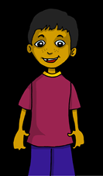
Follow up 4b
Schreib Sätze!
sprechen
Write sentences to describe your partner’s favourite things.
Hast du ein Lieblingsbuch?
1. Favourite book? | Beast Quest
2. Favourite person? | X
3. Favourite film? | Christmas Chronicles
Ja. Mein Lieblingsbuch ist Beast Quest.
Hamzas Lieblingsbuch ist Beast Quest.
Hast du eine Lieblingsperson?
Hamza hat keine Lieblingsperson.
Nein. Ich habe keine Lieblingsperson.
Hamzas Lieblingsfilm ist Christmas Chronicles.
Hamzas Lieblingsbuch [Hamza’s favourite book]. No apostrophe in German.
Notes:
Timing: 3 minutes
Aim: to provide written practice of favourite things vocabulary and use of kein/keine/keinen.
Procedure:
Remind pupils of the conversation between Moritz and Hamza and click to bring up the table showing Hamza’s answers.
Click again for each example sentence to come up. Draw attention to use of keine in second sentence and lack of apostrophe in German for possession.
Ask pupils to write a few sentences about their partner’s favourite things.
Hear a few sentences written by pupils and use these as an opportunity to identify errors and correct as a class.

Slide 12
Follow up 5:

Schreib auf Englisch.
Can you get at least 15 points?
Wörter
 | oben | unten | auch
 | rechts | keine | links
 | der Lehrer | sehr | Herr
 | die Lehrerin | (die) Frau | der Mann
 | der Film | die Musik | und
 | aber | das Lied | Lieblings-
up, above
down, below
also, too
Vokabeln
x3
right, on the right
not a, no (f)
left, on the left
(the) [male] teacher
very
Mr
x2
(the) [female] teacher
(the) woman/ Mrs, Miss, Ms
(the) man
(the) film
(the) music
and
x1
but
(the) song
favourite
Notes:
Timing: 5 minutes
Aim: to practise written production of vocabulary from this and revisited weeks.
Procedure: 1. Give pupils a blank grid. They fill in the English meanings of any of the words they know, trying to reach 15 points in total.
Note: The most recently learnt and practised words are pink, words from the previous week are green and those from week 1 are blue, thus more points are awarded for them, to recognise that memories fade and more effort (heavy lifting!) is needed to retrieve them.

Slide 13
Follow up 5:

Schreib auf Deutsch.
Can you get at least 15 points?
Wörter
 | down, below | also, too | not a, no (f)
 | left, on the left | up, above | right, on the right
 | (the) [female] teacher | (the) man | very
 | (the) woman/ Mrs, Miss, Ms | Mr | (the) [male] teacher
 | (the) music | but | and
 | (the) film | favourite | (the) song
unten
auch
keine
Vokabeln
x3
links
oben
rechts
die Lehrerin
der Mann
sehr
x2
(die) Frau
Herr
der Lehrer
die Musik
aber
und
x1
der Film
Lieblings-
das Lied
Notes:
Timing: 5 minutes
Aim: to practise written production of vocabulary from this and revisited weeks.
Procedure: 1. Give pupils a blank grid. They fill in the German meanings of any of the words they know, trying to reach 15 points in total.
Note: The most recently learnt and practised words are pink, words from the previous week are green and those from week 1 are blue, thus more points are awarded for them, to recognise that memories fade and more effort (heavy lifting!) is needed to retrieve them.

Slide 14
Tschüss!
rot
Notes:
14

Slide 15
Follow up 1
Lies die Wörter. Ist das [au] oder [äu]?
au
äu
Bäume
Baum
Traum
Kräuter
Gebäude
Maus
Häuser
glauben
träumen
laut
Haus
Läufer
Räuber
schau
Mäuse
laufen
häufig
Zaun
genau
Bräuche
Notes:
HANDOUT (1 between 2)

Slide 16
Follow up 5:

Schreib auf Englisch.
Can you get at least 15 points?
Wörter
 | oben | unten | auch
 | rechts | keine | links
 | der Lehrer | sehr | Herr
 | die Lehrerin | (die) Frau | der Mann
 | der Film | die Musik | und
 | aber | das Lied | Lieblings-
Vokabeln
x3
x2
x1
Notes:
HANDOUT

Slide 17
Follow up 5:

Schreib auf Deutsch.
Can you get at least 15 points?
Wörter
 | down, below | also, too | not a, no (f)
 | left, on the left | up, above | right, on the right
 | (the) [female] teacher | (the) man | very
 | (the) woman/ Mrs, Miss, Ms | Mr | (the) [male] teacher
 | (the) music | but | and
 | (the) film | favourite | (the) song
Vokabeln
x3
x2
x1
Notes:
HANDOUT

