Slide 1
Talking about things and things to do
rot
Favourite things (Lieblings-)
Cognates
SSC [äu] vs. [au]
Term 2 Week 5
Notes:
Artwork by Steve Clarke. Pronoun pictures from NCELP (www.ncelp.org). All additional pictures selected from Pixabay and are available under a Creative Commons license, no
attribution required.
Phonics:
Introduce [äu] Häuser [Haus-147] Mäuse [Maus-3463], träumen [1793]
Revisit [au] Haus [147] blau [948] laufen [252]
Vocabulary: Film [505] Lieblings- [n/a] Lied [1733] Musik [509]
Revisit 1: Frau [99] Herr [154] Lehrer, Lehrerin [695] Mann [121] sehr [81]
Revisit 2: links [893] oben [417] rechts [829] unten [710]
Jones, R.L & Tschirner, E. (2019). A frequency dictionary of German: Core vocabulary for learners. London: Routledge.
The frequency rankings for words that occur in this PowerPoint which have been previously introduced in these resources are given in the SOW and in the resources that first
introduced and formally re-visited those words.
For any other words that occur incidentally in this PowerPoint, frequency rankings will be provided in the notes field wherever possible.
Note that the first three lessons of the year teach language that can be continuously recycled as lesson routine every lesson in Y3/4.
The idea would be that the class teacher (whether or not s/he teaches the class German can re-use the language as part of the daily routine with the class.
1

Slide 2
aussprechen
[au]
…
Haus
Notes:
Timing: 1 minute
Aim: to revisit the SSC [au].
Procedure:
Introduce the SSC and present the source word ‘Haus’ (with gesture, if using).
Click to bring on the picture and get pupils to repeat the word ‘Haus’ (with gesture, if using).
Note:
a gesture for ‘Haus’ might be to make a roof above your head with two hands.
2

Slide 3
aussprechen
[au]
…
Haus
[to run, running]
blau
laufen
Notes:
Timing: 1 minute
Aim: to consolidate the SSC [au].
Procedure:
Re-present the SSC and the source word ‘Haus’ (with gesture, if using).
Click to bring on the picture and get pupils to repeat the word ‘Haus’ (with gesture, if using).
Present the cluster words in the same way, bringing on the picture and getting pupils to pronounce the words.
3

Slide 4
aussprechen
[äu]
The sound [äu] is the same as the sound [eu] in Deutschland.
…
Häuser
This is the plural of the word Haus. For more than one Haus, use Häuser.
Notes:
Timing: 1 minute
Aim: to introduce the SSC [äu].
Procedure:
Introduce the SSC and present the source word ‘Häuser’ (with gesture, if using).
Click to bring on the picture and get pupils to repeat the word ‘Häuser’ (with gesture, if using).
Use the call-outs to explain that Häuser is the plural of Haus and to demonstrate that the new sound [äu] is the same sound as last week’s [eu].
4

Slide 5
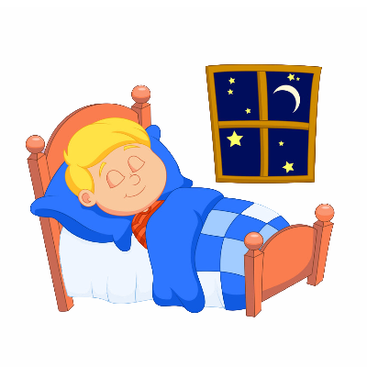
aussprechen
[äu]
The sound [äu] here is the same as the sound [eu] in Deutschland, Freund and heute.
…
Häuser
[to dream]
[mice]
träumen
Mäuse
Notes:
Timing: 1 minute
Aim: to consolidate the SSC [äu].
Procedure:
Re-present the SSC and the source word ‘Häuser’ (with gesture, if using).
Click to bring on the picture and get pupils to repeat the word ‘Häuser’ (with gesture, if using).
Present the cluster words in the same way, bringing on the picture and getting pupils to pronounce the words.
Use the call-out to remind pupils of other words with the [eu] sound from last week, which sound the same as the new [äu].
Word frequency:
Haus [147] Maus [3463] träumen [1793]
Jones, R.L & Tschirner, E. (2019). A frequency dictionary of German: Core vocabulary for learners. London: Routledge.
5

Slide 6
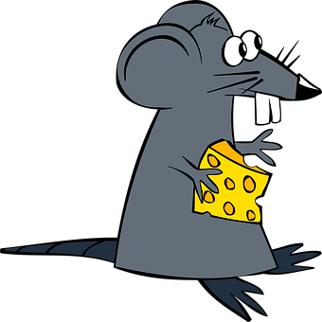
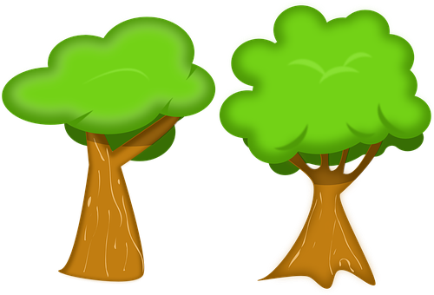
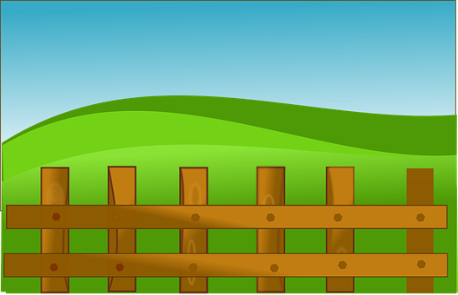
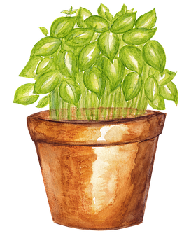
[au] oder [äu]?
Schreib au oder äu.
Hör zu. Ist es [au] oder [äu]?
 | au | äu
B.
1
2
3
4
5
6
7
Maus
Bäume
Traum
Gebäude
laufen
Zaun
Kräuter
Häuser
Notes:
Timing: 5 minutes
Aim: to consolidate the SSCs [äu] and [au] by aurally differentiating between the two sounds.
Procedure:
1. Click B to listen to the example (Beispiel). Pupils decide whether they hear [au] as in Haus or [äu] as in Häuser and write down the correct sound.
2. Click to correct the example.
3. Pupils can listen again and try to write the whole word if appropriate – this could be done on mini whiteboards (or air writing)
4. Click to show the 3rd column and either elicit the meaning of the word if cognate or tell pupils the meaning). See below for the English meanings in brackets.
5. Continue with items 1-7 and click to correct.
Transcript: Beispiel: Maus (mouse) Bäume (trees)
Traum (dream)
Gebäude (building)
laufen (to run, running)
Zaun (fence)
Kräuter (herbs)
Häuser (houses)
Meanings:
Maus (mouse) Bäume (trees)
Traum (dream)
Gebäude (building)
laufen (to run, running)
Zaun (fence)
Kräuter (herbs)
Häuser (houses)
Word frequency (1 is the most frequent word in German): Maus [3463], Baum [1013], Traum [992 ], Gebäude [1386], laufen [252], Kräuter [N/A], Zaun [3279], Haus [147]
Source: Jones, R.L. & Tschirner, E. (2019). A frequency dictionary of German: core vocabulary for learners. Routledge

Slide 7
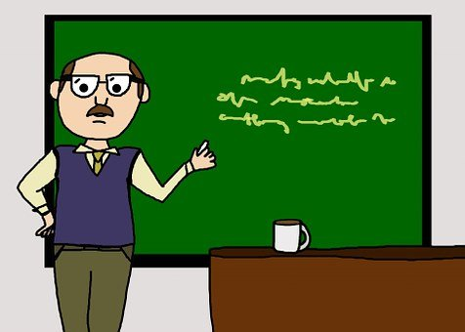
Vokabeln
Vokabeln lernen
Sag die Wörter auf Deutsch. Was ist das auf Englisch?
Wörter
der Film
die Musik
das Lied
Lieblings-
Cognates are words in which all or most of the letters are the same in two languages. The meaning is the same, too. Which of these new words are cognates?
Lieblings- means ‘favourite’. We can add it to any noun to make a compound noun:
e.g. Lieblingsfilm=favourite film
die Lehrerin
der Lehrer
Notes:
Timing: 3 minutes
Aim: to present and practise new vocabulary for this week
Procedure:
1. Click to introduce the new words and their pictures. Practise pronouncing the words as a class and individually.
2. Ask pupils what they think the words mean in English.
3. Use the callout to draw attention to use of Lieblings.
4. They have met Lehrer/Lehrerin before- what is the difference between the 2 words?
5. Use the 2nd callout to talk about cognates. The 2 cognates here are Film and Musik. See if they can make some more compound nouns with Lieblings e.g. Lieblingslehrer= favourite teacher, Lieblingsmusik= favourite music.
6. Click for individual words to disappear and to elicit them from the class. Click again for them to reappear.
7. Click on the images to listen and check pronunciation, if required.
7

Slide 8
Vokabeln
Vokabeln lernen
Wörter
Was ist das auf Englisch?
13. das Lied
6. das Wort
3. der Lehrer
7. die Farbe
14. der Mensch
8. Lieblings
2. die Musik
4. das Buch
11. das Tier
1. der Film
5. das Spiel
9. die Lehrerin
10. die Person
12. der Ort
Notes:
Timing: 5 minutes
Slide 1/2
Aim: to practise new and revisited vocabulary.
Procedure:
1. Click to make the words disappear one by one. Pupils write down the number and the English translation. They have 4 seconds before the word disappears completely.
2. Use the next slide to elicit and then display the English translations.
8

Slide 9
Vokabeln
Vokabeln lernen
Which of these words are cognates?
Wörter
Was ist das auf Englisch?
1. der Film
1. (the) film
8. Lieblings
8. favourite
9. (the) [female] teacher
2. die Musik
2. (the) music
9. die Lehrerin
3. der Lehrer
3. (the) [male] teacher
10. die Person
10. (the) person
4. das Buch
4. (the) book
11. das Tier
11. (the) animal
5. das Spiel
5. (the) game
12. der Ort
12. (the) place
13. das Lied
13. (the) song
6. das Wort
6. (the) word
14. (the) human being
7. die Farbe
7. (the) colour
14. der Mensch
Notes:
2/2
Procedure
Elicit and display the English translations one by one.
Ask pupils to think about which words here are cognates. Some look the same and sound similar e.g. der Film. Others look similar but sound very different e.g. das Wort, die Person.
Click for all the German words to disappear.
Ask pupils to work in pairs to recall the words in German. They should try to remember genders too.
Click again for all words to reappear for pupils to check.
Click on each word to hear the audio, if required.
9

Slide 10
Saying you have / don’t have a thing
As you know, after the verb haben and most other verbs, the masculine
ein changes to einen and the masculine kein changes to keinen.
When we make a compound word, for example by adding Lieblings- to the noun, the new compound word takes its gender from the final noun.
Ich habe einen Lieblingsfilm.
Ich habe eine Lieblingslehrerin.
Ich habe ein Lieblingslied.
I have a favourite film.
I have a favourite
[female] teacher.
I have a favourite song.
Ich habe keinen Lieblingsort.
Ich habe keine Lieblingsfarbe.
Ich habe kein Lieblingsspiel.
I don’t have a favourite
colour.
I don’t have a favourite game.
I don’t have a favourite place.
Notes:
Timing: 2 minutes
Procedure:
Click through the animations to recap ‘ein’ and kein’ changes after haben and most verbs, and to remind pupils of the gender of compound nouns.
Elicit English translation for the German examples provided.
10

Slide 11
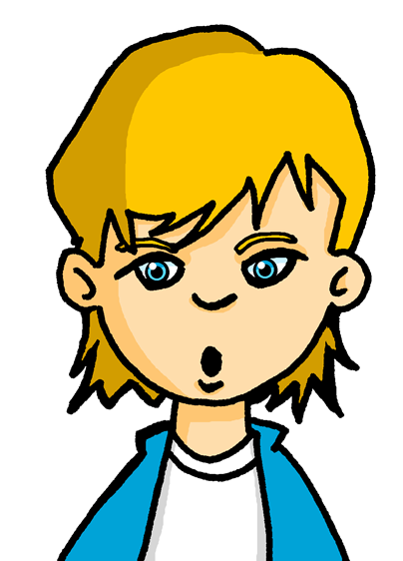
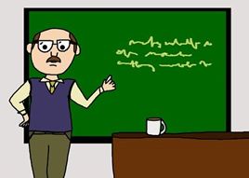
Lieblingsdinge*. Was hat Lukas?
lesen
Moritz is getting to know Lukas and is finding out about his favourite things. Help him to note down whether Lukas does (✔ ) or doesn’t (x) have a favourite.
Ich habe kein Lieblingsbuch aber ich habe einen Lieblingsfilm.
1
2
3
4
5
6
1
Ich habe eine Lieblingslehrerin aber ich habe keinen Lieblingslehrer.
Ich habe ein Lieblingslied aber ich habe kein Lieblingswort.
Ich habe keine Lieblingsperson aber ich habe ein Lieblingstier.
Ich habe keine Lieblingsfarbe aber ich habe einen Lieblingsort.
Ich habe ein Lieblingsspiel aber ich habe keine Lieblingsmusik.
2
3
4
5
6
*Dinge-things
Notes:
Timing: 5 minutes Aim: To provide practice in noticing negation with kein and to practise the use of Lieblings- with new and revisited vocabulary.
Procedure:
Explain the scenario. Lukas is talking about whether or not he has favourite things. Pupils need to look out for ein or kein in each sentence and identify which of the two pictures Lukas has a favourite of, and which he doesn’t.
Ask pupils to write down numbers 1-6.
Read number 1 together. Pupils should write a tick and cross in the correct order, based on which thing Lukas has a favourite of.
Click to display sentences 2-6 and ask pupils to do the same independently.
Click to display answer ticks and crosses.
Note: to tweak this activity for a higher level of challenge, swap the order of some of the items in the table so that pupils need to focus on both the ein / kein and the noun meanings. With this layout, pupils will begin to anticipate that the items are in order (1, 2) each time.

Slide 12
Meine Lieblingsdinge/ My favourite things
As you know, to say ‘my’ we use mein or meine:
masculine
feminine
neuter
mein Film
meine Musik
mein Spiel
my film
my music
my game
You can add the prefix Lieblings- to a noun to talk about your favourite things. Introduce them using mein/meine.
n to talk about your favourite things. Introduce them using …
d the prefix Lie to a noun to talk about your favourite things. Introduce them using.
Mein …
Mein Lieblingsort ist…
Meine Lieblingsfarbe ist…
Mein Lieblingslied ist…
My favourite place is…
My favourite colour is…
My favourite song is…
Lukas, hast du ein Lieblingslied?
Ja, mein Lieblingslied ist Blinding Lights.
Hast du eine Lieblingslehrerin?
Ja, meine Lieblingslehrerin ist Frau Schmidt.
Notes:
Timing: 2 minutes
Aim: to recap the possessive adjective ‘mein’ and to introduce its use with Lieblings- compound nouns
Procedure:
Click through the animations to present the new information.
Elicit English translation for the German examples provided.
Click to show examples of questions and answers between Moritz and Lukas.
12

Slide 13
hören
Lieblingsdinge*
Hör zu. Was hat Moritz? Schreib A oder B.
 | A | B | Yes or no?
1
2
3
4
5
6
B
yes (red)
Moritz, hast du eine Lieblings_______?
1
no
farbe
2
yes (Germany)
3
yes (Johanna)
Ja, meine Lieblings_____ ist rot.
farbe
4
no
5
yes (Bye!)
*Dinge-things
Notes:
Timing: 5 minutes
Aim: to practise aural comprehension of ein, mein and kein forms in the context of favourite things.
Procedure:
Explain the scenario. Now Lukas is finding out about Moritz’ favourite things. Pupils must note down A or B based on the gender of the ein/mein/kein words they hear. They must then write Yes or No for whether or not
Moritz has a favourite. Note: Ja/Nein have been omitted in these short dialogues to avoid pupils relying on these cues for the answers.
2. Click to play B (Beispiel). Click to bring up the speech bubbles for number the example, so pupils can see what they have heard. Discuss as a class how to decide which noun is being discussed. (It is eine and meine so the missing word must be Farbe (f) not Film (m).) Discuss also whether they heard a favourite colour or whether Moritz doesn’t have one. Click to display answers.
3. Play items 1-5.
4. Click to correct. Bonus points if anybody can name the favourite things!
Transcript
B: Hast du eine Lieblings[farbe]?
Meine Lieblings[farbe] ist rot.
1. Hast du ein Lieblings[lied]?
Ich habe kein Lieblings[lied].
2, Hast du einen Lieblings[ort]?
Mein Lieblings[ort] ist Deutschland!
3. Hast du eine Lieblings[person]?
Meine Lieblings[person] ist Johanna.
4. Hast du einen Lieblings[film]?
Ich habe keinen Lieblings[film]
5. Hast du ein Lieblings[wort]?
Mein Lieblings[wort] ist tschüss!
13

Slide 14
Tschüss!
rot
Notes:
14

