Slide 1
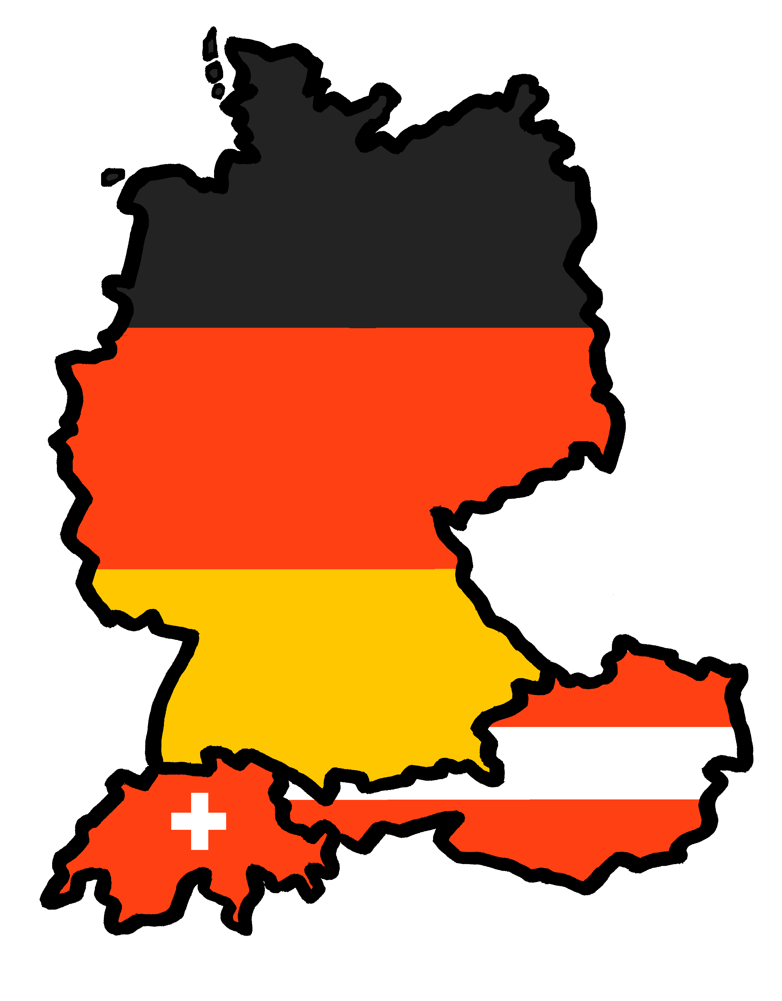
Exploring
Wie ist Deutschland?
blau
Follow ups 1-5
Term 2 Week 1
Notes:
Artwork by Steve Clarke. Pronoun pictures from NCELP (www.ncelp.org). All additional pictures selected from Pixabay and are available under a Creative Commons license, no attribution required.
Phonics: [ä] vs. [a]
spät [171] zählen [680] wählen [64]
Blätter [1270] Hände [180] Länder [134]
Vocabulary: Fluss [1687] Insel [1029] Norden, Nord- [1516] Osten, Ost- [1208] Schloss [1907] Süden, Süd- [1771] Strand [1966] Wald [1028] Westen, West- [1010] bekannt [319] dort [139] für [17]
Revisit 1: essen [323] lesen [305] sitzen [231] sprechen [161] Antwort [522] Hilfe [481] Moment [358] langsam [526] manchmal [382] oft [223] nie [196] schnell [203] neben [266]
Revisit 2: bleiben [113] brauchen [179] Glas, Gläser [885] Idee [451] gewinnen [372] haben [6] helfen [338] kaufen [506] machen [58] planen [579] singen [1063] spielen [205] wiederholen [988] Kind [133] Kinder [133] Stunde [276] dieser, diese, dieses [24]
Jones, R.L & Tschirner, E. (2019). A frequency dictionary of German: Core vocabulary for learners. London: Routledge.
The frequency rankings for words that occur in this PowerPoint which have been previously introduced in these resources are given in the SOW and in the resources that first
introduced and formally re-visited those words.
For any other words that occur incidentally in this PowerPoint, frequency rankings will be provided in the notes field wherever possible.

Slide 2
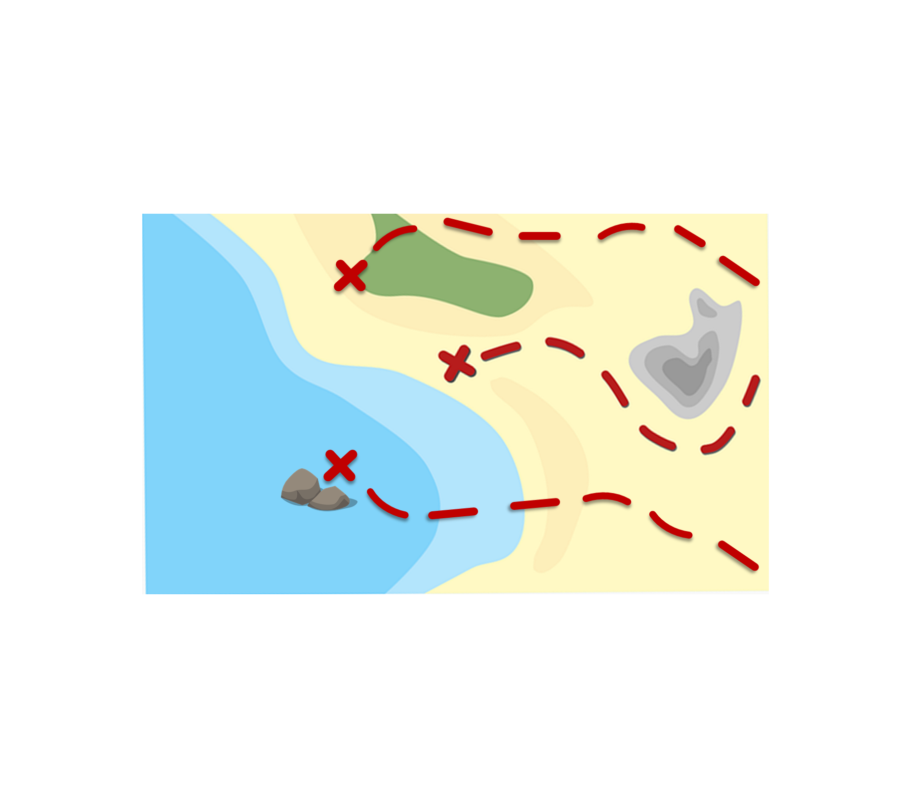
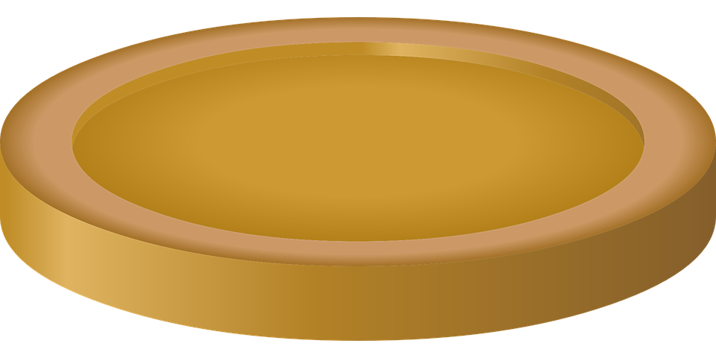
Follow up 1:
*Sammle die Geldstücke – collect the coins
Sag die Wörter und sammle die Geldstücke*.
Montage
aussprechen
60
Jacken
Fußbälle
Strände
Männer
S
Taschen
Äpfel
Sätze
Hände
0
Flaschen
Nächte
Mädchen
START
Notes:
Timing: 5 minutes [2 rounds]
Aim: To practise the pronunciation of German words with the SSC [ä].
Procedure:
Pupils work in pairs to practise pronunciation. They can choose where to start and have one minute to collect as many coins as possible.
Divide the class in A & B and click to indicate it’s ‘Person A’’s turn.
Pupil A starts from either ‘Strände’ ‘Männer’ or ‘Mädchen’, and follows the path to pronounce the words and collect the corresponding coins. S/he tries to do all of the routes. Pupil B listens and notes down the number of coins for his/her partner.
Click to bring up Person B’s turn.
Click on each word to hear it pronounced, as required.

Slide 3
Follow up 2
Wörter
Was ist das auf Englisch?
Schreib das Wort für ‘the’.
Vokabeln
Fluss | Insel | Norden, Nord- | Osten, Ost-| Schloss | Süden, Süd- | Strand | Wald | Westen, West- | Moment
word for ‘the’
word for ‘the’
Englisch
Englisch
1
2
3
4
5
south
der
6
7
8
9
10
river
der
Süden, Süd-
Fluss
Insel
island
die
Strand
der
beach
Norden, Nord-
der
Wald
der
north
forest, woods
east
der
der
Osten, Ost-
west
Westen, West-
castle
das
Moment
der
Schloss
moment
Notes:
Timing: 5 minutes
Aim: to practise written comprehension and spoken production of new & revisited vocabulary and its correct association with the appropriate indefinite article (word for ‘a/an’).
Procedure:
1. Read the instructions in German and establish that pupils are focusing on meaning and gender.
2. Pupils are to write down the English meanings of the nouns (in order as they appear from the left on the ‘tickertape’). Note: the tickertape is set to repeat until the next mouse click. Pupils may need to see as many as 3 – 4 repetitions to get all of the words.
3. Pupils can volunteer the answers orally. Written answers appear on clicks. 4. Teacher clicks to bring up the 2nd prompt ‘word for ‘a/an’’.
5. Pupils write in the indefinite articles.
6. Elicit word by word, prompt pupils for the German word as well, and click to reveal answers.

Slide 4
Order of words in a sentence
Remember in + der/das → in dem → im for locations.
You know this common order of words in a German sentence:
die Insel
ist
im Osten.
Word order
1
SUBJECT
VERB
PLACE ADVERB
The island
is
in the East.
Sometimes, we want to start the sentence with the adverb to emphasise it.
When we do this, the adverb and subject swap places.
Im Osten
ist
die Insel.
Word order
2
PLACE ADVERB
VERB
SUBJECT
English hardly ever changes word order like this, and only in phrases like: “And so say all of us!”
The verb position does not change.
Notes:
Timing: 1 minute
Aim: to recap the order of words in a German sentence, and how this is affected by an initial adverb of place/location.
Procedure:
Click to present the information.
Elicit the English meaning of the words in the sentence.
Ensure that pupils understand that this change is for emphasis – the essential meaning of the sentence remains the same. It’s also important to point out (with the callout) that we hardly ever do this in English, just in phrases like ‘And so say all of us’!
4

Slide 5
Follow up 3
Hör zu. Schreib auf Englisch.
1
North Germany has two languages.
hören
Norddeutschland hat zwei Sprachen.
2
In the North there is an island.
Im Norden gibt es eine Insel.
3
There the beaches are very beautiful.
Dort sind die Strände sehr schön.
4
Berlin is in the East.
Berlin ist im Osten.
5
In the South there is a castle. It is very beautiful.
Im Süden gibt es ein Schloss. Es ist sehr schön.
6
South-Germany is well-known for the blackforest.
Süddeutschland ist bekannt für den Schwarzwald.
Notes:
Timing: 5 minutes
Aim: to practise aural comprehension of this week’s new language in sentences with word order 1 and 2.
Procedure:
Click to listen to each sentence.
Write the English meanings.
Click to reveal answers.
Transcript
Norddeutschland hat zwei Sprachen.
Im Norden gibt es eine Insel.
Dort sind die Strände sehr schön.
Berlin ist im Osten.
Im Süden gibt es ein Schloss. Es ist sehr schön.
6. Süddeutschland ist bekannt für den Schwarzwald.

Slide 6
Follow up 4

*in jedes Kästchen – into each square
Schreib ein Wort auf Deutsch in jedes Kästchen*.
schreiben
river | east
castle | island
beach | north
west | forest, woods
well-known, famous | south
there | for
Notes:
Timing: 5 minutes
Aim: to practise written production of this week’s new language.
Procedure: 1. Pupils choose any 9 of the words from the English table and write them into their grid in German.
2. Teacher then calls out the German for any of the 9 words in the table in whichever order.
3. Pupils call Bingo when they have any three in a row (vertical, horizontal, or diagonal) and then again for the first full house.
4. Click on the blue buttons to hear the German translations if needed to support the activity.
Translation:
Fluss
Schloss
Strand
Westen, West-
bekannt
dort
Osten, Ost-
Insel
Norden, Nord-
Wald
Süden, Süd
für

Slide 7
Follow up 5:

Schreib auf Englisch.
Can you get at least 15 points?
Wörter
 | kaufen | die Kinder | das Kind
 | dieser | planen | dieses
 | schnell | manchmal | essen
 | langsam | nie | lesen
 | die Insel | das Schloss | der Süden, Süd-
 | für | der Wald | der Fluss
 | der Strand | bekannt | dort
to buy, buying
(the) children
(the) child
Vokabeln
x3
this (m)
to plan, planning
this (nt)
fast, quickly
sometimes
to eat, eating
x2
slow, slowly
never
to read, reading
(the) island
(the) castle
(the) south
for
(the) forest, woods
(the) river
x1
(the) beach
well-known, famous
there
Notes:
Timing: 5 minutes
Aim: to practise written comprehension of vocabulary from this and revisited weeks.
Procedure: 1. Give pupils a blank grid. They fill in the English meanings of any of the words they know, trying to reach 15 points in total.
Note: The most recently learnt and practised words are pink, words from the previous week are green and those from week 1 are blue, thus more points are awarded for them, to recognise that memories fade and more effort (heavy lifting!) is needed to retrieve them.

Slide 8
Follow up 5:

Schreib auf Deutsch.
Can you get at least 15 points?
Wörter
 | (the) child | this (m) | this (nt)
 | to buy, buying | to plan, planning | (the) children
 | sometimes | never | fast, quickly
 | to eat, eating | to read, reading | slow, slowly
 | well-known, famous | there | for
 | (the) south | (the) beach | (the) forest, woods
 | (the) river | (the) island | (the) castle
das Kind
dieser
dieses
Vokabeln
x3
kaufen
planen
die Kinder
manchmal
nie
schnell
x2
essen
lesen
langsam
bekannt
dort
für
der Süden, Süd-
der Strand
der Wald
x1
der Fluss
die Insel
das Schloss
Notes:
Timing: 5 minutes
Aim: to practise written production of vocabulary from this and revisited weeks.
Procedure: 1. Give pupils a blank grid. They fill in the German meanings of any of the words they know, trying to reach 15 points in total.
Note: The most recently learnt and practised words are pink, words from the previous week are green and those from week 1 are blue, thus more points are awarded for them, to recognise that memories fade and more effort (heavy lifting!) is needed to retrieve them.

Slide 9
Tschüss!
blau
Notes:
9

Slide 10
Follow up 5:

Schreib auf Englisch.
Can you get at least 15 points?
Wörter
 | kaufen | die Kinder | das Kind
 | dieser | planen | dieses
 | schnell | manchmal | essen
 | langsam | nie | lesen
 | die Insel | das Schloss | der Süden, Süd-
 | für | der Wald | der Fluss
 | der Strand | bekannt | dort
Vokabeln
x3
x2
x1
Notes:
Template for photocopying

Slide 11
Follow up 5:

Schreib auf Deutsch.
Can you get at least 15 points?
Wörter
 | (the) child | this (m) | this (nt)
 | to buy, buying | to plan, planning | (the) children
 | sometimes | never | fast, quickly
 | to eat, eating | to read, reading | slow, slowly
 | well-known, famous | there | for
 | (the) south | (the) beach | (the) forest, woods
 | (the) river | (the) island | (the) castle
Vokabeln
x3
x2
x1
Notes:
Template for photocopying

