Slide 1
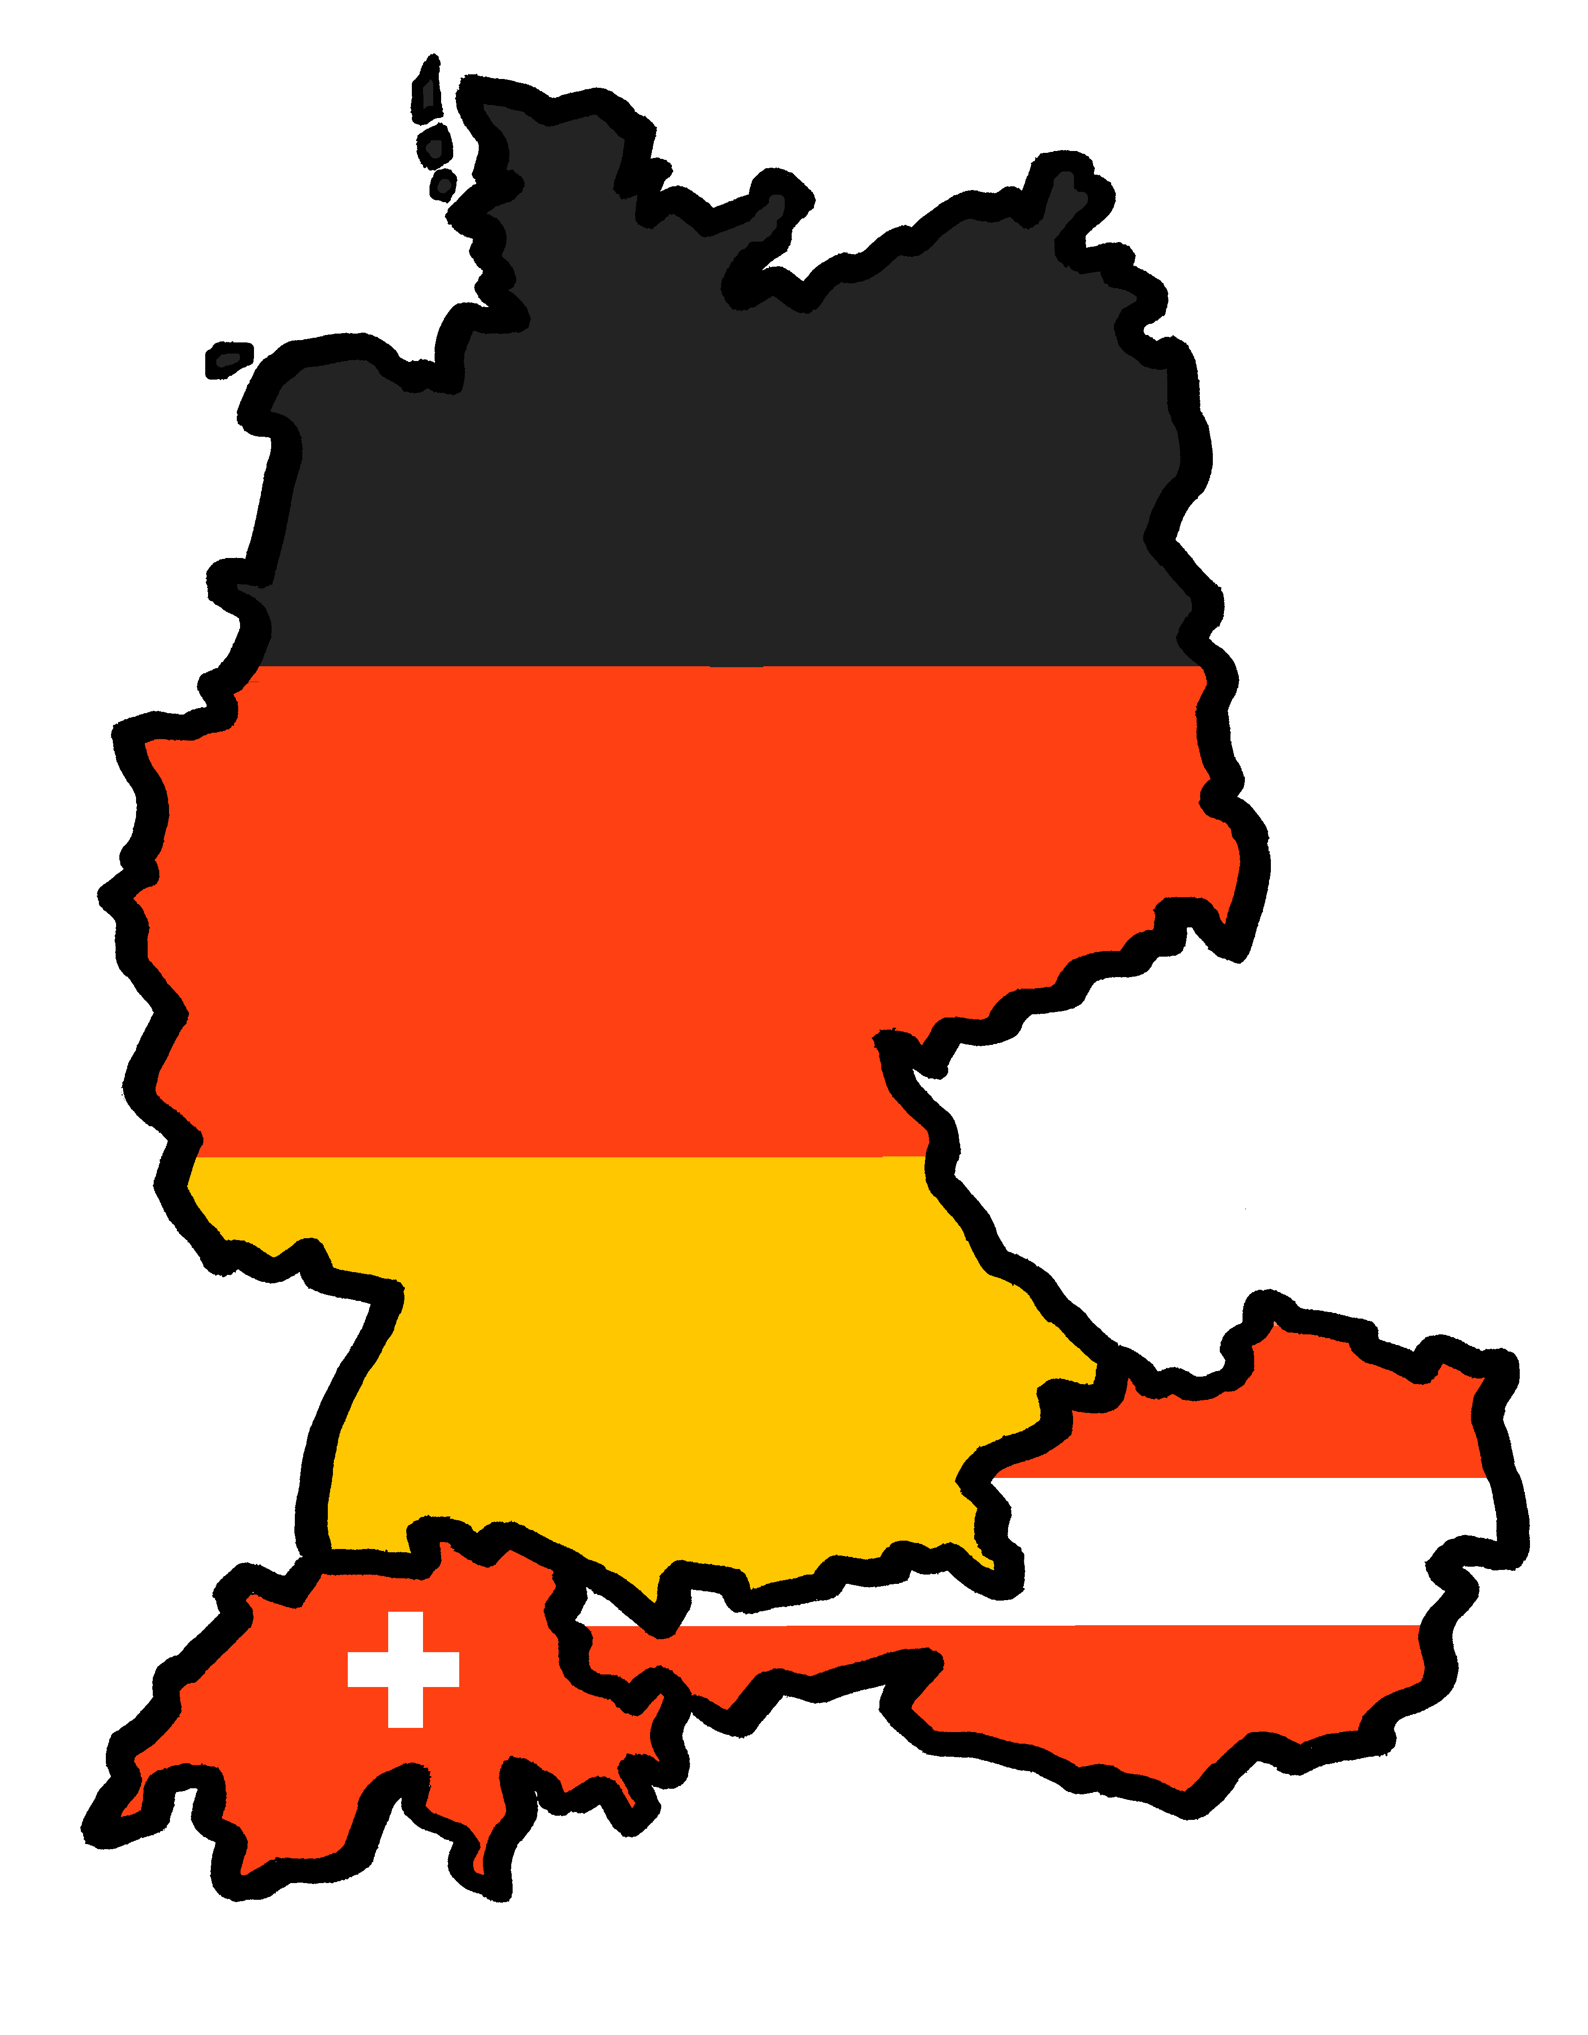
Exploring
Wie ist Deutschland?
blau
WO2 after adverbs of place
SSC [ä] v. [a]
Term 2 Week 1
Notes:
Artwork by Steve Clarke. Pronoun pictures from NCELP (www.ncelp.org). All additional pictures selected from Pixabay and are available under a Creative Commons license, no
attribution required.
Phonics: [ä] vs. [a]
long [a] ja [45] da [239] Tag [111]
short [a] hallo [1077] danke [877] was? [38]
[ä] spät [171] zählen [680] wählen [64] Blätter [1270] Hände [180] Länder [134]
Vocabulary: Fluss [1687] Insel [1029] Norden, Nord- [1516] Osten, Ost- [1208] Schloss [1907] Süden, Süd- [1771] Strand [1966] Wald [1028] Westen, West- [1010] bekannt [319] dort [139] für [17]
Revisit 1: essen [323] lesen [305] sitzen [231] sprechen [161] Antwort [522] Hilfe [481] Moment [358] langsam [526] manchmal [382] oft [223] nie [196] schnell [203] neben [266]
Revisit 2: bleiben [113] brauchen [179] Glas, Gläser [885] Idee [451] gewinnen [372] haben [6] helfen [338] kaufen [506] machen [58] planen [579] singen [1063] spielen [205] wiederholen [988] Kind [133] Kinder [133] Stunde [276] dieser, diese, dieses [24]
Jones, R.L & Tschirner, E. (2019). A frequency dictionary of German: Core vocabulary for learners. London: Routledge.
The frequency rankings for words that occur in this PowerPoint which have been previously introduced in these resources are given in the SOW and in the resources that first
introduced and formally re-visited those words.
For any other words that occur incidentally in this PowerPoint, frequency rankings will be provided in the notes field wherever possible.
Remember that at the start of the course (first three lessons of Rot/Gelb) pupils learnt language (for greetings and register taking) that can still be part of the lesson routines in upper KS2 (Blau/Grün). They are not re-taught, as we anticipate that teachers have built these in from early in lower KS2.
1

Slide 2
aussprechen
long [a]
…
ja
da
Tag
[yes]
[there]
[day]
Lina
Moritz
Notes:
Timing: 2 minutes
Aim: to consolidate the SSC long [a].
Procedure:
Re-present the SSC and the source word ‘da’ (with gesture, if using).
Click to bring on the picture and get pupils to repeat the word ‘da’ (with gesture, if using).
Present the cluster words in the same way, bringing on the picture and getting pupils to pronounce the words.
Note:
a gesture for ‘da’ might be to point at something away from you
2

Slide 3
aussprechen
short [a]
…
was?
hallo
danke
Notes:
Timing: 2 minutes
Aim: to consolidate the SSC short [a].
Procedure:
Re-present the SSC and the source word ‘hallo’ (with gesture, if using).
Click to bring on the picture and get pupils to repeat the word ‘hallo’ (with gesture, if using).
Present the cluster words in the same way, bringing on the picture and getting pupils to pronounce the words.

Slide 4
aussprechen
long [ä]
…
1, 2, 3, …100
spät
wählen
zählen
[to count]
[to choose]
Notes:
Timing: 1 minute
Aim: to introduce the SSC [ä].
Procedure:
Re-present the SSC and the source word ‘spät’ (with gesture, if using).
Click to bring on the picture and get pupils to repeat the word ‘spät’ (with gesture, if using).
Present the cluster words in the same way, bringing on the picture and getting pupils to pronounce the words.
spät [171] zählen [680] wählen [64]
Jones, R.L & Tschirner, E. (2019). A frequency dictionary of German: Core vocabulary for learners. London: Routledge.
4

Slide 5
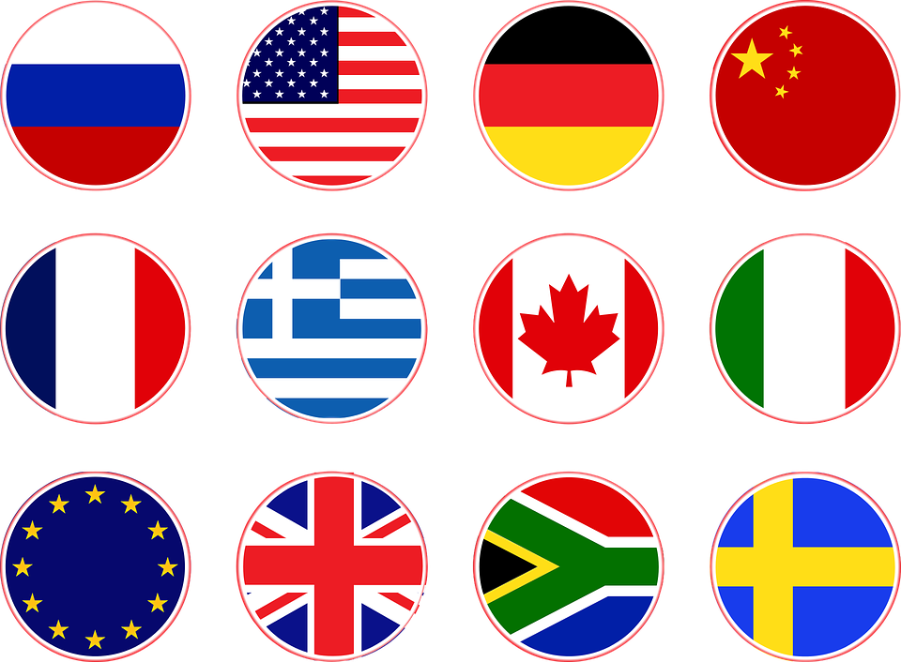
aussprechen
short [ä]
All vowels in German can be long or short, and [ä] is no exception. [ä] is short when followed by two consonants.
…
Blätter²
Hände
Länder
[leaves]
You already know Blatt means sheet. It also means leaf!
Notes:
Timing: 1 minute
Aim: to introduce the SSC short [ä].
Procedure:
Present the SSC and the source word ‘Hände’ (with gesture, if using).
Click to bring on the picture and get pupils to repeat the word ‘Hände’(with gesture, if using).
Present the cluster words in the same way, bringing on the picture and getting pupils to pronounce the words.
Gesture: pupils put up both their hands in front of them, palms facing away from them.
Blatt [1270] Hand [180] Land [134]
Jones, R.L & Tschirner, E. (2019). A frequency dictionary of German: Core vocabulary for learners. London: Routledge.
5

Slide 6
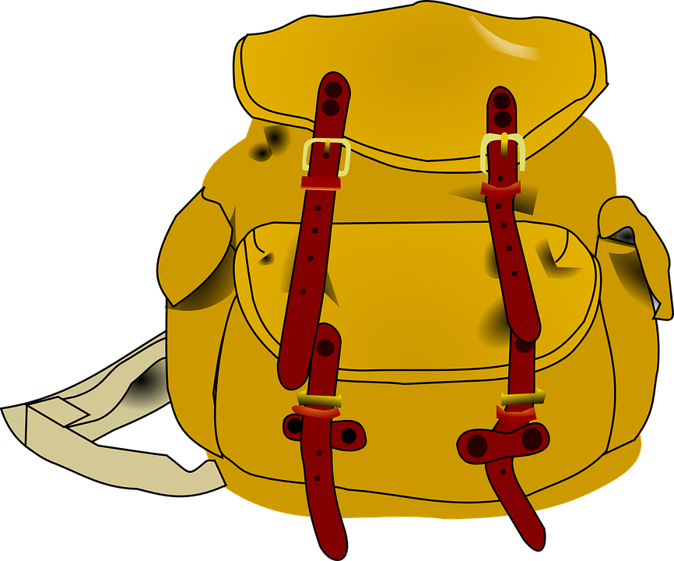
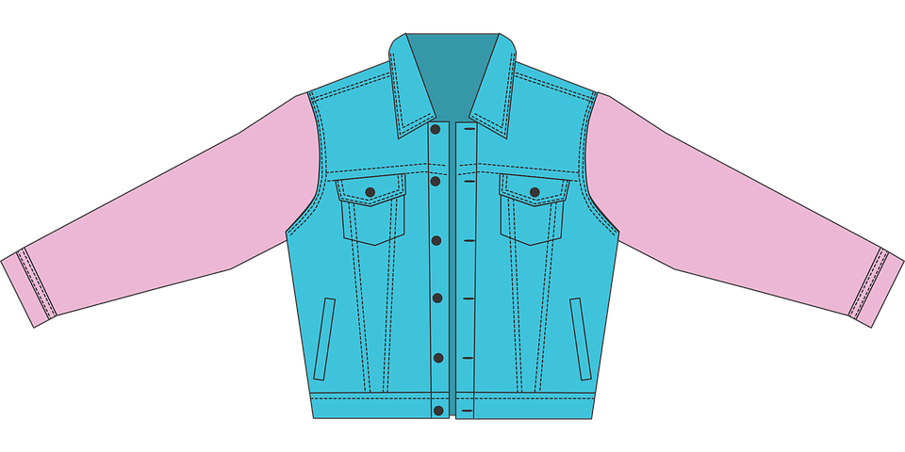
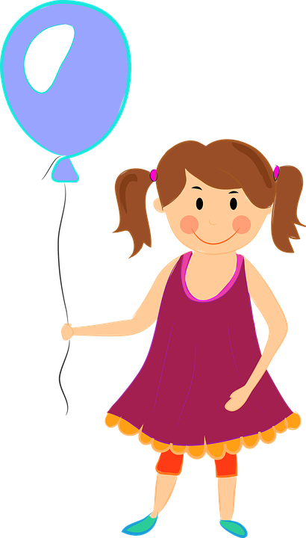
aussprechen
[a] oder [ä]?
Schreib den Buchstaben*
…
der Buchstabe – letter
Fußb ä lle
S a mst a ge
J a cken
M ä nner
S ä tze
Ä pfel
T a schen
T a ge
M ä dchen
Str ä nde
1
6
2
7
3
8
4
9
5
10
Notes:
Timing: 1 minute
Aim: to consolidate the SSC [ä] and differentiate it from [a] in a Phonics listening task using plurals with and without [ä].
Procedure:
Play the first recording by clicking on the number button. Pupils listen and decide whether they hear [a[ or [ä].
Click to reveal the missing vowel.
Elicit the English meaning.
Continue for items 2-10.
Vocabulary: Buchstabe [2905]
Jones, R.L & Tschirner, E. (2019). A frequency dictionary of German: Core vocabulary for learners. London: Routledge.
6

Slide 7
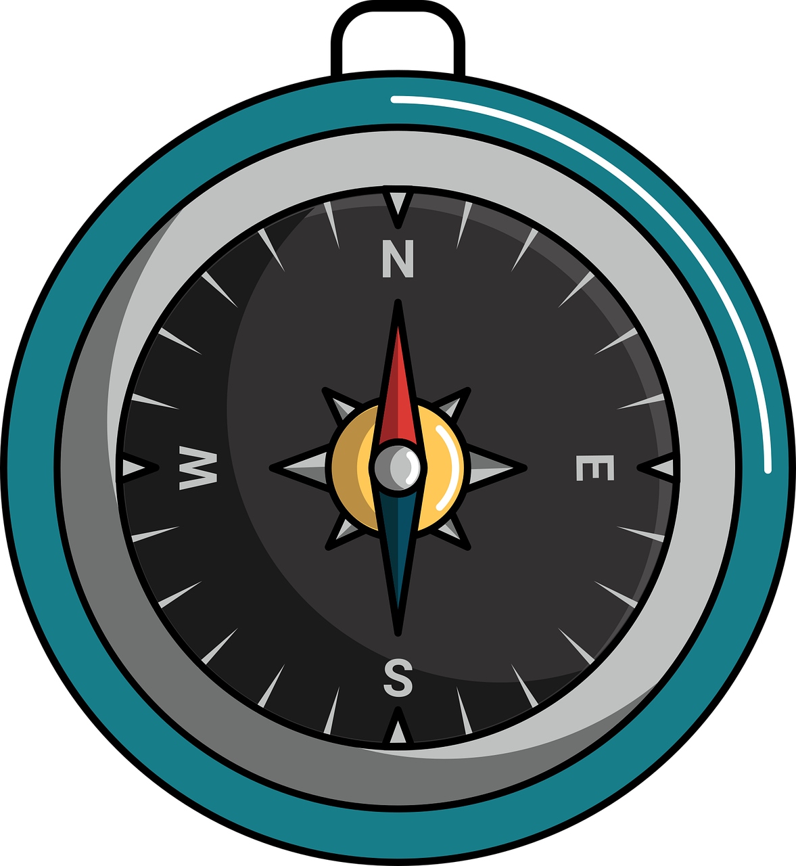
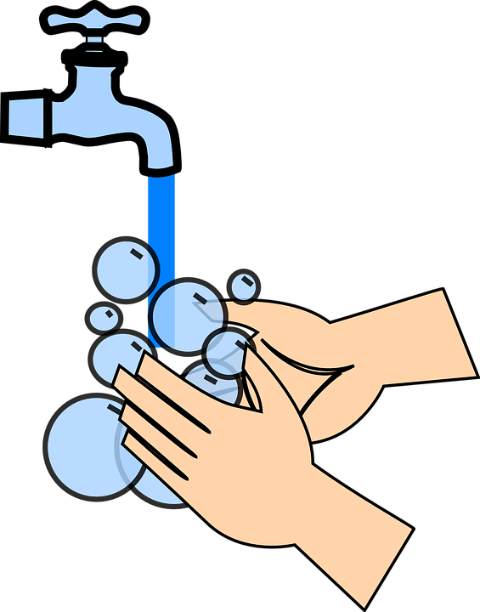
Vokabeln
Use the long form e.g. Norden with the definite article or preposition: im Norden = in the north nach Norden = to/towards the north Use the short form (e.g., Nord) in compounds: Nordafrika = North Africa Nordirland = Northern Ireland
Wörter
Nord, der Norden
[the north]
West, der Westen
Ost, der Osten
[the west]
[the east]
Süd, der Süden
[the south]
Nie ohne Seife waschen.
Never wash without soap!
Notes:
Timing: 5 minutes
Aim: to present and practise written comprehension and read aloud of the new vocabulary for this week.
Procedure: 1. Click for a German word. Elicit pronunciation from pupils.
2. Click for the English meaning and picture prompt. Elicit the German word again.
3. Present all nine words like this, in order.
4. Click for one English meaning to disappear in random order. Elicit the English meaning from pupils. Click for meaning to reappear. Continue with the remaining items.
5. Click for the German word to disappear. Elicit the German from pupils. Click for word to reappear. Continue with the remaining items.
7

Slide 8
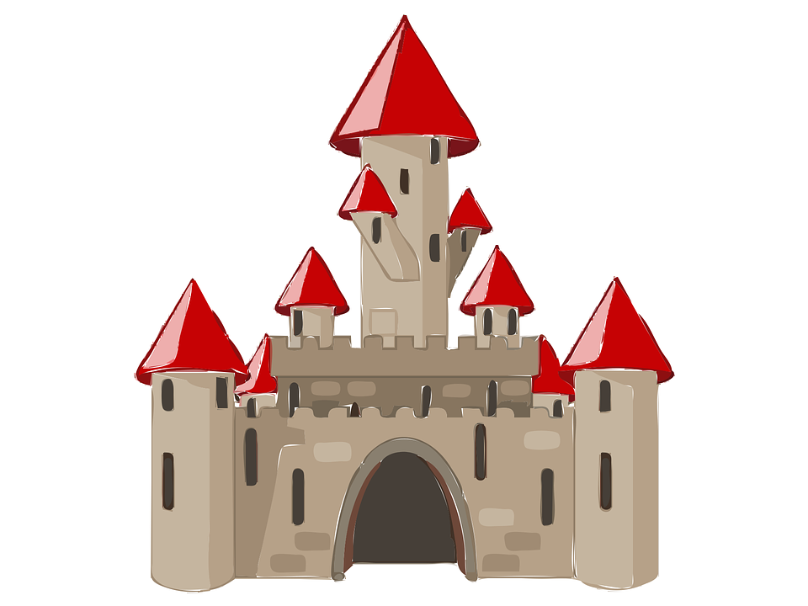
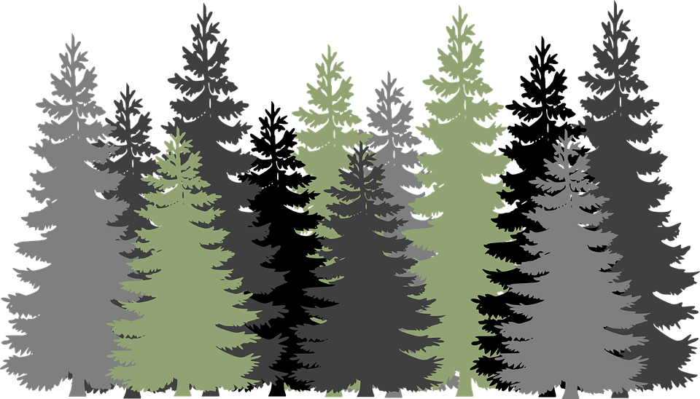
Vokabeln
Hör zu und sag das Wort.
Wörter
S
E
W
der Norden
der Osten
der Süden
der Westen
[(the) North]
[(the) East]
[(the) South)]
[(the) West]
der Fluss
die Insel
das Schloss
[(the) river]
[(the) island]
[(the) castle]
der Strand
der Wald
[(the) beach]
[(the) forest]
Notes:
Timing: 5 minutes
Aim: to present and practise written comprehension and read aloud of the new vocabulary for this week.
Procedure: 1. Click for a German word. Elicit pronunciation from pupils.
2. Click for the English meaning and picture prompt. Elicit the German word again.
3. Present all nine words like this, in order.
4. Click for one English meaning to disappear in random order. Elicit the English meaning from pupils. Click for meaning to reappear. Continue with the remaining items.
5. Click for the German word to disappear. Elicit the German from pupils. Click for word to reappear. Continue with the remaining items.
8

Slide 9
Order of words in a sentence
Remember in + der/das → in dem → im for locations.
You know this common order of words in a German sentence:
die Insel
ist
im Osten.
Word order
1
SUBJECT
VERB
PLACE ADVERB
The island
is
in the East.
Sometimes, we want to start the sentence with the adverb to emphasise it.
When we do this, the adverb and subject swap places.
Im Osten
ist
die Insel.
Word order
2
PLACE ADVERB
VERB
SUBJECT
English hardly ever changes word order like this, and only in phrases like: “And so say all of us!”
The verb position does not change.
Notes:
Timing: 3 minutes
Aim: to explain the order of words in a German sentence, and how this is affected by an initial adverb of place/location.
Procedure:
Click to present the new information.
Elicit the English meaning of the words in the sentence.
Ensure that pupils understand that this change is for emphasis – the essential meaning of the sentence remains the same. It’s also important to point out (with the callout) that we hardly ever do this in English, just in phrases like ‘And so say all of us’!
9

Slide 10
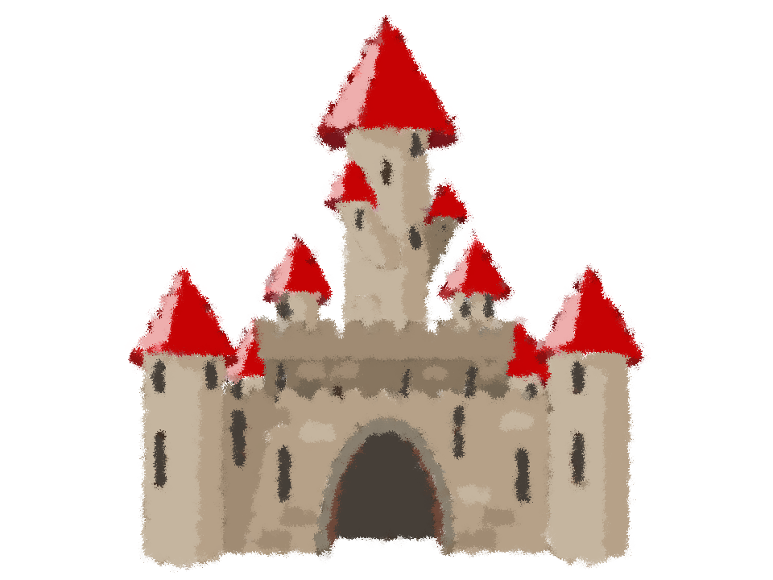
lesen
Johanna und Aisha beschreiben* Deutschland.
Was schreiben Johanna und Aisha?
Deutschland ist sehr schön und bekannt* für viele Dinge…
beschreiben – to describe
bekannt – well-known
1
Im Norden
gibt es eine Insel. Sie heißt Sylt.
-
2
Im Süden
es gibt ein Schloss. Es heißt Neuschwanstein.
-
3
Im Westen
es gibt einen Fluss. Er heißt Ruhr.
-
Im Osten
4
gibt es einen Ort. Er heißt Dresden.
-
Im Norden
5
gibt es eine Sprache. Sie heißt Friesisch.
-
6
Im Süden
es gibt einen Wald. Er heißt Schwarzwald.
-
Notes:
Timing: 8 minutes
Aim: to practise this week’s and previous vocabulary in the context of describing cultural aspects of Germany’s geography.
Procedure:
Explain the scenario.
Pupils identify the correct choice of for item one, based on the syntax of the second part of the sentence.
Click for the incorrect choice to disappear and only the correct choice visible.
Elicit oral translations of each message.
Vocabulary: beschreiben [435]
Jones, R.L & Tschirner, E. (2019). A frequency dictionary of German: Core vocabulary for learners. London: Routledge.
10

Slide 11
Kultur
1
tausend - thousand
5
Was gibt es wo in Deutschland?
4
1
Im Osten ist der Ort
Dresden sehr bekannt. 550,000 Menschen wohnen dort.
Im Norden gibt es die
Insel Sylt. Auf Sylt gibt es viele Strände.
3
5
2
4
In Deutschland sprechen die Menschen Deutsch, und im Norden sprechen sie auch Friesisch.
Das Schloss im Süden heißt Neuschwanstein. Es ist wie Cinderellas Schloss von Disney.
6
Der Schwarzwald ist viele tausend Jahre alt. Dort gibt es viele Bäume.
3
Die Ruhr ist ein Fluss im Westen. Viele Menschen wohnen an der Ruhr.
6
2
Notes:
Timing: 5 minutes
Aim: to present some cultural information and to practise new vocabulary for this week in the reading modality.
Procedure:
Click for the information to appear for each location 1-6.
Click to highlight (word by word) all of this week’s new vocabulary and elicit individual word and then full sentence meanings, supporting pupils to work out meanings, where necessary.
Frequency of unknown words:
tausend [1177]
Jones, R.L & Tschirner, E. (2019). A frequency dictionary of German: Core vocabulary for learners. London: Routledge.
11

Slide 12
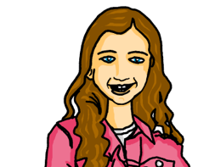
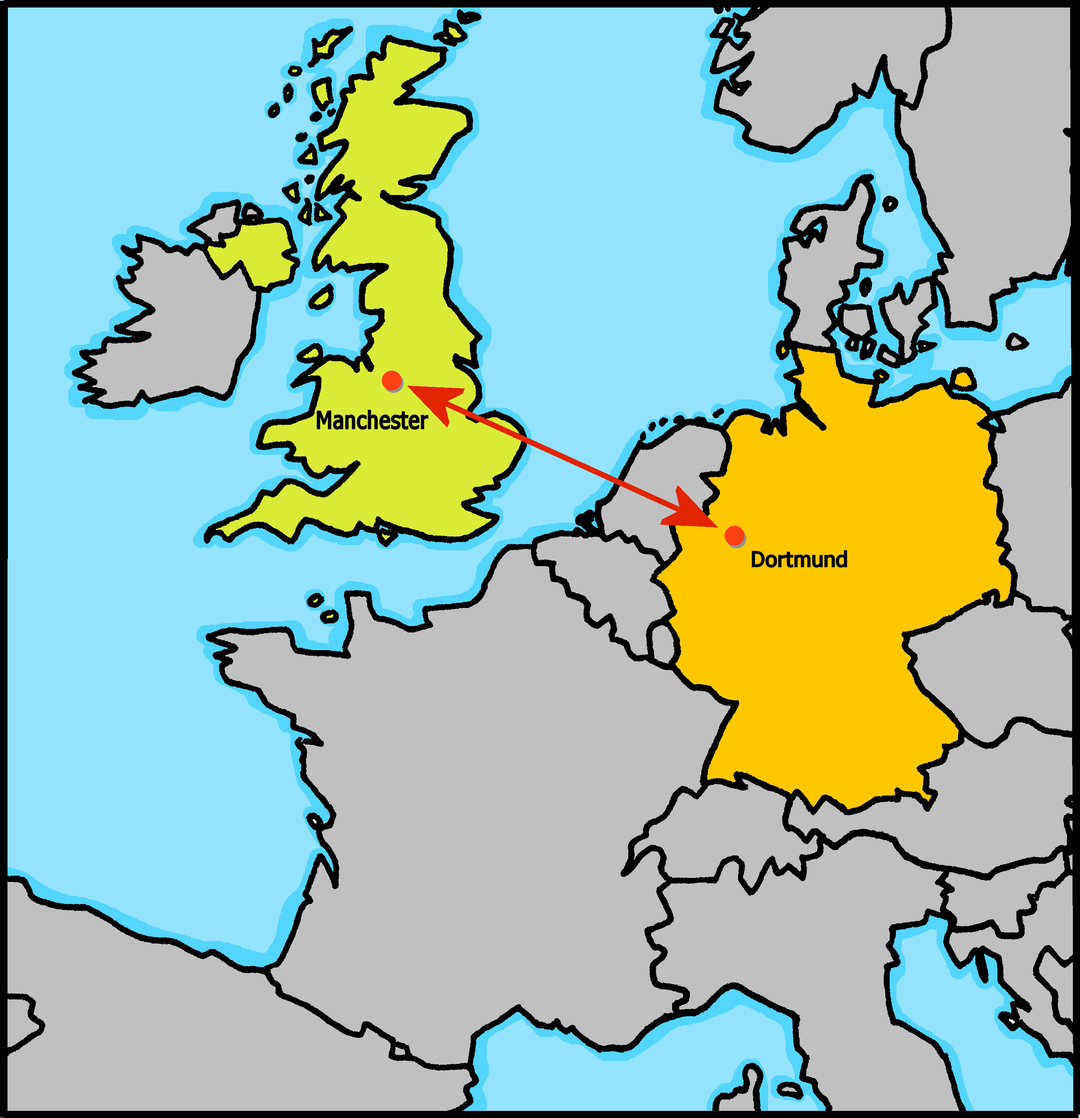
hören
Johanna und Aisha geben die Präsentation über Deutschland, aber es gibt ein Problem mit dem Mikro*!
Hör zu. Was sagen Johanna und Aisha?
A | B
Im Norden | _
_ | Im Süden
Im Osten | _
Im Westen | _
_ | Im Süden
Im Norden | -
1
2
3
4
5
6
das Mikro (informal) - microphone
Notes:
Timing: 5 minutes
Aim: to practise aural distinction between WO1 and WO2 (es gibt / gibt es).
Procedure:
Click to listen to sentences with the beginnings obscured by ‘interference’.
Pupils select the correct beginning – A or B.
3. Click to elicit and confirm answers.
Transcript:
[Im Norden] gibt es zwei Sprachen.
[-] Es gibt das Schloss Neuschwanstein.
[Im Osten] gibt es den Ort Dresden.
[Im Westen] gibt es den Fluss Ruhr.
[-] Es gibt den Wald ‘Schwarzwald’ mit vielen Bäumen.
[-] Es gibt die Sprache Deutsch UND die Sprache Friesisch.
12

Slide 13
Tschüss!
blau
Notes:
13

