Slide 1
Exploring
blau
Follow ups 1-5
Term 2 Week 2
Notes:
Artwork by Steve Clarke. Pronoun pictures from NCELP (www.ncelp.org). All additional pictures selected from Pixabay and are available under a Creative Commons license, no attribution required.
Phonics: [ö] vs. [o]
long [ö] König [1087] Österreich [707] Wörter [194]
short [ö] Köpfe [279] öffnen [508] zwölf [1080]
long [o] wo? [94] wohnen [380] Million [206]
short [o] Kopf [279] offen [382] kommen [61]
Vocabulary: bekommen [212] bleiben [113] lesen [305] machen [58] schreiben [184] sein [3] spielen [205] Abend [342] Essen [323] Film [505] Geschichte [262] Hauaufgabe(n) [n/a] Morgen [621] Nachmittag [1464] Schule [359] heute [116] manchmal [382] oft [223] nie [196] jeden Tag [n/a]
Revisit 1: sehen [79] vergessen [584] nichts [109] Sprache [421] Wochenende [1243] immer [64] jetzt [72] Revisit 2: suchen [293] tanzen [1497] trinken [634] genug [498] Jones, R.L & Tschirner, E. (2019). A frequency dictionary of German: Core vocabulary for learners. London: Routledge.
The frequency rankings for words that occur in this PowerPoint which have been previously introduced in these resources are given in the SOW and in the resources that first
introduced and formally re-visited those words.
For any other words that occur incidentally in this PowerPoint, frequency rankings will be provided in the notes field wherever possible.

Slide 2
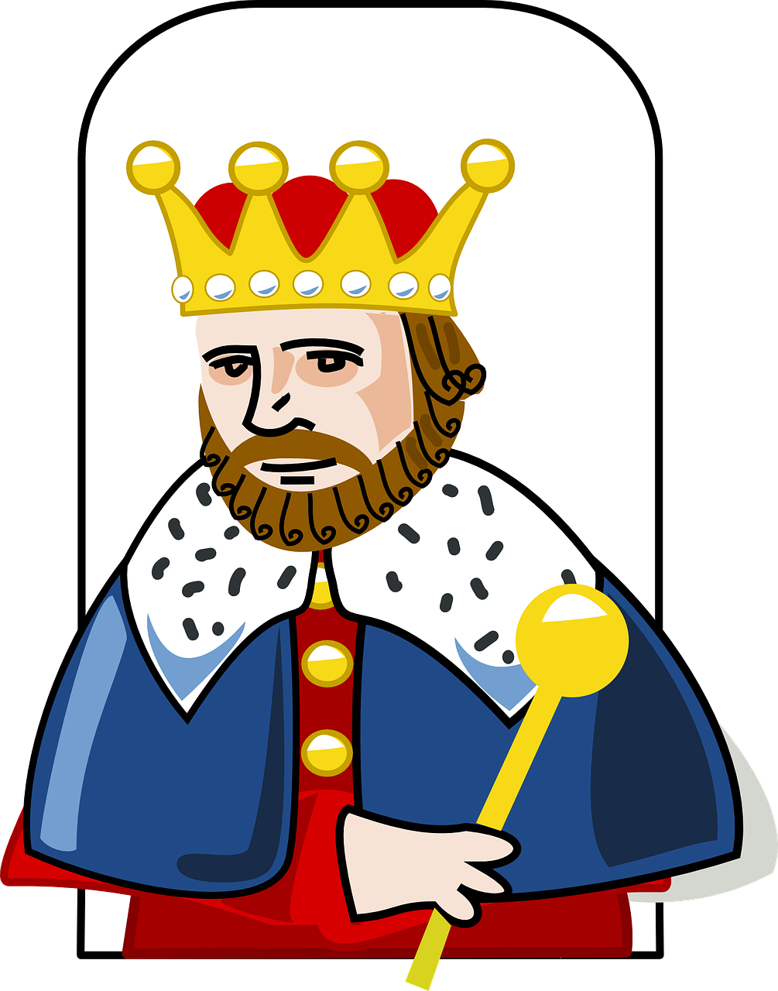
aussprechen
…
long [o] short [o] long [ö] short [ö]
Kopf
wo
König
Köpfe
Notes:
Timing: 1 minute
Aim: to revisit the SSC long [o], short [o], long [ö], short [ö]!
Procedure:
Re-present the SSC and the first of the four source words ‘wo’ (with gesture, if using).
Click to bring on the picture and get pupils to repeat the word.
Present the other three source words in the same way, bringing on first the word the the picture and getting pupils to pronounce the words.
long [ö] König [1087]
short [ö] Köpfe [279]
long [o] wo? [94]
short [o] Kopf [279]
Jones, R.L & Tschirner, E. (2019). A frequency dictionary of German: Core vocabulary for learners. London: Routledge.

Slide 3
aussprechen
Follow up 1:
Lies die Städtenamen*. Ist das [o] oder [ö]?
…
xxxxxxxxxxxxxxxxxxxxxxxx
Rostock
aussprechen
Oldenburg
Städtenamen – town names
30
Osnabrück
Großröhrsdorf
Böhlen
Österreich isn’t a town, but a country of course!
Hohenmölsen
Koblenz
Heilbronn
Bad Kötzting
Österreich
Schönwald
Moschendorf
Köniz
Königsdorf
0
Lugano
Mayrhofen
START
Notes:
Timing: 3 minutes
Aim: to practise the SSCs [o] and [ö].
Procedure:
Before you start, point out that all arrows point to towns in Germany, Austria and Switzerland, but one of them is the odd one out. Which one and why? (Österreich – a country). Click to bring out a callout explaining /confirming this. Then:
Pairwork: One pupil selects 5 town names in their head.
The other pupil reads out town names, trying to ‘guess’ which ones their partner has chosen within the 30 seconds on the timer.
Click the timer to start the game.
Pupils swap roles.
3

Slide 4
Follow up 2
Hör zu.
Remember! Hausaufgaben is Haus (house, home) plus Aufgabe (task, job) → homework!
A Schreib das Verb auf Englisch.
hören
B Schreib die Details auf Englisch.
B.
you do | you get | you read
 | wann? | was? / wo?
B. | today | homework
1 | sometimes | stories
2 | in the mornings | football
3 | in the evening | at home
4 | every day | homework
5 | now | a film (at school)
1
you read | your write | you play
2
do you play | you play | you do
3
you are staying | you are writing | are you staying
4
you do | you get | do you do
5
you do | you are doing | are you doing
Notes:
Timing: 5 minutes
Aim: to practise aural comprehension of this week’s new vocabulary
Procedure:
Click to listen. pupils circle the correct answer (if they have the sheet printed). If not, they can use numbers 1,2.3. Click for answers.
Bring up Section B instruction. Pupils listen again and write the corresponding details into the table in Section B.
Click to reveal answers. After the Beispiel, click to bring up a reminder about Hausaufgaben meaning.
Transcript: B. Ihr bekommt heute Hausaufgaben. [you get]
1. Ihr lest manchmal Geschichten. [you read]
2. Morgens spielt ihr Fußball. [you play]
3. Am Abend bleibt ihr zu Hause. [you stay]
4. Macht ihr jeden Tag Hausaufgaben? [do you do]
5. Ihr macht jetzt einen Film in der Schule. [you are doing]

Slide 5
Follow up 3
Schatzsuche*
Schatzsuche – treasure hunt
Such den Schatz!
Reminder: the du form of sehen ist siehst!
sprechen
spielen
bleiben
bekommen
sehen
machen
schreiben
Du
Du siehst Filme.
Ihr
Ihr macht Hausaufgaben.
Ihr ?
Bleibt ihr zu Hause?
Notes:
slide 1 of 2 – example and instruction slide.
Timing: 8 minutes for two slides.
Aim: to practice this week’s vocabulary and the second persons singular and plural verbs.
Procedure:
Pupils use the table to make sentence e.g.
Pupils choose a square. If they say the sentence correctly, click on the relevant square. There may or may not be a treasure (Schatz) underneath.
Black square: Siehst du einen Film? (NB callout re the ‘ e→ ie’ in the du form). Red square: Ihr macht Hausaufgaben. Yellow square: Bleibt ihr zu Hause?
When the task is clear, click for the next slide to do the taks with the complete table. The noun phrases are the same, but the treasures are in different places.
Note: noun phrases:
Fussball spielen, zu Hause bleiben, Essen bekommen,, Filme/einen Film sehen, Hausaufgaben machen, Geschichten schreiben Additional task suggestions: 1. Elicit English translations.
Vocabulary:
Schatz [2649] Suche [1508]
Jones, R.L & Tschirner, E. (2019). A frequency dictionary of German: Core vocabulary for learners. London: Routledge.

Slide 6
Follow up 3
Schatzsuche*
Schatzsuche – treasure hunt
Such den Schatz!
Reminder: the du form of sehen ist siehst!
sprechen
spielen
bleiben
bekommen
sehen
machen
schreiben
Du
Ihr
Ihr ?
Notes:
slide 2 of 2 – task slide. Procedure on previous slide.

Slide 7
Follow up 4:

Schreib auf Englisch.
Can you get at least 15 points?
Wörter
 | tanzen | nie | genug
 | suchen | trinken | jetzt
 | die Sprache | vergessen | das Wochenende
 | nichts | immer | sehen
 | nachmittags | der Nachmittag | der Abend
 | abends | jeden Tag | der Morgen
to dance, dancing
never
enough
Vokabeln
x3
to search, look for
to drink
now
(the) language
to forget, forgetting
(the) weekend
x2
nothing
always
to see, seeing
in the afternoons
(the) afternoon
(the) evening
x1
in the evenings
every day
(the) morning
Notes:
Timing: 5 minutes
Aim: to practise written production of vocabulary from this and revisited weeks.
Procedure: 1. Give pupils a blank grid. They fill in the German meanings of any of the words they know, trying to reach 15 points in total. 2. Remind pupils that adjectives can refer to male or female persons and they should note this in their translations. E.g. pleased (f), short (m).
Note: The most recently learnt and practised words are pink, words from the previous week are green and those from week 1 are blue, thus more points are awarded for them, to recognise that memories fade and more effort (heavy lifting!) is needed to retrieve them.

Slide 8
Follow up 4:

Schreib auf Deutsch.
Can you get at least 15 points?
Wörter
 | to drink, drinking | enough | never
 | now | to search, look for | to dance, dancing
 | (the) weekend | always | (the) language
 | to see, seeing | to forget, forgetting | nothing
 | in the evenings | in the afternoons | in the mornings
 | (the) evening | (the) afternoon | every day
trinken
genug
nie
Vokabeln
x3
jetzt
suchen
tanzen
das Wochenende
immer
die Sprache
x2
sehen
vergessen
nichts
abends
nachmittags
morgens
x1
der Abend
der Nachmittag
jeden Tag
Notes:
Timing: 5 minutes
Aim: to practise written production of vocabulary from this and revisited weeks.
Procedure: 1. Give pupils a blank grid. They fill in the German meanings of any of the words they know, trying to reach 15 points in total. 2. Remind pupils that adjectives can refer to male or female persons and they should note this in their translations. E.g. pleased (f), short (m).
Note: The most recently learnt and practised words are pink, words from the previous week are green and those from week 1 are blue, thus more points are awarded for them, to recognise that memories fade and more effort (heavy lifting!) is needed to retrieve them.

Slide 9
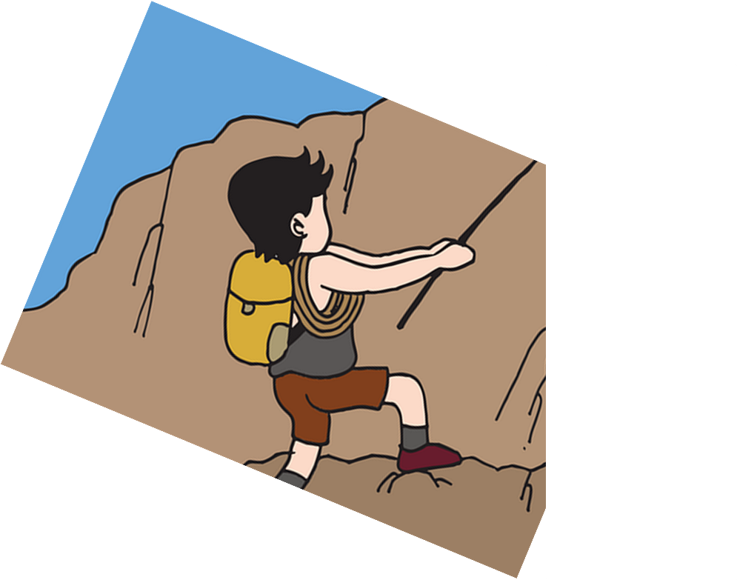
Follow up 5:
Sag den Satz auf Deutsch.
Are you making a film in the evening?
sprechen
ein Spiel
einen Film
Hausaufgaben
5
oft
jeden Tag
abends
am Abend
4
3
macht
ihr
du
machst
2
Machst
Du
Ihr
Macht
1
Notes:
Timing: 5 minutes [5 slides, 5 items] Slide 1/5
Aim: to practise spoken production of sentences using this week’s vocabulary and target structures.
Procedure:
Tell students they need to use the words, starting from the bottom, to climb up the mountain (so that they translate the sentence!).
Ask students to work in pairs to practise first.
Click to trigger the timer (15 seconds per sentence).
Ask a volunteer from a pair to say the German sentence out loud.
Move to the next slide to see the answers.
Repeat with the next 4 sentences (there are 5 in total).

Slide 10
Follow up 5:
Sag den Satz auf Deutsch.
Are you making a film in the evening?
sprechen
ein Spiel
einen Film
Hausaufgaben
oft
jeden Tag
abends
am Abend
macht
ihr
du
machst
Machst
Du
Ihr
Macht
Notes:
ANSWER [1/5]
Procedure:
Click on the English version of the sentence to hear the German sentence audio.

Slide 11
Follow up 5:
Sag den Satz auf Deutsch.
You all write stories every day.
sprechen
ein Eis
ein Buch
Geschichten
5
nie
jeden Tag
abends
heute
4
3
schreibt
ihr
du
schreibst
2
Schreibst
Du
Ihr
Schreibt
1
Notes:
Slide 2/5

Slide 12
Follow up 5:
Sag den Satz auf Deutsch.
You all write stories every day.
sprechen
ein Eis
ein Buch
Geschichten
nie
jeden Tag
abends
heute
schreibt
ihr
du
schreibst
Schreibst
Du
Ihr
Schreibt
Notes:
ANSWER [2/5]

Slide 13
Follow up 5:
Sag den Satz auf Deutsch.
Are you all singing songs in the morning?
sprechen
Songs
ein Lied
Bilder
5
heute
morgens
abends
am Morgen
4
3
singt
ihr
du
singst
2
Singst
Du
Ihr
Singt
1
Notes:
Slide 3/5

Slide 14
Follow up 5:
Sag den Satz auf Deutsch.
Are you all singing songs in the morning?
sprechen
Songs
ein Lied
Bilder
heute
morgens
abends
am Morgen
singt
ihr
du
singst
Singst
Du
Ihr
Singt
Notes:
ANSWER [3/5]

Slide 15
Follow up 5:
Sag den Satz auf Deutsch.
You are playing football in the afternoon.
sprechen
Hausauf-gaben
Fußball
ein Spiel
5
heute
nachmittags
am Nachmittag
4
3
spielt
ihr
du
spielst
2
Spielst
Du
Ihr
Spielt
1
Notes:
Slide 4/5

Slide 16
Follow up 5:
Sag den Satz auf Deutsch.
You are playing football in the afternoon.
sprechen
Hausauf-gaben
Fußball
ein Spiel
heute
nachmittags
am Nachmittag
spielt
ihr
du
spielst
Spielst
Du
Ihr
Spielt
Notes:
ANSWER 4/5

Slide 17
Follow up 5:
Sag den Satz auf Deutsch.
Are you reading stories on Tuesday?
sprechen
ein Buch
Computer
Geschichten
5
dienstags
am Dienstag
4
montags
nie
3
liest
ihr
du
lest
2
Liest
Du
Ihr
Lest
1
Notes:
Slide 5/5

Slide 18
Follow up 5:
Sag den Satz auf Deutsch.
Are you reading stories on a Tuesday?
sprechen
ein Buch
Computer
Geschichten
dienstags
montags
nie
am Dienstag
liest
ihr
du
lest
Liest
Du
Ihr
Lest
Notes:
ANSWER 5/5

Slide 19
Tschüss!
blau
Notes:
19

Slide 20
Follow up 4:

Schreib auf Englisch.
Can you get at least 15 points?
Wörter
 | tanzen | nie | genug
 | suchen | trinken | jetzt
 | die Sprache | vergessen | das Wochenende
 | nichts | immer | sehen
 | nachmittags | der Nachmittag | der Abend
 | abends | jeden Tag | der Morgen
Vokabeln
x3
x2
x1
Notes:
handout

Slide 21
Follow up 4:

Schreib auf Deutsch.
Can you get at least 15 points?
Wörter
 | to drink, drinking | enough | never
 | now | to search, look for | to dance, dancing
 | (the) weekend | always | (the) language
 | to see, seeing | to forget, forgetting | nothing
 | in the evenings | in the afternoons | in the mornings
 | (the) evening | (the) afternoon | every day
Vokabeln
x3
x2
x1
Notes:
handout

