Slide 1
Exploring
Present tense – du vs ihr
WO2 after adverbs of time
SSC [ö] v. [a]
blau
Term 2 Week 2
Notes:
Artwork by Steve Clarke. Pronoun pictures from NCELP (www.ncelp.org). All additional pictures selected from Pixabay and are available under a Creative Commons license, no
attribution required.
Phonics: [ö] vs. [o]
long [ö] König [1087] Österreich [707] Wörter [194]
short [ö] Köpfe [279] öffnen [508] zwölf [1080]
long [o] wo? [94] wohnen [380] Million [206]
short [o] Kopf [279] offen [382] kommen [61]
Vocabulary: bekommen [212] bleiben [113] lesen [305] machen [58] schreiben [184] sein [3] spielen [205] Abend [342] Essen [323] Film [505] Geschichte [262] Hauaufgabe(n) [n/a] Morgen [621] Nachmittag [1464] Schule [359] heute [116] manchmal [382] oft [223] nie [196] jeden Tag [n/a]
Revisit 1: sehen [79] vergessen [584] nichts [109] Sprache [421] Wochenende [1243] immer [64] jetzt [72] Revisit 2: suchen [293] tanzen [1497] trinken [634] genug [498] Jones, R.L & Tschirner, E. (2019). A frequency dictionary of German: Core vocabulary for learners. London: Routledge.
The frequency rankings for words that occur in this PowerPoint which have been previously introduced in these resources are given in the SOW and in the resources that first
introduced and formally re-visited those words.
For any other words that occur incidentally in this PowerPoint, frequency rankings will be provided in the notes field wherever possible.
Note that the first three lessons of the year teach language that can be continuously recycled as lesson routine every lesson in Y5/6.
The idea would be that the class teacher (whether or not s/he teaches the class German can re-use the language as part of the daily routine with the class.
1

Slide 2
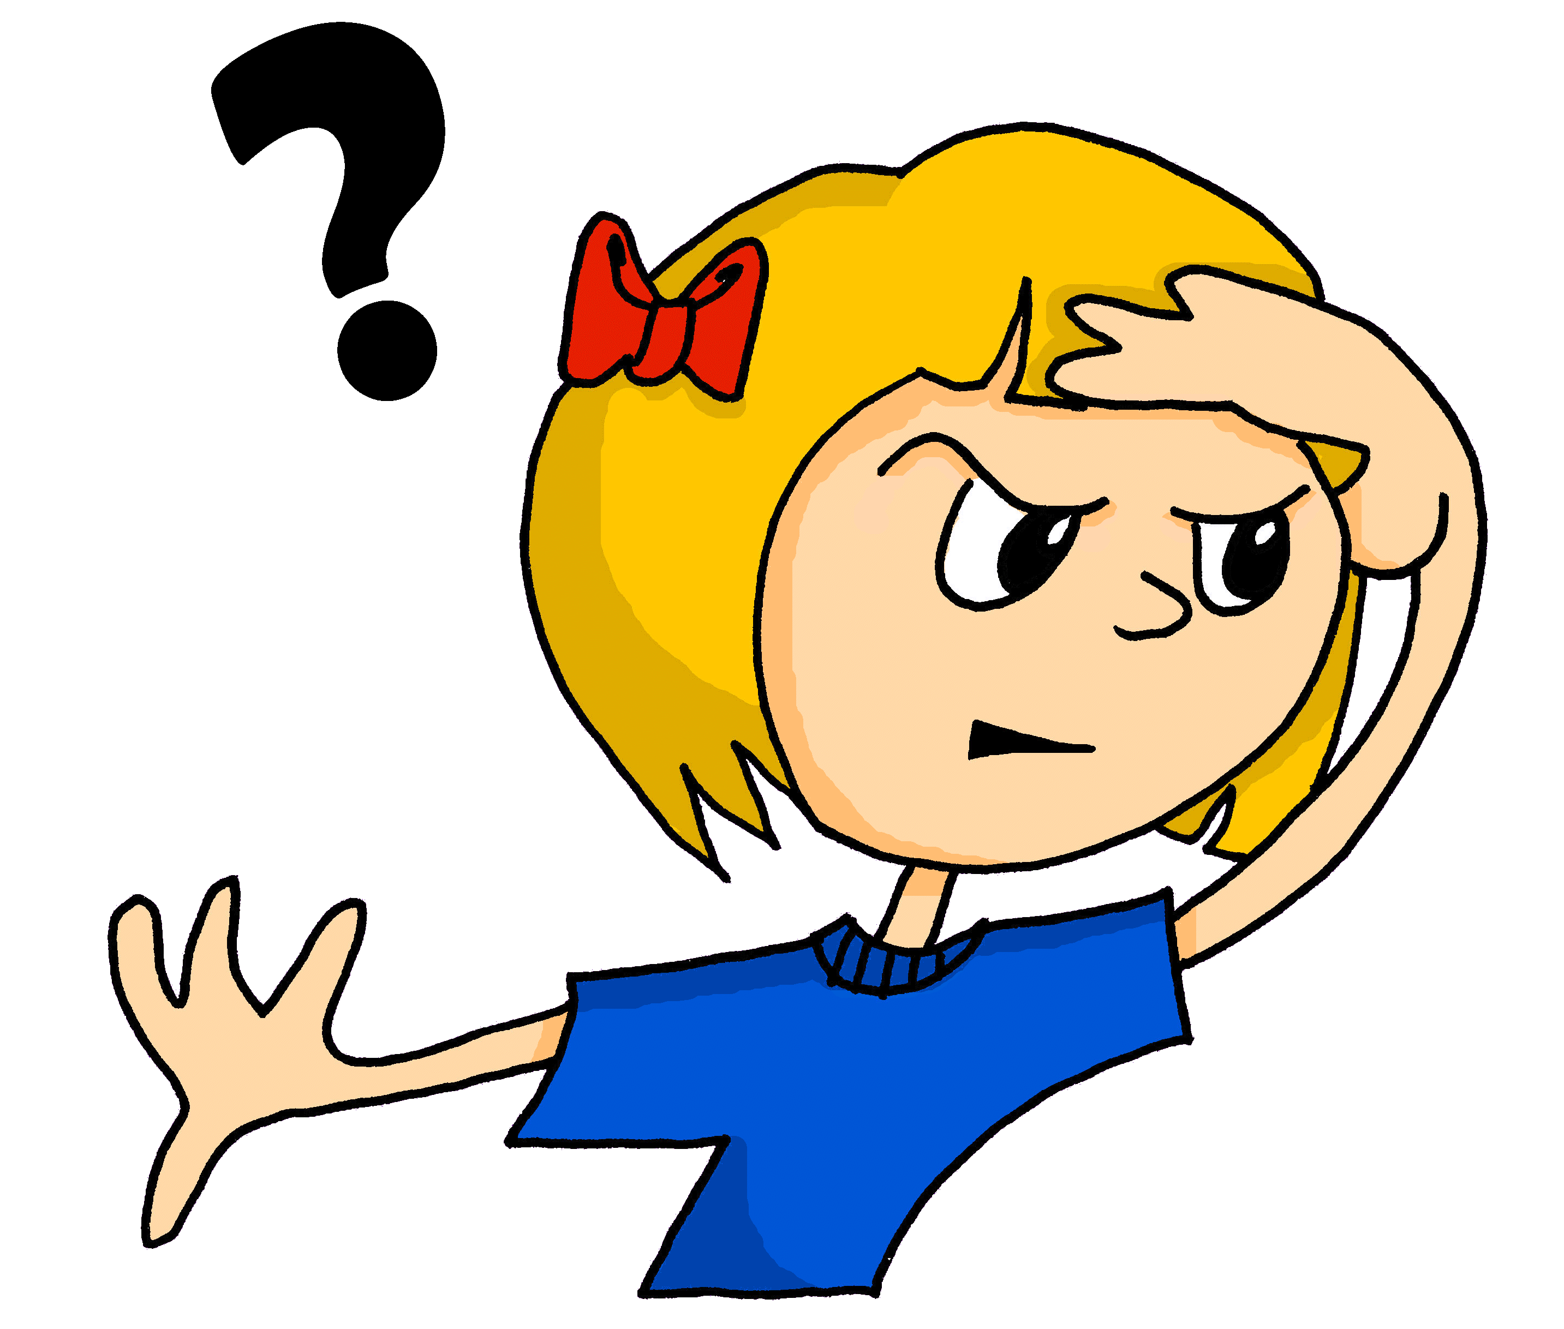
aussprechen
long [o]
…
wo
wohnen
Million
Notes:
Timing: 1 minute
Aim: to revisit the SSC long [o].
Procedure:
Re-present the SSC and the source word ‘wo’ (with gesture, if using).
Click to bring on the picture and get pupils to repeat the word ‘wo’ (with gesture, if using).
Present the cluster words in the same way, bringing on the picture and getting pupils to pronounce the words.
Gesture: mimic the image of ‘wo’? with the character scanning to see ‘where?’ something is.
Word frequency (1 is the most frequent word in German): Million [206]] wo? [94] wohnen [380]
Jones, R.L & Tschirner, E. (2019). A frequency dictionary of German: Core vocabulary for learners. London: Routledge.

Slide 3
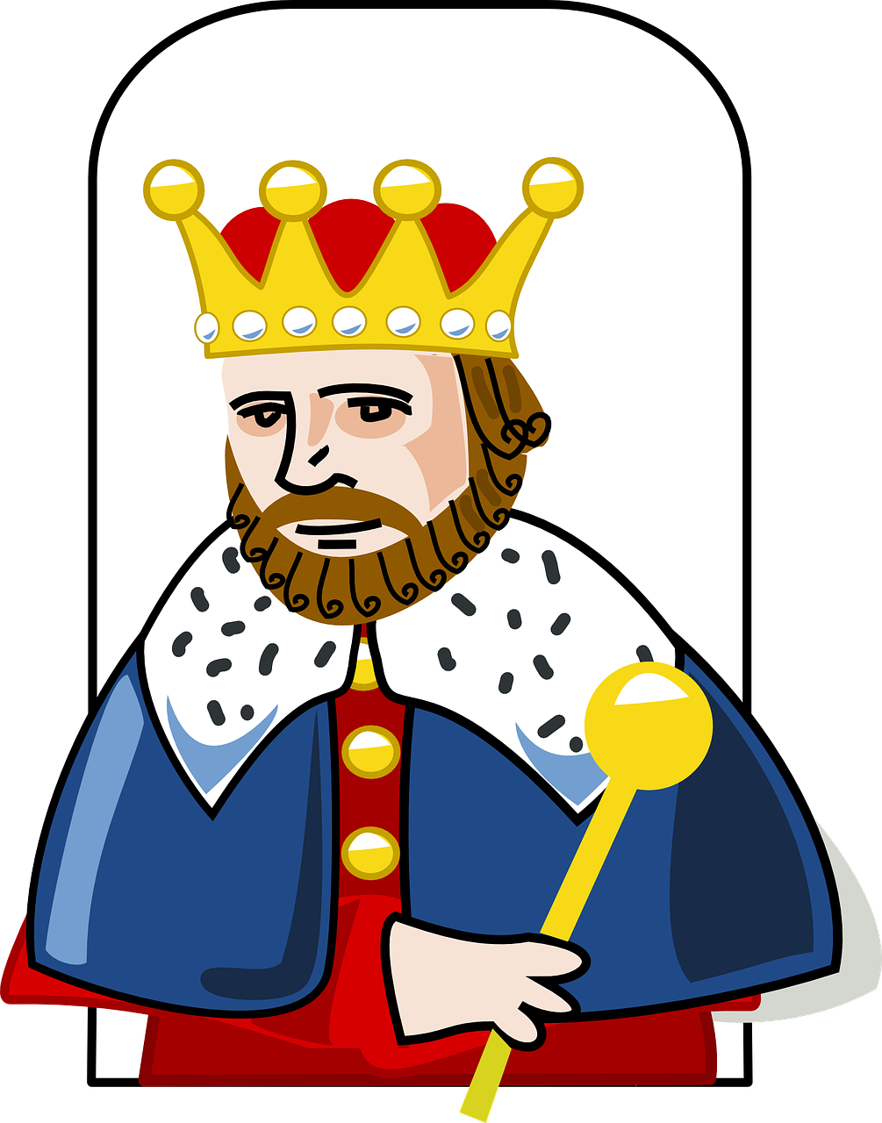
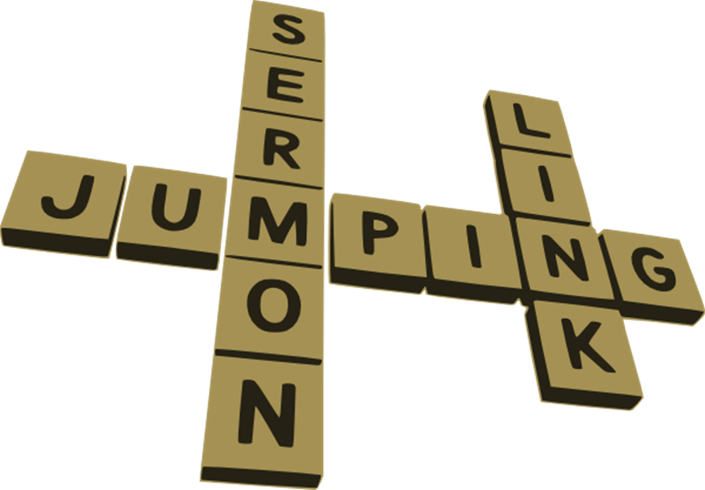
aussprechen
long [ö]
…
Österreich
König
Wörter
[Austria]
[king]
[words]
Notes:
Timing: 1 minute
Aim: to revisit the SSC [ö].
Procedure:
Re-present the SSC and the source word ‘König’ (with gesture, if using).
Click to bring on the picture and get pupils to repeat the word ‘König’ (with gesture, if using).
Present the cluster words in the same way, bringing on the picture and getting pupils to pronounce the words.
Gesture: bring hand to head with hand in a sort of claw shape, fingers towards head (suggesting a crown) and quickly draw the hand up and away from the head, reinforcing the idea of a pointed crown on the head. See the BSL gesture for kind, here: https://www.signbsl.com/sign/king
König [1087] Österreich [707] Wörter [194]
Jones, R.L & Tschirner, E. (2019). A frequency dictionary of German: Core vocabulary for learners. London: Routledge.
3

Slide 4
aussprechen
short [o]
…
kommen
Kopf
offen
kommen – to come
Notes:
Timing: 1 minute
Aim: to consolidate the SSC short [o].
Procedure:
Re-present the SSC and the source word ‘Kopf’ (with gesture, if using).
Click to bring on the picture and get pupils to repeat the word ‘Kopf’ (with gesture, if using).
Present the cluster words in the same way, bringing on the picture and getting pupils to pronounce the words.
Gesture: pupils put their hands to their head.
Word frequency (1 is the most frequent word in German): kommen [61] Kopf [279] offen [382]
Jones, R.L & Tschirner, E. (2019). A frequency dictionary of German: Core vocabulary for learners. London: Routledge.
4

Slide 5
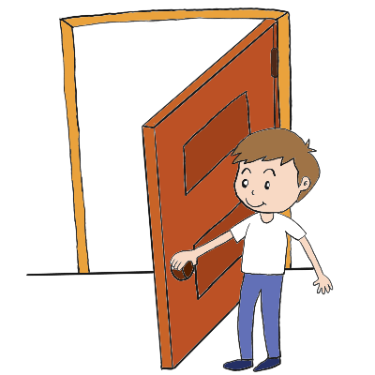
aussprechen
short [ö]
All vowels in German can be long or short, including [ö]. [ö] is usually short when followed by two consonants.
…
12
öffnen
Köpfe
zwölf
[to open]
Notes:
Timing: 1 minute
Aim: to introduce the SSC short [ö].
Procedure:
Present the SSC and the source word ‘Köpfe’ (with gesture, if using).
Click to bring on the picture and get pupils to repeat the word ‘Köpfe’(with gesture, if using).
Present the cluster words in the same way, bringing on the picture and getting pupils to pronounce the words.
Gesture: pupils put their hands to their head but tap twice for the two syllables to suggest more than one, and to reinforce the two syllable plural form.
Kopf [279] öffnen [508] zwölf [1080]
Jones, R.L & Tschirner, E. (2019). A frequency dictionary of German: Core vocabulary for learners. London: Routledge.
5

Slide 6
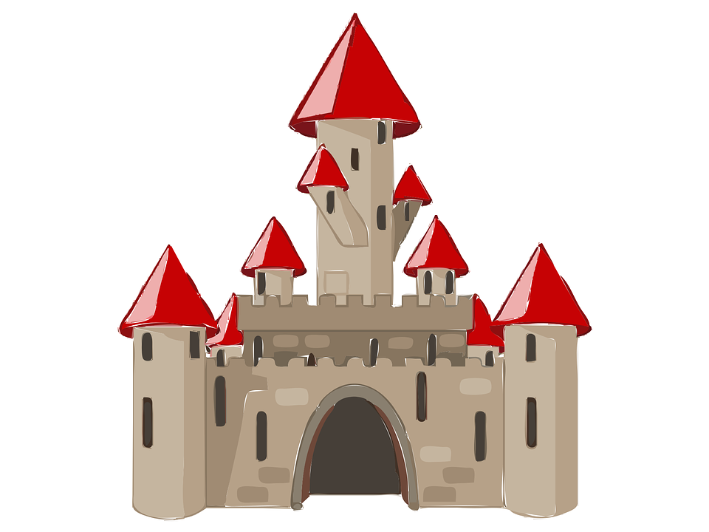
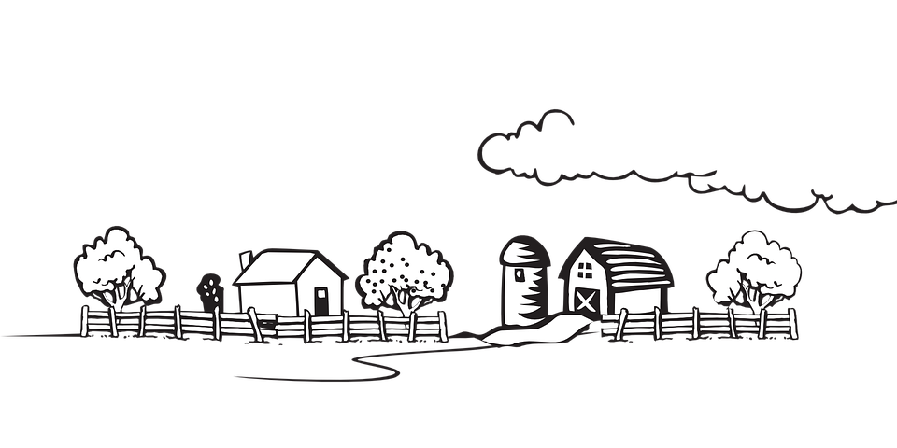
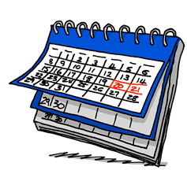
aussprechen
[ö] oder [o]?
Hör zu und schreib [ö] oder [o].
…
 | Bilder | [ö] | [o]
 |  | Wörter
 |  | Schlösser
 |  |  | Personen
 |  | Dörfer
 |  |  | Antworten
 |  |  | Stoffe
 |  |  | Wochenenden
 |  | Vögel
Some words have [o] in singular and [ö] in plural. E.g., der Kopf → die Köpfe. Other plurals keep [o]. Listen carefully – which of these plurals have [ö] and which have [o]?
1
Hallo!
Hallo!
2
3
4
5
6
7
8
Notes:
Timing: 1 minute
Aim: to consolidate the SSC [ö] and differentiate it from [o].
Procedure:
Click to bring up callout explaining that some words do have [o] in singular and [ö] in plural. Click again to disappear callout so that all of the table is visible.
Click on the audio buttons for items 1-8. Pupils decide whether they hear [o] or [ö] and write it down for each item 1-8. Images are provided as clues.
Click to reveal answer ticks and the whole word item by item.
Transcript:
Wörter
Schlösser
Personen
Dörfer
Antworten
Stoffe
Wochenenden
Vögel
6

Slide 7
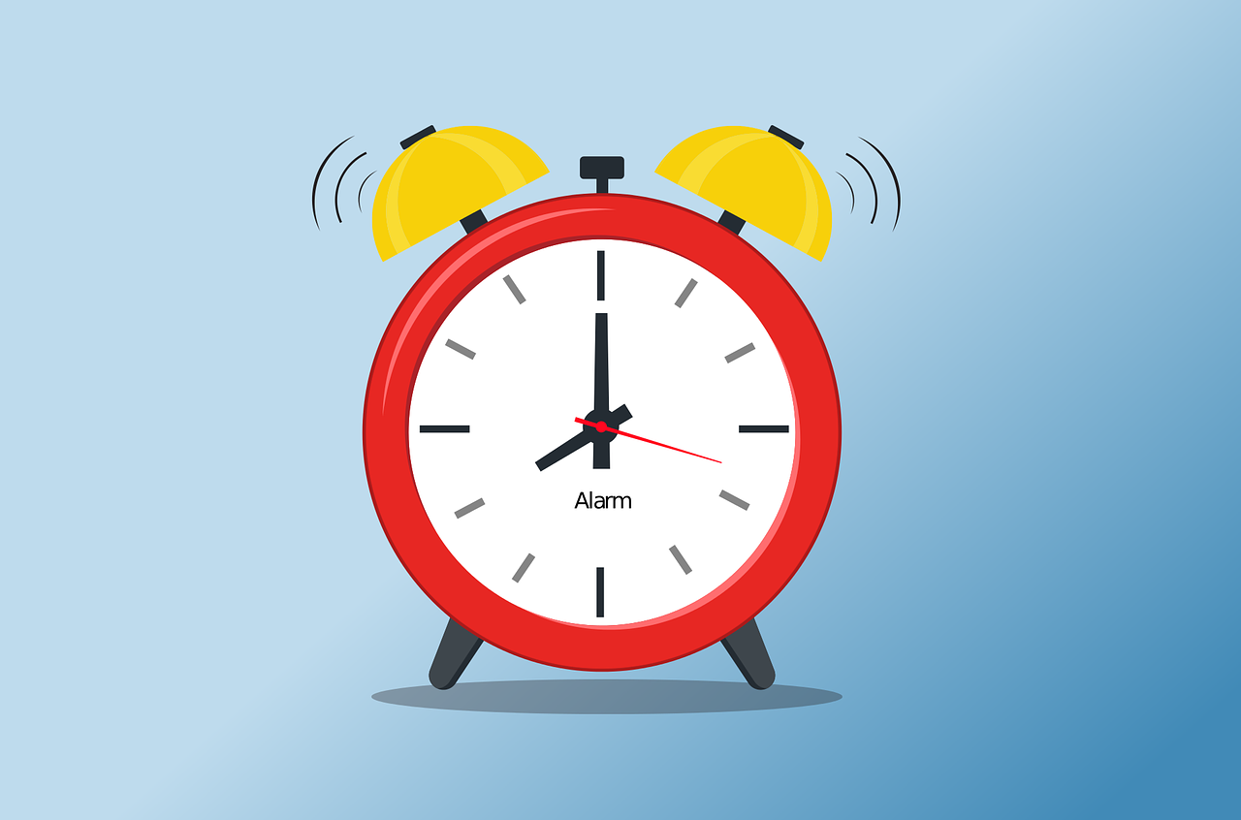
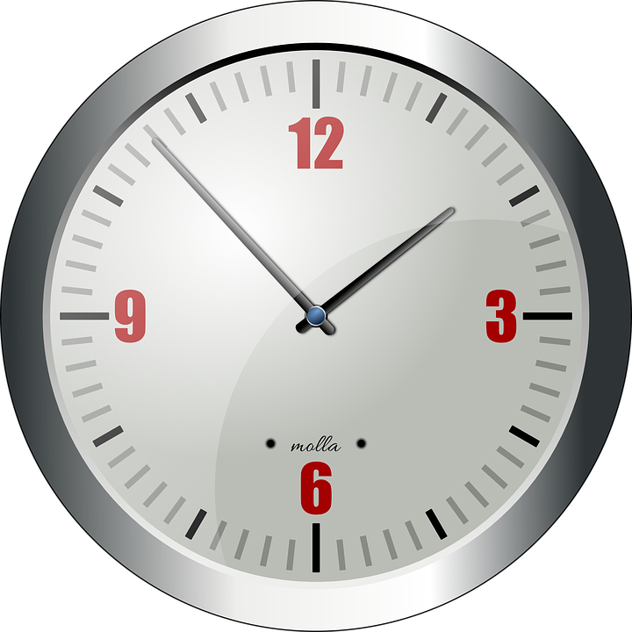
Vokabeln
Hör zu und sag das Wort.
Wörter
You already know how to say (the) morning in German:
am Nachmittag → in the afternoon|this afternoon
nachmittags → afternoons | every afternoon
der Morgen
These two together are:
The German word for afternoon is:
der Tag
der Nachmittag
heute nachmittag
heute morgen
am Abend → in the evening|this evening
abends → evenings | every evening
And after ‘der Tag’ comes:
der Abend
Another way to say ‘this evening’ is ‘heute abend’ (today evening). What would this morning be? And this afternoon?
Notes:
Timing: 5 minutes
Aim: to present and practise written comprehension and read aloud of the new vocabulary for this week.
Procedure: 1. Click through the animations to present known and new times of the day, starting with der Morgen, which pupils already know.
2. Elicit ‘der Tag’ which is der Morgen and der Nachmittag.
3. Click to explain the difference between ‘am + noun’ and final ‘s’ (this, and every).
4. Click to explain the use of ‘heute’ + time of day.
7

Slide 8
Vokabeln
Put these time adverbs in order from most to least frequent. Careful! There is one adverb you can’t use.
Wörter
immer
jeden Tag
oft
manchmal
nie
most frequent
always
every day
often
sometimes
never
least frequent
immer
jeden Tag
manchmal
nie
oft
heute!
heute
Notes:
Timing: 5 minutes
Aim: to present and practise written comprehension and read aloud of the new vocabulary for this week.
Procedure: 1. Explain that the task is to put the time adverbs in order from most to least frequent, but that there is one adverb which pupils can’t use (heute).
2. Click for each adverb in turn to move to the timeline in order of frequency.
3. ‘Heute’ will be left over!
4. Click for the German meanings to disappear in order and elicit the English meaning.
5. ‘Reverse the flow’ by eliciting the German again, which will reappear in order form left to right alongside the English as you click.
8

Slide 9
Present tense: du (you) | ihr (you all)
Remember! English has two present tenses, but German only has one!
Remember! To mean ‘you’ to one person, use du:
Du schreibst Geschichten.
You write stories.
You are writing stories.
The time adverb in English suggests which present tense to use. E.g., Every day you … write | are writing stories.
To mean ‘you all’ or ‘you both’, use ihr:
Ihr schreibt Geschichten.
You (all) write stories.
You (all) are writing stories.
Notes:
Timing: 2 minutes
Aim: to recap the 2nd person singular (‘you) and plural form (‘you all’) of regular present tense.
Procedure:
Click through the animations to present the information.
Elicit English translation for the German examples provided.
9

Slide 10
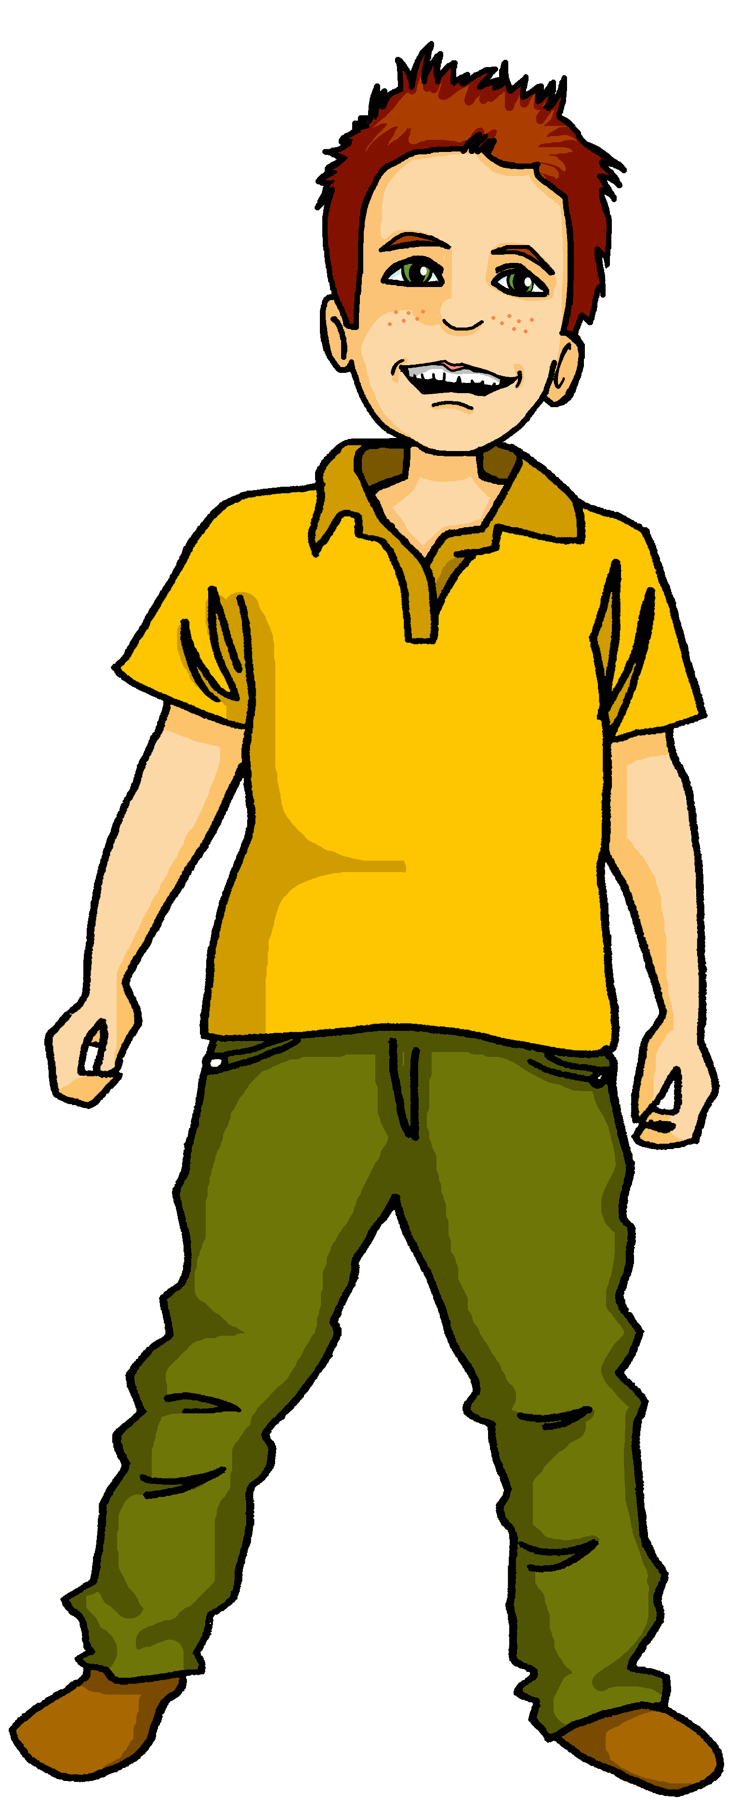
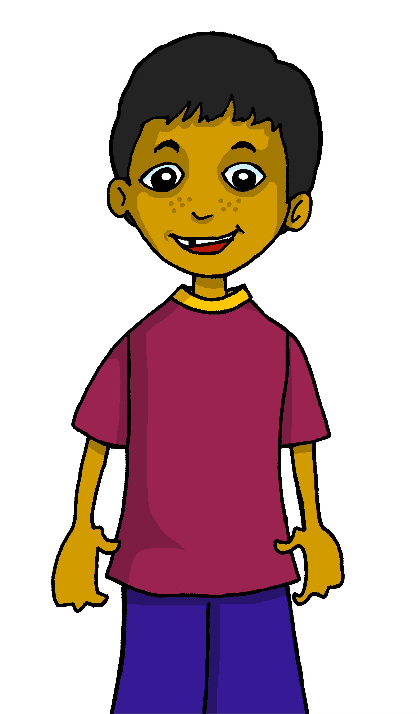
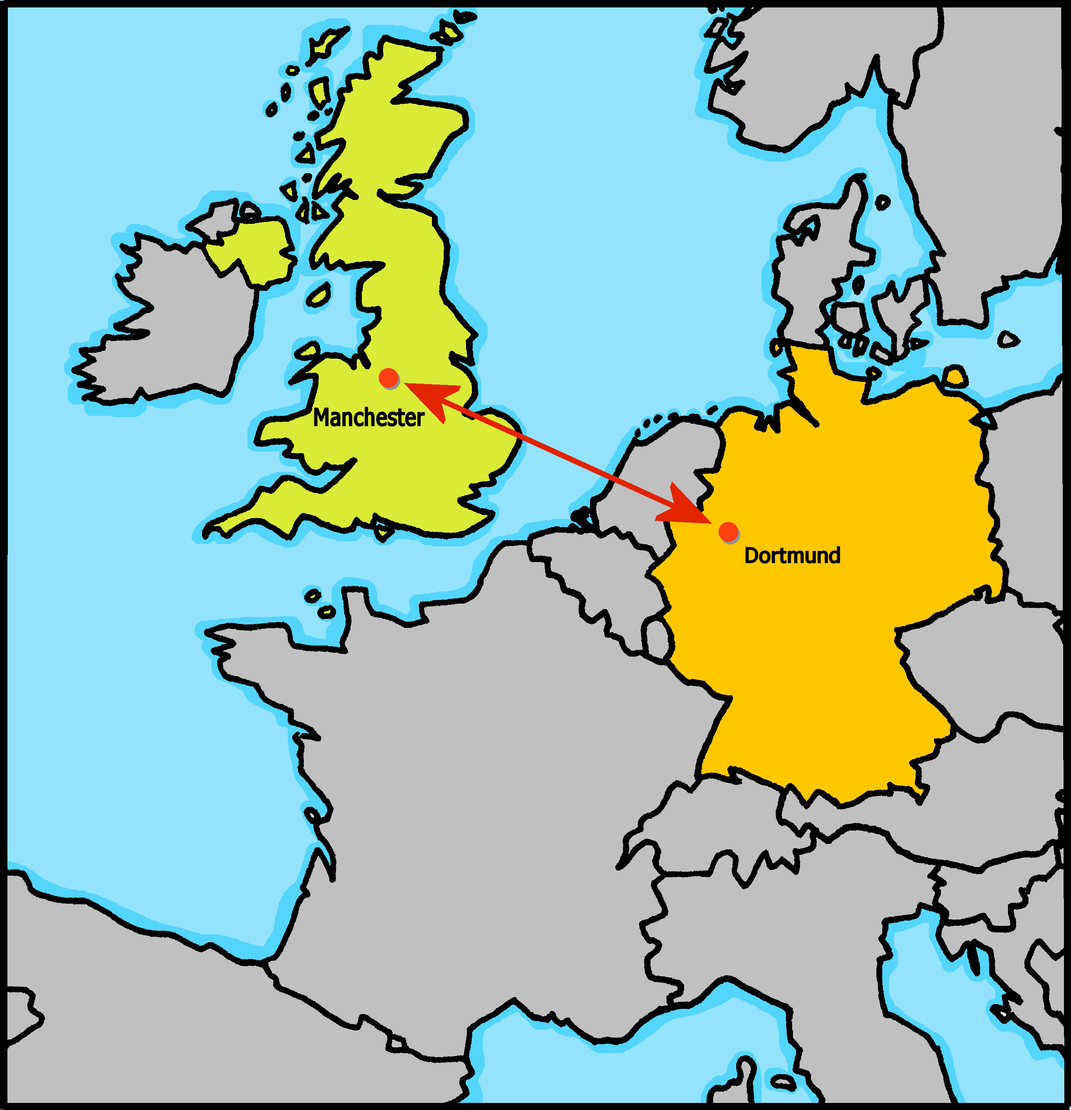
hören
Moritz und Hamsa fragen* die Klasse in Manchester.
Hör zu. Was sagen Moritz und Hamsa? ‘Du’ oder ‘ihr’?
du | ihr | was?
 |  | _{get much homework}
 |  | write stories
 |  | read books
 |  | play football
 |  | sometimes use computers
 |  | study at home in the afternoons
 |  | watch films in the evening
B.
1
2
3
4
5
6
fragen – to ask
Notes:
Timing: 5 minutes
Aim: to practise aural distinction between WO1 and WO2 (es gibt / gibt es).
Procedure:
Moritz and Hamza are doing an exchange class survey asking questions of the Manchester class. Are they asking one person or all of them?
Play the example with the pronoun bleeped out. Pupils select the correct pronoun.
Click to elicit and confirm the answer.
Elicit the English meaning of the question.
Click to elicit and confirm the answer.
Continue for items 1-6.
Transcript:
Beispiel: Bekommt [ihr] viele Hausaufgaben?
1. Schreibst [du] Geschichten?
2. Liest [du] Bücher?
3. Spielt [ihr] Fußball?
4. Benutzt [ihr] manchmal Computer?
5. Lernst [du] normalerweise nachmittags?
6. Seht [ihr] am Abend Filme?
10

Slide 11
Order of words in a sentence
You know we can start a German sentence with the place adverb to emphasize it.
When we do this, the adverb and subject swap places.
This works with time adverbs too.
Jeden Tag
schreibt ihr
Geschichten.
Word order
2
TIME ADVERB
VERB + SUBJECT
OBJECT
Every day
you (all) write
stories.
The verb position stays the same – just the adverb and subject swap around!
English hardly ever changes word order like this, and only in phrases like: “And so say all of us!”
Notes:
Timing: 3 minutes
Aim: to explain the order of words in a German sentence, and how this is affected by an initial adverb of time.
Procedure:
Click to present the information.
Elicit the English meaning of the words in the sentence.
Ensure that pupils understand that this change is for emphasis – the essential meaning of the sentence remains the same. It’s also important to point out (with the callout) that we hardly ever do this in English, just in phrases like ‘And so say all of us’! Pupils already know this from adverbs of place.
11

Slide 12
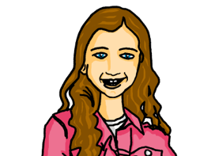
lesen
Johanna stellt* Hamza und Moritz Fragen
Fragen stellen – to ask/put questions
Hamza makes some mistakes. Is A or B the right word order ?
Bekommt ihr jeden Nachmittag Hausaufgaben? Wann macht ihr die Hausaufgaben?
1
A
B
2
A
Wir bekommen wir nachmittags Hausaufgaben.
Abends wir machen wir Hausaufgaben.
B
3
4
You already know Aufgabe (task, job) and Haus (house, home) – together they make Hausaufgaben – homework! It is usually used in the plural form.
Was macht ihr morgens?
A
A
Morgens wir gehen wir in die Schule.
Am Morgen wir singen wir dort einen Song.
B
B
Seht ihr abends Filme? Oder was macht ihr?
5
A
B
6
am Dienstagabend Hamza spielt Hamza Fußball.
Ja, wir sehen wir abends Filme, aber...
A
B
Notes:
Timing: 8 minutes (two slides)
Aim: to distinguish between Word Order 1 or 2, and the different meanings of am Abend / abends in the present tense: once or repeated action.
Procedure:
Explain the scenario: Johanna is asking Moritz and Hamza questions. Read the messages left to right row by row – Johanna asking, M/H answering.
Read Johanna’s first question with the class. Click to bring up callout re the word ‘Hausaufgaben’ (they should know Aufgabe + Haus, but not together as yet). Click again to make callout disappear so you can continue with the rest of the task.
Pupils identify the correct choice for item one, A or B.
Click for the wrong word order to be removed.
Continue with items 2-6.
Click to correct and move on to the next slide.
Note: a comprehension task for the same texts is on the next slide.
Vocabulary: Fragen stellen [N/A]
Jones, R.L & Tschirner, E. (2019). A frequency dictionary of German: Core vocabulary for learners. London: Routledge.
12

Slide 13
lesen
Johanna stellt* Hamza und Moritz Fragen
What do they answer? Does it happen once, or repeatedly?
answers | once | repeated
1
Wir bekommen nachmittags Hausaufgaben.
Abends machen wir Hausaufgaben.
1
We get homework in the afternoons.
2
We do homework in the evenings.
2
3
In the mornings we go to school.
4
In the morning we are singing a song there.
5
We watch films in the evenings.
3
Morgens gehen wir in die Schule.
Am Morgen singen wir dort einen Song.
On Tuesday evening Hamza is playing footie.
6
4
Remember! The time adverb is the clue. E.g. I do homework in the afternoons. (repeated) I am doing homework this afternoon. (once)
5
Ja wir sehen abends Filme, aber am Dienstagabend spielt hat Hamza Fußball.
6
Notes:
Procedure:
Click to bring up the callout to remind pupils how to distinguish between simple and continuous in the present tense.
Pupils translate each sentence (they can do this chorally or write the answers down) and decide if the action is repeated or once.
Elicit oral translations of each message.
Click to reveal and decide if the events / actions are being repeated or happen only once.
13

Slide 14
Tschüss!
blau
Notes:
14

