Slide 1
Exploring
Present tense – sie (they) vs sie (she)
WO2 after adverbs of time
SSC [ü] v. [u]
blau
Term 2 Week 3
Notes:
Artwork by Steve Clarke. Pronoun pictures from NCELP (www.ncelp.org). All additional pictures selected from Pixabay and are available under a Creative Commons license, no
attribution required.
Phonics: [ü] vs. [u]
long [ü] Tür [375] grün [682] müde [2000]
short [ü] fünf [274] Glück [641] wünschen [630]
long [u] du [54] gut [76] super [1772]
short [u] Punkt [248] Nummer [806] dunkel [706]
Vocabulary: no new vocabulary. Instead revisit new vocabulary from the previous two weeks: Fluss [1687] Insel [1029] Norden, Nord- [1516] Osten, Ost- [1208] Schloss [1907] Süden, Süd- [1771] Strand [1966] Wald [1028] Westen, West- [1010] bekannt [319] dort [139] für [17] bekommen [212] bleiben [113] lesen [305] machen [58] schreiben [184] sein [3] spielen [205] Abend [342] Essen [323] Film [505] Geschichte [262] Hauaufgabe(n) [n/a] Morgen [621] Nachmittag [1464] Schule [359] heute [116] manchmal [382] oft [223] nie [196] jeden Tag [n/a]
Revisit 1: Revisit language from Term 1
Revisit 2: Aufgabe [256] Aktivität [1422] Beispiel [94] Bild [253] Blatt, Blätter [1270] Buch [300] Computer [1252] Frage [157] Frau [99] Heft [3862] Kuchen [4381] Lehrer [695] Lied [1733] Liste [1792] Preis [334] Schüler [556] Text [473] Tisch [529] Wort [194] Zimmer [665] keine² [46] Jones, R.L & Tschirner, E. (2019). A frequency dictionary of German: Core vocabulary for learners. London: Routledge.
The frequency rankings for words that occur in this PowerPoint which have been previously introduced in these resources are given in the SOW and in the resources that first
introduced and formally re-visited those words.
For any other words that occur incidentally in this PowerPoint, frequency rankings will be provided in the notes field wherever possible.
Note that the first three lessons of the year teach language that can be continuously recycled as lesson routine every lesson in Y5/6.
The idea would be that the class teacher (whether or not s/he teaches the class German can re-use the language as part of the daily routine with the class.
1

Slide 2
aussprechen
long[u]
…
gut
du
super
[good]
[you]
Ruth
Lukas
Notes:
Timing: 2 minutes
Aim: to consolidate the SSC long [u].
Procedure:
Re-present the SSC and the source word ‘du’ (with gesture, if using).
Click to bring on the picture and get pupils to repeat the word ‘du’ (with gesture, if using).
Present the cluster words in the same way, bringing on the picture and getting pupils to pronounce the words.
Note:
a gesture for ‘du’ might be to point at someone else.
2

Slide 3
aussprechen
long [ü]
…
grün
Tür
müde
[green]
[door]
[tired]
Notes:
Timing: 1 minute
Aim: to intorduce the SSC long [ü].
Procedure:
Present the SSC and the source word ‘Tür’ (with gesture, if using).
Click to bring on the picture and get pupils to repeat the word ‘Tür’ (with gesture, if using).
Present the cluster words in the same way, bringing on the picture and getting pupils to pronounce the words.
Gesture: a gesture for ‘Tür’ might be to pretend pushing down a door handle and opening a door.
long [ü] Tür [375] grün [682] müde [2000]
Jones, R.L & Tschirner, E. (2019). A frequency dictionary of German: Core vocabulary for learners. London: Routledge.
3

Slide 4
aussprechen
short [u]
…
Nummer
Punkt
dunkel
[number]
[dot, full stop]
[dark]
Notes:
Timing: 2 minutes
Aim: to consolidate the SSC short [u].
Procedure:
Re-present the SSC and the source word ‘Punkt’ (with gesture, if using).
Click to bring on the picture and get pupils to repeat the word ‘Punkt’ (with gesture, if using).
Present the cluster words in the same way, bringing on the picture and getting pupils to pronounce the words.
short [u] Punkt [248] Nummer [806] dunkel [706]
Jones, R.L & Tschirner, E. (2019). A frequency dictionary of German: Core vocabulary for learners. London: Routledge.

Slide 5
aussprechen
short [ü]
All vowels in German can be long or short, including [ü]. [ü] is usually short when followed by two consonants.
…
Glück
fünf
wünschen
[luck|happiness]
[to wish, wishing]
Notes:
Timing: 1 minute
Aim: to introduce the SSC short [ü].
Procedure:
First click for callout explaining about long and short vowels and [ü]. Click again for callout to disappear.
Present the SSC and the source word ‘fünf’ (with gesture, if using).
Click to bring on the picture and get pupils to repeat the word ‘fünf ’(with gesture, if using).
Present the cluster words in the same way, bringing on the picture and getting pupils to pronounce the words.
Gesture: hold out your open hand showing all five fingers
fünf [274] Glück [641] wünschen [630]
Jones, R.L & Tschirner, E. (2019). A frequency dictionary of German: Core vocabulary for learners. London: Routledge.
5

Slide 6
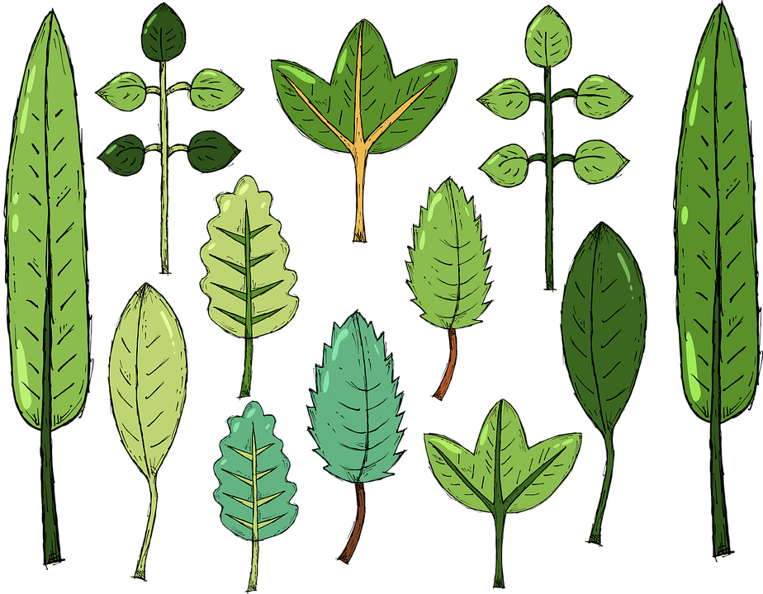
hören
[ü] oder [u]?
Hör zu. Ist es [ü] oder [u]?
1
m ü s s e n
n a t ü r l i c h
j u n g
_
_
3
_
[to have to, must]
2
[young]
U n t e r –
n e h m e n
R ü c k e n
ü b e r –
l e g e n
4
_
_
6
_
[company]
5
[to think]
[back]
g l ü c k –
l i c h
b e n u t z e n
u r -
s p r ü n g-
l i c h
7
_
_
9
_
_
[to use, using]
8
[original]
Notes:
Timing: 5 minutes
Aim: to consolidate the SSC [ü] by aurally differentiating between [ü and [u].
Procedure:
1. Click to listen to the first item. Pupils decide whether they hear [ü] or [u].
2. Click to reveal the answer.
3. Continue with items 2-9 and click to reveal answers.
Transcript: müssen
natürlich
jung
Unternehmen
Rücken
überlegen
glücklich
benutzen
ursprünglich
Word frequency (1 is the most frequent word in German): glücklich [1070] jung [199] müssen [43] natürlich [137] Unternehmen [236] Rücken [1060] überlegen [1047] ursprünglich[ 1332] Source: Jones, R.L. & Tschirner, E. (2019). A frequency dictionary of German: core vocabulary for learners. Routledge

Slide 7
Vokabeln
Hör zu und sag das Wort.
Wörter
(the) river
(the) island
der Fluss
die Insel
north
der Norden, Nord-
east
der Osten,
Ost-
(the) castle
south
(the) beach
der Wald
das Schloss
der Süden,
Süd-
der Strand
(the) forest, woods
bekannt
there
for
west
famous
dort
für
der Westen,
West-
Hausauf-gaben
jeden Tag
homework
(the) evening
(the) afternoon
every day
der Abend
der Nachmittag
Notes:
Timing: 5 minutes
Aim: to practise oral recall of vocabulary.
Procedure:
1. Pupils sketch a 4x4 grid.
2. Working in pairs, they take turns to choose a word to translate orally into English.
3. Pupils should work as quickly as they can without repeating a word the other has already said. If their partner agrees the given translation is correct, the speaking pupil ‘claims’ the relevant square on the grid by putting their initials in it. If they cannot translate a word, or translate it incorrectly, they do not claim a square and the game moves on.
4. Click to reveal translations one by one.
5. Pupils count up the number of squares they have claimed. The pupil with the most squares wins.
7

Slide 8
Present tense: er, sie, es| sie (they)
Note: sehen (to see) → sieht
Remember! To mean ‘she’ use sie with ‘t’ verb ending:
Remember! English has two present tenses, but German only has one!
Sie schreibt Geschichten.
Sie sieht Filme.
She writes | is writing stories.
She sees | is seeing films.
Note: no spelling change in ‘they’ form.
To mean ‘they’ use sie with ‘en’ verb ending:
Sie schreiben Geschichten.
Sie sehen Filme.
They write | are writing stories.
They see| are seeing films.
Notes:
Timing: 2 minutes
Aim: to recap the 3rd person singular (‘s/he, it) and plural form (‘they’) of regular (weak) and strong present tense.
Procedure:
Click through the animations to present the information.
Elicit English translation for the German examples provided.
8

Slide 9
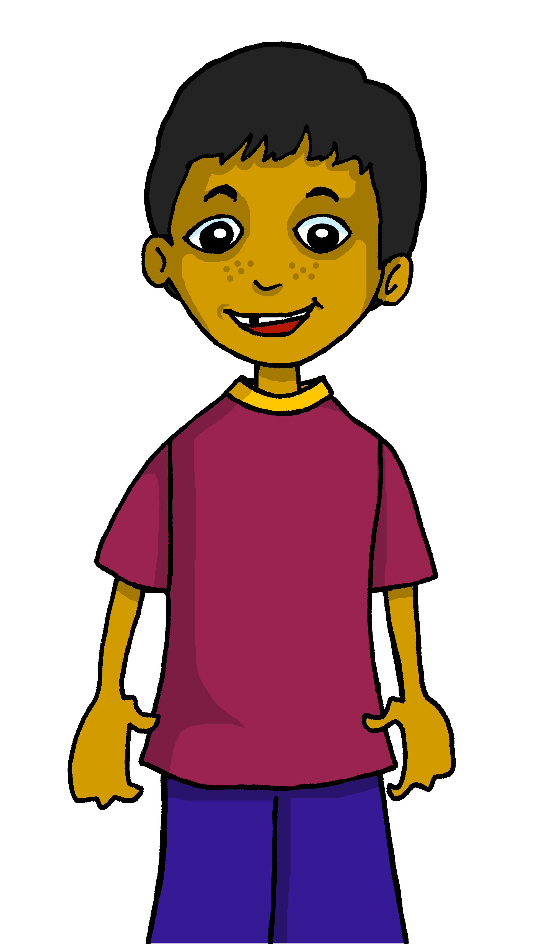
hören
Hamza fragt* Johanna.
Hör zu. Was sagt Hamza? Ist es ‘sie’ (she) oder ‘sie’ (they)?
sie (she) | sie (they) | was?
 |  | gets a lot of homework
 |  | learn English every day
 |  | forgets nothing
 |  | uses the computer sometimes
 |  | often read books in the evening
 |  | eat at school in the afternoons
 |  | talks fast in the mornings
B.
1
2
3
4
5
6
fragen – to ask
Notes:
Timing: 5 minutes
Aim: to practise aural distinction between WO1 and WO2 (es gibt / gibt es).
Procedure:
Hamza asks Johanna some questions about her and Aisha. He reports back. Is he talking about something Johanna and Aisha do (they?), or something only Johanna does (she)?
Play the example with the pronoun bleeped out. Pupils select the correct pronoun.
Click to elicit and confirm the answer.
Elicit the English meaning of the question.
Click to elicit and confirm the answer.
Continue for items 1-6.
Transcript:
Beispiel: Sie bekommt sehr viele Hausaufgaben.
1. Sie lernen jeden Tag Englisch.
2. Sie vergisst nichts.
3. Sie benutzt manchmal den Computer.
4. Sie lesen abends oft Bücher.
5. Sie essen nachmittags in the der Schule.
6. Sie spricht morgens schnell.
9

Slide 10
Order of words in a sentence
You know we can start a German sentence with the place adverb to emphasize it.
When we do this, the adverb and subject swap places.
This works with time adverbs too.
Jeden Tag
schreiben sie
Geschichten.
Word order
2
TIME ADVERB
VERB + SUBJECT
OBJECT
Every day
they write
stories.
The verb position stays the same – just the adverb and subject swap around!
Notes:
Timing: 3 minutes
Aim: to recap the order of words in a German sentence, and how this is affected by an initial adverb of time.
Procedure:
Click to present the information.
Elicit the English meaning of the words in the sentence.
Ensure that pupils understand that this change is for emphasis – the essential meaning of the sentence remains the same.
10

Slide 11
lesen
Hamza schreibt seine* Antworten.
sein(e) – his
Wo ist ‘sie’? Ist es 1 oder 2? Was ist das auf Englisch?
Deutsch
Englisch
B
Jeden Tag bekommt sie viele Hausaufgaben.
1
She gets lots of homework every day.
Oops! Hamza spills hot chocolate!
2
Sie vergisst nichts.
She forgets nothing.
1
1
2
 | WO1 | WO2
B.
1
2
3
4
5
6
2
Sie benutzt manchmal den Computer.
She sometimes uses the computer.
1
2
3
Abends lesen sie oft Bücher.
In the evenings they often read books.
1
2
4
Sie essen nachmittags an der Schule.
In the afternoons they eat at school.
1
2
Sie lernen jeden Tag Englisch.
5
1
2
Every day they learn English.
Morgens spricht sie sehr schnell.
In the mornings she speaks very fast.
6
1
2
Notes:
Timing: 8 minutes
Aim: to distinguish between Word Order 1 or 2, 3rd persons singular and plural, and to practise comprehension of recently learnt vocabulary.
Procedure:
Explain the scenario: Hamza is writing up his survey answers but spills chocolate on them.
Pupils identify the correct choice for item one, Word order 1 or Word order 2.
Click for the numbered spillages to be removed and to bring up the answer ticks in the table. If desired, click the numbered buttons to hear full, correct sentences.
Then give pupils times to translate the example into English and elicit responses from pupils.
Click to correct, ensuring that they note the difference between –t/-en verb endings.
Continue with items 1-6.
Click to correct all items.
11

Slide 12
Tschüss!
blau
Notes:
12

