Slide 1
Exploring
Online-Austausch
blau
Follow ups 1-5
Term 2 Week 4
Notes:
Artwork by Steve Clarke. Pronoun pictures from NCELP (www.ncelp.org). All additional pictures selected from Pixabay and are available under a Creative Commons license, no
attribution required.
Phonics:
[au] Haus [147] blau [948] laufen [252]
[eu] Deutschland [140] Freund [273] heute [116]
Vocabulary: finden [103] Sie [7] Arbeit [208] Essen [323] Pause [1441] Uniform [3857] Unterricht [1823] zusammen [533]
Revisit 1: Fluss [1687] Insel [1029] Norden, Nord- [1516] Osten, Ost- [1208] Schloss [1907] Süden, Süd- [1771] Strand [1966] Wald [1028] Westen, West- [1010] bekannt [319] dort [139] für [17]
Revisit 2: alles [36] alle [36] viele [56] Beispiel [94] Bild [253] Computer [1252] Eis [1874] Essen¹ [323] Foto [633] Frage [157] Handy [1693] Heft [3862] Kunst [554] Lied [1733] Liste [1792] Preis [334] Satz [432] Song [3373]
Text [473] Tisch [529]
Jones, R.L & Tschirner, E. (2019). A frequency dictionary of German: Core vocabulary for learners. London: Routledge.
The frequency rankings for words that occur in this PowerPoint which have been previously introduced in these resources are given in the SOW and in the resources that first
introduced and formally re-visited those words.
For any other words that occur incidentally in this PowerPoint, frequency rankings will be provided in the notes field wherever possible.
Remember that at the start of the course (first three lessons of Rot/Gelb) pupils learnt language (for greetings and register taking) that can still be part of the lesson routines in upper KS2 (Blau/Grün). They are not re-taught, as we anticipate that teachers have built these in from early in lower KS2.

Slide 2
aussprechen
[au]
…
Haus
Notes:
Timing: 1 minute
Aim: to introduce the SSC [au].
Procedure:
Introduce the SSC and present the source word ‘Haus’ (with gesture, if using).
Click to bring on the picture and get pupils to repeat the word ‘Haus’ (with gesture, if using).
Note:
a gesture for ‘Haus’ might be to make a roof above your head with two hands.
2

Slide 3
aussprechen
[eu]
…
Deutschland
Notes:
Timing: 1 minute
Aim: to introduce the SSC [eu].
Procedure:
Re-present the SSC and the source word ‘Deutschland’
Click to bring on the picture and get pupils to repeat the word ’Deutschland’

Slide 4
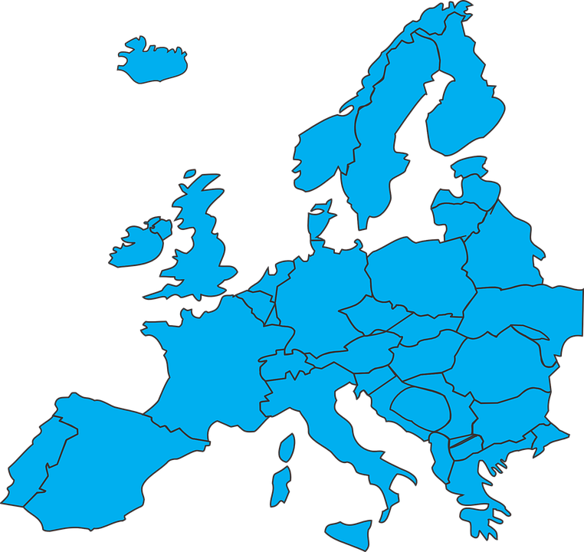
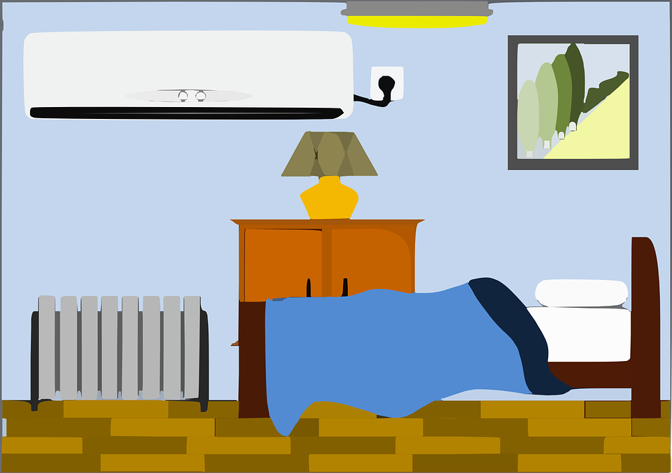
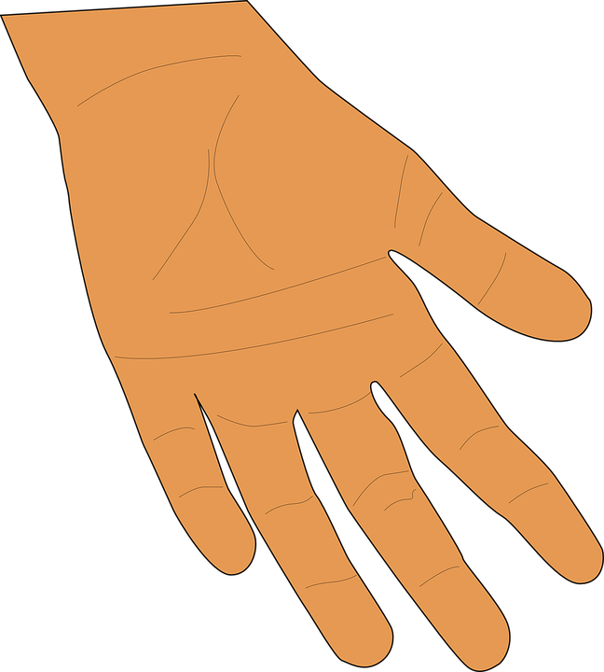
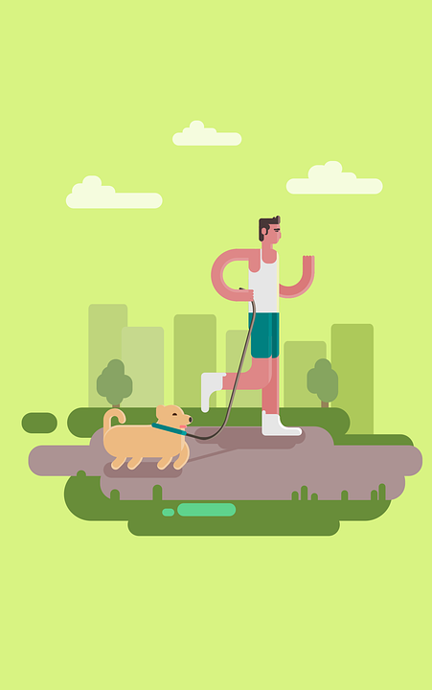
Follow up 1
[au|eu]
Ist das [au] oder [eu]?
A. Hör zu.
Which order are the SSCs in?
der Grand Prix
A: [au]
B: [eu]
aussprechen
Frauen | freuen
Schau | Scheu
Hau | Heu
Schlaufe | Schleuse
baute | Beute
hausen | heulen
sausen | seufzen
Trauer | treuer
B. Say these words one after the other as quickly as you can. Your partner will count and check.
1
B-A
2
A-B
3
A-B
Europa
Schau
Beutel
Auto
4
B-A
5
A-B
Ungeheuer
Raum
Zeugnis
Autor
6
A-B
[to bend]
[nosy]
[skin]
beugen
Traum
neugierig
Haut
7
B-A
[cross-roads]
8
A-B
[meaning]
Bedeutung
tausend
Kreuzung
Lauf
Notes:
Timing: 5 minutes
Aim: to practise aural recognition and pronounciation of this week’s SSC [au/eu]
Procedure:
Click to play the audio of the paired words. Pupils write down the order in which they hear the SSCs – e.g. 1. freuen | Frauen (Answer B – A).
Click to reveal the answer.
Click to bring up task B.
Pupils apply their phonics knowledge to read aloud these words alternating between [au] and [eu].The listening partner can send his/her partner back to the start if s/he hears the [au/eu] pronounced with English pronunciation.
Teacher circulates to listen and support, as needed.
Pupils swap roles.
Transcript
freuen, Frauen
Schau, Scheu
Hau, Heu
Schleuse, Schlaufe
baute, Beute
hausen, heulen
seufzen, sausen
Trauer, treuer
Vocabulary:
Auto [361] Autor [723] beugen [2543] Beutel [N/A] Lauf [1377] Haut [1149] Kreuzung [4990] neugierig [3040] Raum [403] Schau [4346] tausen d[1177] Traum [992] Ungeheuer [4453] Zeugnis [4456]
Jones, R.L & Tschirner, E. (2019). A frequency dictionary of German: Core vocabulary for learners. London: Routledge.

Slide 5
Follow up 2
Lies die Fragen.
Help them sort out the questions for the teacher (you formal) from their planning questions (they).
Rafi und Sarah haben ein Problem!
B
Finden sie die Fragen einfach?
lesen
1
2
B. Do they find the questions easy?
Finden Sie die Schule wunderbar?
Finden Sie das Essen in der Schule gut?
3. Do they find the school day too long?
6. Do they find the persons there friendly?
3
4
Finden sie den Schultag zu* lang?
Finden Sie die Pause ruhig?
1. Do you find the school wonderful?
zu - too
2. Do you think that the food in the school is good?
5
6
Finden Sie den Unterricht toll?
Finden sie die Personen dort freundlich?
4. Do you find the break quiet?
5. Do you find the lessons great?
Notes:
Timing: 5 minutes
Aim: to practise written distinction between Sie (you formal) and sie (they) in present tense questions.
Procedure:
Click to bring up the instructions.
Pupils read the questions on the post-it notes and decide whether the question is for the teacher (you formal) or for their planning (they).
Elicit who each question is for.
Click to bring up the answer.
Continue for items 1-6.
Vocabulary:
zu [21]
Jones, R.L & Tschirner, E. (2019). A frequency dictionary of German: Core vocabulary for learners. London: Routledge.

Slide 6
Follow up 3
Hör zu. Ist die Frage für Johanna (du) oder für Frau Bahlsen (Sie)?
hören
Wie heißt die Frage auf Englisch?
B
Do you watch videos in the lessons?
1
Do you do homework every night?
2
Do you write stories every night?
3
Are you reading a book in the afternoon?
4
Do you get cake at the weekend?
5
Do you sometimes play football?
6
Do you find the song great?
Notes:
Timing: 5 minutes
Aim: to practise distinguishing between du and Sie, and to practise previously learnt vocabulary in a sentence translation task.
Procedure:
Explain that the scenario from the lesson continues - Sarah and Rafi have more questions! They decide to ask either Johanna (du) or Frau Bahlsen (Sie). Pupils decide which one they hear.
Click to hear the example.
Elicit answer, click for answer tick.
Elicit English translation, click to reveal written form.
Continue for items 1-6.
Transcript:
Beispiel. Siehst du Videos im Unterricht?
1. Machst du jeden Tag Hausaufgaben?
2. Schreiben Sie jeden Abend Geschichten?
3. Lesen Sie am Nachmittag ein Buch?
4. Bekommst du am Wochenende Kuchen?
5. Spielen Sie manchmal Fußball?
6. Findest du das Lied toll?

Slide 7
Follow up 4:

Schreib auf Englisch
Can you get at least 15 points?
Wörter
 | bekannt | dort | für
 | das Eis | die Kunst | das Essen
 | die Insel | der Fluss | der Wald
 | das Schloss | der Strand
 | die Uniform | Sie | finden
 | die Pause | die Arbeit | der Unterricht
well-known, famous
there
for
Vokabeln
x3
(the) ice-cream, ice
(the) art
(the) food
(the) island
(the) river
(the) forest, woods
x2
(the) castle
(the) beach
(the) uniform
you (formal)
to find, finding
x1
(the) break
(the) work
(the) teaching, lessons
Notes:
Timing: 5 minutes
Aim: to practise written production of vocabulary from this and revisited weeks.
Procedure: 1. Give pupils a blank grid. They fill in the English meanings of any of the words they know, trying to reach 15 points in total.
Note: The most recently learnt and practised words are pink, words from the previous week are green and those from week 1 are blue, thus more points are awarded for them, to recognise that memories fade and more effort (heavy lifting!) is needed to retrieve them.

Slide 8
Follow up 4:

Schreib auf Deutsch.
Can you get at least 15 points?
Wörter
 | (the) ice-cream, ice | (the) food | art
 | well-known, famous | there | for
 | (the) beach | (the) forest, woods
 | (the) river | (the) island | (the) castle
 | (the) break | (the) uniform | (the) teaching, lessons
 | to find, finding | you (formal) | (the) work
das Eis
das Essen
die Kunst
Vokabeln
x3
bekannt
dort
für
der Strand
der Wald
x2
der Fluss
die Insel
das Schloss
die Pause
die Uniform
der Unterricht
x1
finden
Sie
die Arbeit
Notes:
Timing: 5 minutes
Aim: to practise written production of vocabulary from this and revisited weeks.
Procedure: 1. Give pupils a blank grid. They fill in the German meanings of any of the words they know, trying to reach 15 points in total.
Note: The most recently learnt and practised words are pink, words from the previous week are green and those from week 1 are blue, thus more points are awarded for them, to recognise that memories fade and more effort (heavy lifting!) is needed to retrieve them.

Slide 9
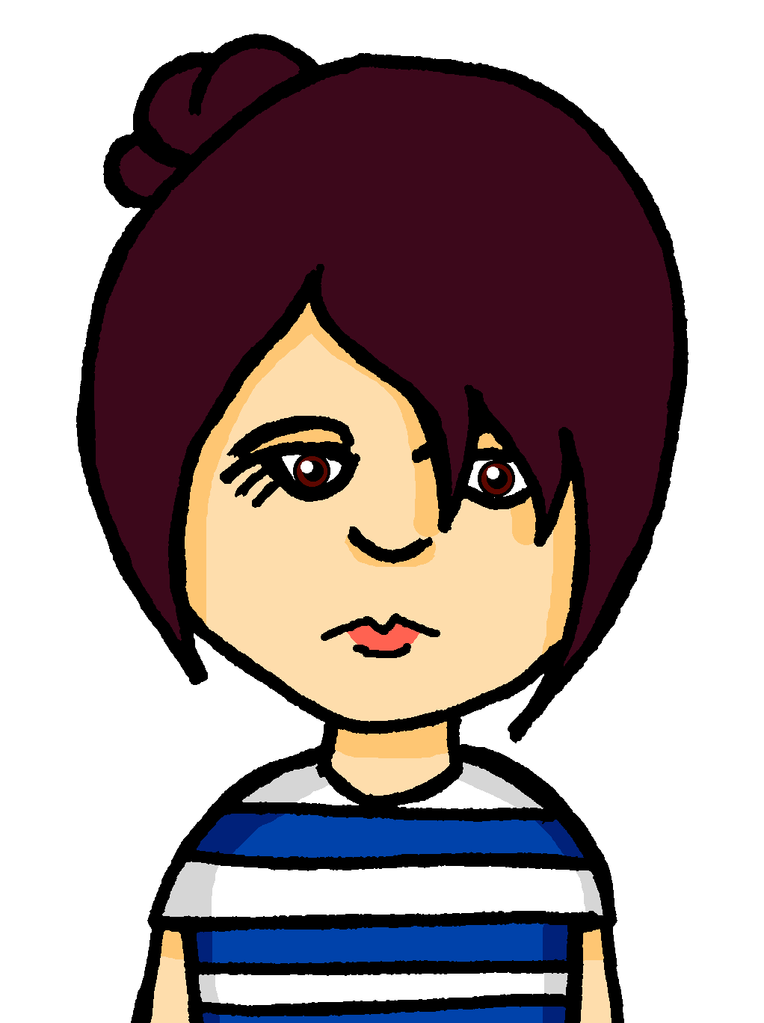
Follow up 5
Rede mit deinem Partner/deiner Partnerin.
Ba
Bb
Person A: Finden Sie das Essen toll?
sprechen
Person B: Das ist eine Frage für Frau Bahlsen.
Person A: Ja, richtig!
Frau Bahlsen
Johanna
1a
1b
2a
2b
3a
3b
Aisha
Herr Bauer
Ali
Frau Schleuter
Herr Maus
Hamza
4a
4b
5a
5b
6a
6b
Moritz
Doktor Reuter
Paula
Frau Beusen
Frau Bahlsen
Johanna
Notes:
1/2
Timing: 6 minutes
Aim: to practise using and identifying du and Sie as appropriate in a speaking task.
Procedure:
Click to bring up the instructions.
Talk pupils through the example. Person A picks either a or b from the example and asks a question. Person B has to identify who the question is for by deciding is it formal (Sie) or informal (du).
When pupils have worked through items 1-6, they will swap roles for a second slide.

Slide 10
Follow up 5
Rede mit deinem Partner/deiner Partnerin.
Ba
Bb
Person B: Findest du das Essen toll?
sprechen
Person A: Das ist eine Frage für Johanna.
Person B: Ja, richtig!
Frau Bahlsen
Johanna
1a
1b
2a
2b
3a
3b
Aisha
Herr Bauer
Ali
Frau Schleuter
Herr Maus
Hamza
4a
4b
5a
5b
6a
6b
Moritz
Doktor Reuter
Paula
Frau Beusen
Frau Bahlsen
Johanna
Notes:
2/2 Pupils swap roles.
NB the example is the only difference between the two slides.

Slide 11
Tschüss!
blau
Notes:
11

Slide 12
Follow up 4:

Schreib auf Englisch.
Can you get at least 15 points?
Wörter
 | bekannt | dort | für
 | das Eis | die Kunst | das Essen
 | die Insel | der Fluss | der Wald
 | das Schloss | der Strand
 | die Uniform | Sie | finden
 | die Pause | die Arbeit | der Unterricht
Vokabeln
Notes:
HANDOUT

Slide 13
Follow up 4:

Schreib auf Deutsch.
Can you get at least 15 points?
Wörter
 | (the) ice-cream, ice | (the) food | art
 | well-known, famous | there | for
 | (the) beach | (the) forest, woods
 | (the) river | (the) island | (the) castle
 | (the) break | (the) uniform | (the) teaching, lessons
 | to find, finding | you (formal) | (the) work
Vokabeln
x3
x2
x1
Notes:
HANDOUT

