Slide 1
Exploring
Online-Austausch
blau
Using formal ‘you’ (Sie)
Yes/no questions
SSC [au] and [eu]
Term 2 Week 4
Notes:
Artwork by Steve Clarke. Pronoun pictures from NCELP (www.ncelp.org). All additional pictures selected from Pixabay and are available under a Creative Commons license, no
attribution required.
Phonics:
[au] Haus [147] blau [948] laufen [252]
[eu] Deutschland [140] Freund [273] heute [116]
Vocabulary: finden [103] Sie [7] Arbeit [208] Essen [323] Pause [1441] Uniform [3857] Unterricht [1823] zusammen [533]
Revisit 1: Fluss [1687] Insel [1029] Norden, Nord- [1516] Osten, Ost- [1208] Schloss [1907] Süden, Süd- [1771] Strand [1966] Wald [1028] Westen, West- [1010] bekannt [319] dort [139] für [17]
Revisit 2: alles [36] alle [36] viele [56] Beispiel [94] Bild [253] Computer [1252] Eis [1874] Essen¹ [323] Foto [633] Frage [157] Handy [1693] Heft [3862] Kunst [554] Lied [1733] Liste [1792] Preis [334] Satz [432] Song [3373]
Text [473] Tisch [529]
Jones, R.L & Tschirner, E. (2019). A frequency dictionary of German: Core vocabulary for learners. London: Routledge.
The frequency rankings for words that occur in this PowerPoint which have been previously introduced in these resources are given in the SOW and in the resources that first
introduced and formally re-visited those words.
For any other words that occur incidentally in this PowerPoint, frequency rankings will be provided in the notes field wherever possible.
Remember that at the start of the course (first three lessons of Rot/Gelb) pupils learnt language (for greetings and register taking) that can still be part of the lesson routines in upper KS2 (Blau/Grün). They are not re-taught, as we anticipate that teachers have built these in from early in lower KS2.
1

Slide 2
aussprechen
[au]
…
Haus
Notes:
Timing: 1 minute
Aim: to introduce the SSC [au].
Procedure:
Introduce the SSC and present the source word ‘Haus’ (with gesture, if using).
Click to bring on the picture and get pupils to repeat the word ‘Haus’ (with gesture, if using).
Note:
a gesture for ‘Haus’ might be to make a roof above your head with two hands.
2

Slide 3
aussprechen
[au]
…
Haus
[to run, running]
blau
laufen
Notes:
Timing: 1 minute
Aim: to consolidate the SSC [au].
Procedure:
Re-present the SSC and the source word ‘Haus’ (with gesture, if using).
Click to bring on the picture and get pupils to repeat the word ‘Haus’ (with gesture, if using).
Present the cluster words in the same way, bringing on the picture and getting pupils to pronounce the words.
3

Slide 4
aussprechen
[eu]
…
Deutschland
Notes:
Timing: 1 minute
Aim: to introduce the SSC [eu].
Procedure:
Re-present the SSC and the source word ‘Deutschland’
Click to bring on the picture and get pupils to repeat the word ’Deutschland’

Slide 5
aussprechen
[eu]
…
[today]
[friend]
Freund
heute
Deutschland
Notes:
Timing: 1 minute
Aim: to consolidate the SSC [eu].
Procedure:
Re-present the SSC and the source word ‘Deutschland’
Click to bring on the picture and get pupils to repeat the word ’Deutschland’
Present the cluster words in the same way, bringing on the picture and getting pupils to pronounce the words.

Slide 6
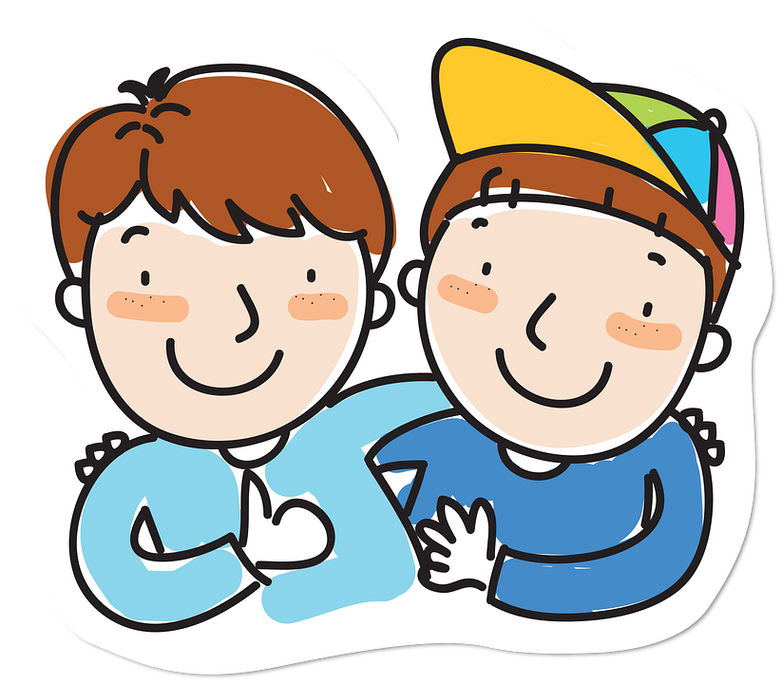
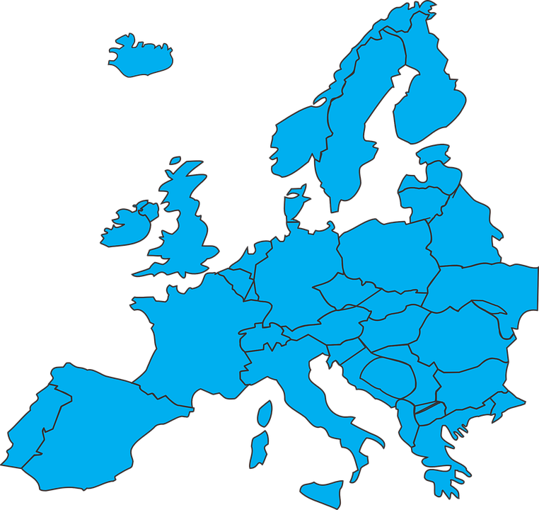
Hör zu.
Schreib 1-8 und das Wort. Ist es mit [au], [eu] oder [au] und [eu]?
1. L_ _ te
2. B_ _ m
Baum
Leute
4. k_ _fen
brauchen
Freund
3. br_ _ chen
aufheulen*
eu
au
6. P_ _se
Neubau
heute
kaufen
5. _ _fh_ _ len
8. _ _ ropa
Pause
Europa
7. h_ _ te
10. Fr_ _ nd
aufheulen – to cry out
der Neubau – new building
9. N_ _b_ _
Notes:
Timing: 5 minutes
Aim: to practise recognising aurally the SSCs [au] and [eu].
Procedure:
Click to bring up instructions. Pupils write down 1-8 and will write the full word with [eu] or [au], based on what they hear.
Click the audio button for item 1 to hear the first word, elicit the answer from pupils and click to display answer.
Repeat for items 2-10. Note: please click the arrows in the order of 1-10, otherwise the answers don’t match the clues.
Transcript:
Leute
Baum
brauchen
kaufen
aufheulen
Pause
heute
Europa
Neubau
Freund
Word frequency (1 is the most frequent word in German): aufheulen [N/A] Baum [1013] brauchen [179] Europa [294] Freund [273] heute [116] kaufen [506] Neubau [4344] Pause [1441]
Source: Jones, R.L. & Tschirner, E. (2019). A frequency dictionary of German: core vocabulary for learners. Routledge

Slide 7
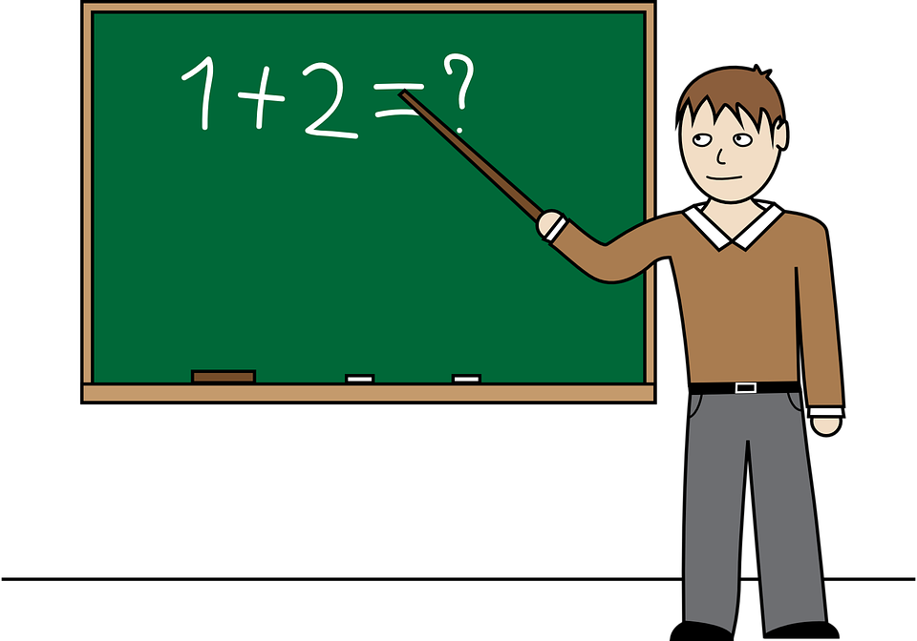
Vokabeln
Sag die Wörter auf Deutsch. Was ist das auf Englisch?
Wörter
die Arbeit
der Unterricht
[(the) work]
[teaching, lessons]
die Pause
sie with small ‘s’ can mean ‘she’ or ‘they’. Sie with capital ‘s’ means ‘you’ to an adult you don’t know well.
finden
[(the) pause, break]
[to find, finding]
die Uniform
Sie
[you (formal)]
[(the) uniform]
Notes:
[1/3]
Timing: 3 minutes
Aim: to introduce new vocabulary.
Procedure 1. Pupils either work by themselves or in pairs, reading out the words and recapping their English meaning (1 minute). When you come to the last item, Sie, click to bring up callout to explain the difference between sie (she/they) and Sie (you formal). Explain that the handshaking image signifies formality by shaking hands. 2. Then, on the next slide, students try to recall the English orally (chorally), looking at the German (1 minute). 3. Then, on the following slide, they to recall the German meanings orally (again, chorally), looking at the English (1 minute).
Notes:
Note that images/words won’t disappear and appear in this activity as in previous resources.
7

Slide 8
Vokabeln
Sag die Wörter auf Deutsch. Was ist das auf Englisch?
Wörter
(the) work
t_ _ _ _ _ _ _ ,
l_ _ _ _ _ _
(the) w_ _ _
die Arbeit
teaching, lessons
der Unterricht
(the) b_ _ _ _, p_ _ _ _
(the) break, pause
t_ f_ _ _ , f_ _ _ _ _ _
die Pause
to find, finding
finden
y_ _
(formal)
you (formal)
(the) u_ _ _ _ _ _
Sie
(the) uniform
die Uniform
Notes:
[2/3]
Procedure: 1. Students try to recall the English orally (chorally), looking at the German (1 minute). 2. Elicit answers and click to reveal
3. Then, in the following slide, they to recall the German meanings orally (again, chorally), looking at the English (1 minute).
8

Slide 9
Vokabeln
Sag die Wörter auf Deutsch. Was ist das auf Englisch?
Wörter
(the) work
d_ _ A_ _ _ _ _
teaching, lessons
die Arbeit
d_ _
U_ _ _ _ _ _ _ _ _ _
der
Unterricht
(the) break, pause
die Pause
to find, finding
d_ _ P_ _ _ _
f _ _ _ _ _
finden
(the) uniform
you (formal)
S_ _
Sie
d_ _ U_ _ _ _ _ _
die Uniform
Notes:
[3/3]
Procedure: 1. Students recall the German meanings orally (again, chorally), looking at the English (1 minute)
2. Click to reveal the answers.
9

Slide 10
Using Sie to mean ‘you’
You already know du and ihr mean you:
In English, we usually say ‘Do you think that the food is good?’
Kultur
e
Findest du das Essen gut?
Do you _{[one person]} find the food good?
Add ‘e’ to make these parts of finden easier to say: du findest er, sie, es findet ihr findet
e
Findet ihr den Unterricht einfach?
Do you _{[all|both]} find the lessons/teaching easy?
Use Sie to mean you to any adult or adults you don’t know well:
Finden Sie die Arbeit schwer?
With Sie, the verb form is the same as the infinitive.
Do you _{[formal]} find the work hard?
Notes:
Timing: 2 minutes
Procedure:
Click through the animations to present the new information.
Elicit English translation for the German examples provided.
10

Slide 11
lesen
Rafi und Sarah schreiben Fragen für die Klasse in Deutschland.
Ist die Frage für Johanna oder für Frau Bahlsen?
B.
Finden Sie die Arbeit gut?
1. Do you find the food good?
1
Findest du das Essen gut?
2. Do you think that the Uniform is beautiful?
2
Findest du die Uniform schön?
4. Do you think that the break is wonderful?
3
Finden Sie den Unterricht einfach?
4
B. Do you find the work good?
Findest du die Pause wunderbar?
3. Do you find the teaching easy?
5
Finden Sie die Fragen schwer?
5. Do you find the questions hard?
6
Finden Sie den Lehrer nett?
6. Do you think that the teacher is nice?
Notes:
Timing: 8 minutes
Aim: to practise written comprehension of du and Sie questions, connecting form and meaning.
Procedure:
Read through the scenario and instruction.
Read the example with pupils. Teachers asks: Ist die Frage für Johanna oder für Frau Bahlsen? They say ‘Johanna’ or ‘Frau Bahlsen’.
Click to bring up the person’s icon next to the question.
Teacher asks: Wie heißt die Frage auf Englisch? and elicits pupils’ response.
Click to reveal the question’s English meaning in the correct person’s box on the right hand side of the slide.
11

Slide 12
hören
Sarah und Rafi stellen Fragen.
Hör zu. Ist die Frage für Johannas Klasse oder für Frau Bahlsen?
Remember! You would ask ‘Findet ihr…’ to mean you all.
Schreib die Frage auf Englisch.
B
Do you think that the uniform is nice?
1
Do you find the food wonderful?
2
Do you think that the break is good?
3
Do you find the work lovely?
4
Do you find the persons friendly?
5
Do you think that the art is good?
6
Do you find the computers slow?
7
Do you find the lessons quiet?
Notes:
Timing: 5 minutes
Aim: to practise aural comprehension of ihr and Sie questions, connecting form and meaning.
Procedure:
Explain the scenario. Sarah and Rafi decide to ask either Frau Bahlsen or all the pupils in the class, so they need the ihr form or the Sie form.
Click to bring up callout to remind pupils of the meaning of ‘ihr’. Click to disappear callout.
Click to hear the example.
Elicit answer, click for answer tick.
Elicit German meaning, click to reveal written form.
Continue for items 1-7.
Transcript:
B. Findet [ihr] die Uniform schön?
Finden [Sie] das Essen wunderbar?
Findet [ihr] die Pause gut?
Finden [Sie] die Arbeit schön?
Findet [ihr] die Personen freundlich?
Findet [ihr] die Kunst gut?
Finden [Sie] die Computer langsam?
Finden [Sie] den Unterricht ruhig?
12

Slide 13
Tschüss!
Don’t forget this more formal way to say Goodbye!
Auf Wiedersehen!
blau
Notes:
13

