Slide 1
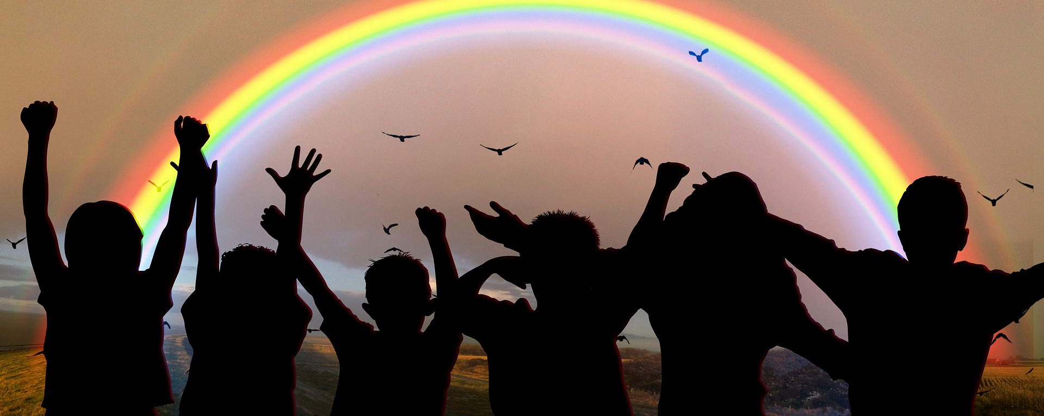
Exploring
Wir helfen!
blau
Follow ups 1-5
Term 2 Week 5
Notes:
Artwork by Steve Clarke. Pronoun pictures from NCELP (www.ncelp.org). All additional pictures selected from Pixabay and are available under a Creative Commons license, no
attribution required.
Phonics:
Introduce [äu] Häuser [Haus-147] Mäuse [Maus-3463] träumen [1793]
Revisit [au] Haus [147] blau [948] laufen [252]
Vocabulary: bleiben [113] kaufen [506] machen [58] schlafen [679] tragen [271] verkaufen [721] waschen [2315] Auto [361] (Party)Kleidung [2820] Stunde [276] Nacht [325] ruhig [991]
Revisit 1: bekommen [212] bleiben [113] lesen [305] machen [58] schreiben [184] sein [3] spielen [205] Abend [342] Essen [323] Film [505] Geschichte [262] Hausaufgabe(n) [n/a] Morgen [621] Nachmittag [1464] Schule [359] heute [116]
manchmal [382] oft [223] nie [196] jeden Tag [n/a]
Revisit 2: geben [49] Ball [1782] Baum [1013] Bild [253] Blume [2463] Buch [300] Computer [1252] Foto [633] Glas [885] Jacke [3287] Kleidung [2820] Spiel [328] Stoff [758] Tier [614]
Jones, R.L & Tschirner, E. (2019). A frequency dictionary of German: Core vocabulary for learners. London: Routledge.
The frequency rankings for words that occur in this PowerPoint which have been previously introduced in these resources are given in the SOW and in the resources that first
introduced and formally re-visited those words.
For any other words that occur incidentally in this PowerPoint, frequency rankings will be provided in the notes field wherever possible.
Remember that at the start of the course (first three lessons of Rot/Gelb) pupils learnt language (for greetings and register taking) that can still be part of the lesson routines in upper KS2 (Blau/Grün). They are not re-taught, as we anticipate that teachers have built these in from early in lower KS2.

Slide 2
aussprechen
[au]
…
Haus
Notes:
Timing: 1 minute
Aim: to introduce the SSC [au].
Procedure:
Introduce the SSC and present the source word ‘Haus’ (with gesture, if using).
Click to bring on the picture and get pupils to repeat the word ‘Haus’ (with gesture, if using).
Note:
a gesture for ‘Haus’ might be to make a roof above your head with two hands.
Frequency: Haus [147] Jones, R.L & Tschirner, E. (2019). A frequency dictionary of German: Core vocabulary for learners. London: Routledge.
2

Slide 3
aussprechen
[äu]
…
Häuser
Notes:
Timing: 1 minute
Aim: to introduce the SSC [äu].
Procedure:
Introduce the SSC. Click to bring up callout to explain that it is the same sound as [eu], which they already know (e.g. Deutschland).
Present the source word ‘Häuser’ (with gesture, if using). A callout to explain that it is the plural of Haus comes up at the same time.
Click to bring on the picture and get pupils to repeat the word ‘Häuser’ (with gesture, if using).
Note:
a gesture for ‘Haus’ might be to make a roof above your head with two hands, and then do it again to indicate plural.
Frequency:
Häuser [Haus-147]
Jones, R.L & Tschirner, E. (2019). A frequency dictionary of German: Core vocabulary for learners. London: Routledge.
3

Slide 4
Follow up 1
Partnerarbeit! Partner A turns away, Partner B reads out sentences 1-4. A translates, B corrects. Then swap roles for 5-8.
Hör zu und schreib das Verb auf Deutsch.
hören
_ _ _ _ _ _
Du t r ä g s t jeden Tag Partykleidung.
1
t r ä g s t
You wear party clothes every day.
2
Du s p r i c h s t in der Schule.
You speak in school.
_ _ _ _ _ _ _ _
Geben and sprechen change e → i
s p r i c h s t
Geben and sprechen change e → i.
_ _ _ _ _ _ _ _
v e r k a u f t
He sells old clothes.
3
Er v e r k a u f t alte Kleidung.
4
_ _ _ _
She gives (donates) games.
Sie g i b t Spiele.
g i b t
5
Ich t r a g e am Wochenende Taschen für Leute.
I carry bags for people at the weekend.
_ _ _ _ _
t r a g e
No stem change for kaufen/verkaufen!
No stem change for kaufen|verkaufen!
6
k a u f s t
_ _ _ _ _ _
Du k a u f s t alte Computer.
You buy old computers.
_ _ _ _ _ _
She washes cars for the teachers.
w ä s c h t
7
Sie w ä s c h t Autos für die Lehrer.
8
Er s c h l ä f t eine Nacht im Garten.
s c h l ä f t
_ _ _ _ _ _ _ _
He sleeps in the garden for one night.
Notes:
Timing: 8 minutes
Aim: to practise this week’s vocabulary and grammar focus in a verb transcription, read-aloud and comprehension task.
Procedure:
Click on the first audio button to play the recording of the verb from. Pupils transcribe the verb form.
Continue for items 2-8.
Click for next instructions. Partner A to turns away from the board and partner B reads out the German sentences 1-4. Partner A translates the German sentence. B corrects if necessary.
The swap roles. Once Partner B has turned away from the board, click for sentences 5-8.
Note: in the audio version, click on the German sentences to hear them pronounced, as required.
Transcript 1. trägst
2. sprichst
3. verkauft
4. gibt
5. trage
6. kaufst
7. wäscht
8. schläft

Slide 5
Present tense: strong verbs a→ ä
In German, strong verbs change the stem vowel in the er/sie/es form and also the du form:
Ich laufe.
I run/am running.
Du läufst.
You run/are running.
Sie läuft.
She runs/is running.
All plural forms (you all, we, they) keep the original vowel, like ich:
Ihr lauft.
You (all) run/are running.
Notes:
Timing: 3 minutes
Aim: to introduce that the ihr-form (second person plural) for strong verbs which change a→ä in the second person singular always keep the original vowel ‘a’.
Procedure:
Click through the animations to present the information.
Elicit English translation for the German examples provided.
5

Slide 6
Follow up 2
Is Moritz asking about Ronja (she-sie) or asking Lias about him and Ronja (you both (ihr)?
Lies die Fragen.
Moritz wants to know more from Lias.
B
Schläft sie eine Nacht in der Schule?
sie (she)
lesen
B. Is she sleeping in school for a night?
1
2
Sprecht ihr nicht für einen Tag?
Tragt ihr keine Uniform in der Schule?
3. Is she giving the teachers flowers?
4. Is she running for an hour?
6. Is she wearing party clothes for football?
3
4
Gibt sie Blumen für die Lehrer?
ihr (you both)
Läuft sie für eine Stunde?
1. Are you both not speaking for one day?
2. Are you both not wearing uniform in school?
5
6
Wascht ihr Autos am Wochenende?
Trägt sie Partykleidung für Fußball?
5. Are you both washing cars at the weekend?
Notes:
Timing: 5 minutes
Aim: to identify the distinction between strong verb verbs a→ ä and e → in the 3rd person singular (she) and 2nd person plural (ihr).
Procedure:
Click to bring up the instructions.
Pupils decide, based on the verb form, whether Moritz is asking Lias about sie (Ronja) or ihr (Lias and Ronja).
Click in turn to bring up the translation in the correct box.

Slide 7
Follow up 3:

Schreib auf Englisch.
Can you get at least 15 points?
Wörter
 | der Stoff | das Bild | geben
 | die Kleidung | das Spiel | der Baum
 | manchmal | jeden Tag | die Hausaufgaben
 | der Nachmittag | der Abend | der Morgen
 | schlafen | waschen | tragen
 | das Auto | die Nacht | verkaufen
Vokabeln
(the) material
(the) picture
to give, giving
x3
(the) clothing
(the) game
(the) tree
sometimes
every day
(the) homework
x2
(the) afternoon
(the) evening
(the) morning
to sleep, sleeping
to wash, washing
to wear, to carry)
x1
(the) car
(the) night
to sell, selling
Notes:
Timing: 5 minutes
Aim: to practise written comprehension of vocabulary from this and revisited weeks.
Procedure: 1. Give pupils a blank grid. They fill in the English meanings of any of the words they know, trying to reach 15 points in total.
Note: The most recently learnt and practised words are pink, words from the previous week are green and those from week 1 are blue, thus more points are awarded for them, to recognise that memories fade and more effort (heavy lifting!) is needed to retrieve them.

Slide 8
Follow up 3:

Schreib auf Deutsch.
Can you get at least 15 points?
Wörter
 | (the) picture | (the) game | (the) tree
 | to give, giving | (the) material | (the) clothing
 | every day | sometimes | (the) morning
 | (the) evening | (the) homework | (the) afternoon
 | to wash, washing | (the) car | (the) night
 | to sleep, sleeping | to wear, to carry | to sell, selling
Vokabeln
das Bild
das Spiel
der Baum
x3
geben
der Stoff
die Kleidung
jeden Tag
manchmal
der Morgen
x2
der Abend
die Hausaufgaben
der Nachmittag
waschen
das Auto
die Nacht
x1
verkaufen
schlafen
tragen
Notes:
Timing: 5 minutes
Aim: to practise written production of vocabulary from this and revisited weeks.
Procedure: 1. Give pupils a blank grid. They fill in the German meanings of any of the words they know, trying to reach 15 points in total.
Note: The most recently learnt and practised words are pink, words from the previous week are green and those from week 1 are blue, thus more points are awarded for them, to recognise that memories fade and more effort (heavy lifting!) is needed to retrieve them.

Slide 9
Follow up 4

After time adverb swap verb and subject!
Schreib die Wörter auf Deutsch und auf Englisch.
Am Nachmittag _________ ___ Bilder und Spiele.
___ ____ ____________ Stoff für Kleidung.
Meine Freundin ________ _______ am Morgen.
Mein Freund läuft ______ ____ für eine Stunde.
Sie tragen _____________ für Hausaufgaben machen.
schreiben
verkaufe ich
________________ I am selling ____________________.
I sometimes give ________ for ___________.
___ _______ is washing cars __ ___ _________ .
My friend __ _______ every day ___ ____ ____.
____ ____ _________ party clothes for doing ____________.
Verb and subject stay together in German.
In the afternoon
pictures and games
Ich gebe manchmal
material
clothing
wäscht Autos
My friend
in the morning.
jeden Tag
is running
for one hour
Partykleidung
They are wearing
homework
Notes:
Timing: 5-10 minutes
Aim: to practise written production of this week’s new vocabulary and written comprehension of other new and revisited vocabulary.
This is a jigsaw translation task.
Procedure:
Click to remind pupils about Word Order 2 and that the verb and subject always stay together in German (compare with English where we often split them around the adverb – I sometimes give).
Pupils write the missing words in both German and English to complete the sentences.
Teacher clicks to provide the written answers and/or clicks the audio buttons to hear the full German sentences.
Differentiation: 1. For a different challenge (i.e. to practise spelling rather than full written recall of the missing German words), the task could be completed as a transcription task initially, by listening to the full sentences and writing the words.
2. Then pupils could complete the English part of the jigsaw.

Slide 10
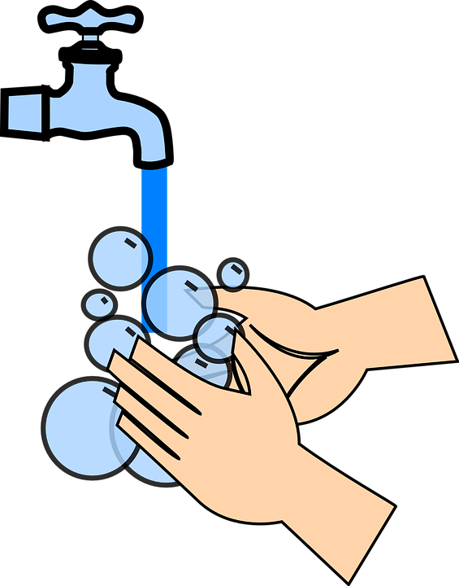
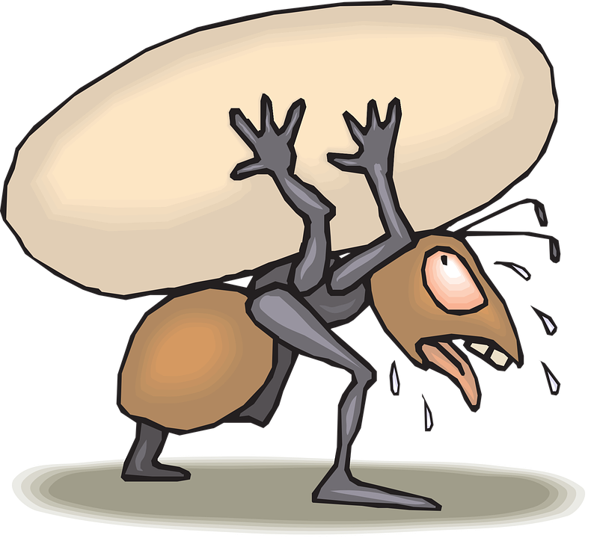
Follow up 5:

Schreib auf Deutsch. Dann sprich auf Deutsch.
Choose three images. Write a sentence choosing either er or sie to describe each one.
Say your sentences. Your partner will try to draw the images. Swap roles.
schreiben
sprechen
Beispiel: Sie trägt Partykleidung in der Schule.
5KM
2 Minuten
7 Stunden
Notes:
Timing: 5-10 minutes
Aim: to practise oral production of sentences with strong verbs in the 3rd person singular.
Procedure:
Pupils have approximately three minutes to choose three images from the screen and plan one sentence to describe each. They must keep their choices and sentences hidden from their partners. Note: explain that the gender symbol means they choose either er or sie – trying to get away from the ideal that short hair = boy, longer hair = girl.
Once the preparation time is over, click to cover the pictures on the screen.
Pupils then take it in turns to read their sentences to their partner, who attempts to draw the images being described. When the partner draws ‘he’ or ‘she’ they could use the correct gender symbol or annotate their picture with ‘she’ or ‘he’.
Click to reveal the images on screen again for pupils to compare their drawings.
Example sentences (left to right, top to bottom): Er/Sie verkauft Kuchen. Er/Sie schläft eine Nacht im Garten. Er/Sie trägt Partykleidung in der Schule. Er/Sie gibt Kleidung.
Er/Sie wäscht Autos für die Lehrer. Er/Sie läuft fünf Kilometer. Er/Sie trägt eine Person für zwei Minuten. Er/Sie schläft eine Nacht nicht.
Er/Sie spricht für sieben Stunden nicht.

Slide 11
Tschüss!
blau
Notes:
11

Slide 12
Follow up 3:

Schreib auf Englisch.
Can you get at least 15 points?
Wörter
 | der Stoff | das Bild | geben
 | die Kleidung | das Spiel | der Baum
 | manchmal | jeden Tag | die Hausaufgaben
 | der Nachmittag | der Abend | der Morgen
 | schlafen | waschen | tragen
 | das Auto | die Nacht | verkaufen
Vokabeln
x3
x2
Notes:
Handout

Slide 13
Follow up 3:

Schreib auf Deutsch.
Can you get at least 15 points?
Wörter
 | (the) picture | (the) game | (the) tree
 | to give, giving | (the) material | (the) clothing
 | every day | sometimes | (the) morning
 | (the) evening | (the) homework | (the) afternoon
 | to wash, washing | (the) car | (the) night
 | to sleep, sleeping | to wear, to carry | to sell, selling
Vokabeln
x3
x2
x1
Notes:
Handout

