Slide 1



Exploring
Wir helfen!
blau
Present tense strong verbs (a → ä)
SSC [au] and [äu]
Term 2 Week 5
Notes:
Artwork by Steve Clarke. Pronoun pictures from NCELP (www.ncelp.org). All additional pictures selected from Pixabay and are available under a Creative Commons license, no
attribution required.
Phonics:
Introduce [äu] Häuser [Haus-147] Mäuse [Maus-3463] träumen [1793]
Revisit [au] Haus [147] blau [948] laufen [252]
Vocabulary: bleiben [113] kaufen [506] laufen [252] machen [58] schlafen [679] tragen [271] verkaufen [721] waschen [2315] Auto [361] (Party)Kleidung [2820] Stunde [276] Nacht [325] ruhig [991]
Revisit 1: bekommen [212] bleiben [113] lesen [305] machen [58] schreiben [184] sein [3] spielen [205] Abend [342] Essen [323] Film [505] Geschichte [262] Hausaufgabe(n) [n/a] Morgen [621] Nachmittag [1464] Schule [359] heute [116] manchmal
[382] oft [223] nie [196] jeden Tag [n/a]
Revisit 2: geben [49] Ball [1782] Baum [1013] Bild [253] Blume [2463] Buch [300] Computer [1252] Foto [633] Glas [885] Jacke [3287] Kleidung [2820] Spiel [328] Stoff [758] Tier [614]
Jones, R.L & Tschirner, E. (2019). A frequency dictionary of German: Core vocabulary for learners. London: Routledge.
The frequency rankings for words that occur in this PowerPoint which have been previously introduced in these resources are given in the SOW and in the resources that first
introduced and formally re-visited those words.
For any other words that occur incidentally in this PowerPoint, frequency rankings will be provided in the notes field wherever possible.
Remember that at the start of the course (first three lessons of Rot/Gelb) pupils learnt language (for greetings and register taking) that can still be part of the lesson routines in upper KS2 (Blau/Grün). They are not re-taught, as we anticipate that teachers have built these in from early in lower KS2.
1

Slide 2

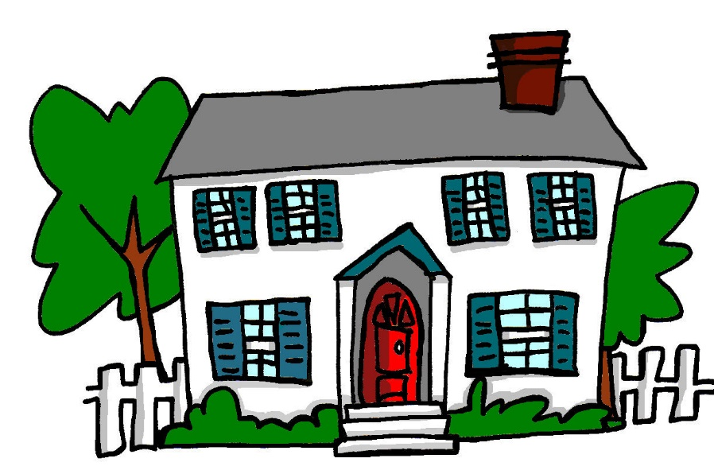
aussprechen
[au]
…
Haus
Notes:
Timing: 1 minute
Aim: to introduce the SSC [au].
Procedure:
Introduce the SSC and present the source word ‘Haus’ (with gesture, if using).
Click to bring on the picture and get pupils to repeat the word ‘Haus’ (with gesture, if using).
Note:
a gesture for ‘Haus’ might be to make a roof above your head with two hands.
Frequency:
Haus [147]
Jones, R.L & Tschirner, E. (2019). A frequency dictionary of German: Core vocabulary for learners. London: Routledge.
2

Slide 3


aussprechen
[au]
…
Haus
[to run, running]
blau
laufen
Notes:
Timing: 1 minute
Aim: to consolidate the SSC [au].
Procedure:
Re-present the SSC and the source word ‘Haus’ (with gesture, if using).
Click to bring on the picture and get pupils to repeat the word ‘Haus’ (with gesture, if using).
Present the cluster words in the same way, bringing on the picture and getting pupils to pronounce the words.
Frequency:
Haus [147] blau [948] laufen [252]
Jones, R.L & Tschirner, E. (2019). A frequency dictionary of German: Core vocabulary for learners. London: Routledge.
3

Slide 4

aussprechen
[äu]
This is the same sound as [eu] –
as in Deutschland, for example!
…
Häuser
The plural of Haus is Häuser!
Notes:
Timing: 1 minute
Aim: to introduce the SSC [äu].
Procedure:
Introduce the SSC. Click to bring up callout to explain that it is the same sound as [eu], which they already know (e.g. Deutschland).
Present the source word ‘Häuser’ (with gesture, if using). A callout to explain that it is the plural of Haus comes up at the same time.
Click to bring on the picture and get pupils to repeat the word ‘Häuser’ (with gesture, if using).
Note:
a gesture for ‘Haus’ might be to make a roof above your head with two hands, and then do it again to indicate plural.
Frequency:
Häuser [Haus-147]
Jones, R.L & Tschirner, E. (2019). A frequency dictionary of German: Core vocabulary for learners. London: Routledge.
4

Slide 5

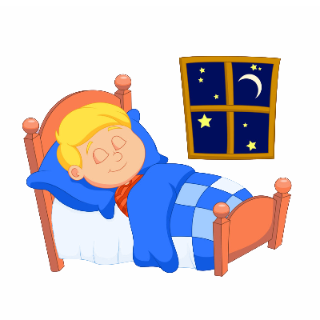
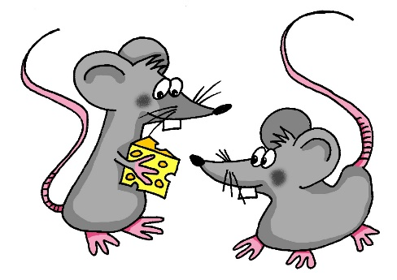
aussprechen
[äu]
…
Häuser
[mice]
[to dream]
träumen
Mäuse
Notes:
Timing: 1 minute
Aim: to consolidate the SSC [äu].
Procedure:
Re-present the SSC and the source word ‘Häuser’ (with gesture, if using).
Click to bring on the picture and get pupils to repeat the word ‘Häuser’ (with gesture, if using).
Present the cluster words in the same way, bringing on the picture and getting pupils to pronounce the words.
Word frequency:
Häuser [Haus-147] Mäuse [Maus-3463] träumen [1793]
Jones, R.L & Tschirner, E. (2019). A frequency dictionary of German: Core vocabulary for learners. London: Routledge.
5

Slide 6










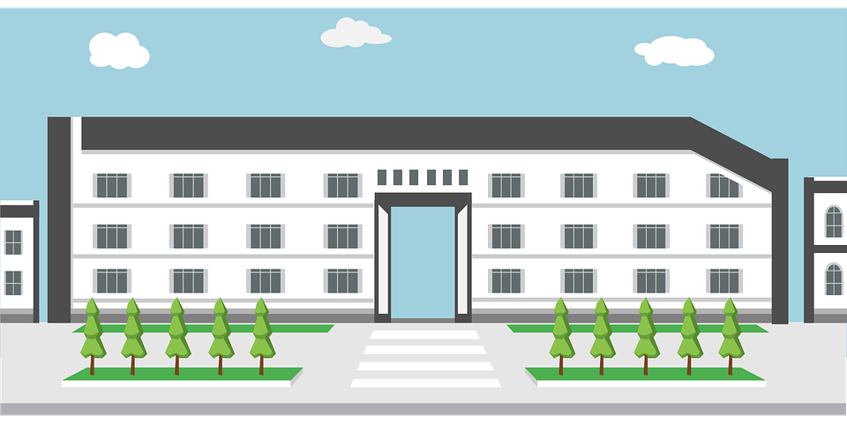



Hör zu.
The pupils are donating things for a jumble sale.
Schreib 1-10 und das Wort. Ist es mit [au], [äu], oder [au] und [äu]?
hören
1. H_ _ ser
6. Puppenh_ _s
Baum
Häuser
2. B_ _ m
Auto
Mäuse
7. k_ _fen
aufbäumen*
au
äu
3. _ _ to
Stauräume*
Gebäude
Puppenhaus*
8. Geb_ _ de
4. M_ _ se
Bäume
kaufen
9. St_ _r_ _me
der Stauraum – storage
5. _ _fb_ _ men
das Puppenhaus – doll’s house
aufbäumen – to rear up
10. B_ _me
Notes:
Timing: 5 minutes
Aim: to practise recognising aurally the SSCs [au] and [äu].
Procedure:
Click to bring up instructions. Pupils write down 1-8 and will write the full word with [au] or [äu], based on what they hear.
Click the audio button to hear the first word, elicit the answer from pupils and click to display answer.
Repeat for items 2-10. Note: Click the sound arrows in numerical order so that the answers will appear in the right order.
Transcript:
Häuser
Baum
Auto
kaufen
aufbäumen
Puppenhaus
Mäuse
Gebäude
Stauräume
Bäume
Word frequency (1 is the most frequent word in German):
aufbämen [n/a] Stauraum [n/a] Puppe [4674]
Source: Jones, R.L. & Tschirner, E. (2019). A frequency dictionary of German: core vocabulary for learners. Routledge

Slide 7

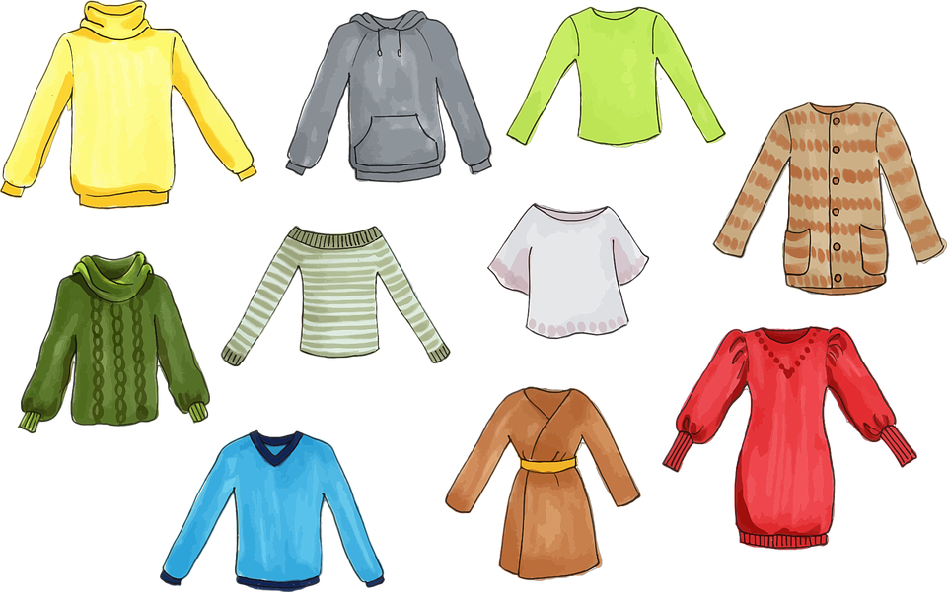
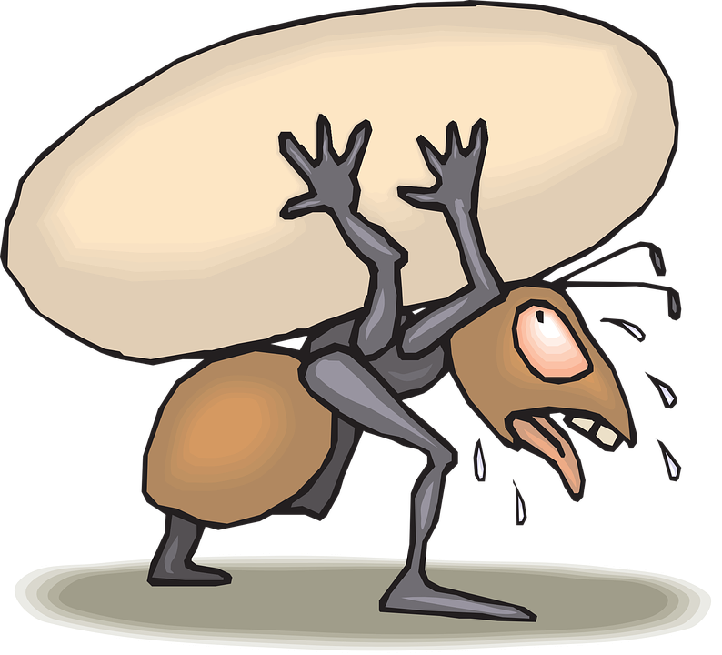


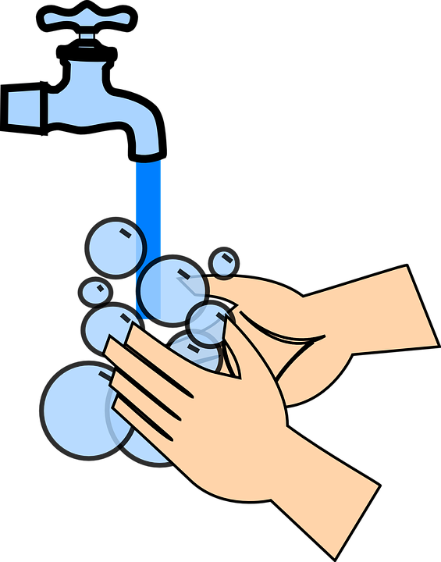

tragen has two different meanings!
You already know the verb ‘kaufen’ – to buy!
Vokabeln lernen
Wörter
[to wear]
[to carry]
[to run, running ]
[to sell]
schlafen
tragen
laufen
verkaufen
waschen is a cognate – but watch the German [w] sound!
waschen
das Auto
die Nacht
Notes:
[1/2]
Timing: 3 minutes (two slides)
Aim: to introduce the new items of vocabulary for this week.
Procedure
1. Click to introduce the new words and their pictures.
2. Check that pupils are clear what the words mean in English.
3. Draw attention to the callouts.
4. Practise pronouncing the new words as a class and individually.
2. Then, on the next slide, pupils try to match the German and the pictures, then try to recall the German words.

Slide 8

Vokabeln lernen
laufen
tragen
schlafen
die Nacht
das Auto
waschen
verkaufen
1
2
4
5
6
7
3
Notes:
2/2
Aim: to provide written recognition and read aloud practice of the new vocabulary.
Procedure:
1. Pupils match the German nouns to the pictures in their heads.
2. The teacher gives the pupils a number and the pupils must say the correct word in German. The number prompts are the trigger (i.e. click on the number) for the lines to connect the correct word to the picture.
3. Click to make each German word disappear in turn. Can pupils say the German words aloud?

Slide 9





Present tense: strong verbs a → ä
Some German verbs change the vowel in the er/sie/es form.
The ‘a’ in the stem changes to ‘ä’:
We call these strong verbs.
Ich schlafe.
I sleep/am sleeping.
This changes the vowel sound!
Sie schläft.
She sleeps/is sleeping.
In strong verbs with ‘au’, the ‘ä’ changes the vowel sound a lot, too!
Ich laufe.
I run/am running.
Er läuft.
He runs/is running.
The verb endings are the same for all verbs in the present tense.
Notes:
Timing: 2 minutes
Aim: to present the vowel changes from a → ä for strong verbs in the 3rd person singular.
Procedure:
Click through the animations to present the new information.
Elicit English translation for the German examples provided.
9

Slide 10


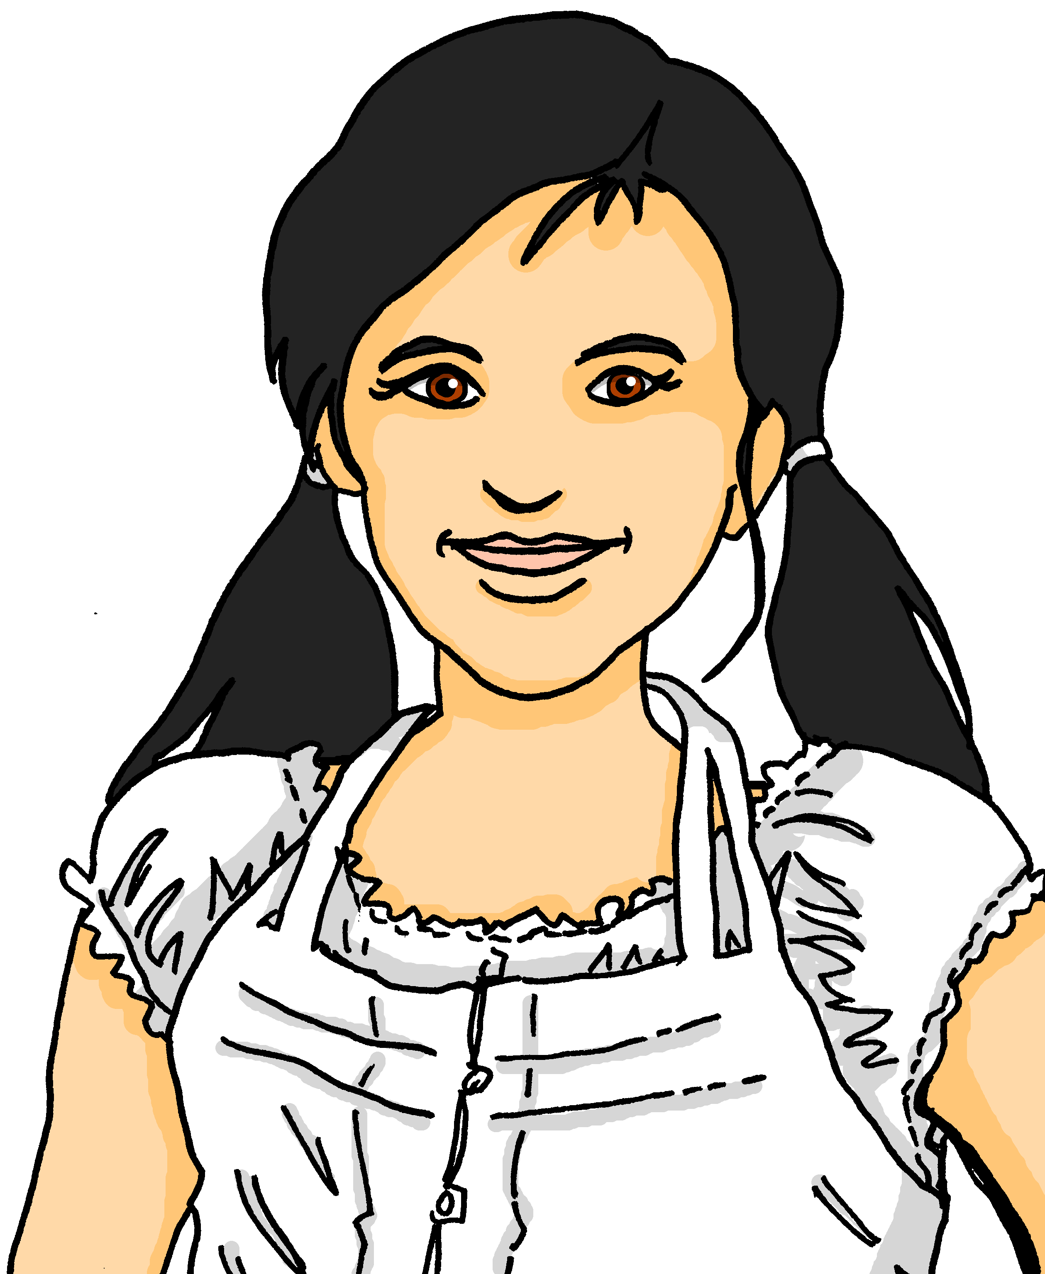
lesen
Ein Projekt für UNICEF
Lias and Ronja are planning fund-raising activities for UNICEF.
Ronja schreibt an Johanna. Wer macht was? Schreib 1 – 6, ich (Ronja)
oder er (Lias), und die Aktivität auf Englisch.
3. I wear a suit to school.
1. Er läuft jeden Tag sechs Kilometer.
4. Ich wasche am Wochenende Hunde.
ich
4.
1. n läufn jeden Tag sechs Kilometer!
n waschn am Wochenende Hunde.
4. I wash dogs at the weekend.
5. I carry bags for people in the evenings.
2. Er schläft eine Nacht in der Schule!
5. Ich trage abends Taschen für Leute.
n schläfn eine Nacht in der
Schule!
n tragn abends Taschen für Leute.
2.
5.
1. He runs 5km every day.
er
2. He sleeps in school for one night!
3. Ich trage ein Kostüm in der Schule.
6. Er wäscht Autos in der Pause für die Lehrer.
n tragn ein
Kostüm in der
Schule.
n wäschn Autos
in der Pause für die Lehrer.
3.
6.
6. He washes cars for the teachers in the break.
Notes:
Timing: 5 minutes
Aim: to practise recognising stem changes between ich and sie in strong verbs and connecting these with meaning.
Procedure:
Pupils write down 1 to 6 .
Pupils read Ronja’s messages, and for each message say whether it applies to ich (Ronja) or er (Lias), based upon whether or not there is a stem change.
3. Elicit full phrase answers from pupils in German – click to reveal written messages.
4. Elicit English meanings, and click to confirm these.
10

Slide 11
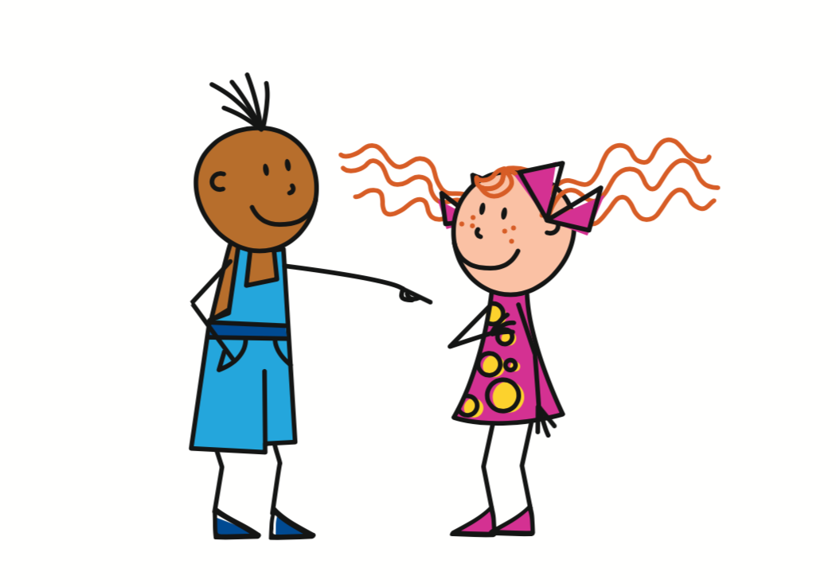
Present tense: strong verbs a→ ä
In German, strong verbs change the stem vowel in the er/sie/es form and also the du form:
Ich laufe.
I run/am running.
Sie läuft.
She runs/is running.
Du läufst.
You run/are running.
Notes:
Timing: 3 minutes (two slides)
Aim: to the stem vowel change for strong verbs a→ä in the second person singular.
Procedure:
Click through the animations to present the information.
Elicit English translation for the German examples provided.
11

Slide 12
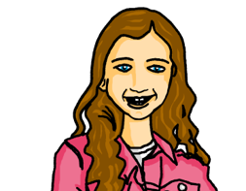


hören
Ein Projekt für UNICEF
Johanna wants to do the same with Moritz.
Hör zu. Wer macht das?
Johanna (ich) oder Moritz (du)?
I am carrying bags for people at the weekend.
I run for two hours.
You don’t sleep for one night.
You are wearing party clothes in school.
I wash the car for mum and dad.
You are sleeping in the garden for one night.
I am carrying a person for one minute.
ich (I)
du (you)
Was? Schreib auf Englisch.
B.
1
2
3
4
5
6
Notes:
Timing: 8 minutes
Aim: to practise aural comprehension of strong verbs in 1st and second persons singular in this lessons’ context of fundraising.
Procedure:
Ensure that the scenario is clear.
Explain the pupils need to listen out for the verb to decide if Johanna is talking about herself (I) or to Moritz (du).
Explain that they will listen again and write the action/activity in English.
Complete the example. Click to give feedback.
Repeat steps 1-4 for items 1 – 6.
Click to correct.
Note: there are two clues in the verbs here, the verb ending and the vowel, so we are not just isolating the vowel change for practice.
Transcript:
Beispiel: [ich] trage am Wochenende Taschen für Leute.
[ich] laufe zwei Stunden lang.
[du] schläfst eine Nacht nicht.
[du] trägst Party-Kleidung in der Schule.
[ich] wasche das Auto für Mutti und Vati.
[du] schläfst eine Nacht im Garten.
[ich] trage eine Person für eine Minute.
12

Slide 13
Tschüss!
Don’t forget this more formal way to say Goodbye!
Auf Wiedersehen!
blau
Notes:
13

