Slide 1
Exploring
Klassenfahrt nach Köln
blau
Follow ups 1-5
Term 2 Week 7
Notes:
Artwork by Steve Clarke. Pronoun pictures from NCELP (www.ncelp.org). All additional pictures selected from Pixabay and are available under a Creative Commons license, no
attribution required.
Phonics:
[s-] [-s-] singen [1063] Person [357] langsam [526] sehr [81] besuchen [820]
[z] Zug [675] sitzen [231] Platz [326] Zimmer [665] zehn [333]
Vocabulary: gehen [66] sein [3] Bibliothek [2366] Dom [4916] Garten [1158] Haus [147] Kino [2020] Stadt [204] Wohin? [1811]
Revisit 1: finden [103] Sie [7] Arbeit [208] Essen [323] Pause [1441] Uniform [3857] Unterricht [1823]
Revisit 2: sehen [79] vergessen [584] nichts [109] Sprache [421] Wochenende [1243] immer [64] jetzt [72]
Jones, R.L & Tschirner, E. (2019). A frequency dictionary of German: Core vocabulary for learners. London: Routledge.
The frequency rankings for words that occur in this PowerPoint which have been previously introduced in these resources are given in the SOW and in the resources that first
introduced and formally re-visited those words.
For any other words that occur incidentally in this PowerPoint, frequency rankings will be provided in the notes field wherever possible.
Remember that at the start of the course (first three lessons of Rot/Gelb) pupils learnt language (for greetings and register taking) that can still be part of the lesson routines in upper KS2 (Blau/Grün). They are not re-taught, as we anticipate that teachers have built these in from early in lower KS2.
1

Slide 2
aussprechen
[s]
Before a vowel, German 's' sounds like English ‘z’.
…
singen
langsam
besuchen
sehr
Person
other words: Person langsam sehr
besuchen
(we then have all the vowels represented)
Notes:
Timing: 1 minute
Aim: to consolidate the SSC [s] before a vowel.
Procedure:
Re-present the SSC and the source word ‘singen’ (with gesture, if using).
Click to bring on the picture and get pupils to repeat the word ‘singen’ (with gesture, if using).
Present the cluster words in the same way, bringing on the picture and getting pupils to pronounce the words.

Slide 3
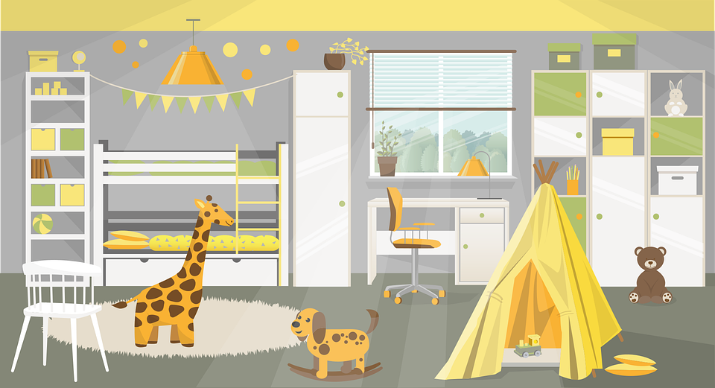
aussprechen
[z]
Which words are nouns? How do you know?
…
Zug
sitzen
Platz
zehn
Zimmer
Notes:
Timing: 1 minute
Aim: to consolidate the SSC [z].
Procedure:
Re-present the SSC and the source word ‘Zug’ (with gesture, if using).
Click to bring on the picture and get pupils to repeat the word ‘Zug’ (with gesture, if using).
Present the cluster words in the same way, bringing on the picture and getting pupils to pronounce the words.
Click to bring up call-out explaining the pronounciation of ‘z’.
Click to bring up the prompt to identify the nouns (the ones with capital letters). This is still very new knowledge for pupils, so it’s good to revisit this as often as we can. Plus, it gives an additional opportunity to pronounce the words.
Click to highlight the 3 x nouns.
Vocabulary:
sitzen [231] Platz [326] Zimmer [665] zehn [333]
Jones, R.L & Tschirner, E. (2019). A frequency dictionary of German: Core vocabulary for learners. London: Routledge.

Slide 4
Follow up 1:
Sag die Wörter.
aussprechen
Sahne
Nase
Amsel
sechzehn
60
…
segeln
Zimmer
Zug
S
sagen
Zeichen
zwei
zusammen
sitzen
0
START
Notes:
Timing: 5 minutes
Aim: to practise applying knowledge of [s] and [z] to known and unknown words.
Procedure: 1. Start the timer. Pupil A tries to read aloud all of the words paying attention to [s] and [z], within the 60 seconds allowed.
2. Pupil B listens. If Pupil A makes a mistake, Pupil B can direct him/her to start again from the beginning. 3. They swap roles and repeat the task.
Vocabulary: Amsel [>5009] Nase [1264] sagen (40] Sahne [>5009] segeln [>5009] Zeichen [1155]
Jones, R.L & Tschirner, E. (2019). A frequency dictionary of German: Core vocabulary for learners. London: Routledge.

Slide 5
Follow up 2
Hör zu.
 | Person? | be | go ? | Where? | Where to?
hören
we
are
in the cinema
1
you
go/ are going
into the cathedral
2
3
I
am
in (the) school
4
you (all)
go/are going
into (the) town
5
she
is
in the garden
you (all)
are
in the room
6
7
she
goes/ is going
home
8
they
go/are going
into the library
Notes:
Aim: to identify all the person verb forms of sein and gehen, and to translate their meaning into English.
Procedure:
Play the recordings by clicking on the audio buttons.
Answers are revealed by consecutive mouse clicks.
Transcript: 1. Wir sind im Kino.
2. Du gehst in den Dom.
3. Ich bin in der Schule.
4. Ihr geht in die Stadt.
5. Sie ist im Garten.
6. Ihr seid im Zimmer.
7. Sie geht nach Hause.
8. Sie gehen in die Bibliothek.

Slide 6
Follow up 3
Rede mit deinem Partner/deiner Partnerin.
Person A spricht.
sprechen
Person B antwortet.
Person A schreibt.
Person A sagt:
I go/am going .......................
1)
in den Garten
im Kino
into the garden
Ich gehe in den Garten.
Ich gehe…
A
B
Notes:
1/2: Model slide
Timing: 5-10 minutes
Aim: to practise productive knowledge of ‘ich gehe’ and ‘ich bin’ and receptive knowledge of R2 and R3 articles following verbs of location / movement.
Procedure:
Print handouts for Pupils A and B (slides 12 and 13).
Use this slide to model the task.
Pupil A looks at no. 1 on their sheet to see if they have ’I go’/am going (‘Ich gehe’) or ‘I am’ (‘Ich bin’). They say this in German to pupil B.
Pupil B looks at their sheet and identifies the correct ending to the sentence. In the example, ‘Ich gehe’ can be followed by ‘in den Garten’ but not ‘im Kino’.
B completes the spoken sentence with the correct option.
A writes person B’s response on their sheet in English.
Complete items 1-5.
Then swap to complete roles.

Slide 7
Follow up 3
Runde 1
Runde 2
sprechen
Person A sagt:
1) I am ....................................................................
2) I go/am going ..................................................
3) I am ....................................................................
4) I am ....................................................................
5) I go/am going ..................................................
Person B sagt:
1) I go/am going ..................................................
2) I go/am going ..................................................
3) I am ....................................................................
4) I go/am going ..................................................
5) I am ....................................................................
in the cinema
into the school
into the school
into the library
in the town
in the school
in the garden
into the cathedral
into the cinema
in the town
B
Notes:
4/4
Answers for both rounds

Slide 8
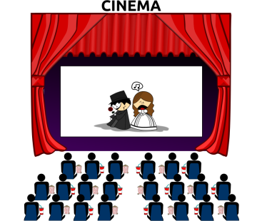
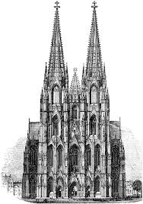
Follow up 4:
Wo bist du? Wohin gehst du?

Schreib auf Deutsch.
schreiben
Johanna and Aisha are trying to meet up with others in their class.
Schreib vier SMS für Johanna und Aisha: “Wir sind... aber wir gehen jetzt…”
Notes:
Timing: 5 minutes
Aim: to practise written production of sentences using R2 and R3 articles correctly, following in + sein (location) and gehen (movement).
Procedure:
Read the title and instructions with pupils and ensure that the task is clear.
Pupils write four messages, using up all of the 8 pictures.
Note: The sentences won’t be identical as students can choose which combination of places to talk about in each sentence.
Pupils can be encouraged to share their texts with each other. They can orally translate these into English, and peer check answers for meaning.
Teachers can circulate as students are writing to check accuracy of Row 2/Row 3 articles.

Slide 9
Follow up 5:

Schreib auf Englisch.
Can you get at least 15 points?
Wörter
 | die Sprache | nichts | das Wochenende
 | jetzt | immer | vergessen
 | Sie | finden | die Uniform
 | die Pause | die Arbeit | der Unterricht
 | die Stadt | die Bibliothek | das Kino
 | der Dom | wohin? | gehen
(the) language
nothing
(the) weekend
Vokabeln
x3
now
always
to forget, forgetting
you (formal)
to find, finding
(the) uniform
x2
(the) break, pause
(the) work
(the) teaching, lessons
(the) town
(the) library
(the) cinema
x1
(the) cathedral
where (to)?
to go, going
Notes:
Timing: 5 minutes
Aim: to practise written comprehension of vocabulary from this and revisited weeks.
Procedure: 1. Give pupils a blank grid. They fill in the English meanings of any of the words they know, trying to reach 15 points in total.
Note: The most recently learnt and practised words are pink, words from the previous week are green and those from week 1 are blue, thus more points are awarded for them, to recognise that memories fade and more effort (heavy lifting!) is needed to retrieve them.

Slide 10
Follow up 5:

Schreib auf Deutsch.
Can you get at least 15 points?
Wörter
 | (the) weekend | always | now
 | to forget, forgetting | (the) language | nothing
 | (the) break, pause | (the) uniform | (the) teaching, lessons
 | to find, finding | you (formal) | (the) work
 | (the) cinema | (the) town | where (to)?
 | to go, going | (the) library | (the) cathedral
Vokabeln
das Wochenende
immer
jetzt
x3
vergessen
die Sprache
nichts
die Pause
die Uniform
der Unterricht
x2
finden
Sie
die Arbeit
das Kino
die Stadt
wohin?
x1
gehen
die Bibliothek
der Dom
Notes:
Timing: 5 minutes
Aim: to practise written production of vocabulary from this and revisited weeks.
Procedure: 1. Give pupils a blank grid. They fill in the German meanings of any of the words they know, trying to reach 15 points in total.
Note: The most recently learnt and practised words are pink, words from the previous week are green and those from week 1 are blue, thus more points are awarded for them, to recognise that memories fade and more effort (heavy lifting!) is needed to retrieve them.

Slide 11
Tschüss!
blau
Notes:
11

Slide 12
Follow up 3
Person A Runde 1
Person A Runde 2
Person A sagt:
1) I am ....................................................................
2) I go/am going ..................................................
3) I am ....................................................................
4) I am ....................................................................
5) I go/am going...................................................
1)
2)
3)
4)
5)
sprechen
in die Schule
im Dom
im Garten
in die Bibliothek
in der Schule
ins Kino
in den Dom
im Haus
in der Stadt
in den Unterricht
B
Notes:
Handout A

Slide 13
Follow up 3
Person B Runde 1
Person B Runde 2
1)
2)
3)
4)
5)
Person B sagt:
1) I go/am going ..................................................
2) I go/am going ..................................................
3) I am ....................................................................
4) I go/am going ..................................................
5) I am ....................................................................
sprechen
in den Garten
im Kino
im Dom
in die Schule
in der Stadt
in die Bibliothek
in die Pause
im Garten
im Haus
ins Kino
B
Notes:
Handout B

Slide 14
Follow up 5:

Schreib auf Englisch.
Can you get at least 15 points?
 | die Sprache | nichts | das Wochenende
 | jetzt | immer | vergessen
 | Sie | finden | die Uniform
 | die Pause | die Arbeit | der Unterricht
 | die Stadt | die Bibliothek | das Kino
 | der Dom | wohin? | gehen
x3
x2
x1
Notes:
Template

Slide 15
Follow up 5:

Schreib auf Deutsch.
Can you get at least 15 points?
 | (the) weekend | always | now
 | to forget, forgetting | (the) language | nothing
 | (the) break, pause | (the) uniform | (the) teaching, lessons
 | to find, finding | you (formal) | (the) work
 | (the) cinema | (the) town | where (to)?
 | to go, going | (the) library | (the) cathedral
Notes:
Template

