Slide 1
Exploring
Klassenfahrt nach Köln
blau
Follow ups 1-5
Term 2 Week 8
Notes:
Artwork by Steve Clarke. Pronoun pictures from NCELP (www.ncelp.org). All additional pictures selected from Pixabay and are available under a Creative Commons license, no
attribution required.
Phonics:
[ß] [ss] [-s] groß [67] essen [323] Fußball [1277] tschüss [3766] heißen [126]
Vocabulary: gehen [66] kommen [62] schwimmen [1863] sein [3] tanzen [1497] Fest [2089] Platz [326] Straße [391] auf [16] nach Hause [n/a]
Revisit 1: bleiben [113] kaufen [506] laufen [252] machen [58] schlafen [679] tragen [271] verkaufen [721] waschen [2315] Auto [361] (Party)Kleidung [2820] Stunde [276] Nacht [325] ruhig [991]
Revisit 2: language from Term 1
Jones, R.L & Tschirner, E. (2019). A frequency dictionary of German: Core vocabulary for learners. London: Routledge.
The frequency rankings for words that occur in this PowerPoint which have been previously introduced in these resources are given in the SOW and in the resources that first
introduced and formally re-visited those words.
For any other words that occur incidentally in this PowerPoint, frequency rankings will be provided in the notes field wherever possible.
Remember that at the start of the course (first three lessons of Rot/Gelb) pupils learnt language (for greetings and register taking) that can still be part of the lesson routines in upper KS2 (Blau/Grün). They are not re-taught, as we anticipate that teachers have built these in from early in lower KS2.

Slide 2
Follow up 1:
[s] [ss] [ß]
…
Wer macht was auf der Klassenfahrt?
Lies die Sätze.
aussprechen
aussprechen
Sandro
Moses
Susie
Massimo
Sieglinde
Saskia
Saskia
1
Sandro
2
Susie
3
…sucht köstliche Süßigkeiten.
…geht am Samstag ins Schloss.
…singt sieben klasse Songs.
Massimo
4
Sieglinde
5
Moses
6
…isst siebenundsiebzig Salzbretzeln*!
…sitzt mit Susie und Sandro.
…hasst grünes Eis.
die Saltzbretzel – salty pretzel
Notes:
Timing: 5 minutes
Aim: Consolidation of SSCs [s], [ss] and [ß] in a read-aloud activity.
Procedure:
Pupils read the phrases aloud in pairs and match them to each person.
Click on buttons to play the audio.
Pupils listen and check their answers.
Click to reveal answers.
Vocabulary
Bretzel [N/A] hassen [2673] klasse [N/A] Salz [2608]
Jones, R.L & Tschirner, E. (2019). A frequency dictionary of German: Core vocabulary for learners. London: Routledge.

Slide 3
Follow up 2
Hör zu. Was ist das auf Englisch? A, B oder C?
 | A | B | C
 | She is going to the market. | They are going to the market. | She is at the market.
 | We are coming home. | We are home. | You (all) are coming home.
 | You (all) are running onto the street. | You are running into the street. | You are in the street.
 | He is in the cinema. | They are going to the cinema | He is going to the cinema.
 | I am running in the woods. | She is running in the woods. | I am sleeping in the woods.
 | They are going to the festival. | She is going to the festival. | They are at the festival.
hören
B.
1
2
3
4
5
Notes:
Timing: 5 minutes
Aim: to practise aural comprehension of a range of the new language learnt so far in the course. Procedure: 1. Read the teacher instruction for the activity.
2. Click to listen to the first item
3. Pupils write down the correct letter (A. B or C) of the English translation.
4. Click to reveal the correct column A, B or C.
5. Complete items 2-6 and click to correct.
Transcript: B. Sie ist auf dem Markt.
Wir kommen nach Hause.
Du läufst auf die Straße.
Er geht ins Kino.
Ich laufe im Wald.
Sie sind auf dem Fest.

Slide 4
Follow up 3
Place, verb or noun?
…
Person B: Write 3 words in German from the table below. Person A: Ask yes/no questions in German to work out the words.
sprechen
Ist es ein Ort?
Nein!
das Substantiv – noun
Ist es ein Verb?
Nein!
Person A
Person B
Ist es ein Substantiv*?
Ja!
Then swap roles and play again!
Ist es ‘die Nacht’?
Ja!
kommen | tragen | die Nacht | schlafen
das Fest | verkaufen | das Auto | die Uhr
die Straße | nach Hause | waschen | die Stunde
schlafen | der Platz | kaufen | die (Sport)kleidung
Notes:
Timing: 5 minutes
Aim: to practise asking and answering yes/no questions to identify previously taught vocabulary and the new vocabulary from this week. Procedure:
Pupil B chooses 3 words and writes them down secretly.
Pupil A asks yes/no questions using the categories place, verb or noun and then asks ‘Ist es…’ until they work out the 3 words on B’s list.
Then pupils swap roles and play again. Vocabulary
Substantiv [N/A] hassen [2673] klasse [N/A] Salz [2608]
Jones, R.L & Tschirner, E. (2019). A frequency dictionary of German: Core vocabulary for learners. London: Routledge.

Slide 5
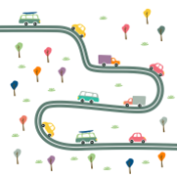
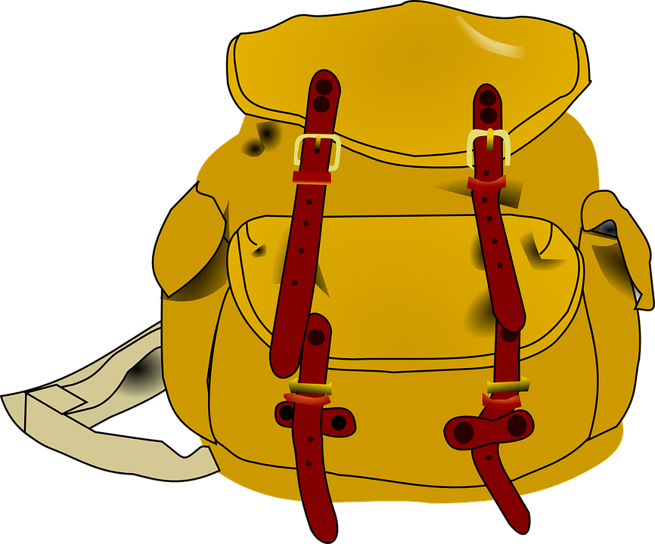
Follow up 4:
Johanna schreibt an ihre Brieffreundin Laura.
She draws pictures for some of the words for Laura to practise her German.
schreiben
Hallo Laura! Wie geht’s?
Wir sind heute auf Klassenfahrt in Köln. Im Moment
sind wir auf dem Platz in der Stadt(mitte).
1
2
Heute Nachmittag gehen wir in den Dom
und dann auf das Fest auf
der Straße.
3
4
5
Am Dom verkaufen Leute* Souvenirs. Ich mag Souvenirs, und du? Ich trage sie in der Tasche.
6
Heute Abend kommen wir müde aber glücklich nach Hause.
Leute – people
glücklich – happy
Laura, was machst du auf deiner Klassenfahrt? Deine Johanna.
Notes:
Timing: 5 minutes
Aim: to practise written comprehension of vocabulary and structures from this week and revisited weeks.
Procedure:
Pupils use the visual prompts to complete Johanna’s letter to Laura. Ensure these are clear and provide hints in English where necessary.
Click to reveal the answers.
Help pupils to translate the postcard into English.
Vocabulary
glücklich [1070] Leute [224] Souvenir [N/A].
Jones, R.L & Tschirner, E. (2019). A frequency dictionary of German: Core vocabulary for learners. London: Routledge.

Slide 6
Follow up 5:

Schreib auf Englisch.
Can you get at least 15 points?
Wörter
 | jeden Tag | die Uhr | der Nachmittag
 | zusammen | um vier Uhr | der Abend
 | waschen | die Nacht | schlafen
 | verkaufen | laufen | tragen
 | nach Hause | kommen | das Fest
 | der Platz | die Straße | auf
every day
(the) watch, clock, o’clock
(the) afternoon
Vokabeln
x3
at four o’clock
(the) evening
together
to wash, washing
(the) night
to sleep, sleeping
x2
to sell, selling
to run, running
to wear, to carry
(to) home
(the) festival, celebration
to come, coming
x1
(the) square, place, room
(the) street
on, to, at
Notes:
Timing: 5 minutes
Aim: to practise written production of vocabulary from this and revisited weeks.
Procedure: 1. Give pupils a blank grid. They fill in the English meanings of any of the words they know, trying to reach 15 points in total.
Note: The most recently learnt and practised words are pink, words from the previous week are green and those from week 1 are blue, thus more points are awarded for them, to recognise that memories fade and more effort (heavy lifting!) is needed to retrieve them.

Slide 7
Follow up 5:

Schreib auf Deutsch.
Can you get at least 15 points?
Wörter
 | (the) evening | (the) afternoon | every day
 | (the) watch, clock, o’clock | together | at four o’clock
 | to sell, selling | to wash, washing | (the) night
 | to run, running | to sleep, sleeping | to wear, to carry
 | (the) street | on, to, at | (to) home
 | to come, coming | (the) festival, celebration | (the) square, place, room
der Abend
der Nachmittag
jeden Tag
Vokabeln
x3
zusammen
um vier Uhr
(die) Uhr
verkaufen
waschen
die Nacht
x2
laufen
schlafen
tragen
die Straße
auf
nach Hause
x1
kommen
das Fest
der Platz
Notes:
Timing: 5 minutes
Aim: to practise written production of vocabulary from this and revisited weeks.
Procedure: 1. Give pupils a blank grid. They fill in the German meanings of any of the words they know, trying to reach 15 points in total.
Note: The most recently learnt and practised words are pink, words from the previous week are green and those from week 1 are blue, thus more points are awarded for them, to recognise that memories fade and more effort (heavy lifting!) is needed to retrieve them.

Slide 8
Tschüss!
blau
Notes:
8

Slide 9
Follow up 5:

Schreib auf Englisch.
Can you get at least 15 points?
Wörter
 | jeden Tag | die Uhr | der Nachmittag
 | zusammen | um vier Uhr | der Abend
 | waschen | die Nacht | schlafen
 | verkaufen | laufen | tragen
 | nach Hause | kommen | das Fest
 | der Platz | die Straße | auf
Vokabeln
x3
x2
x1
Notes:
TEMPLATE

Slide 10
Follow up 5:

Schreib auf Deutsch.
Can you get at least 15 points?
Wörter
 | (the) evening | (the) afternoon | every day
 | (the) watch, clock, o’clock | together | at four o’clock
 | to sell, selling | to wash, washing | (the) night
 | to run, running | to sleep, sleeping | to wear, to carry
 | (the) street | on, to, at | (to) home
 | to come, coming | (the) festival, celebration | (the) square, place, room
Vokabeln
x3
x2
x1
Notes:
TEMPLATE

