Slide 1
Exploring
Klassenfahrt nach Köln
blau
auf (R3) location and in (R2) movement
present tense
SSC [ss|ß|-s]
Term 2 Week 8
Notes:
Artwork by Steve Clarke. Pronoun pictures from NCELP (www.ncelp.org). All additional pictures selected from Pixabay and are available under a Creative Commons license, no
attribution required.
Phonics:
[ß] [ss] [-s] groß [67] essen [323] Fußball [1277] tschüss [3766] heißen [126]
Vocabulary: gehen [66] kommen [62] schwimmen [1863] sein [3] tanzen [1497] Fest [2089] Platz [326] Straße [391] auf [16] nach Hause [n/a]
Revisit 1: bleiben [113] kaufen [506] laufen [252] machen [58] schlafen [679] tragen [271] verkaufen [721] waschen [2315] Auto [361] (Party)Kleidung [2820] Stunde [276] Nacht [325] ruhig [991]
Revisit 2: language from Term 1
Jones, R.L & Tschirner, E. (2019). A frequency dictionary of German: Core vocabulary for learners. London: Routledge.
The frequency rankings for words that occur in this PowerPoint which have been previously introduced in these resources are given in the SOW and in the resources that first
introduced and formally re-visited those words.
For any other words that occur incidentally in this PowerPoint, frequency rankings will be provided in the notes field wherever possible.
Remember that at the start of the course (first three lessons of Rot/Gelb) pupils learnt language (for greetings and register taking) that can still be part of the lesson routines in upper KS2 (Blau/Grün). They are not re-taught, as we anticipate that teachers have built these in from early in lower KS2.
1

Slide 2
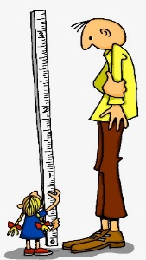
aussprechen
[s][ss][ß]
…
You know that ‘s’ in front of a vowel sounds like the English ‘z’.
ß is just a special way of writing ‘ss’ after a long vowel.
At all other times German ‘s’, ‘ss’ and ‘ß’ sound like English ‘s’.
groß
[big, tall]
Notes:
Timing: 1 minute
Aim: To introduce SSC [s/ss/ß] when not in front of a vowel.
Procedure:
Introduce the SSC and say the [s/ss/ß] sound first, on its own. Pupils repeat it with you.
Present the source word ‘groß’ (with gesture, if using).
Click to bring on the picture and get pupils to repeat the word ‘groß’ (with gesture, if using).
Use the callouts to emphasise the difference between ‘s’ in front of a vowel and ‘s’ at all other times and to explain about the new letter ß.
Note:
A gesture for this could be to reach high above your head.
groß [67]
Jones, R.L & Tschirner, E. (2019). A frequency dictionary of German: Core vocabulary for learners. London: Routledge.
2

Slide 3
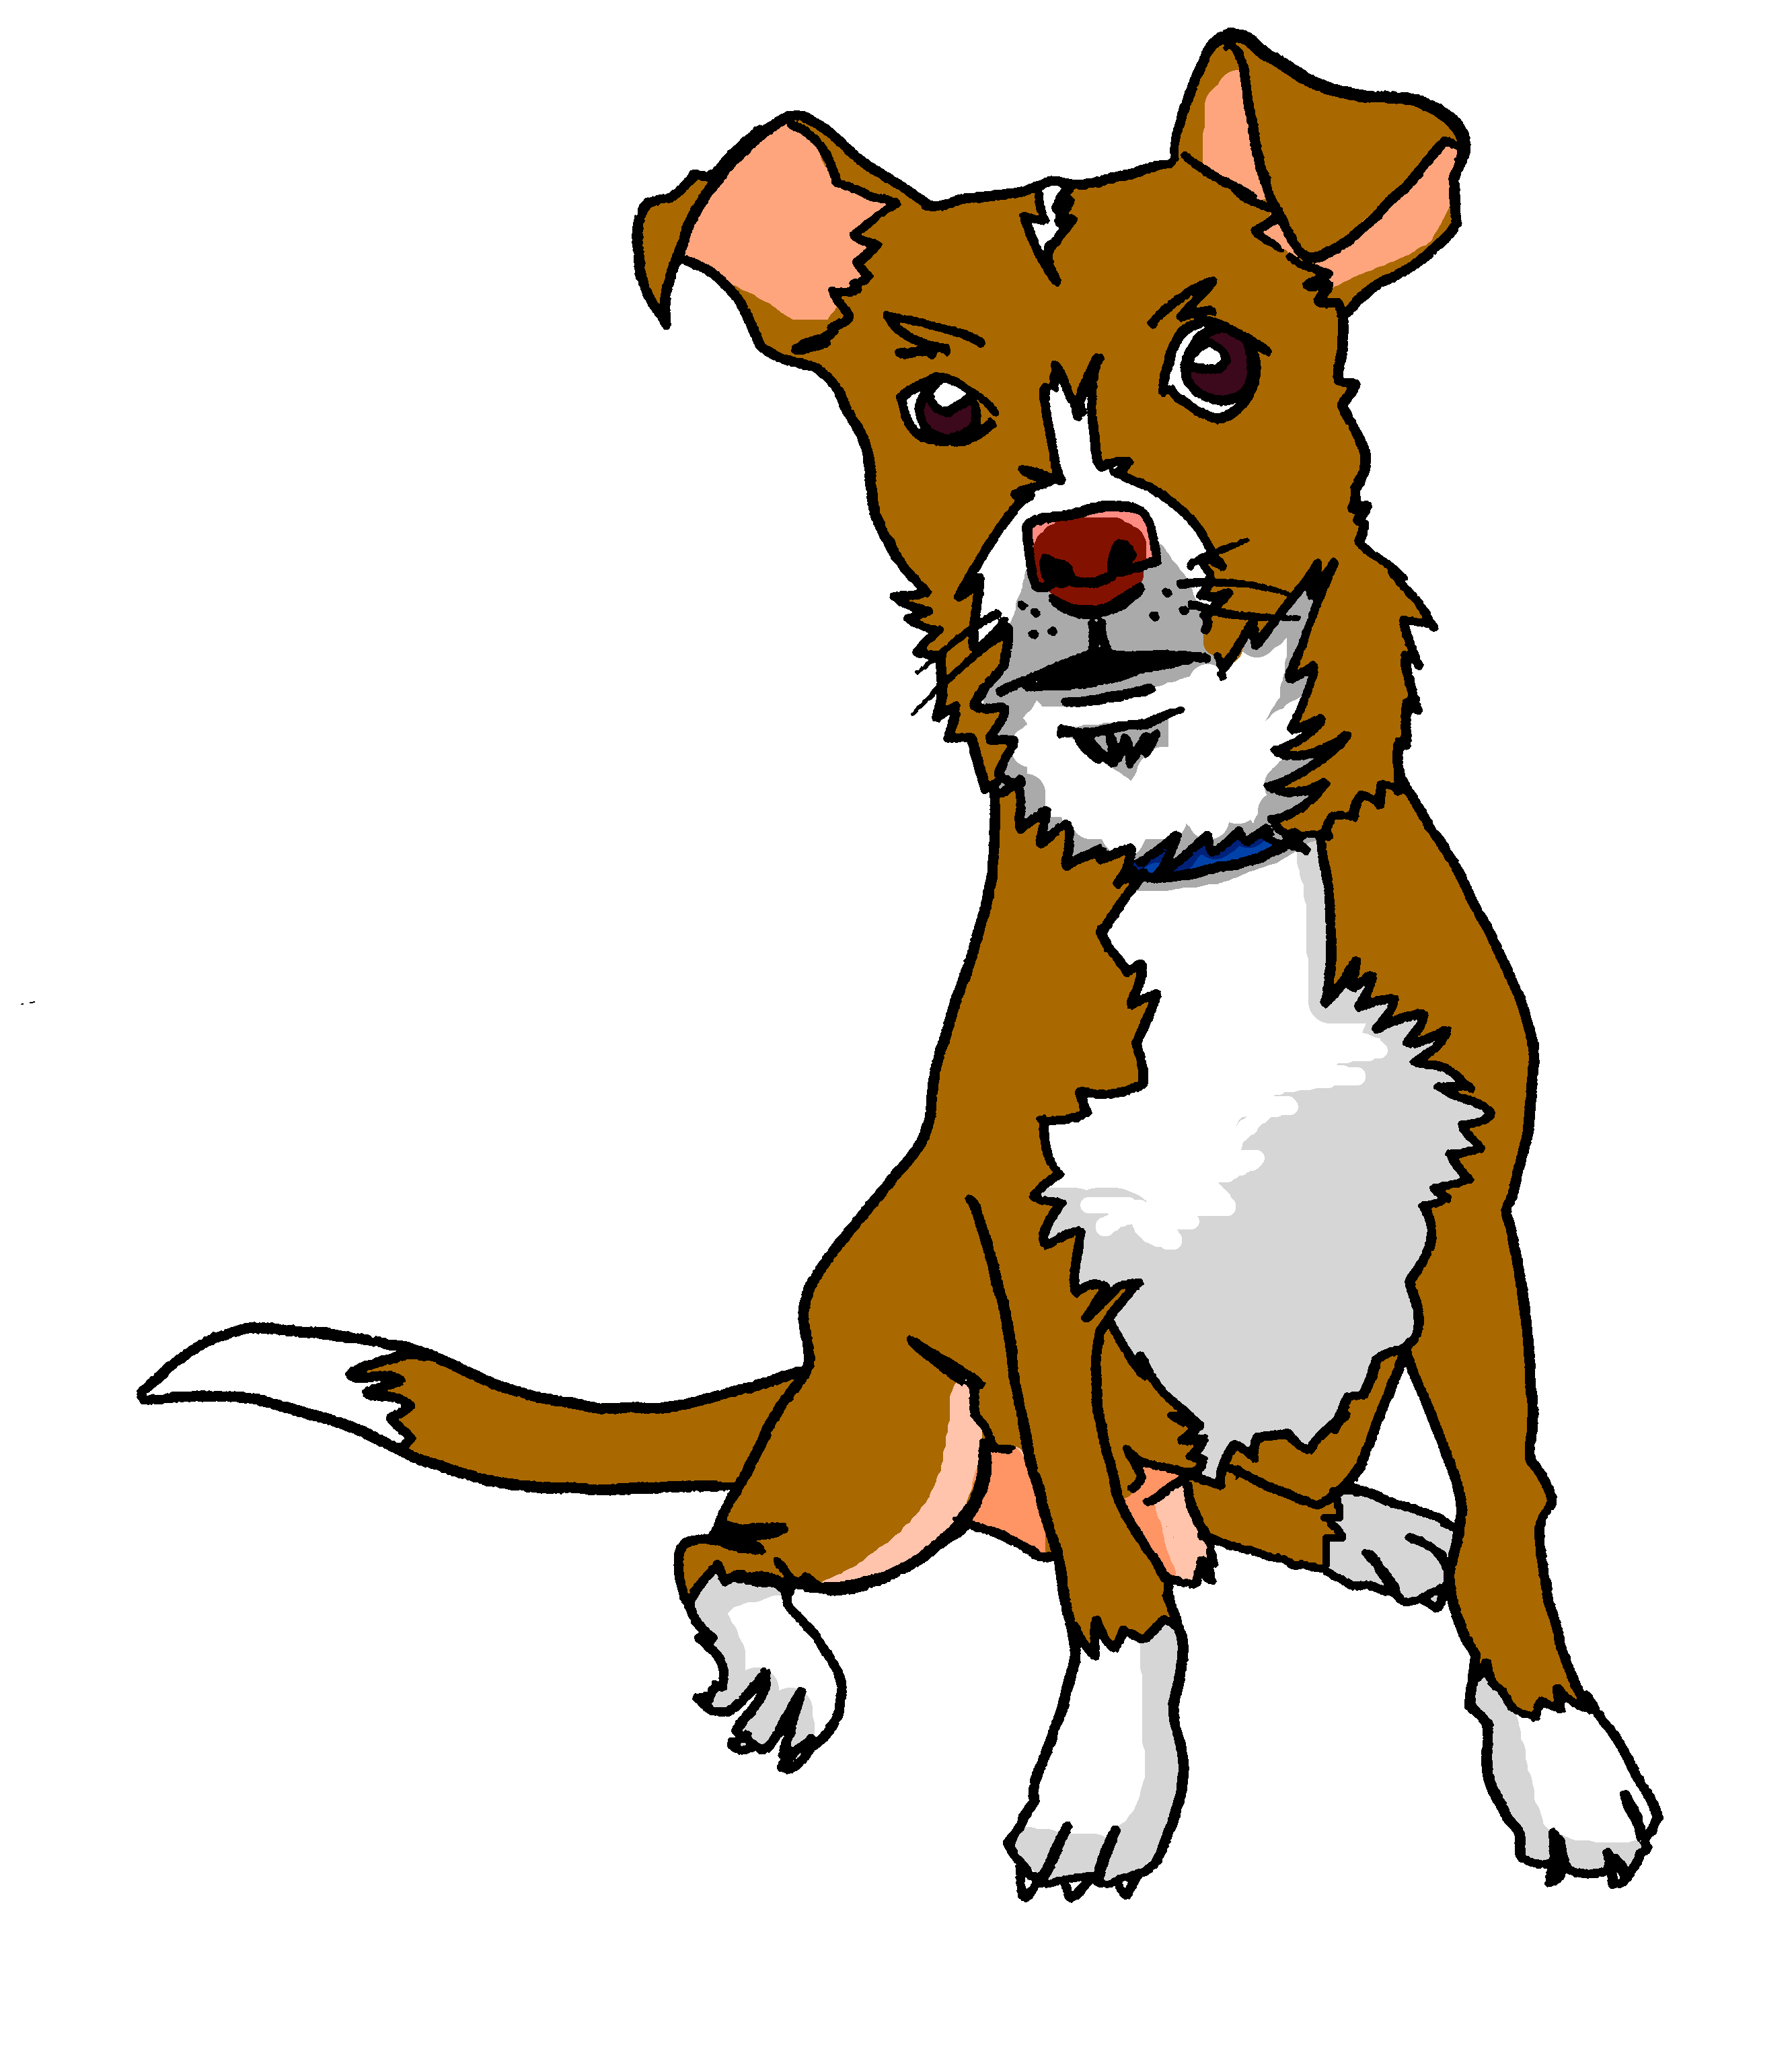
aussprechen
[s][ss][ß]
…
Tasso
Fußball
heißen
groß
essen
tschüss
This can be written with ‘s’ or ‘ss’ at the end.
[to eat, eating]
Notes:
Timing: 1 minute
Aim: to introduce the SSC [s/ss/ß].
Procedure:
Re-present the SSC and the source word ‘groß’ (with gesture, if using).
Click to bring on the picture and get pupils to repeat the word ‘groß’ (with gesture, if using).
Present the cluster words in the same way, bringing on the pictures and getting pupils to pronounce the words.
Note: It’s very important that pupils start to recognise ß as an ‘s’ sound, and don’t confuse it with a B.
essen [323] Fußball [1277] tschüss [3766] heißen [126]
Jones, R.L & Tschirner, E. (2019). A frequency dictionary of German: Core vocabulary for learners. London: Routledge.
3

Slide 4
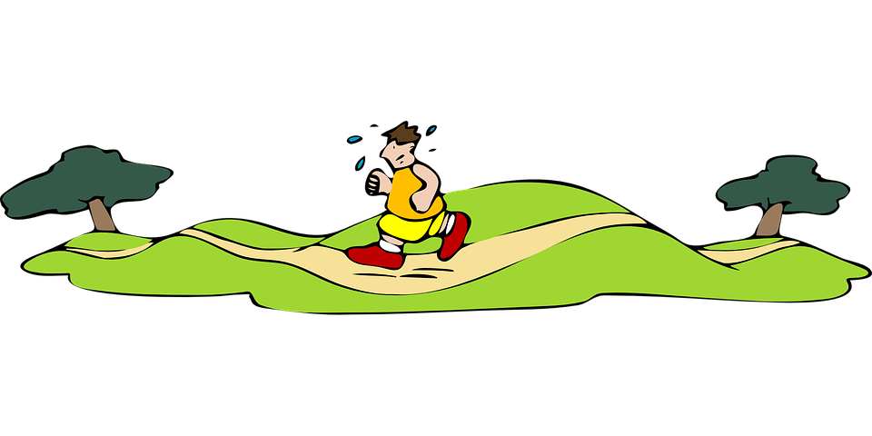
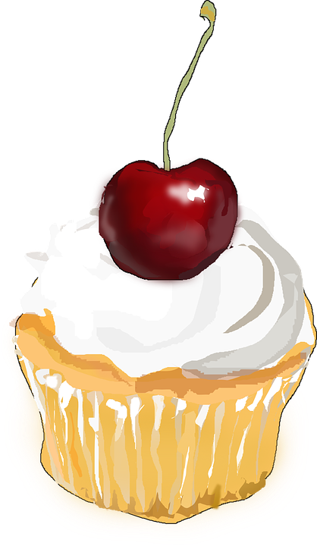
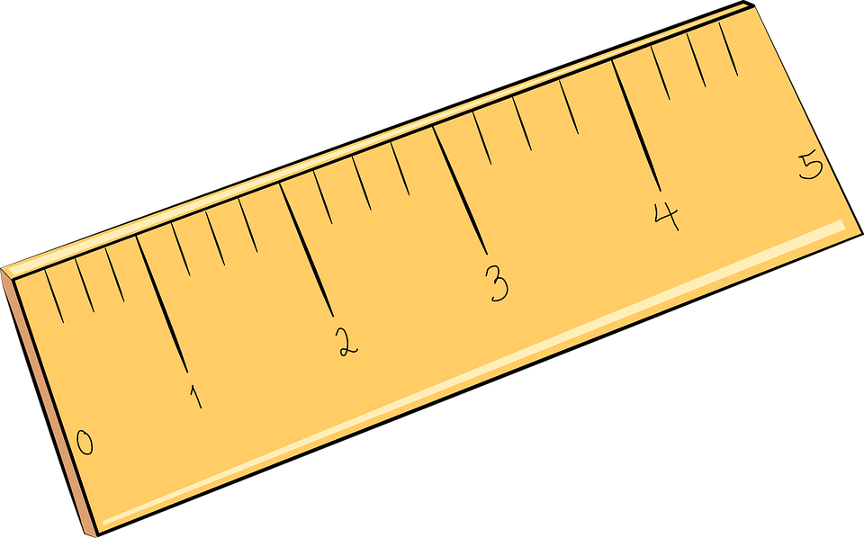
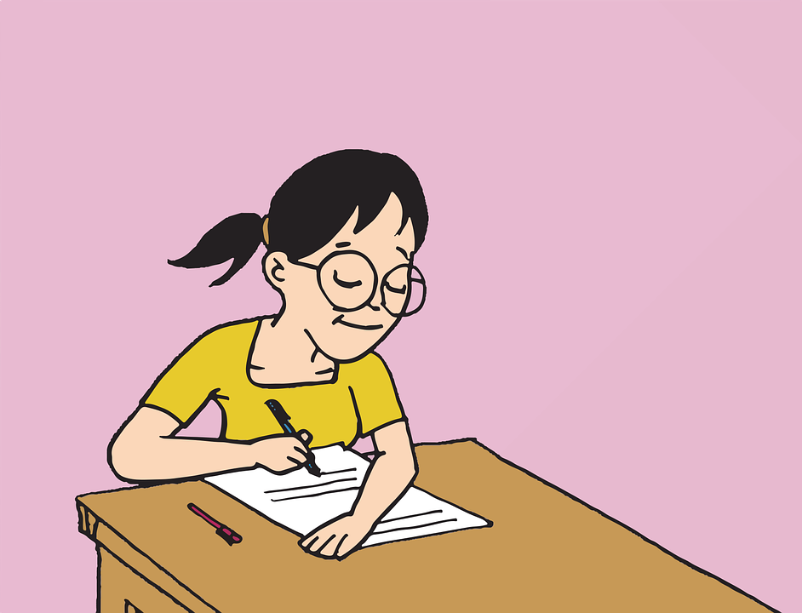
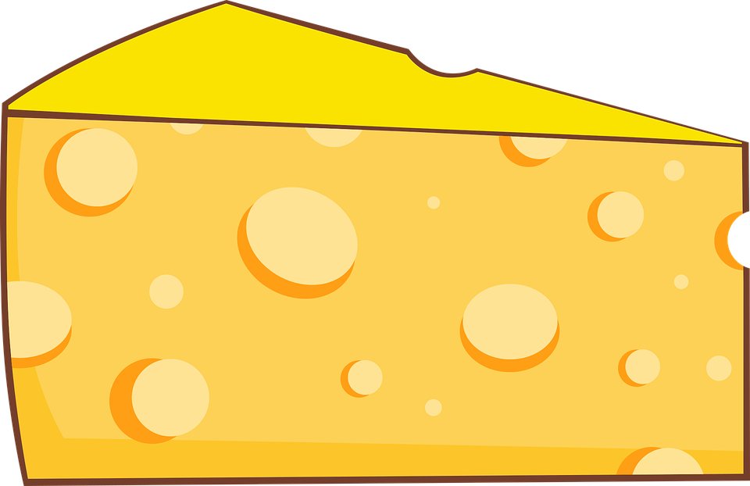
hören
Hör zu.
Ist es [s] oder [ss]?
 | Tra__e
 | Wa__er
 | __ahne
 | me__en
 | Ra__en
 | __atz
 | Kä__e
[s] | [ss]
 |  | [trail]
 |  | [cream]
 |  | [to measure, measuring]
 |  | [lawn]
B.
1
2
3
4
5
6
Notes:
Timing: 5 minutes
Aim: to practise aural identification of [s] versus [ss] in known and unknown words.
Procedure:
1. Click on the sound buttons to play the recording. B stands for Beispiel (example).
2. Elicit the answer. Click to bring up the answer tick.
3. Click to bring up image /and or meaning.
Transcript:
Beispiel: Trasse
Wasser
Sahne
messen
Rasen
Satz
Käse
Vocabulary: Käse [4094] messen [896] Rasen [4521] Sahne [N/A] Trasse [N/A] Jones, R.L & Tschirner, E. (2019). A frequency dictionary of German: Core vocabulary for learners. London: Routledge.
4

Slide 5
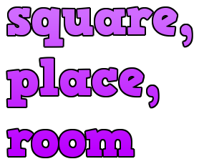
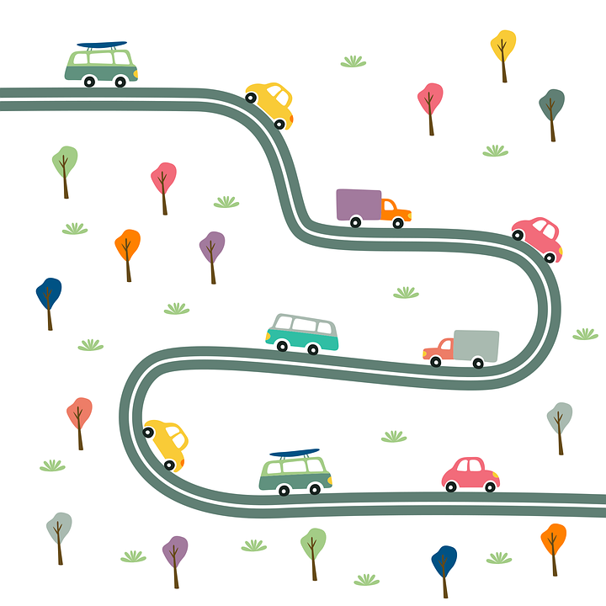
Vokabeln
Vokabeln lernen
Wörter
kommen
das Fest
auf
nach Hause
der Platz
die Straße
Notes:
Timing: 5 minutes
Aim: to present and practise written comprehension and read aloud of the new vocabulary for this week.
Procedure: 1. Click for a German word. Elicit pronunciation from pupils.
2. Click for the English meaning and picture prompt. Elicit the German word again.
3. Present all six words like this, in order.
4. Click for one English meaning to disappear. Elicit the English meaning from pupils. Continue with the remaining items.
5. Click for the German word to disappear. Elicit the German from pupils. Continue with the remaining items.
5

Slide 6
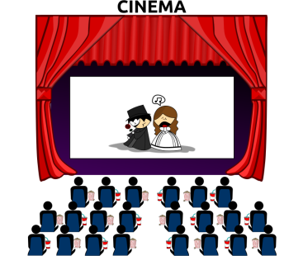
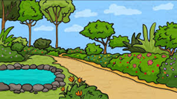
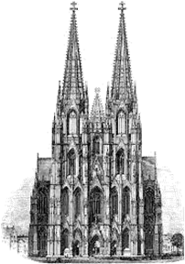
schreiben
der Buchstabe - letter
Schreib ‘the’ auf Deutsch.
Welcher Buchstabe ist es?
das
a
b
c
_________ Kino
_________ Bibliothek
_________ Schloss
_________ Dom
_________ Stadt(mitte)
_________ Wald
_________ Fest
_________ Straße
_________ Garten
_________ Platz
d
die
a
das
i
der
d
e
f
g
h
die
b
der
g
das
f
h
i
j
die
c
der
e
der
j
Notes:
Timing: 5 minutes
Aim: to practise written production of the correct definite articles and their association with some previously taught nouns.
Procedure:
1. Read the instruction in German.
2. Pupils to identify the gender of the nouns and write the correct indefinite article.
3. Pupils match the pictures to the words to reinforce their understanding.
Transcript:
das Kino
die Bibliothek
das Schloss
der Dom
die Stadt(mitte)
der Wald
das Fest
die Straße
der Garten
der Platz
Vocabulary:
Buchstabe [2905]
Jones, R.L & Tschirner, E. (2019). A frequency dictionary of German: Core vocabulary for learners. London: Routledge.
6

Slide 7
Was ist das?
…
sprechen
der
die
das
Notes:
Timing: 3 minutes Aim: To practise use of the definite article with new nouns from this week, without gender or word support. Procedure: 1. Ask ‘Was ist das?’ 2. Elicit ‘Das ist der/die/das…’ Words are triggered so that students can respond in any order and volunteer those they are most confident with first. 3. Click on the words to make them ‘fly’ into the appropriate gender ‘bin’ at the bottom.
Note: ‘das Wasser’ and ‘die Schule’ have been added to this slide.
7

Slide 8
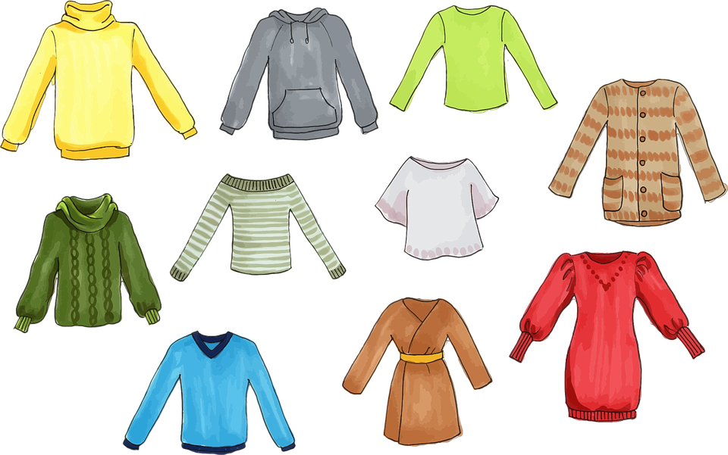
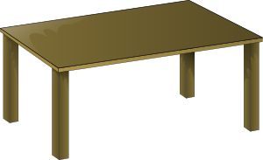
The preposition ‘auf’ (onto, on)
We shorten ‘auf das‘ to ‘aufs’.
Auf (on, onto) works the same as in (in, into) in German.
For ‘onto’ (movement):
masculine
feminine
neuter
Minze springt…
auf den Tisch
auf die Kleidung
auf das Auto
Minze jumps/is
jumping…
onto the table
onto the clothes
onto the car
Compare ‘on’ (location):
Minze schläft…
auf dem Tisch
auf der Kleidung
auf dem Auto
Minze sleeps/is sleeping…
on the table
on the clothes
on the car
Notes:
Timing: 2 minutes
Aim: to introduce the preposition ‘auf’.
Procedure:
Click through the animations to present the grammar of ‘auf’.
8

Slide 9
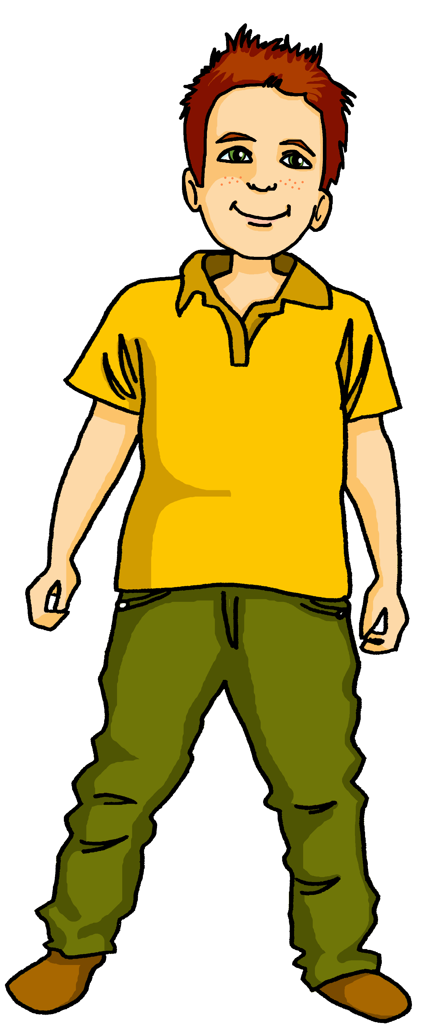
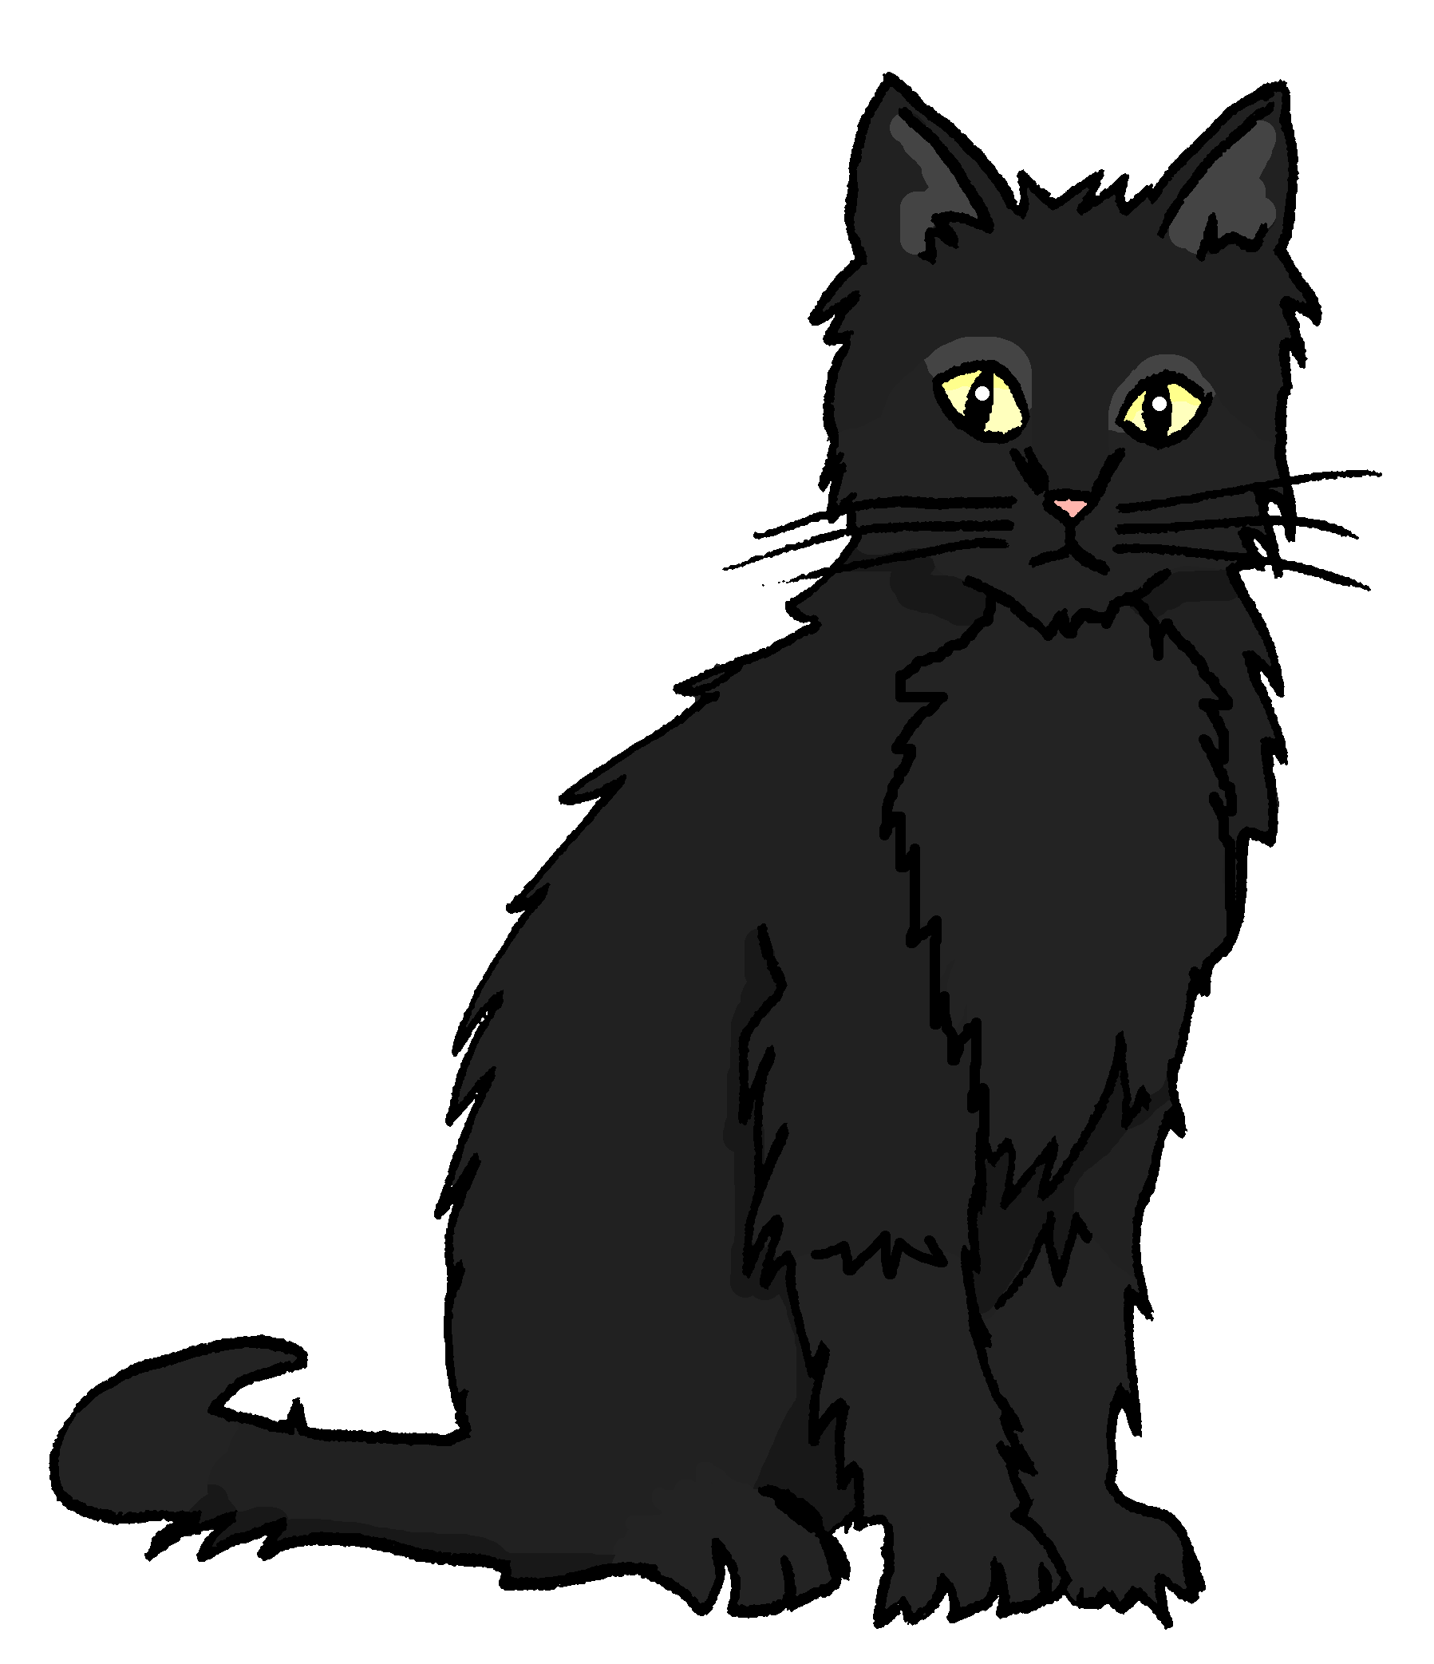
hören
Hör zu. Moritz schickt Sprachnachrichten über Minzes Tag.
The traffic noise blocks out some of Moritz’ voice messages.
Is Minze jumping on something or sitting on something?
jumping | sitting
B.
1
2
3
4
5
6
Notes:
Timing: 5 minutes
Aim: to practise aural comprehension of the articles used with auf with movement (accusative) and without movement
Procedure:
1. Click the audio button for the example to play the recording.
2. Elicit the answer. Is Minze jumping or sitting? Pupils decide, based on the article.
3. Click to bring up the answer tick.
4. Continue for items 1-6.
Transcript:
Beispiel: Sie [springt] auf die Blume.
Sie [sitzt] auf dem Spiel.
Sie [sitzt] auf der Tasche.
Sie [springt] auf das Haus.
Sie [sitzt] auf dem Foto.
Sie [springt] auf die Frau.
Sie [sitzt] auf dem Buch.
9

Slide 10
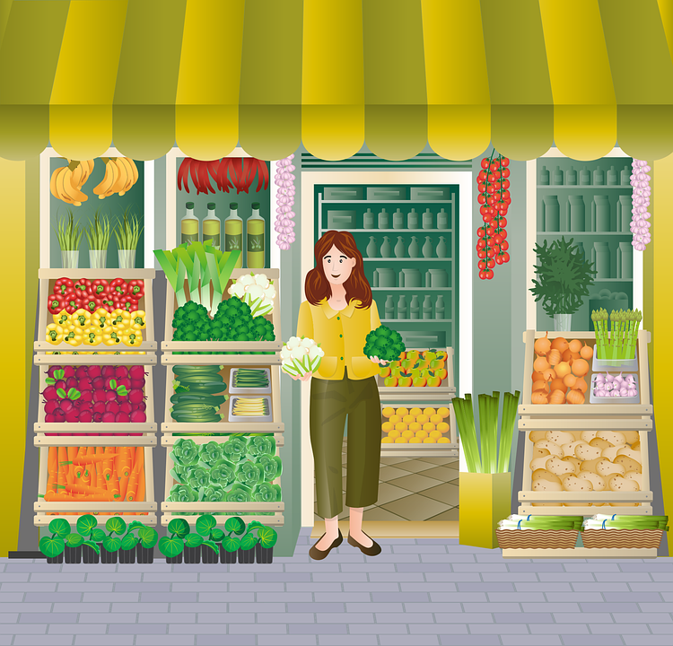
The preposition ‘auf’ (at, to)
We shorten ‘auf das‘ to ‘aufs’.
Auf can also mean ‘at’ or ‘to’ for open spaces or events:
masculine
feminine
neuter
Ich gehe…
auf den Markt
auf die Straße
auf das Fest
I go/am going…
to the market
(on)to the street
to the festival
Ich bin…
auf dem Markt
auf der Straße
auf dem Fest
I am…
at the market
on the street
at the festival
Notes:
Timing: 2 minutes
Aim: to introduce more complex grammar for the preposition ‘auf’.
Procedure:
Click through the animations to present the grammar of ‘auf’.
10

Slide 11
lesen
A lot of messages!
Tick the correct meaning of ‘auf’.
on
on
1
Wir gehen auf das Fest.
4
onto
Wir essen auf dem Marktplatz.
onto
at
at
to
to
on
5
on
2
Wir tanzen auf der Straße.
Eine Katze springt auf den Tisch.
onto
onto
at
You have learnt the phrase ‘nach Hause’ earlier this lesson!
at
to
to
3
on
on
6
Wir kommen spät nach Hause.
Wir gehen auf den Markt.
onto
onto
at
at
to
to
Notes:
Timing: 5 minutes
Aim: to practise written comprehension of the articles used with movement and without movement following ‘auf’.
Procedure:
Pupils write 1-6 and the correct English meaning from the four options given.
Click to reveal answers.
11

Slide 12
Tschüss!
blau
Notes:
12

