Slide 1
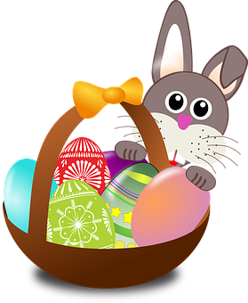
Talking about things and things to do
rot
Vocabulary &
Grammar quiz
Easter activities
Term 2 Week 10
Notes:
Word frequency (1 is the most frequent word in German):
Jones, R.L & Tschirner, E. (2019). A frequency dictionary of German: Core vocabulary for learners. London: Routledge.
The frequency rankings for words that occur in this PowerPoint which have been previously introduced in these resources are given in the SOW and in the resources that first introduced and formally re-visited those words. For any other words that occur incidentally in this PowerPoint, frequency rankings will be provided in the notes field wherever possible.
1

Slide 2
Vocabulary
A For each question, put a cross (x) under the English meaning that matches what you hear. You will hear each German word twice. Choose one correct answer only. (4 marks on this slide)
hören
A | B | C | D
 | thing | present | notebook | board
 | ☐ | ☐ | ☐ | ☐
 | I | you | she | he
 | ☐ | ☐ | ☐ | ☐
 | to understand | to play | to win | to have
 | ☐ | ☐ | ☐ | ☐
 | human being | friend | dog | woman
 | ☐ | ☐ | ☐ | ☐
1
2
3
4
Notes:
1/2.
Timing: 20-25 minutes (all assessment slides)
Aim: to practise aural comprehension of vocabulary taught in terms 1 and 2 of the course.
Procedure:
1. Click the audio buttons to play each item. (The words are recorded twice with a pause to allow pupils to process the information).
2. Pupils can either write 1C, etc.. or if they have the assessment on a print out they can put a X in the correct box.
3. After items 1-4, continue to the next slide to complete the remainder of the task.
Transcript:
das Geschenk
er
gewinnen
der Mensch
2

Slide 3
Vocabulary
A For each question, put a cross (x) under the English meaning that matches what you hear. You will hear each German word twice. Choose one correct answer only. (4 marks on this slide)
hören
A | B | C | D
 | wrong | right | red | yellow
 | ☐ | ☐ | ☐ | ☐
 | very | often | or | but
 | ☐ | ☐ | ☐ | ☐
 | bag | water | song | word
 | ☐ | ☐ | ☐ | ☐
 | to be | to think | to do, make | to know
 | ☐ | ☐ | ☐ | ☐
5
6
7
8
Notes:
2/2
Transcript
5. richtig
6. oft
7. das Wort
8. machen
3

Slide 4
Vocabulary
B For each question, put a cross (x) under the type of word you hear. You will hear each German word twice. Choose one correct answer only. (4 marks)
hören
This word is a good example of …
 | A | B | C | D
 | a number | a place | an activity | a person
 | ☐ | ☐ | ☐ | ☐
 | a colour | an animal | a question word | a greeting
 | ☐ | ☐ | ☐ | ☐
 | a person | an object | a food | a place
 | ☐ | ☐ | ☐ | ☐
 | an activity | a number | a colour | an animal
 | ☐ | ☐ | ☐ | ☐
1
2
3
4
Notes:
1/1
Aim: to practise aural comprehension of vocabulary taught in terms 1 and 2 of the course.
Procedure:
1. Click the audio buttons to play each item. (The words are recorded twice with a pause to allow pupils to process the information).
2. Pupils can either write 1C, etc.. or if they have the assessment on a print out they can put a X in the correct box.
Transcript:
sieben
Guten Tag
das Handy
blau
4

Slide 5
Vocabulary
C Translate the underlined German word to complete each English sentence. (12 marks)
lesen
1. Auf Wiedersehen Frau Schmidt! | _________________ Mrs Schmidt! | (1)
2. Ist er da? | Is he _________________? | (1)
3. Was ist dein Lieblingstier? | What is your _________________________________? | (2)
4. Er ist zu Hause. | He is __________________________________. | (2)
5. Der Tisch ist sehr klein. | The table is _________________ small. | (1)
6. Das Bild ist groβ und gelb. | The picture is big _________________ yellow. | (1)
7. Ich höre Musik. | I _________________ music. | (1)
8. Wie sagt man ‘German’? | _________________________________‘German’? | (3)
Notes:
1/1
Aim: to practise written recall of previously taught vocabulary.
Procedure:
Ensure that the task is clear.
Pupils could write 1 – 8 and the individual English word meanings (or they could fill in if they have printed assessment sheets).
If necessary, explain that ‘Schmidt’ is a common German surname.
5

Slide 6
Vocabulary
D For each question, put a cross (x) under the word that best fits each category. Choose one correct answer only. (5 marks)
lesen
This word is a good example of …
 | A | B | C | D
1. a number | rot ☐ | acht ☐ | unten ☐ | wie ☐
2. a food | Kuchen ☐ | Frau ☐ | Punkt ☐ | Lied ☐
3. a country | Haus ☐ | Wasser ☐ | Fenster ☐ | Deutschland ☐
4. an activity | sein ☐ | spielen ☐ | haben ☐ | verstehen ☐
5. a place | Tafel ☐ | Nummer ☐ | Schule ☐ | Herr ☐
Notes:
1/1
Aim: to practise written recall of previously taught vocabulary.
Procedure:
Ensure that the task is clear.
Pupils can either write 1C, etc.. or if they have the assessment on a print out they can put a X in the correct box.
6

Slide 7
Vocabulary
E Translate the underlined English words to complete the German sentence. (15 marks)
schreiben
1. Yes, I am here. | ___________ , ich ___________ hier. | (write two words)
2. Here is the dog. | Hier ist der ___________. | (write one word)
3. There are four things. | ___________ ___________ vier Dinge. | (write two words)
4. Max sings. | Max ___________. | (write one word)
5. Jakob has ten flowers. | Jakob hat ___________ Blumen. | (write one word)
6. Where is my book? | Wo ist mein ___________ ? | (write one word)
7. I think. | Ich ___________. | (write one word)
8. The example is false. | Das Beispiel ist ___________. | (write one word)
9. How’s it going? Not so good! | Wie geht’s? Nicht so ___________. | (write one word)
10. You have the game. | Du hast das ___________. | (write one word)
Notes:
1/1
Aim: to practise written recall of previously taught vocabulary.
Procedure:
Ensure that the task is clear.
Pupils could write 1 – 10 and the individual English word meanings (or they could fill in if they have printed assessment sheets).
7

Slide 8
Grammar
A Put a (X) next to the person the sentence is about. (5 marks)
lesen
1 | ☐ I ☐ you _{[singular]} ☐ she/he | … habe das Foto.
2 | ☐ I ☐ you _{[singular]} ☐ she/he | … lernst viel.
3 | ☐ I ☐ you _{[singular]} ☐ she/he | … bist toll.
4 | ☐ I ☐ you _{[singular]} ☐ she/he | … spiele Fußball.
5 | ☐ I ☐ you _{[singular]} ☐ she/he | … ist in Deutschland.
Notes:
1/1
Aim: to practise written understanding of previously taught grammar features (verb endings for 1st, 2nd, 3rd person with familiar verbs).
Procedure:
Ensure that the task is clear.
Pupils could write 1 – 5 and the correct English pronoun (or they could fill in if they have printed assessment sheets).
8

Slide 9
Grammar
B Add a full stop (.) or a question mark (?) next to each sentence to show whether it is a statement or a question. (2 marks)
lesen
 | Hört sie Musik
 | Du singst ein Lied
1
2
Notes:
1/1
Aim: to practise written understanding of previously taught grammar features (word order).
Procedure:
Ensure that the task is clear.
Pupils could write 1 – 2 and the correct punctuation (or they could fill in if they have printed assessment sheets).
9

Slide 10
Grammar
C Put a (X) next to the English meaning of the German sentence. (3 marks)
lesen
1 | Das Buch ist nicht klar. | ☐ The book is clear. ☐ The book is not clear.
2 | Du hast keinen Fuβball. | ☐ You have a football. ☐ You don’t have a football.
3 | Das ist ein Bleistift. | ☐ That is a pencil. ☐ That is not a pencil.
Notes:
1/1
Aim: to practise written understanding of previously taught grammar features (negation)
Procedure:
Ensure that the task is clear.
Pupils could write 1 – 3 and 1 (top) or 2 (bottom) for each answer (or they could fill in if they have printed assessment sheets).
10

Slide 11
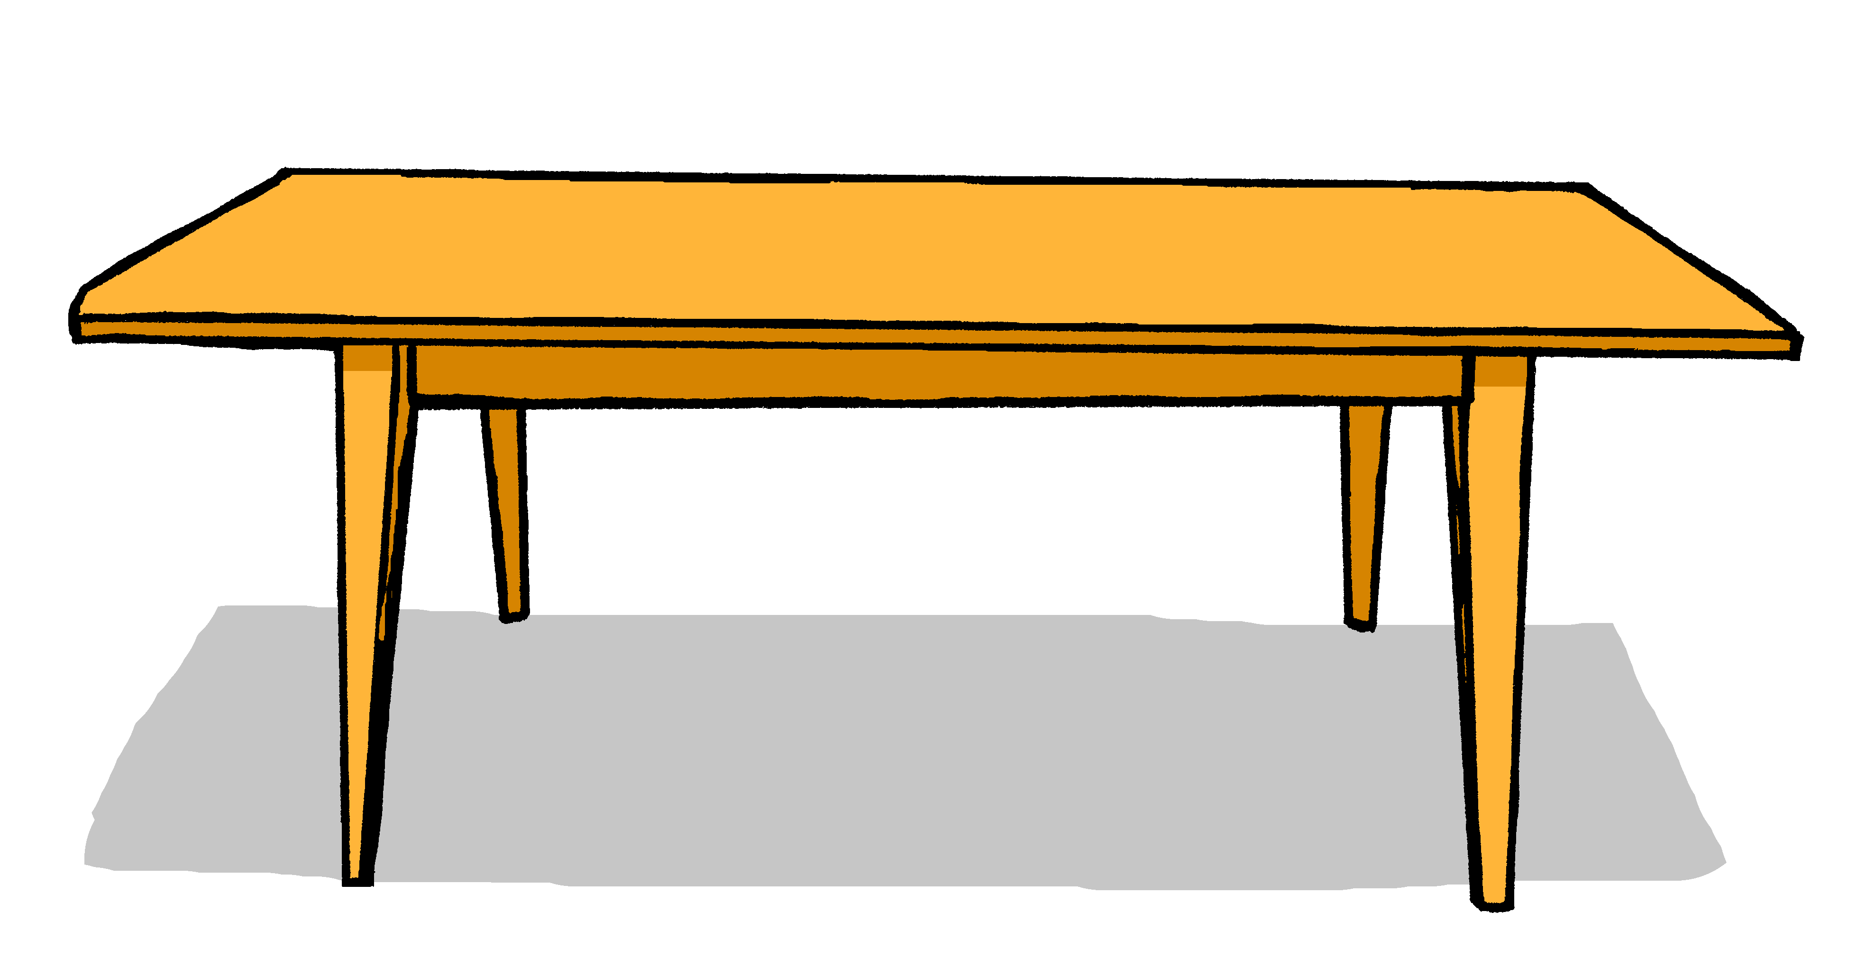
Grammar
D Write the German word for ‘a’ in the gap. (2 marks)
schreiben
1 | _________ Blume (f)
2 | Sie hat _________ Tisch. (m)
E Write the German word for ‘the’ in the gap (2 marks)
1 | _________ Haus (nt)
2 | Du hast _________ Kuchen. (m)
Notes:
1/1
Aim: to practise written recall of previously taught grammar features (articles).
Procedure:
Ensure that the task is clear.
Pupils could write 1 – 2 and the target word (or they could fill in if they have printed assessment sheets).
11

Slide 12
Grammar
F Write the German word for ‘my’ in the gap. (2 marks)
schreiben
1 | Das ist _________ Film (m)
2 | Das ist _________ Tasche (f)
Notes:
1/1
Aim: to practise written recall of previously taught grammar features (articles).
Procedure:
Ensure that the task is clear.
Pupils could write 1 – 2 and the target word (or they could fill in if they have printed assessment sheets).
12

Slide 13
Grammar
G Look at these male nouns.
Write the female version of each noun in the table below. (2 marks)
schreiben
1 | der Lehrer | die _________________
2 | the (male) teacher | the (female) teacher
2 | der Freund | die _________________
4 | the (male) friend | the (female) friend
Notes:
1/1
Aim: to practise written recall of previously taught grammar features (articles).
Procedure:
Ensure that the task is clear.
Pupils could write 1 – 2 and the target word (or they could fill in if they have printed assessment sheets).
13

Slide 14
Grammar
G Write the plural version of each noun in the table below. (2 marks)
schreiben
1 | ein Film | zwei _________________
2 | one (a) film | two films
2 | eine Flasche | zwei _________________
4 | one (a) bottle | two bottles
Notes:
1/1
Aim: to practise written recall of previously taught grammar features (articles).
Procedure:
Ensure that the task is clear.
Pupils could write 1 – 2 and the target word (or they could fill in if they have printed assessment sheets).
14

Slide 15
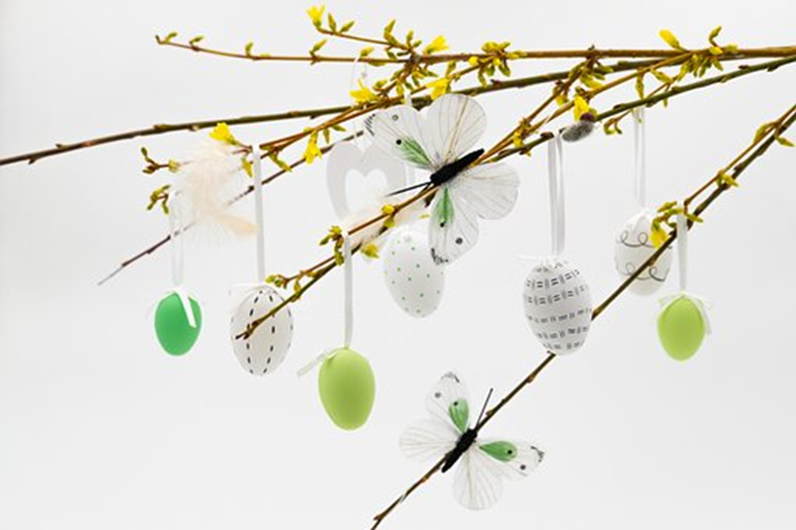
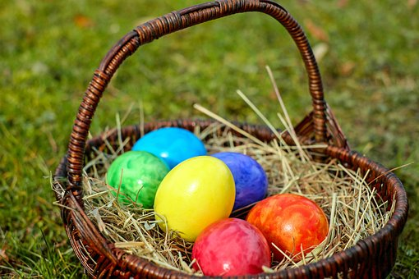
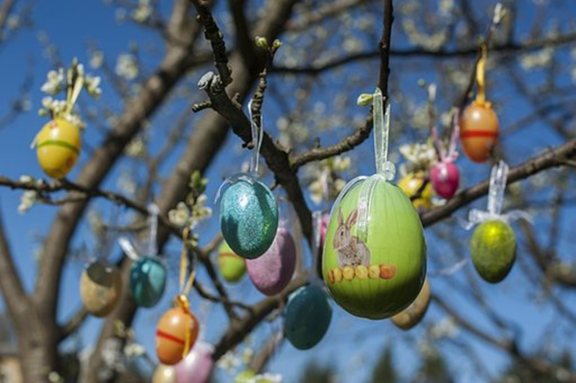
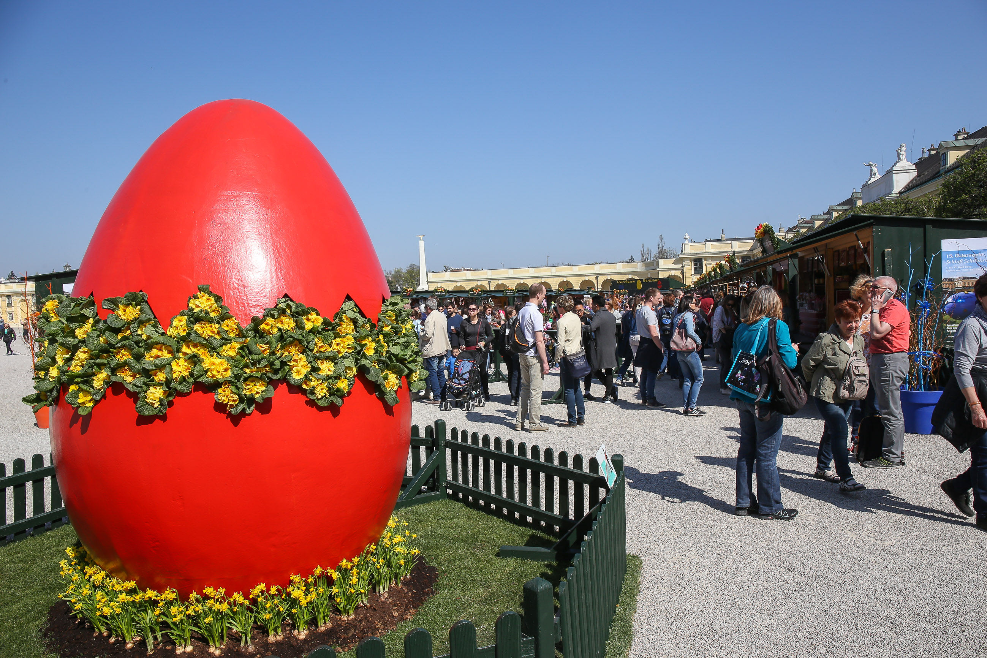
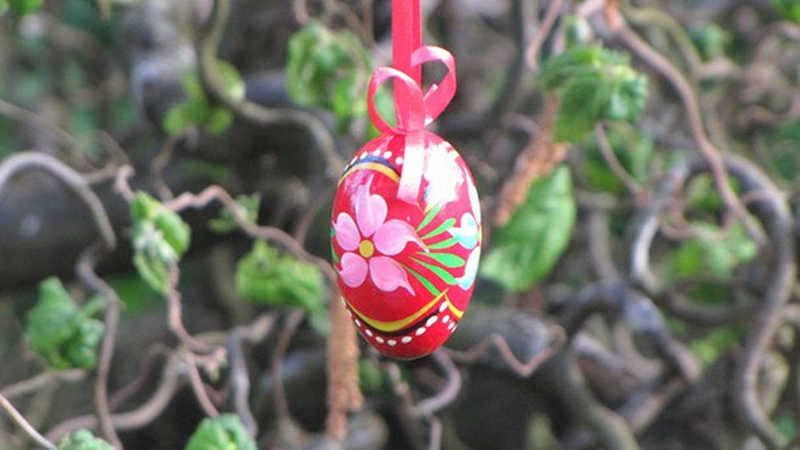
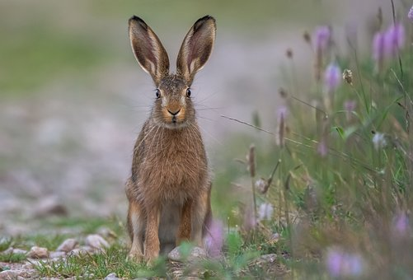
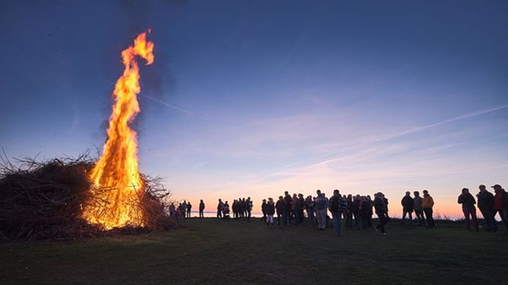
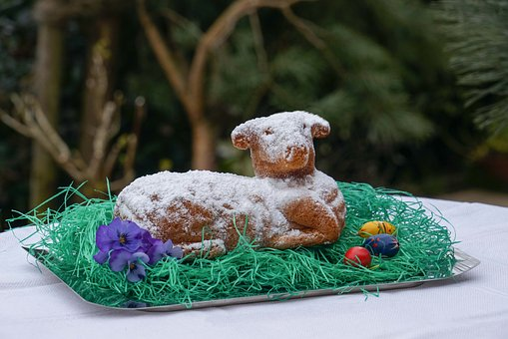
At Easter time, German families often create an ‘Easter tree’ [Ostereierbaum] by hanging colourful hand-painted eggs on branches.
Ostern in Deutschland
German Easter markets sell decorated eggs, chocolate bunnies, spring ornaments and Easter crafts.
Eggs are dyed and hand-painted to be used as decorations, gifts or for games such as egg rolling!
der Ostermarkt
bunte
Eier
der Osterhase
The Easter fire, lit the night before Easter Sunday, represents the end of Winter and the start of Spring, hope & renewal.
This delicious baked cake in the shape of a lamb is a favourite with children at Easter time.
das gebackene Osterlamm
das Osterfeuer
Did you know that the Easter Bunny is believed to come from Germany originally?
Can you find out what some other German Easter traditions are, by pronouncing the words on the Easter tree correctly?
Notes:
Timing: 5-10 mins (whole class)
Aim: To familiarise pupils with a few German Easter traditions and to encourage them to compare with their own experiences/traditions; to encourage recognition of compound nouns; to practise pronunciation of unknown words using SSCs previously met.
Procedure:
Introduce the word ‘Ostern’ (Easter) and the idea of the Easter tree and click to bring up the 3 photos.
Click again to bring up the tree illustration and large eggs. Pupils should have a go at using their phonics knowledge to pronounce these other German Easter traditions. Use ‘hook’ words they know to help e.g. eu= Deutschland= Feuer. Click directly on the words to check pronunciation. Encourage pupils to recognise the compound nature of these nouns (Oster-).
Click inside the large eggs (but not on the words) to bring up a picture clue to help pupils translate the words/traditions. Click inside the egg again to bring up the call-out with an explanation. Pupils could share their own experiences of these or similar traditions.
Word frequency (1 is the most frequent word in German): Ostern [N/A] Ei [1999] bunt [1817] Baum [1013] Feuer [1576] Lamm [N/A] Markt [476] Hase [4807]
Source: Jones, R.L. & Tschirner, E. (2019). A frequency dictionary of German: core vocabulary for learners. Routledge

Slide 16
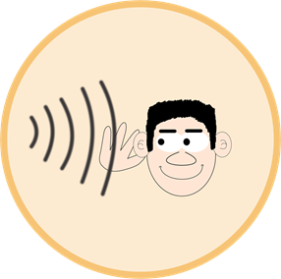
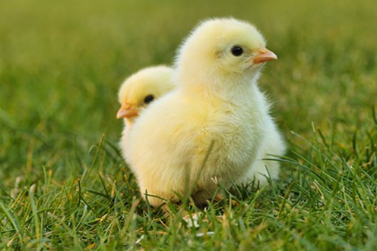
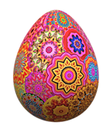
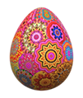
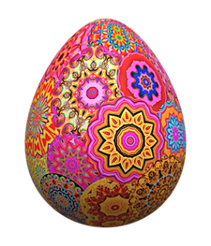
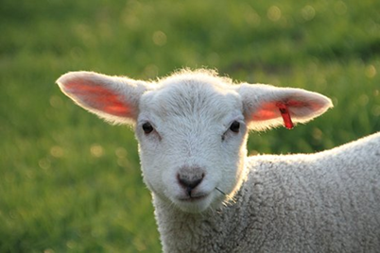
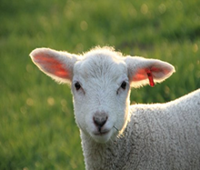
Ostereisuche*!
Make sentences to find all the hidden Easter eggs!
sprechen
?
?
?
Ich
Du
Er
Ostereisuche- Easter egg hunt
Notes:
Timing: 5-10 minutes (whole class)
Aim: to practise oral production of statements and questions using singular verb forms and a range of regular verbs.
Procedure:
Explain that as a class pupils need to find all the Easter eggs by saying correct sentences to reveal the squares. In total there are 17 eggs to collect. Allocate 1 pupil to keep track of the eggs as they collect them.
A pupil selects a pronoun from the vertical axis and a verb from the horizontal axis and makes a sentence or a question e.g. ich spiele Fußball; du gewinnst ein Spiel; er hört Musik. If there is a ?, they need to make a question instead e.g. lernst du Deutsch?
Hover over the chosen square and click to reveal what is beneath.
Repeat with different pupils selecting different squares until they have found all the Easter eggs.

Slide 17
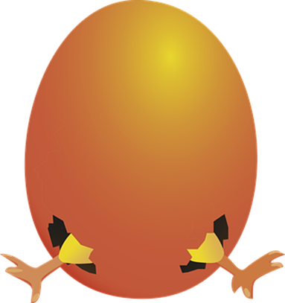
Tschüss!
rot
Notes:
17

Slide 18
Vocabulary (ANSWERS)
A For each question, put a cross (x) under the English meaning that matches what you hear. You will hear each German word twice. Choose one correct answer only. (4 marks on this slide)
hören
A | B | C | D
 | thing | present | notebook | board
 | ☐ | X | ☐ | ☐
 | I | you | she | he
 | ☐ | ☐ | ☐ | X
 | to understand | to play | to win | to have
 | ☐ | ☐ | X | ☐
 | human being | friend | dog | woman
 | X | ☐ | ☐ | ☐
1
2
3
4
Notes:
1/2.
ANSWERS
Transcript:
das Geschenk
er
gewinnen
der Mensch
18

Slide 19
Vocabulary (ANSWERS)
A For each question, put a cross (x) under the English meaning that matches what you hear. You will hear each German word twice. Choose one correct answer only. (4 marks on this slide)
hören
A | B | C | D
 | wrong | right | red | yellow
 | ☐ | X | ☐ | ☐
 | very | often | or | but
 | ☐ | X | ☐ | ☐
 | bag | water | song | word
 | ☐ | ☐ | ☐ | X
 | to be | to think | to do, make | to know
 | ☐ | ☐ | X | ☐
5
6
7
8
Notes:
2/2
ANSWERS
Transcript
5. richtig
6. oft
7. das Wort
8. machen
19

Slide 20
Vocabulary (ANSWERS)
B For each question, put a cross (x) under the type of word you hear. You will hear each German word twice. Choose one correct answer only. (4 marks)
hören
This word is a good example of …
 | A | B | C | D
 | a number | a place | an activity | a person
 | X | ☐ | ☐ | ☐
 | a colour | an animal | a question word | a greeting
 | ☐ | ☐ | ☐ | X
 | a person | an object | a food | a place
 | ☐ | X | ☐ | ☐
 | an activity | a number | a colour | an animal
 | ☐ | ☐ | X | ☐
1
2
3
4
Notes:
1/1
ANSWERS
Transcript:
sieben
Guten Tag
das Handy
blau
20

Slide 21
Vocabulary (ANSWERS)
C Translate the underlined German word to complete each English sentence. (12 marks)
lesen
1. Auf Wiedersehen Frau Schmidt! | Goodbye Mrs Schmidt! | (1)
2. Ist er da? | Is he there? | (1)
3. Was ist dein Lieblingstier? | What is your favourite animal? | (2)
4. Er ist zu Hause. | He is at home. | (2)
5. Der Tisch ist sehr klein. | The table is very small. | (1)
6. Das Bild ist groβ und gelb. | The picture is big and yellow. | (1)
7. Ich höre Musik. | I listen to music. | (1)
8. Wie sagt man ‘German’? | How do you day ‘German’? | (3)
Notes:
1/1
ANSWERS
21

Slide 22
Vocabulary (ANSWERS)
D For each question, put a cross (x) under the word that best fits each category. Choose one correct answer only. (5 marks)
lesen
This word is a good example of …
 | A | B | C | D
1. a number | rot ☐ | acht X | unten ☐ | wie ☐
2. a food | Kuchen X | Frau ☐ | Punkt ☐ | Lied ☐
3. a country | Haus ☐ | Wasser ☐ | Fenster ☐ | Deutschland X
4. an activity | sein ☐ | spielen X | haben ☐ | verstehen ☐
5. a place | Tafel ☐ | Nummer ☐ | Schule X | Herr ☐
Notes:
1/1
ANSWERS
22

Slide 23
Vocabulary (ANSWERS)
E Translate the underlined English words to complete the German sentence. (15 marks)
schreiben
1. Yes, I am here. | Ja, ich bin hier. | (write two words)
2. Here is the dog. | Hier ist der Hund. | (write one word)
3. There are four things. | Es gibt vier Dinge. | (write two words)
4. Max sings. | Max singt. | (write one word)
5. Jakob has ten flowers. | Jakob hat zehn Blumen. | (write one word)
6. Where is my book? | Wo ist mein Buch? | (write one word)
7. I think. | Ich denke. | (write one word)
8. The example is false. | Das Beispiel ist falsch. | (write one word)
9. How’s it going? Not so good! | Wie geht’s? Nicht so gut. | (write one word)
10. You have the game. | Du hast das Spiel. | (write one word)
Notes:
1/1
ANSWERS
23

Slide 24
Grammar (ANSWERS)
A Put a (X) next to the person the sentence is about. (5 marks)
lesen
1 | ☒ I ☐ you _{[singular]} ☐ she/he | … habe das Foto.
2 | ☐ I ☒ you _{[singular]} ☐ she/he | … lernst viel.
3 | ☐ I ☒ you _{[singular]} ☐ she/he | … bist toll.
4 | ☒ I ☐ you _{[singular]} ☐ she/he | … spiele Fußball.
5 | ☐ I ☐ you _{[singular]} ☒ she/he | … ist in Deutschland.
Notes:
1/1
ANSWERS
24

Slide 25
Grammar (ANSWERS)
B Add a full stop (.) or a question mark (?) next to each sentence to show whether it is a statement or a question. (2 marks)
lesen
 | Hört sie Musik
 | Du singst ein Lied
1
?
.
2
Notes:
1/1
ANSWERS
25

Slide 26
Grammar (ANSWERS)
C Put a (X) next to the English meaning of the German sentence. (3 marks)
lesen
1 | Das Buch ist nicht klar. | ☐ The book is clear. ☒ The book is not clear.
2 | Du hast keinen Fuβball. | ☐ You have a football. ☒ You don’t have a football.
3 | Das ist ein Bleistift. | ☒ That is a pencil. ☐ That is not a pencil.
Notes:
1/1
ANSWERS
26

Slide 27
Grammar (ANSWERS)
D Write the German word for ‘a’ in the gap. (2 marks)
schreiben
1 | eine Blume (f)
2 | Sie hat einen Tisch. (m)
E Write the German word for ‘the’ in the gap (2 marks)
1 | das Haus (nt)
2 | Du hast den Kuchen. (m)
Notes:
1/1
ANSWERS
27

Slide 28
Grammar (ANSWERS)
F Write the German word for ‘my’ in the gap. (2 marks)
schreiben
1 | Das ist mein Film (m)
2 | Das ist meine Tasche (f)
Notes:
1/1
ANSWERS
28

Slide 29
Grammar (ANSWERS)
G Look at these male nouns.
Write the female version of each noun in the table below. (2 marks)
schreiben
1 | der Lehrer | die Lehrerin
2 | the (male) teacher | the (female) teacher
2 | der Freund | die Freundin
4 | the (male) friend | the (female) friend
Notes:
1/1
ANSWERS
29

Slide 30
Grammar (ANSWERS)
G Write the plural version of each noun in the table below. (2 marks)
schreiben
1 | ein Film | zwei Filme
2 | one (a) film | two films
2 | eine Flasche | zwei Flaschen
4 | one (a) bottle | two bottles
Notes:
1/1
ANSWERS
30

