Slide 1
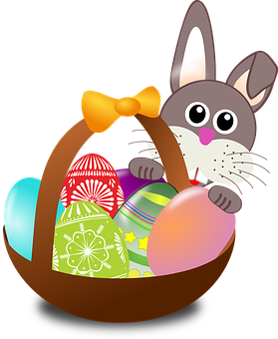
Talking about things and things to do
rot
Phonics quiz
Easter activities
Term 2 Week 11
Notes:
Word frequency (1 is the most frequent word in German):
Jones, R.L & Tschirner, E. (2019). A frequency dictionary of German: Core vocabulary for learners. London: Routledge.
The frequency rankings for words that occur in this PowerPoint which have been previously introduced in these resources are given in the SOW and in the resources that first introduced and formally re-visited those words. For any other words that occur incidentally in this PowerPoint, frequency rankings will be provided in the notes field wherever possible.
1

Slide 2
[eu]
[au]
aussprechen
aussprechen
neu
Pause
Notes:
Phonics quiz
Timing: flexible during Week 11 Procedure:
Print out one set of these 14 phonics cards.
Working with one pupil at a time, elicit the pronunciation of each word.
Say: You have not learnt these words, but you have learnt how to read aloud these sounds, so just have a go at reading each word aloud.
Focus only on the accurate pronunciation of the target SSC and tolerate any other inaccuracies.
Use the pupil scoring sheet at the end of this presentation to assess SSC knowledge and give feedback.
Note: Whilst working with individual children, others can be doing the Easter activities at the end of this presentation.
2

Slide 3
[ä]
[ö]
aussprechen
aussprechen
Blätter
schön
Notes:
Phonics quiz
Timing: flexible during Week 11 Procedure:
Print out one set of these 14 phonics cards.
Working with one pupil at a time, elicit the pronunciation of each word.
Say: You have not learnt these words, but you have learnt how to read aloud these sounds, so just have a go at reading each word aloud.
Focus only on the accurate pronunciation of the target SSC and tolerate any other inaccuracies.
Use the pupil scoring sheet at the end of this presentation to assess SSC knowledge and give feedback.
Note: Whilst working with individual children, others can be doing the Easter activities at the end of this presentation.
3

Slide 4
[ü]
short [i]
aussprechen
aussprechen
grün
Kind
Notes:
Phonics quiz
Timing: flexible during Week 11 Procedure:
Print out one set of these 14 phonics cards.
Working with one pupil at a time, elicit the pronunciation of each word.
Say: You have not learnt these words, but you have learnt how to read aloud these sounds, so just have a go at reading each word aloud.
Focus only on the accurate pronunciation of the target SSC and tolerate any other inaccuracies.
Use the pupil scoring sheet at the end of this presentation to assess SSC knowledge and give feedback.
Note: Whilst working with individual children, others can be doing the Easter activities at the end of this presentation.
4

Slide 5
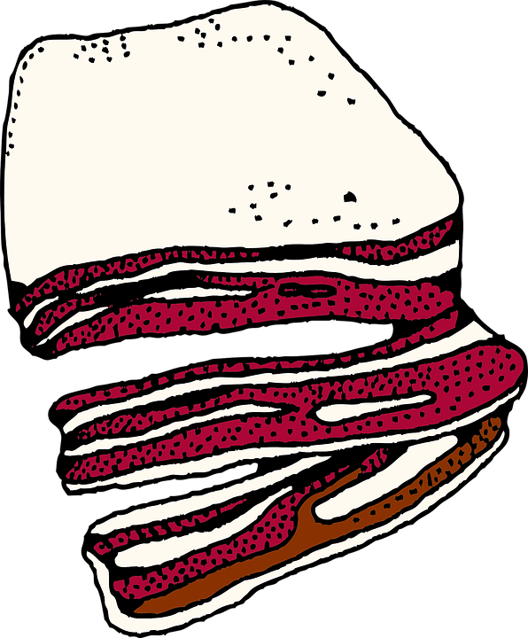
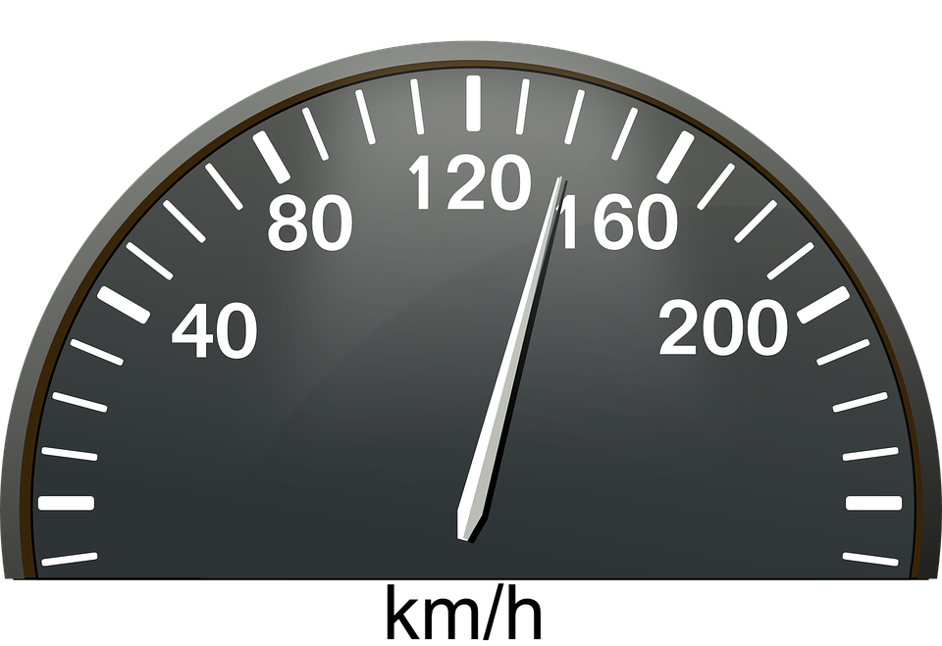
[sp]
[sch]
aussprechen
aussprechen
Speck
schnell
Notes:
Phonics quiz
Timing: flexible during Week 11 Procedure:
Print out one set of these 14 phonics cards.
Working with one pupil at a time, elicit the pronunciation of each word.
Say: You have not learnt these words, but you have learnt how to read aloud these sounds, so just have a go at reading each word aloud.
Focus only on the accurate pronunciation of the target SSC and tolerate any other inaccuracies.
Use the pupil scoring sheet at the end of this presentation to assess SSC knowledge and give feedback.
Note: Whilst working with individual children, others can be doing the Easter activities at the end of this presentation.
5

Slide 6
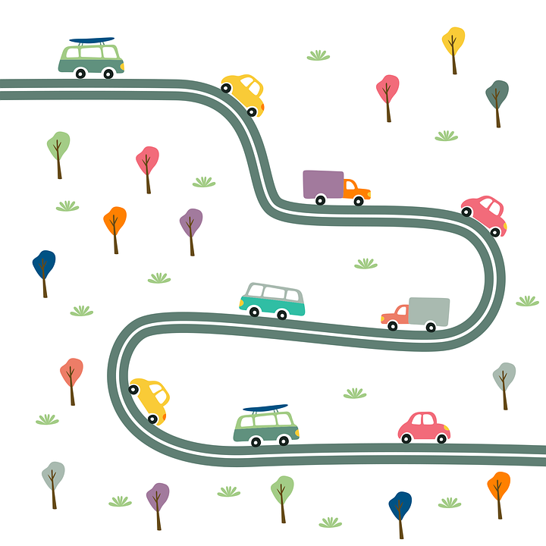
[s-]
[ß]
aussprechen
aussprechen
suchen
Straße
Notes:
Phonics quiz
Timing: flexible during Week 11 Procedure:
Print out one set of these 14 phonics cards.
Working with one pupil at a time, elicit the pronunciation of each word.
Say: You have not learnt these words, but you have learnt how to read aloud these sounds, so just have a go at reading each word aloud.
Focus only on the accurate pronunciation of the target SSC and tolerate any other inaccuracies.
Use the pupil scoring sheet at the end of this presentation to assess SSC knowledge and give feedback.
Note: Whilst working with individual children, others can be doing the Easter activities at the end of this presentation.
6

Slide 7
[ie]
[ei]
aussprechen
aussprechen
Brief
Arbeit
Notes:
Phonics quiz
Timing: flexible during Week 11 Procedure:
Print out one set of these 14 phonics cards.
Working with one pupil at a time, elicit the pronunciation of each word.
Say: You have not learnt these words, but you have learnt how to read aloud these sounds, so just have a go at reading each word aloud.
Focus only on the accurate pronunciation of the target SSC and tolerate any other inaccuracies.
Use the pupil scoring sheet at the end of this presentation to assess SSC knowledge and give feedback.
Note: Whilst working with individual children, others can be doing the Easter activities at the end of this presentation.
7

Slide 8
[z]
[w]
aussprechen
aussprechen
Konzert
Woche
Notes:
Phonics quiz
Timing: flexible during Week 11 Procedure:
Print out one set of these 14 phonics cards.
Working with one pupil at a time, elicit the pronunciation of each word.
Say: You have not learnt these words, but you have learnt how to read aloud these sounds, so just have a go at reading each word aloud.
Focus only on the accurate pronunciation of the target SSC and tolerate any other inaccuracies.
Use the pupil scoring sheet at the end of this presentation to assess SSC knowledge and give feedback.
Note: Whilst working with individual children, others can be doing the Easter activities at the end of this presentation.
8

Slide 9
Pupil name:
Pupil name:
SSC and word | px
neu
Pause
Blätter
schön
grün
Kind
Speck
schnell
suchen
Straße
Brief
Arbeit
Konzert
Woche
SSC and word | px
neu
Pause
Blätter
schön
grün
Kind
Speck
schnell
suchen
Straße
Brief
Arbeit
Konzert
Woche
aussprechen
Notes:
Pupil feedback and assessment sheet
9

Slide 10
Teacher audio version
SSC and word | px
neu
Pause
Blätter
schön
grün
Kind
Speck
SSC and word | px
schnell
suchen
Straße
Brief
Arbeit
Konzert
Woche
Notes:
Teacher audio version for preparation
10

Slide 11
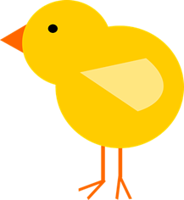
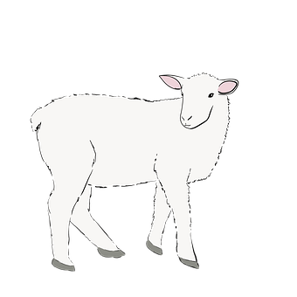
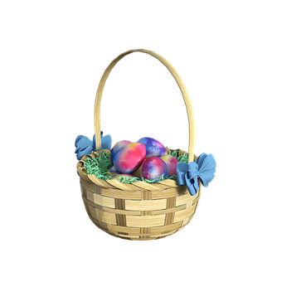
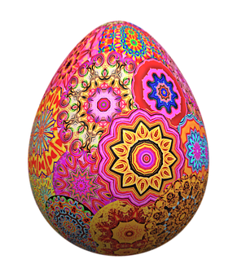
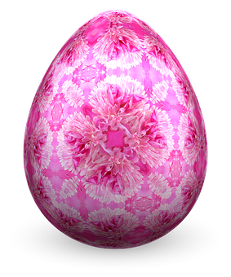
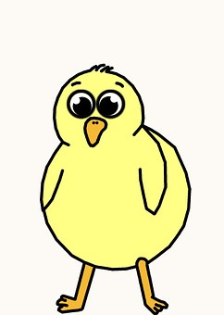
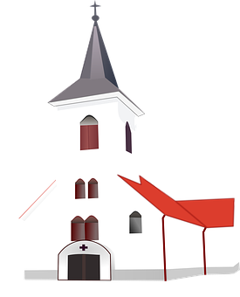
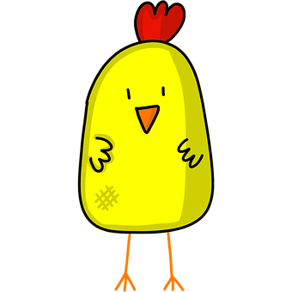
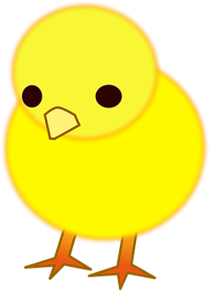
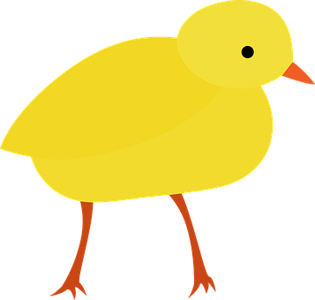
Ostern
1. Fill in the missing numbers on the eggs.
3. Count the Easter pictures and write how many you see.
Was? | Wie viele?
Küken
Lämmer
Osterkörbe
Osterglocken
Osterhasen
Kirchen
Ostereier
eins
zwei
drei
vier
fünf
sechs
sieben
fünf [5]
acht [8]
2. Match each chick to an egg. Write the English translations below.
vier [4]
A
B
zwölf [12]
hast
spiele
hört
denkst
habe
macht
sieben [7]
zwei[2]
ich
du
sie
elf [11]
er
ich
du
I play
You have
He listens
I have
She does/makes
You think
Notes:
Timing: 10-15 mins (independent)
Aim: to provide written practice of German numbers 1-12 and reading comprehension of singular verb endings and meanings.
This activity is designed as a worksheet for pupils to complete independently after completing assessments. Worksheet at end of this presentation. Answers on this slide. It should be used in conjunction with the next slide for activity 3.
Pupils fill in the missing German numbers to complete the sequence.
Pupils match a chick to an appropriate egg by looking at the pronouns and verb endings. They then write the English translation below each chick.
Pupils count up the number of each type of Easter picture on the next slide in a kind of ‘I spy’ activity and write the number in German.

Slide 12
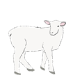
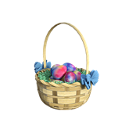
Ich sehe was, was du nicht siehst…
Notes:
‘I spy’ slide to be used for Activity 3 on previous slide/ worksheet.

Slide 13
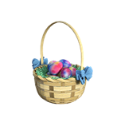
Wie schreibt man das auf Deutsch…und auf Englisch?
schreiben
1. Ich _______ zehn Ostereier.
2. _____ _____ den Korb?
3. Er hat ______ ________.
4. Ich habe ______ ____________.
5. Hast du ______ ____________?
6. _____ _______ Osterspiele.
1. ____ have ________ Easter eggs.
2. Do you have ______ basket?
3. _____ _______ two baskets.
4. ____ _________ a flower!
5. ____ _____ _______ three flowers?
6. She is playing ________ ___________.
habe
I
ten
Hast du
the
zwei Körbe
He has
eine Blume!
I have
drei Blumen
Do you have
Sie spielt
Easter games
Notes:
Timing: 5-10 minutes
Aim: to practise written recognition and production of the verb haben, definite and indefinite articles (Row 2 accusative), plural noun patterns, weak verbs and numbers. This is a jigsaw translation task.
NOTE: This task would be best attempted once pupils are familiar with some Easter vocab e.g. Osterei and Korb (see slides 11 & 12), though they are never asked here to produce those words.
Procedure:
Students write the missing words in both German and English to complete the sentences. You may want to write a checklist of things for pupils to think about (see aims of task).
Teacher clicks to provide the written answers. (Click on audio buttons to play full German sentence.)
Differentiation: 1. For a different challenge (i.e. to practise spelling rather than full written recall of the missing German words), the task could be completed as a transcription task initially, by listening to the full sentences and writing the words.
2. Then pupils could complete the English part of the jigsaw.

Slide 14
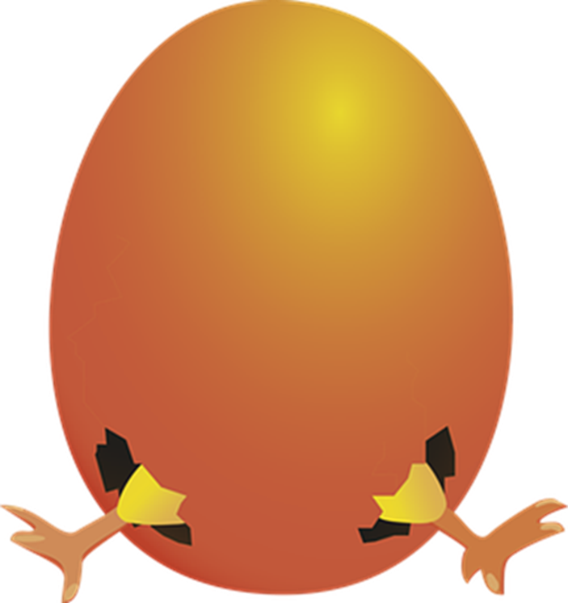
Vokabeln
Wörter
F
R
O
H
E
O
S
T
E
R
N
oto
ot
rt
austier
To say ‘Happy Easter’ in German, we say ‘Frohe Ostern’. Can you think of a German word you have learnt for each letter?
ins
stern
ingen
afel
s gibt
echts
icht
Notes:
Timing: 10-15 minutes (independent)
Aim: to practise written recall of previously learnt vocabulary and to familiarise pupils with ‘Happy Easter’ in German.
Procedure:
1. Explain that Frohe Ostern means ‘Happy Easter’ and ask pupils to copy down the letters vertically down the page.
2. Ask pupils to think of a German word (from Term 1 or Term 2) which begins with each letter. Pupils can also choose words with the letter in the middle too, and write either side of the Frohe Ostern. Pupils could work in pairs and ‘race’ in the class to do this.
3. Ask pupils to illustrate, either with the meanings of their chosen words, or with Easter pictures.

Slide 15
Poem
Frohe Ostern
1.

Slide 16
Tschüss!
rot
Notes:
16

Slide 17
Ostern
1. Fill in the missing numbers on the eggs.
3. Count the Easter pictures and write how many you see.
Was? | Wie viele?
Küken
Lämmer
Osterkörbe
Osterglocken
Osterhasen
Kirchen
Ostereier
eins
drei
fünf
sieben
fünf [5]
2. Match each chick to an egg. Write the English translations below.
A
B
hast
spiele
hört
denkst
habe
macht
ich
du
sie
du
er
ich
_________
_________
________
_________
_____________
___________
Notes:
HANDOUT

Slide 18
Wie schreibt man das auf Deutsch…und auf Englisch?
schreiben
1. Ich _______ zehn Ostereier.
2. _____ _____ den Korb?
3. Er hat ______ ________.
4. Ich habe ______ ____________.
5. Hast du ______ ____________?
6. _____ _______ Osterspiele.
1. ____ have ________ Easter eggs.
2. Do you have ______ basket?
3. _____ _______ two baskets.
4. ____ _________ a flower!
5. ____ _____ _______ three flowers?
6. She is playing ________ ___________.
Notes:
HANDOUT

